Slide 1
SESSION 3 Update on GFOI Developments & CEOS Role
SDCG-14: Ispra, 4-6 September, 2018

Slide 2
CEOS Agency Support for GFOI and SIT TW discussion on AHTs
SDCG-14: Ispra, 4-6 September, 2018

Slide 3
CEOS support and AHT Lifecycle
Objectives
Explain the summary context paper prepared for CEOS Principals in support of discussion for renewed CEOS agency support for Phase 2 of GFOI @ SIT TW and Plenary
Explain the broader context of SIT Chair initiative to get clarity and consistency on CEOS Ad-hoc Teams (of which SDCG is one) and their lifecycle and processes
Hear from CEOS agencies as to their position and intentions with regards to engagement in the CEOS GFOI activities
Preliminary conclusions as to whether a critical mass exists and how agencies would like to CEOS proceed organisationally

Slide 4
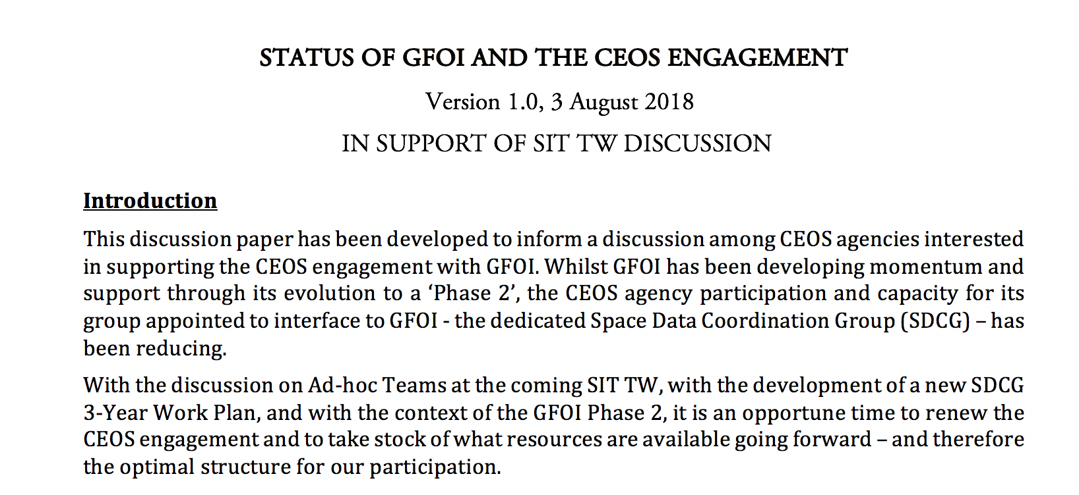
SIT TW Paper developed for GFOI discussion
Osamu as CEOS Lead taking initiative to gather support

Slide 5
SIT TW Paper developed for GFOI discussion
Contents
Introduction
Historical context of CEOS and GFOI
Phase 2 of GFOI and SDCG Draft Work Plan highlights
SDCG Participation & Capacity
Options for the way forward on GFOI engagement

Slide 6
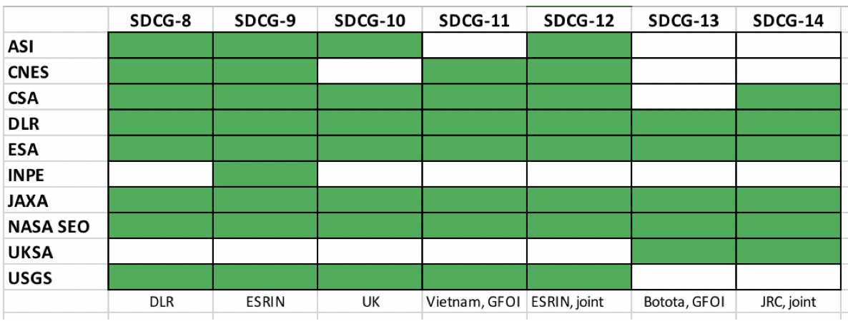
SDCG Participation & Capacity
Participation:
Capacity:
Lost Australian funding
Lost USGS Co-Chair
Co-Chairs and Lead struggle to apply capacity to Work Plan (ongoing effort to get support for SEC work within their agencies)
SDCG SEC will step down at Plenary to clarify the debate (also as Component Manager)

Slide 7
The Way Forward
The way forward for the CEOS engagement with GFOI depends on whether a critical mass of agencies exists to continue a stand-alone group (such as SDCG or some evolution of it); as well as the provision of capacity for the management of that group and for the execution of the Work Plan targets.
"CEOS might take the view that with the accomplishment of the global baseline coverage, we can adopt a much more passive view of GFOI engagement, with just a liaison person (likely no longer a GFOI Lead) handling space data related requests from GFOI. It is for individual CEOS agencies to decide as to whether there is sufficient appeal in the GFOI framework to merit the resources required to engage. And for these agencies collectively to decide the best structure for that engagement and to ensure that representation is underpinned by participation of the staff from their agency forest/climate programmes."
Overall we also need more clarity on the GFOI side on the form and function of the new Data Component (World Bank etc)

Slide 8
The Way Forward – ISSI paper
Never has there been as many and as explicit policy needs vs forest monitoring opportunities…. A coordinated approach for multi- sensor estimation and validation is needed….The new IPCC good practice guidance is set to recognize the use of biomass maps from space as an aid to estimate emissions for national GHG inventory purposes
Open data platforms and standards
SAR and Lidar product fusion potential
Validation supersites needed
Need to clarify how different user requirements translate to specifications for multi-mission biomass estimation and validation, and mechanisms for uptake of the data and products. The Global Forest Observations Initiative (GFOI) along with the CEOS LPV cal/val group could coordinate such an effort.
Substantial coordination needed and senior-level recognition and support
Need to consult in formulating a Plenary proposal

Slide 9
Options?
Minimal engagement.
dissolve SDCG
resign as GFOI Lead, and as Data Component Manager
appoint a CEOS Liaison to GFOI (who may attend GFOI Plenary as business requires)
address issues arising at LSI-VC meetings and/or CEOS SEC as appropriate.
Continuity of dedicated group
renew SDCG with clarity in leadership and capacity
assure contributions to new WP – developed by consensus of contributors
appoint & resource new Data Component Manager
continue annual meeting at GFOI Plenary (~Apr) and jointly with LSI and GEOGLAM (~ Sept)
SDCG constituted based on SIT TW discussion, either as AHT or standing group
ensure optimal representation from CEOS agency relevant programmes
Expanded and reinforced dedicated group
actively seek stronger connection with and resource from the major space agency forest monitoring programmes, including new biomass missions,
consider expanded leadership group with sustained support
active engagement of World Bank as Data Component partner and identification of new collaborative activities
standing CEOS group: SDCG/LPV/missions…

Slide 10
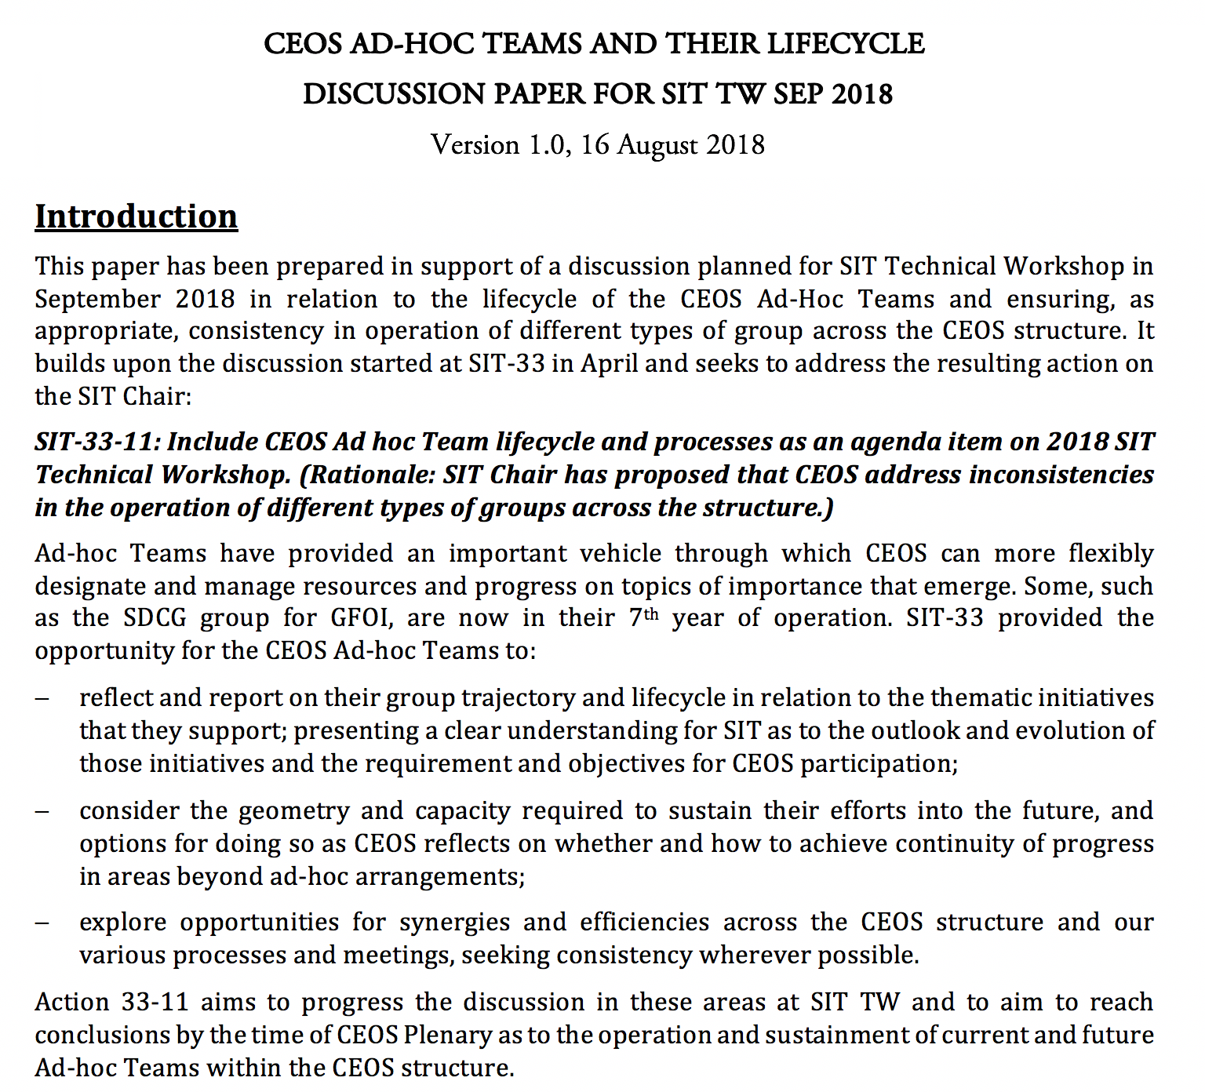
CEOS AHT Lifecycle - context

Slide 11
Current AHTs and intentions
FDA: AHT concluding with WP tasks going to WGISS (mainly) and LSI-VC;
SDCG/GFOI: subject to stakeholder agency support and capacity for GFOI Phase 2;
GEOGLAM: keen to continue as a stand-alone entity for at least a year;
SDGs: subject to stakeholder agency support and capacity.

Slide 12
Issues for debate at SIT TW (& Plenary)
Taking stock of the intentions of the four AHTs and a strategic and collective consideration of their way forward and the renewal review process at Plenary
Improvements in procedural consistency to reflect the importance of all three types of CEOS subsidiary group
Including the procedures around establishment, leadership and resourcing; and the lines and instruments of reporting within CEOS. For example, it is currently unclear to whom each of the four current teams are supposed to report. CEOS might also consider strengthening the processes around establishment and annual review of AHTs.
Explicit focus on the evolution from ad-hoc status to standing and sustained CEOS activities where appropriate
Of the three subsidiary group mechanisms available for organising work on CEOS (WGs, VCs, and AHTs):
The VCs are each single-measurement focused and represent a very specific community of practice and their science groups;
The WGS represent a mix of cross-cutting functions that underpin space agency EO programme operation and exploitation (such as information systems, cal-val, and capacity building) and more recently, with a thematic observations focus (currently being climate (since 2010) and disasters (since 2013)).
GFOI, GEOGLAM and the SDGs are thematic in nature and possible candidates for a WG structure equivalent to climate and disasters (albeit noting that the SDGs is exceptionally broad in scope but nevertheless represents a recognised and focused community and observing need).
Sustainment of the activities covered currently by the AHTs
Regardless of the vehicle through which the AHT activities proceed, the availability of capacity for operation of the entities - for realisation of their WP outcomes, and for maintenance of the interfaces and external meeting processes which they handle for CEOS – must be clear (noting that CEOS WG Chairs are responsible for provision of operating capacity during their term).

Slide 13
SDCG input to debate
Much depends on the critical mass of engagement and the underpinning connection to the CEOS agency mission and forest application programmes – including to the new biomass programmes
Request that delegates engage their Principals in forming a view ahead of CEOS Plenary
CEOS Lead for GFOI seeks to coordinate agencies (CEOS Principals) through email and telcons
Suggestions? Discussion

