Slide 1
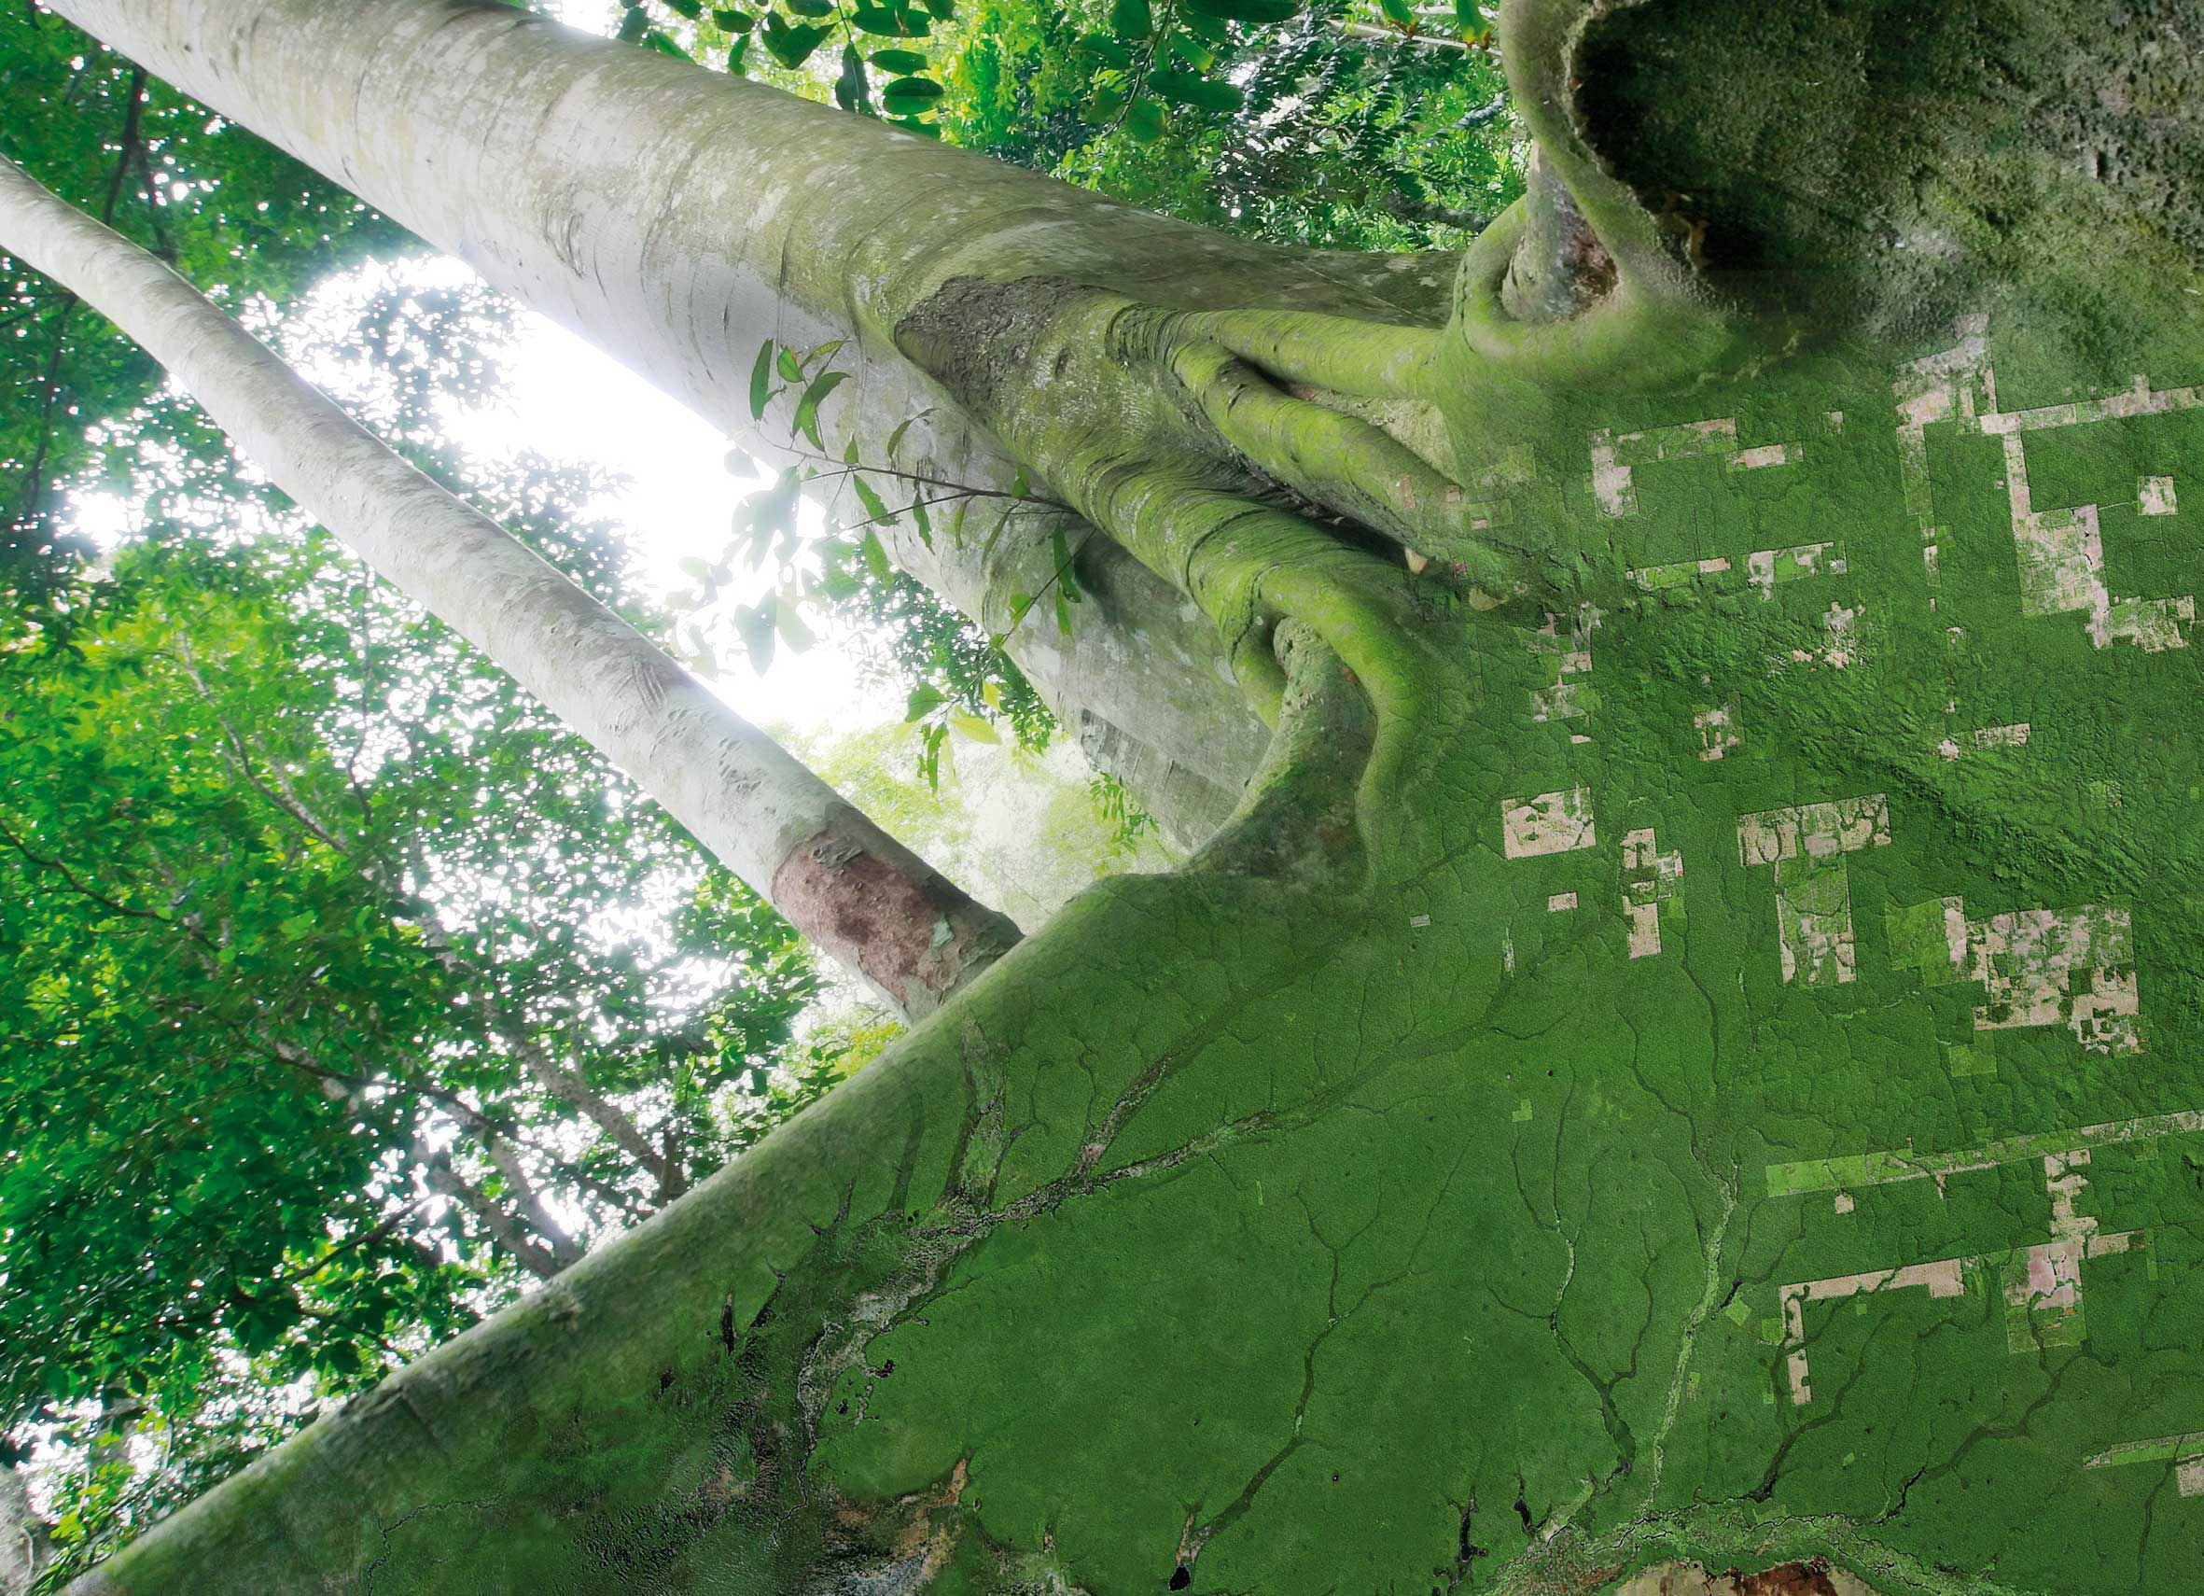




GFOI update & outlook
SDCG-14 – 4 September 2018, JRC, Ispra
@GFOI_FOREST
GFOI.ORG
GFOI1

Slide 2
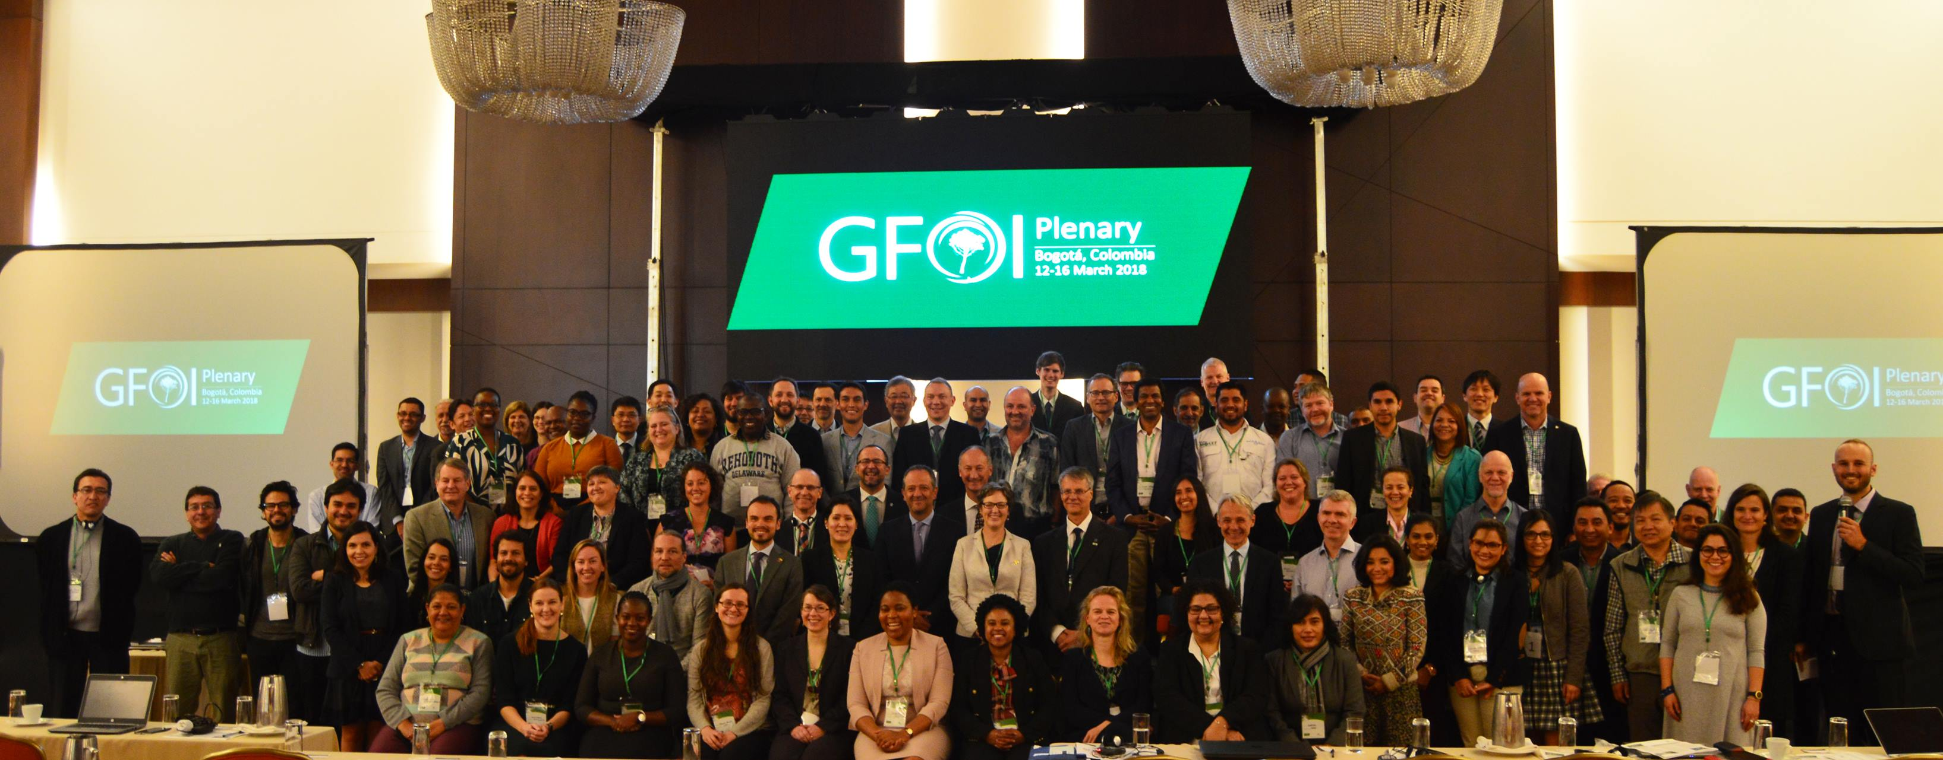
Overview
GFOI coordinates international support on forest monitoring and
GHG accounting for REDD+ and related forums.
@GFOI_FOREST
GFOI.ORG
GFOI1

Slide 3
GFOI Overview
Founded under Group on Earth Observations (GEO) in 2011
Lead partners: initially Australia, CEOS, FAO, Norway, USA
recently joint: UK, the World Bank and ESA
Current Chair of Leads: Ellen Bruzelius Backer (Norway)
        Other Leads: Nikki Fitzgerald (Australia)
        落合 治 Osamu Ochiai (CEOS)
Anssi Pekkarinen (FAO)
        Juliann Aukema & Sylvia Wilson (USA)
        Selina Newell (UK)
        Andres Espejo (Worldbank)
        Frank Martin Seifert (ESA)
Many other contributor including UNFCCC, IPCC, universities, technical and policy experts.
@GFOI_FOREST
GFOI.ORG
GFOI1

Slide 4
GFOI Phase 2
GFOI independent review completed in 2016-17
Plenary’17 considered outcomes of the review ➔ transition to Phase 2
Phase 2 took shape with Plenary’18
  Greater focus on country needs
  Greater focus on coordination across donors on capacity development
  Data component to increase focus on use and analysis of the data
@GFOI_FOREST
GFOI.ORG
GFOI1

Slide 5
GFOI Goals
Provide REDD+ countries with a larger and more targeted package of support than any one international partner can provide alone
Enable consistency or complementarity in support
Ensure support is targeted at country needs to help accelerate progress towards reporting and action
Foster a network of experts to help address challenges and bottlenecks to progress
Facilitate exchanges resources, comparative advantages, south-south collaboration and enable learning between partners
Avoid overlaps and duplication of effort by developing countries and international partners.
@GFOI_FOREST
GFOI.ORG
GFOI1

Slide 6
Four Components
@GFOI_FOREST
GFOI.ORG
GFOI1
Notes:
I will get you higher res files for this slide and the next

Slide 7
GFOI Priorities: 2018-19
Establish a common approach to country needs assessments
Target international support to meet priority needs, through collaborative work planning that utilizes comparative advantages etc
Develop an inventory of GFOI partners’ activities globally and make this publically available
Continue to align forest monitoring activities with reporting forums
Establish the new Data Component to coordinate the availability, accessibility and capacity to use data and tools
Facilitate expert meetings to address obstacles to progress
Continue to foster the network of international partners
Targeted at priority country needs!
@GFOI_FOREST
GFOI.ORG
GFOI1

Slide 8
SDCG in GFOI
SDCG is the CEOS engagement in GFOI!
New home in the Data Component, includes in-situ data
➔ DC scoping meeting 2/3 July,Tokyo
Baseline acquisition with medium resolution satellites established
➔ integration of upcoming missions in baseline scenario
➔ integration of biomass missions
Tools and Data Services related to country needs
“availability, accessibility and capacity to use data and related tools”
➔ Data Cubes, Cloud Platforms, ARD
R&D element ➔ phase out and move to dedicated and funded R&D activities clearly addressing country needs and operational obstacles
Early Warning as a new GFOI activity
➔ user need assessment under lead of WRI (workshop 10/12 July, Lima)
@GFOI_FOREST
GFOI.ORG
GFOI1

