Slide 1
SESSION 3 Update on GFOI Developments & CEOS Role
SDCG-14: Ispra, 4-6 September, 2018

Slide 2
Data Component Planning Meeting Outcomes
SDCG-14: Ispra, 4-6 September, 2018

Slide 3
Phase 2 of GFOI – whats it about?
Joint assessments of country needs and collaboration to address them
Complementary and consistent with core business activities
IPCC- and UNFCCC-compliant country guidance for REDD+ reporting
Expanded data support to put more emphasis on access, uptake and application and the relevant tools
Coordinated R&D activities to support above (lead by R&D Component)
Expanded participation and leadership

Slide 4
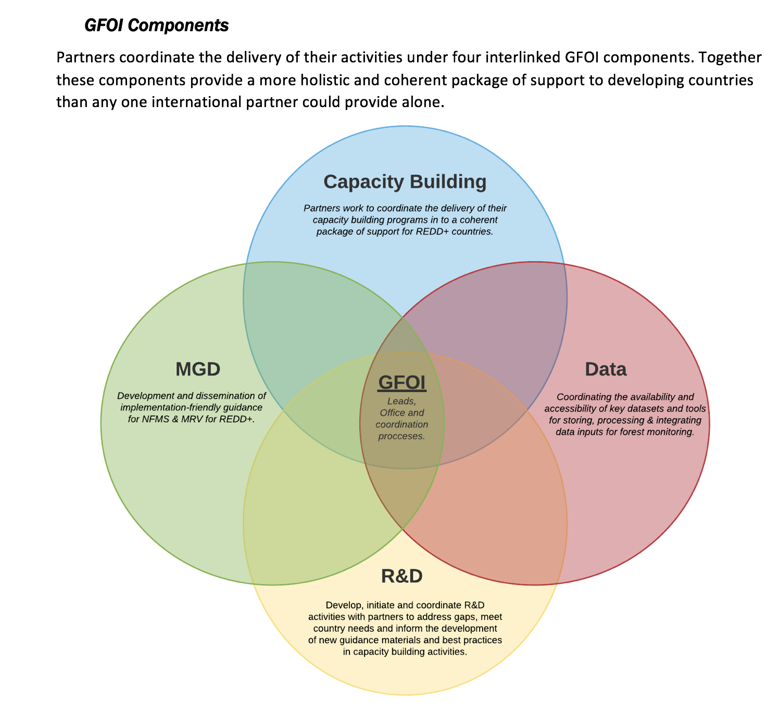
Phase 2 of GFOI

Slide 5
Data Component Planning Meeting
Australia pushed in 2017 and again in 2018 for a scoping meeting to formulate the form and function of the new ‘Data Component’ of GFOI
As CEOS Lead for GFOI, JAXA, offered to host the meeting in Tokyo in early July 2018
Attendance: Australia, JAXA, UKSA, SilvaCarbon, FAO, CSIRO, R&D, World Bank, US, GFOI Office
Objective: to discuss the key features of the Data Component within the GFOI structure and make a final recommendation on the design of the Component to the GFOI Leads Group for endorsement.

Slide 6
CEOS-specific themes – for discussion
GFOI has brought CEOS closer to thematic user community – and CEOS wishes to continue to grow that relationship: ‘DUAG’ mechanism?
Expanded participation brings in major forest donor governments and provides opportunity to ensure EO aspects benefit (UK and DE both have active space agencies)
Better ROI for GFOI R&D programme data suppliers. Phase 2 needs more specific, prioritised programme of funded R&D activities. Current model is not specific enough to to provide high value to GFOI and data suppliers and will be discontinued next year.
World Bank membership provides engagement opportunities related to CEOS IFI strategy

Slide 7
Tokyo meeting headlines from Office
World Bank pro-active and volunteered to co-lead with CEOS the Data Component with emphasis on country engagement aspects
Await new Country Needs Assessment process (some tension on WB approach) – possible new requirements on Data Component
Emphasis on GFOI CALM process for shortlist of endorsed tools and data
Continued data availability and access – including hi-res where possible (Norway?)
In-situ data guidance to be reviewed and updated (USFS, FAO)
Hosting of tools on SEPAL (FAO and Norway advocating SEPAL hard for GFOI)
Office volunteered to lead on TORs and SOPs – CEOS made clear limitations on capacity pending CEOS debate on GFOI Phase 2 (meetings at GFOI Plenary)
Will need CEOS stakeholder agency review and engagement to ensure SOPs suit CEOS

Slide 8
GFOI Flows
R&D
Pre-operational
CALM
Operational
Country Identified Needs
Training
MGD Advisory Group
REDD+ countries
Guidance
MGD
Capacity Building partners
Dataset or tool etc.
Operational
CALM
REDDcompass
Pre-Operational
*Criteria for consistently Assessing Levels of Maturity (CALM)

Slide 9
CEOS perspective on outcomes
World Bank pro-active and volunteered to co-lead with CEOS the Data Component with emphasis on country engagement aspects Considerable interest from World Bank though no contact since Tokyo meeting. Much to be discussed regarding the dynamic and roles. Very much in direction of the SIT strategy for IFI engagement to help sustain EO data initiatives.
Await new Country Needs Assessment process (some tension on WB approach) – possible new requirements on Data Component
Emphasis on GFOI CALM process for shortlist of endorsed tools and data Constructive & practical approach to simplifying options for countries. Needs CEOS-preferred solutions to be aware and engage in the process
Continued data availability and access – including hi-res where possible (Norway?) CEOS Space Data Strategy for GFOI still needed. L-band constellation possible? Norway will fund some HR data purchases. Biomass datasets much anticipated. Key role for SDCG

Slide 10
CEOS perspective on outcomes
In-situ data guidance to be reviewed and updated (USFS, FAO) As usual in-situ data discussions get awkward. USFS may help. No suggestion of any data coordinator – just improved guidance for MGD.
Hosting of tools on SEPAL (FAO and Norway advocating SEPAL hard for GFOI) SEPAL may become a de facto standard for at least a portion of countries and we may need to find constructive ways to engage FAO. CEOS Data Cube needs to show operational examples (e.g. Colombia) to progress in CALM
Office volunteered to lead on TORs and SOPs – CEOS made clear limitations on capacity pending CEOS debate on GFOI Phase 2 (meetings at GFOI Plenary) Assuming CEOS stays in Lead role for GFOI and within Data Component, we should be proactive in ensuring TORs and SOPs meet our expectations and limitations
QUESTIONS? DISCUSSION?

