Slide 1
SDCG WP Update
SDCG-14, Sep 2018

Slide 2
SDCG WP
3 year horizon
Used very successfully for structuring SDCG meetings and telcons
To reflect evolution to GFOI Phase 2
And related developments within CEOS and agencies

Slide 3
Phase 2 of GFOI – whats it about?
Refreshed structure and stronger focus on user countries
Joint assessments of country needs and collaboration to address them
Complementary and consistent CB activities
IPCC- and UNFCC-compliant country guidance for REDD+ reporting: appealing to major donors
Expanded data support to put more emphasis on access, uptake and application and the relevant tools
Coordinated R&D activities to support above
Expanded participation and leadership, including World Bank in the Data Component

Slide 4
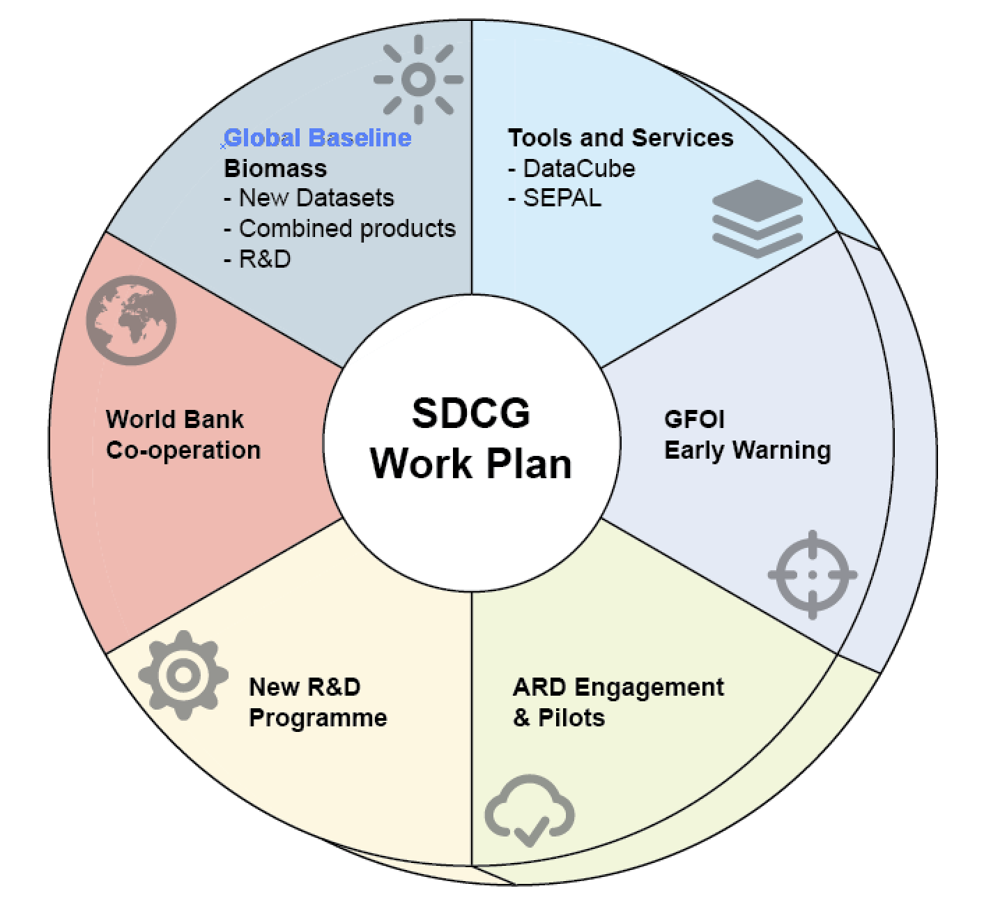
SDCG WP V2
Same structure
Baseline global observations
Space Data Services
Support to R&D
Component coordination and country engagement
Update process focused on outcomes as basis for discussion
Very little feedback to date

Slide 5
Main updates
Continuation of global baseline coverage, and expansion to include new generation of biomass instruments, seeking to accelerate the policy-relevance of these data-streams including through early provider-user dialogue; this includes: SAOCOM series (CONAE); TanDEM-L (DLR); NISAR (ISRO and NASA); BIOMASS (ESA); GEDI and MOLI lidars (NASA and JAXA); ALOS-4 (JAXA); ICESAT-2 (NASA)
Greater emphasis on tools and services for discovery, access and application of the data – within the GFOI framework to develop shortlists of recommended data and tools
Including technical exchange opportunities among GFOI countries on issues such as CEOS Data Cube for forest monitoring

Slide 6
Main updates
Support to the new GFOI Early Warning activity, which will be critically dependent on space data supply
Establishment of a GFOI reference community for feedback and engagement in CEOS Analysis Ready Data standards and pilots
Coordination with the GFOI R&D Component on a new R&D programme to address technical obstacles to space data application
New cooperation with World Bank through Data Component – to be explored

Slide 7
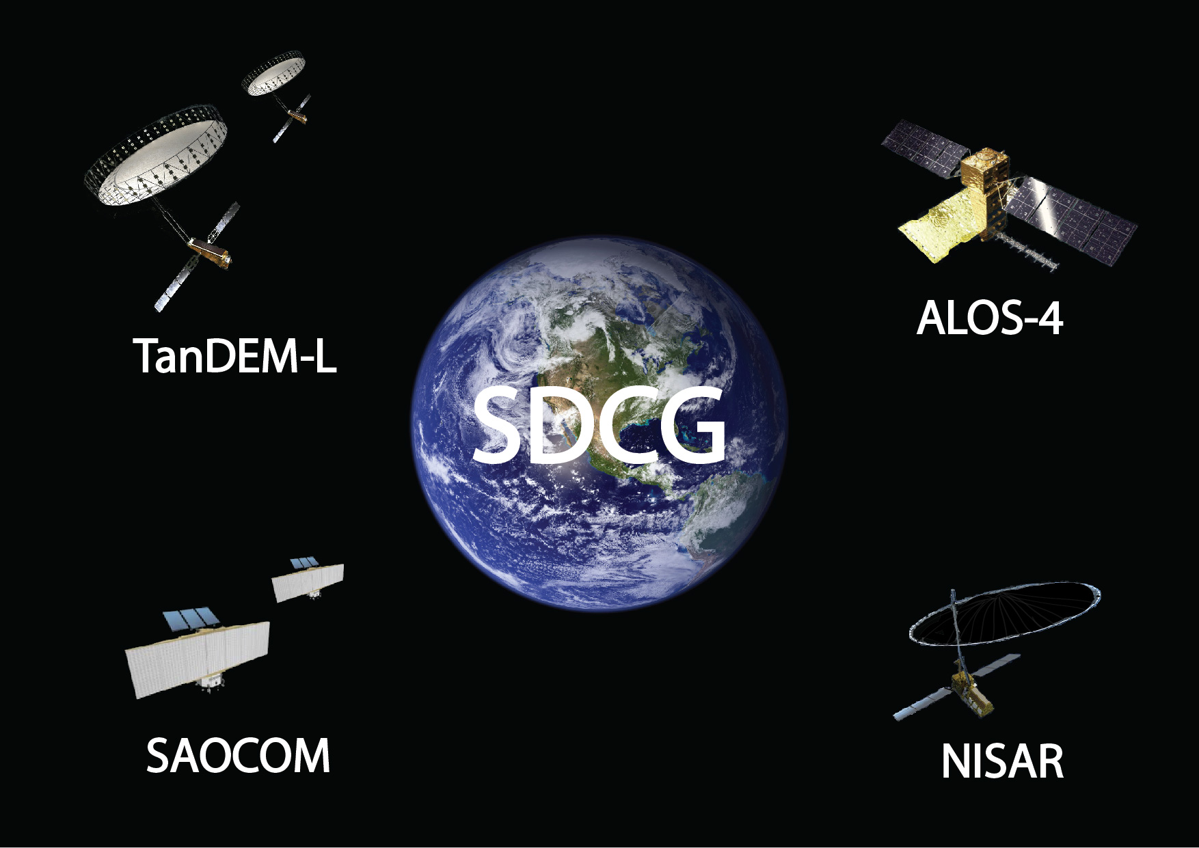
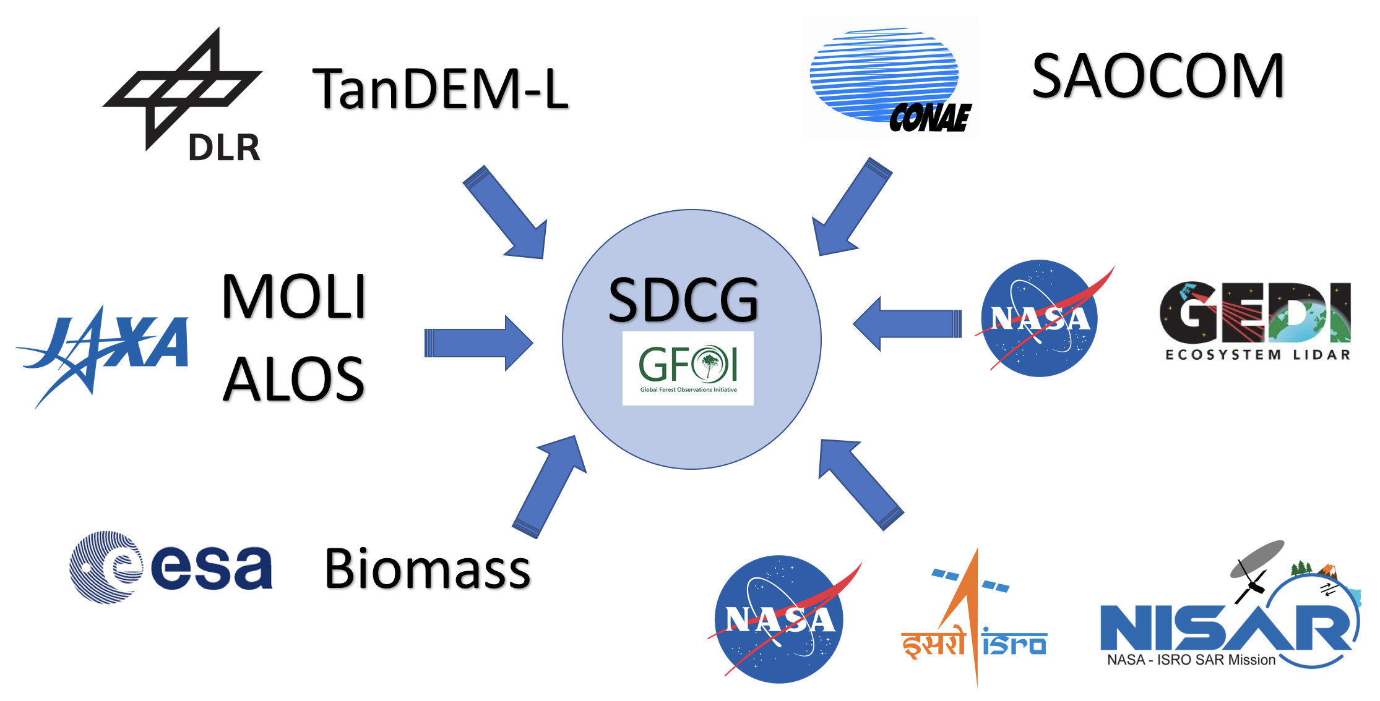
In agency terms..?
L-band SAR Constellation? (CONAE, DLR, JAXA, NASA…)
and data system (CEOS ARD)
Above Ground Biomass product teams engagement (above ..plus ESA (Biomass), JAXA (MOLI), NASA (GEDI))
Closer integration of CEOS’s GFOI work with the relevant mission and application teams in these agencies – more effective framework for cooperation
WGCV/LPV coordination

Slide 8
Discussion
Does the Work Plan address the interests and priorities of the SDCG agencies?
Does the Work Plan meet GFOI needs for the Data Component – noting uncertainties around World Bank etc?
Leadership & capacity on individual tasks and reporting to SDCG
Way forward for Work Plan and inputs to CEOS Work Plan process

