Slide 1

CEOS Analysis Ready Data for Land (CARD4L) Overview & Status
(15:45 – 16:05)
Committee on Earth Observation Satellites
Geoscience Australia
SDCG-14
JRC, Ispra
4th September 2018

Slide 2
Presentation Outline
CEOS ARD for Land
  Background
  Framework
Product Family Specifications
  Background
  Documents
  Improvements
  Ongoing Work

Slide 3
CEOS ARD for Land - Background
LSI-VC served as the forum for developing the CEOS Analysis-Ready Data definition (now known as CARD4L – CEOS Analysis-Ready Data for Land)
The CARD4L definition and the overall framework were endorsed by the CEOS Plenary in 2016
CARD4L underpins a large amount of the future data architectures work being progressed within CEOS
The purpose of CARD4L is to allow many users to more rapidly use data. This also allows space agencies to maximise the potential of their data.

Slide 4
CEOS ARD for Land - Definition
CEOS Analysis Ready Data for Land (CARD4L) definition:
  CARD4L are satellite data that have been processed to a minimum set of requirements and organized into a form that allows immediate analysis with a minimum of additional user effort, and, interoperability both through time and with other datasets
CARD4L is a framework for establishing ‘minimum requirements’ for products that:
  Are ready for ‘immediate analysis’
  Require minimal additional user effort to prepare
  Interoperable with other CARD4L datasets

Slide 5
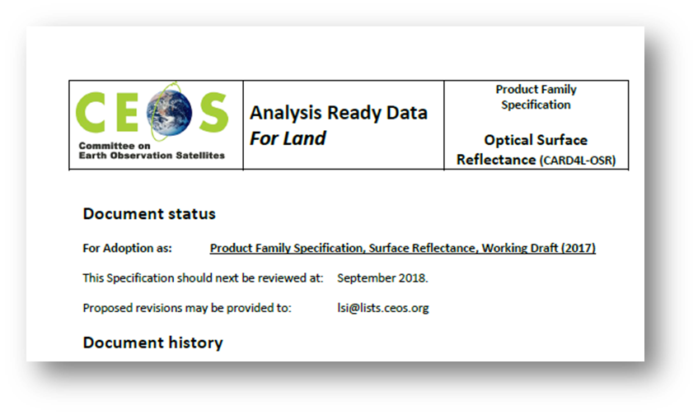
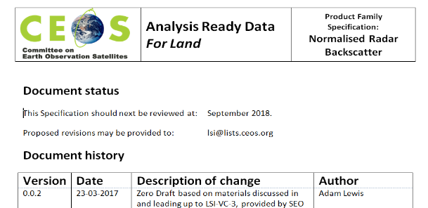
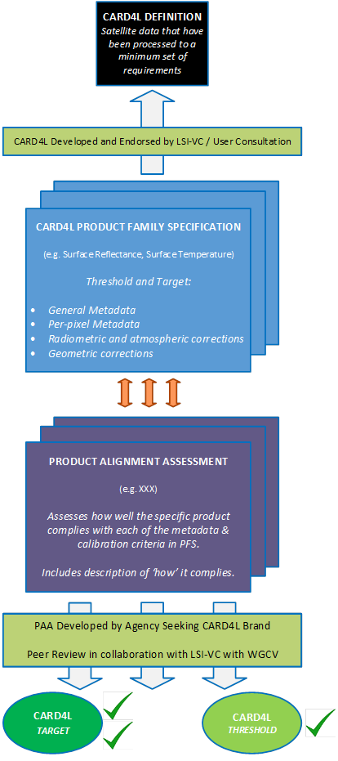
LSIVC POC will verify data provider’s product self-assessment
CEOS ARD for Land - Framework
LSIVC POC will obtain the feedback from WGCal/Val
LSIVC POC will be identified for each PFS
Definition of CARD4L
Current (Surface Reflectance, Land Surface Temperature and Radar Backscatter)
Under development (Polarimetric covariance, Polarimetric decomposition, INSAR LOS, INSAR Coherence, Geocoded SLC)
Product Family Specs
Providers
Self-assessment
Product Alignment Assessment
- SR: S2 (ESA) & landsat (USGS) - current
- ST: S3 (ESA) & landsat (USGS) - current
- RB: ALOS (JAXA) - planned
Peer review
CARD4L Stamp

Slide 6
CEOS ARD for Land - Framework
Definition of CARD4L
Current (Surface Reflectance, Land Surface Temperature and Radar Backscatter)
Under development (Polarimetric covariance, Polarimetric decomposition, INSAR LOS, INSAR Coherence, Geocoded SLC)
Product Family Specs
Providers
Self-assessment
Product Alignment Assessment
Peer review
CARD4L Stamp

Slide 7
CARD4L Product Family Specifications - Background
Product Family Specifications (PFS) have been first developed (early 2017)
A SAR ARD definition Team has been proposed and created to lead further development of radar PFS
Other PFS will probably emerge in a near future and they will be mainly driven by user needs
Product Family Specifications are technical documents and are intended to set outcomes, not methods
Detailed input to the draft CARD4L specifications was received in June - Sep 2017, in Dec 2017 (technical teleconferences) and during 2018
Very strong support for CARD4L is indicated by a range of experiences and activities (JAXA, UK, ESA, USGS, NASA, Canada, GA, CNES, etc.)
http://ceos.org/ard/ (andreia.Siqueira@ga.gov.au)

Slide 8
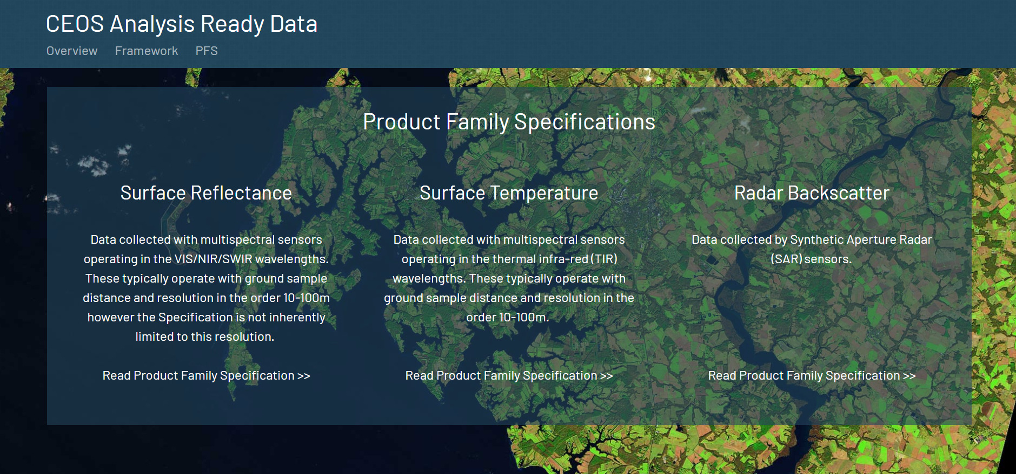
http://ceos.org/ard/

Slide 9
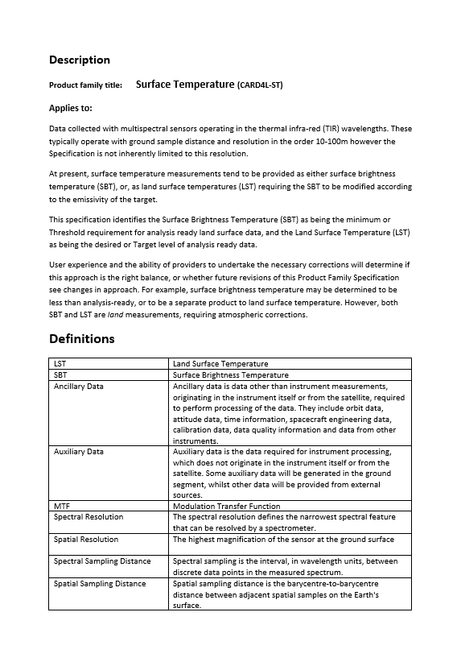
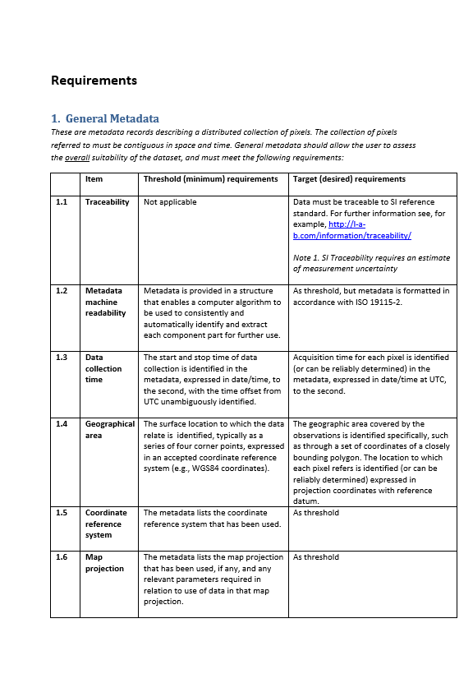
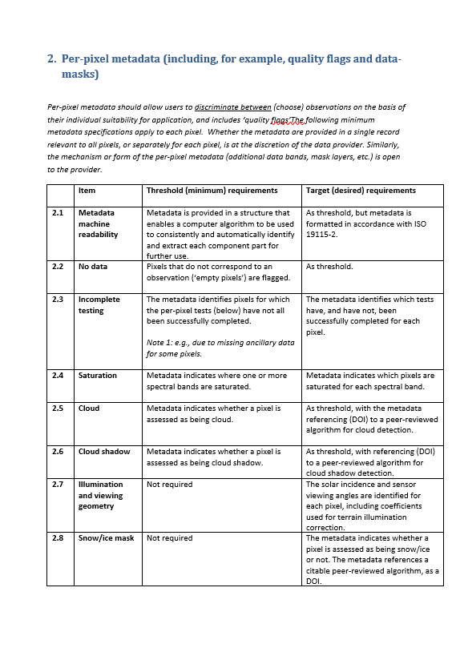
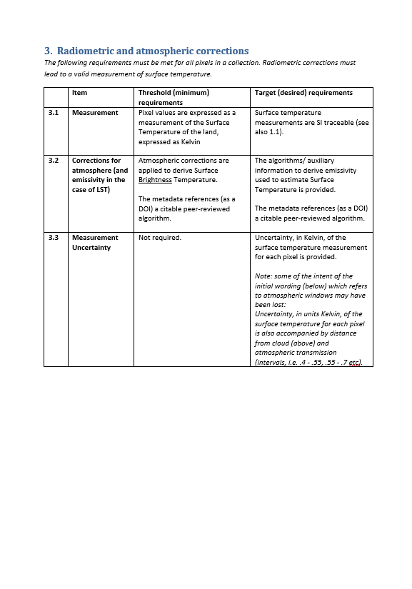
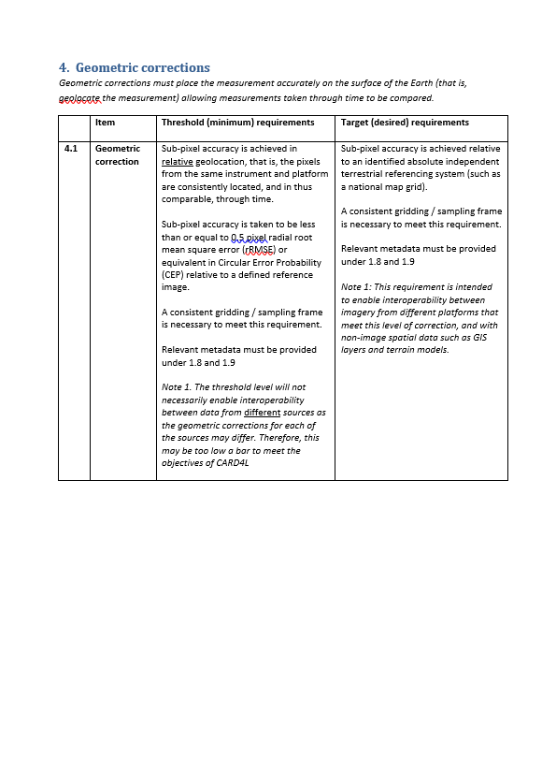
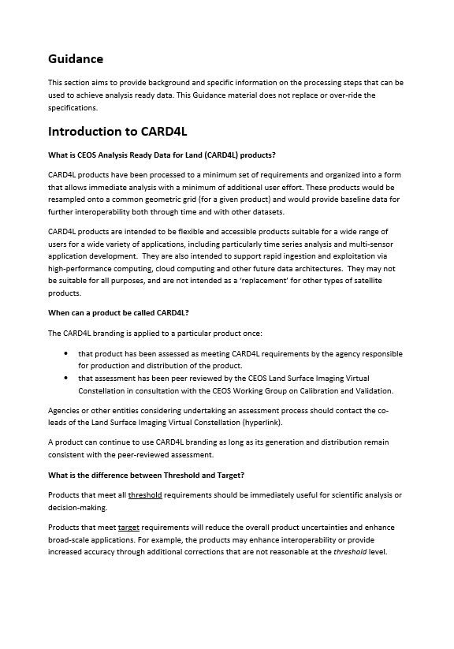
CARD4L Product Family Specifications - Documents
Each PFS document has a Description section
Requirements
  General Metadata – lineage, coverage “what is it and where did it come from?”
  Per-pixel Metadata – “is this observation (pixel) suitable to use?”
  Radiometric and atmospheric corrections – “a measurement of the land surface”
  Geometric corrections – “accurately located on the land surface”
Each PFS document has a guidance section:
  Discussion on the difference between ‘threshold’ and ‘target’ levels of processing
  References to example processes that could be used to produce analysis ready data
  Specific examples of data and processing that produces CARD4L

Slide 10
CARD4L Product Family Specifications - Improvements
PFS may change over time in a controlled process, e.g.:
  Feedback gathered from technical experts
  Proposed changes are collated
  Proposed changes are submitted to CEOS (LSI-VC) for acceptance
Evolutions will be possible when identified as necessary
However PFS stability is to be prioritised

Slide 11
CARD4L Product Family Specifications – Ongoing Work
LSI-VC has moved into an implementation phase with several objectives:
  “Road-test” the PFS, including through further technical teleconferences
    Surface reflectance: S2 (ESA) & landsat (USGS) – current
    Surface temperature: S3 (ESA) & landsat (USGS) – current
    Radar Backscatter: ALOS (JAXA) – planned
  Develop the process for datasets to be assessed as CARD4L
  Identify data products that are on-track to become CARD4L
  Monitor and communicate progress of individual products toward CARD4L
  Outreach and promotion of the CARD4L (covering meetings, conferences, etc.)
  The PFS will continue to evolve as the LSI-VC gathers feedback in the Alignment Assessments

Slide 12
Thank you!

