Slide 1
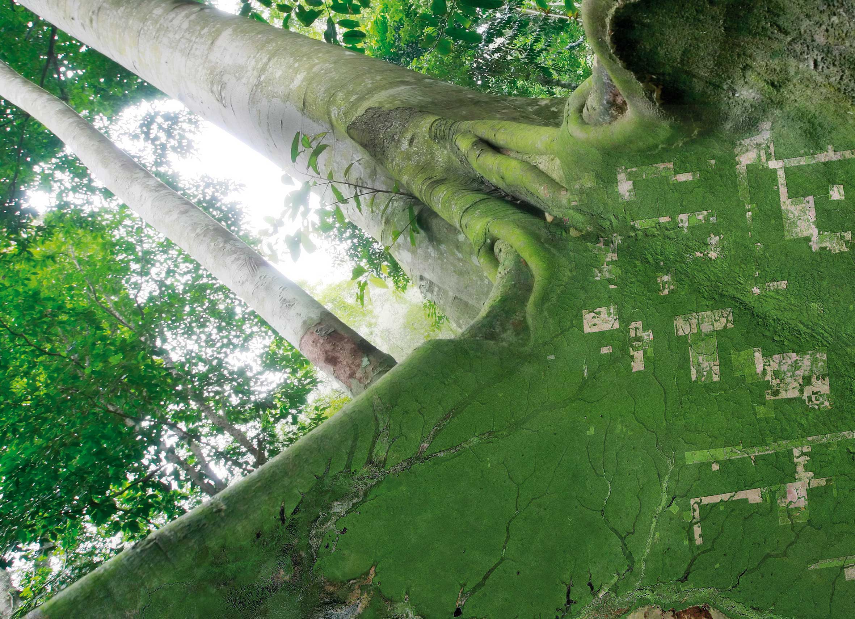
SESSION 5, Item 18 CARD4L for GFOI – Evolution and Trials
SDCG-14: Ispra, 4-6 September, 2018

Slide 2
Objective and Approach
Practical demonstrations of the utility of the ARD
Engage ARD test users with the capacity to identify the advantages and disadvantages
Leveraging existing GFOI / SDCG activities to both support and realise efficiency
Considerations
Identified two potential countries –GFOI engagement required?
Consider building on ‘GFOI Data Cube Club’ from Bogota?
Establish reference from MGD to ARD / CARD4L?
Consider ‘regions’ rather than countries
e.g. Mekong, Northern South America?

Slide 3
Potential Countries / Groups
Colombia
Mature Cube, existing relationship, GFOI engagement
Copernicus Hub Agreement
Vietnam
GFOI engagement?
Vietnam Cube established
CEOS Chair 2019 – profile and tangible outcome
Existing articulation of data requirements early 2018
https://docs.google.com/spreadsheets/d/12ShiRw_jmg-YeG3AW8_qL58c5nUXV9XKk8WY7LLT7TE/edit#gid=0
Add known ‘high capacity’ ODC user? Taiwan?

Slide 4
Target Data
Discussion list of target data from Core Data Streams
Landsat-5/7/8
Sentinel-1
Sentinel-2
ALOS mosaics (7 epochs)
Other Data Sets?
How to generate or source ARD for Sentinel-1 and Sentinel-2?
Issue for Thursday joint session with LSI-VC?

Slide 5
Next Steps?
Colombia
Brian to follow-up with existing contacts?
Confirm status of Copernicus agreement
Look to identify focused project that needs ARD supply
Vietnam
George / Stephen to approach?
Context of Vietnam Cube and CEOS Chair 2019
Promote forests as a priority and encourage GFOI engagement
Others?

