Slide 1
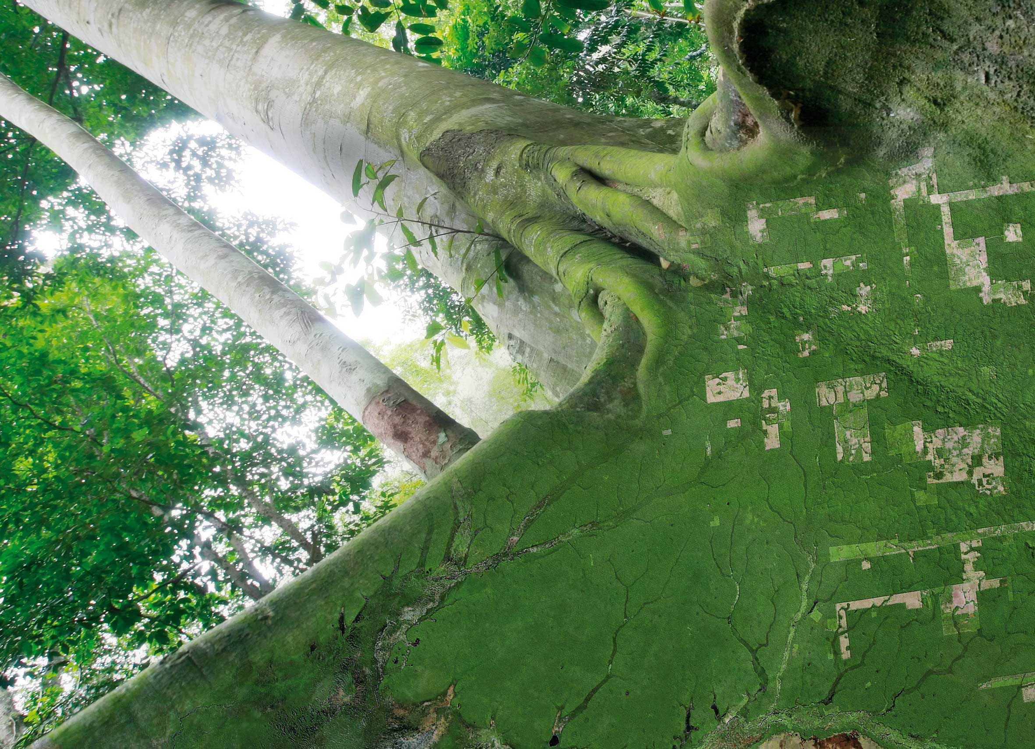



SESSION 6:
Global Baseline
SDCG-14 – 5 September 2018, JRC, Ispra

Slide 2
SDCG Element 1: Global Baseline
Multiple annual global coverages of the world’s forested areas
with provision for coverage for the foreseeable future by inclusion of GFOI requirements in the basic observation scenarios of the core data streams – i.e. based on publicly open satellite data.
Efficient and effective global flows of data
to accommodate in-country development of GFOI-recommended Forest Map products.
Commitment of core data stream providers to include GFOI requirements in the definition of consistent information products
including ‘Analysis Ready’ products.
Achieved since 2017

Slide 3
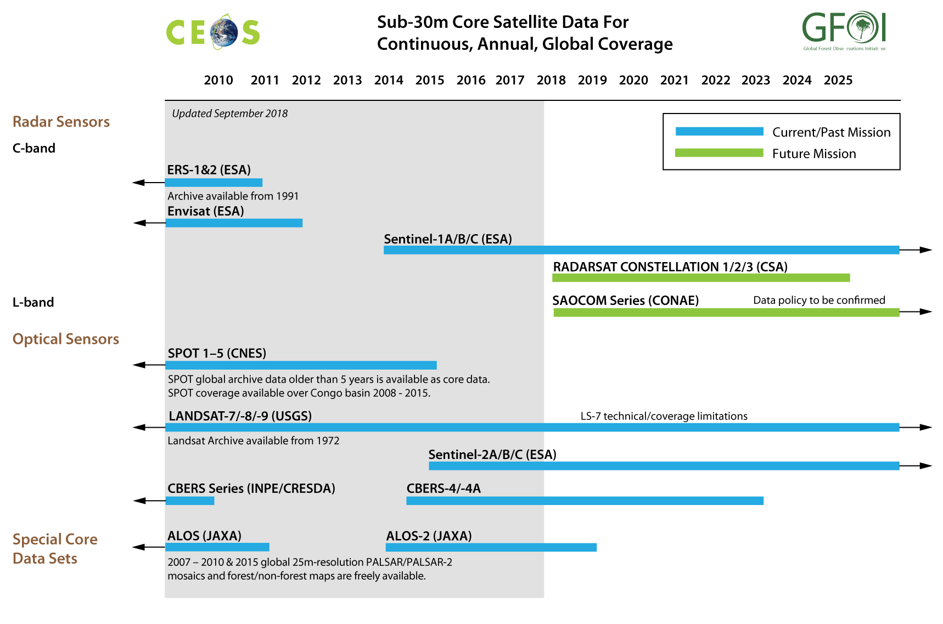


Slide 4
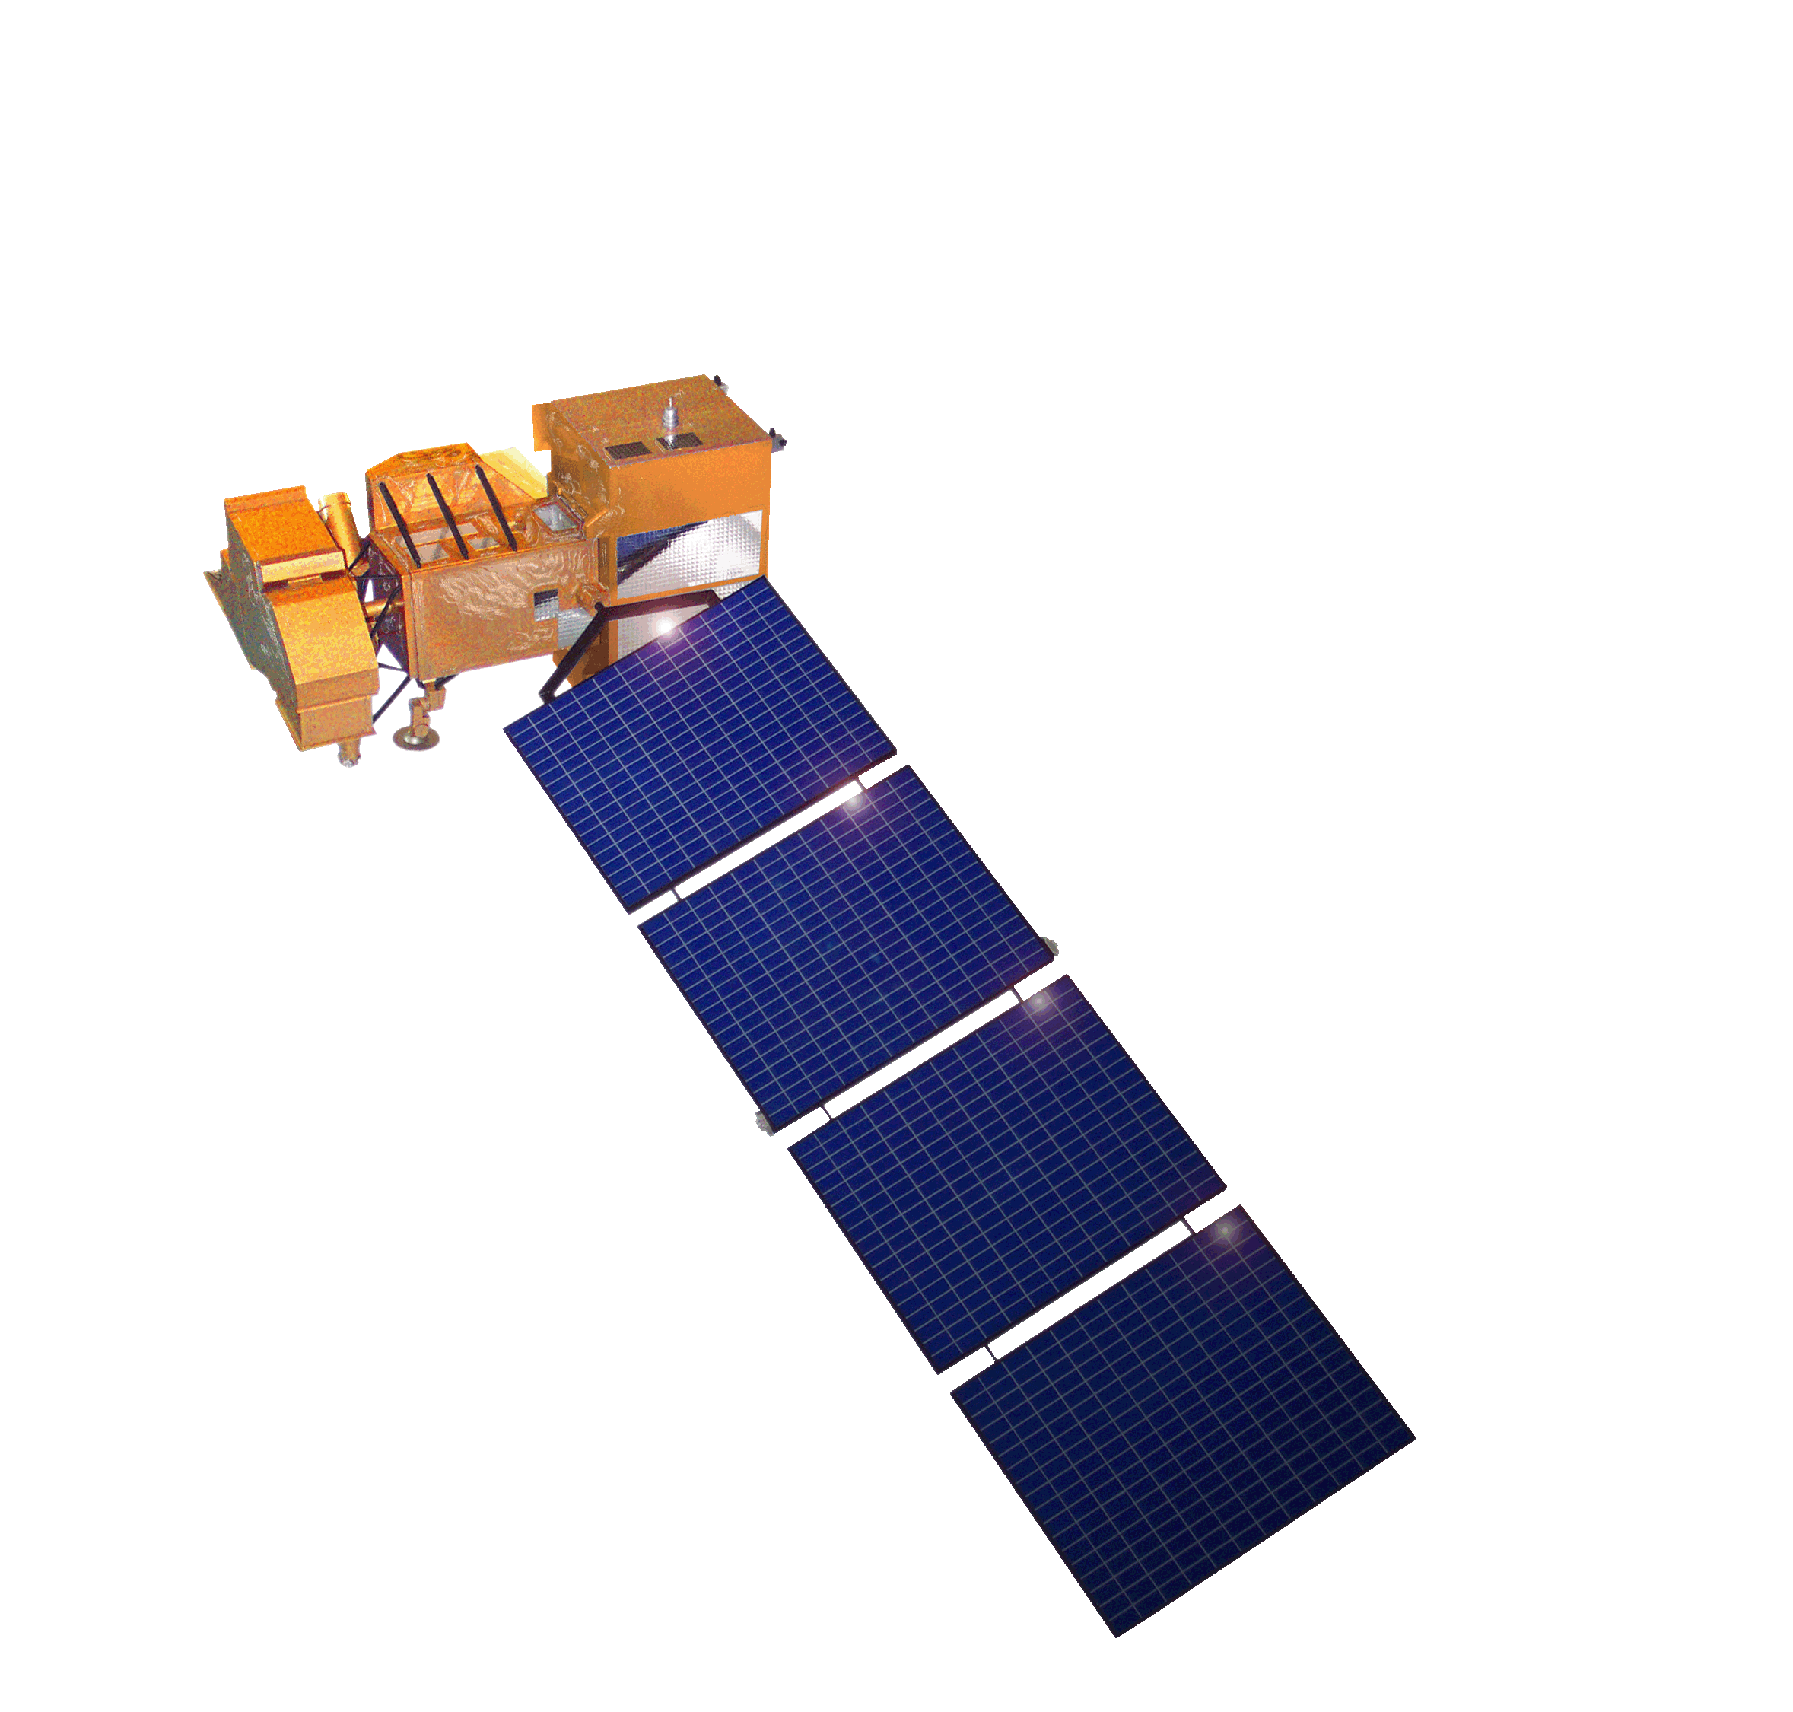
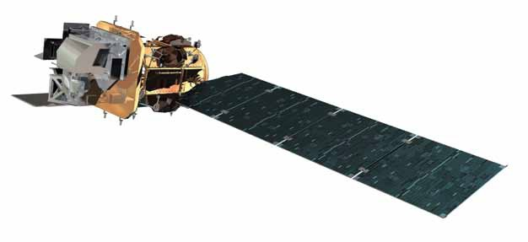
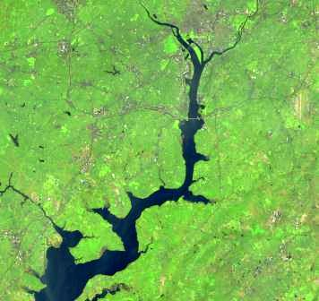
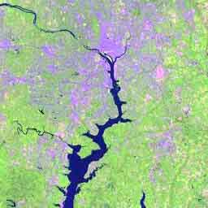
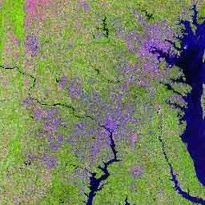
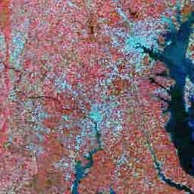
USGS/NASA Landsat
40 + years of Landsat
programme
In orbit Landsat 7 & 8 –
acquisitions close to 100% of observation capacity over land
Landsat 9 (fully Class-B rebuild of Landsat 8) for launch in Dec 2020
Landsat 10 (Class B full spectrum) to launch ~2027-2028

Slide 5
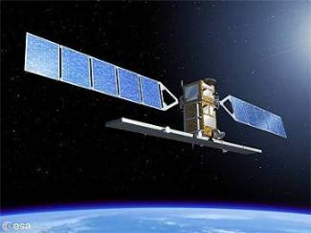
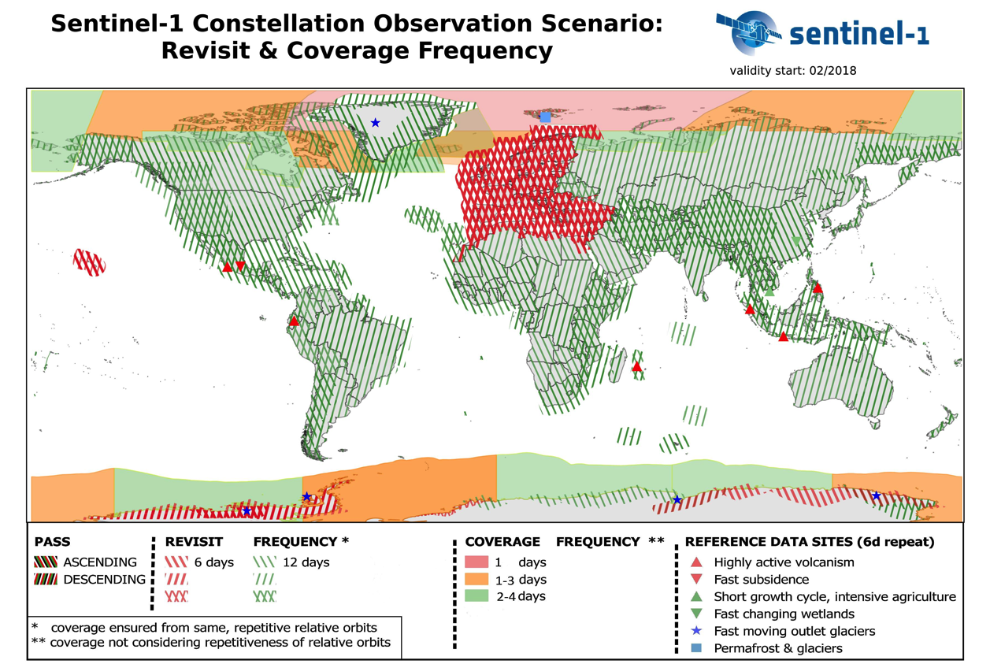
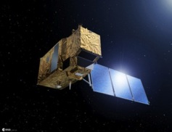
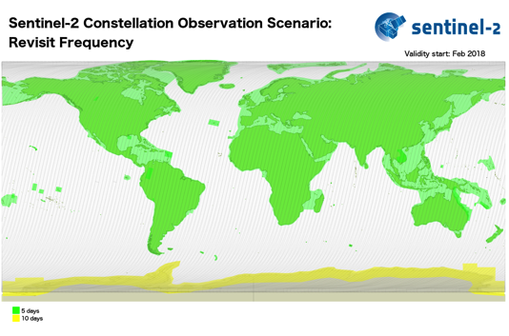


Core Data from COPERNICUS: the Sentinels
Sentinel-1A / -1B
night and day radar imaging
C-band SAR
12 days repeat cycle (1 satellite)
Sentinel-2A / -2B
multispectral (13 bands)
10 days repeat cycle (1 satellite)

Slide 6
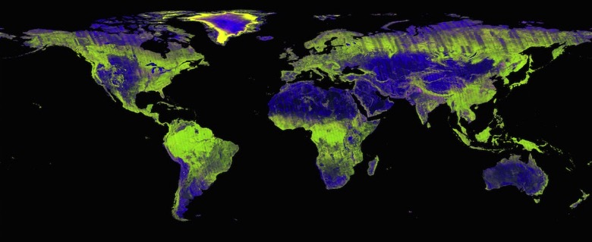
ALOS-2 PALSAR-2 Global Mosaic
Annual mosaics of PALSAR-2, 25 m resolution, freely available

Slide 7
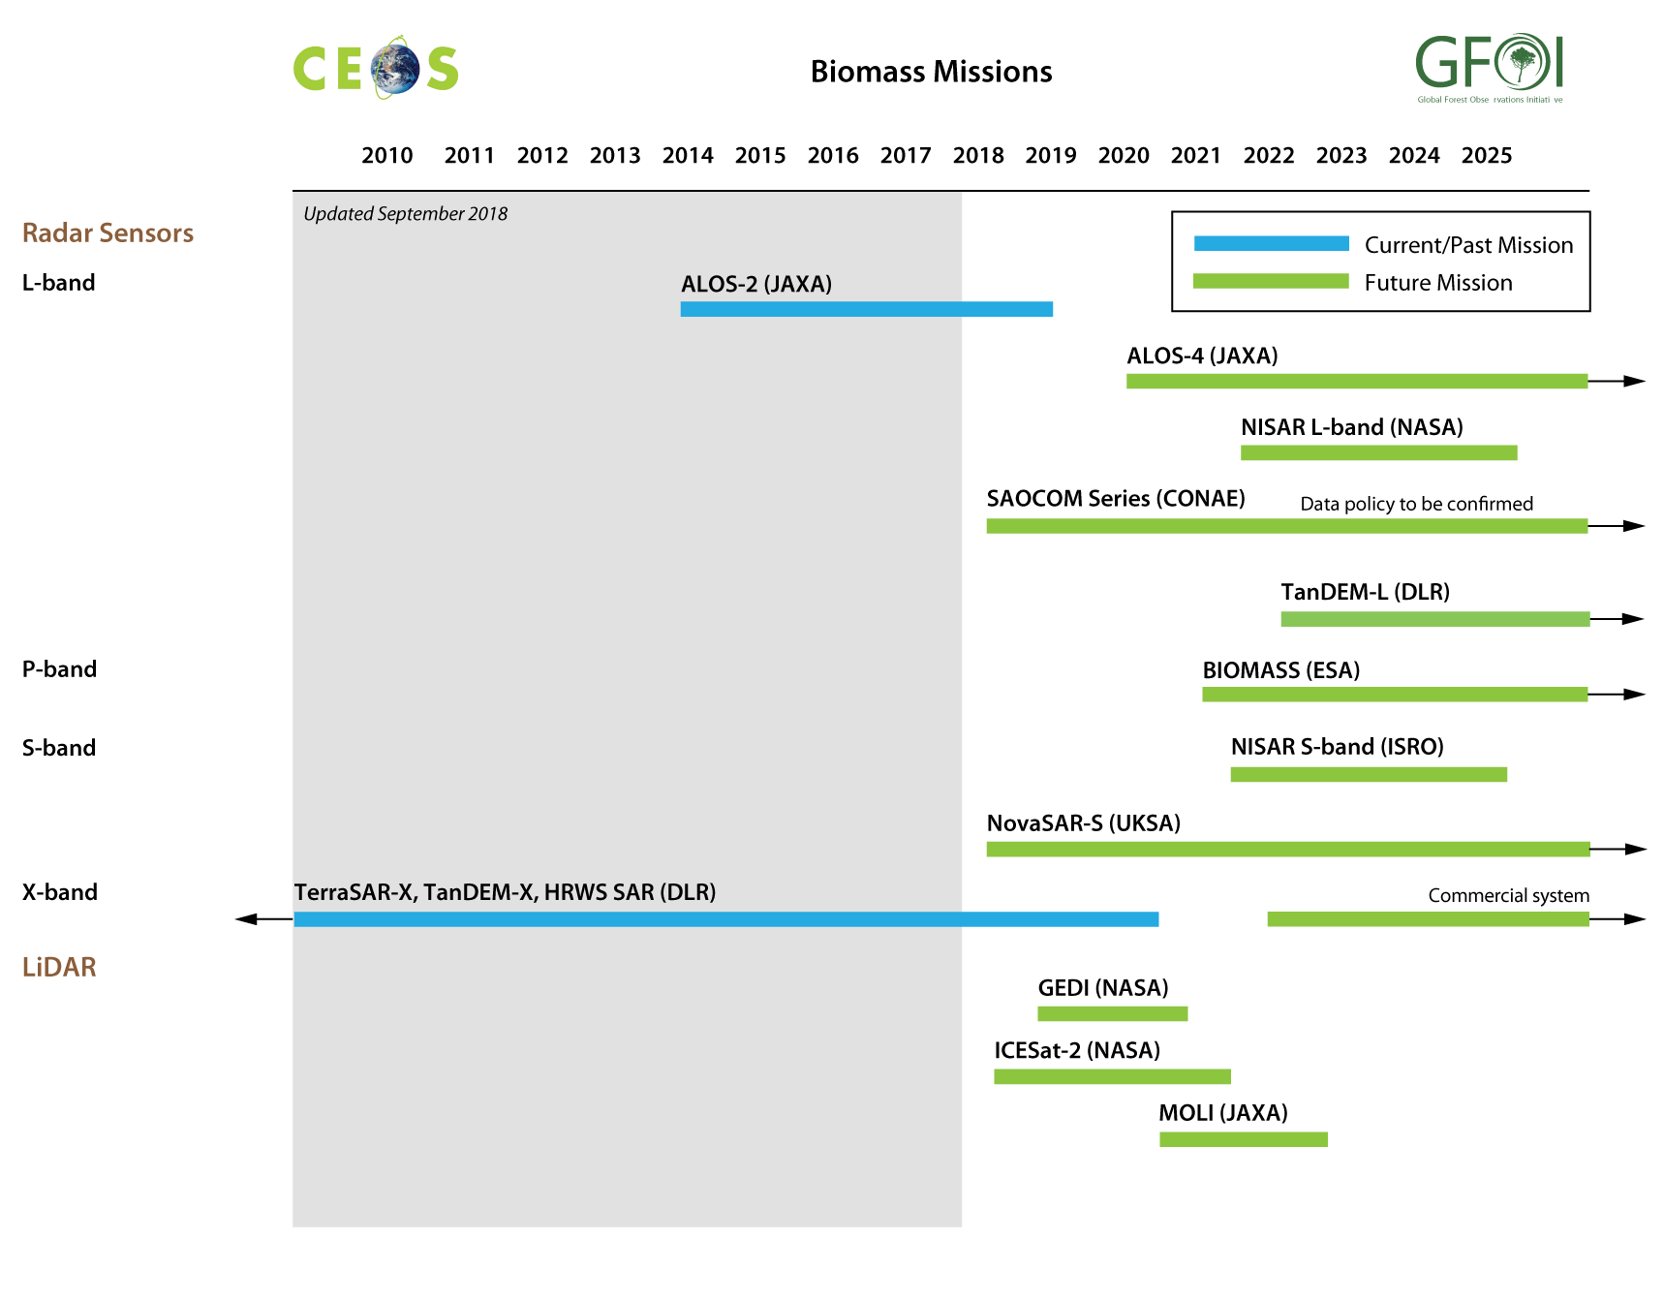
Missions related to Biomass

Slide 8
Expected Outcome
Multiple annual global coverages of the world’s forested areas
integration of upcoming missions in baseline scenario
integration of biomass missions addressing emission factors
Efficient and effective global flows of data
Provision of ARD

