Slide 1
SESSION 6, Item 21 Future Core Datastreams
SDCG-14 @ JRC/Ispra, Italy – 5 September, 2018

Slide 2
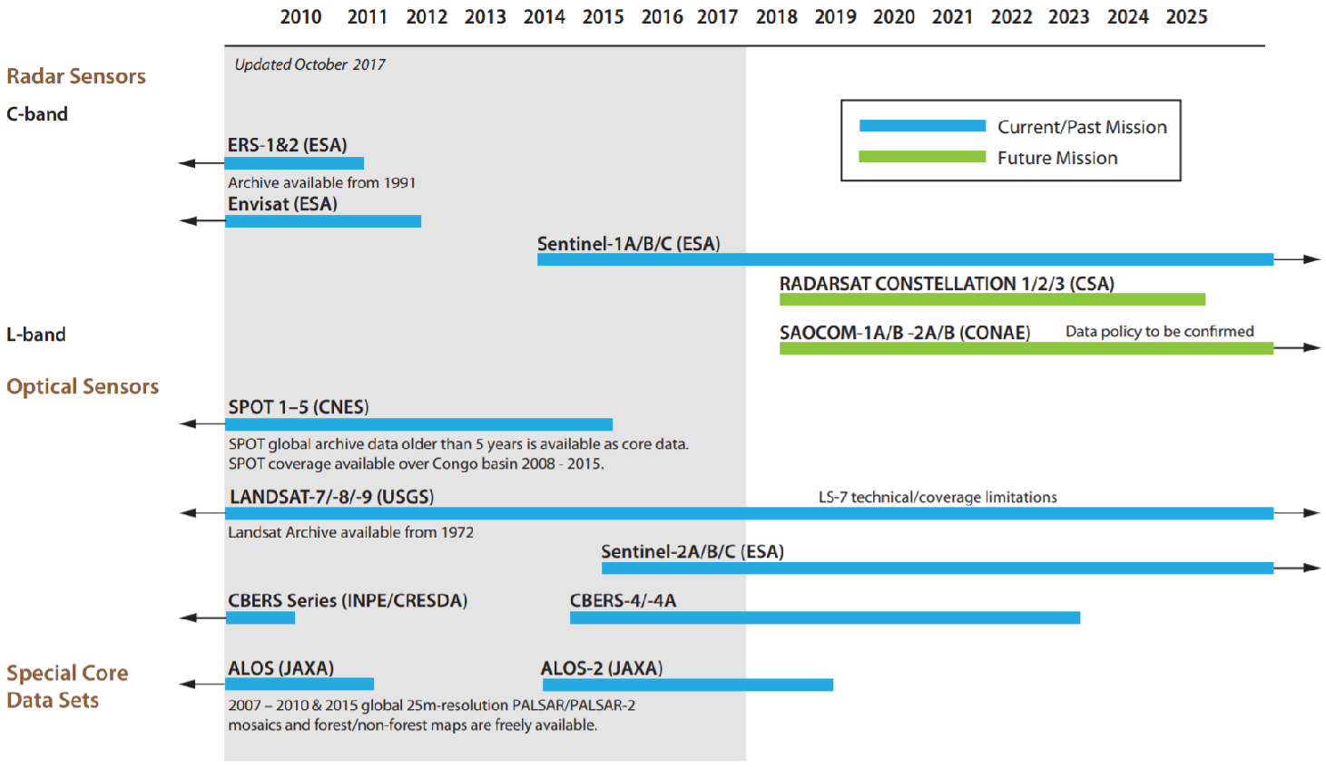
CEOS Achievement Satellite Data Coordination – Core Data Stream

Slide 3
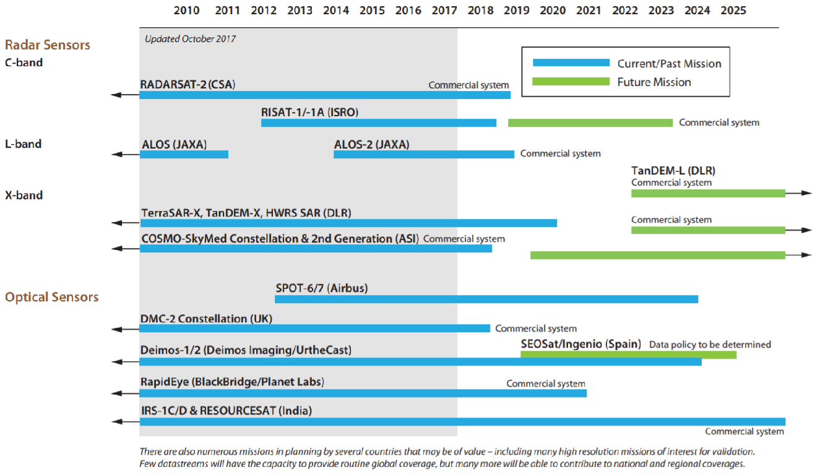
CEOS Achievement Satellite Data Coordination – Future Missions of interest

