Slide 1
GFOI Space Data Services
Brian Killough / NASA, CEOS SEO
SDCG-14, September 5, 2018
Agenda Item #21

Slide 2
Agenda
3-Year Work Plan Tasks and Outcomes
#6: Ensured On-going Coverage
#7: Interoperable Data Discovery Tools
#8: Assembly and Delivery of Core Data
#10: Cloud-Computing Pilot Projects
#11: Model National GFOI Data Services
Open Data Cube

Slide 3
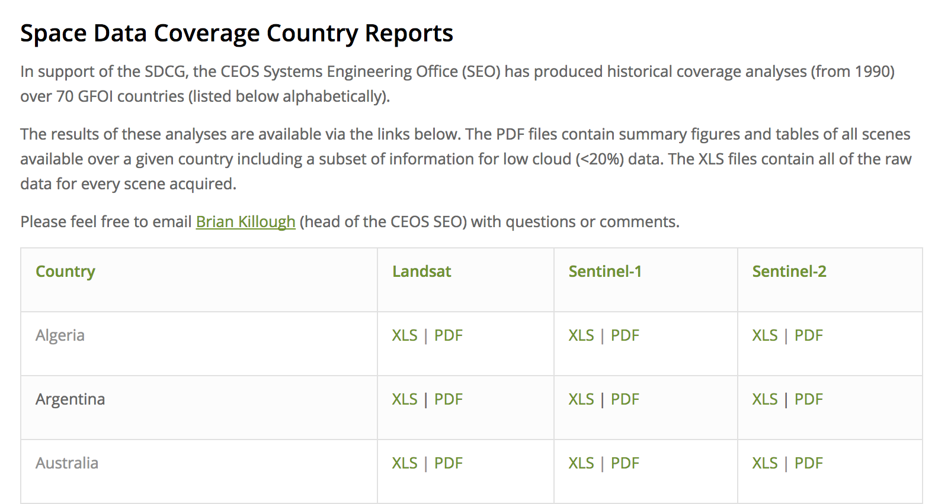
#6: Ensured On-going Coverage
Archive Characterization
The SEO has now automated the production of Landsat, Sentinel-1 and Sentinel-2 country reports and they are posted online for all 70 GFOI countries. The reports are updated on an annual basis and current through 2017.
These reports will be valuable for countries to assess available scenes and cloud cover for future data ordering.

Slide 4
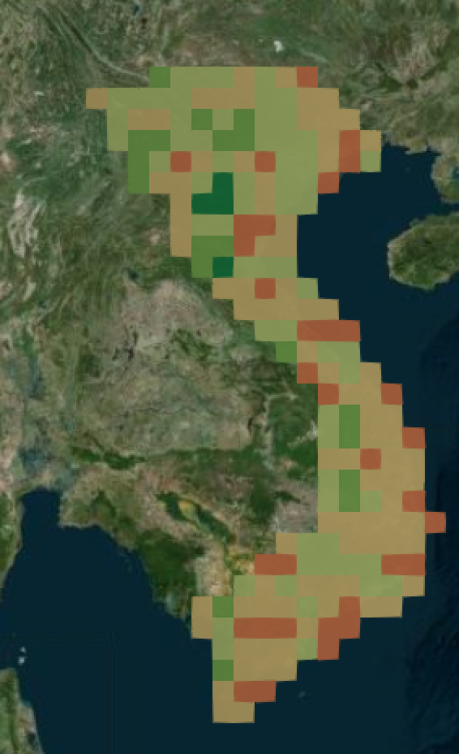
#7: Interoperable Data Discovery Tools
The COVE Tool includes links to archive databases from: Landsat 7/8, Sentinel-1A/1B and Sentinel-2A. Current issues with S1 archive at ASF to be resolved in 6-8 weeks.
The SEO vision is that the COVE tool can provide a “one-stop” location to perform coverage assessments and “discovery” of valid images. It also gives the user direct links to data ordering, when possible.
The new COVE ”Coverage Analyzer” tool can perform country-level and global queries of the Landsat and Sentinel archives. The new COVE “Data Browser” tool allows detailed browsing of scene information to support data ordering decisions.
Sentinel-1 acquisitions over Vietnam for Jan-Jun 2017 at 0.5 deg

Slide 5
Future Updates to the COVE Tool
Custom mission capability
Metadata archive additions and connection updates (ALOS-2, Radarsat-2, Resourcesat-2, Spot, Pleiades, TerraSar-X, CBER-4)
Coverage / Revisit Performance calculation capabilities
Cloud Cover overlays derived from Landsat historical metadata (13 in total, 1 raw average, 12 monthly average files)
Coincident calculations for both future predictions and historical archive data
Addition of viewing angle calculations previously available in Rapid Acquisition Tool
Further optimization in the Acquisition Forecaster to improve runtimes on long duration queries

Slide 6
#8: Assembly/Delivery of Core Data
The provision of “core data” for GFOI purposes is in place and there are few issues.
Countries can use the FAO SEPAL tools or the new Open Data Cube tools as methods for data analysis. These tools can be deployed locally, or on data hubs or computing clouds.
The SEO worked with Google to develop a method for making Sentinel-1 data cubes using the Google Earth Engine ARD holdings. It is possible to create an S1 cube anywhere in the world in less than a day.
The move toward sustained Analysis Ready Data (ARD) significantly improves the efficiency and effectiveness of core satellite data. This is being worked within CEOS.

Slide 7
Action SDCG-13-08
Compile a list of datasets (incl. ARD), algorithms and tools relevant to GFOI and MGD workflows
Datasets: Landsat (ARD), Sentinel-1 (SEPAL, ARD, Google ARD, S1 Toolbox can be used for ARD generation), Sentinel-2 (Sen2Cor can be used fro ARD generation), ALOS Mosaics (ARD with 7 epochs), Planet and Digital Globe (via SEPAL), CBERS-4 (ARD unknown), SAOCOM-1 (ARD unknown), Radarsat (ARD unknown).
Tools: FAO SEPAL, Open Data Cube (ODC), Google Earth Engine (GEE), ESA Foresty TEP
Algorithms: (1) SEPAL BFAST (deforestation), and Open Foris Toolset (many algorithms) (2) ODC Application Library (DCAL): - Landsat = Cloud-filtered mosaics (median, geomedian), PyCCD (deforestation), NDVI Anomaly (deforestation), PCA (Colombia Data Cube), NDVI Trend (Vogelmann), Random Forest and K-Means Clustering (land classification). - ALOS = Change Detection using Band Thresholds with Open Data Cube (deforestation) - Sentinel-1 = Deutscher (land change, deforestation)

Slide 8
#10: Cloud Computing Pilot Projects
The SEO continues to work with Amazon to test Data Cube cloud storage and computing. This cloud system has become the baseline for many countries, including the new Africa Regional Data Cube (ARDC).
The SEO and Australia (GA) are working with several DIAS contractors to install the Open Data Cube on their systems and test the ability to generate Sentinel cubes and/or run ODC algorithms.
Most countries prefer local deployment of data for analysis purposes, but there are several countries that desire to use cloud computing (e.g. African Regional Data Cube, Uruguay, Mexico). Colombia is also planning to move in that direction in the coming year.

Slide 9
#11: Model National GFOI Data Services
To date, we have not identified a “Model National GFOI Data Services” system.
FAO is continuing to enhance its SEPAL tool and CEOS is working on its Open Data Cube tools.
As these two initiatives progress, GFOI should communicate with users to make sure they understand the available options.
Colombia is planning to move toward the use of the Open Data Cube for their national forest monitoring system.

Slide 10
Which have an interest in Forests?
The CDC team is engaging with ~50 different countries to consider the deployment of Data Cubes. Many of those countries have a desire to support forest applications.
We know that these 9 countries have an interest in forest applications: Colombia, Switzerland, Vietnam, Taiwan, Kenya, Hondurus, Canada, Guatemala, Brazil, Costa Rica, Indonesia.

