Slide 1
SESSION 6, Item 23 Data for R&D (El-3) & Phase 2 discussion
SDCG-14 @ JRC/Ispra, Italy – 5 September, 2018

Slide 2
Status Overview of 3-Year Work Plan Tasks and Outcomes

Slide 3
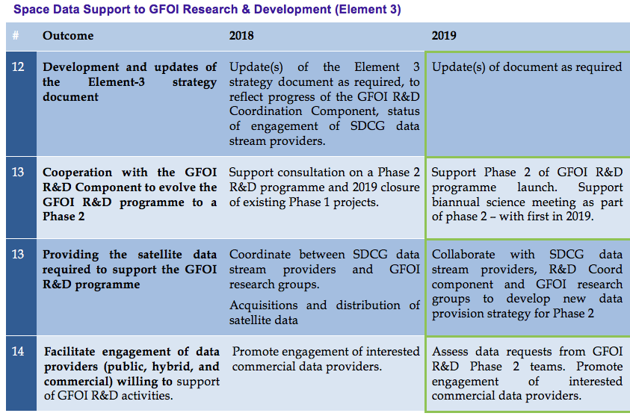
3-Year Work Plan – Element-3

Slide 4
3-Year Work Plan – Element-3
Status: Phase 1 On schedule, Phase 2 Pending
El-3 v4.0 submitted “for information” to SIT-33 (April 2018)
Update 2018 (v5) to reflect new focus of GFOI R&D Coordination component. Waiting for GFOI R&D Coordination component lead to be selected by ESA

Slide 5
3-Year Work Plan – Element-3
Status: Not started
…

Slide 6
3-Year Work Plan – Element-3
Status: Phase 1 On schedule
All SDCG agencies in the process of tasking and/or provision of data to the selected teams
Phase 1 R&D programme to be wrapped up in Q1/2019 (~2019 GFPO Plenary)

Slide 7
3-Year Work Plan – Element-3
Status: Static
Private sector engagement
AD&S (SPOT 6/7) – No feedback from Airbus. Efforts to engage aborted.
SSLT (NovaSAR) – Launch Sept 2018. Data to be available 6 months after launch. UKSA contact point Joanne. Australia (CSIRO) partner in mission with data distribution capacity.
Planet – Contacts (re-)established at GFOI Plenary in Saigon. Pushing ARD amongst commercial providers. Holding on on El-3 further contacts until new R&D Coord component up running and plans defined

Slide 8
R&D support in GFOI Phase 2

Slide 9
Phase 2

Slide 10
R&D Coord for Phase 2 – key points
a revised strategy has been developed by the GFOI R&D together with the SDCG to address priority research gaps that relate more to pre-operational elements and focus more on large-area demonstrations rather than smaller test studies
Phase 1 will be completed in 2019. The existing research program will continue to be monitored until the end of this phase, when a Science Meeting can be foreseen. Research teams will be encouraged to consolidate their research effort and then to move to larger area and national demonstrations. The SDCG and R&D component will pursue stronger cooperation together through this effort.
Results from research into the key topics will be discussed and disseminated at Science Meetings which will be organized every 2 years to ensure greater transparency and communication between researchers. Expert workshops will occur more frequently, with the aim of addressing key issues with the use of tools and data which are considered to be operational or pre-operational.

Slide 11
R&D Coord for Phase 2 – key points
Current key topics as discussed in the GFOI Plenary 2018, and which can be directly addressed by R&D and SDCG are:
Use of data from new satellite missions, and integration of Sentinel satellite data with Landsat time series
Use of very high resolution data (0.5-5 m) for targeted sampling in stratified area change estimation (for long-term monitoring) to support the wide-scale application of GFOI MGD guidance
Early warning: responding to user needs, demonstration and upscaling in the theme of near-real time forest monitoring in contribution to the GFOI Early Warning task force
Biomass mapping from space taking advantage of 6-7 upcoming missions in a co-ordinated and consistent way in close collaboration with CEOS WGCV LPV efforts

