Slide 1
JAXA L-band SAR heritage and ALOS Next Generation and MOLI Mission Plans for Forest & Carbon
Osamu Ochiai (JAXA)
Takeo Tadono (JAXA)
Ake Rosenqvist (soloEO)
SDCG-15 Biomass Day, Hampton (VA) USA
26 March 2019

Slide 2
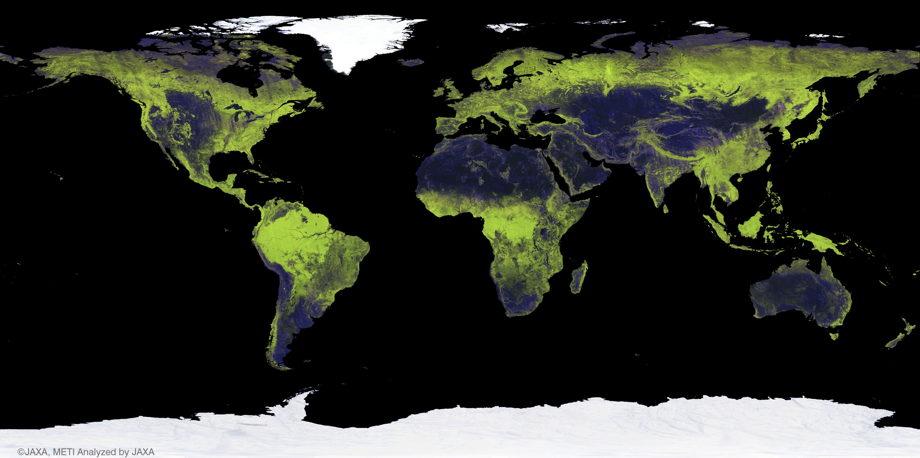
L-band SAR Heritage
Systematic Acqusition Strategies were first developed and implemented by JAXA (NASDA) more than 20 years ago → a rich archive of L-band SAR data
JERS-1 SAR GRFM (1995 – 1998: Pan-tropical, Pan-boreal) [Public open]
ALOS PALSAR BOS (2006 – 2011: Global) [Free or cost of reproduction (JPN)]
ALOS-2 PALSAR-2 BOS (2014/Q3 – present: Global) [Commercial]
25m L-band SAR mosaics
1996
2007
2008
2009
2010
2015
2016
(2017+)
http://www.eorc.jaxa.jp/ALOS/en/palsar_fnf/fnf_index.htm

Slide 3
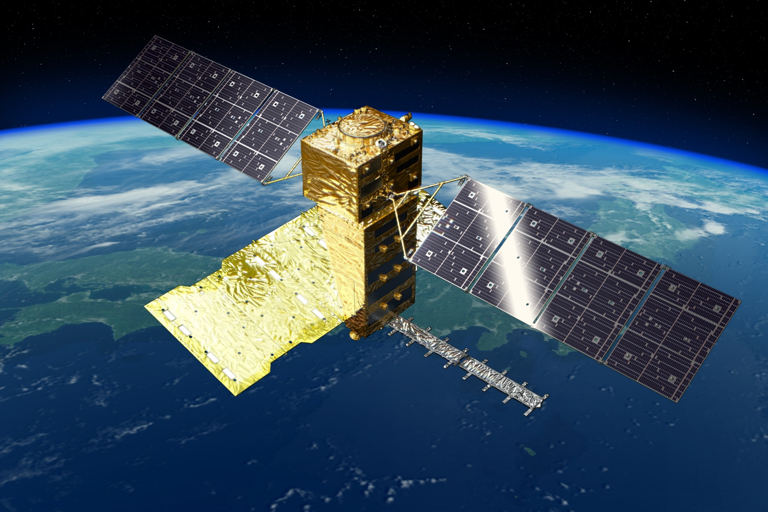
ALOS-4 (Advanced Land Observing Satellite-4)
Input by Takeshi Motohka (JAXA TKSC)

Slide 4
ALOS-4 Mission Objectives
Continuation and enhancement of the JERS-1, ALOS and ALOS-2 missions & new applications
  Land deformation and subsidence monitoring
    Detecting anomalies at an earlier stage by increasing observation frequency
  Disaster monitoring
    Keeping observation capability at night and at bad-weather conditions
    Wide-area coverage for large earthquakes and multiple events
  Other continuous missions and new applications
    Environmental monitoring: time-series change of forests, wetlands, ice sheets, etc.
    Ocean: ship detection, sea ice drift monitoring, etc.
    Agriculture and natural resources
    Inspection of increasing aging infrastructures (dams, airports, etc.) using time-series interferometry

Slide 5
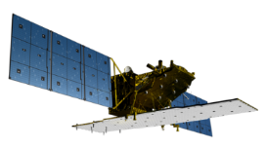
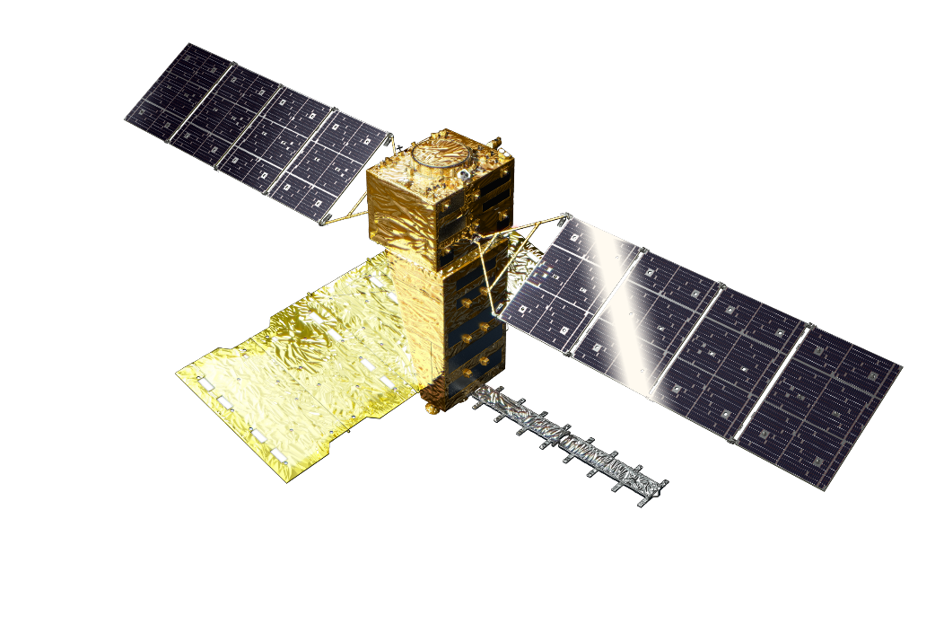
ALOS Next-Generation - Development and operation plan
2014 | 2015 | 2016 | 2017 | 2018 | 2019 | 2020 | 2021
ALOS-2
Launch
Mission operation (5 years)
Post mission operation
Development
Launch
ALOS-4
（L-band SAR）
Development
Launch
ALOS-3
（Optical）

Slide 6
ALOS-4 System Characteristics
Y
Launch | JFY 2020, H3 launch vehicle
Orbit | Same orbit as ALOS-2 Sun-synchronous sub-recurrent orbit Altitude: 628 km Inclination angle: 97.9 degree Local sun time at descending: 12:00 ± 15 min. Revisit time: 14 days (14+11/14 rev/day)
Lifetime | 7 years
Satellite Mass | approx. 3 tons
Downlink | 3.6 Gbps/1.8 Gbps (Ka-band)
Mission Instruments | PALSAR-3 (Phased Array type L-band Synthetic Aperture Radar-3) SPAISE3 (SPace based AIS Experiment 3)
Prime contractor | Mitsubishi Electric Corporation
X
Z
Solar array paddle
PALSAR-3
antenna
Ka-band DT antenna
SPAISE3
antenna

Slide 7
PALSAR-3 characteristics
Expanded swath width with maintained spatial resolution and image quality of PALSAR-2 by digital beam forming (DBF).
To guarantee the continuity of ALOS-2 applications, PALSAR-3 will inherit the major function and performance (NESZ, S/A, etc.) of PALSAR-2
 | ALOS-4 | ALOS-2
Stripmap (res. 3/6/10 m) | 100-200 km | 30-70 km
ScanSAR (res. 25m*) | 700 km | 350-490 km
Spotlight (res. 1 x 3 m) | 35km×35km | 25km×25km
*single look
Swath width 100-200 km

Slide 8
User needs to system requirements
Main user needs
System requirements
Land deformation and subsidence
High spatial resolution
(same level as ALOS-2)
High observation frequency and spatial resolution
Basemap observation over Japan
High observation frequency
(> 20 times/year)
Disaster monitoring
Wide area coverage
(> 200 km swath)
Observation at night time and bad weather condition
Quick initial response
Repeat-pass orbit and
the same orbit as ALOS-2
Continuation from ALOS-2 and new applications
Wide observable range and
high-speed data transmission
Infrastructure (dams, etc.)
Forest and wetland
Ship detection
Agriculture
Sea ice and ice sheet
Natural resources
Polarimetric observation
Long time continuous operation
(long lifetime)

Slide 9
ALOS vs ALOS-2 vs ALOS-4
 | ALOS 2006-2011 | ALOS-2 2014- | ALOS-4 2020-
Antenna size | 3 m×9 m | 3 m×10 m | 3.6 m×10 m
Number of T/R module | 80 (Si) | 180 (GaN) | 232 (GaN)
Transmit power | 2,000 W | 6,120 W | 7,888 W
Receive beam | Single beam | Dual beam (azimuth) | DBF (range) + Dual beam (azimuth)
Ionospheric correction | N/A | N/A | Split-band mode
Pointing | Right | Right and Left | Right and Left
Orbit control | < +/- 2.5 km (at Equator) | < +/- 500 m (all latitudes) | < +/- 500 m (all latitudes) Laser reflector for calibration
Data recorder | 90 GB | 128 GB | 1 TB
Data transmission | 120 / 240 Mbps | 800 Mbps | 3.6 / 1.8 Gbps

Slide 10
MOLI
  Multi-footprint Observation LIDAR and Imager (MOLI)
  JAXA LIDAR mission to fly on the International Space Station, Japan Experimental Module (ISS-JEM)
  Mission Design Review completed May 2017
  Operations foreseen from around 2020

Slide 11
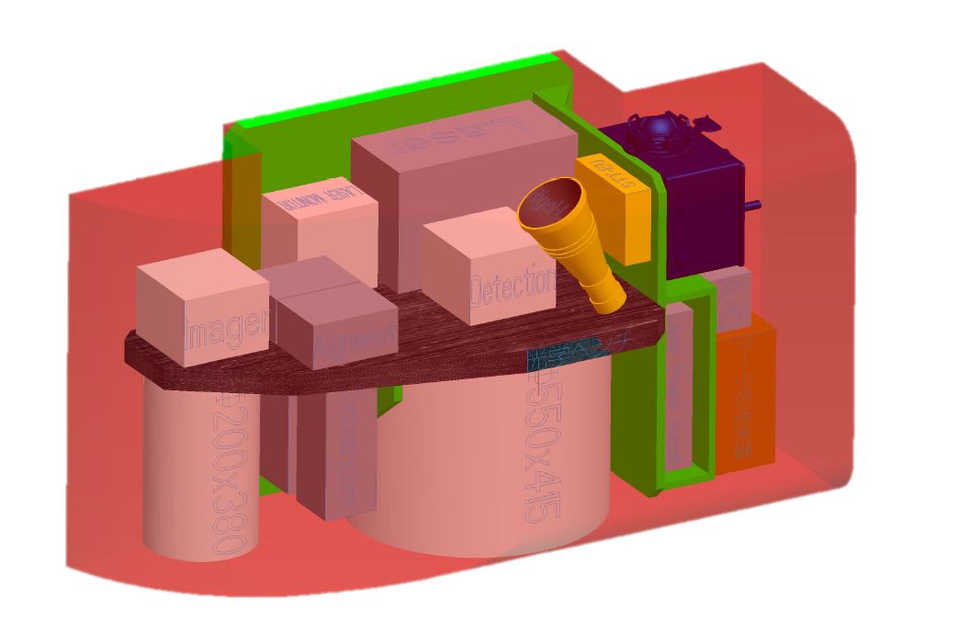
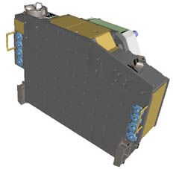
MOLI Overview
MOLI characteristics
Demonstration mission on ISS-JEM
ISS Orbit
  Altitude 400 km, Inclination 51.6 deg
Instruments
  Double beam LIDAR
    Wavelength: 1064nm
    Pulse width: less than 7ns
    PRF: 150 Hz
    Double beam (2 foot prints)
  Multiband Imager
    Resolution: 5 m
    Swath: 1 km
    Band: NIR, R, G
Canopy measurements
  Foot print 25m diameter
  Height accuracy =< 3m
Mission duration; > 1 year
Planned Launch year 2020
+
i-SEEP
(IVA-replaceable Small Exposed Experiment Platform)
Envelope 1600x640x830
MOLI
Schematic diagram of MOLI
Using i-SEEP platform, more flexible environment and services by astronauts are expected.
Laser Transmitter to be returned (post mission) for degradation evaluation on ground.
Notes:
MOLI has LIDAR to measure canopy height and optical imager to understand canopy location and vegetational parameters.
Explaining LIDAR, laser is transmitted to the ground, and reflected signal is received by telescope. Detector Unit detects the signal.
MOLI also has support sensors, STT and GPS to determine footprint positions.

Slide 12
Foot print design for terrain relief calibration
For calibration of terrain relief:
  Staggered double footprints with the same transmitting timing
For estimation of ground surface slope angle:
  Slope estimation using 3 footprints
  Target slope: ≦30 deg. No snow cover.
50m (PRF 150Hz)
Along track
15 m
15m
25m
in diameter
(beam divergence
62.5mrad )
(n)th pulse
(n+1)th pulse
・・・
Notes:
Next is sampling design.
A lot of sample is needed for measuring accurate biomass,
so MOLI samples 2 lines along track.
It means MOLI must create 2 footprints per 1 laser pulse. by transmitting 2 laser beams.
MOLI can also estimate a slope angle of the ground surface using 3 footprints.
These distance is determined by pixel pitch of array detector.

Slide 13
MOLI data products
Standard Products (quality assured)
level | Product category | Products | Remark
L1 | Lidar footprint products | Full waveforms | including geolocation data
 | Imager product (1km swath) | Image | geometrically corrected
L2 | Lidar footprint products | Canopy heights | including geolocation data
 |  | AGB* | including geolocation data
Research Products (quality evaluated)
*: Above Ground Biomass
level | Product category | Products | Remark
L3 | Synergy products with MOLI Lidar and imager (1km swath) | Tree canopy heights | Line to 2D expansion
 |  | Forest biomass
L4 | Synergy products with MOLI and other satellites Wall-to-Wall map products | Tree canopy height Map | “Wall2Wall” expansion
 |  | Forest biomass map
Notes:
This table shows the tentative list of data products.
In level 1 there are waveforms data and geometrically corrected image data.
In level 2 there are footprint level canopy height, biomass.

Slide 14
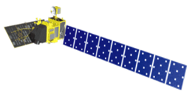

Updated Schedule of ALOS/ALOS-2
Data Processing and Open Free Access
As of February 2019
 |  | 2018 |  |  |  | 2019
 |  | 1Q Jan Mar | 2Q Apr Jun | 3Q Jul Sept | 4Q Oct Dec | 1Q Jan Mar | 2Q Apr Jun | 3Q Jul Sept | 4Q Oct Dec
ALOS | AVNIR-2 (10 m)
 | PALSAR (10 m)
ALOS-2 | ScanSAR (100 m)
 | Fine Mode (10 m)
Japan Area
±60
Degree Area
Global
Data Processing
Japan Area
±60
Degree Area
Global
Data Processing
on Supercomputer
JICA-JAXA JJ-FAST intermediate products (ARD) processing
Data Processing
Under negotiation with commercial data provider

Slide 15

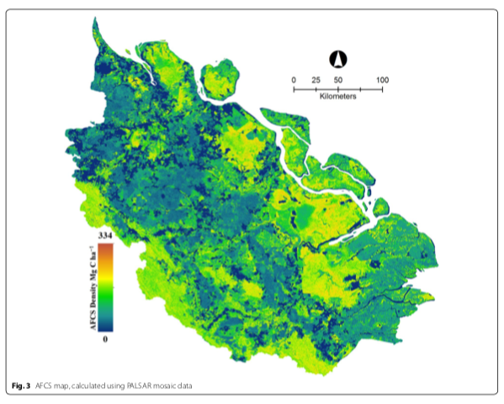
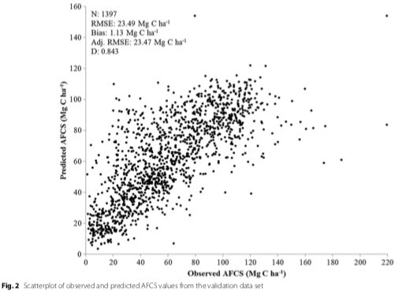
Use of PALSAR time-series and LIDAR for mapping of above-ground carbon stocks

Slide 16
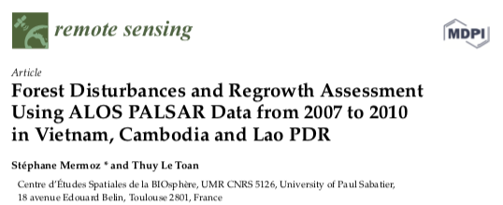
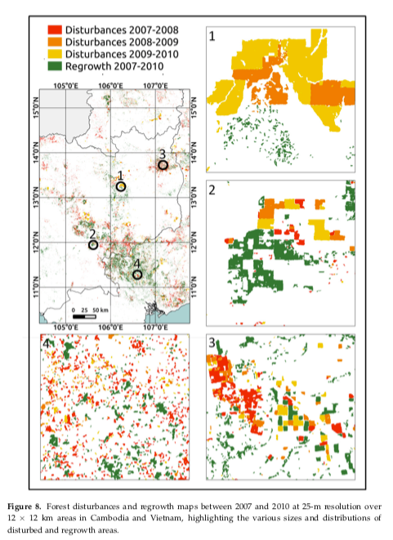
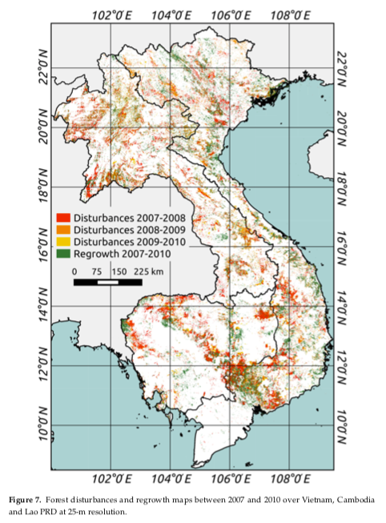
Use of PALSAR global mosaics for mapping of disturbances and regrowth

Slide 17
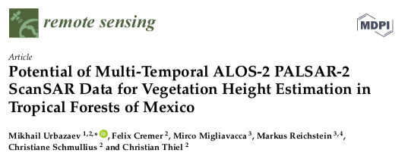
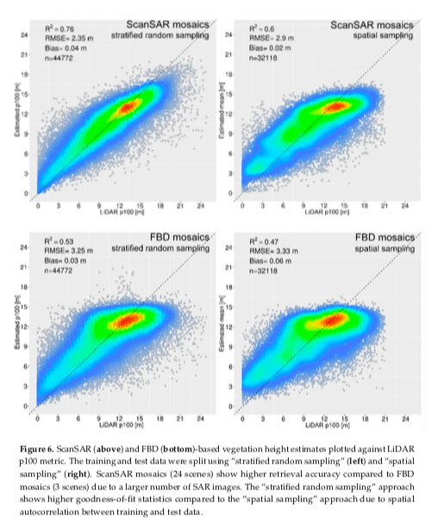
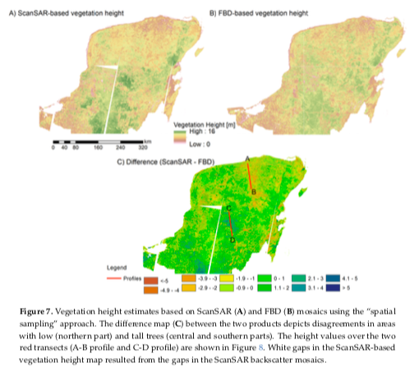
Vegetation height estimation by
PALSAR-2 ScanSAR time-series

Slide 18
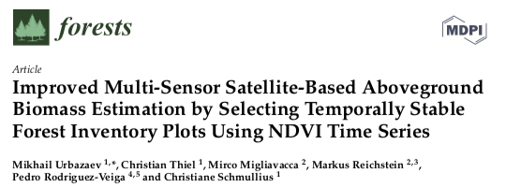
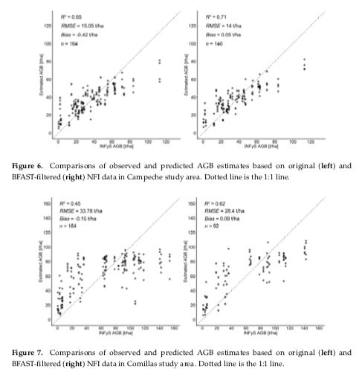
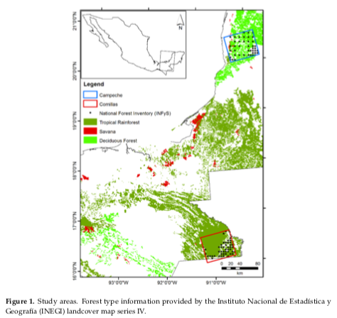
PALSAR-based multi-sensor approach for AGB estimation in Mexico

