Slide 1
JAXA missions and datasets
Status update
A. Rosenqvist, O. Ochiai, T. Tadono (JAXA)
SDCG-15 Session 2 Item#5

Slide 2
ALOS-2 - 2018
PALSAR-2 instrument status nominal
Major revision of Basic Observation Scenario (BOS) implemented from Jan 2018
10m dual-pol Fine Beam mode
Observation windows increased (4 → 6)
Boreal observations in May-Sept period to reduce seasonal impact on backscatter
Increased obs frequency in the tropics
50m ScanSAR
Staggered observations to improve acq. success rate
Every 42-day repeat maintained
6m Quad-pol
Global observations discontinued → focus on Super Sites
3m Ultra-Fine
Global observation plan completed

Slide 3
ALOS-2 - 2019
PALSAR-2 instrument status nominal
Completing 5 years in orbit. PALSAR-2 entering “post-operational” phase from May 2019
Reduction of duty cycle from 50% to 30%
Impact on Basic Observation Scenario (BOS)
10m dual-pol Fine Beam mode
Observations reduced to single global cover age per year at top priority
Additional observations planned at low priority
50m ScanSAR
No change.
Every 42-day repeat maintained

Slide 4
Schedule of ALOS/ALOS-2 Data Processing and Open Free Access
As of February 2019
 |  | 2018 |  |  |  | 2019
 |  | 1Q Jan Mar | 2Q Apr Jun | 3Q Jul Sept | 4Q Oct Dec | 1Q Jan Mar | 2Q Apr Jun | 3Q Jul Sept | 4Q Oct Dec
ALOS | AVNIR-2 (10 m)
 | PALSAR (10 m)
ALOS-2 | ScanSAR (100 m)
 | Fine Mode (10 m)
Japan Area
±60
Degree Area
Global
Data Processing
Japan Area
±60
Degree Area
Global
Data Processing
on Supercomputer
JICA-JAXA JJ-FAST intermediate products (ARD) processing
Data Processing
Under negotiation with commercial data provider

Slide 5
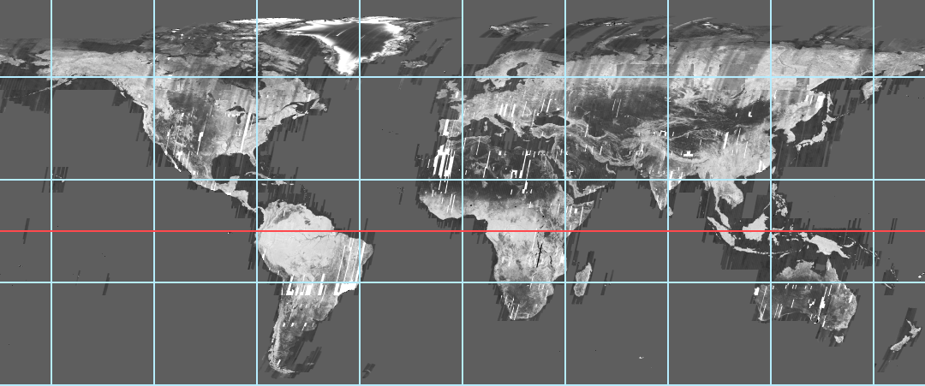
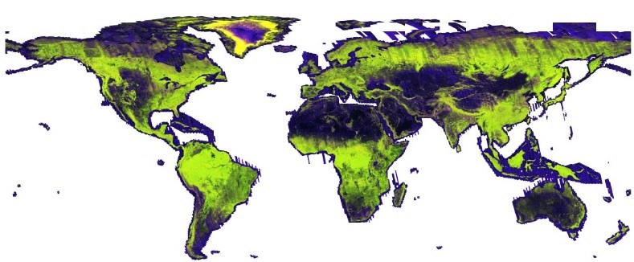
GFOI Core Data Set –
25 m L-band SAR mosaics and Forest/Non-Forest maps
Annual global mosaics and Forest/Non-Forest (FNF) map
JERS-1 (1996) ~ ALOS (2007-2010) ~ ALOS-2 (2014-2017) → Over 20 years changes
• HH backscatter (gamma-0) 16 bits
• HV backscatter (gamma-0) 16 bits
• Mask image (no-data, water, layover, shadowing.) 8 bits
• Local incidence angle image, 8 bits BYTE
• Observation date image (DN = days after mission launch) 16 bits
• Forest/Non-forest map
1996 JERS-1
(only HH-pol.)
2007-2010 ALOS
2015-2017
ALOS-2

Slide 6
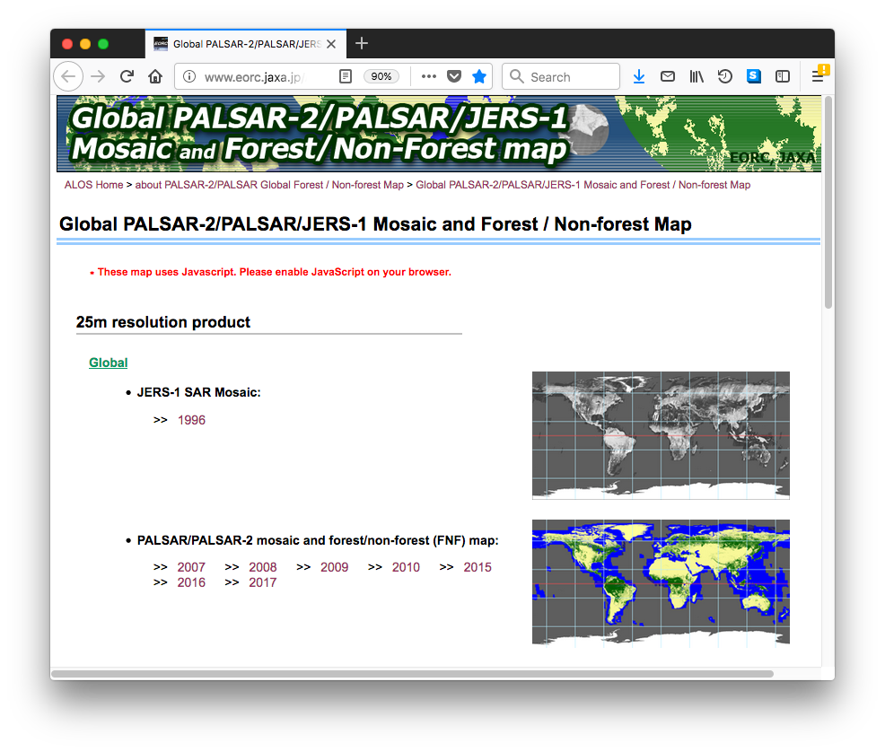
GFOI Core Data Set –
25 m L-band SAR mosaics and Forest/Non-Forest maps
Global coverage
PALSAR-2 2018 (release
Q3 2019)
PALSAR-2 2017
PALSAR-2 2016
PALSAR-2 2015
PALSAR 2007 – 2010
JERS-1 ~1996
Free download at:
http://www.eorc.jaxa.jp/ALOS/en/palsar_fnf/fnf_index.htm

Slide 7
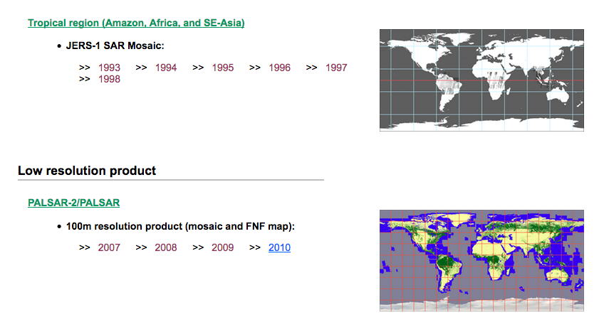
GFOI Core Data Set –
25 m L-band SAR mosaics and Forest/Non-Forest maps
Regional (pan-tropical) coverage (25m)
JERS-1: 1996 – 1998
Global low resolution (100m) coverage
JERS-1: 1996 – 1998
Free download at:
http://www.eorc.jaxa.jp/ALOS/en/palsar_fnf/fnf_index.htm

Slide 8
SAR Global Mosaic Status
Issue: Discontinuity of mosaic image in 2017
Solutions:
1. To use only summer season data from 2014 to 2018 as “MASTER”.
2. To widen the width of Path Ortho data.
2017 mosaic

Slide 9
SAR Global Mosaic Status
Solution 1: To generate MASTER mosaic from only summer season data
For making Master mosaic, JAXA/EORC set the rule.
In the “2017 mosaic”, the rule of path selection was as following.
2017 Summer (from May to Aug)
→ 2017-Winter (the other month)
→ 2016 Summer → 2016 Winter → 2015 Summer → 2015 Winter
The rule of “Master mosaic” is as following.
Monthly priority; Jul → Aug → Sep → Jun → May → Oct
Yearly priority; 2018 → 2017 → 2016 → 2015→ 2014

Slide 10
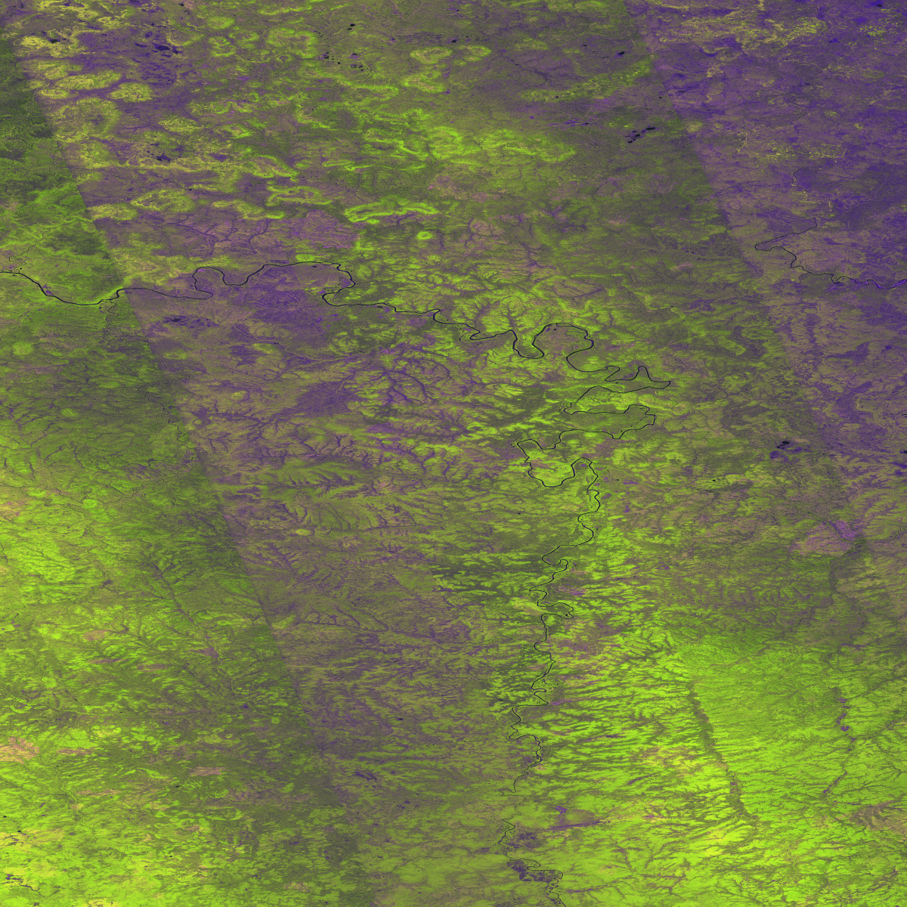
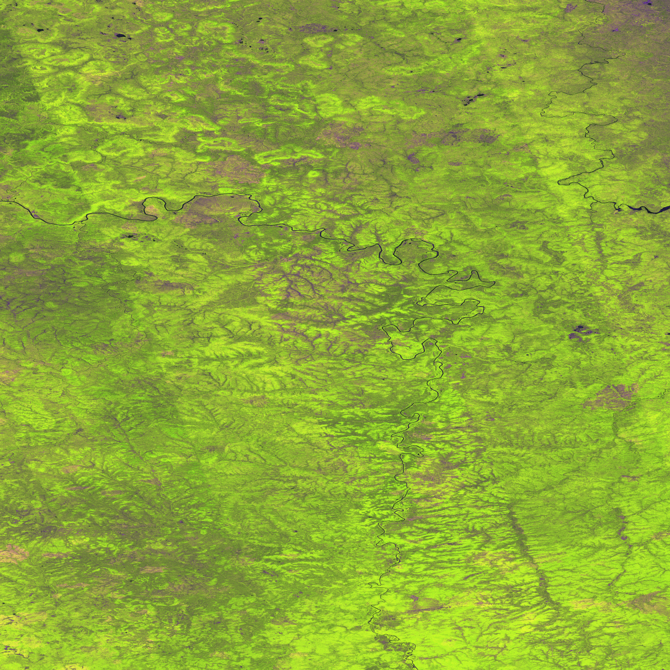
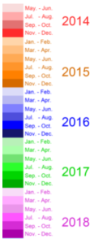
SAR Global Mosaic Status
Solution 1: To generate MASTER mosaic from only summer season data
2017 mosaic appeared the seasonal efficient because it is used the Jan-Feb data.
MASTER mosaic uses only summer season data.
→ Backscatter is smoothly.
Jan-Feb
N65E105 (2017 mosaic)
N65E105 (MASTER mosaic)
RGB
date
RGB
date
#Light Color in the date image indicates the early phase of the year.

Slide 11
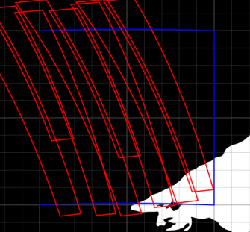
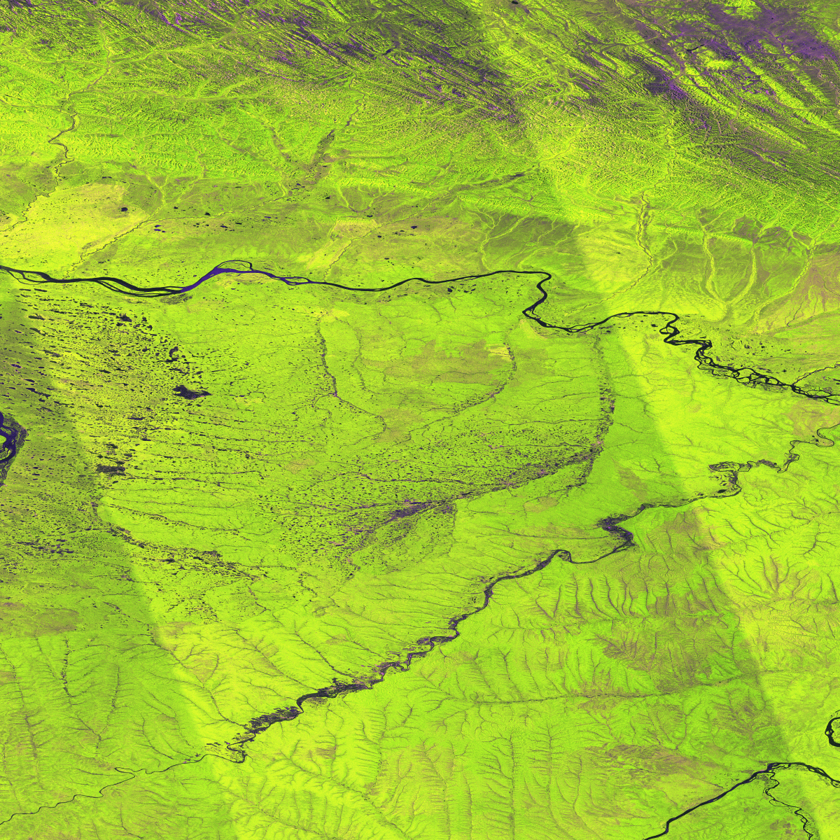
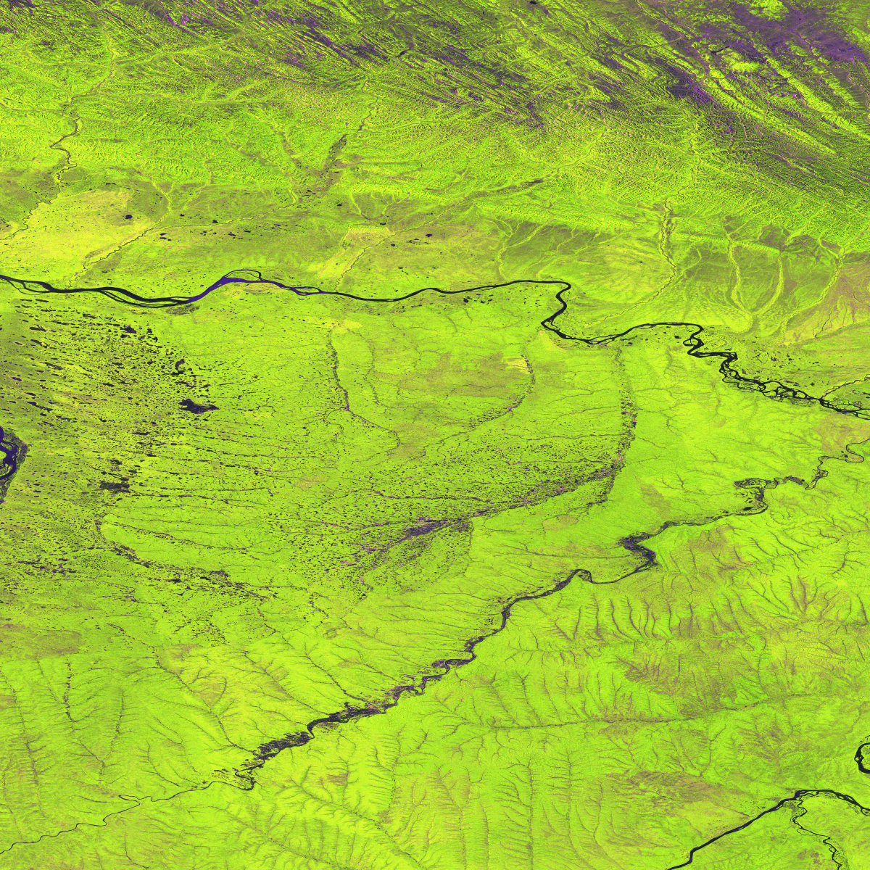
SAR Global Mosaic Status
Solution 2: To widen the width of Path Ortho data
The width of the image paths are extended in order to reduce striping effects.
N65E130
N65E130(2017)
⑦
⑧
④
①
N65E130(New mosaic)
⑥
⑤
③
②
①Jun-17, 2017, ② Sep-05, 2017
③Sep-05, 2017, ④ Jul-24, 2017
⑤Sep-19, 2017, ⑥Sep-01, 2017
⑦Sep-29, 2017, ⑧Sep-15, 2017

Slide 12
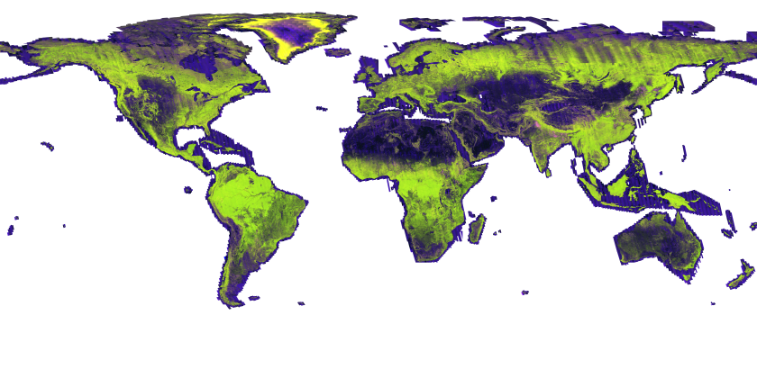
SAR Global Mosaic Status
2017 Global mosaic

Slide 13
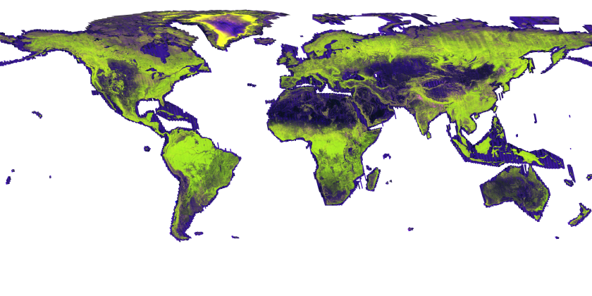
SAR Global Mosaic Status
MASTER Global mosaic

Slide 14
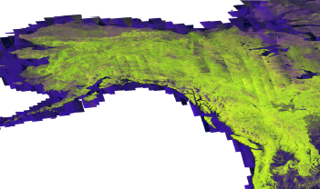
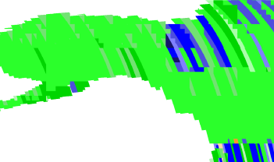
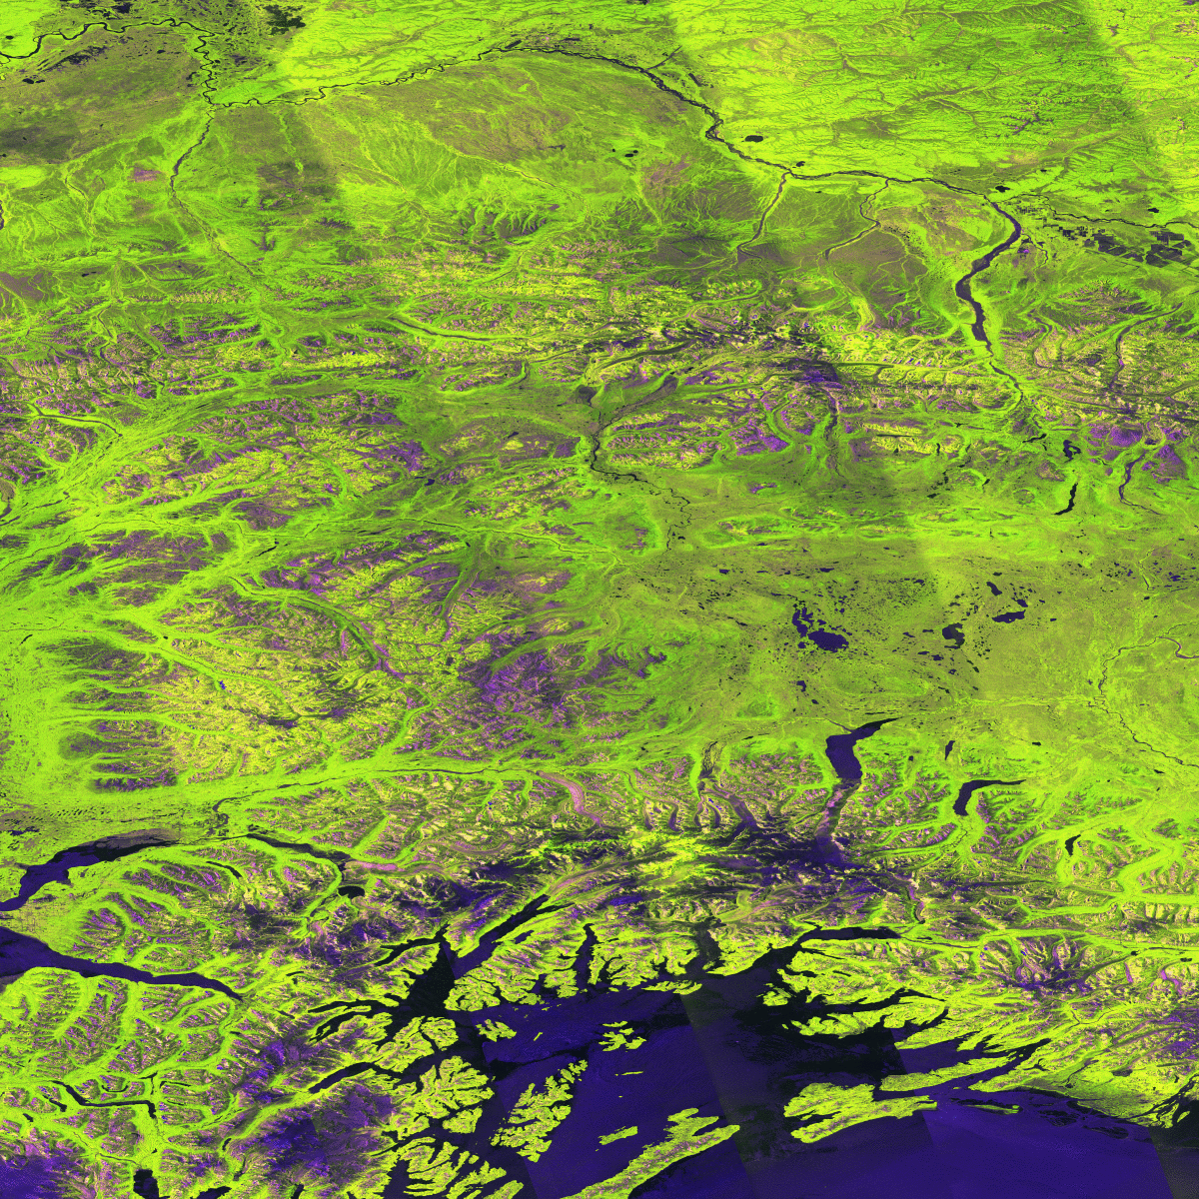
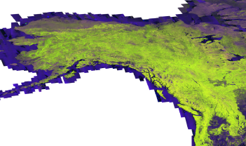
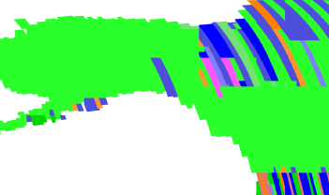
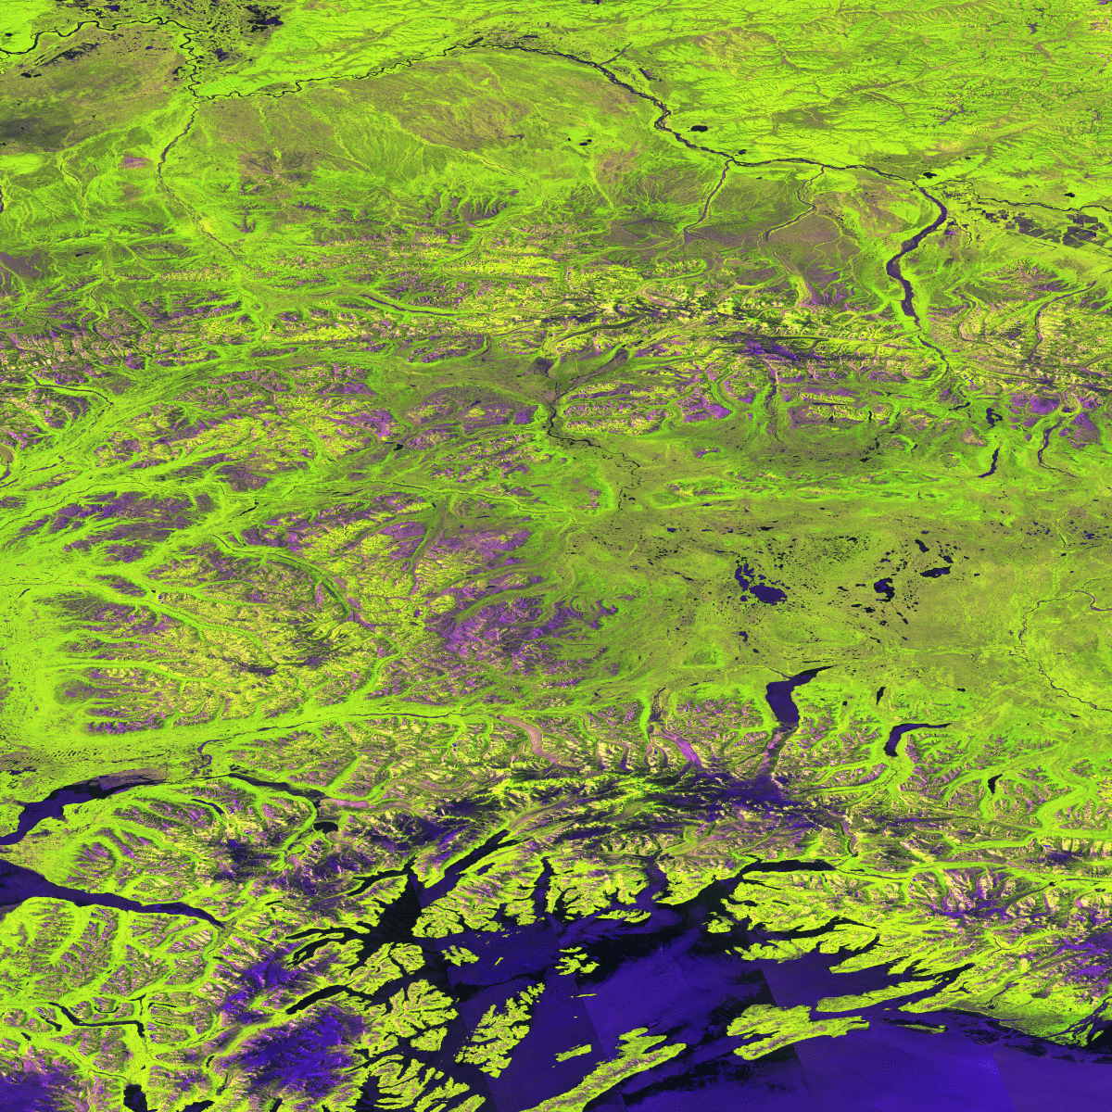
SAR Global Mosaic Status
Ex. Alaska
Specially, Alaska mosaic has changed smoothly.
2017 RGB
2017 date
2017 N65W150
#Light Color indicates
the early phase of the year.
MASTER RGB
MASTER date
MASTER N65W150

Slide 15
Global Mangrove Watch
An international collaborative project established as part of JAXA’s Kyoto & Carbon (K&C) Initiative
Mapping of extent and changes in global mangrove area
Thematic Datasets
Global mangrove baseline extent maps for 2010 (PALSAR + Landsat)
Global maps of annual changes in the global mangrove extent – public release 2018/Q4
1996 (JERS-1)
2007 – 2009 (ALOS PALSAR)
2015, 2016 & 2017 (ALOS-2 PALSAR-2)

Slide 16
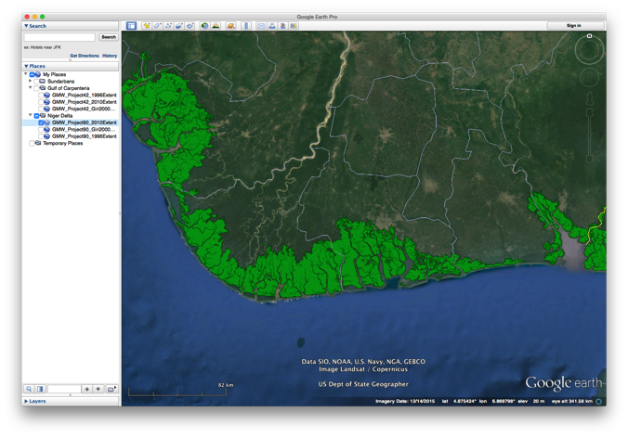
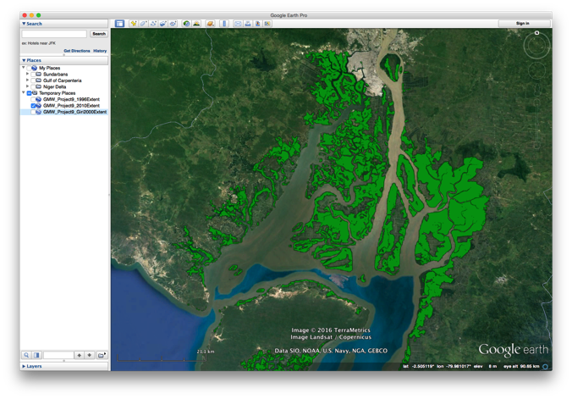
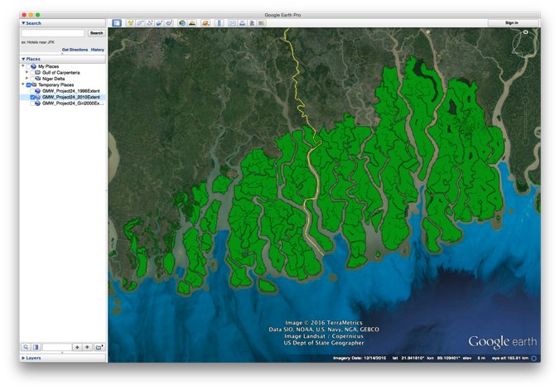
Niger river delta, Nigeria
2010 global mangrove baseline
Guayaquil, Ecuador
Sundarbans, India & Bangladesh

Slide 17
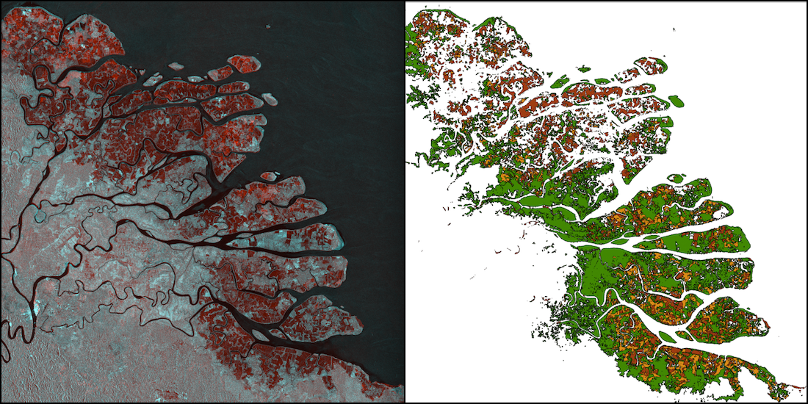
Changes over time (7 epochs)
Kahan river delta, North Kalimantan, Indonesia.
(Left) Multi-temporal SAR composite (1996 JERS-1 SAR and 2016 ALOS-2 PALSAR-2)
(Right) Mangrove extent and changes, Red – mangroves lost 1996-2007, Orange – loss 2007-2016, Green – mangrove cover in 2016.

Slide 18
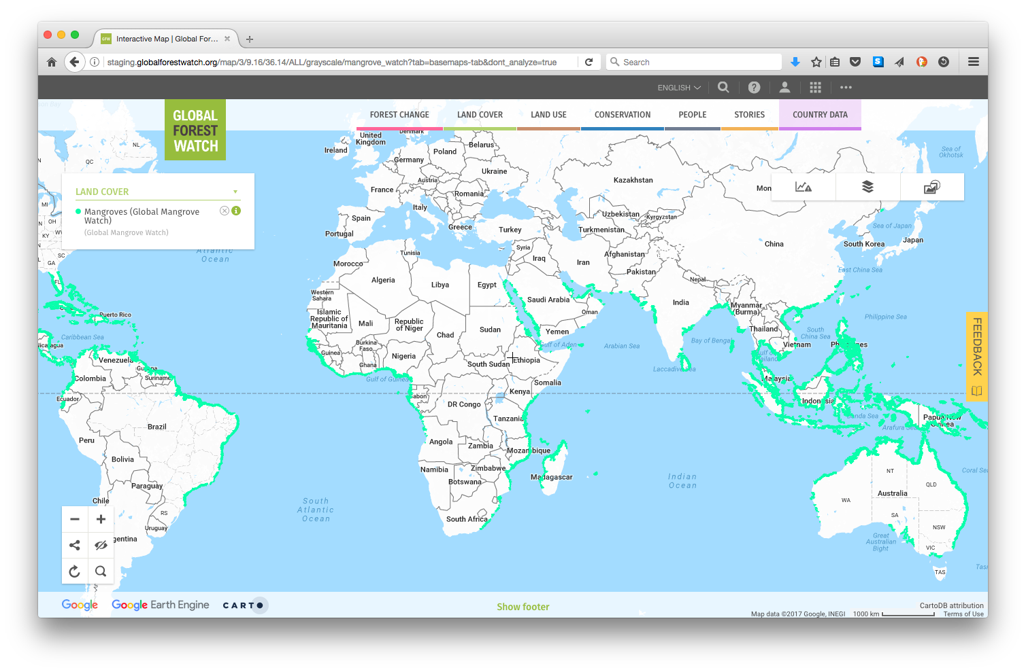
Global 2010 baseline (v2.0) online at www.gfw.org
and for public download at data.unep-wcmc.org/datasets/45

