Slide 1
GFOI MGD Update
Ake Rosenqvist with material provided by Carly Green
SDCG-15
Session 7, Item#3

Slide 2
2017/2018 Highlights
IPCC 2019 Refinement during 2018
Significant MGD Component participation
At least 15 MGD authors contributed to the refinement
MGD referenced 14 times across 2 volumes and multiple chapters
MGD content referenced included: ground data, sampling remote sensing analysis techniques, time series consistency, integration,…….etc

Slide 3
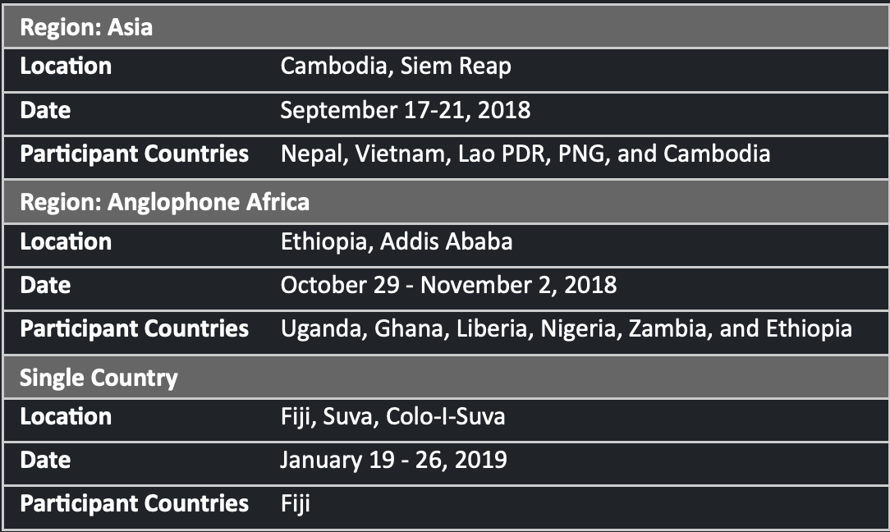
2017/2018 Highlights
GFOI CNA aligned with REDDCompass & MGD
The Country Needs Assessment (CNA) workshop structure has been developed to align with REDDcompass Action framework and MGD guidance
Funded by the World Bank, 12 countries have participated in the CNA workshops and have documented their progress and priority areas for improvement in the context of REDDcompass
This process has provided country specific information to the component on guidance areas of importance as countries move to operationalise their National Forest Monitoring Systems

Slide 4
MGD Work Plan 2019/2020
Refine and extend MGD 2016
Upgrade and extend REDDcompass
Cross component collaboration

Slide 5
1. Refine and Extend MGD 2016
Ensure consistency with IPCC 2019 Refinement
An assessment of impact to the MGD revealed relatively minor impact, mainly to do with terminology
Align priority content to country needs
Guidance related to priority improvement areas identified by countries through the Country Needs Assessment workshops will be the focus of refinement or extension of MGD

Slide 6
1. Refine and Extend MGD 2016
Ensure consistency with IPCC 2019 Refinement
An assessment of impact to the MGD revealed relatively minor impact, mainly to do with terminology
Align priority content to country needs
Guidance related to priority improvement areas identified by countries through the Country Needs Assessment workshops will be the focus of refinement or extension of MGD
Update EO related info
EO mission info presently out of date
New EO based methodologies

Slide 7
MGD Update Concept
MGD to be updated after the 2019 refinement published in May 2019
Concept
Updates to the MGD will be conducted using a Modular Approach rather than updating the whole document
More responsive, updatable and accessible
New guidance linked to the existing MGD through improved REDDcompass structure
MGD v2 will remain available to be read on line (→ outdated (EO) info frozen in?)
@GFOI_FOREST
GFOI.ORG
GFOI1

Slide 8
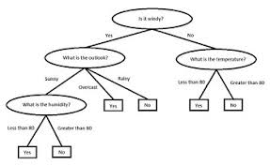
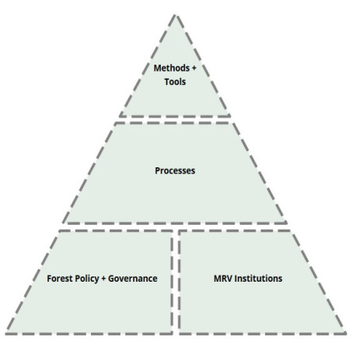
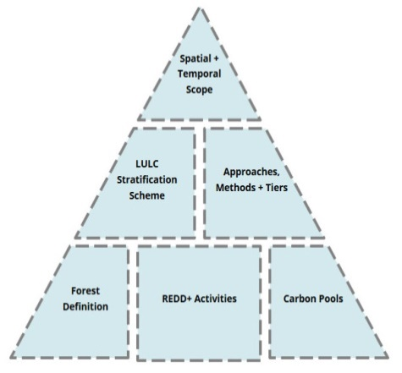
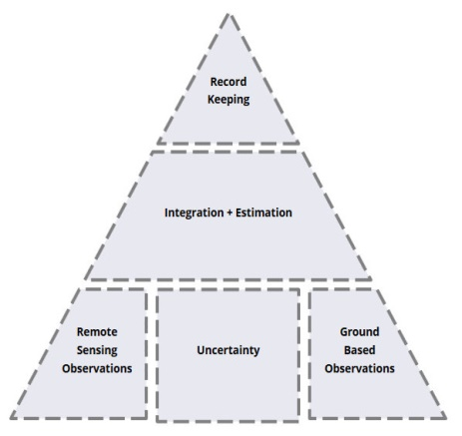
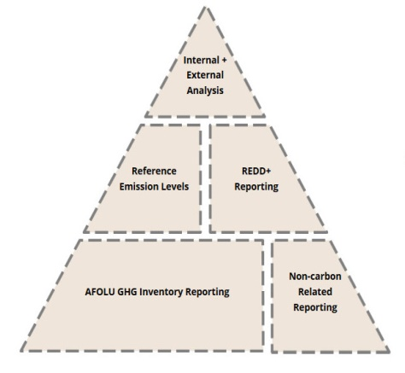
MGD Version 3.0 Concept
Other Resources
MGD V1/2
Modules
@GFOI_FOREST
GFOI.ORG
GFOI1

Slide 9
MGD Version 3.0 Process
REDDcompass
MGD Advisory Group
MGD V1/2
Modules
CNA
Lead Author Team
MGD AG Secretariat
GFOI
Authors
Module Request
Other
@GFOI_FOREST
GFOI.ORG
GFOI1

Slide 10
MGD Update Process
Develop outline of new guidance requirements
Redesign of REDDcompass will occur in parallel
Detailed design/ prototype and work plan available early 2019
Start mid 2019
Complete June 2020
@GFOI_FOREST
GFOI.ORG
GFOI1

Slide 11
2. Upgrade & Extend REDDcompass
Make content and associated training and tools more accessible through REDDcompass
Modify REDDcompass to increase alignment between MGD guidance, the CNA workshop material and the Repository of Tools
Provide MGD author functionality through REDDcompass
MGD content will be authored and made available online through REDDcompass

Slide 12
3. Cross Component Collaboration
Cross Component - Areas of Focus:
Repository of Tools to be hosted on REDDcompass
CALM to be used to assess status of tools
Training materials related to tools to be linked to MGD guidance and hosted on REDDcompass

Slide 13
3. Cross Component Collaboration
Cross Component - Areas of Focus:
Repository of Tools to be hosted on REDDcompass
CALM to be used to assess status of tools
Training materials related to tools to be linked to MGD guidance and hosted on REDDcompass
Data Component/SDCG?...

Slide 14
MGD revision
EO-related updates necessary – MGD v2 outdated
Key missions now fully operational
New missions in orbit
CEOS Biomass protocol emerging
New global datasets (e.g. Global Mangrove Watch)
CARD4L process – tailored for country users
Cloud computing and Data Cubes...
Revision process “inclusive”. Great opportunity for SDCG to improve visibility of CEOS and EO

Slide 15
