Slide 1
ESA and Copernicus
Frank Martin Seifert, Steven Hosford
Earth Observation Directorate
ESA-ESRIN, Frascati
SDCG-15 | Hampton (VA), USA | 27 March 2019

Slide 2

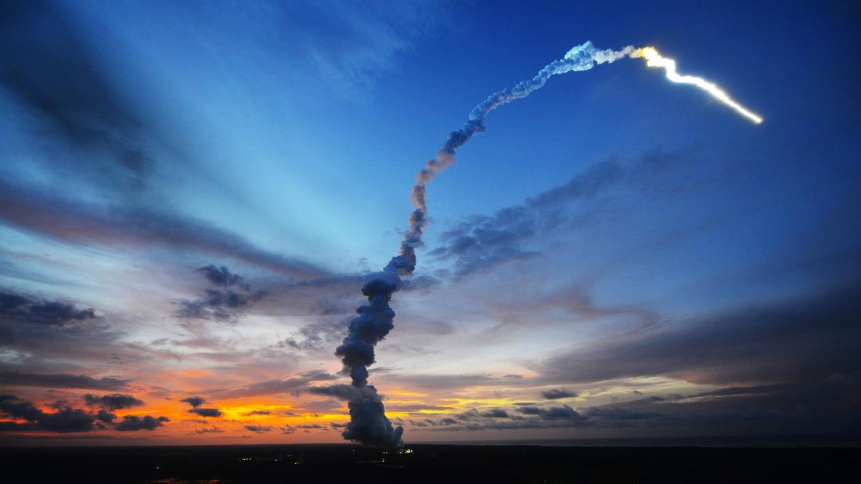

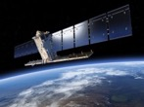
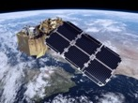
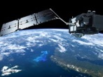
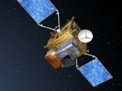
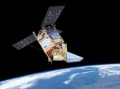
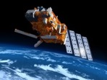
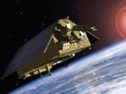

Sentinel Launches
S-1
S-2
S-3
S-4
S-5P
S-5
S-6
GFOI
Core
GFOI
Core
Radar
High Resolution Optical
Medium Resolution Optical & Altimetry
Atmospheric Chemistry (GEO)
Atmospheric Chemistry (LEO)
Atmospheric Chemistry (LEO)
Altimetry
A
3 Apr. 2014
A
23 Jun. 2015
A
16 Feb. 2016
A
2021
A
13 Oct. 2017
A
2021
A
2020
B
25 Apr. 2016
B
6 Mar. 2017
B
25 Apr. 2018
B
2027
B
2027
B
2025
C
2022/23
C
2022/23
C
2023
C
> 2027
D
> 2022/23
D
> 2022/23
D
> 2023
Notes:
S-1 and S-2 are GFOI core satellites

Slide 3
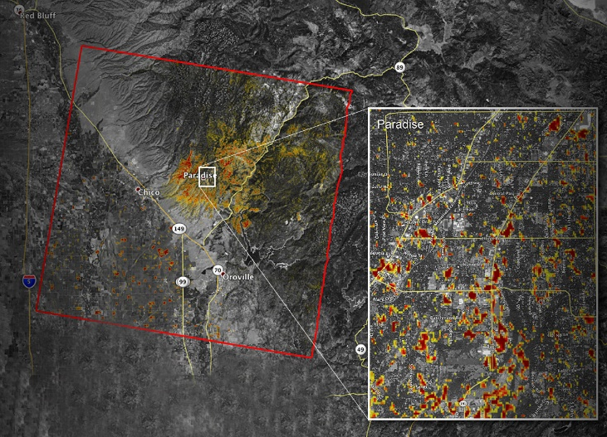

Sentinel-1 Mission Status
Sentinel-1A and Sentinel-1B mission operations → nominal
Sentinel-1 contribution to emergency activations, in particular from the Copernicus Emergency Management Service, continues to be very high, for flood monitoring in particular
A dedicated campaign aiming at demonstrating the monitoring of hurricanes over seas / oceans has been successfully conducted and will be pursued
Good health of both Sentinel-1A and Sentinel-1B satellites
Sentinel-1 is operated close to its full mission capacity
(i.e. difficulty to accommodate additional observations)
A slight increase of the SAR operating time duty cycle constraint has started (outside 3-month eclipse season), mainly allowing to further stabilise the observation scenario
Forest fire in California, USA
(Paradise, November 2018)
SAR can also be used to assess forest fire extension
The colour variation from yellow to red indicates increasingly more significant changes in the ground surface
Copyright: Contains modified Copernicus Sentinel data (2018) / processed by NASA/JPL - Caltech

Slide 4
Evolution of SAR Daily Production Volume
May
2017
May
2018
Sentinel-1 operational daily production volume is exceeding 12TB/day, since almost 2 years
Notes:
Stable since MAY 2018
30% over spec.

Slide 5
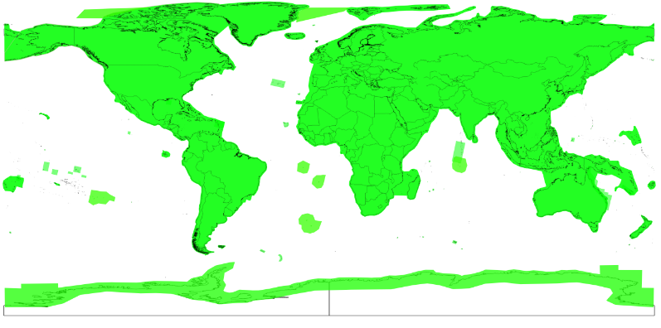
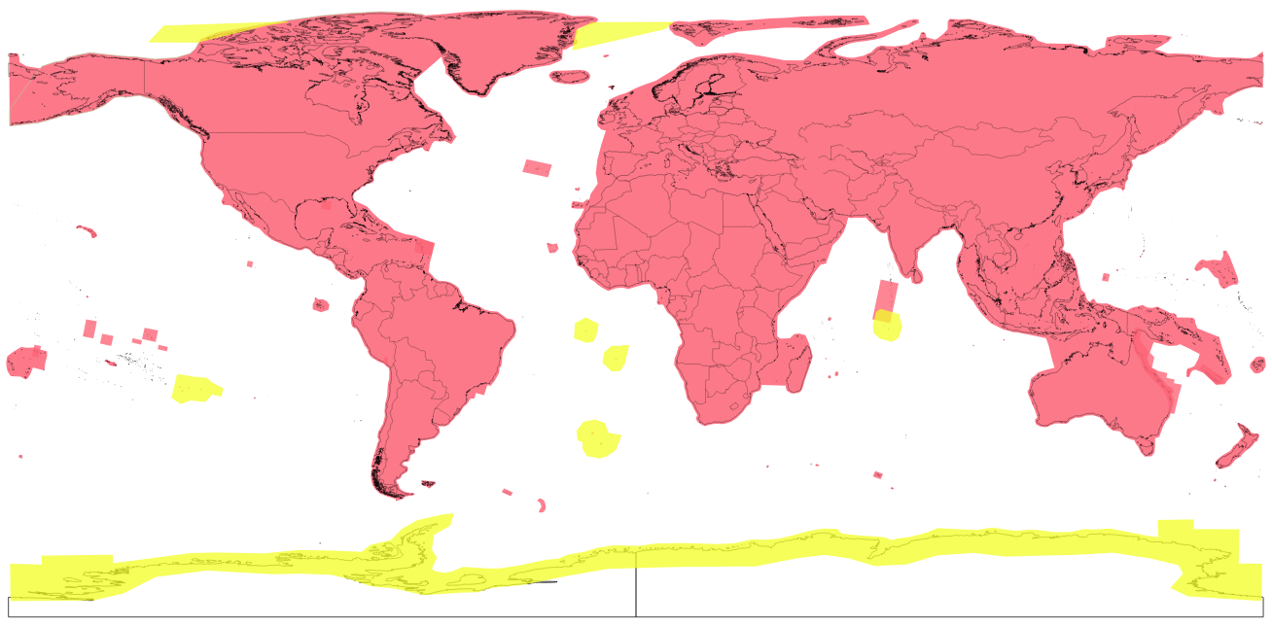
Sentinel-2 Mission Status Highlights
Both Sentinel-2A and -2B fully operational exceeding the nominal observation requirements
Systematic global coverage every 5 days
since 17 Feb 2018 (Antarctica 10 days)
Surface reflectance product (Level-2A)
➔ Europe: since 26 March 2018
➔ L2A product evolution: since 8 Oct 2018
usage of CCI land-cover auxiliary data
➔ Global: since 13 December 2018.
Current Observation Scenario
Revisit Time
B11
Band 11

Slide 6
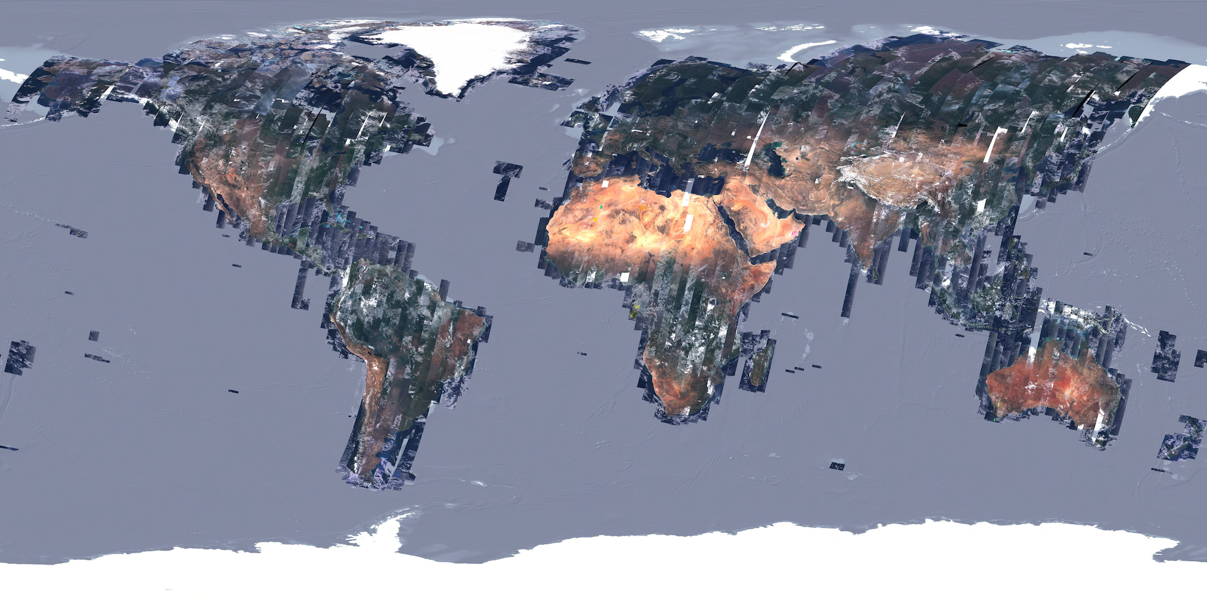
Sentinel-2: Next Steps
L2A on-demand service for Copernicus Services and later to all users.
Start of the geometry-refined production using Global Reference
Image (GRI).
Usage of improved DEM
for L1C and L2A
productions.
Continuous improvement
of L1C and L2A products
B11
Band 11

Slide 7
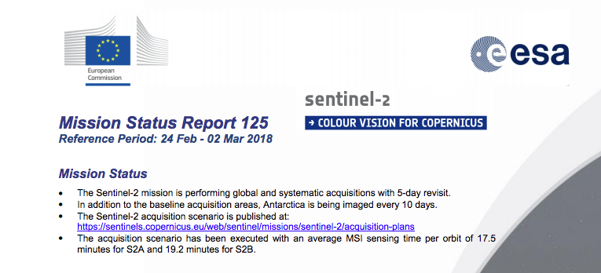
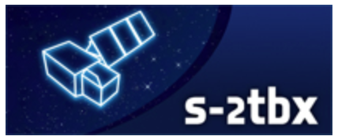
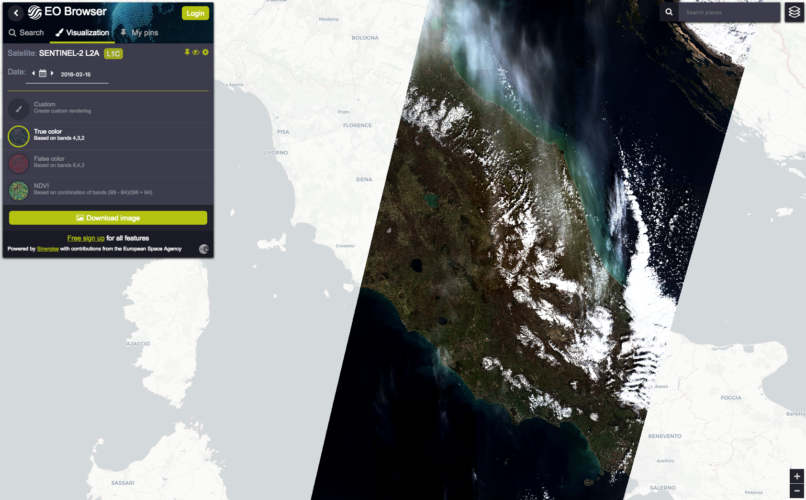
Sentinel-2: Related Resources
Sentinel-2 Mission Status Reports available at:
https://sentinel.esa.int/web/sentinel/missions/sentinel-2/mission-status
Data Quality Reports available at:
https://sentinels.copernicus.eu/documents/247904/685211/Sentinel-2_L1C_Data_Quality_Report
https://sentinels.copernicus.eu/documents/247904/685211/Sentinel-2-L2A-Data-Quality-Report
SNAP: Visualisation & processing of Sentinel-2 MSI data and other optical data: http://step.esa.int/
sen2cor: Level-2A processor:
http://step.esa.int/main/third-party-plugins-2/sen2cor/
EO-BROWSER: Visualisation of Sentinel-2, Sentinel-3, Landsat, Proba-V data: http://apps.sentinel-hub.com/eo-browser/

Slide 8

Copernicus Space Component Evolution
Next-Gen. missions will replace current & expansion missions
2014
Current Sentinels
Sentinel Next Generation
Sentinel Expansion
Copernicus for Security

Slide 9
Sentinel Expansion
It is assumed that the following Sentinels are confirmed
as a result of the user consultation process and
following a gap analysis:
Sentinel-7: a anthropogenic CO₂ monitoring mission
Sentinel-8: a Thermal Infrared Imager (companion to Sentinel-2 C/D)
Sentinel-9: components:
  S-9 ICE: Enhanced Ice and Snow Continuity mission
  S-9 HEO: Polar Weather Payload on a Highly Elliptical Orbit
Sentinel-10: a Hyper-spectral mission
Sentinel-11: L-band SAR mission
Candidates
to be verified through
requirements process!
Statistics: 7 February 2017
Notes:
Upd – status> done

Slide 10
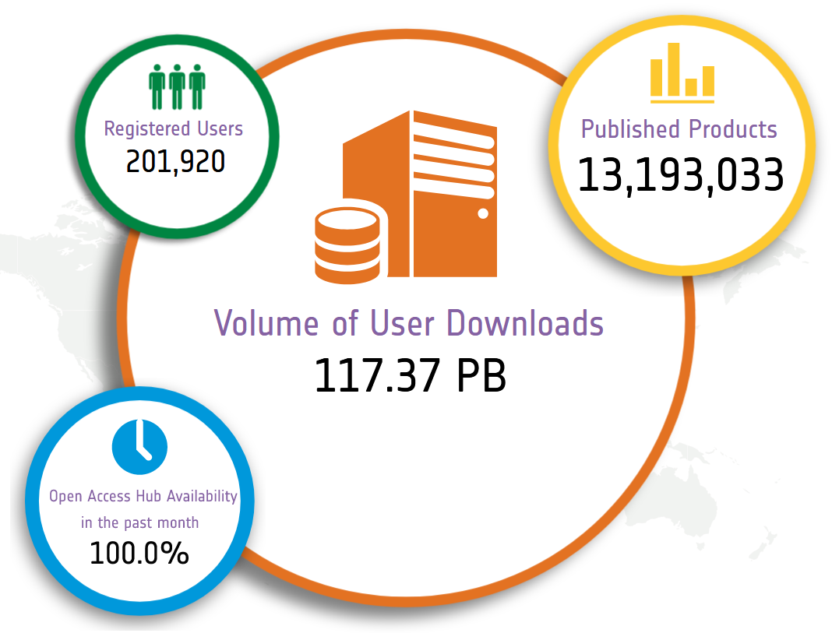
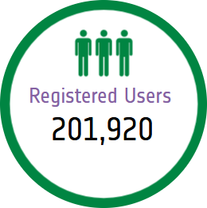
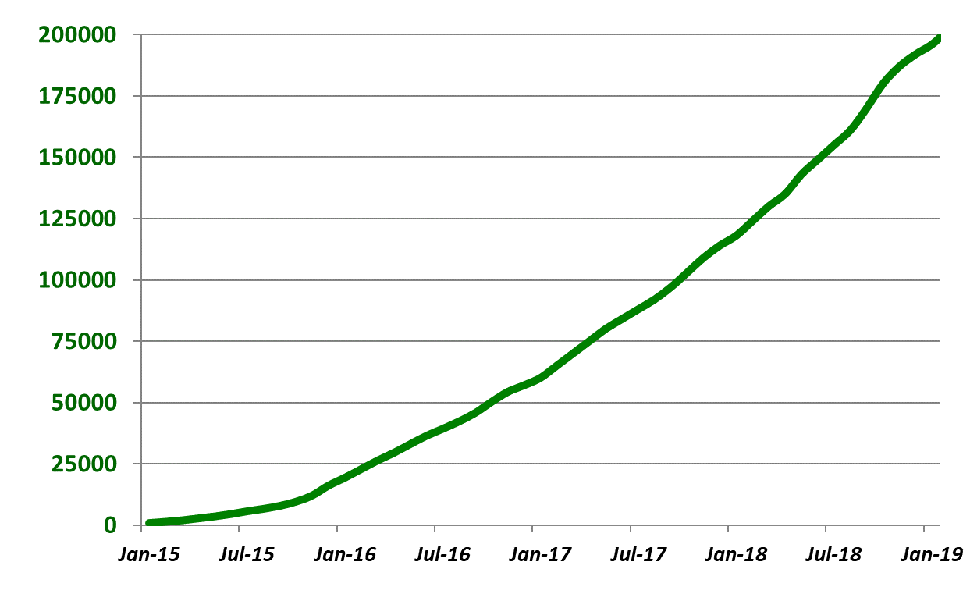







Evolution of registered users on Sentinel Open Access Hub
Number of registered users
Now access to data of first 7 Sentinel satellites
Statistics at beginning February 2019

Slide 11
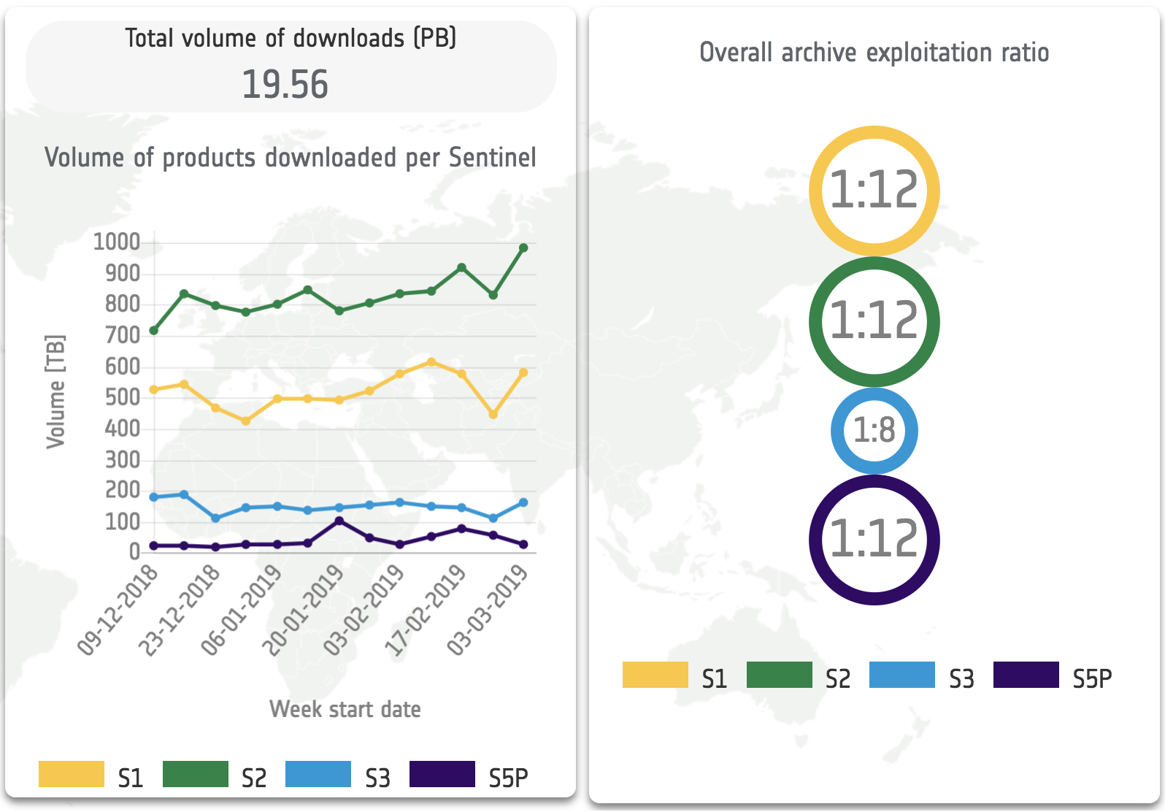















Data Access
Private companies re-distributing Sentinel products through free and pay-per-use schemes
Copernicus Data Hubs
Collaborative mirror sites
International partners mirror sites disseminating towards own national communities

Slide 12

DIAS – Creating an EO Data Ecosystem
Copernicus Data and Information Access Services
Common approach of DG GROW, ESA, and EUMETSAT to EO data exploit-ation with Copernicus at its core
Create & enable European EO Data ecosystem for research & business
DIAS are public since June 2018
Notes:
Closes the European “gap” between Data Generation and Exploitation layer
4 DIAS are being established through ESA / 1 through EUMETSAT
Building on the principles and mechanisms identified in G/S evolution strategy
DIAS is one of the cornerstones of the partnership & aligned programming between DG-GROW and ESA.
Implementing the “EO-Innovation Europe” concept in full complementarity with the COM initiatives notably the Copernicus Data and Information Access Services

Slide 13
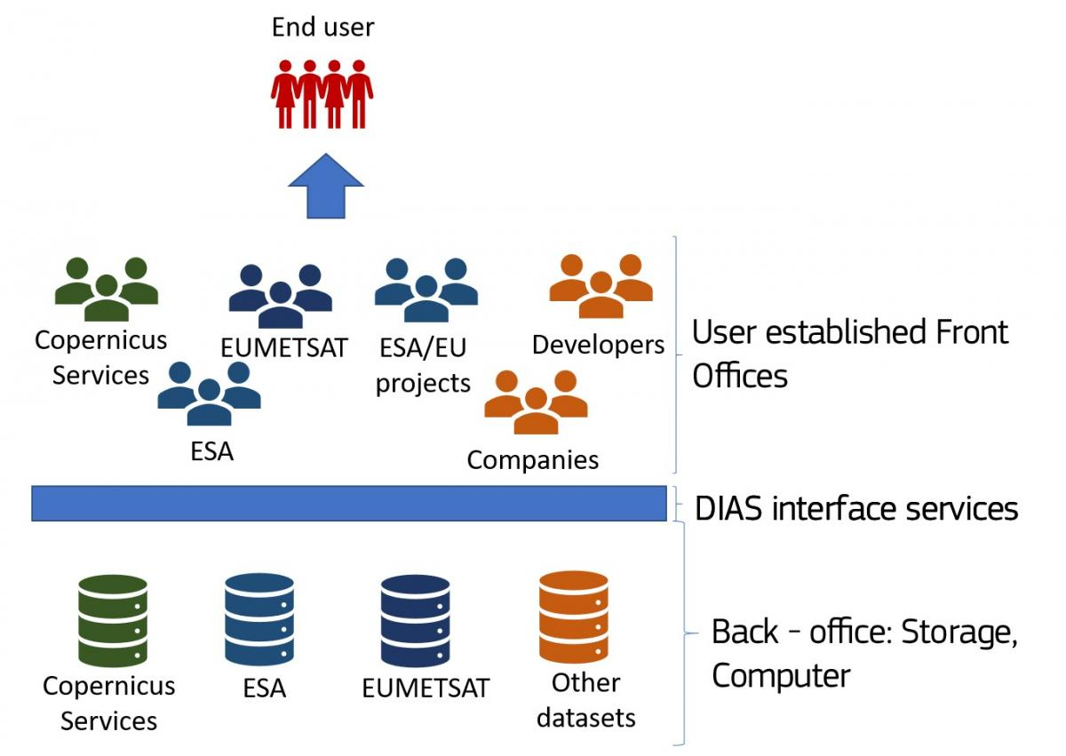
Data and Information Access Services
Creating and enabling a European EO Data ecosystem for research and business.
5 DIAS systems under COPERNICUS
(4 managed by ESA, one by Eumetsat)
To facilitate access to Copernicus data and information from the Copernicus services
To discover, manipulate, process and download Copernicus data and information from the Copernicus services.
B11
Band 11

Slide 14
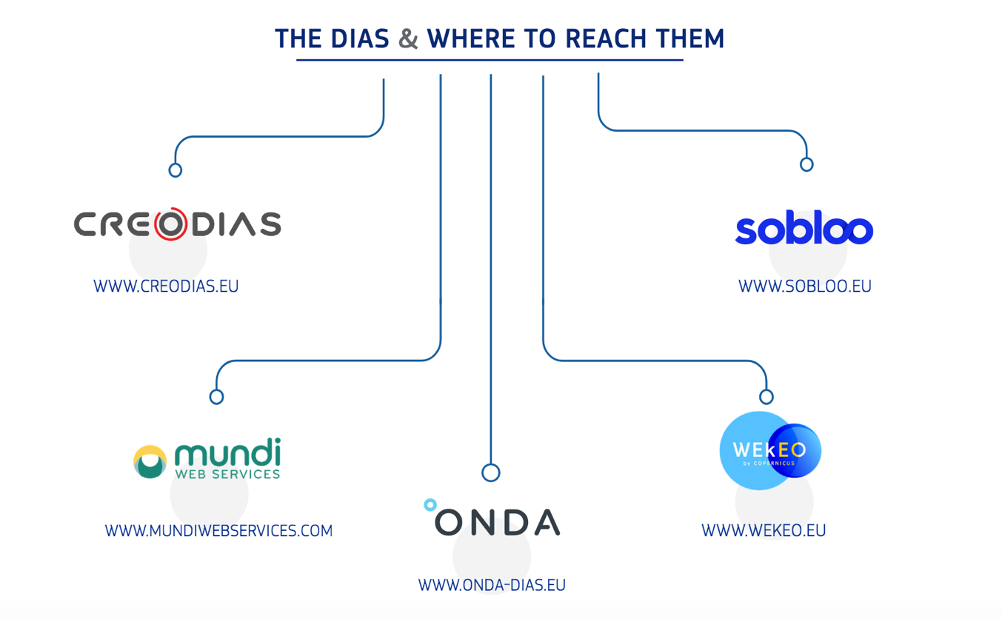
Data and Information Access Services
The 5 DIAS are operational since June 2018
B11
Band 11
Notes:
Creodias (CloudFerro, creoTECH, geomathys, …)
Mundi WebServices (ATOS, T-System, Thales-Alenia, DLR, GAF, Sinergise, …)
Onda (Serco, OVH, Sinergise, GAEL)
Sobloo (Airbus, Orange)
WekEO (EUMETSAT, ECMWF, MERCATOR OCEAN)

Slide 15
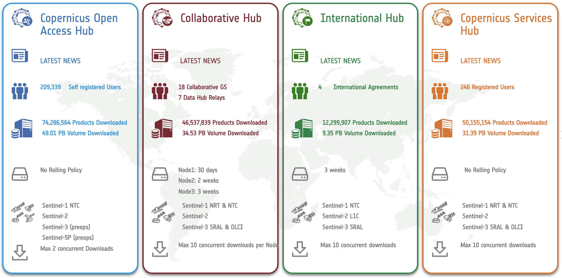
Data Access

Slide 16


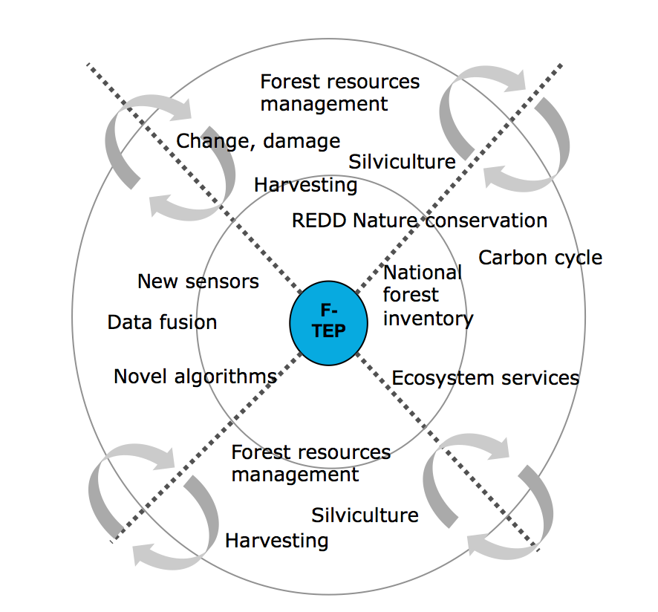
Forestry - Thematic Exploitation Platform
”One-stop shop for forestry remote sensing services for the academic, public
and commercial sectors”
Flipping the data access paradigm – from
transferring Terabytes of raw data to moving Megabytes of results / products
Moving away from model where each user
works in their own ‘silo’
Community centric work environment
Reduce the costs of data acquisition from miscellaneous sources with varying formats
and processing levels
Self-service environment with support
➔ https://forestry-tep.eo.esa.int/
Notes:
Platform developed from scratch
EO data: Sentinel-1, S-2, Landsat, Envisat, some ALOS PALSAR, Pleiades, RapidEye… partly commercial
Tools on F-TEP: SNAP - Sentinel toolboxes, Monteverdi / Orfeo toolbox, QGIS, Open Foris (FAO)
Services: Freemium model ➔ basic ones free of charge, higher value commercial
Pre-ops phase finalised

Slide 17
Satellite Monitoring for Forest Management
GEF project to develop and demonstrate forest information products for tropical dry forest management
4 tools
Cloud free mosaics for LU/LV classificationS-1/S-2 mosaics – on F-TEP
Annual forest biomass change (ALOS) – on F-TEP
Continuous monitoring of forest change (S-2)
Identify drivers for forest change (S-2)
Demo at GFOI Plenary in Maputo
Mapping
Forest monitoring

Slide 18
Service Cases for Mozambique
Supporting the GEF project on sustainable monitoring of dry tropical forests
Demo at GFOI Plenary in Maputo
Mapping undesired broadleaved tree shrubs on forest regeneration areas in Finland
Forest monitoring for REDD+ in Chiapas, Mexico

Slide 19

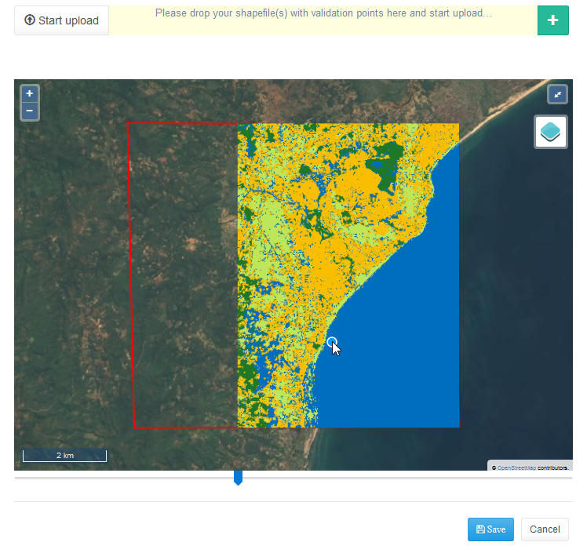
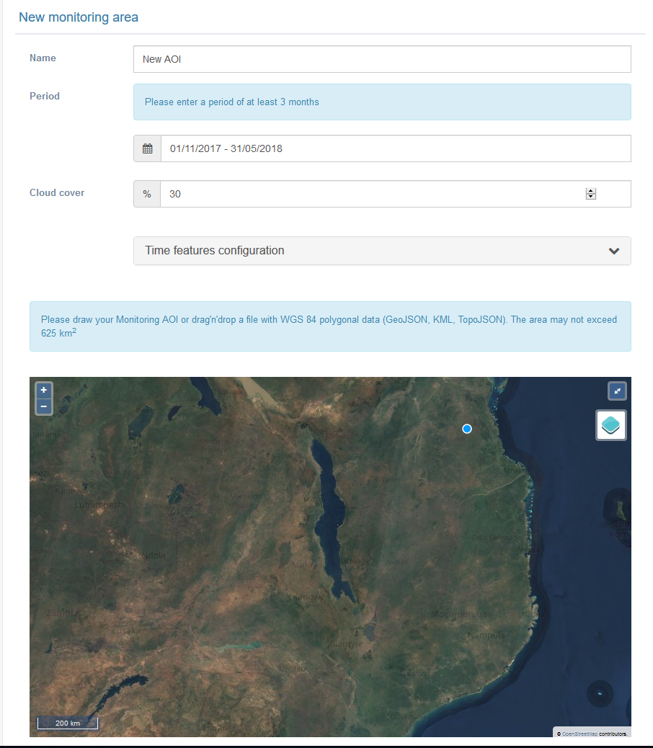
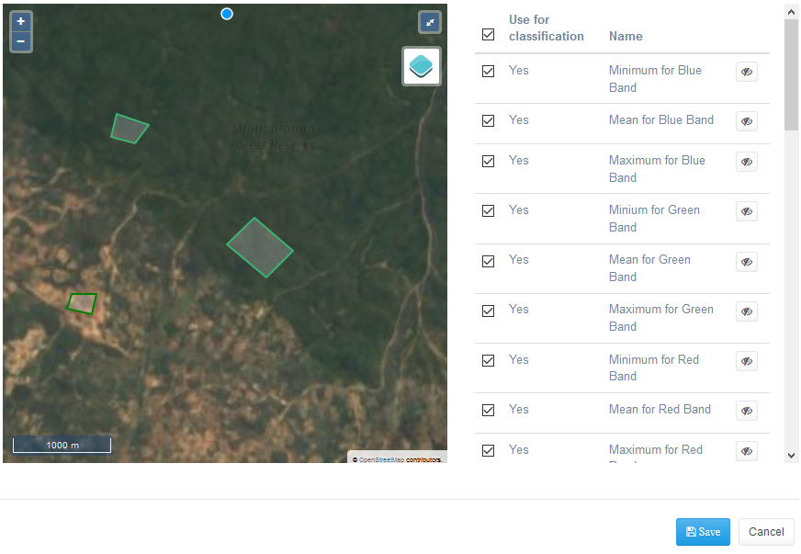
Cloud based Forest Monitoring for Malawi
Front-end demonstrator of cloud based services with DIAS as back-office
User friendly cloud-based application for land cover mapping based on Sentinel-2 time series data
State-of-the art classification algorithm
Operational in developing country environment (lightweight on bandwidth)
Provide validation and uncertainty assessment tools within the application
Project Definition
Validation Module
Classification Training
Notes:
Opencall proposal. S
Project started in autumn 2018 – last one year.

Slide 20
Summary
  The European Copernicus Programme will secure continuity of observations and data availability for the next 20+ years;
  Copernicus Data policy: free and open access for everybody
  ➔ https://scihub.copernicus.eu/
  Sentinel-1 and -2 are core mission for GFOI
  Growing user community on Open Hub and other distribution channels
  5 European DIAS platforms for cloud processing of Sentinel data and info
  On-going discussion on extension of the Sentinel family

