Slide 1
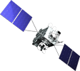
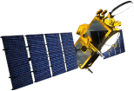
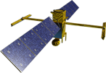
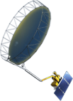
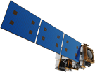
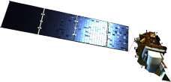
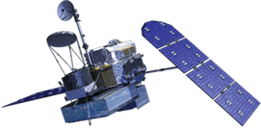
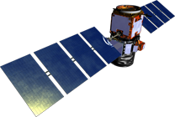
NASA Earth Science Missions: Present through 2023
PREFIRE (2) (TBD)
(Pre)Formulation
PACE (2022)
Implementation
TSIS-2 (2020)
GeoCARB (~2021)
Primary Ops
TROPICS (12) (~2021)
Extended Ops
MAIA (2020)
Landsat 9 (2020)
Sentinel-6A/B (2020, 2025)
NI-SAR (2021)
ISS Instruments
LIS (2020), SAGE III (2020)
TSIS-1 (2018), OCO-3 (2019), ECOSTRESS (2019), GEDI (2020) CLARREO-PF (2020), EMIT (TBD)
SWOT (2021)
TEMPO (2018)
InVEST/CubeSats
RAVAN (2016)
RainCube (2018)
TEMPEST-D (2018)
CubeRRT (2018)
CSIM (2018)
CIRiS (2019)
HARP (2019)
SNoOPI*
HyTI*
CTIM*
TACOS*
* Launch date TBD
ICESat-2 (2021)
GRACE-FO (2) (2023)
CYGNSS (8) (2019)
JPSS-2 Instruments
OMPS-Limb (2018)
SMAP
(>2022)
Landsat 7
(USGS) (~2022)
NISTAR, EPIC
(DSCOVR /
NOAA) (2019)
SORCE,
TCTE (NOAA) (2019)
Suomi NPP (NOAA) (>2022)
Terra (>2021)
Landsat 8
(USGS) (>2022)
Aqua (>2022)
CloudSat (2021)
GPM (>2022)
CALIPSO (>2022)
Aura (>2022)
OCO-2 (>2022)
OSTM/Jason-2 (NOAA) (>2022)
03.18.19
Notes:
Fleet - Earth Science Division - Missions (with color key; editable)
Aug. 18, 2018: GRACE-FO and ECOSTRESS moved to prime ops; QuickSCAT removed due to pending decommission; MAIA moved to implementation
Jan. 16, 2018: Reformatted, includes all missions, dates and cube sats
Dec. 15, 2015
Credit: NASA/J. Mottar
------------------------------
SLIDE INFO
CORRECTION DENNING PER RIVERA Feb 18, 2016
Changed misspelling of “Sentinal” to “Sentinel”
UPDATE DENNING PER FREILICH DECISIONS FEB 12, 2016
Changed OCO-3 to Formulation color and moved lower in list
Changed RBI to Formulation color
Changed GEDI to Implementation color and moved to line above it
Added TSIS-2 in Formulation color
UPDATE DENNING PER FREILICH DECISIONS FEB 4, 2016
Changed “Altimetry FO (Formulation in FY16) to “Sentinal-6A/B”
On Landsat 9, removed comma and TIRFF
Change I was going to make – “NISTAR, EPIC (NOAA’s DSCOVR) to green primary ops was already corrected
Dec. 15, 2015 – Updated: TEMPO changed to Implementation phase; NISTAR, EPIC changed to Primary Ops phase; ; OCO-3 and ECOSTRESS changed to Implementation phase; Aquarius removed; slide now fully editable. JMottar
May 18, 2015 – Added to SMD Multimedia Library.
May 18, 2015 – Updated the outdated 2014 version: TRMM was removed; NISTAR, EPIC (NOAA's DSCOVR) were added; SMAP icon was updated; moon at top left was removed; color key moved to top left.-JMottar
ID: I-EA-15-0040 (image)
ID: SL-EA-15-0068 (slide)

Slide 2
NASA Earth Science Missions: Present through 2023
PREFIRE (2)
(Pre)Formulation
PACE
Implementation
TSIS-2
GeoCARB
Primary Ops
TROPICS (12)
Extended Ops
MAIA
Landsat 9
Sentinel-6A/B
NI-SAR
ISS Instruments
LIS, SAGE III,
TSIS-1, OCO-3, ECOSTRESS, GEDI, CLARREO-PF, EMIT
SWOT
TEMPO
InVEST/CubeSats
RAVAN
RainCube
TEMPEST-D
CubeRRT
CSIM
CIRiS
HARP
SNoOPI
HyTI
CTIM
TACOS
ICESat-2
GRACE-FO (2)
CYGNSS (8)
JPSS-2 Instruments
OMPS-Limb
SMAP
Landsat 7
(USGS)
NISTAR, EPIC
(DSCOVR /NOAA)
SORCE,
TCTE (NOAA)
Suomi NPP (NOAA)
Terra
Landsat 8
(USGS)
Aqua
CloudSat
GPM
CALIPSO
Aura
OCO-2
OSTM/Jason-2 (NOAA)
03.18.19
Notes:
Fleet - Earth Science Division - Missions (with color key; editable)
Aug. 18, 2018: GRACE-FO and ECOSTRESS moved to prime ops; QuickSCAT removed due to pending decommission; MAIA moved to implementation
Jan. 16, 2018: Reformatted, includes all missions, dates and cube sats
Dec. 15, 2015
Credit: NASA/J. Mottar
------------------------------
SLIDE INFO
CORRECTION DENNING PER RIVERA Feb 18, 2016
Changed misspelling of “Sentinal” to “Sentinel”
UPDATE DENNING PER FREILICH DECISIONS FEB 12, 2016
Changed OCO-3 to Formulation color and moved lower in list
Changed RBI to Formulation color
Changed GEDI to Implementation color and moved to line above it
Added TSIS-2 in Formulation color
UPDATE DENNING PER FREILICH DECISIONS FEB 4, 2016
Changed “Altimetry FO (Formulation in FY16) to “Sentinal-6A/B”
On Landsat 9, removed comma and TIRFF
Change I was going to make – “NISTAR, EPIC (NOAA’s DSCOVR) to green primary ops was already corrected
Dec. 15, 2015 – Updated: TEMPO changed to Implementation phase; NISTAR, EPIC changed to Primary Ops phase; ; OCO-3 and ECOSTRESS changed to Implementation phase; Aquarius removed; slide now fully editable. JMottar
May 18, 2015 – Added to SMD Multimedia Library.
May 18, 2015 – Updated the outdated 2014 version: TRMM was removed; NISTAR, EPIC (NOAA's DSCOVR) were added; SMAP icon was updated; moon at top left was removed; color key moved to top left.-JMottar
ID: I-EA-15-0040 (image)
ID: SL-EA-15-0068 (slide)

Slide 3
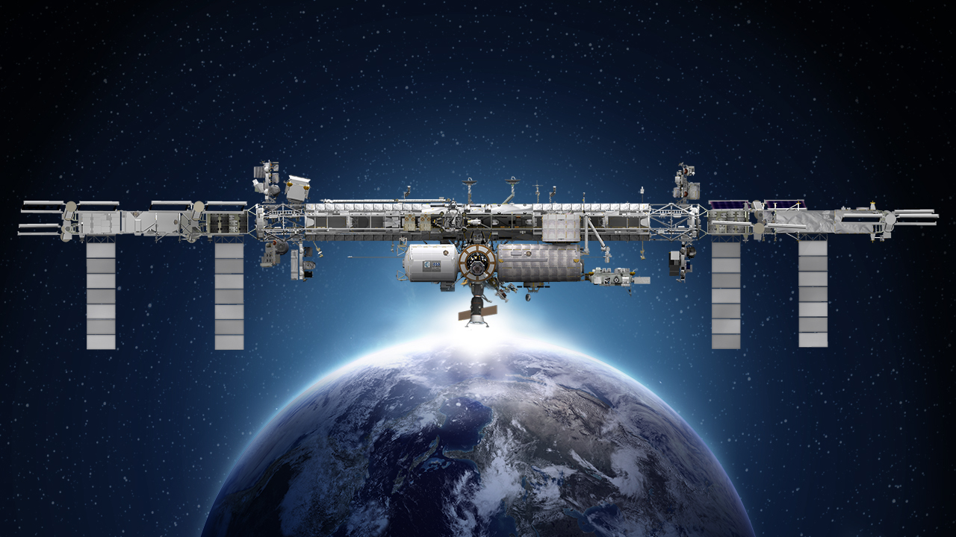
International Space Station
Earth Science Operating Missions
TSIS-1 (2018)
ELC-2
EMIT (TBD)
ELC-3
AMS
ESP-3
ELC-4
Columbus EF
JEMEF
ELC-1
OCO-3 (2019)
GEDI (2020)
ECOSTRESS (2019)
SAGE III (2020)
LIS (2020)
CLARREO PF (2020)
Formulation
External Logistics Carriers: ELC-1, ELC-2, ELC-3
External Stowage Platforms: ESP-3
Alpha Magnetic Spectrometer
Columbus External Payload Facility
Kibo External Payload Facility
Implementation
Primary Ops
Extended Ops
03.18.19
Notes:
Jan. 16, 2018: Updated as part of full set
UPDATED: COLORS AND CONTENT TO MATCH MISSION CHARTS; ADDED KEY AND DATE
12/20/17: Reformatted to 16:9; lost some content that was part of old background (title, moon, lower left box); tried to recreate
12/01/17: edited to remove CATS
5/23: removed TSIS-2
DGH changes 04/14/2017:
Added LIS date (2017); changed TSIS-1 to (2018), GEDI to (2018), OCO-3 to (2018), TISIS-2 to (2020), Ecostress to (2017), Clarreo PF to (2020) per main fleet chart; Removed RapidSCAT; changed istalled instruments to orange (consistent w/ fleet charts); put shadow behind text to make it easier to see; used fleet chart green for shapes
Changes EJD on Feb 4, 2016:
Deleted “CY” on years for SAGE III, CLARREO PF, LIS, OCO-3
Changed dates of TSIS-2 from (2020) to (2020/22)
Changed date of OCO-3 from (2018) to (2017)
Changed dates of GEDI from (2020) to (2018/20)

Slide 4
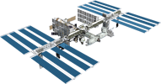
NASA Earth Science Current Operating Missions
OSTM/Jason-2
(NOAA)
ICESat-2
Terra
GRACE-FO (2)
ISS: LIS, SAGE III, TSIS-1, ECOSTRESS, GEDI
CYGNSS (8)
InVEST/CubeSats
RAVAN
RainCube
TEMPEST-D
CubeRRT
CSIM
Landsat 7
(USGS)
SMAP
Aqua
Suomi NPP (NOAA)
NISTAR, EPIC
(DSCOVR / NOAA)
SORCE,
TCTE (NOAA)
Landsat 8
(USGS)
Aura
CALIPSO
GPM
CloudSat
OCO-2
03.18.19
Notes:
Jan. 16, 2018: Reformatted with entire set, operating missions only
OPERATING MISSIONS ONLY 06/16/2017
12/20/17: Reformatted to 16:9 ratio only.
12/01/17: edited to remove CATS from ISS
10/27/17: DGH updated to remove Grace after end of mission

Slide 5
NASA Earth Science Current Operating Missions
International Collaborations
OSTM/Jason-2
(NOAA)
ICESat-2
GRACE-FO (2)
Terra
ISS: LIS, SAGE III, TSIS-1, ECOSTRESS, GEDI
CYGNSS (8)
InVEST/CubeSats
RAVAN
RainCube
TEMPEST-D
CubeRRT
CSIM
Landsat 7
(USGS)
SMAP
Aqua
Suomi NPP (NOAA)
NISTAR, EPIC
(DSCOVR / NOAA)
SORCE,
TCTE (NOAA)
Landsat 8
(USGS)
Aura
GPM
CALIPSO
CloudSat
OCO-2
03.18.19
Notes:
Jan. 16, 2018: Reformatted with entire set, operating missions only
OPERATING MISSIONS ONLY 06/16/2017
12/20/17: Reformatted to 16:9 ratio only.
12/01/17: edited to remove CATS from ISS
10/27/17: DGH updated to remove Grace after end of mission

Slide 6
NASA Earth Science International Collaborations
Sentinel-6A/B (2020, 2025)
Implementation
NI-SAR (2021)
Primary Ops
SWOT (2021)
Extended Ops
GRACE-FO (2) (2023)
Terra (>2021)
GPM (>2022)
Aqua (>2022)
OSTM/Jason-2 (NOAA) (>2022)
Aura (>2022)
CALIPSO (>2022)
03.18.19
Notes:
Fleet - Earth Science Division - Missions (with color key; editable)
Jan. 16, 2018: Reformatted, includes all missions, dates and cube sats
Dec. 15, 2015
Credit: NASA/J. Mottar
------------------------------
SLIDE INFO
CORRECTION DENNING PER RIVERA Feb 18, 2016
Changed misspelling of “Sentinal” to “Sentinel”
UPDATE DENNING PER FREILICH DECISIONS FEB 12, 2016
Changed OCO-3 to Formulation color and moved lower in list
Changed RBI to Formulation color
Changed GEDI to Implementation color and moved to line above it
Added TSIS-2 in Formulation color
UPDATE DENNING PER FREILICH DECISIONS FEB 4, 2016
Changed “Altimetry FO (Formulation in FY16) to “Sentinal-6A/B”
On Landsat 9, removed comma and TIRFF
Change I was going to make – “NISTAR, EPIC (NOAA’s DSCOVR) to green primary ops was already corrected
Dec. 15, 2015 – Updated: TEMPO changed to Implementation phase; NISTAR, EPIC changed to Primary Ops phase; ; OCO-3 and ECOSTRESS changed to Implementation phase; Aquarius removed; slide now fully editable. JMottar
May 18, 2015 – Added to SMD Multimedia Library.
May 18, 2015 – Updated the outdated 2014 version: TRMM was removed; NISTAR, EPIC (NOAA's DSCOVR) were added; SMAP icon was updated; moon at top left was removed; color key moved to top left.-JMottar
ID: I-EA-15-0040 (image)
ID: SL-EA-15-0068 (slide)

