Slide 1
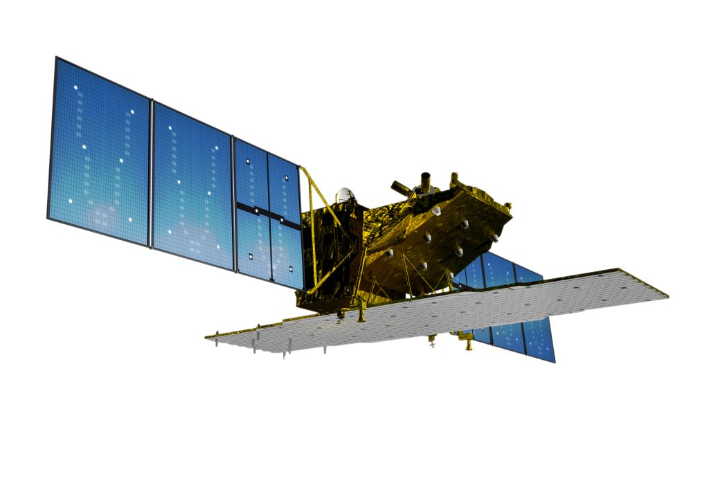

ALOS-2 status and Acquisition Strategy Update
Osamu Ochiai (JAXA SAPC)
on behalf of
Masanobu Shimada, SDCG representative (JAXA EORC)
and the JAXA BOS-2 group
CEOS SDCG#2
USGS HQ, Va/USA, Sept 13-14 2012

Slide 2
ALOS-2 satellite
Launch : 2013
Revisit time : 14 days
Orbit type : Sun-synchronous
Altitude : 628 km +/- 500 m (for reference orbit)
LSDN : 12:00 +/- 15 min
ALOS-2
PALSAR-2
L-band Synthetic Aperture Radar
Active Phased Array Antenna type
two dimensions scan (range and azimuth)
Antenna size : 3m(El) x 10m(Az)
Bandwidth : 14 – 84MHz
Peak transmit Power : 5100W
Observation swath : 25 – 490km
Resolution : Range: 3 m to 100 m
      Azimuth: 1 m to 100 m
X
Solar paddles
Y
Z
SAR antenna

Slide 3
PALSAR-2 Specifications
 |  |  | Spotlight | Ultra Fine | High sensitive | Fine | ScanSAR nominal |  | ScanSAR wide
Bandwidth |  |  | 84MHz | 84MHz | 42MHz | 28MHz | 14MHz | 28MHz | 14MHz
Resolution |  |  | Rg×Az： 3×1m | 3m | 6m | 10m | 100m |  | 60m
Swath |  |  | Rg×Az： 25×25km | 50km | 50km | 70km | 350km (5-scan) |  | 490km (7-scan)
Polarization |  |  | SP | SP/DP | SP/DP/QP/CP |  | SP/DP
NESZ |  |  | -24dB | -24dB | -28dB | -26dB | -26dB | -23dB | -23dB
S/A | Rg |  | 25dB | 25dB | 23dB | 25dB | 25dB |  | 20dB
 | Az |  | 20dB | 25dB | 20dB | 23dB | 20dB |  | 20dB
SP : HH or VV or HV , DP : HH+HV or VV+VH , FP : HH+HV+VH+VV , CP : Compact pol (Experimental mode)
Main applications:
Fine beam (DP): Forest and land cover monitoring / DinSAR
ScanSAR (DP): Rapid deforestation / wetlands / InSAR (ScanSAR-ScanSAR)
Spotlight (SP): Emergency observations
Ultra Fine (SP) : Global map, InSAR base mapping
High sensitive (QP): Global map
ScanSAR wide (SP) : Polar ice

Slide 4
ALOS-2 status
ALOS-2 is planned for launch in 2013, with a design lifetime of 7 years.
A global systematic acquisition strategy (“Basic Observation Scenario” – BOS) is under development. It is comprised of a global (described here) and a dedicated national component covering Japan.
The ALOS-2 BOS builds on the ALOS acquisition strategy (2006-2011). It will provide continuity of key acquisitions but with enhanced image characteristics (spatial resolution, polarisations, radiometric sensitivity).
The ALOS-2 Data Policy is yet to be determined.

Slide 5
The ALOS-2
Basic Observation Scenario (BOS)
– Global component –
(as of September 2012)

Slide 6
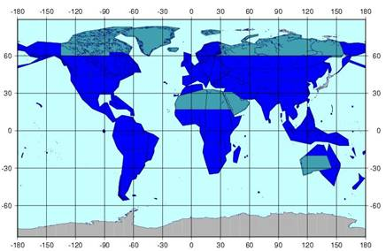
Global land areas – baseline mapping
Temporal repeat: 2 cov/year
GSD: 10 m
Mode: Dual-pol (HH+HV)
Prio 1
Prio 2

Slide 7
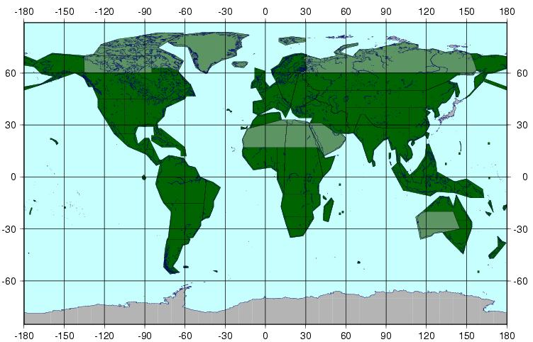
Global land areas – VHR baseline mapping
Temporal repeat: 1 cov/ 3 years
GSD: 3 m
Mode: Single-pol (HH or HV) (TBD)
Prio 1
Prio 2

Slide 8
Global land areas – Polarimetric baseline
Temporal repeat: 1 cov/ 3 years
GSD: 6 m
Mode: Quad-pol (HH+HV+VV+VH)

Slide 9
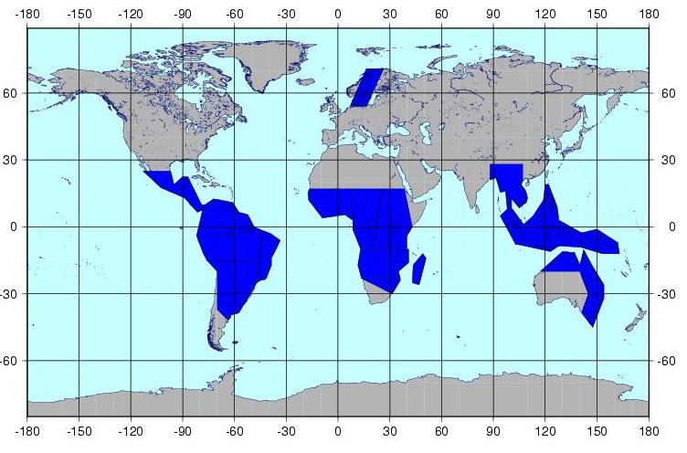
Forest monitoring
Temporal repeat: 2-6 cov/year (tropics: 6 cov, incl.
GSD: 10 m
Mode: Dual-pol (HH+HV)
14-day InSAR)

Slide 10
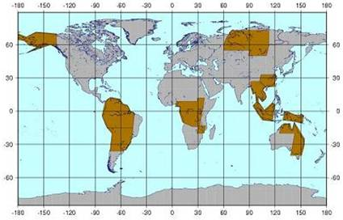
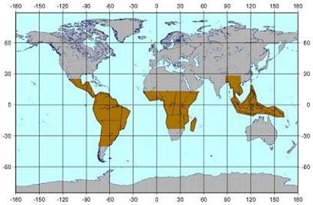
Wetlands & Rapid deforestation monitoring
Temporal repeat: 9 cov/year (42 days repeat)
GSD: 100 m
Mode: WB-350km (HH+HV)

Slide 11
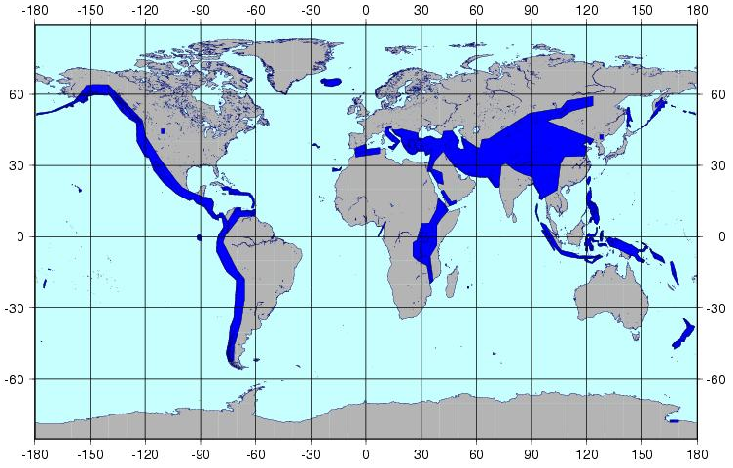
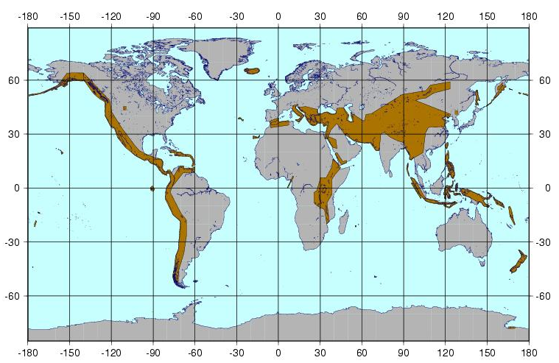
Crustal Deformation
Temporal repeat: 2-6 cov/year & 9 cov/year (42 d)
GSD: 10 m & 100 m
Mode: Dual-pol (HH+HV) & WB-350km (HH+HV)

Slide 12
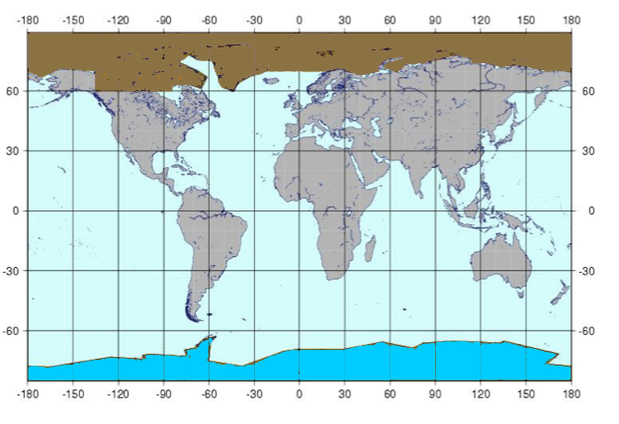
Polar Ice
Temporal repeat: 3 cov/year
GSD: 100 m
Mode: WB (HH or HH+HV) (TBD)
Right look
Left look

Slide 13
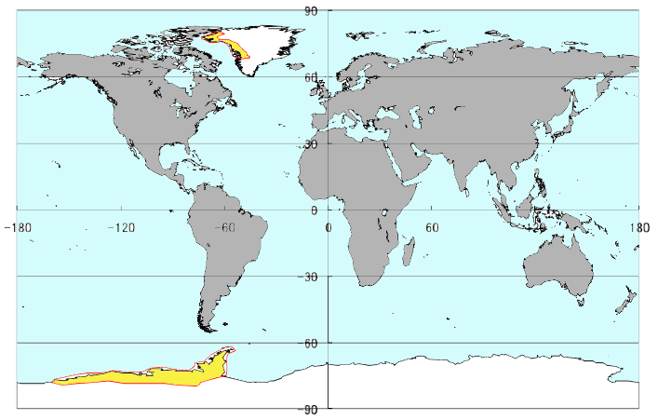
Glacier movement (Super Sites)
Temporal repeat: 2-3 cov/year
GSD: 10 m
Mode: SP (HH)

Slide 14
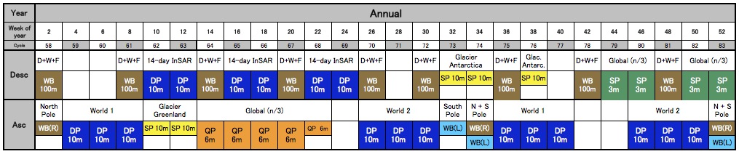
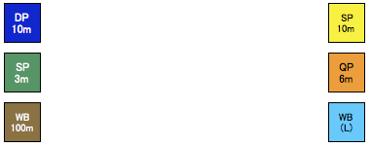
Observation pattern for annual acquisitions *
10m DP (HH+HV) 10m SP (HH)
3m SP (HH or HV) 6m QP (HH+HV+VV+VH)
100m WB (HH+HV) 100m WB (HH+HV)
(Right) (Left)
* 3m SP and 6m QP modes require 3 years for global coverage

Slide 15
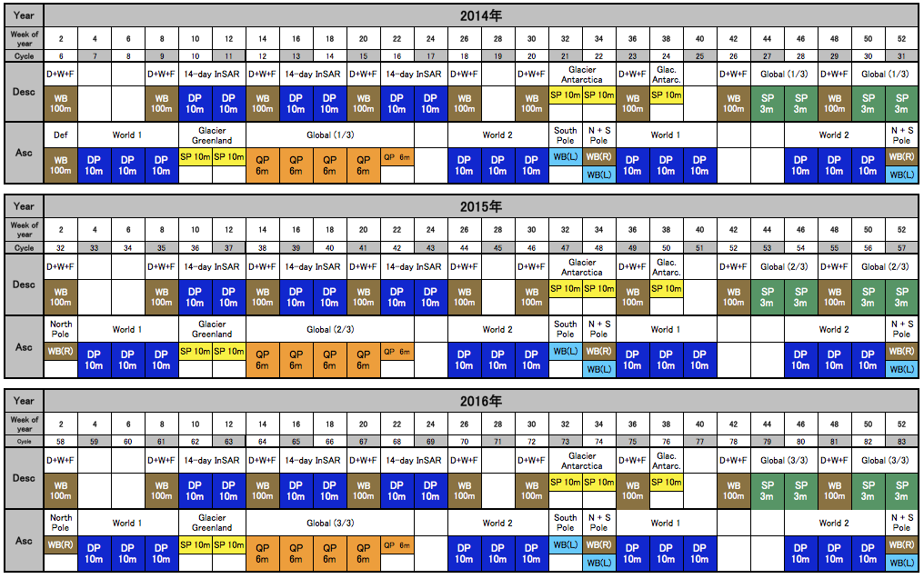
Pattern repeated on a 3-year basis

Slide 16
Emergency observations
Emergency observations – such requested through the International Disaster Charter, by Japanese institutions or by JAXA itself – have highest priority and superseed the Basic Observation Scenario programming.
Cal/Val
Requests related to Cal/Val also have higher priority than the BOS, but are as far as possible already integrated into the BOS planning.
Top priority
Satellite house-keeping has top priority and superseed all the above.

Slide 17
Schedule
2011-2012: Observation plan development with associated
software simulations to optimise data collection
verses recording and downlink capacity and use
of other system resources (power, etc.)
2013: BOS implementation and satellite launch
L - L+2m: Initial mission check
L+2 - L+7m: Cal/Val phase
L + 7 m: Start of distribution of standard products
2013+ The BOS plan will be reviewed on a regular basis (ALOS: 2 times/year) by JAXA and related Japanese institutions, and modified as required.

Slide 18
Thank you
ありがとう。
CEOS SDCG#2
USGS HQ, Reston (VA) Sept 13-14, 2012

