Slide 1
CEOS Data Acquisition Plan – Global Baseline strategy (Level 1)
EO monitoring requirements
Space Data Coordination Group (SDCG)
John Faundeen, USGS
Ake Rosenqvist, for NSC
Frank-Martin Seifert, ESA

Slide 2
Tentative monitoring requirements
Category A
Product category | Name | Monitoring requirements | Approx. GSD
A1 | Land Use / Land Cover | Optical: Best suited sensor type for category A products. At least one annual coverage, at dry season. Dual season or better improves class distinction. | ~30m
A2 | IPCC Land Category map | C-band SAR: Insufficient on its own. One annual coverage (dry season) in combination with optical and/or SAR can help resolve specific classes (e.g. Acacia). Dual polarisation needed | ~30m
A3 | IPCC Land Category Transition map (Activity Data) | L-band SAR: Useful on its own, but generally lower class separability than optical sensors. At least one annual coverage (dry season). Dual season improves class distinction. X-band SAR: (R&D) Insufficient on its own. One annual dry season coverage in combination with optical and/or C- and/or L-band SAR can help resolve specific classes. Dual polarisation needed | ~30m

Slide 3
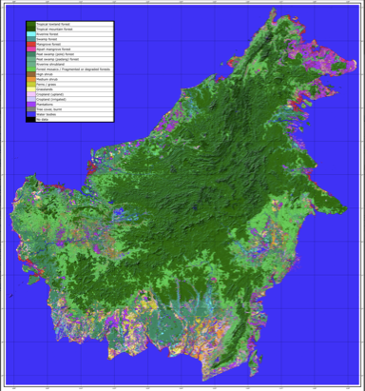
Tentative monitoring requirements
Category A
Indonesia
Category A1
Land cover

Slide 4
Tentative monitoring requirements
Category B
Product category | Name | Monitoring requirements | Approx. GSD
B1 | Forest Types | Same as Category A products. Higher temporal frequency (3-4 obs/year) data can improve class distinction and classification accuracy due to phenological and seasonal effects. | ~30m
B2 | Forest / Non-Forest Cover
B3 | Forest Cover Change | Optical and L-band SAR: Same as Cat. A. C-band SAR: Dense time-series (~monthly) required to detect and track changes (under a B2 forest mask) X-band SAR: R&D topic but potentially useful. Time-series data absolute requirement. | ~30m
B3' | Historical Forest Cover Change | Pixel mining compositing using all available archived optical (Landsat) data. | ~30m

Slide 5
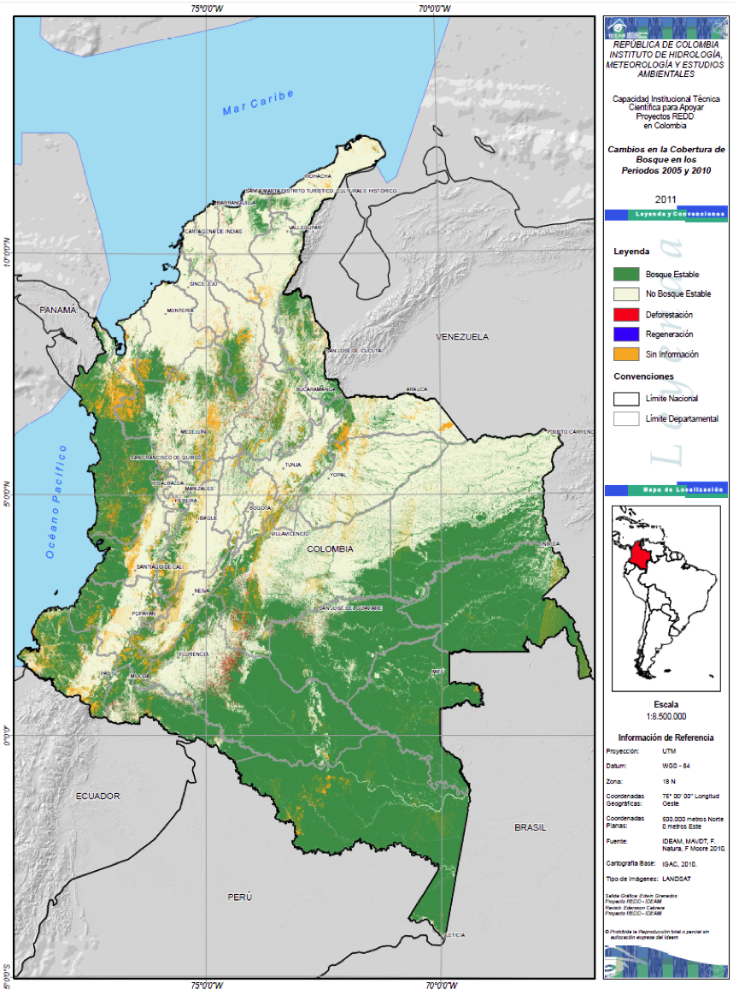
Tentative monitoring requirements
Category B
Colombia
Category B2
Forest cover

Slide 6
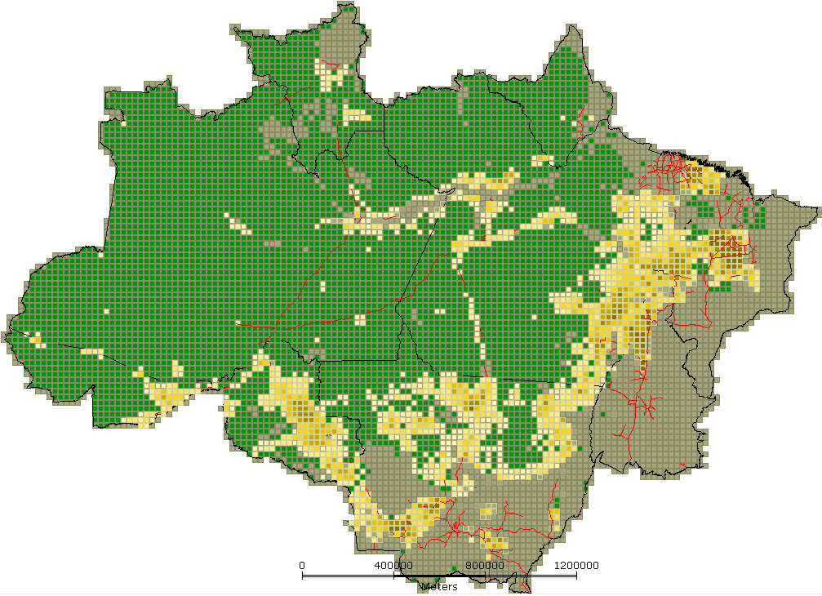
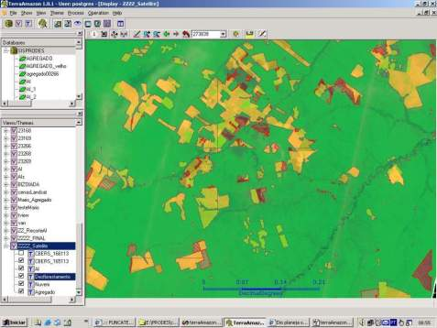
Tentative monitoring requirements
Category B
Brazil
Category B3 (and B2)
Forest cover change
(PRODES)

Slide 7
Tentative monitoring requirements
Category C
Product category | Name | Monitoring requirements | Approx. GSD
C1 | Degradation (and enhancements of C stocks) | High or Very High resolution optical or X-band SAR: (R&D) Bi-weekly to bi-monthly, dependent on degradation type | High (5-10m) or Very High (<5m)
C2 | Near-Real Time Forest Change Indicators | Low-resolution optical: weekly/bi-weekly. Low res (ScanSAR) L-band : ~monthly C-band SAR: Same as B3. | 100~ 250 m

Slide 8
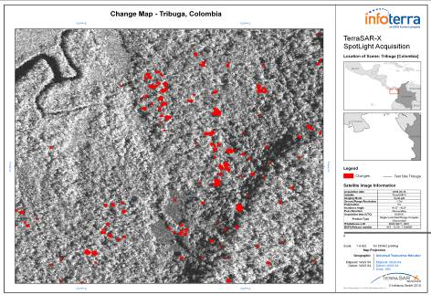
Tentative monitoring requirements
Category C
Colombia – Category C1
Degradation (selective logging)

Slide 9
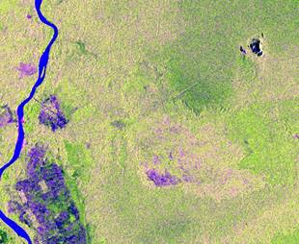
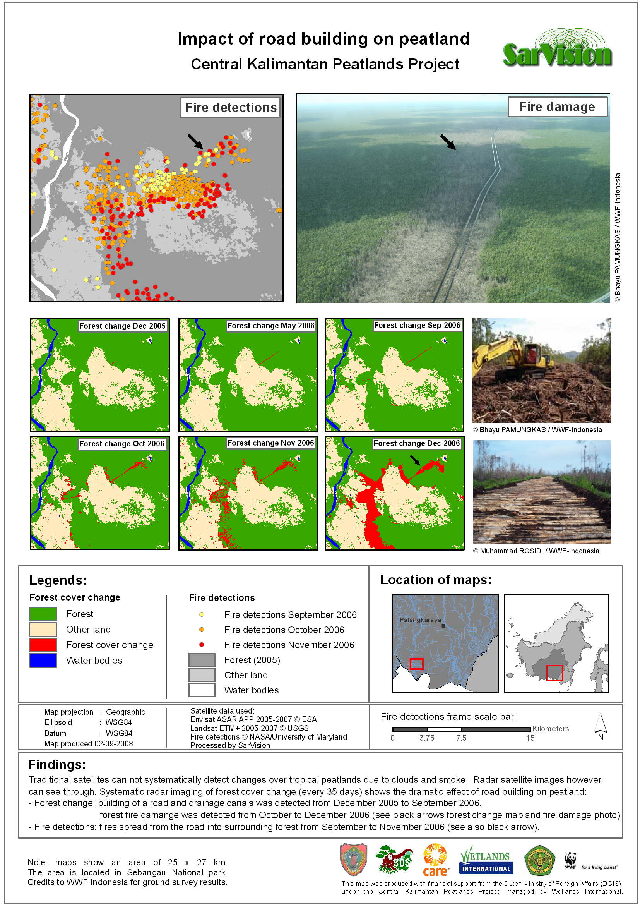
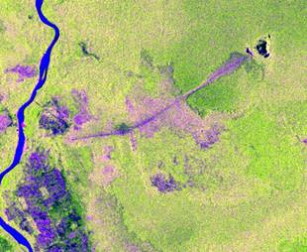
Tentative monitoring requirements
Category C
Indonesia:
Category C2
Near-real time deforestation indicators

Slide 10
Tentative monitoring requirements
Category D
Product category | Name | Monitoring requirements | Approx. GSD
D1 | Above-Ground Biomass Estimates | Optical + SAR(L) or L-band SAR: Same as Cat. A (Semi-annual - dual season) | 50~ 250 m

Slide 11
Tentative monitoring requirements
Category D
Australia (QL, NSW)
Category D1
Above-ground biomass estimates

Slide 12
Optical sensors
Minimum: one cloud-free coverage/year at peak of dry season, for each region (A₁₂₃, B₂₃)
Good: Dual-season, or better (+B₁)
Optimal: Monthly/bi-monthly (+C₂)
Geographical focus: Global/GFOI ROI
Notes: Use cloud statistics data to estimate the required number of acquisitions to achieve above. Stratify by region/country.
Resulting observation requirements

Slide 13
C-band SAR
Minimum: one coverage/year at peak of dry season, for each region (complement to A₁, B₁)
Good: TBC
Optimal: Monthly/bi-monthly (B₃, C₂)
Geographical focus: w2w: GFOI ROI
Dense time series: Deforestation/degradation hot spot regions within GFOI ROI.
Notes: Dual polarisation key requirement. R&D
Resulting observation requirements

Slide 14
L-band SAR
Minimum: one coverage/year for each region (A₁₂₃, B₂₃, D₁)
Good: Dual-season, or better
Optimal: Monthly/bi-monthly (+C₂)
Geographical focus: Global/GFOI ROI
Notes: Dual polarisation key requirement
Resulting observation requirements

Slide 15
VHR sensors (optical, X-band SAR)
Minimum: TBD
Good: TBD
Optimal: Monthly/bi-monthly (B₃, C₁)
Geographical focus: Deforestation/degradation hot spot regions within GFOI ROI.
Notes: R&D
Resulting observation requirements

