Slide 1
GFOI Space Data Acquisition Plan Gap Analysis
Space Data Coordination Group (SDCG)
John Faundeen, USGS
Ake Rosenqvist, for NSC
Frank-Martin Seifert, ESA

Slide 2
Overview
Three Periods
Near-Term (2012 to mid-2013)
Transitional (mid-2013 to 2014)
Operational (2015 Onward)
Gaps Identified
Mitigation Strategies
Initiation Transition Operations
2012 2013 2014 2015

Slide 3
2012 to Mid-2013
Famine……(and eventually Feast?)
Core Data Set……only Landsat-7 & Radarsat 2 (Hybrid) Remain
Will CBERS-3 Begin a New Era?

Slide 4
Projected Gap
We are in a Gap Now!
Mitigation – Hang on
CBERS-3 December 2012 Launch
LDCM February 2013 Launch
New Data Flows Hopefully April/May 2013!

Slide 5
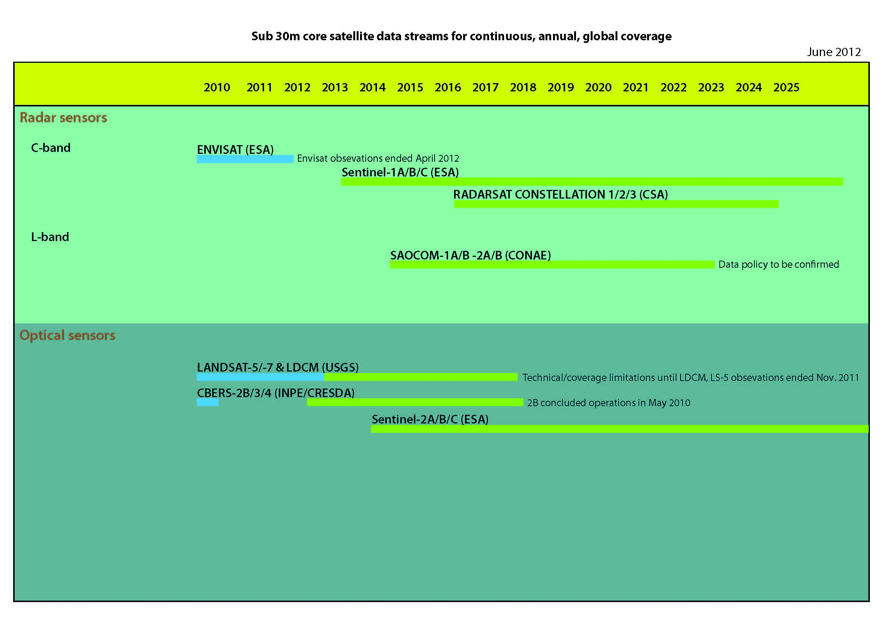

Slide 6
Mid-2013 to 2014 CORE
Landsat-7
CBERS-3
LDCM

Slide 8
Mid-2013 to 2014 Non-CORE
Radarsat-2
Continuation of 2012 FCT ND Wall-To-Wall?
RapidEye
TerraSAR-X/TanDEM-X

Slide 9
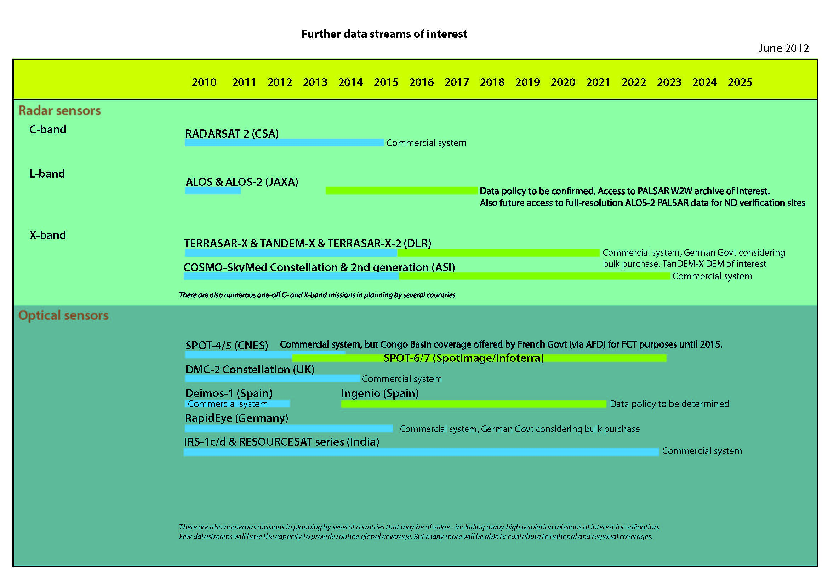

Slide 10
Mid-2013 to 2014 Gaps
2013 still part of low water mark for coverage and data provision.
Landsat 7 operates with global focus
Scanline error and cloud coverage insufficient for the gap-free coverage
Radarsat-2 also continue over selected FCT National Demonstrator countries?
CBERS-3 over INPE and CRESDA ground station most frequent coverage
Gaps can still be expected in particularly cloud-prone areas
African continent gaps where at least initially only L7 and LDCM collected.
Sentinel-1A is scheduled for launch in 2013
Operations expected for 2014.

Slide 11
2014 to 2015 Core
Landsat 7
LDCM
CBERS-3
Sentinel-1A
Sentinel-2A
Amazonia-1

Slide 13
2014 to 2015 Non-Core
Radarsat-2
SPOT-4
SPOT-5
RapidEye
ALOS-2

Slide 15
2014 to 2015 Gaps
Acquisition capacity for Sentinel-2A is anticipated to be limited initially in 2014
increase gradually in 2014 and 2015
The expected acquisition capacity for Amazonia-1 is TBC by INPE.
The CBERS-3 observation capacity over Africa is dependent on upgrades
Sentinel-1A represents the first core mission SAR system and operations are expected to increase gradually over 2014-2015

Slide 16
2015 and Beyond Core
Landsat-7
LDCM
CBERS-3
Sentinel-1A
Sentinel-2A
Radarsat Constellation Mission
Amazonia-1
SAOCOM-1A

Slide 18
2015 and Beyond Non-Core
Radarsat-2
SPOT-4
SPOT-5
RapidEye
ALOS-2

Slide 20
2015 and Beyond Gaps
?

Slide 21
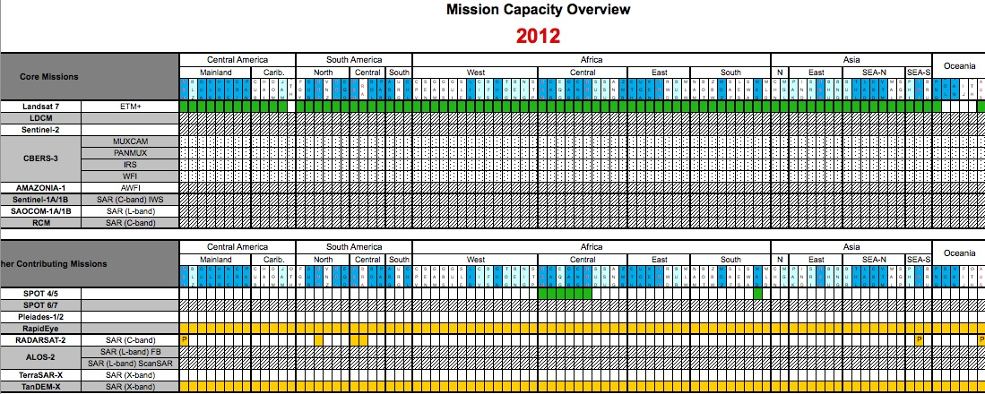
Critical Spatial / Regional Needs

Slide 22
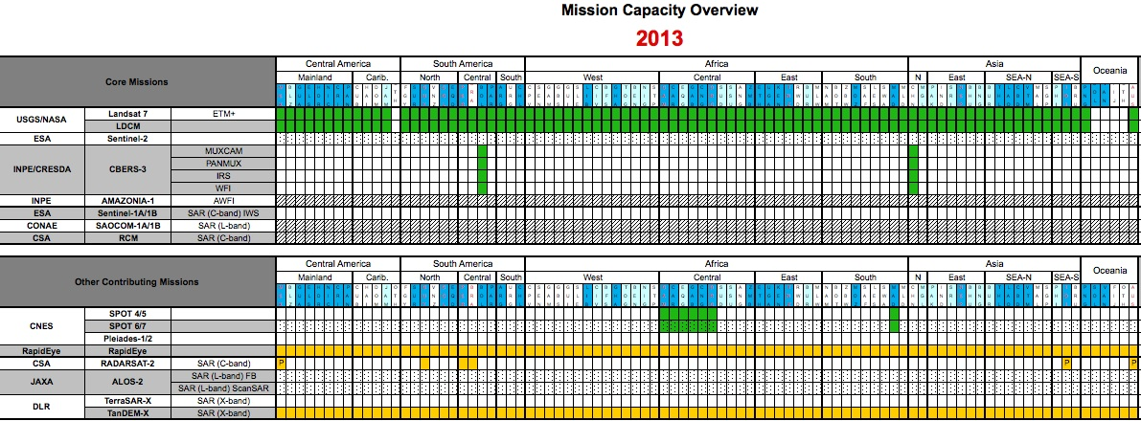
Critical Spatial / Regional Needs

Slide 23
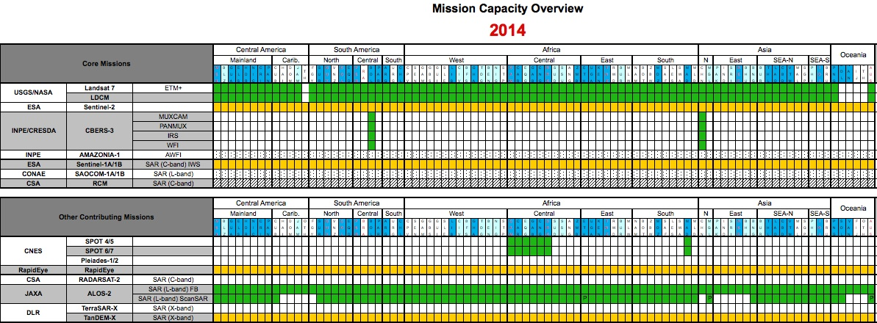
Critical Spatial / Regional Needs

Slide 24
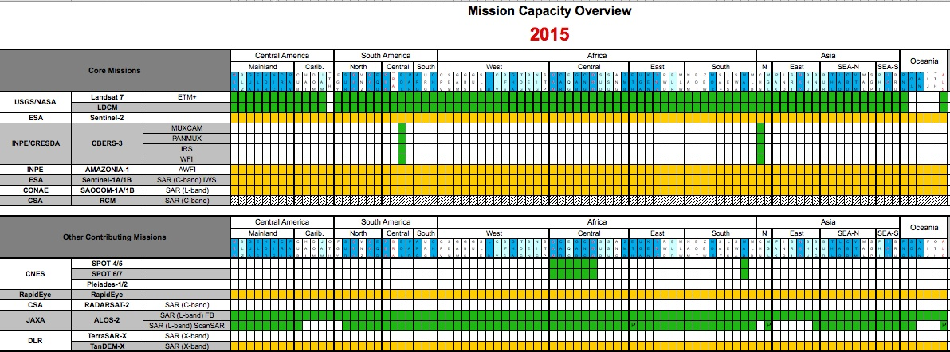
Critical Spatial / Regional Needs

Slide 25
Essential Space Mission Needs

