Slide 1
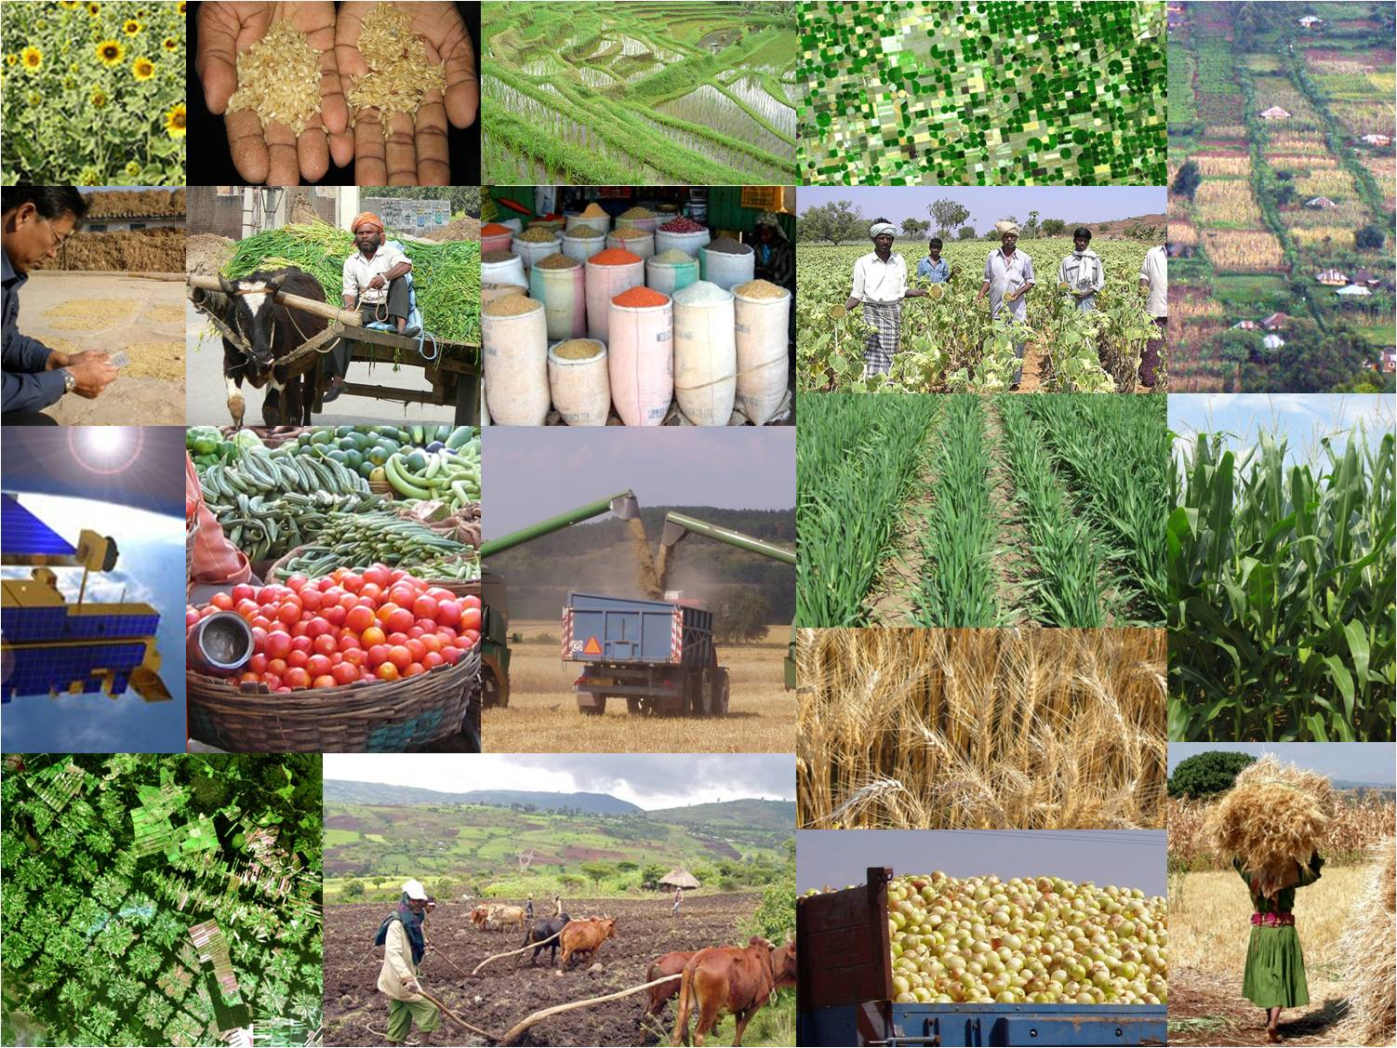



Status Update on The GEOGLAM
Initiative
Inbal Becker-Reshef, Chris Justice, Alyssa Whitcraft, Matt Hansen, Joao Soares
CEOS SDCG-3 Meeting
February 7-9, 2013
Sydney, Australia

Slide 2
G20 GEOGLAM Goal:
To strengthen the international community’s capacity to produce and disseminate relevant, timely and accurate forecasts of agricultural production at national, regional and global scales through the use of EO
Outcome: an improved and more harmonized systems of systems taking advantage of new satellite assets and methods and a higher level of international coordination
GEO-GLAM will be implemented in the framework of GEO

Slide 3

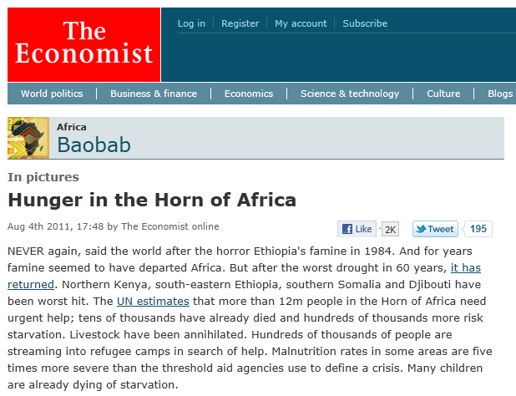
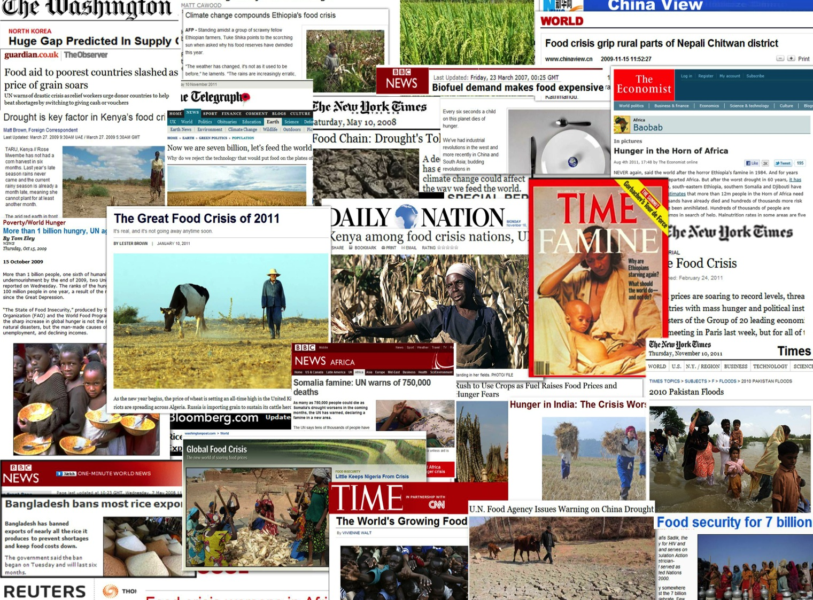



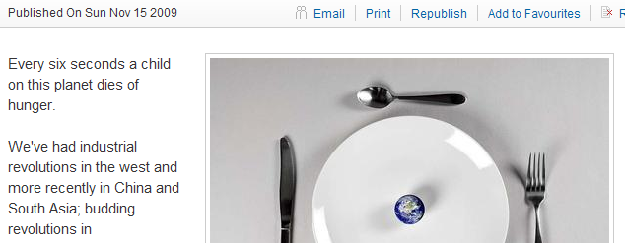
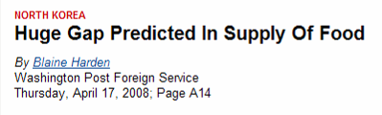
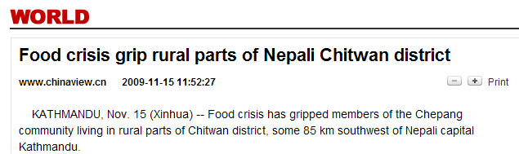
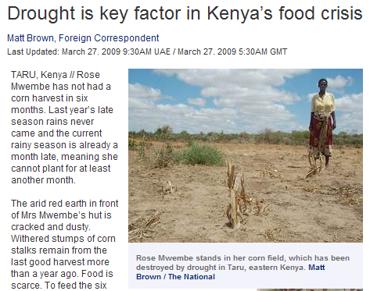

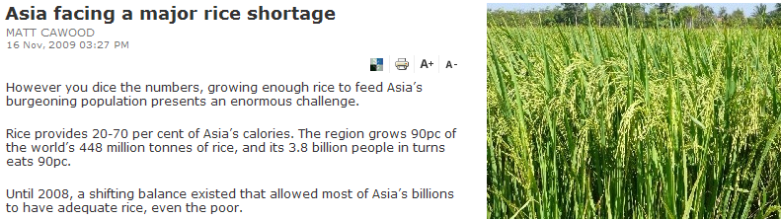
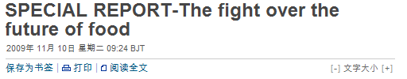
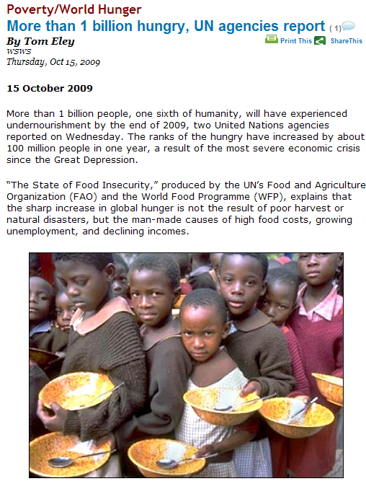
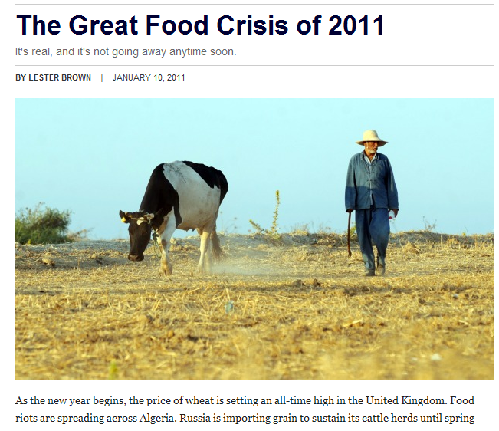


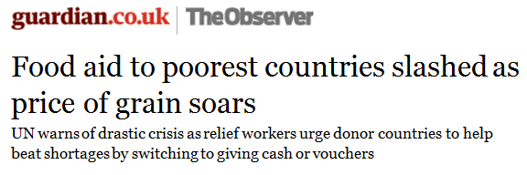




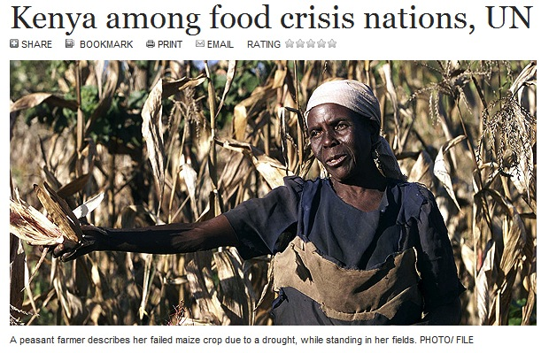
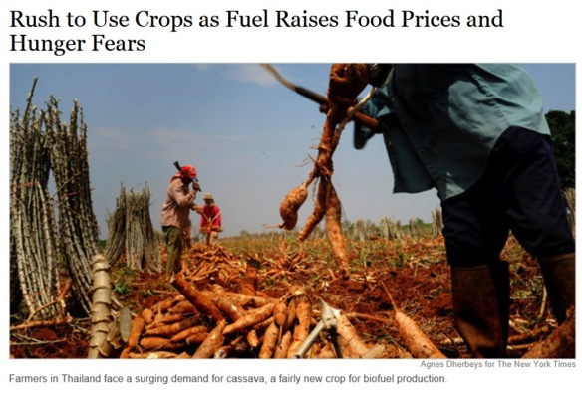
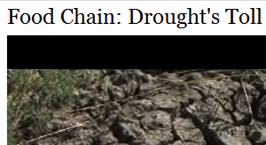
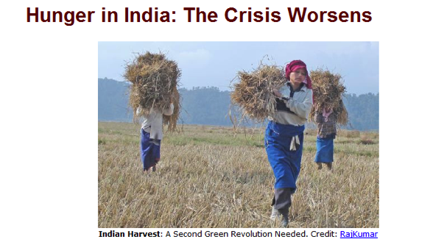

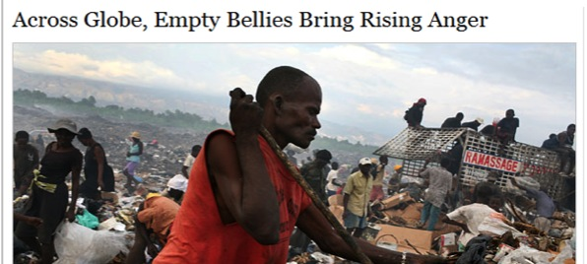
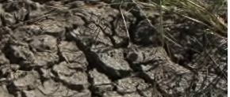



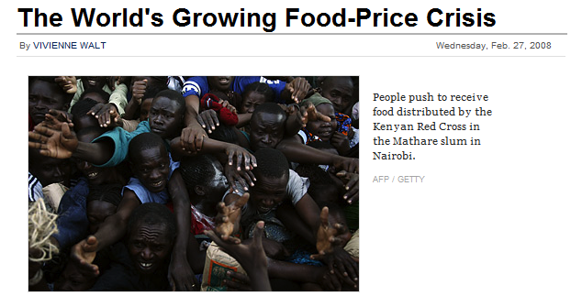



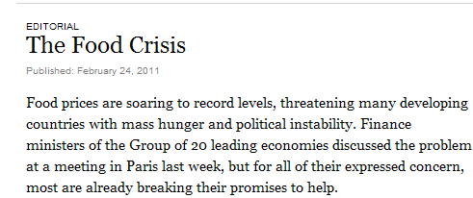

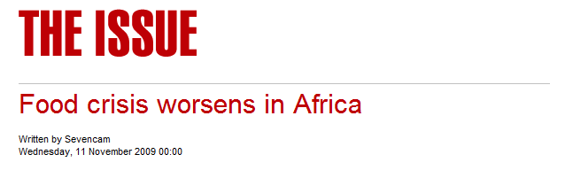
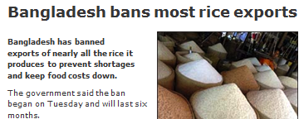
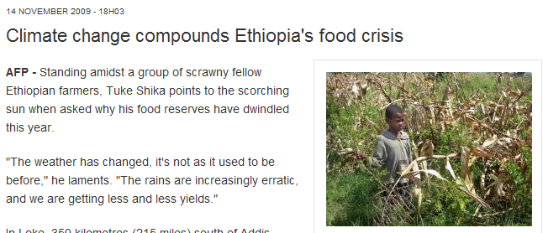


NEED TO INCREASE FOOD PRODUCTION BY 50%-70% BY 2050! (FAO)
Challenges:
  extreme weather events (droughts) Climate change
  Price volatility
  Population growth and changing diets
  Limited land and water resources
  Biofuels - tighter connection to energy markets
  Low investment in R&D
Notes:
There is a lot of attention to food in recent years concerning global food in particular in response to food price volatility.
This problem is not going away especialy recognizing that to feed the world need to increase production by 70%

Slide 4
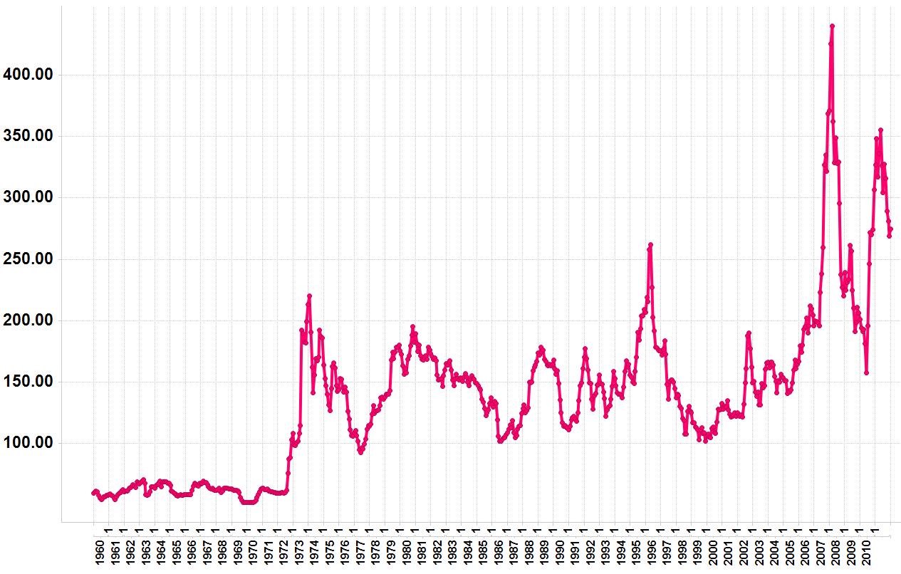
Context for GEOGLAM
Monthly Wheat Prices 1960-2011($/Metric Ton)
Source: World Bank
2008 Price hikes
Droughts:
Australia & Ukraine
2010/11 Price hikes
Drought:
Russia
1971/2’s price hike
Drought: Russia
Landsat 1 Launched (1972)
Nominal wheat price in US $/metric Ton
Notes:
World prices of wheat, rice, corn, and soybeans rose 226% from 2002 2008
Between June of 2010 and May 2011 price of wheat increased by over 80%
The 2010/11 price increases have pushed an additional 44 million people into poverty (FAO)
2011 Horn of Africa drought left over 13 million in need of food aid (FAO)
2012 crop prices for major crops increased rapidly in past few months

Slide 5
Why This Matters: Looking Forward
Agriculture Faces Major Challenges in this Century
Increasing pressures on agricultural land and production from:
  Increased severe weather events and climate change
  Population growth & changing diets
  Fuel vs. Food vs. Feed
  Limited water and suitable arable land
Higher price volatility for major grains
Commodity markets are increasingly linked (good and bad)
Rising fuel prices impact food prices (transport, fertilizer)
NEED TO INCREASE GLOBAL PRODUCTION BY 70% BY 2050 TO MEET DEMAND (FAO)
→ Data and tools for monitoring and reliably forecasting production are essential for anticipating market imbalances and enhancing policy responses

Slide 6

The GEO Global Agricultural Monitoring
(Initiated in 2007)
Task Co-Leads:
Chris Justice, University of Maryland, USA (NASA supported)
Derrick Williams, USDA FAS, USA
Wu Bingfang, Institute of Remote Sensing Applications, CAS, Beijing, China
Olivier Leo, Joint Research Centre, European Commission, Ispra, Italy
Task Executive Director: Jai Singh Parihar, Space Applications Centre (ISRO), India
JECAM Sub-task Lead: Ian Jarvis, Agriculture and Agri-Food Canada
Production Area Yield Lead: Inbal Becker-Reshef, UMD, Meng Jihua, China
CEOS GEO Agriculture POC: Prasad Thenkabail, USGS
GEO Secretariat PoC: Joao Soares, GEO Secretariat, Geneva

Slide 7

















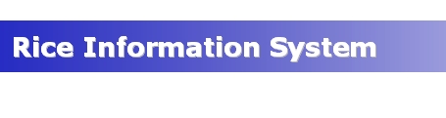












GEO Agriculture Monitoring Community of Practice
(an open community of Data Providers, Brokers and Users)
Several global/regional scale systems in place – with common data needs, few common standards and protocols and inconsistent results
Most countries have a national agricultural monitoring system

Slide 8
Need for Improved Agricultural Intelligence
International recognition of critical need for improved information including at the World Summit on Food Security 2009, G20 Action Plan on Food Price Volatility and Agriculture, 2011
official statement of The Extraordinary Joint Intersessional meeting of the Intergovernmental Group (IGG/FAO) on Grains, Rome 2010:
“Unexpected price hikes and volatility are amongst
major threats to food security and their root causes
need to be addressed, in particular regarding the lack
of reliable and up-to-date information on crop supply
and demand and export availability….”

Slide 9
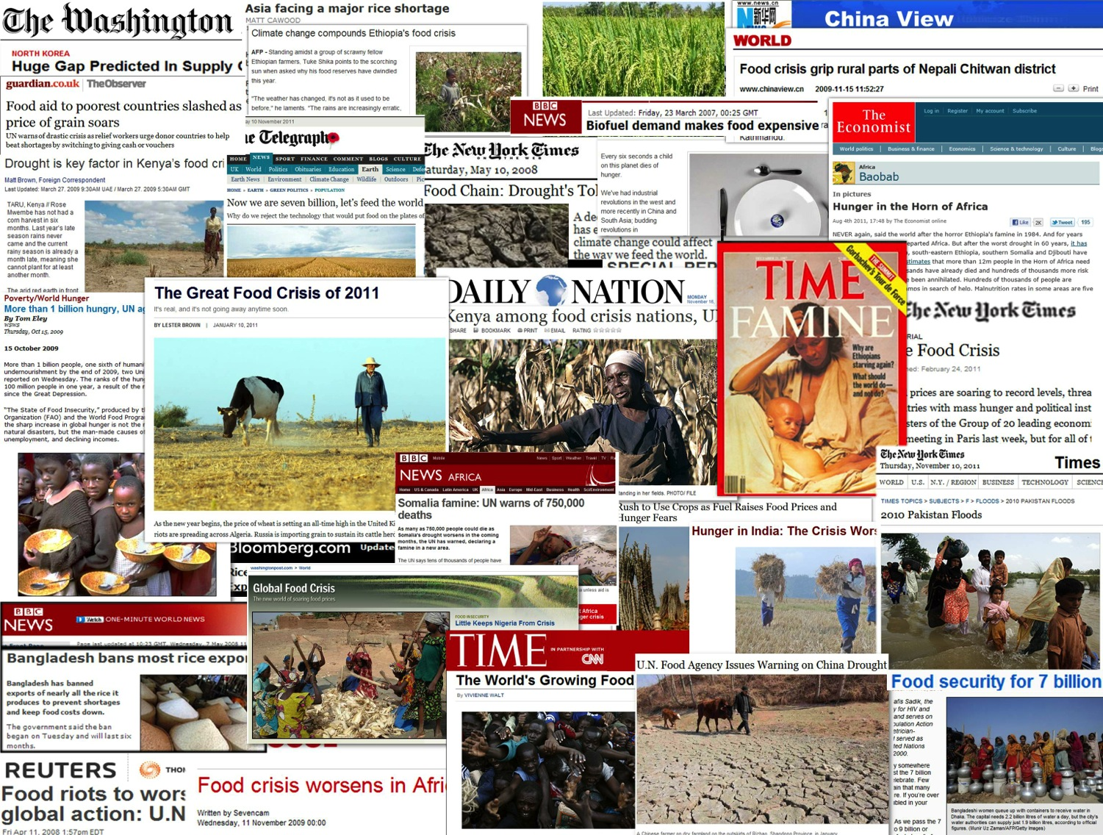
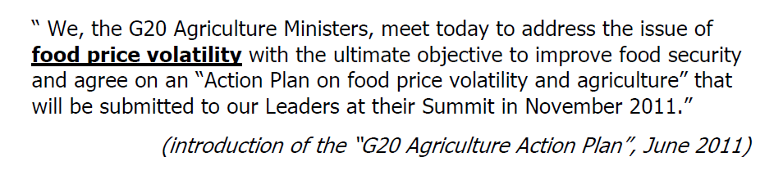

Slide 10
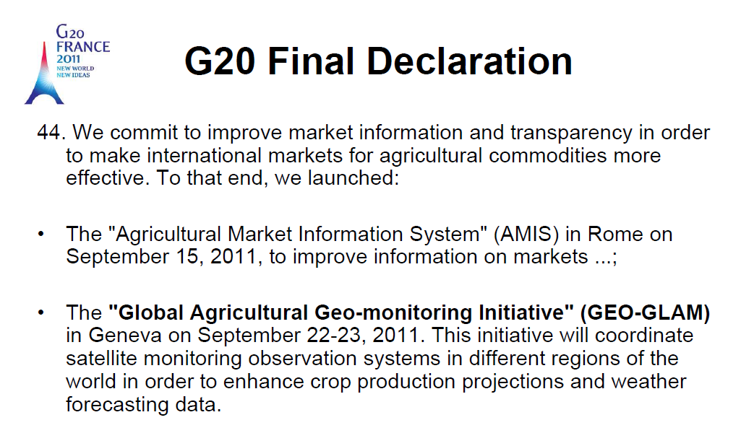
The G20 Initiative: GEO-GLAM
The G20 Cannes Summit (November 2011) Action Plan on Food Price Volatility and Agriculture
Reaffirmed GEOGLAM commitment at the 2012 G-20 Los Cabos Declaration & in Agriculture Ministers Report

Slide 11
How We are Organized
GEOGLAM Secretariat in Geneva- Project coordinator (Pascal K. seconded by France) 2 support staff
The GEOGLAM Coordination Committee: includes task team leaders of the agreed components of the initiative and a Project Manager, who serves as its chair
The steering committee for GEOGLAM consists of the Executive Director of the GEO Secretariat and representatives from donors and stakeholders.
  Its high level role is to provide guidance on key issues such as objectives, budgetary audit, marketing strategy and resource allocation
Component Offices are distributed:
  Japan: Asia Rice
  JECAM: Canada
  National Capacity building: FAO
  Global Producer Countries: JRC USDA
  Countries at Risk: USAID/ FAO

Slide 12
Support: Current & Anticipated
NASA
  GEOGLAM operations to UMD
  Drought monitoring system prototype
  Global Soy Area Estimation
  Wheat Yield Forecasting prototype
  Indicated support for the initial prototyping of developing EO requirements
Japan:
  Asia Rice Initiative
China:
  GEO Agriculture- MOST, indication will support GEOGLAM next year
EU FP 7:
  9 Million Euro
France-
  GEOGLAM operations- secondment of Pascal K- project coordinator
Canada-
  JECAM office
Gates Foundation –
  Indicated interest in supporting Countries at Risk Component
Germany
  Indicated interest to support GEOGLAM
US GEO

Slide 13


GEOGLAM Components
4. EO DATA COORDINATION
5. METHOD IMPROVEMENT through R&D coordination (JECAM)
6. Data, products and INFORMATION DISSEMINATION
Stakeholders
Governments
AMIS
FAO
The 26th CEOS Plenary – Bengaluru, India - 24-27 October, 2012

Slide 14
GEOGLAM Components
Component 1: Monitoring Global Producer Countries
  Focus: Global crop outlooks, markets and trade, long term trends (climate change implications, extreme events, etc)
Component 2: National Monitoring Systems
  Focus: National statistics, national policy, subsidies, insurance
Component 3: Countries at Risk
  Focus: Early warning & food security
Component 4:Earth Observations Coordination
  Focus on acquisition, availability, access needed for GEOGLAM implementation
Component 5: R&D
  Focus: Operational R &D, Best practices, Research to Operations, Joint Experiments -JECAM
Component 6: Information dissemination
  Focus on timely and transparent availability of information

Slide 15
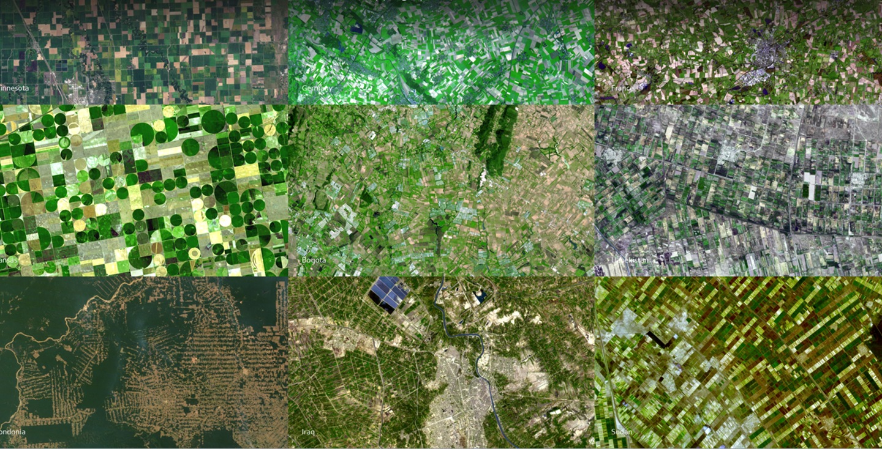
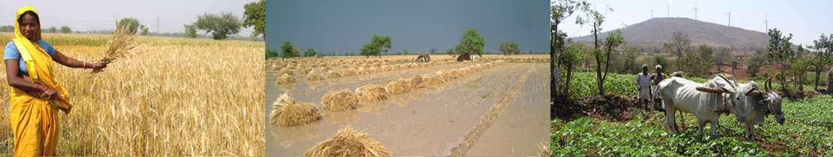
Recognition that cropping systems are inherently diverse which dictates the monitoring observations and methods

Slide 16
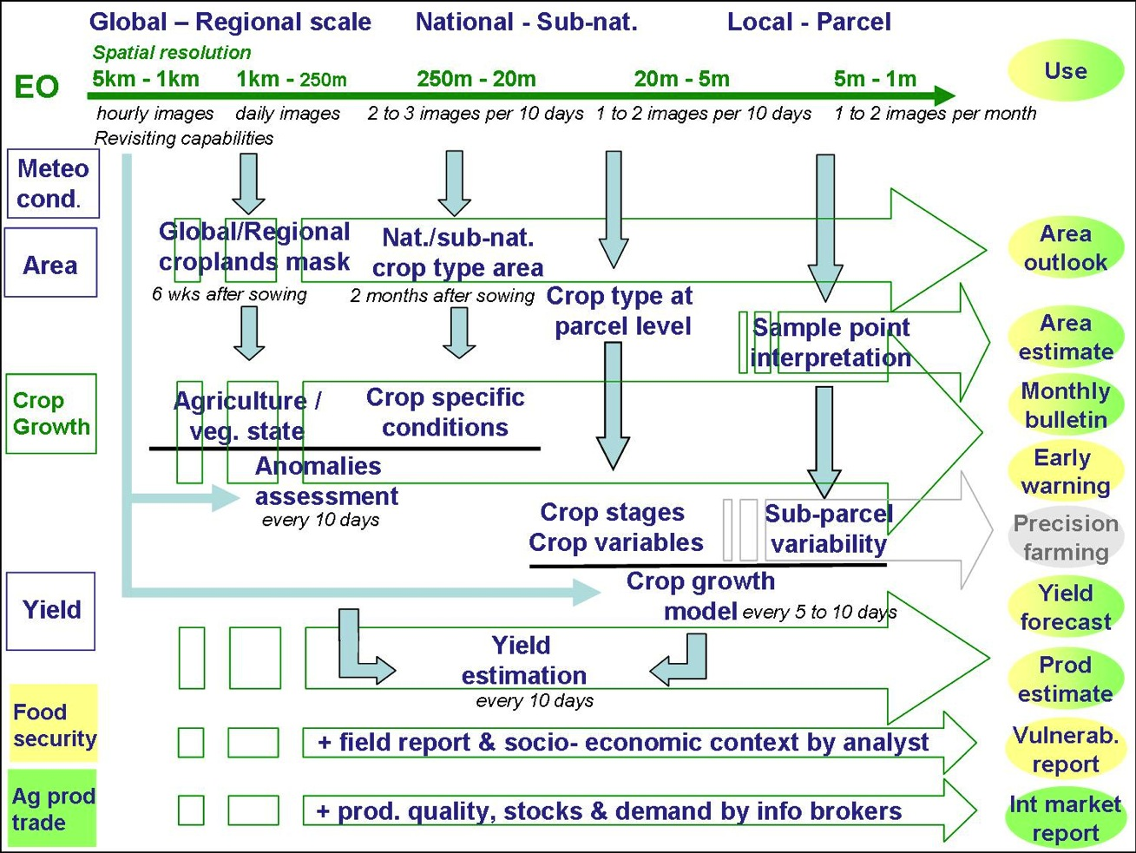
Developing the Observation Requirements

Slide 17
GEOGLAM Component 4 Activities:
  Developing EO requirements strategy though phased approach
  Developing required baseline datasets and database for requirement assessment
  Interoperability of VIIRS with MODIS for agricultural monitoring
  Joint LDCM/Sentinel 2 processing for agricultural monitoring (ESA/NASA)
  Near real time data processing of MODIS and VIIRS
  Development of customized national crop condition monitoring systems

Slide 18
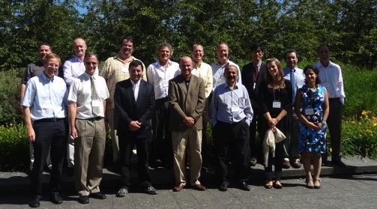
First GEOGLAM/CEOS Ad Hoc Team Workshop on Developing the GEOGLAM OBSERVATION REQUIREMENTS
CSA, Montreal July 10-11, 2012
Tabulating the satellite observation requirements (spatial resolution, frequency, and period of coverage ) for GEOGLAM

Slide 19
Information Products
Identifying Information and Product Types
Data Products
crop condition/outlook
area estimate
early warning
yield forecast
production estimate
Food Sec/vulnerability report
Statistics reports
Cropland mask
Crop condition indicators
Crop type
Biophysical variables
Environmental variables (soil moisture)
ag practices
yield forecasts
production estimates

Slide 20
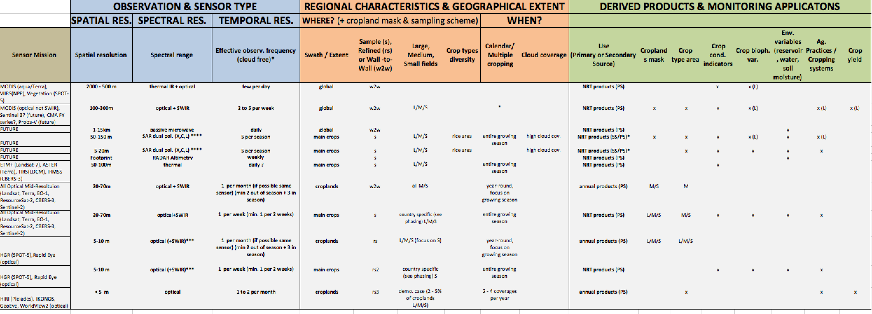
Workshop Outcome: EO Data Requirements Table
  developed taking into consideration the observation needs, the derived products they will
  serve, and regional specificities; CEOS-GEOGLAM July 2012 Montreal)
How often ?
Where?
When?
For What?
spatial & spectral

Slide 21
  Example: Global and regional monitoring- Component 1
Crop Condition Global Outlook: GEOGLAM input to AMIS
Sensors: MODIS, SPOT Vegetation, VIIRS
Resolution: 250m-1km
Frequency: Daily
Optical, SWIR
All Croplands

Slide 22

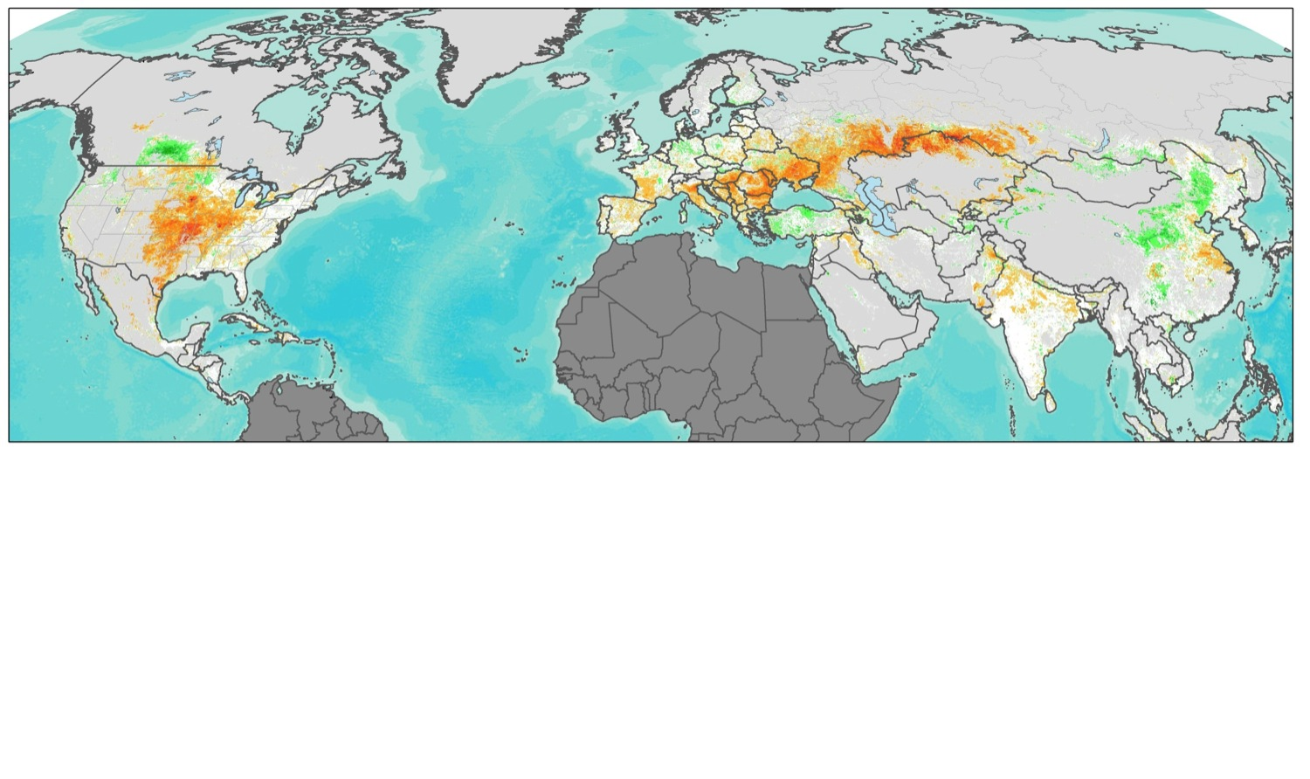
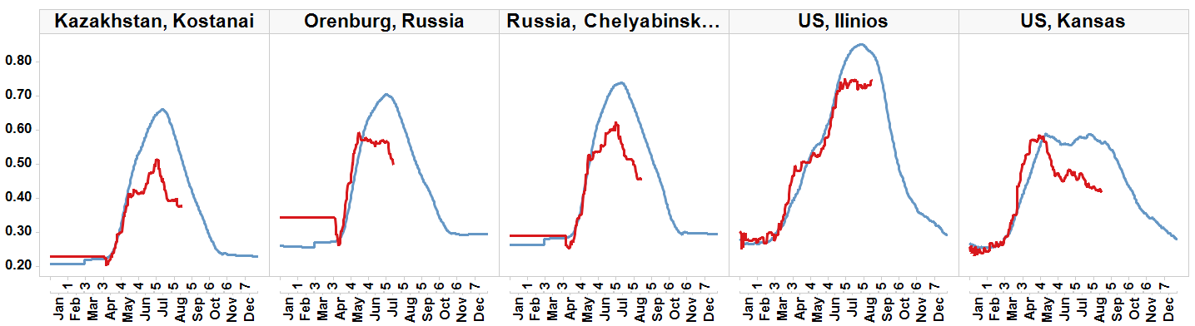


Crop Condition Global Outlook: Building International Consensus
Assessment of Crop Conditions in Northern Hemisphere- input to AMIS
Crop NDVI Anomaly, August 13th, 2012
Canada
Russia
Ukraine
Kazakhstan
USA
China
Crop NDVI Anomaly
India
Non Cropland
Not shown
-0.4 0 0.4
Worse than normal
normal
Better than normal
Russia, Orenburg
Spring Wheat
Spring Wheat
Spring Wheat
Corn/
Soy
anomaly
Winter Wheat/ Corn
anomaly
anomaly
NDVI
anomaly
anomaly
Current season crop development (2012)
Average season development (2000-2011)

Slide 23
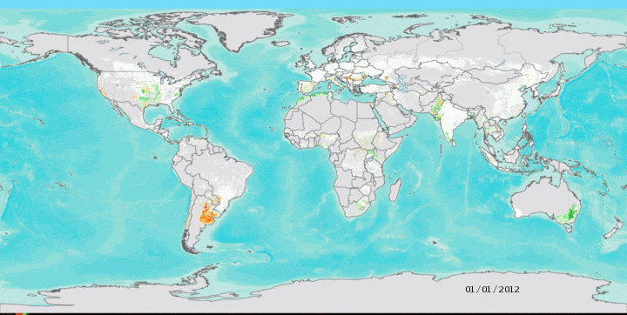

2012 Daily MODIS Crop NDVI Anomaly
January 1 through September 10th, 2012
Crop NDVI Anomaly
-0.4 0 0.4
Worse than normal
normal
Better than normal
NDVI Departure from Median (2000-2011)

Slide 24
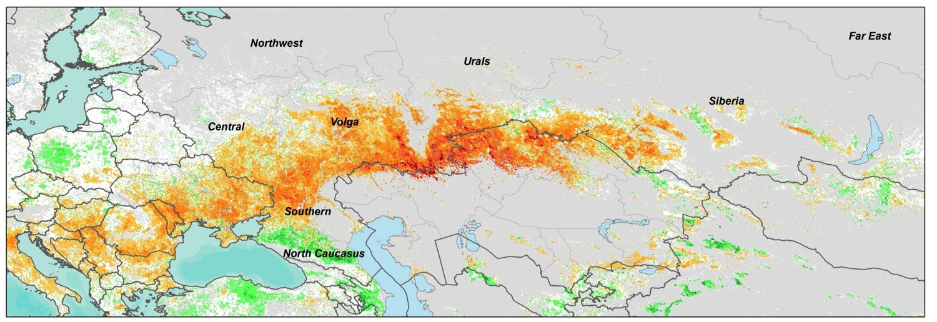
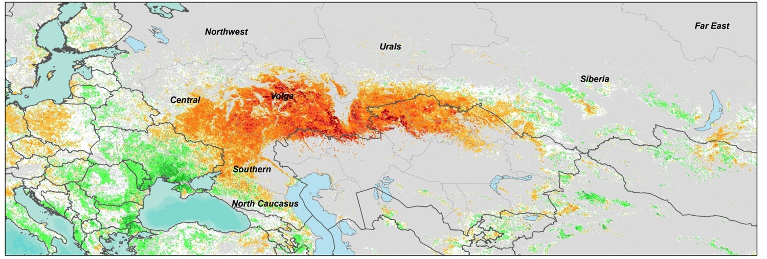
Comparing the 2012 Black Sea Region Drought to the 2010 Drought
Crop Condition July 17, 2012
Russia Production 38MT = 32%
Ukraine Production 15.5 MT = 30%
Kazakhstan Production 10.5 MT = 53%
2012 drought affecting crop production in Russia, Ukraine, Kazakhstan
Crop Condition During the 2010 Russian Drought: (July 17 2010)
Vegetation Anomaly during the 2010 Russian drought, when grain production decreased by 30% and wheat prices rose over 80% in 6 months
Notes:
RELATIONSHIP BETWEEN ndvi AND PRODUCTION

Slide 25
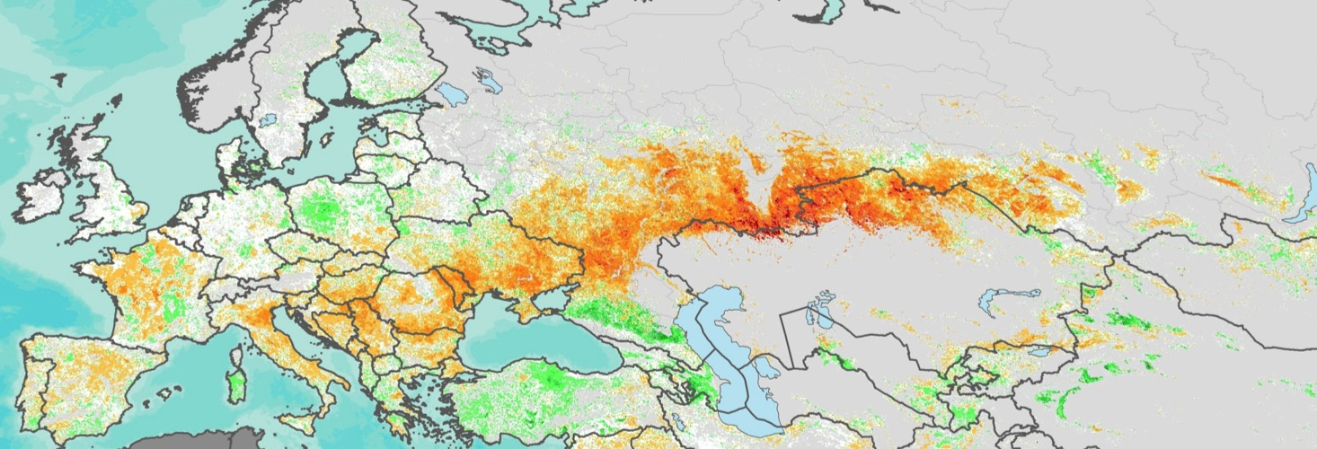
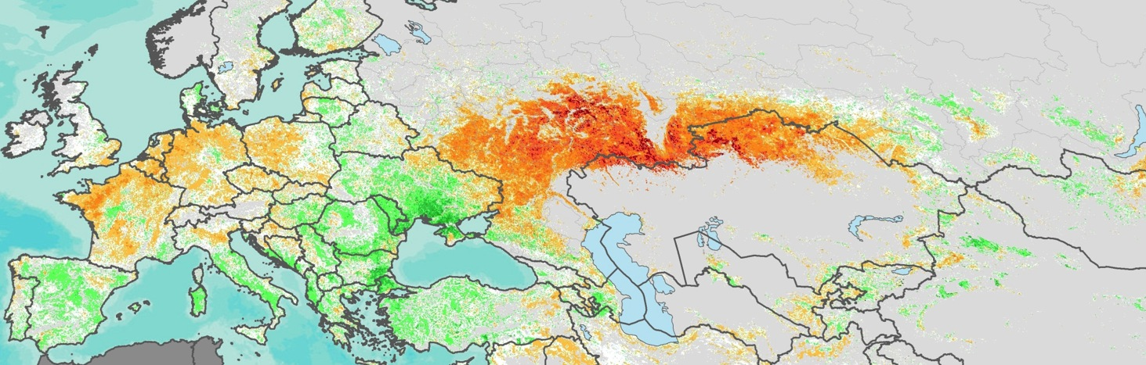
Comparing the 2012 Black Sea Region Drought to the 2010 Drought
Crop NDVI Anomaly July 17, 2012
2012 drought affecting wheat production in Russia, Ukraine, Kazakhstan
Crop NDVI Anomaly During the 2010 Russian Drought: (July 17 2010)
Vegetation Anomaly during the 2010 Russian drought, when grain production decreased by 30%

Slide 26
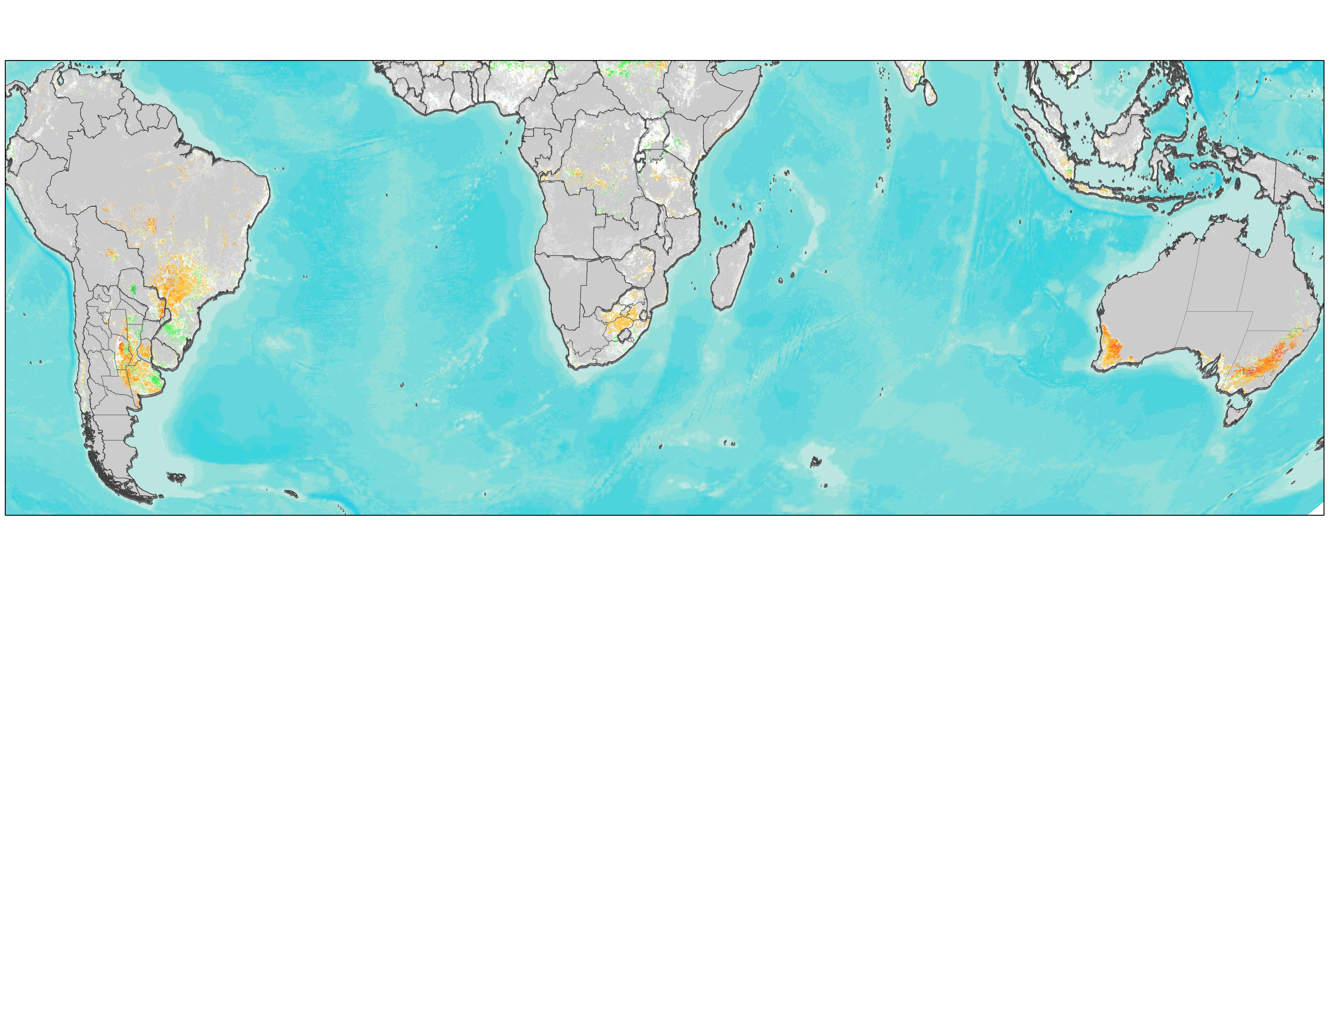

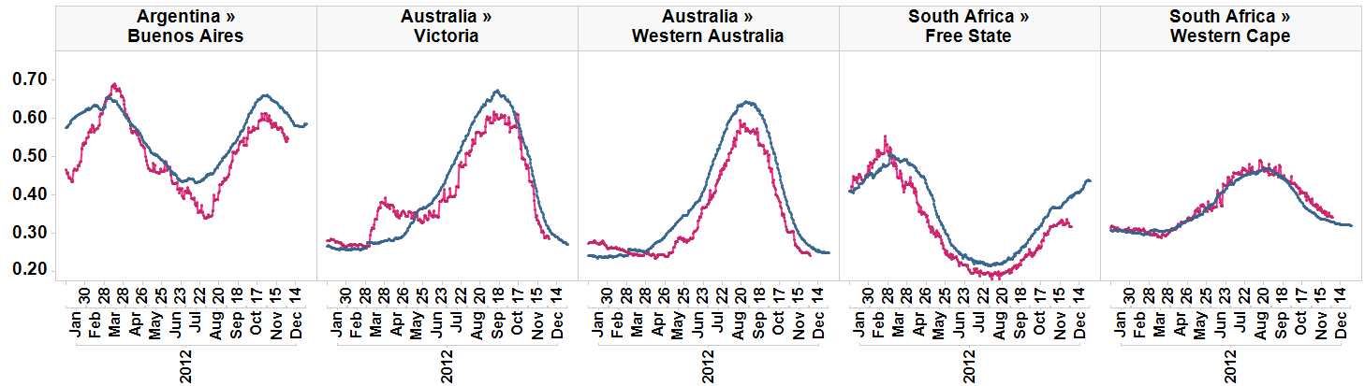
Southern Hemisphere Crop NDVI Anomaly, September 15th, 2012
Brazil/Argentina: Wheat
Australia: Wheat
Crop NDVI Anomaly
South Africa: Wheat
Non Cropland
-0.4 0 0.4
Worse than normal
normal
Better than normal
Current season crop development (2012)
Median season development (2000-2011)

Slide 27
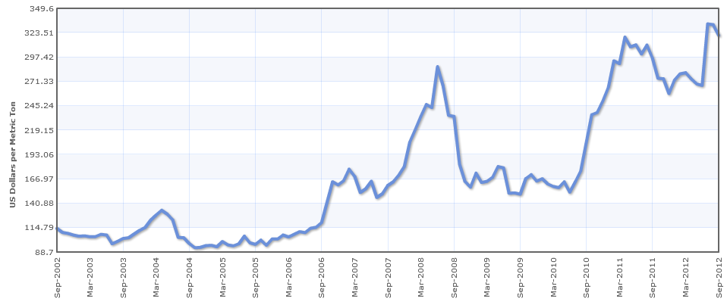
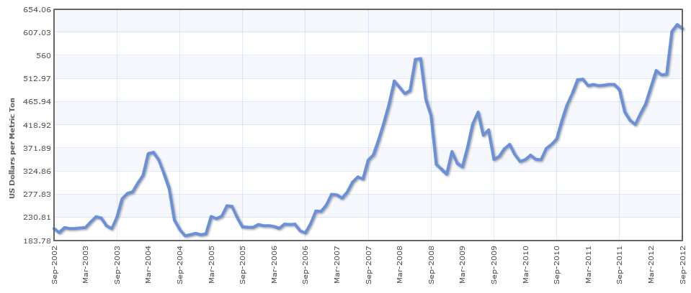
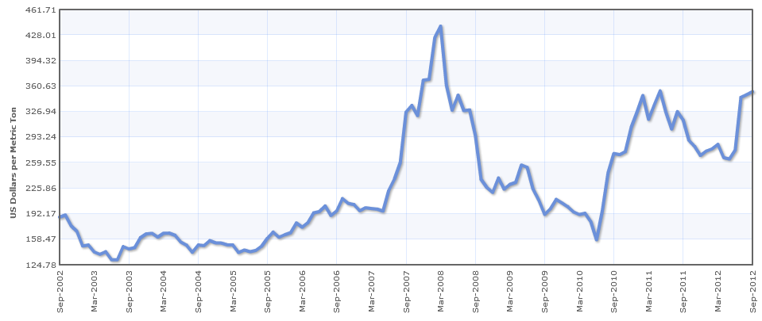
Monthly Market Prices of Corn, Soybeans and Wheat
Highlighting Current Prices
Corn Monthly Prices $/MT 2002-2012
Soybeans Monthly Price $/MT 2002-2012
Wheat Monthly Price$/MT 2002-2012

Slide 28
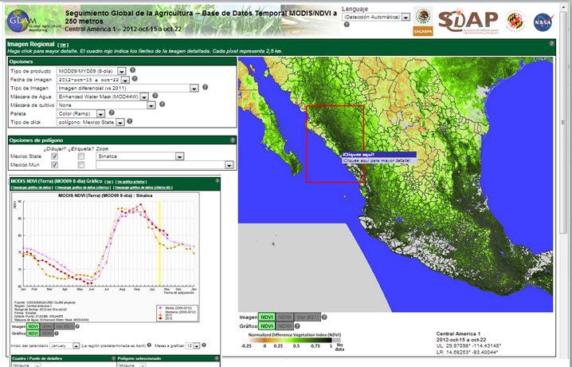
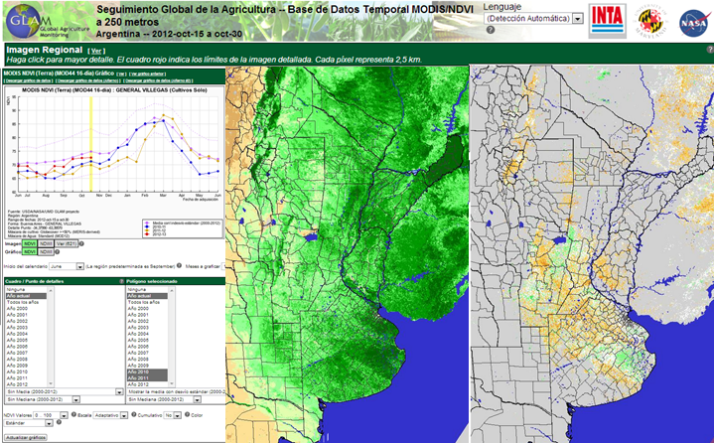
Mexico & Argentina Examples:
Developing National EO Crop Condition
Monitoring Systems

Slide 29
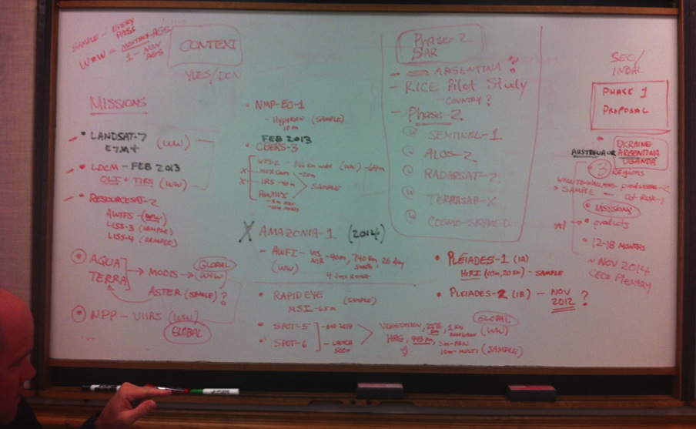
Developing a Phased Approach
CEOS-GEOGLAM meeting Langley November 2012
The proposed approach has three phases over five years, with growing capacity in:
number of countries
sensors and sensor types
processing, product creation, distribution and assimilation,
capacity building, particularly in at-risk countries for ingestion and processing of EO data

Slide 30
Proposed GEOGLAM Phased Approach
To be discussed at GEOGLAM Feb meeting
Phase 1 : Demonstration & Early Feasibility Phase (Nov2012 – Nov 2014 )
  Developing requirements approach & strategy
  Development of baseline datasets
  Focused on 5 countries (4 large producer, 1 ‘at risk’)
  Initial volumetric assessments
  Focus on available Optical and SWIR
Phase 2 : Assessment & Expansion (March 2014 – November 2015)
  Pilot global sampling strategy for the main producers
  New countries (~ 5)
  New missions (SAR & sentinels)
  Asia Rice
  Sampling strategy for at risk region- initiated
Phase 3: Pre-Operational (March 2016 - November 2017)
  Expand to all large producer countries (global producer sampling)
  3-5 At risk countries
  New missions acquired and new products
  Validation/evaluation
Phase 4: Operational (Begins Nov 2017)
  Hand-off from CEOS to GEOGLAM

Slide 31
GEOGLAM Phased Implementation Approach
Ultimately, at the end of 5 years GEOGLAM would aim to cover :
the main producer countries (producing 80% of global food) in order to generate national and global yield and area assessments for the 4 main crops
3-5 selected countries at risk (where we have in-country partners), in order to produce national level crop condition, area and yield assessments for selected crops
regions of risk – ie. the areas that FEWSNET and GIEWS focus on, in order to generate regional level assessments of condition and crop production prospects

Slide 32
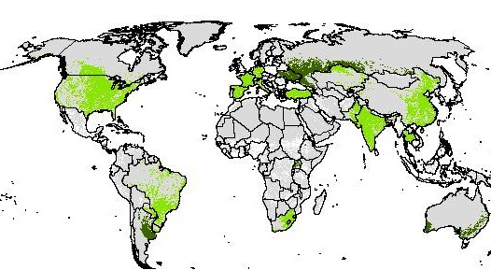
Countries responsible for 96% of total world exports of corn, soy, wheat and rice combined

Slide 33
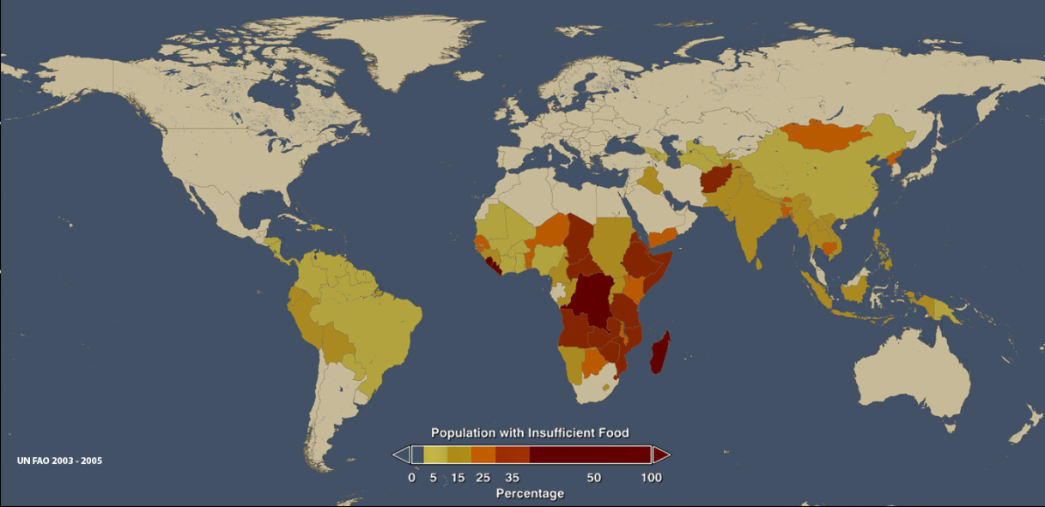
Percent of Population by Country with Insufficient Food
UN FAO 2003-2005
Primary countries at Risk – needs updating

Slide 34
Phase 1
Proposed Countries (to be confirmed in Feb Meeting):
  Ukraine, Russia, Australia, Argentina, Uganda
  Crops: maize, wheat, corn soy (producer countries)
  Focus on optical and SWIR, (SAR missions will only be used within the Asia Rice initiative)
  Develop baseline data sets (crop calendars, field size distribution, cloud probabilities, cropland maps)
  Develop relationship and strategy with country partners
  Country needs assessment
  Prototype and evaluate nested sampling frame approach
  Prototype information products (according to country priorities)
  Define criteria for success of phase 1
  Evaluation of usefulness, robustness and affordability

Slide 35

Phase 1 Proposed Countries
Phase 1 Countries | Major Crops | Area Harvested (1000 Ha) | Avg Growing Season Length | % Small Field Percent (< 1.5 ha) | % Medium Field Percent (< 1.5 - 50 ha) | %Large Field Percent (<50ha)
Argentina | soy, wheat, corn | 33,000 | 6-9 months | 4 | 55 | 41
Australia | wheat | 22,000 | 5-8 months | 2 | 38 | 60
Russian Federation | wheat, corn | 44,500 | 4-8 months | 7 | 57 | 36
Uganda | maize, millet, sorghum, cassava, beans, sweet potatoes, groundnuts | 2,500 | 8-11 months | 98 | 2 | 0
Ukraine | wheat, corn | 22,000 | 6-8 months | 6 | 60 | 35

Slide 36

Phase 1: Baseline Data Sets Status

Slide 37


WHERE?
Source: IIASA, Fritz et al. Beta Version 1

Slide 38

AT WHAT LEVEL OF DETAIL(SPATIAL RESOLUTION)?
Data Source: Fritz et al. IIASA, Ecosystems Services & Management

Slide 39

- Beta Version
- Next product will be designed early next year
Data Source: Fritz et al., based on interpolation of 50,000 GEOWIKI collected validation points
Notes:
This is a beta product still

Slide 40
WHEN?
Data source: Whitcraft (UMD) Beta Version

Slide 41
WHEN?
Data source: Whitcraft (UMD) Beta Version

Slide 42
WHEN?
Data source: Whitcraft (UMD) Beta Version

Slide 43
HOW OFTEN?

Slide 44
Note: am acquisition better for majority of croplands during the peak of the growing season

Slide 45
Data source: Whitcraft (UMD), based on MODIS Terra data from 2000-2011

Slide 46
Whitcraft

Slide 47
Whitcraft

Slide 48
Developing an EO Requirements Geodatabase
Example → 5-10 m Optical & SWIR
Peak start to Peak end
When?
Layer identifying small fields (both) & target countries (main croplands)
Frequency?
Which fields?
Repeat time required for monthly image
year round & during AGS [early, peak, late]:
All croplands
Repeat time required for
weekly image during AGS [early, peak, late]:
Main croplands
Imaging Start: 151
Imaging Peak: 220-255
Imaging End: 305
RTR, Early: 4 days
RTR, Peak: 3 days
RTR, Late : 4 days
RTR, Non-AGS: 16 days
Whitcraft
Click a point
Notes:
When → GSCs [year-round for monthly images]
Frequency was stated (weekly or monthly), need to break it down by different portions of the AGS and the rest of the year … to determine actual repeat time required
Also, incorporate a layer identifying where small fields are (for all croplands) and where the target countries are (for the weekly images)
The idea is to build a GUI to access this information, where you can click on a pixel (which represents some portion of the Earth’s surface – could be 0.5 degrees, could be 5 degrees, et.), and the timing and frequency requirements pop up.
Will probably use Eric Vermote’s 0.05 degree CMG cropland mask to mask out unnecessary areas
Will fill in the empty GSC cells (interpolation or with Sacks et al., 2010)

Slide 49
Step 2: Developing a Sampling Approach

Slide 50
Sampling Strategy
  Preference is for wall to wall coverage BUT this is not feasible for all GEOGLAM regions, with high acquisition frequency, especially given cloud cover during growing season.
  A nested stratified, multi-resolution sampling approach is an alternative which allows for more frequent acquisitions over selected sites that are statistically representative of entire area
  S1: Moderate res sample blocks
    Number of sample blocks depends primarily on variability of crop types, of crop rotations, size of region, desired standard error
    Blocks should be quite small (5-20km)
  Frequency of acquisition, will depend on the complexity of the cropping system- approximately 5 scenes per growing season; 1-2 out of season
  S2: Smaller Subset of sample blocks requested for fine res with same acquisition frequency as S1 blocks
  NASA likely to fund initial design of sampling approach

Slide 51
Sampling: Example of proposed Sampling approach to global soy Area using multi-res data
Study area, consisting of the top four soybean production countries, nearly 90% of global soybean production. Top left, United States; top right, Brazil; lower left, Argentina; lower right, China. For each country, the administrative subset shown accounts for over 95% of national soybean acreage, except for China, where the subset shown represents 88% of national soybean acreage.
Hansen et al

Slide 52
Objectives
Employ multiple resolution data: MODIS, Landsat, RapidEye and field data to estimate national-scale crop area by type
Test a generic approach to estimate cultivated soybean area in the USA, Brazil, Argentina and China, which account for almost 90% of global soybean production
Illustrate the viability of remote sensing-based global crop type area estimation using a sampling approach

Slide 53
Method
MODIS used for turn-key, generalized models to generate per nation/sub-region to indicate within growing-season soybean cultivation based on sub-pixel percent cover training data
  The models estimate percent soy-cover and enable the stratification of national-scale cropland growing regions for sampling purposes
S1- Landsat samples used to map per sample block soybean cultivated area
S2- RapidEye allows for per country/region calibration of Landsat area estimates
The Landsat sample blocks are then analyzed to quantify national-scale crop type area

Slide 54

High, medium and low soybean strata using MODIS
Red=high (>19.8%), orange=medium (7.2-19.8%), yellow=low (0.5-7.2%)

Slide 55

Landsat sample blocks (S1)
3-4 acquisitions during growing season
Red=high (>19.8%), orange=medium (7.2-19.8%), yellow=low (0.5-7.2%)

Slide 56

RapidEye sample blocks- S2
Red=high (>19.8%), orange=medium (7.2-19.8%), yellow=low (0.5-7.2%)

Slide 57

SW Minnesota Landsat 5-4-3
24km x 20km, centered on 95 35 24W, 44 19 38N

Slide 58

SW Minnesota RapidEye 4-5-3

Slide 59


Slide 60


Slide 61


Slide 62


Slide 63


Slide 64


Slide 65

RapidEye – 140 acres, Landsat 126 acres

Slide 66
Calibration of Landsat with Rapid Eye
Rapid Eye vs. Landsat Area estimates per Block
Preliminary Results
Comparison of Area Estimates using Landsat sample blocks vs. wall to wall Landsat based estimate
Hansen et al

Slide 67

Argentina strata
• Preliminary result: 160,030 km2 with a standard error of 10,600 km2
Red=high (>19.8%), orange=medium (7.2-19.8%), yellow=low (0.5-7.2%)
Hansen et al

Slide 68



Argentina field data collection over selected sample blocks (Feb 2012)

Slide 69
Summary
  GEOGLAM has substantive and complex observation data needs (what, where and when) which underpin its implementation – no one satellite system can meet the data needs – international cooperation is needed
Approach: work in close partnership with CEOS Ad hoc committee and commercial data providers to establish and implement data acquisition with a phased approach
GEOGLAM requests:
  limited support from SDGC within the next year for implementation of of phase 1, with an understanding that increased support will be needed in 2014
  Feedback on proposed phased approach
  Feedback on possible synergies between GFOI and GEOGLAM
  Commitment to support GEOGLAM to implement its proposed phased approach
  Clear steps required for GEOGLAM to become a CEOS priority initiative

Slide 70






A
Thank You!

Slide 71
Strengthening the case for EO agricultural Monitoring: A demonstration Case Study
Objective: Demonstrate the potential benefit of EO-based crop forecasts for informing crop commodity markets
  Explore the potential impact of reliable, timely EO-based forecasts on reducing price volatility. Using 2010 as a demonstration case study

Slide 72

Where should attention be focused on for EO-based yield forecasting to make an impact on market Stability?
Focus on largest exporters:
Wheat Production of 7 largest exporters account for ~ 35% of total production and ~ 75% for total wheat exports
Focus on forecasting anomalous seasons (shortfalls):
Impact of a 5% increase/decrease of yield on price
(based on projections from OECD/FAO between 2011-2020)
Group 1: Share of global wheat exports
WHEAT
75%
Notes:
Organisation for Economic Co-operation and Development (OECD)

Slide 73

2010/2011 Demonstration Case Study
Focus on 2010/11: Year of major Drought in Russia resulted in 30% grain loss → 80% increase in price
Harvest
Final Estimate

Slide 74


2012
2010
As production forecast decreases price increases
Green- Production forecast
Gray- Price

Slide 75

Aggregation of Wheat Production Forecasts from Main Wheat Export Countries vs. International Market Price
2010-2012
Price ($/Ton), Production Forecasts 1,000 MT
Final Estimate
2012
2010
2011
Data source: GEOGLAM PAY database, USDA and FAO

Slide 76


Estimate monthly wheat price for 2010 based on production forecasts
Estimated Price_{t} = -0.01 * Production Forecast_{t} + 1158.39

Slide 77


Monthly Wheat Price Estimates Comparisons:
Actual, vs. Computed USDA Forecast vs. EO-integrated forecast
Can EO-based estimates potentially contribute towards reducing price volatility?

Slide 78

Can EO-based estimates potentially contribute towards reducing price volatility?
Case Study Results

Slide 79
Case Study Conclusions
Monitoring production in the 7 main wheat export countries can provide a good indicator of international wheat prices
Price volatility maybe reduced in part with timely accurate production forecasts afforded by better integration of EO-based methods into operational monitoring systems
  In the hypothetical case the 2010/2011 price volatility reduced from 22% to 9% by integrating early season EO-based production forecasts (assuming these are timely and accurate)
EO-based forecasts are likely to be of most value to operational monitoring systems, during the first estimates of the season, prior to harvest and the release of other reliable market information

