Slide 1
GEOGLAM Phase-1 Analysis by the CEOS SEO
Brian Killough CEOS SDCG-3 Meeting February 7-9, 2013 Sydney, Australia

Slide 2
Goal and Outcome
Goal: Perform a Phase-1 volumetric data analysis for GEOGLAM over 5 countries (Australia, Argentina, Russia, Ukraine, Uganda). Preliminary release at SIT-28 and final release at CEOS Plenary (late 2013).
Outcome: Refine the GEOGLAM measurement requirements and determine the required missions and instruments needed to support the phased implementation approach. Assess the yearly data volume for each region to support long-term data acquisition planning.

Slide 3
Phase-1 Regions
NOTE: Uganda is considered an “at-risk” country.

Slide 4
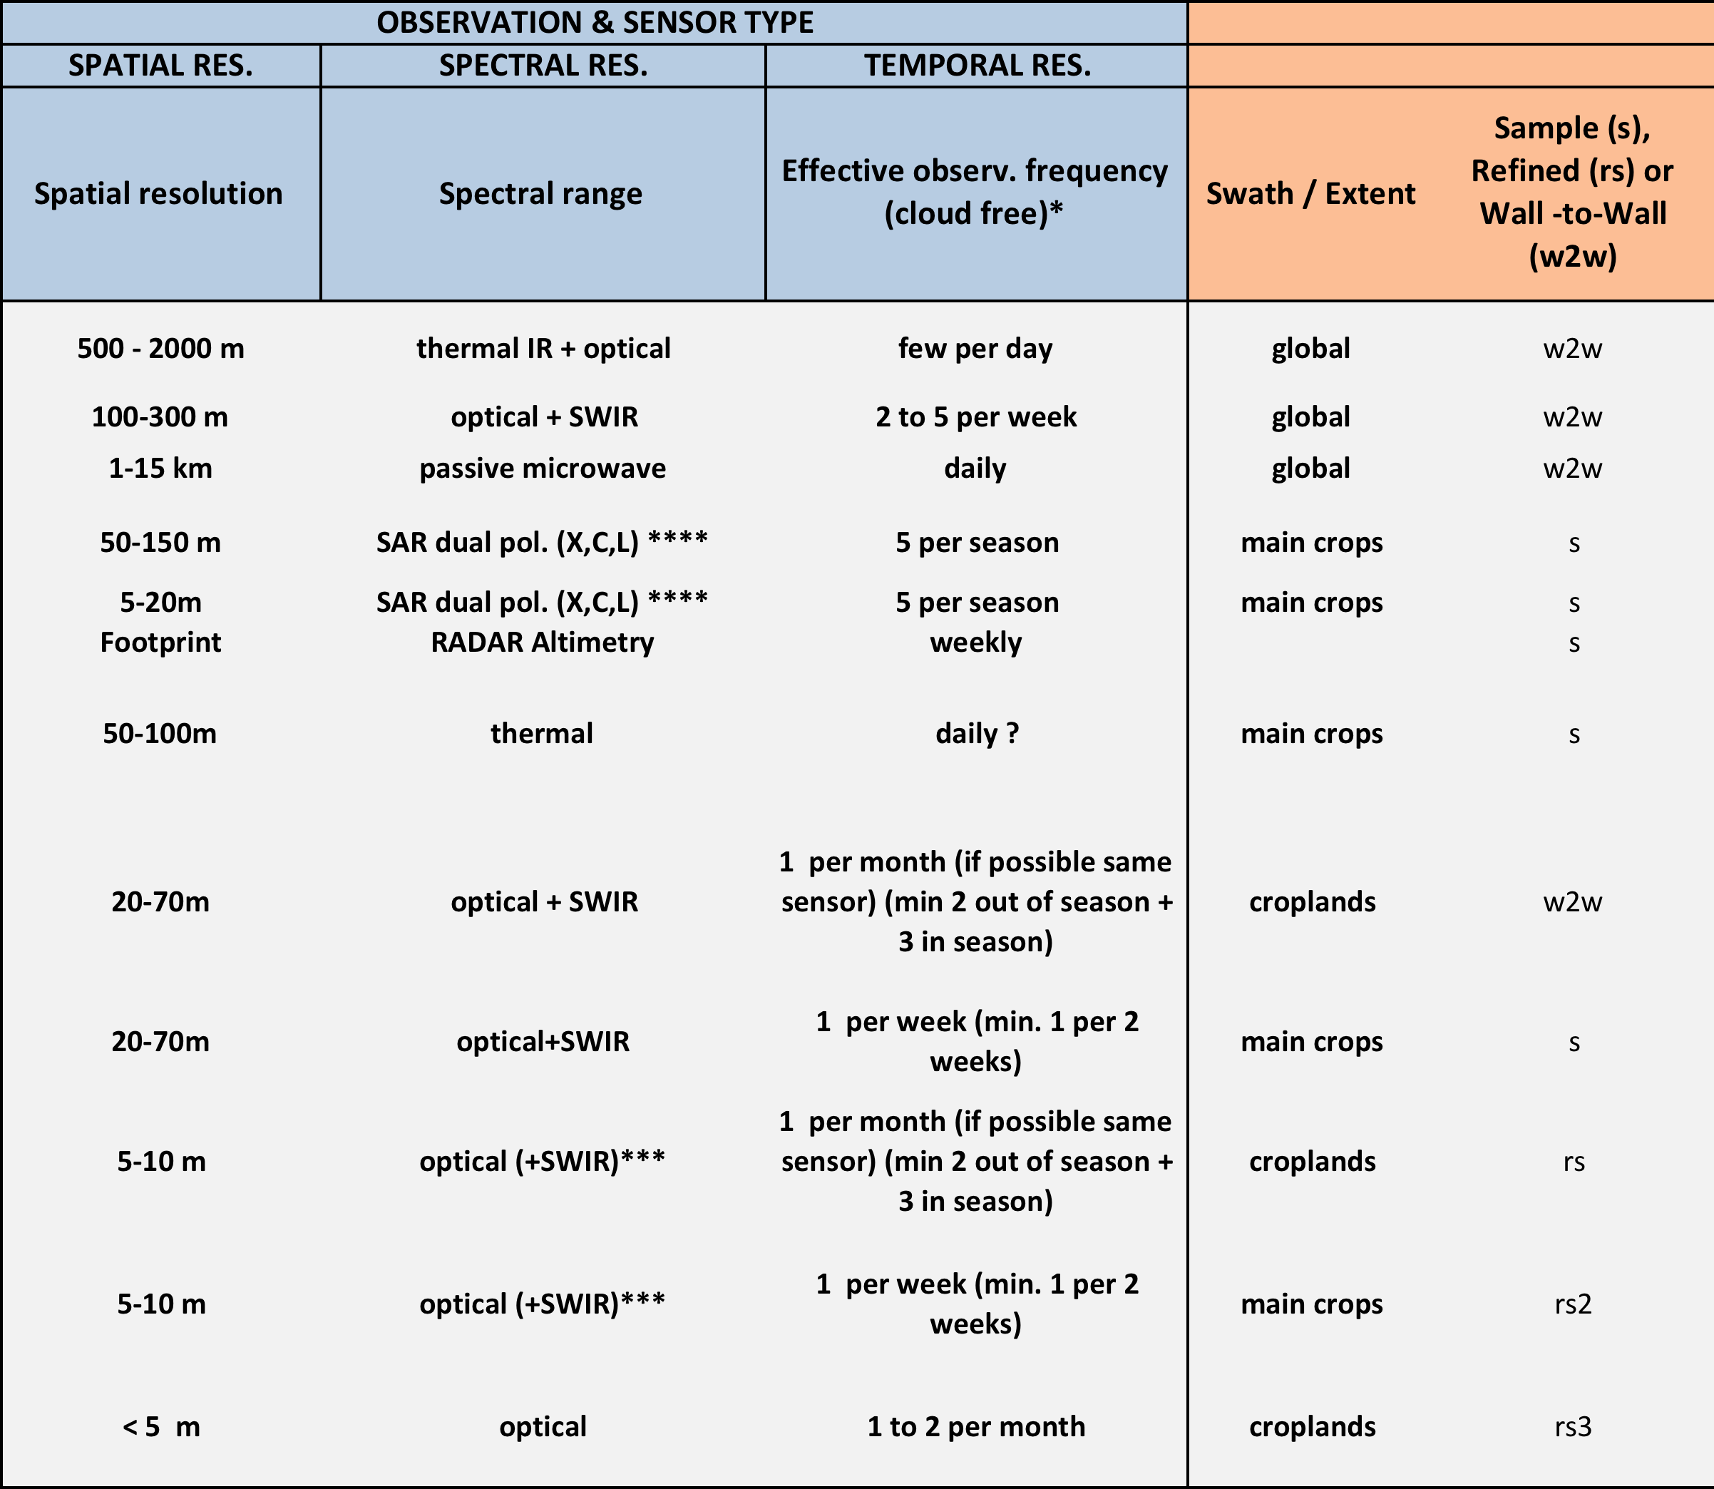
Phase-1 Requirements
Mixture of Optical (low to high resolution) and SAR.
Temporal sampling varies from daily to seasonal.
Spatial sampling varies from wall-to-wall to small-scale cropland samples.

Slide 5
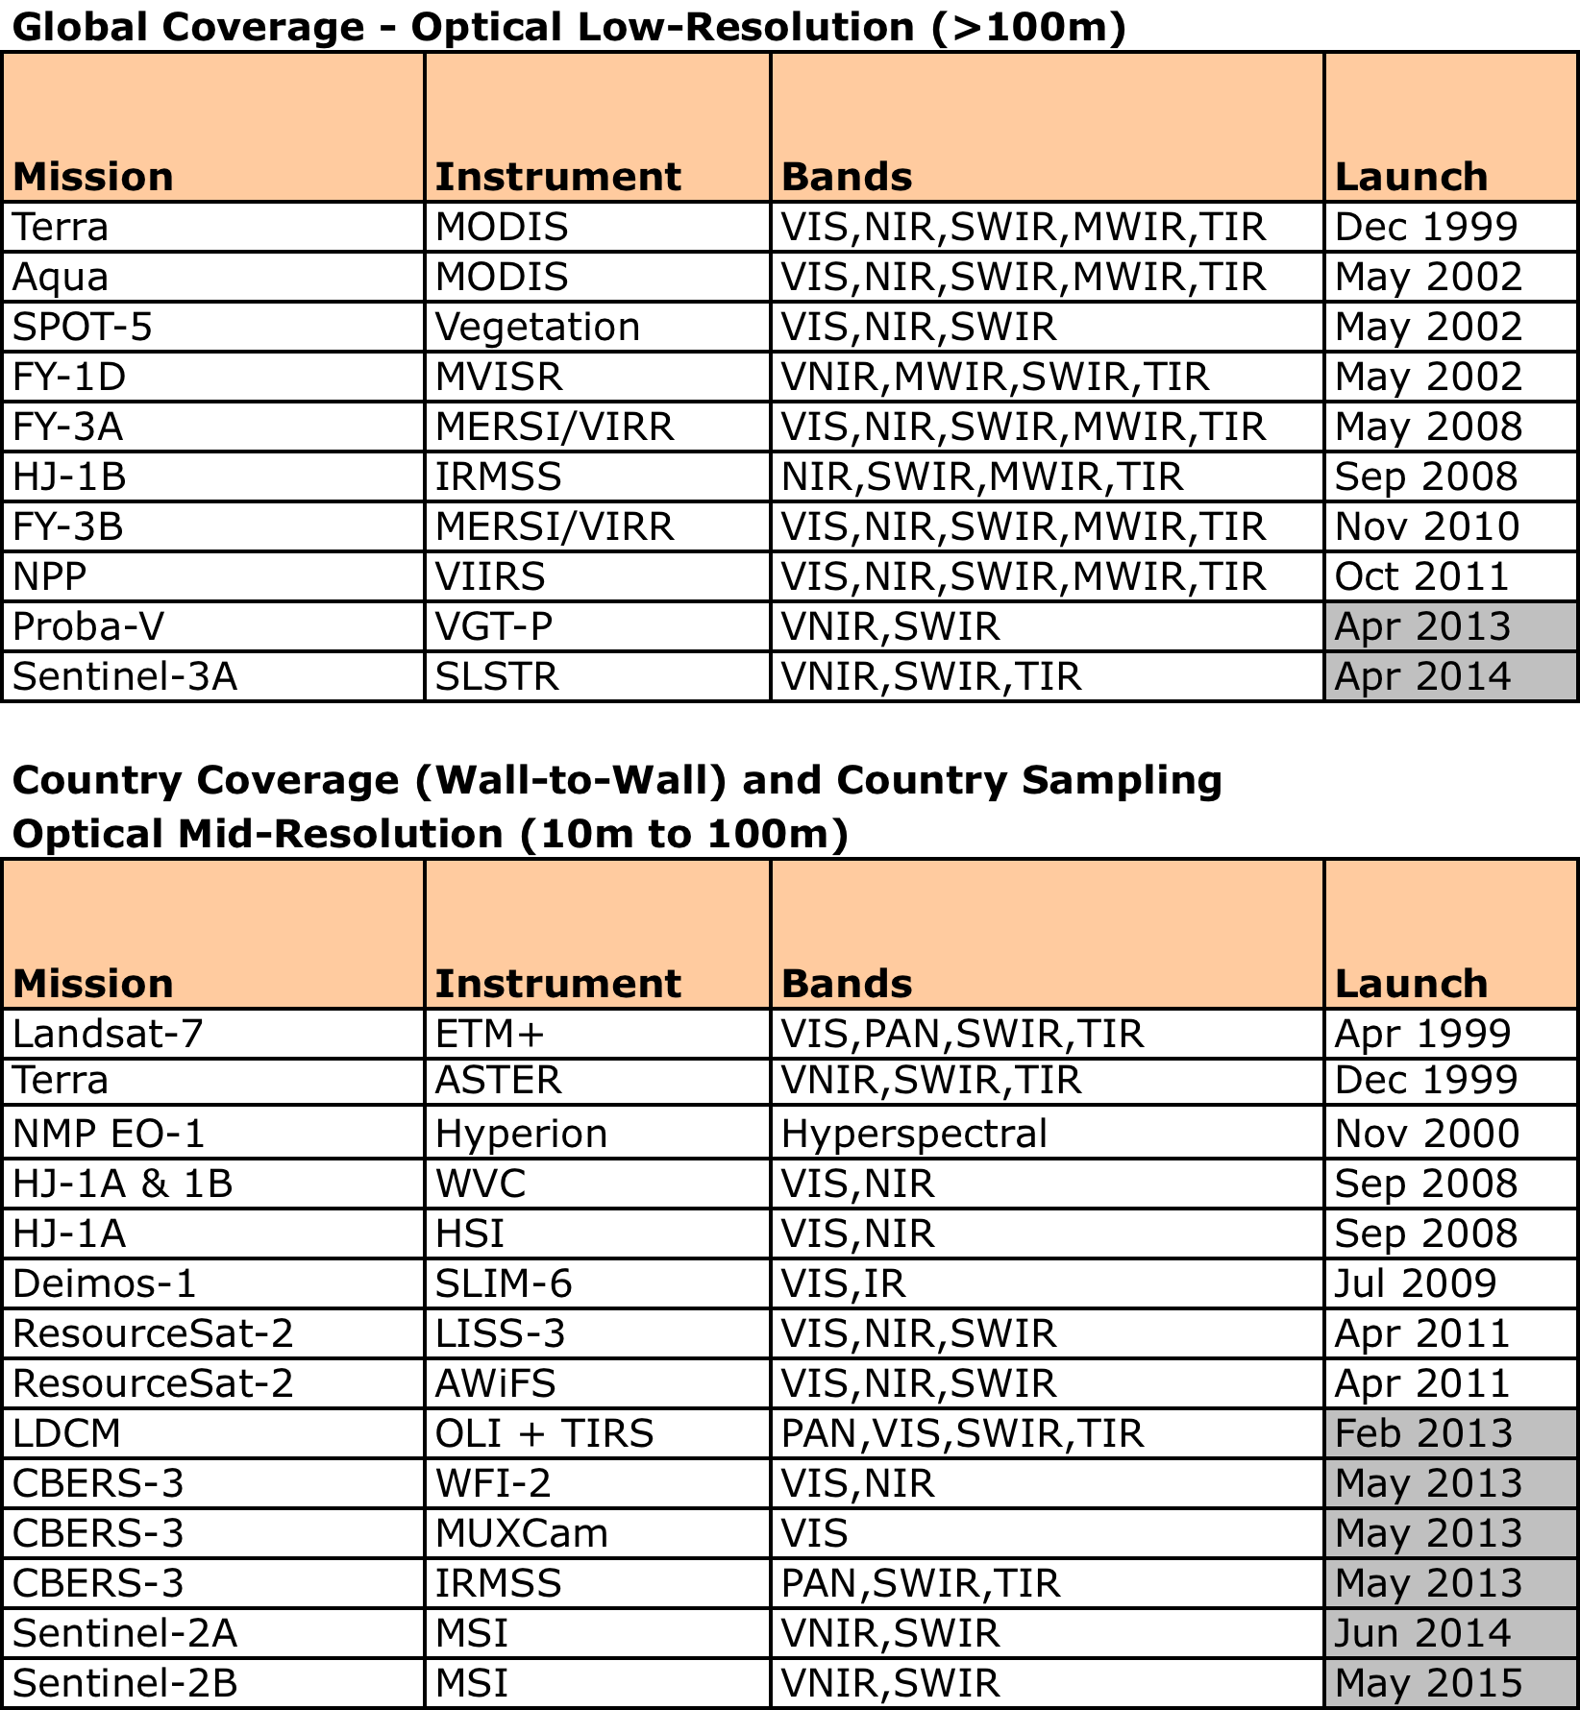
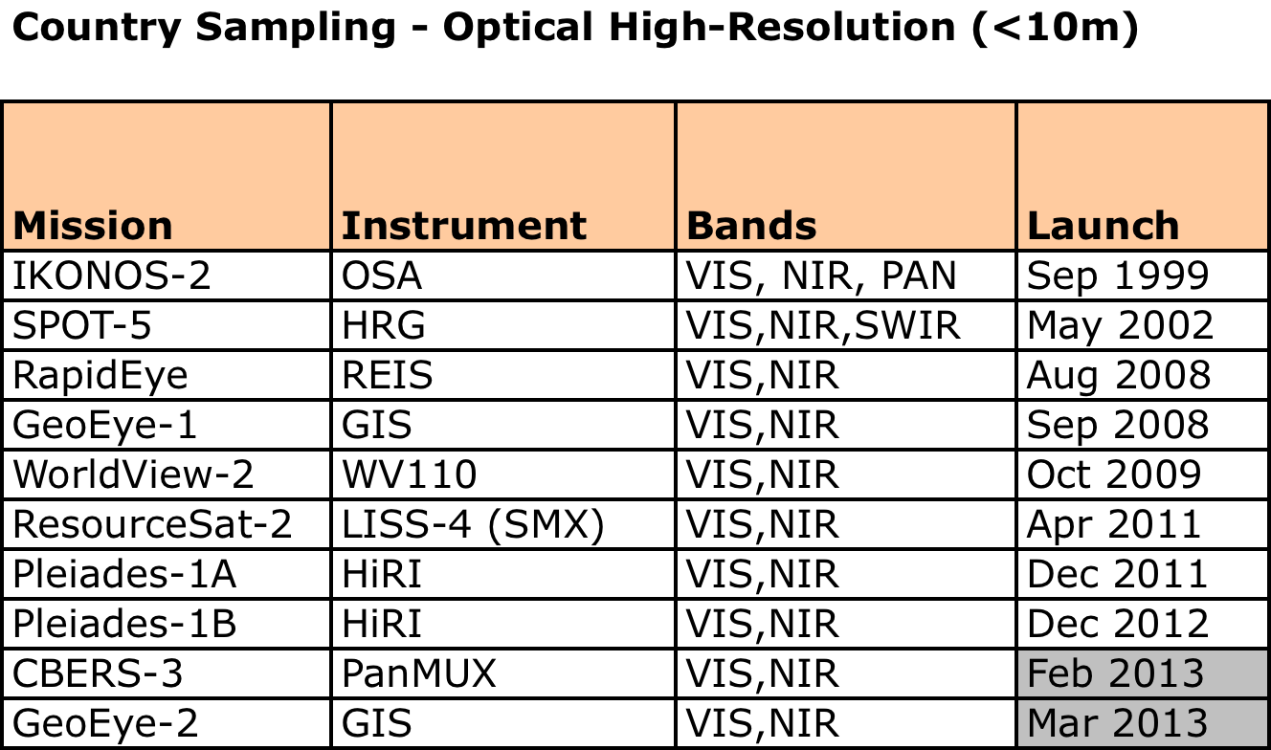
Missions and Instruments
These tables represent candidate GEOGLAM missions. The phased implementation approach will evaluate the utility and need of each dataset to develop long-term plans.

Slide 6
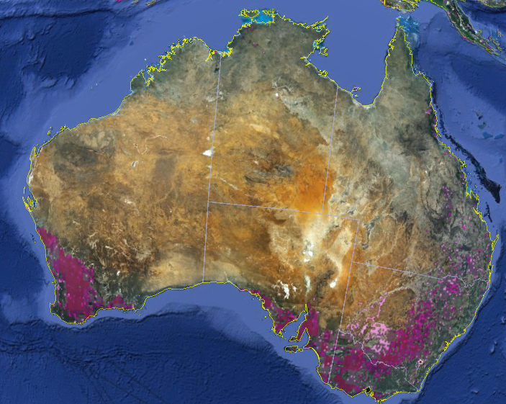
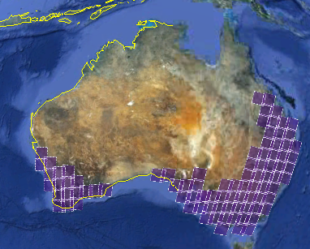
Australia
Cropland Map
Landsat scenes for region = 54

Slide 7
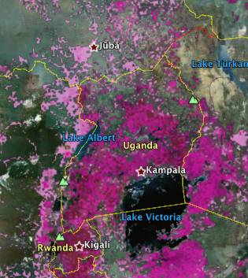
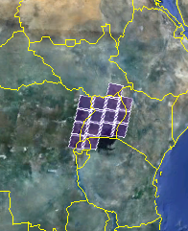
Uganda
Cropland Map
Landsat scenes for region = 15

Slide 8
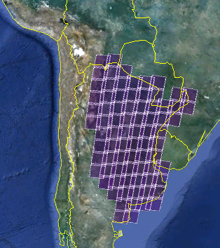
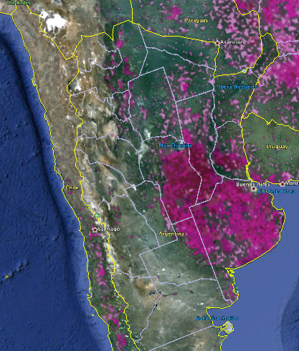
Argentina
Cropland Map
Landsat scenes for region = 78

Slide 9
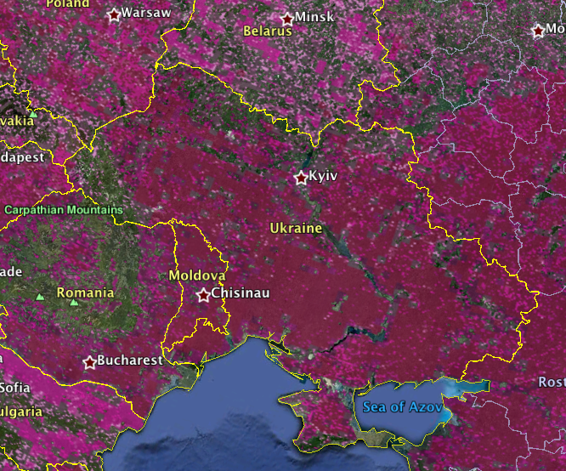
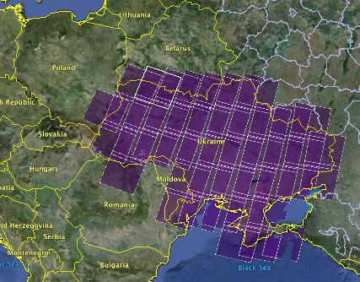
Ukraine
Cropland Map
Landsat scenes for region = 45

Slide 10
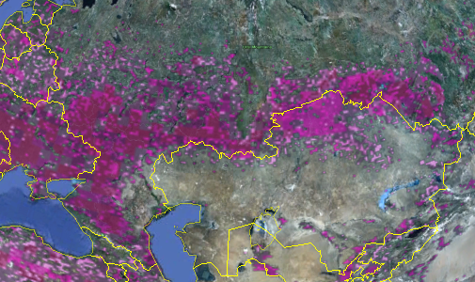
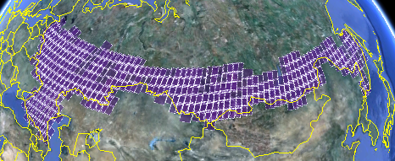
Russia
Cropland Map (top left)
Landsat WRS scenes (bottom-left)
Landsat scenes for region = 382

Slide 11
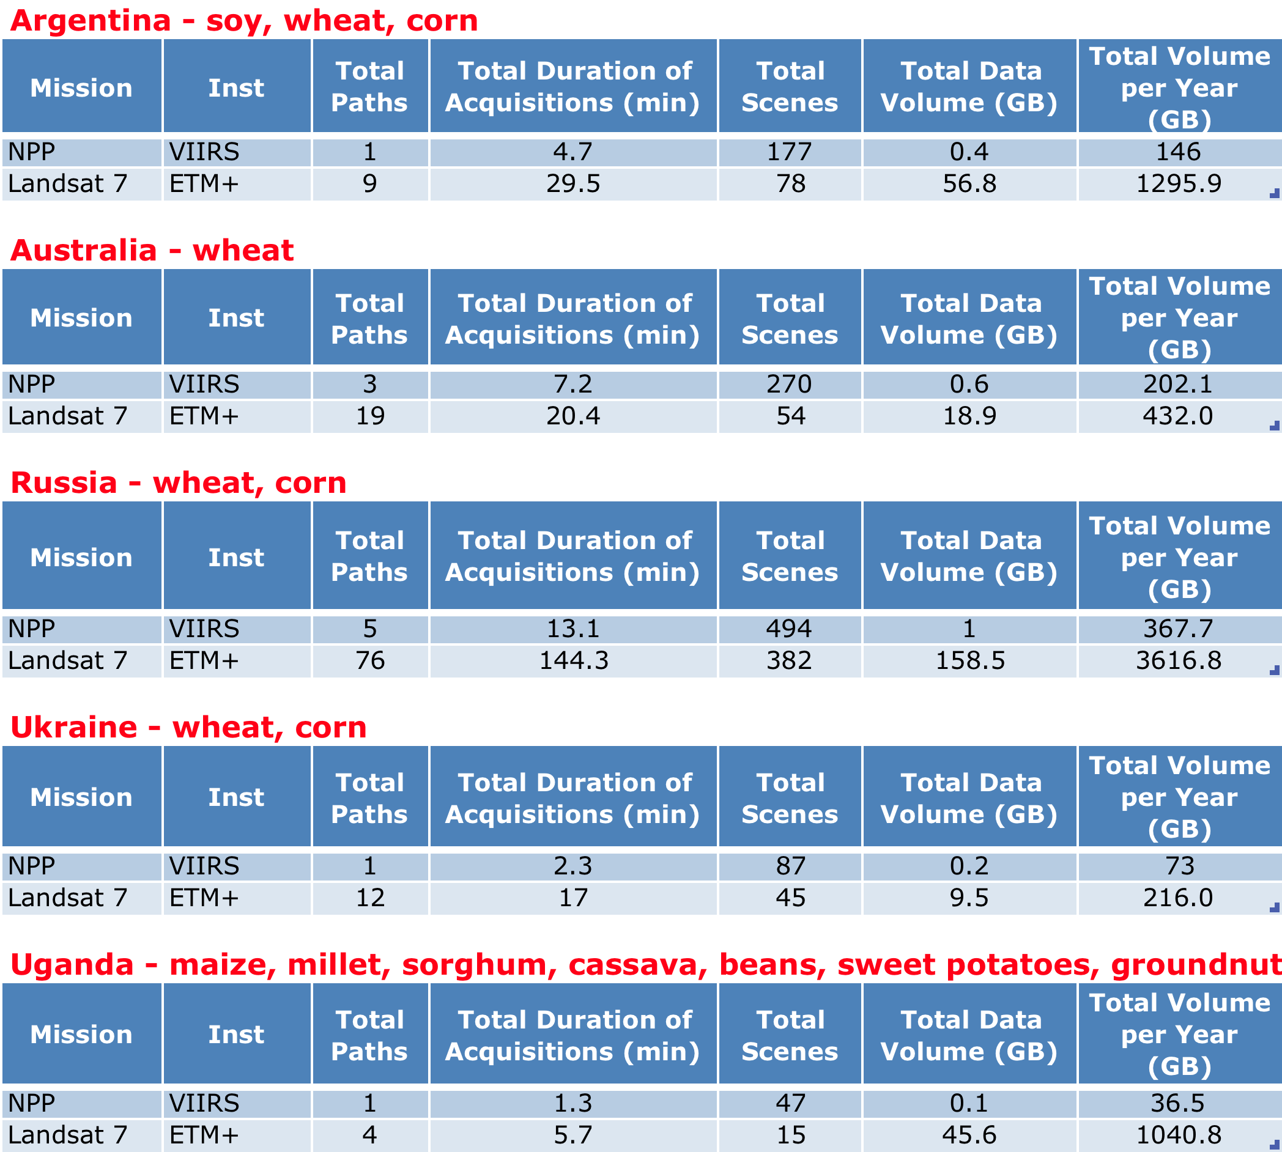
Preliminary GEOGLAM Volumetric Assessments Results
Preliminary results only assessed Landsat-7 and NPP (VIIRS). Future revisions will introduce more missions and instruments.
This analysis represents the MAXIMUM amount of data. Updates will need to consider GEOGLAM required scenes and available scenes due to clouds or other restrictions.

Slide 12
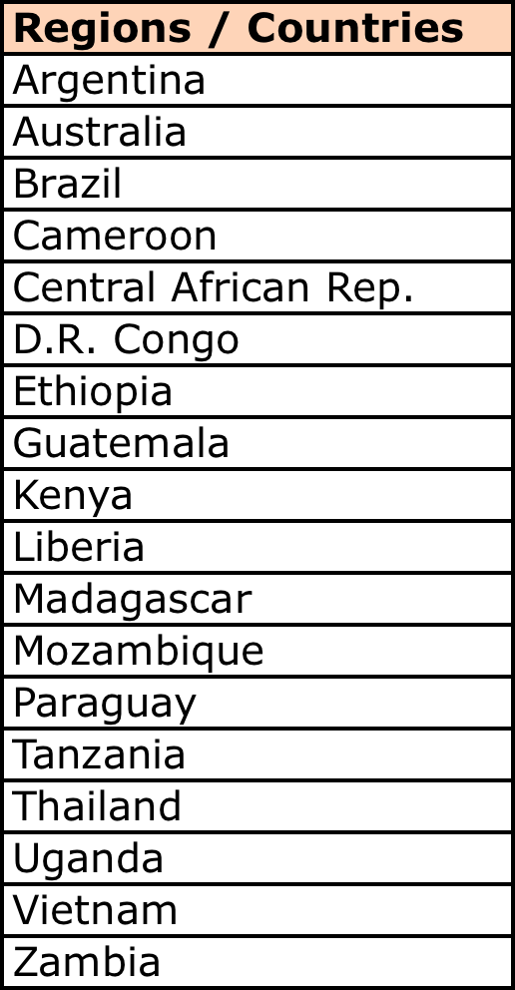
Synergies with GFOI
Forest and agriculture regions within any country are not likely the same.
Wall-to-wall optical coverage is the likely synergy for acquisitions.
GFOI country list includes FCT, REDD+ and UN-REDD = 44 total. GEOGLAM country list includes 21 “producers” and 24 “at risk” countries = 45 total.
There are 18 countries that are common between GFOI and GEOGLAM (see table). 6 of these are “producer” countries …Argentina, Australia, Brazil, Paraguay, Thailand, Vietnam.

Slide 13
Next Steps
Complete the preliminary volumetric analysis for all Phase-1 regions (5 countries) and the full set of missions/instruments.
Participate in the GEOGLAM Meeting on Feb 20-22 in Washington, DC.
Prepare a SIT-28 response for three GEOGLAM actions. Next 3 charts ….

Slide 14
SIT Action 27-11
Action: An Ad Hoc CEOS team to take responsibility for working with GEOGLAM to further develop the space-based observations component suggested by the draft Work Plan. Initial membership should include Yves Crevier, John Faundeen, Brian Killough, Prasad Thenkabail, Brad Doorn, and Stephen Ward. Due: CEOS Plenary
Proposed Response: An Ad Hoc CEOS team has been working with GEOGLAM to develop a phased implementation approach leading toward an operational GEOGLAM in ~5 years (2018). The initial 2-year concept phase (Nov 2012 to Nov 2014) is an extension of the JECAM efforts and will target 5 agriculture regions in Australia, Argentina, Russia, Ukraine and the at-risk country of Uganda. A GEOGLAM data planning meeting was held in November 2012 and a GEOGLAM strategic planning meeting was held in February 2013. This phased plan and the long-term support desired from CEOS will be presented at SIT-28.

Slide 15
SIT Action 27-12
Action: ESA will explore with SDCG the possibility of tasking/augmenting the SDCG group to undertake a preliminary global acquisition strategy in support of GEOGLAM needs. SDCG tasking would begin following approval at Plenary. Due: CEOS Plenary
Proposed Response: The Ad Hoc CEOS GEOGLAM team recognizes the important efforts of SDCG and their support to GFOI. Though the team is not ready for the full support of SDCG, it would like to continue scoping discussions with the group to learn how it is supporting GFOI and explore the potential for SDCG to similarly support GEOGLAM in the future. It is anticipated that the team will not require significant support from SDCG in 2013. The Ad Hoc CEOS GEOGLAM team would like to present a status of its accomplishments at the 2013 CEOS Plenary and discuss potential support from SDCG beyond 2013.

Slide 16
SIT Action 27-13
Action: Building upon the outcomes of the user requirements and space data coordination activities, responsible CEOS team will provide their analysis and recommendations to CEOS leadership on further steps vis-à-vis the GEOGLAM initiative – including a plan for the pre-2015 outcomes. Due: SIT-28
Proposed Response: The Ad Hoc CEOS Team for GEOGLAM will present a status of its Phasing Plan at SIT-28 leading toward an operational GEOGLAM in ~5 years (2018). Several meetings have been held to develop requirements (July 2012), develop preliminary phasing and data acquisition plans (November 2012), discuss synergies and potential support from SDCG (September 2012 and February 2013) and develop long-term implementation strategies (February 2013). The GEOGLAM phased approach includes a 2-year conceptual pilot phase (through 2014) that is focused on optical and SWIR measurements over 5 targeted regions, a preliminary phase (through 2015) that adds SAR measurements, more targeted regions, and Asian Rice products, and a critical phase (through 2017) that targets all large producing countries (~21) and 5+ at-risk countries, additional missions and products, and a sampling strategy for product validation.

