Slide 1
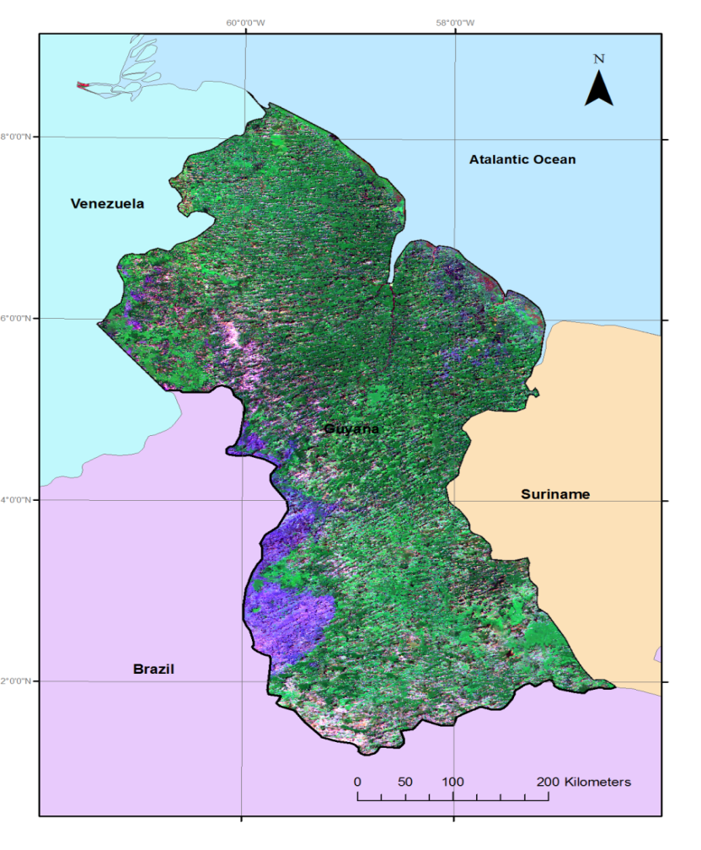
Case study; from acquisition to REDD+ -reporting
Dr Pete Watt pete.watt@indufor-ap.com
Andrew Meredith andrew.meredith@indufor-ap.com

Slide 2
Team Overview
GFC (Guyana)
Project Coordinator Pradeepa Bholanath
FRIU RS/GIS team leader Jeff Pickering (secondment from IAP)
Indufor Asia Pacific (IAP)
Project coordinator/ Technical lead Pete Watt
Remote sensing/ Development Andrew Meredith
IPCC Reporting Dr Rosa Rivas Palma
University of Durham
Accuracy assessment team leader Prof. Danny Donoghue
Winrock International
Design of the Forest Carbon Monitoring System Dr Sandra Brown
Det Norske Veritas (DNV) External project auditors
MRVS Technical Sub-Committee
EPA Responsible for the promotion, facilitation and coordination of effective environmental management and protection and the sustainable use of Guyana's natural resources
GL&SC Management of land titling and surveying of land
GGMC Management of mining and mineral resources
GFC Management of forest resources

Slide 3
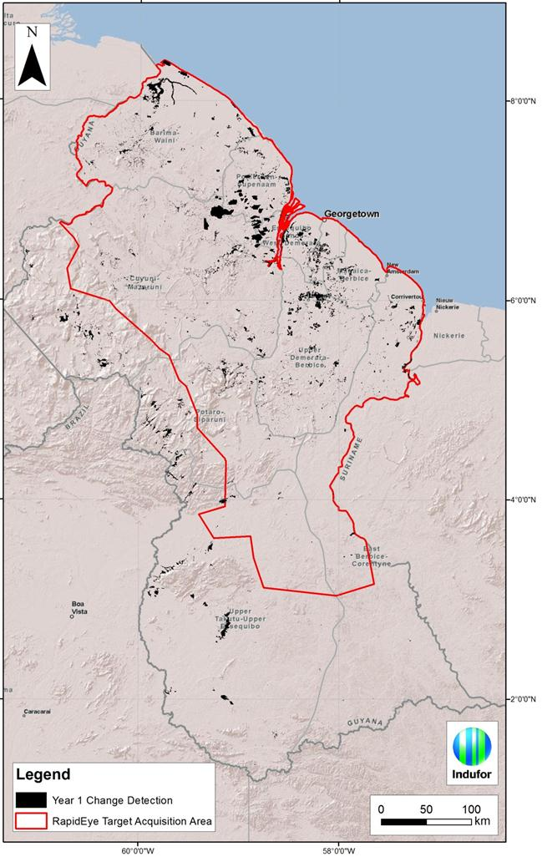
Guyana - Overview
Known
Change drivers
Small population
Largely forested (18.3 million ha)
Clear and very supportive organisational structure
Agencies proficient in GIS
Challenges
Historical time series limited & cloudy
No definitive baseline information to start with
Strict reporting timelines
Imaging period constrained
Large areas inaccessible
A need to develop routines and implement operationally

Slide 4
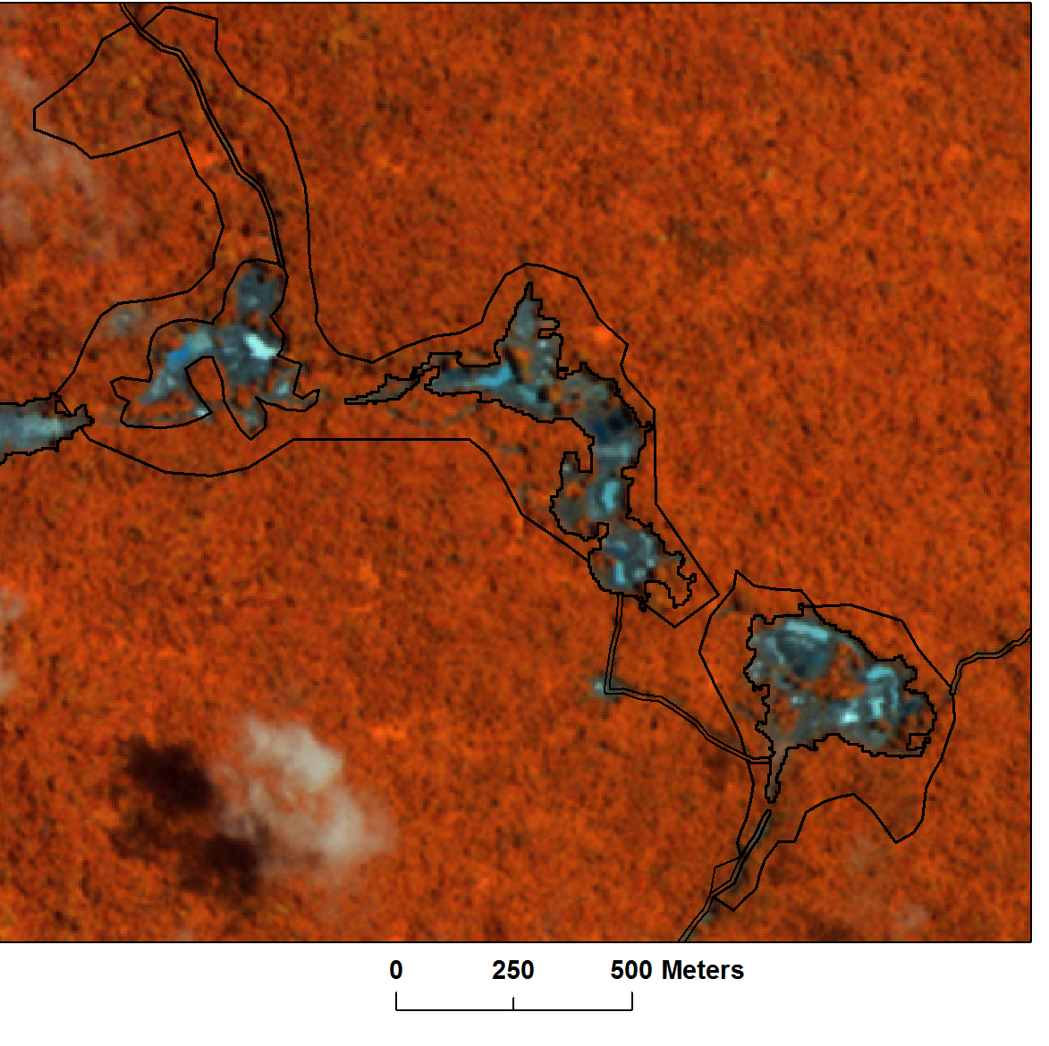
Guyana MRV Development
2011- Year 1
Determining the forested area
Setting the 1990-2009 Change baseline
Accuracy of Mapping & Change 97%
2012 – Year 2
Degradation process implemented
Batch processing of 300+ RE tiles to a change product
Accuracy of Mapping & Change 97%
2013 – Year 3
100% country coverage with RE
Integration of Shifting cultivation
Integration of Afforestation monitoring
Base mapping improvements / Automation
Tier 3 & Approach 3 run operationally in parallel to the MRV this year
Notes:
Current Reporting geared towards meeting Interim Measures team increased in Guyana to six GIS operators
The intention is that these interim measures will be phased out
as the Monitoring Reporting and Verification System (MRVS) is established
System designed to allow – spatial tracking of forest change and degradation
Flexible to process a range of imagery and take advantage of existing skill sets
It is clear that targeted acquisition of satellite data is important to ensure effective
land use change monitoring as required to adhere to best practice. If a proactive approach
is not adopted then there is a risk that a national level assessment could not be conducted
Current Reporting geared towards meeting Interim Measures
The intention is that these interim measures will be phased out
as the Monitoring Reporting and Verification System (MRVS) is established
System designed to allow – spatial tracking of forest change and degradation
Flexible to process a range of imagery and take advantage of existing skill sets
It is clear that targeted acquisition of satellite data is important to ensure effective
land use change monitoring as required to adhere to best practice. If a proactive approach
is not adopted then there is a risk that a national level assessment could not be conducted

Slide 5
Guyana’s MRVs Process
Image order
GIS datasets
Spatial data
Forest Definitions
Interim measures
& IPCC requirements
R&D
Image
processing
& Analysis
Method development
& field testing
Reporting:
Deforestation
Degradation
Afforestation
External
Accuracy
assessment
Public consultation
External Audit / verification
Guyana Report: http://www.forestry.gov.gy/news.html

Slide 6
Datasets
Applications | Satellite/Source | Spectral Bands | Spatial Res (m) | Image Extent (km) | No Scenes | Temporal Coverage | Image Coverage
Land Use & Forest Change Mapping | RapidEye | VNIR (RedEdge) | 5 | tiles or swaths | 16 Swaths (1B) | Aug - Dec 2012 | Full
 | Landsat 5 & 7 | VNIR & SWIR | 30 | 185km x 185km | 35 | Aug - Dec 2012 | Full
 | IRS | VNIR & SWIR | 23.5 | 142km x 142km | 8 | Oct-12 | Partial
 | MODIS | VNIR | 250 | ~2000 | 2 | Dec-12 | Full
 | RADAR | HH & HV |  |  |  | 2012
Verification & Accuracy Assessment | Quickbird & Worldview | MS & Pan | 0.5 - 2 |  | ~10 | Late 2012 | Partial
 | Aerial inspections |  |  |  |  |  | Sample-based
Due to cloud can’t rely on a single dataset

Slide 7
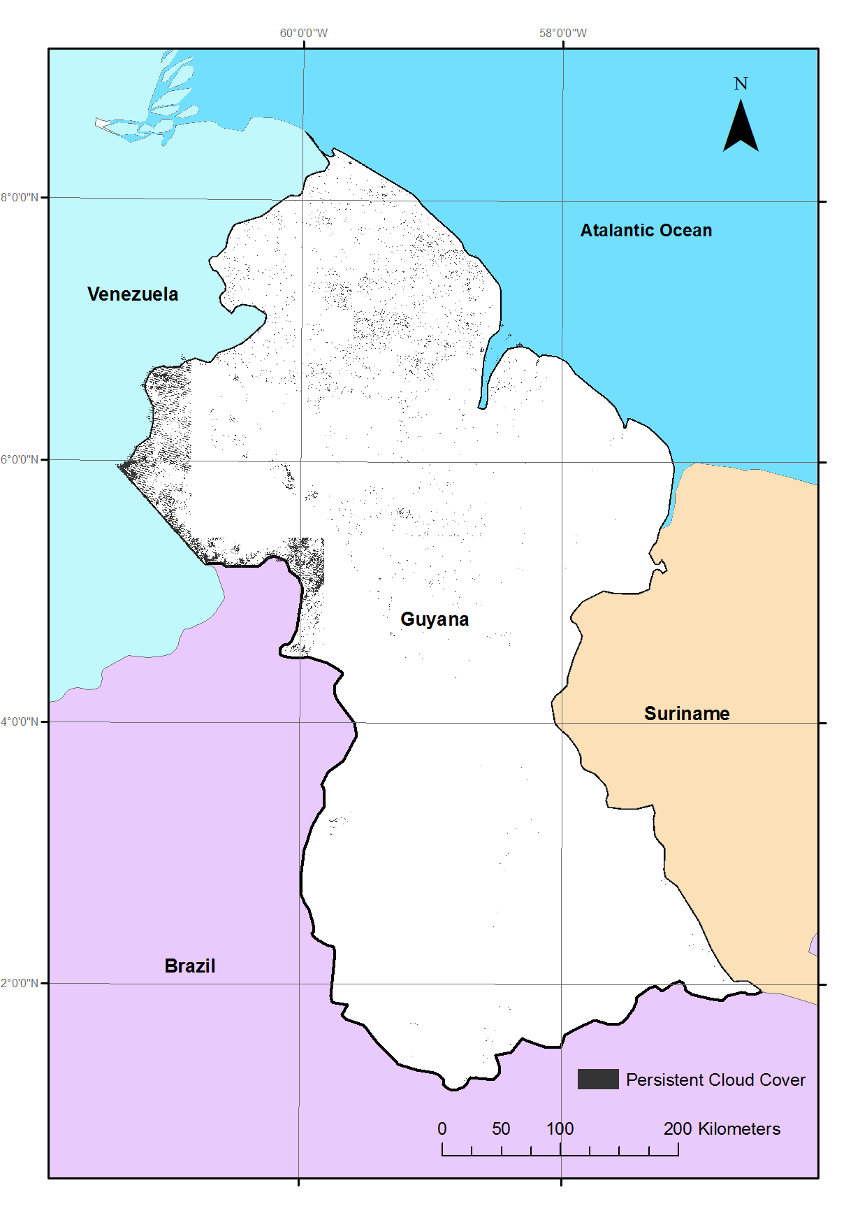
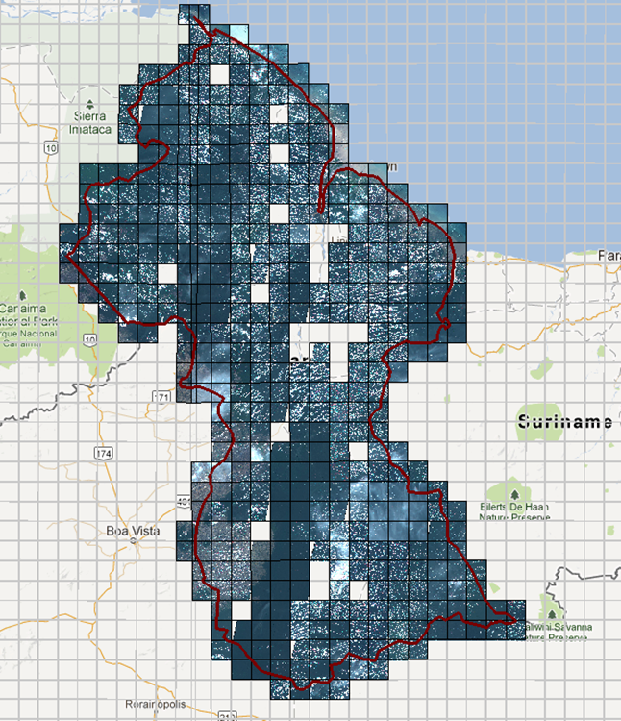
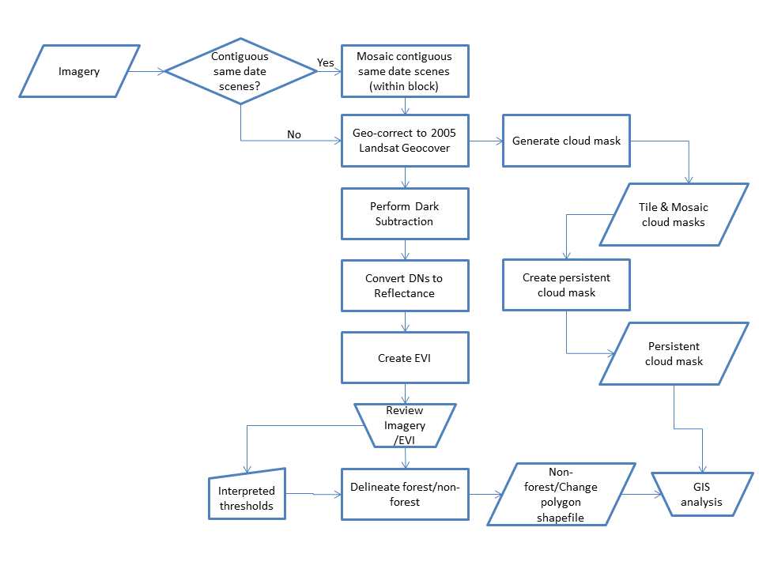
Image Process Flow
Focal point:
Design a flow that copes with Cloudy data and can be incorporated into existing GIS workflows.

Slide 8
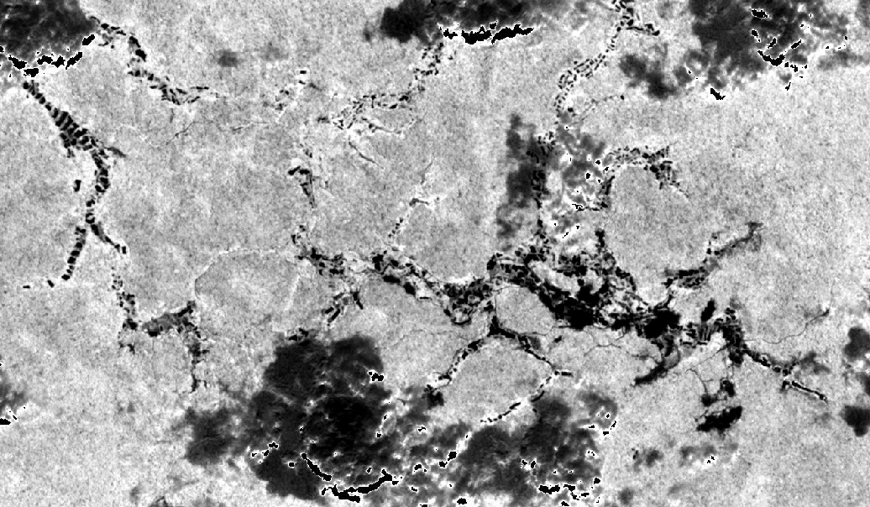
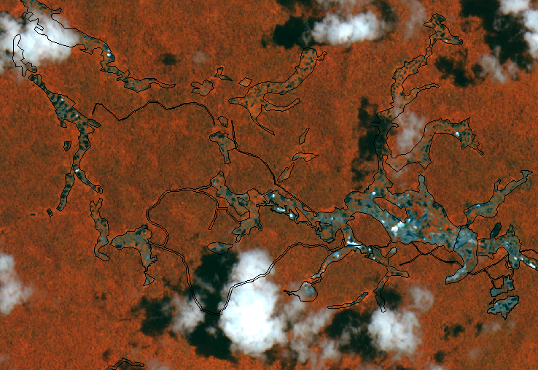
Change Detection → Integration into the GIS Mapping
EVI-based Detection | Mapped Change
Notes:
The automated change detection process produces a vector layer delineating the potential areas of non-forest. The vector layer is subsequently input into the GIS for review, editing and attribution.

Slide 9
Mapping Approach : Customised Tools Developed
Remote sensing Tools
GIS Tools
Developed based on 2 years operational research and customised to suit local working
environments.
The result means standardised outputs and processes which allow effective reporting

Slide 10
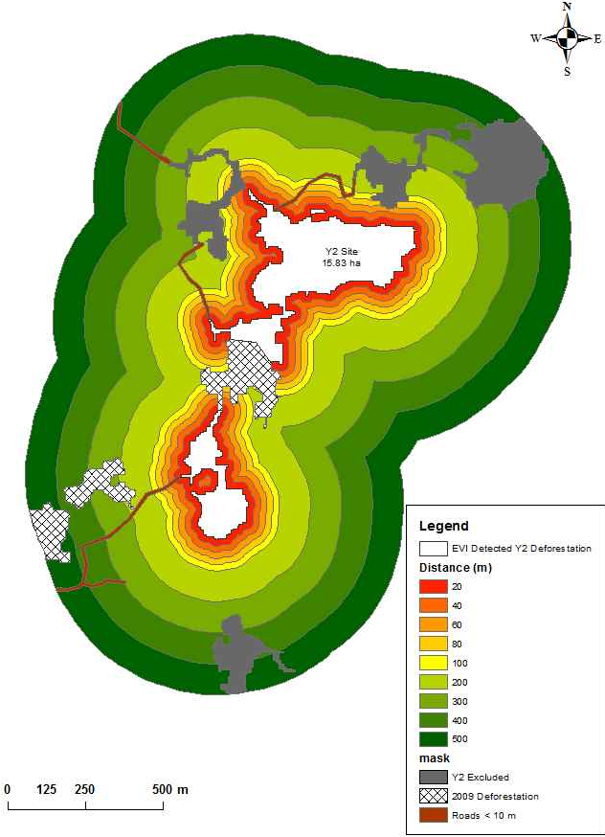
Degradation Mapping
Default position Interim measures 500 m buffer applied to deforestation events 50% of carbon stocks lost due to degradation.
The approach taken in Year 2 was to estimate the area of degradation surrounding new infrastructure with the 5 m RapidEye satellite imagery

Slide 11
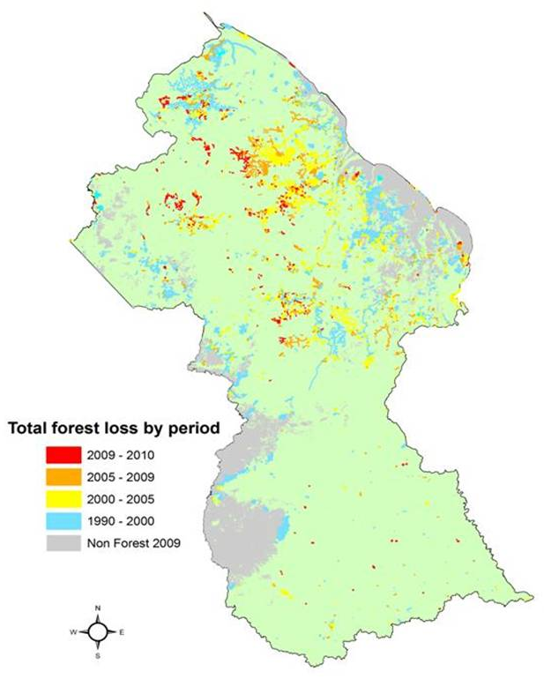
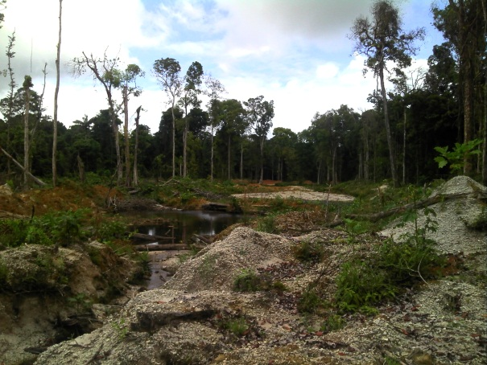
Change Rates & Trends
Forest to non-forest change 1990- end 2011
Notes:
About 10,000 ha change annually and 94% is mining

Slide 12
Where Next
Development of methods to monitor and map shifting cultivation. The focus of this will be to monitor the temporal change of shifting cultivation plots.
Spatial mapping of forest harvesting activities and potential development of linkages to log extraction information.
Development of methods to map afforestation resulting from regenerating non-forest areas. A study to evaluate the ability of multi-temporal high resolution data to detect regeneration.
Improvements in existing data layers such as the non-forest layer (naturally occurring) and historical pre-Year 2 change layers.
Development of GIS-based reporting tools to allow further automation of forest change reporting.
Integration of carbon measurements with spatial datasets to create activity-specific look-up values.
Development of the MRVS to ensure repeatability in calculations and improved documentation of datasets and processes.
Further training will also be undertaken with a full-time Remote Sensing specialist embedded in GFC’s Forest Resources Information Unit (FRIU).

Slide 13
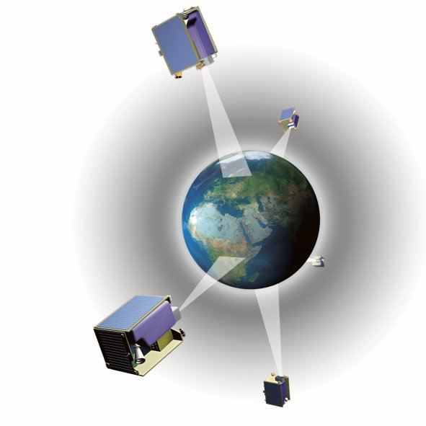
Resource Mapping & Climate Change
Indufor Asia Pacific Ltd
Auckland City
New Zealand
www.indufor-ap.com
Indufor OY
Helsinki
Finland
www.indufor.fi

