Slide 1
Guyana Path-Row 230-59 Study
From 1-Aug-2010 to 31-Dec-2010, 5 sub 50% cloud scenes from Gyuana studied
All 5 of these scenes were in Google EE
Believe that EE does not import scenes > 50% cloud scenes from Landsat archive, but still confirming

Slide 2
Path-Row 230-59 – Guyana – 47% cloud
13-Aug-2010 Browse Image (LE72300592010225ASN00)

Slide 3
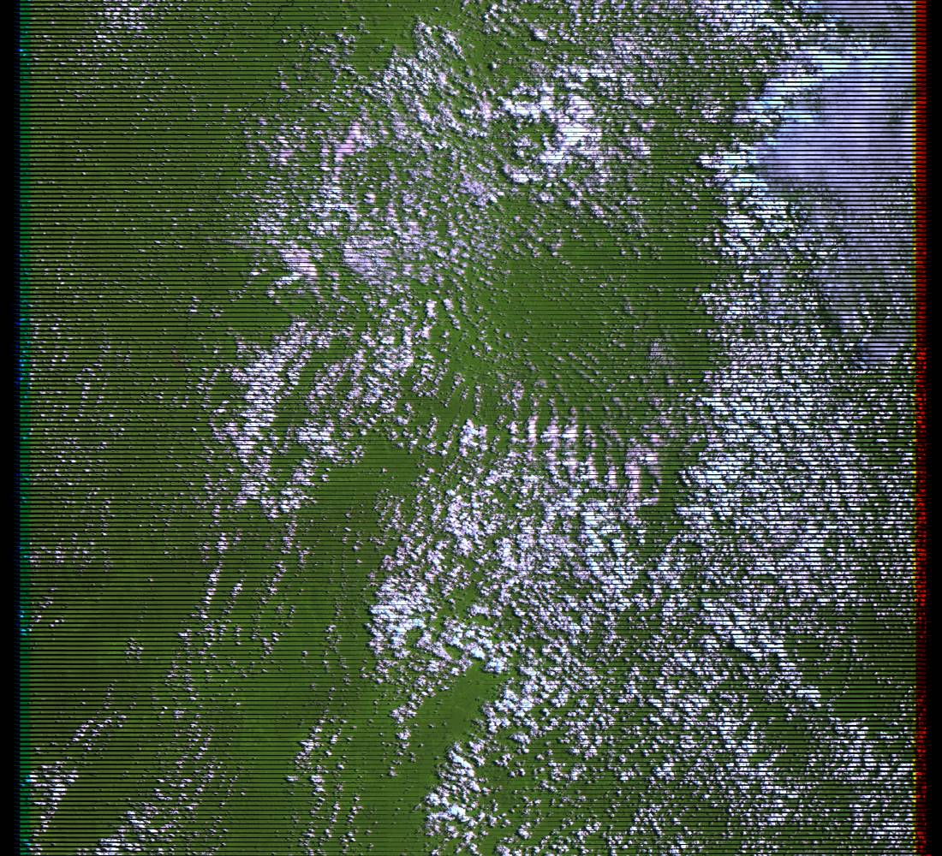
Path-Row 230-59 – Guyana – 28% cloud
29-Aug-2010 Browse Image (LE72300592010241EDC00)

Slide 4
Path-Row 230-59 – Guyana – 7% cloud
14-Sep-2010 Browse Image (LE72300592010257EDC00)

Slide 5
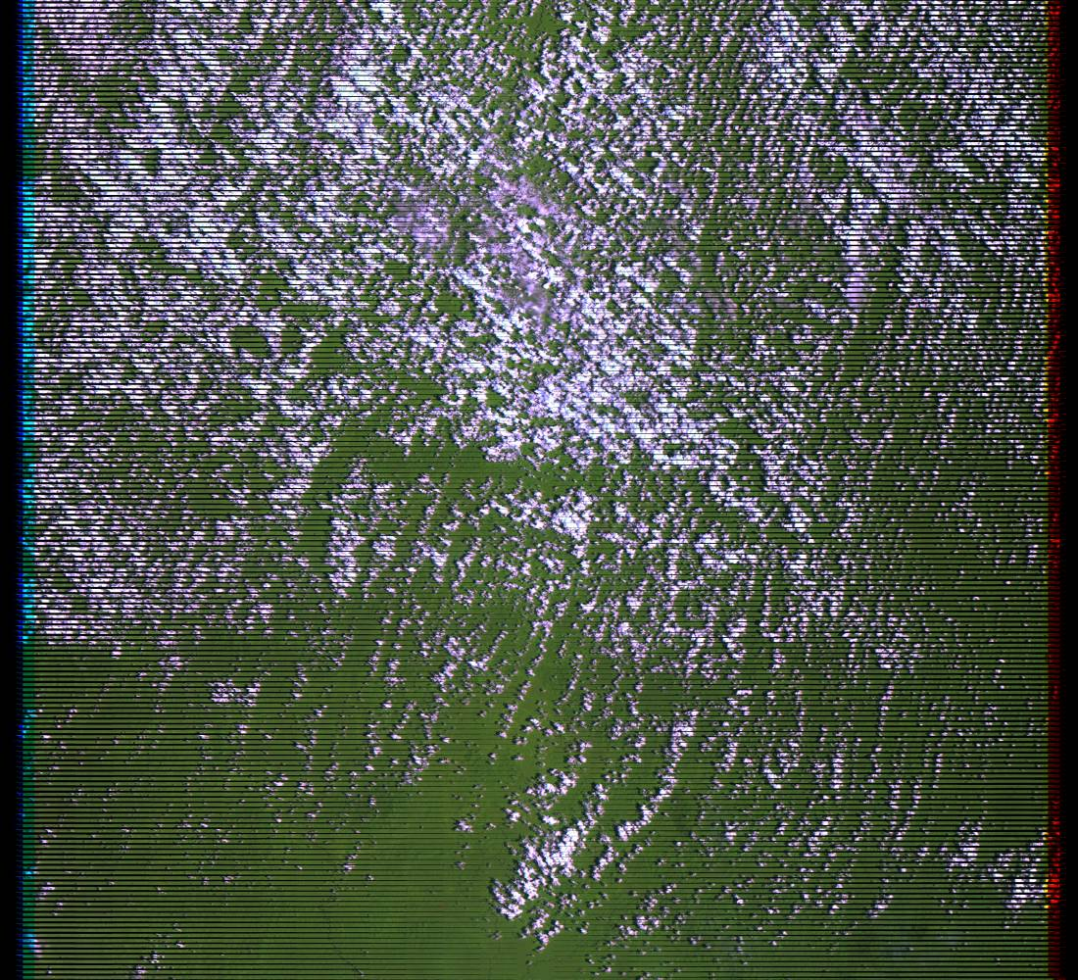
Path-Row 230-59 – Guyana – 28%
16-Oct-2010 Browse Image (LE72300592010289EDC00)

Slide 6
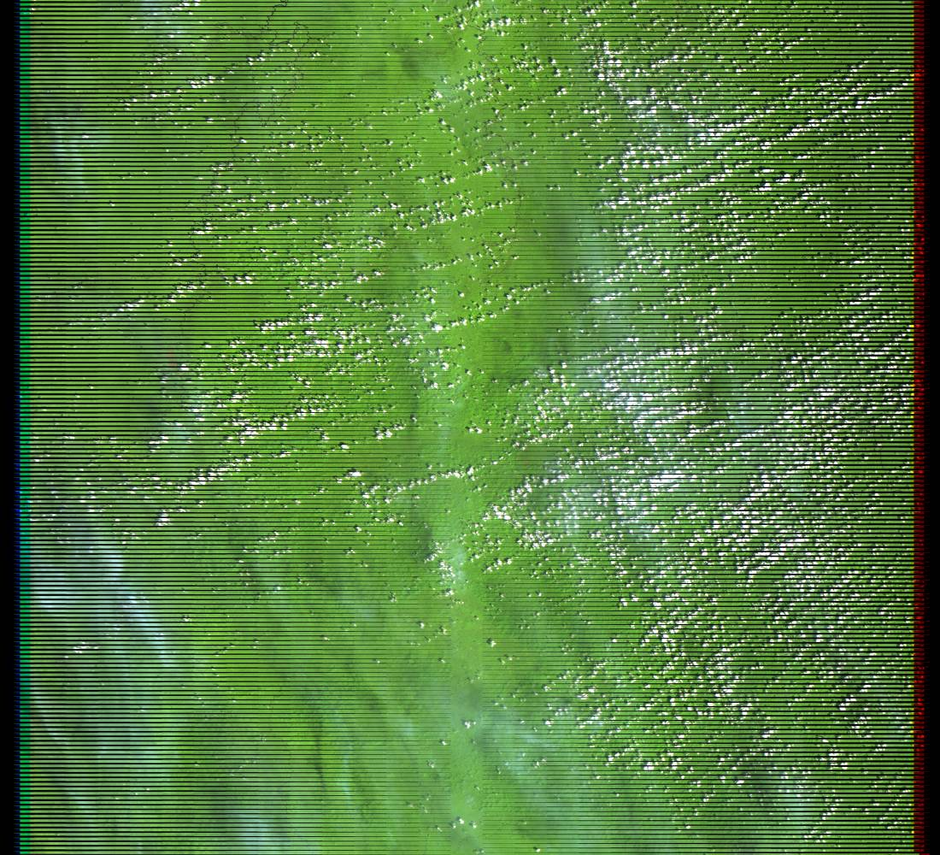
Path-Row 230-59 – Guyana – 7%
3-Dec-2010 Browse Image (LE72300592010337EDC00)

Slide 7
Google EE Mosaics
Median pixel
i.e. From the stack, pick 150: 50, 100, 150, 200, 255
Qualitatively still pretty cloud affected
Minimum pixel
i.e. From the stack, pick 50: 50, 100, 150, 200, 255
Qualitatively shows that pixels from just five scenes can improve greatly
Very simplified method – need to remove cloud shadow effects for example

Slide 8
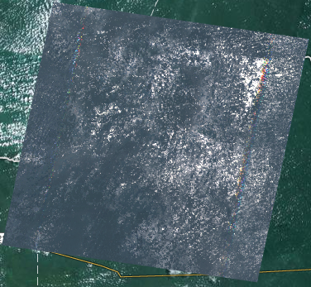
SceneID | Date | % Cloud
LE72300592010225ASN00 | 13/08/10 | 47%
LE72300592010241EDC00 | 29/08/10 | 28%
LE72300592010257EDC00 | 14/09/10 | 7%
LE72300592010289EDC00 | 16/10/10 | 28%
LE72300592010337EDC00 | 3/12/10 | 7%
Path-Row 230-59 – Guyana – Google EE Median Pixel Mosaic
1-Aug-2010 – 31-Dec-2010 (5 sub-50% cloud scenes)

Slide 9
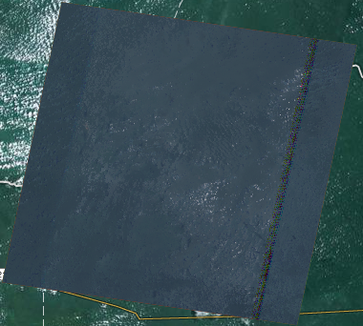
SceneID | Date | % Cloud
LE72300592010225ASN00 | 13/08/10 | 47%
LE72300592010241EDC00 | 29/08/10 | 28%
LE72300592010257EDC00 | 14/09/10 | 7%
LE72300592010289EDC00 | 16/10/10 | 28%
LE72300592010337EDC00 | 3/12/10 | 7%
Path-Row 230-59 – Guyana – Google EE Minimum Pixel Mosaic
1-Aug-2010 – 31-Dec-2010 (5 sub-50% cloud scenes)

Slide 10
Partially Complete
Perform some basic quantitative analysis of the improvement
“Count the white pixels”
Better understand of variability over arbitrary time windows
Taking seasonality into account
Build up to scale the application
For example, automatically assess cloud-free pixels over a whole country based on KML geometry
Assessment of LS and input to Element 2 process

Slide 11
Partially Complete
Use LS-5 + LS-7 to get a combined assessment
Work with EE to have them ingest >50% cloudy scenes for a small study area to see the ROI for adding these >50% scenes
More …

