Slide 1
Element 2 of the CEOS Data Strategy for GFOI What is it?
SDCG-3, Sydney
7th – 9th February 2013
Stephen Ward
for DCCEE

Slide 2
CEOS Data Strategy for GFOI
Element 1: A baseline, coordinated global data acquisition strategy involving a number of ‘core data streams’ that can be used free-of-charge for GFOI purposes. This will involve systematic and sustained wall-to-wall acquisitions of forested areas globally
Element 2: A coordinated strategy for national data acquisitions
Element 3: Data supply in support of the FCT activities, including in support of: the science studies assisting the development and evolution of the GEO-branded methods and protocol documents for GFOI

Slide 3
Element 2
A coordinated strategy for national data acquisitions in response to national needs assessments undertaken in the course of GFOI implementation, commencing in late 2011, and input to the GFOI Linkages Forum in 2012. This will accommodate countries that have specific technical requirements, or heritage and experience on working with a particular data source or type, as well as the numerous intergovernmental arrangements that may exist or emerge for the supply of certain data to one or more countries. This will involve a wider range of satellite data sources, including data that is ordinarily provided on a commercial basis.

Slide 4
Element 2
Global baseline is a statement of capability
Element 2 requires national needs of individual governments to be explored and coverage to be guaranteed in detail
Take account of readiness and existing activities – strategy may be modified if readiness not confirmed
Engagement of relevant institutions in-country
Establish supply channels and arrangements
Practical data coverage strategy and detailed plan for the immediate year ahead
Identify role for non-core data streams, engage suppliers

Slide 5
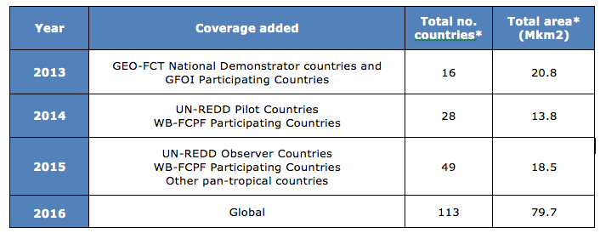
Phasing

Slide 6
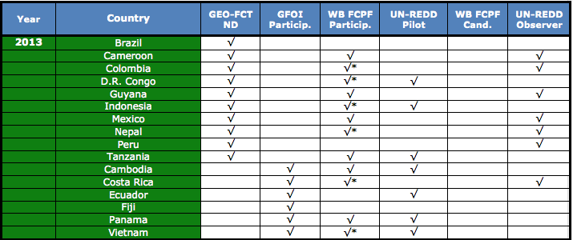
Element 2

Slide 7
Element 2
Easy: Brazil, Indonesia, Guyana, Mexico, Tanzania ?
Harder: 11 other countries
2014 sees 28 more countries covered under Element 1
Element 2 cannot match the phasing of Element 1
So what is the phasing and how does it match the ambitions for GFOI growth?
How does GFOI become part of the larger FCPF and REDD+ machinery of in-country activities to reduce the interface burden and avoid repeating engagement overhead? (Steering Committee & PO assistance?)

Slide 8
Element 2
Detailed coverage guarantee detail is Element 2?
Service elements
Pixel mining service
Acquisition monitoring and adaptation service (Element 1?)
Requirements process
Efficient to use in-country experience of FCPF and REDD+

Slide 9
Possible scenario
2013 acquisitions for 16 countries
Acquisition monitoring service (USGS, Google Earth Engine..)
Element 2 scoping
Service model and requirements process defined with WB and REDD+
In parallel: national coverage detail supported for X countries
Investment in pixel mining

Slide 10
Discussion
Service modules for countries for each element
Acquisition programming
Coverage tracking
…

