Slide 1
Data delivery pilots..
SDCG, February 2013,
Sydney - Australia

Slide 2
The R&D pre-processing pilot

Slide 3
Status for the R&D pre-processing pilot
We have got funding and support from Norway’s International Climate and Forest Initiative to set up an R&D- pilot/demonstration of a pre-processing service, with focus on high resolution optical data
Guyana Forestry Commission (Guyana) and Conabio (Mexico) - in addition to Tanzanian authorities, have confirmed their interest in participating in this effort.
Institutions involved in research, as well as longer term operation of the system have started to look into research needs and operational scenarios.

Slide 4
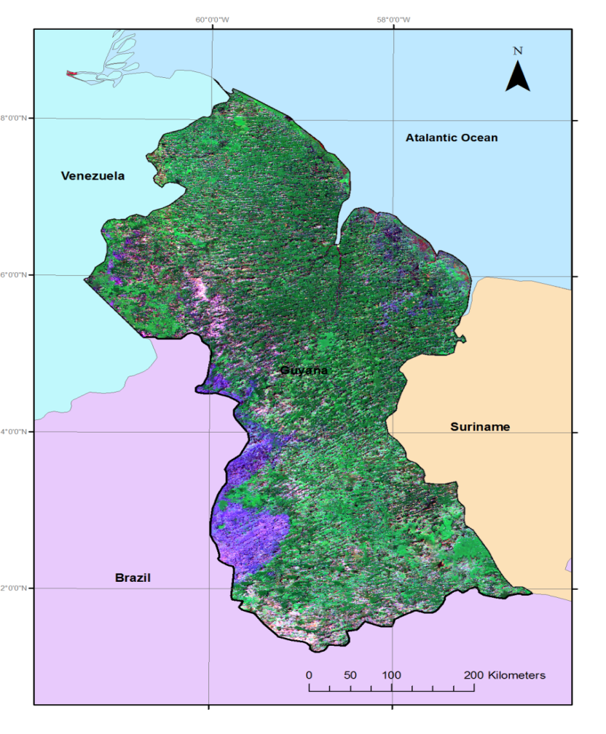
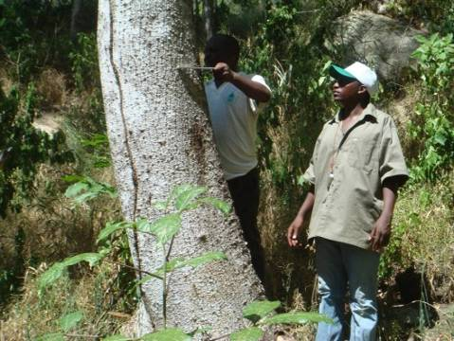
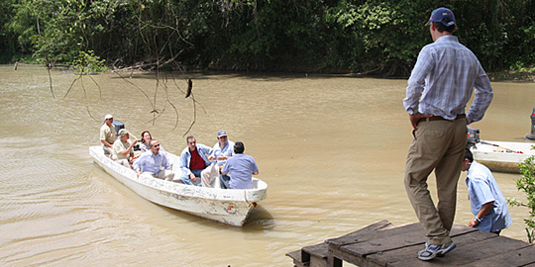
Collaboration with Guyana, Mexico and Tanzania - all these countries are using/ planning to use HR-optical data for their national forest monitoring (and will have different contributions in the pilot)

Slide 5
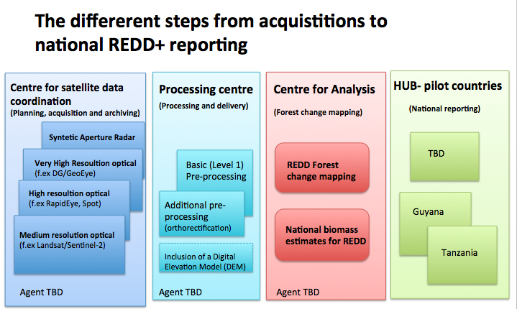

Slide 6
The distribution part..

Slide 7
Test of data distribution to Tanzania?
Distribution of data through EUMETCAST
uses telecommunication satellites so avoids the problem of fiber
network
possible issues with data size (should be less than 100 MB, especially
for older receiving stations )
Delivery test to Tanzania:
USGS Landsat data
5 user stations in Tanzania
sent to Ministry of Natural Resources and Tourism ground station
test started in October 2012, but first successful delivery was on the 3rd
of December
another test after the holidays failed again, but it got repaired
in general, positive feedback and willingness to work with it in the future

Slide 8
Data distribution – from the data provider’s side
Relatively straightforward:
not restricted to a particular format, but preferably compressed files
push to EUMETCAST server, EUMETCAST takes it from there
conversion to DVB stream, which is uplinked to communications
satellite
receiving station gets copy of the files on their hard disk
Layers of complication:
multiple channels for different data streams, different priorities, different footprints (related to Eumetcast distributions)
the larger the file, the larger the risk for interruption of communication
and loss of data stream
bandwidth: possible funding by data provider needed
constraints on type of data
(two points above most likely not applicable to GFOI data)

Slide 9
Data distribution – from the Tanzanian side
October 2012:
weak signal due to telecommunication tower interruption
had to wait for installation of new powerful LNB from AMESD
(The African Monitoring of the Environment for Sustainable Development) received on the 3rd of December 2012
December 2012:
better signal
successful processing test
January 2013:
again difficulties and data loss
small update done by AMESD
problems with software, identified and dealt with by EUMETSAT
afterwards, another successful test
.

Slide 10
Questions/discussion points .

Slide 11
How is the SDCG strategy regarding..
Pre-procession of different datasets..
To what level is this the responsibility/fully-financed by the satellite owner?
Development of forest products (f. ex pixel-mining through the WELD-project)..
Is this financed/ the responsibility of the satellite owner? Would it be possible for SDCG to develop a timeframe for (potential) deliverables to different forest countries, as is being done regarding CEOS-acquisitions?
Distribution of satellite data..
Do the satellite owner have a responsibility to deliver the data through a portal and/or distribution network?
How do SDCG plan to relate to the forest countries? Through the GFOI-office? ..Need for EUMETCAST/ parallel or just an Internet connection (f. ex VSAT-terminals)..

Slide 12
The HUB-philosophy..
Co-location of different datasets in processing centre, since it is foreseen that many tropical forest countries will not be able to plan, order, store, pre-process and analyse satellite data (that most possibly will need to be further integrated with other satellite data and NFI-data).
How does this HUB-idea relate to the SDCG-agencies..
Would it be possible for SDCG to develop a list of challenges that needs to be resolved, to get the acquired CEOS-satellite data to the forest countries in their preferred form – f. ex through one/ several HUB(s)?
Resources needed to collocate satellite data (and what would be the most practical way to move large datasets..?)
Resources needed for additional pre-processing (orthorectification and/or DEM), and
Would it be possible/useful to set up an ”pixel mining on request scheme” for the forest countries, and share the potential workload between different HUBs?
The forest countries (most probably) will need to report on carbon stock, but do they need (and want) to have all the datasets in the country? … or would deliverables of requested forest products for REDD+ reporting be sufficient?

Slide 13
SDCG & the donors/forest countries - more questions..
Would it be possible for SDCG to define clearly what is their responsibility regarding CEOS satellite data, and what needs to be handled by the forest countries/ “REDD+” donors..?
Would it be possible for SDCG to give recommendations to donors on resources needed regarding satellite products and deliverables for REDD+ implementing countries?,
f. ex on
Plans, time-schedule, and resources needed for pre-processing of CEOS satellite data
Plans and resources needed for delivery of CEOS data to “HUBs/centre” for pre-processing/analysis
Plans, time-schedule, and resources needed for pixel-mining.
(Additional) resources needed to set up distribution systems for satellite data/products to forest countries
Resources needed for making a more high resolution DEM available for forest countries
Svalbard for SAOCOM
Securing of acquisition and/or (pre-) processing of high resolution optical data
NB! GFOI Steering Committee-meeting in Canberra next week, and potential follow up meeting with UN REDD, WB, Germany, Australia and Norway In Oslo.

