Slide 1
Forest Carbon Tracking –
Canadian Space Agency Update
Science and Data Summit - 4
Sydney, Australia
February, 2013
Yves CREVIER
yves.crevier@asc-csa.gc.ca
www.geo-fct.org

Slide 2
Presentation Outline
Canadian Space agency assets in support of the FCT and GFOI
Data planning and ordering process for Radarsat 2 and related End-User Licence Agreement

Slide 3
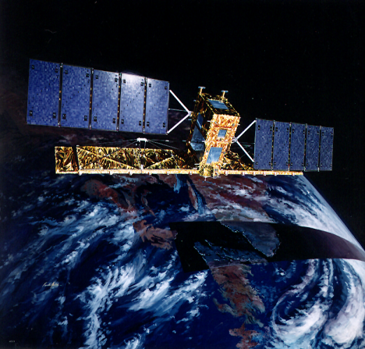
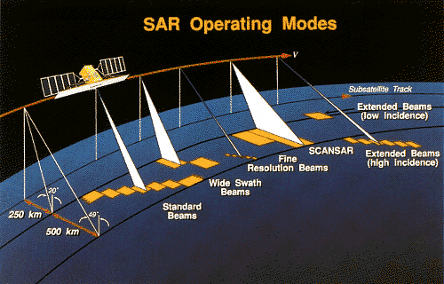
RADARSAT 1 http://www.asc-csa.gc.ca/eng/satellites/radarsat1/default.asp
C-Band SAR sensor (single pol. capability – H)
In operation since 1996
Demonstrated potential for routine observation (support science and operational activities)
17+ years of archive collected over the globe – still imaging

Slide 4
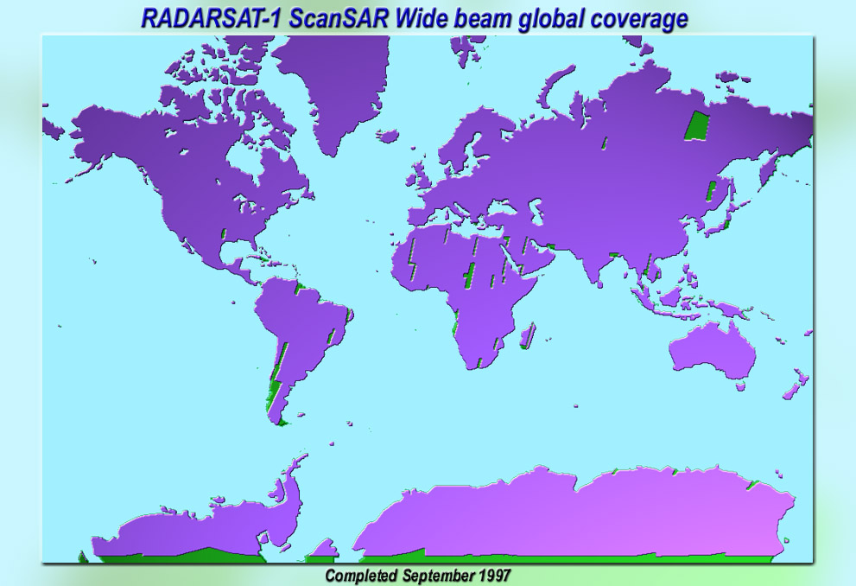
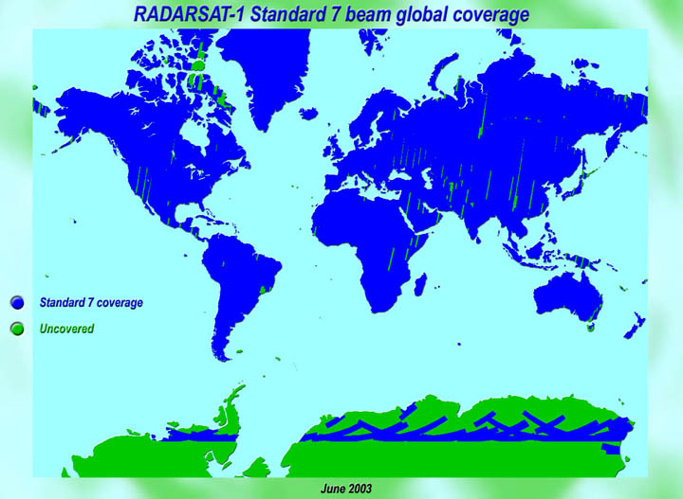
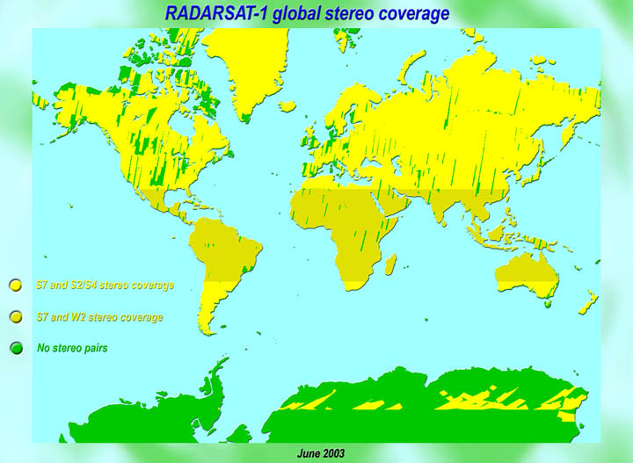
Background Mission
SCW
S7
S7 and S2/S4
S7 and W2

Slide 5
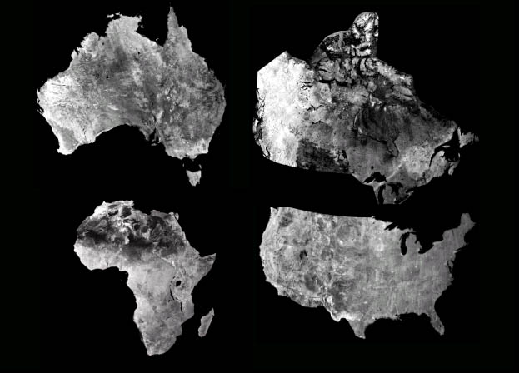
Continental Mosaics
Canada
Africa
Australia

Slide 6
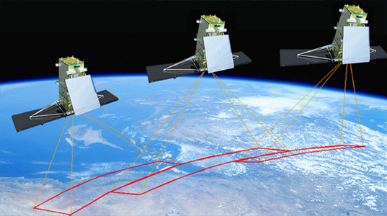
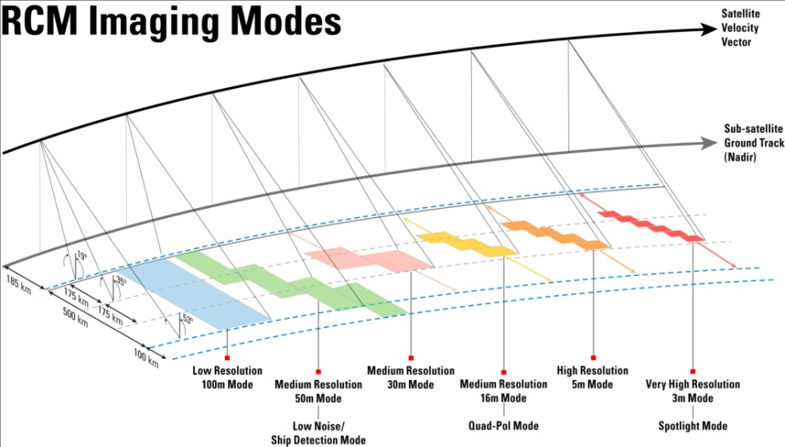
RADARSAT Constellation Mission http://www.asc-csa.gc.ca/eng/satellites/radarsat/default.asp
Evolution of the RADARSAT Program (i.e. 3 satellites – 32 minutes separation);
Continuity of C-Band SAR for Operational Users
Improved revisit over wide areas
Improved reliability (i.e. redundancy and scalability)
Evolution to wider Operational use
Government-owned and operated
Average daily global access of land and oceans (daily revisit – 50m res.) & int. areas;

Slide 7
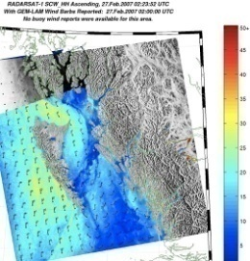
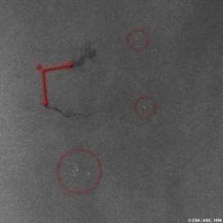
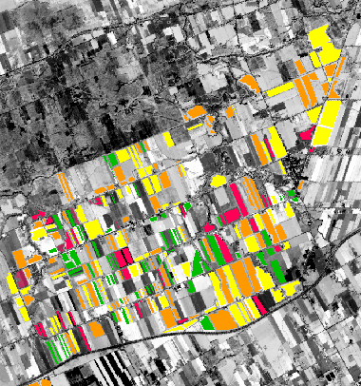
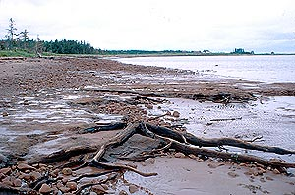
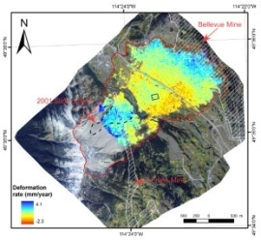
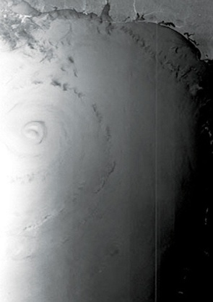
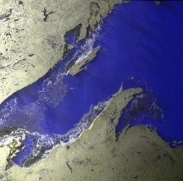
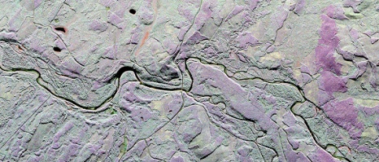
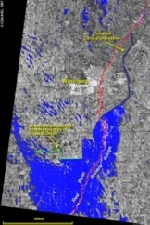
Core Use Areas
Maritime Surveillance
Environmental Monitoring
Disaster Management
Ice & Iceberg Monitoring
Pollution Monitoring
Vessel Detection
  Including AIS
Marine Winds
Forestry
Protected Areas & Wildlife Habitat
Agriculture
Wetlands
Coastal Change
Flood Monitoring
Wind Storms
Earthquakes
Landslides
Volcanic Activity
Permafrost

Slide 8
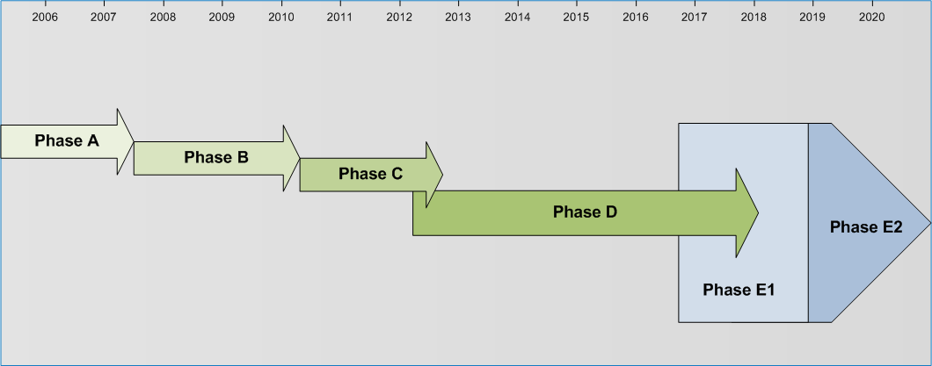
RADARSAT Constellation Mission
Project Schedule
Dec 2017
Now
N

Slide 9
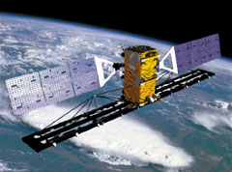
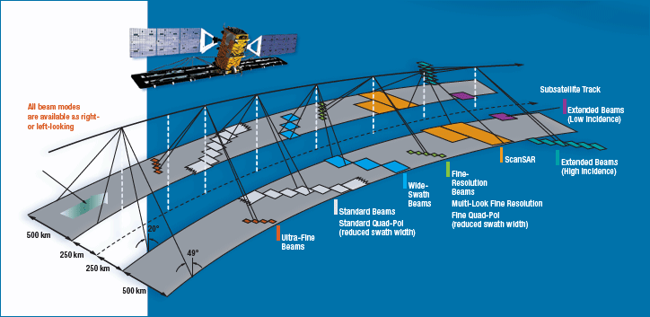
RADARSAT 2 http://www.asc-csa.gc.ca/eng/satellites/radarsat2/inf_data.asp
Advanced SAR instrument – polarimetric, high-resolution, heritage modes
Owned and operated by MDA
GoC data allocation available for science activities
High and very high resolution, dual-sided imaging, multi-pol and quad-pol.

Slide 10
General Remarks - Radarsat 2
Preferred beam mode (according to experts):
  Wide 3 for national coverages
  Fine Quad (greater than 34 degrees) for verification sites – Ultra Fine only available in selective single pol.
National coverages – 2 times/year (1 wet and 1 dry coverage) – if required
Verification sites – images acquired in ascending and descending modes every cycles (every 24 days) – if required
Support Science plan on Degradation

Slide 11
Proposed approach for Ordering and Planning of Radatsat 2
Science and Operational Applications Research (SOAR)
  Joint partnership program between MacDonald Dettwiler and Associates Ltd. - Geospatial Services Inc. (MDA GSI) and the Canadian Space Agency (CSA)
  The program provides access to RADARSAT-2 data for research and testing purposes.
  The SOAR program provides an opportunity to explore the enhanced capabilities of RADARSAT-2 and their potential contributions to various applications.
Endorsed framework:
  Agreement between MDA and CSA
  Define rules specific to FCT needs (number of images, reporting by the end-users, sharing rules, etc – included in Guidance Document GEO FCT GD 004.

Slide 12
Data Request, Distribution Process and Stakeholders Engagement
The PD team lead must register for the SOAR-FCT initiative; you will be contacted by the CSA and given access to the online secure website: www.asc-csa.gc.ca/eng/programs/soar/.
The PD team lead must submit a RADARSAT-2 Product Request and have it approved by CSA. The information requested is approximately the same as that which was previously requested by the FCT Secretariat and used to approve the FCT ND.
The PD team lead must sign an agreement with CSA and MDA GSI concerning the lending of RADARSAT-2 Products for research purposes.
The PD team lead and CSA will coordinate the ordering and delivery details.
The PD team lead will:
  publish the results of the research project and appropriately acknowledge the SOAR-FCT initiative;
  provide CSA with advance copies of their publications and communications;
  submit to CSA, on request, the results and methods used for promotional purposes;
  attend a SOAR linked workshop or symposium to present results;
  return the RADARSAT-2 Products loaned back to MDA GSI following completion of the project.

Slide 13
Data Sharing in the Context of the FCT Request
Proposed data policy in context of GEO FCT
  Can data be shared among the FCT sites?
    Yes – need to complete a Multi-User Request Form
    Some restriction – RSSSA and EULA
  Can data be shared within the wider GEO Community?
    Unlikely
Can previously acquired data over FCT sites be made available?
  Same as new data

Slide 14
Summary of CSA contribution
RADARSAT 2 data acquired over the National Demonstrators (NDs) as coordinated with C-Band agencies.
  Use of RADARSAT 2 background mission – low priority on acquisitions
  Full National coverages planned over multiple cycles acquired during wet and dry seasons
  All verification sites are imaged every 24-day cycles
Introducing a formal planning, ordering an distribution process that should facilitate the acquisition and access to data – SOAR FCT program
Offered support for the key science issue of DEGRADATION

