Slide 1
Session 10
Co-session GFOI - GEOGLAM
FM Seifert (ESA)
G Dyke (Australia)

Slide 2
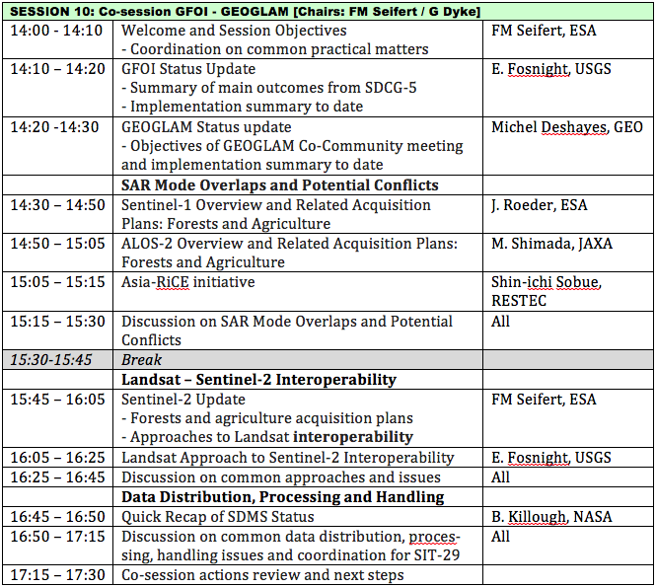
Session 10 Agenda

Slide 3
Session 10 Objectives
Canvass GFOI and GEOGLAM status [30 mins]
Discuss three potentially overlapping topics:
SAR Mode Overlaps and Potential Conflicts [60 mins]
Landsat – Sentinel-2 “Interoperability” [60 mins]
Data Distribution, Processing and Handling [30 mins]
Wrap-up [15 mins]

Slide 4
GFOI and GEOGLAM Status
Brief summary of program and institutional status for both initiatives
Common issues facing these two “GEO Flagship” initiatives
Plans for 2014

Slide 5
SAR Mode Overlaps and Potential Conflicts
Sentinel-1 forests and agriculture planning
ALOS-2 forests and agriculture planning
Asia-RiCE and coordination of SAR acquisitions
Potential overlaps and conflicts

Slide 6
Landsat – Sentinel-2 “Interoperability”
Sentinel-2 forests and agriculture acquisition plans
Landsat approach to Sentinel-2 interoperability
“Interoperability” in the broader GFOI sense of using Landsat and Sentinel-2 interchangeably in order to maximise application to both GFOI and GEOGLAM

Slide 7
Data Distribution, Processing and Handling
Space Data Management System status
Common data handling and processing issues
Data delivery to countries and other end users
Strategies and approaches for overcoming data delivery barriers in areas where internet service is poor

Slide 8
CEOS-GEOGLAM Co-Community Meeting
Following Thursday and Friday
Major topics:
GEOGLAM Phase 1 Implementation and Lessons Learned
Phase 2 scoping
2014 activities
Will revisit GFOI-GEOGLAM interaction on Friday afternoon

Slide 9
Session 10 Agenda

