Slide 1
2014 GEOGLAM Programmatics Calendar of events Milestones and deliverables GEOGLAM IP updates
Michel Deshayes (GEO)
CEOS-GEOGLAM meeting, 27th-28th February 2014
ESA/ESRIN, Frascatti, Italy

Slide 2
Calendar of Events (1/2)
GEOGLAM
JECAM meeting, Ottawa, July 2014
Implementation Board meeting, Beijing, Autumn 2014 (in connection with SIGMA meeting)
Rangelands meeting, Paris, Autumn 2014
Regional “GEOGLAM” Workshops
African workshop, Addis Ababa (Ethiopia), 16-19June 2014 "Evidence based Information for food security and agriculture in Africa“ (follow up of CRAM meetings)
South Africa, Autumn 2014 (tbc)
EO conferences, with sessions on GEOGLAM-AgMon
Sen2 for Science, Frascati, 20-22 May 2014
GEO-UA 2014, Kiev (Ukraine), 26-30 May 2014
IGARSS, Québec, 13-18 July 2014…

Slide 3
Calendar of Events (2/2)
AMIS meeting
Mexico, 20-21 May 2014
CEOS meetings
SIT-29, Toulouse (FR), 8-10 April 2014
SIT Technical Workshop, Montpellier (FR), 16-18 Sept. 2014
CEOS-29, Tromsø (Norway), 28-30 October 2014
GEO meeting
GEO-XI, Libreville (Gabon), 12-14 Nov. 2014
G20 meeting
G20, Sydney (Australia), Autumn 2014
International Food & Agriculture meetings
Global Forum for Food & Agriculture, Berlin, January 2015

Slide 4
Milestones and deliverables (1/2)
GEOGLAM website
To be put online before August 2014
C#2 “Capacity Building”
Use of results of FAO’s GFAS survey, when available (May-June?)
GFAS = Global Framework for Agricultural Statistics
Inventory of on-going CB activities in countries
Analysis of strengths and weaknesses
Inventory of Best Practices
Inventory of training modules
Definition of priorities (countries, activities)
Report (2nd half 2014)

Slide 5
Milestones and deliverables (2/2)
C#3 “Countries @ Risk”
Use of results of FAO’s analysis
LIFDC = Low Income - Food Deficit Countries
Inventory of on-going support to Countries
Contacts with main actors : FAO, JRC, FEWS-NET, WMO, Gates…
Definition of priorities (countries, activities…)
Report (2nd half 2014)
C#5 JECAM
2013 Annual JECAM report

Slide 6
GEOGLAM IP update
Next Implementation Board meeting
Beijing, Autumn 2014 (close to SIGMA meeting)
An updated IP
End 2014 – Early 2015

Slide 7
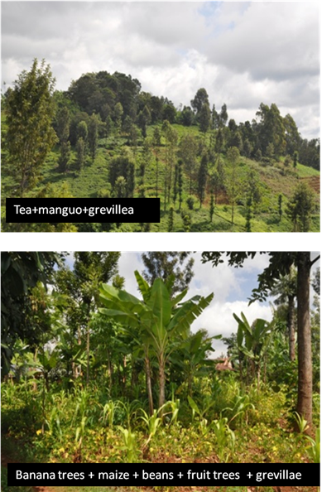
Research Challenge : Adaptation to Regional Agrosystems
ex. Mixed crops – Rungbe, Tanzania
Agroforestry systems based on :
Crops: perennial (coffee, banana, cocoa, fruit trees, tea) and annual (corn, rice).
Small fields : 300-1500 m².
« CBM » : Coffee, Banana, and Maize
Trends
Upper zone : CBM progressing, with gradual trimming of the tea-cropping areas and the Afromontane forest.
Lower areas : CBM being abandoned in advantage of cocoa and rice monoculture, supported by significant investments (irrigation).
C. Lelong CIRAD
7 / 30

