Slide 1
Partners in developing countries
Capacity building and monitoring
John Latham
FAO
GEOGLAM-CEOS Global Agricultural Monitoring
Frascati, Italy
27 - 28 February 2014

Slide 2
GEOGLAM Implementation Plan:
DESIRED OUTCOME:
New improved and more harmonized monitoring systems taking advantages of:
High level of international coordination
New satellite assets and methods. The use of satellite based data will bring transparency and timely information for decision making on food security.
National Capacity Development. This component focuses on supporting national and regional institutions willing and able to assimilate agricultural monitoring capacities through the use of Earth observation and modeling.

Slide 3
GEOGLAM Partnership – proliferation of activities need for coordination and harmonization of approaches
The list include, to name a few:
USDA (FAS GLAM),
FAO ( RS and GIS unit NRL; GIEWS, Global Strategy, FIVIMS),
WMO (Agricultural Meteorological Program and WAMIS),
WFP
EC/JRC (MARS unit),
USAID (FEWSNET),
GMFCS (now Copernicus),
CSIRO and ABARES (Australia),
VITO (Belgium),
IIASA, ISRO, NASA, ESA, INPE, JAXA, SANSA, CONAB (Brazil), CGIAR, INTA (Argentina), IRSTEA and CIRAD (France), Agri-food (CANADA), University of Maryland (USA), Université catholique de Louvain (Belgium), SADC, RADI (China CropWatch), CILSS, AMESD and Asia Rice.
Et al…

Slide 4
GEOGLAM Pillars and cross-cutting elements
The three pillars are:
  Enhancement of Global and Regional systems;
  National capacity development and
  Countries-at-Risk.
Cross-cutting components are:
  EO data coordination;
  R&D coordination and,
  Information systems (for disseminating data, products and information).

Slide 5
Component 2: National Capacity Development
Aims to develop/strengthen capacity of national agencies concerned with the collection, consolidation, and use of geospatial data to provide timely and precise agricultural statistics based on the integration of improved estimates.
The methodology employed will be to increase the knowledge, skills, and competencies of their staff.
Emphasis will also be placed on strengthening and sustaining the capacity of regional and national training centers to develop and deliver good-quality training in agricultural statistics and statistics-related subjects, with a focus on the efficient use of EO data.
Provide technical and institutional training, training of trainers, methodological guidelines and tools, facilitated access to Earth observation including meteorological data and expert advice and support.

Slide 6
Component 2: National Capacity Development
Builds on linkages & feedback with global/regional monitoring systems and activities:
E.G. - FAO on-going efforts in supporting capacity development among the concerned agencies of member countries, with emphasis on the use of EO to increase accuracy and reduce costs for their crop statistics system (e.g. Area Frame Dev – Nat Res. Monitoring Unit & the Global Strategy for Agric. Statistics program).
Several national on-going efforts to leverage on the increasing offer of ‘public good’ space-based Remote Sensing data to add timeliness and transparency to their systems and reducing costs from traditional systems (e.g. Argentina, Australia, Brazil, Mexico, South Africa, Ukraine, Russia, Kazakhstan, India) .
On-going and developing bilateral cooperation between GEOGLAM members, Agr. and Dev. Agencies to enhance agricultural monitoring capabilities through the enhanced use of EO (e.g. CropWatch and RADI/China with many organizations in Thailand; USDA and Pakistan).

Slide 7
Pathway for National Capacity Development
Define pilot countries/regions according to food surplus/exporter/importer. PI focus on 5 countries (3+2) and 1 Region (Asia);
Conduct a series of regional workshops/questionaires for status assessment, needs and priorities through regional incubator / institutions;
National engagement and commitments by interested parties;
Assess national capacity in agriculture monitoring and EO data use, and enhancement needs;
Define data coverage requirements based on national needs assessment;
Define processes and activities that can assist national implementation;
Regional training / information exchange and continued regional networking.
National Uptake and maintenance and improved reporting
Notes:
Define pilot countries/regions according to food surplus/exporter/importer. Focus on 5 countries 1 Region;
Conduct a series of regional workshops for status assessment, needs and priorities through regional incubator / institutions;
National engagement and commitments by interested parties;
Assess national capacity in agriculture monitoring and EO data use, and enhancement needs;
Define data coverage requirements based on national needs assessment;
Define processes and activities that can assist national implementation;
Regional training / information exchange and continued regional networking.

Slide 8
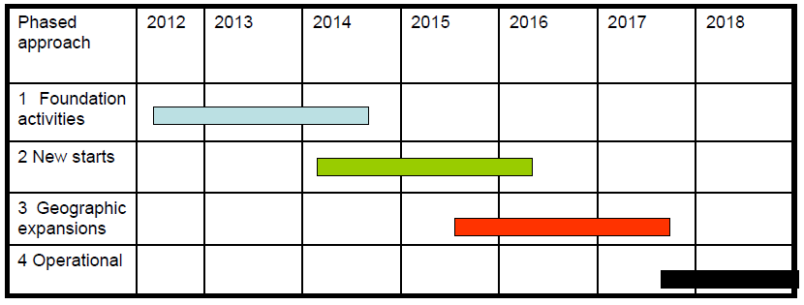
The GEOGLAM phased implementation calendar
Phase 1 (P1, 2012-2014) focuses on foundation activities, building on existing activities and on pilot projects for a few countries, and scoping out the programme for the following phases;
Phase 2 (P2, 2014-2015) will review and expand phase 1 activities with new starts;
Phase 3 (P3, 2016-2017) will be the last building pre-operational one with the completion of P1/P2 projects and geographical expansion up to when the Operational Phase starts.
Operational Phase (2018 forward).

Slide 9
Phase 1: Tasks and activities
The Phase 1 (P1) spans between 2012 and 2014 focusing on foundation activities, mainly existing initiatives for few countries, and scoping out the programme for the following phases.
This demonstration & early feasibility phase regards 5 countries and 1 Region (4 large producers according to AMIS and 2 ‘at risk’ and focuses on the main commodities of concern to the G20: wheat, maize, rice and soybeans.
Six main tasks have been identified for phase 1/2 to implement the national capacity development component of GEOGLAM:
  Set-up / preparatory phase;
  National needs assessment;
  National baseline datasets;
  Research & Development; best practices;
  Data, Products and Information Dissemination;
  Technical assistance and capacity building
Notes:
Define pilot countries/regions according to food surplus/exporter/importer. Focus on 5 countries 1 Region;
Conduct a series of regional workshops for status assessment, needs and priorities through regional incubator / institutions;
National engagement and commitments by interested parties;
Assess national capacity in agriculture monitoring and EO data use, and enhancement needs;
Define data coverage requirements based on national needs assessment;
Define processes and activities that can assist national implementation;
Regional training / information exchange and continued regional networking.

Slide 10
Main tasks to implement the national capacity development
Set-up / Preparatory Phase
Selection Pilot - Priority countries/regions
Identification of point of contacts, regional incubators, national institutions
Regional assessment/networking workshop
National Needs Assessment
Develop country needs assessment methodology and questionnaire
Assess national needs, gaps and priorities
Status of EO based national agricultural monitoring
National baseline datasets
Available national core data sets, including EO and weather data
Coarse resolution cropland map and crop (specific) mask (distribution)
National/regional harmonized and standard based land cover

Slide 11
Main tasks to implement the national capacity development
Research & Development; best practices
Initiate national JECAM/other sites and associated research agenda
R&D on crop (specific) area estimate (selected regions) methodologies
R&D on crop (specific) yield forecasting
Development/sharing of tools, guidelines and documents on standards and best practices (
Data, Products and Information Dissemination
Crop Condition interface prototyping
Technical assistance and capacity building on the use of EO data
Need-based training programmes, tools and toolkits
Technical assistance/trainings on methodologies, tools, best use of EO data
Improvement infrastructure and human capacity for carrying out national monitoring programme

Slide 12
Phased Approach for National Capacity Development
Argentina
P1 Assessment of current status and priorities for enhancements – crop monitoring
P1 Crop condition monitoring/cropland mapping/ crop area prototype
P2 Prototype yield, evaluate crop area approach and expand
Mexico
P1 Regional Needs Assessment Workshop
P1 Cropland mask and crop type mapping
Russia – Ukraine/Belarus/Kazakhstan
P1 Regional Needs Assessment Workshop
P2 National Engagement
Australia
P1 Assessment of current status and priorities for enhancements – crop monitoring
P1 JECAM/crop condition/cropland mapping/ crop area prototype
P2 Prototype yield, evaluate crop area approach and expand
Brazil
P1 Scope out activities for in-country institutional arrangements for including/increasing use of EO in the crop statistics/monitoring system
P2 Prototype/pilot studies
Status Report from Partners:
Notes:
Define pilot countries/regions according to food surplus/exporter/importer. Focus on 5 countries 1 Region;
Conduct a series of regional workshops for status assessment, needs and priorities through regional incubator / institutions;
National engagement and commitments by interested parties;
Assess national capacity in agriculture monitoring and EO data use, and enhancement needs;
Define data coverage requirements based on national needs assessment;
Define processes and activities that can assist national implementation;
Regional training / information exchange and continued regional networking.

Slide 13
Phased Approach for National Capacity Development
Thailand – Laos/Philippines/Vietnam
P1 Pilot activities for Agricultural and rural statistics
P2 Implementation and workshop / capacity building
P2 GEOGLAM augmentation needed in terms of data access – ALOS2/RISAT /Radarsat /Sentinel 1.
Pakistan
P1 / P2 Capacity Building for Crop Reporting Services – FAO/UMD/USDA Exemplar
Uganda
P1 / P2 Pilot Early Warning and National Monitoring (NUDC/FEWSNET)
Ethiopia
P1 / P2 National Monitoring System (FAO and others)
Algeria
P1 / P2 Crop outlook and yield forecast (EU/INRA Min Ag)
North Africa (regional)
P1 Regional Workshop on Status and Needs (EU/JRC
Southern Africa (regional SADC)
P1 AMESD / MESA / GEOGLAM Workshop on National Monitoring (EU)
P2 Pilot activities (crop condition, area, yield)
P2/P3 Implementation of a regional/national operational system / Moderate Resolution Data Delivery
Notes:
Define pilot countries/regions according to food surplus/exporter/importer. Focus on 5 countries 1 Region;
Conduct a series of regional workshops for status assessment, needs and priorities through regional incubator / institutions;
National engagement and commitments by interested parties;
Assess national capacity in agriculture monitoring and EO data use, and enhancement needs;
Define data coverage requirements based on national needs assessment;
Define processes and activities that can assist national implementation;
Regional training / information exchange and continued regional networking.

Slide 14
Country selection by different projects, program meS, initiatives……. Yesterdays presentation
WB data
NRL model
Global Strategy
AMIS
GEOGLAM
JECAM
GIEWS
GATES Foundation

Slide 15
Countries at Risk – Nat Capacity Dev
Focus: Early warning & food security
Agricultural monitoring in countries at risk supports timely food security assessment and early warning of potential significant food shortages. It is relevant to the three principal questions of food security assessment:
  Availability: How much food is present in-country, in the form of current production, stocks, and imports?
  Access: To what extent do market prices, or other institutional factors, prevent households from accessing available food?
  Utilization: To what extent do disease, sanitation, traditional practices, etc., prevent households from deriving full benefit from accessible food?
Many national and regional agricultural monitoring institutions in at-risk countries have a limited ability to generate agricultural production data, and they are often unable to integrate them into a broader assessment of current or near-future food security. At the same time, the avenues available to them for improving their technical capabilities for producing data and information products are limited.
Notes:
GEOGLAM
Components
• Component 1: Monitoring Global Producer Countries– Focus: Global crop outlooks, markets and trade, long term trends(climate change implications ,extreme events,etc)
• Component2: National Monitoring Systems– Focus: National statistics, national policy, subsidies, insurance
• Component 3:Countriesat Risk– Focus :Early warning & food security
• Component 4:EarthObserva7onsCoordina7on– Focus on acquisition, availability, access needed for GEOGLAM implementation
• Component5:R&D– Focus:Opera,onalR&D,Bestprac,ces,ResearchtoOpera,ons,JointExperiments--‐JECAM
• Component6:Informa7ondissemina7on– Focus on, timely and transparent availability of information

Slide 16
Countries at Risk
Focus: Early warning & food security
Definition of “Country at Risk”
Not a formal definition but more of a working definition. Based on FAO's Resilience to crisis strategy (SO5), at risk countries are those identified as relatively poor and prone to facing the primary threats (crisis) to FNS, including:
Natural disasters (e.g., geo-climatic and extreme weather events originating from natural hazards - droughts, floods, fires, landslides, volcanic eruptions, tsunamis, earthquakes, storms, extreme temperatures, hailstorms, etc.);
Food chain emergencies of transboundary or technological threats (e.g., transboundary plant, forest, animal, aquatic and zoonotic pests and diseases, food safety events, radiological and nuclear emergencies, dam failures, industrial pollution, oil spills, etc);
Socio-economic crises (e.g. volatility in agricultural commodity markets, soaring food prices, and recent financial shocks);
Violent conflicts (e.g., civil unrest, regime change, interstate conflicts, civil wars, etc.);
Protracted crises (i.e. complex, prolonged emergencies that combine two or more aspects of the above-mentioned crises).
Notes:
GEOGLAM
Components
• Component 1: Monitoring Global Producer Countries– Focus: Global crop outlooks, markets and trade, long term trends(climate change implications ,extreme events,etc)
• Component2: National Monitoring Systems– Focus: National statistics, national policy, subsidies, insurance
• Component 3:Countriesat Risk– Focus :Early warning & food security
• Component 4:EarthObserva7onsCoordina7on– Focus on acquisition, availability, access needed for GEOGLAM implementation
• Component5:R&D– Focus:Opera,onalR&D,Bestprac,ces,ResearchtoOpera,ons,JointExperiments--‐JECAM
• Component6:Informa7ondissemina7on– Focus on, timely and transparent availability of information

Slide 17
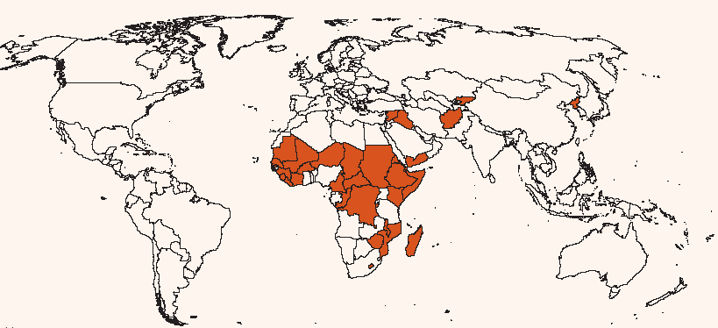
Countries @ risk:(country requiring external assistance for food) http://www.fao.org/docrep/019/aq119e/aq119e00.htm
GIEWS crop prospect and country at risk
Severe localized food insecurity
Sierra Leone
Burundi
Cameroon
Central African Republic
Congo
Côte d’Ivoire
Democratic Republic of the Congo
Ethiopia
Guinea
Kenya
Madagascar
Mozambique
Senegal
Somalia
South Sudan
Sudan
Exceptional shortfall in aggregate food production/supplies
Iraq
Syrian Arab Republic
Widespread lack of access
Democratic People’s Republic of Korea
Yemen
Severe localized food insecurity
Afghanistan
Kyrgyzstan
Exceptional shortfall in aggregate food production/supplies
Haiti
Exceptional shortfall in aggregate food production/supplies
Burkina Faso
Chad
Gambia
Lesotho
Mali
Mauritania
Niger
Zimbabwe
Widespread lack of access
Djibouti
Eritrea
Liberia
Malawi
Source: crop prospects and food situation, Dec 2012
Notes:
The main objective of GEOGLAM is to reinforce the international community’s capacity to produce and disseminate relevant, timely and accurate forecasts of agricultural production at national, regional and global scales by using Earth Observation data. This will be achieved by:
enhancing national agricultural reporting systems, including through a geo-spatial education curriculum to enable training of participants worldwide;
establishing a sustained international network of agricultural monitoring and research organisations and practitioners; and
harmonizing the operational global agricultural monitoring systems based on both satellite and in situ observations, including through improved coordination of satellite observations
We commit to improve market information and transparency in order to make international markets for agricultural commodities more effective. To that end, we launched: The “Agricultural Market Information System” (AMIS) in Rome on September 15, 2011, to improve information on markets. It will enhance the quality, reliability, accuracy, timeliness and comparability of food market outlook information. As a first step, AMIS will focus its work on four major crops: wheat, maize, rice and soybeans. AMIS involves G20 countries and, at this stage, Egypt, Vietnam, Thailand, the Philippines, Nigeria, Ukraine and Kazakhstan. It will be managed by a secretariat located in FAOThe “Global Agricultural Geo-monitoring Initiative” in Geneva on September 22-23, 2011. This initiative will coordinate satellite monitoring observation systems in different regions of the world in order to enhance crop production projections and weather forecasting data.
The overarching goal of JECAM is to reach a convergence of approaches, develop monitoring and reporting protocols and best practices for a variety of global agricultural systems. JECAM is enabling the global agricultural monitoring community to compare results based on disparate sources of data, using various methods, over a variety of global cropping systems. The JECAM experiments will facilitate international standards for data products and reporting, eventually supporting the development of a global system of systems for agricultural crop assessment and monitoring

Slide 18
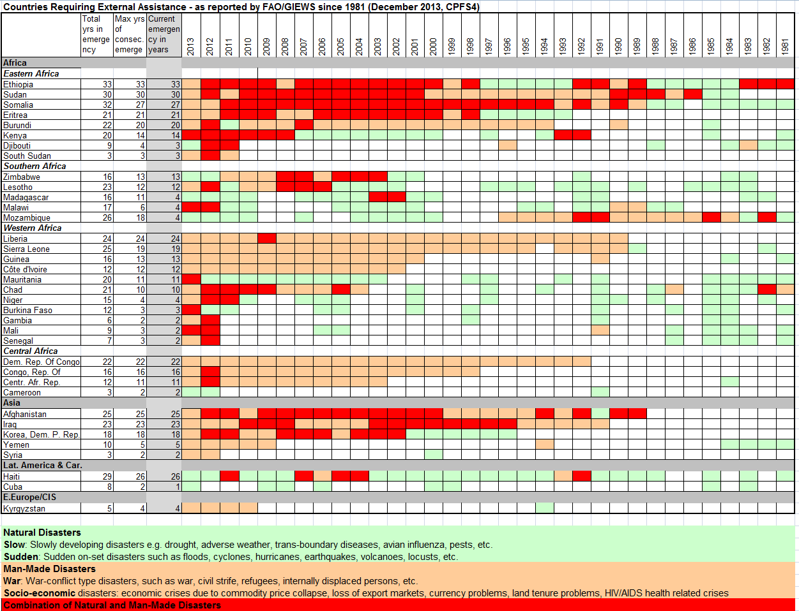
GIEWS Countries Requiring External Assistance as reported by FAO/GIEWS (Dec 2013)

Slide 19
Global Strategy and National Capacity Development
Global Strategy Purpose:
Provide the vision for national and international statistical systems to produce the basic data and information to guide the decision making required for the 21st century. The global strategy is based on 3 pillars:
Pillar 1: Identifying a minimum set of core data and determining national priorities.
Pillar 2: Integration of Agricultural and Rural Statistics into the National Statistical System.
Pillar 3: The sustainability of agriculture statistics through governance and statistical capacity building.
Process to implement the Global Strategy:
Pilot Countries selection
Country assessment
Identification of first phase countries and development of proposals
Implementation of country activities

Slide 20
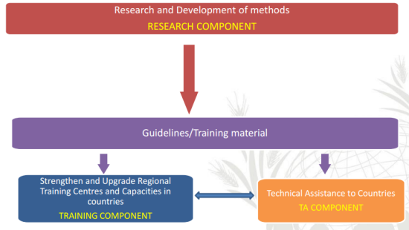
Global Strategy and National Capacity Development
Pillar 3: The sustainability of agriculture statistics through governance and statistical capacity building:
establish the governance and capacity that are the foundations of sustainable statistical systems.
Three technical components:
  Research
  Training
  Technical assistance

Slide 21
Global Strategy and National Capacity Development
Training Component
Strengthen existing training institutions
    Establish regional centers of excellence for advanced training
    Decentralize initial training to National Institutions
Improve the curricula existing courses and develop new ones
    Specialized courses (use of remote sensing)
    Develop a broad package of training courses
      (initial/advanced, general/specialized, long/medium/short duration; formal/on the job, etc.)
Promote e‐learning & distance learning
Strengthen real demand for training / Develop a training market

Slide 22
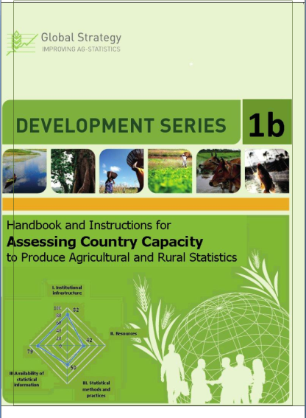
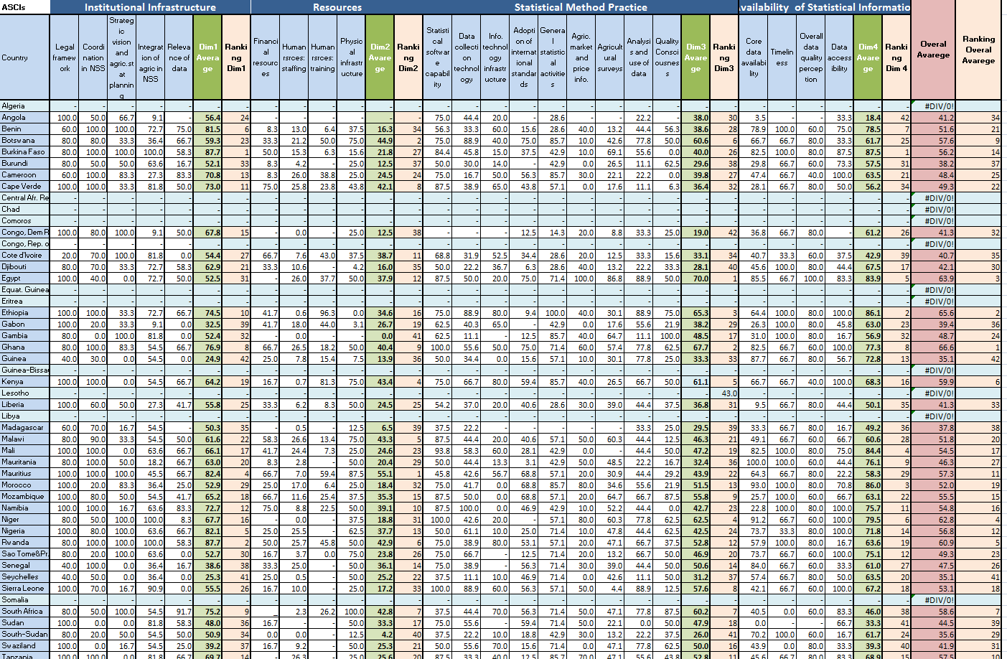
Level of statistical development
Guidelines on Compiling Indicators of Country Capacity to Produce Agricultural and Rural Statistics
Capacity indicator I: Institutional infrastructure
Capacity Indicator II: Resources
Capacity indicator III: Statistical methods and practices
Capacity Indicator IV : Availability of statistical information
Political reasons....?...

Slide 23
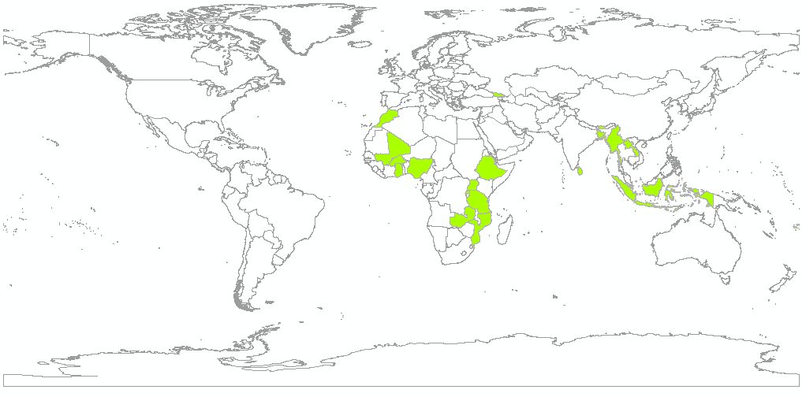
FAO-Global Strategy Priority countries selected for 2013-14
Priority list
for Africa in 2013
Burkina Faso
Ethiopia
Ghana
Nigeria
Mali
Tanzania
Uganda
Cape Verde
Morocco
Mozambique
Rwanda
Zambia
Priority list
for Asia for 2013/2014
Bhutan
Indonesia
Lao PDR
Fiji
Samoa
Myanmar
Sri Lanka
Georgia
Bangladesh
Criteria
Political will and commitment to improve country’s agricultural statistics and to provide the required government contributions in cash or in kind;
Active donor interests in the country;
Importance of agriculture:
    For the national economy—percentage of agricultural value added to the total gross domestic product (GDP);
    Contribution of the country to global food production—share of the country’s cereal production to world cereal production.
Share of rural population;
Level of statistical development.

Slide 24
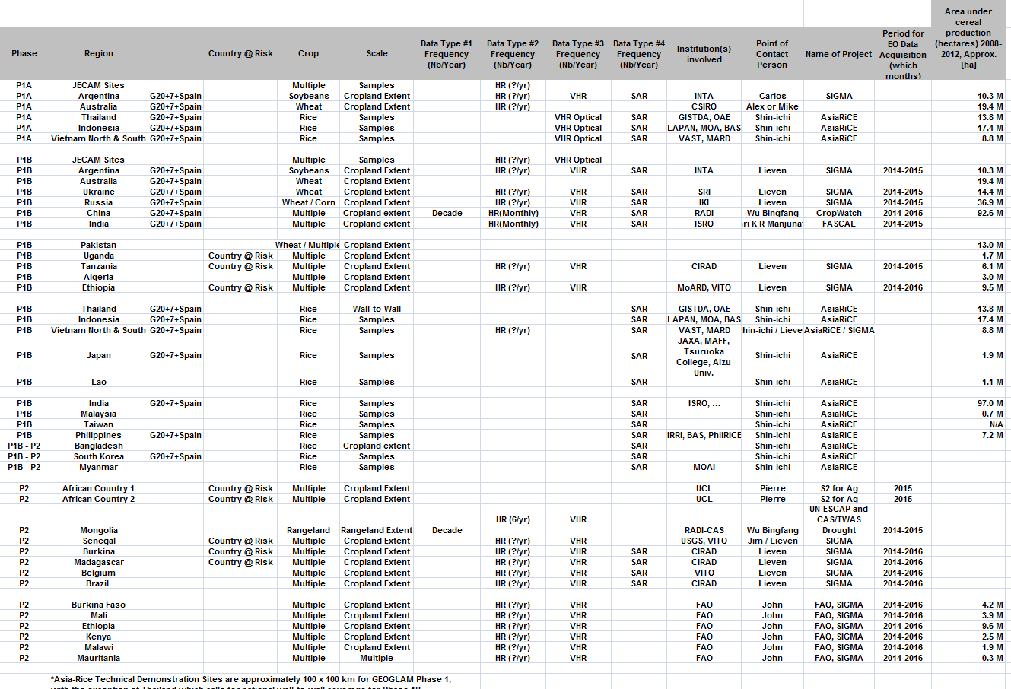
Preliminary Country Selection

Slide 25

National capacity development IN Pakistan - OPERATIONALIZING THE CONCEPT – AN example
Objectives and activities
This project focuses on enhancing and improving current systems for the integral use of remotely sensed data into existing data collection, analysis, and dissemination systems
Also focuses on the development of complementary systems to enable the integration of satellite remotely-sensed data and improved field estimates for area and yield forecasting and estimation as well as continuous crop status monitoring.
These goals will be obtained through
  Developing sustainable methods and tools which improve the quality of Pakistan's agricultural statistics based on the integral use of geospatial information;
  Building human and technical capacity in integral use of remote sensing, and GIS, and statistics;
  Creating knowledge base for scaling methods, tools, and capacities to other Pakistan departments and ministries
Project: Agriculture Information System
Building Provincial Capacity for Crop Forecasting and Estimation

Slide 26
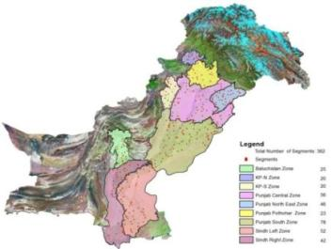

Exemplar: National capacity development IN Pakistan
Outcomes
Increased knowledge for the design and implementation of an operational agriculture survey that improves quality of statistics using geospatial data at provincial level
Increased accuracy and decreased costs of field measurements and data collection
Adopted sustainable methodologies and tools that improve the quality of geospatial information used
Trained in country geospatial professionals at provincial level capable to improve monthly crop forecasting bulletin
Disseminated of lessons learned from the project to other entities in Pakistan
Built infrastructures and capacities in 2 Universities to support provincial CRS
Automated field survey

Slide 27
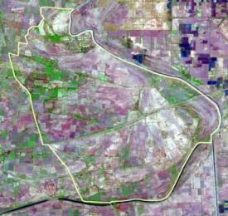
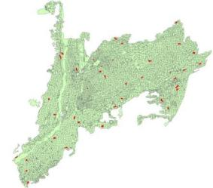
National capacity development IN Pakistan
Methodology Assessment: Area Frame Survey
SUPARCO uses satellite based area frame sampling, a fully operational system for the estimation of crop areas, the system has been developed over the last 6 years
The Satellite Based Area Frame technique use a three stage stratification process to group districts and homogenous areas in order to use statistical inference to estimate crop areas.
Stratification makes it possible to produce more accurate estimates by reducing variability between samples.
These statistical procedures are all part of a scientific probability survey system SUPARCO has implemented
Punjab South Zone broken down into PSU (red)
Sampling unit
Notes:
Area frame is based on 2.5 m resolution satellite data of SPOT 5 drawn during peak growth period of crops during 3rd decadal of September and 3rd decadal of February.
Ten strata have been defined based on I intensity of vegetation cover plus other land surface features as water bodies, deserts etc.
Th administrative unit is region consisting of 5 to 10 district or more.
These sample are assigned in multiples of 20 in each polygon/region.
In all 360 random samples called segments have been drawn.
The size of each segment is 30 ha.
The total sampled area is about 11000 ha against 1.3 million ha by VMS system.
The principle of probability proportion and working of raising factor for each strata is similar to VMS.
SUPARCO is in the processes of increasing the no of region in Punjab from 4 to 6 and in Sindh from 2 to 4 and in other provinces 2 each.

Slide 28
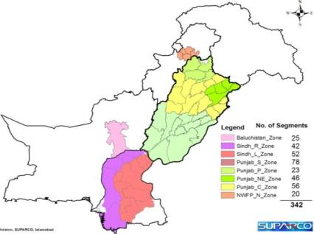

National capacity development IN Pakistan
Area Frame: Design & Testing Sampling Strategies
To substantiate the satellite based image classification system, an area frame sampling system has been designed (see below).
The spatial distribution of sampled segments as laid down by standard statistical/remote sensing techniques is shown below.
Area Frame System
Sampled Segments
Notes:
To substantiate the satellite based image classification system, an area frame sampling system has been designed. This system is based on acquisition of satellite imagery during peak growth season in February and September in high resolution of 2.5 m. The area of interest is stratified into large uniform chunks of land, according to the density of plant cover and other surface features called primary sampling units. These units are further subdivided into Secondary sampling Units. About 20 sampling segments in each polygon, of the size of 25 ha each is drawn to represent these polygons. In overall about 340 segments are drawn in Pakistan. Field surveys of these segments are carried in each cropping season to ascertain crops grown therein. These data from the sampling units are used to extract data on crop area sown in a given administrative unit, by using a raising factor.
The total cultivated area of Pakistan is 21.3 million ha. The area of sampled segments is 10.3 thousand ha. This makes 0.05 percent of the cultivated area.

Slide 29
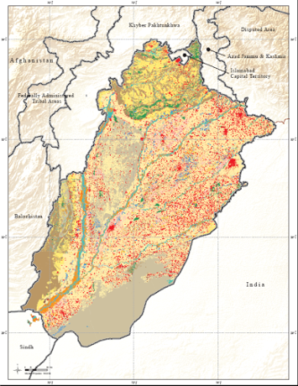
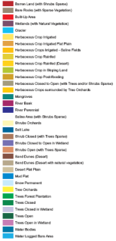
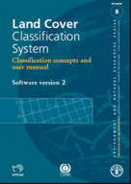
National capacity development IN Pakistan
Improving Sampling Strategies: Land Cover database
A reliable and up-to-date land cover database has been just completed by SUPARCO for Sindh and Punjab provinces. It provides:
  Description of the environment
  Information on land cover / use
  Baseline data on agricultural land Information to support the management of natural resources
  Information on human intervention on the land
The FAO methodologies and tools on land cover mapping were used to conduct the task, including one site trainings and backstopping missions by FAO experts in land cover databases production.

Slide 30
National capacity development IN Pakistan
Development Agricultural Mask
Crop masking is a fundamental requirement in satellite remote sensing to conduct investigative research on crop forecasting /estimation of area distribution among all crops in both Kharif and Rabi seasons.
Conducted study using both coarse and high resolution satellite data during peak crop growth season
This endeavor (by FAO, UMD and USDA, executed by SUPARCO) will bring up the specific crop masks per province, designed for varying requirements rather than one crop mask under use for all seasons and crops.
Objectives
Provide a mask showing distribution of different seasonal crops
Understand the pattern of different main crops in response to market condition
Extraction of crop statistics
Study of floods , developing flood extent maps and damage need assessment.
Assess the changes in agricultural land use
Database on spatial-temporal variation of different crops for decision making

Slide 31
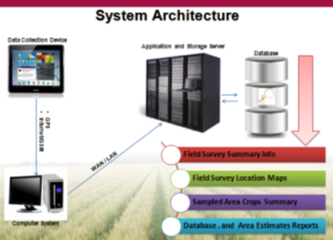
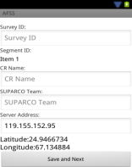
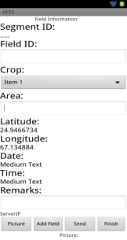
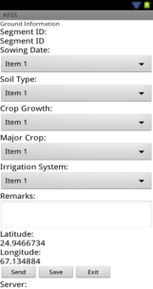
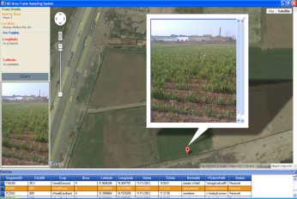
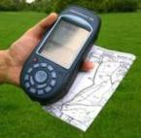
National capacity development IN Pakistan
Revise Survey Methodology and Tools
Improvement of data transmission of ground truth information through use of smart phones based on Android platform.
Mobile Application Interface
Database management
Notes:
This is designed to implicitly remove a large component of non sampling errors from the estimation procedures.
In consultation with CRSs, SUPARCO has developed the Automatic Ground Information Collection System (AGICS) web application. The AGICS collects data through smart phone and transmits it in real-time to the centralized database along with its Geospatial information's (Latitude, Longitude and geo-tagged field pictures).
This system would facilitate collection and transmission of data related to different crops sown, cropped area, crop growth, soil, water resources, farmers cost of production and others.

Slide 32
National capacity development IN Pakistan
Acreage and Yield Estimation Approach
Crop yield is a major component for the crop production forecast and estimation in Pakistan.
Statistical models are being used by SUPARCO for the estimation of the Yield. The following parameters are being incorporated on decadal basis in the model. The GLAM system of UMD is being developed and customized for Pakistan .
Crop Yield Forecast/Estimates
Linear and Non Linear Yield Model Developments
Satellite Based Vegetation Analysis
Weather Impacts on Crop
Irrigation Water Availability
Agriculture Mask Development
Crop Yield Assessments Surveys
Fertilizer Availability
SUPARCO currently starts with CRS yield estimates and adjusts them based on remote sensing and GIS technologies.
Crop yield research at SUPARCO is currently focused on crop yield forecast modeling for early assessments and warning through monitoring of vegetation dynamics, agricultural inputs status. Improvement through introduction of the GLAM system installed in SUPARCO and CRS.

Slide 33
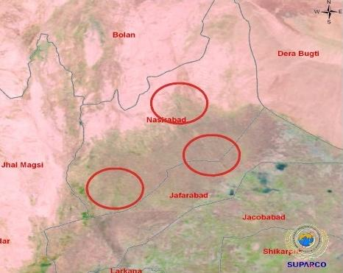
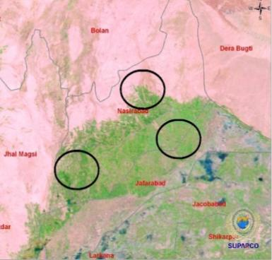
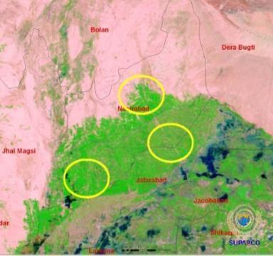
National capacity development IN Pakistan
29-04-2011
Crop Monitoring System
Major crops are being continuously monitored by the PC1 programme across the country for crop forecasting, yield & production estimation to ensure food security
31-03-2011
27-02-2011

Slide 34
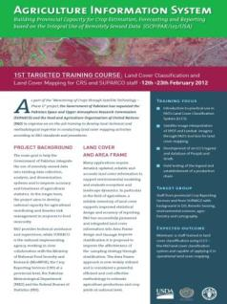
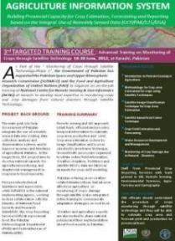
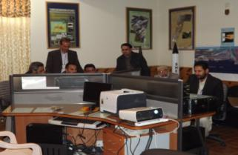
National capacity development IN Pakistan
2014 TRAININGS
Islamabad, Pakistan: Training workshop on Crop Portal administration and use and geospatial data management
2013
University of Maryland-Washington DC: “Pakistan Satellite-Based Crop Monitoring” Workshop
SUPARCO-Islamabad: 8th Targeted Training Course: "Field Data Collection Automation through Mobile Technology"
CRS-Lahore: 7th Targeted Training Course: "Field Data Collection through Mobile Technology"
SCF-Lahore: 6th Targeted Training Course: "Advanced Training on Crops Yield Forecast & Estimation System
Lahore: Awareness Workshop on Crop Information Portal: status of development and next steps
SUPARCO Islamabad: 5th Targeted Training Course: "Land Cover Database Enrichment“
2012
Advanced Training Courses on Monitoring of Crops through Satellite Technology for CRS staff; on Estimation of crop area using Area Frame Sampling; on Land Cover Classification and Mapping.

Slide 35
National capacity development IN Pakistan
Crops Area Estimation
  Satellite based Area Frame Technique
  Satellite Data Image Processing
Crop Yield Forecasting and Estimation
  Crops/Agri-Land Use Mask Development Techniques
  Crop Phenology and Growth Stage Monitoring
  Model Calibration matrices and analysis
  GLAM System
Future trainings:
04 x Area Frame
02 x Yield modeling using Remote Sensing and GIS
03 x IT system maintenance/operation
01 x Training on Exogenous Shocks
01 x Market Outlook Improvement
Distance Learning:
AF development
Acreage/yield estimation
Utilization of auxiliary information on Remote Sensing

Slide 36

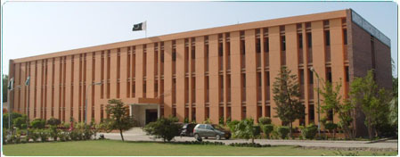
National capacity development IN Pakistan
Support to Universities
University of Agriculture, Faisalabad (UAF)
The university's faculty comprises more than 500 teachers and accommodates over 5,000 students. University have a core staff educated in Remote sensing and GIS.
Sindh Agriculture University, Tandojam
The university is an academic complex of five faculties, two centers, one constituent college and Directorate of Advanced Studies and Research.
Established activities
Computer hardware , software and setup
Development of human resource and technical capacities
Post set-up consultations
Establish fully functional units able to provide valuable agricultural crop statistics derived from the integration of ground truth data and earth observation satellite systems
Specialized short-term United States-based training (4 trainees)
Technical training

Slide 37

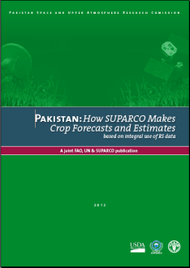
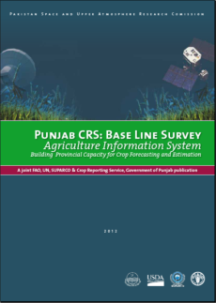
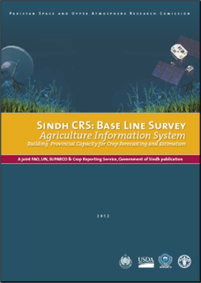
National capacity development IN Pakistan
Technical Consultations & Reports
Pakistan: Advanced Training on Monitoring of Crops through Satellite Technology
Pakistan: How Pakistan Makes Crop Forecasts and Estimates based on integral use of RS data
Punjab CRS: Base Line Survey
Sindh CRS: Base Line Survey
Notes:
Guideline to frontline and senior officers in the Crop Reporting Services to improve the techniques and delivering capacity of the Provincial Governments to provide time series information on crops and develop capacity to handle emergency situations during floods, drought or other unprecedented events.
This manual has been developed in consultation with FAO and SUPARCO to summarize how RS in Pakistan is being used to monitor crops .
This manual describes statistical methods for a pragmatic, rapid and cost effective solution for the provision of timely and verifiable information on crop growth, forecasts and estimations.
Timely crop forecasts & estimates are crucial to both policy makers and other stake holders involved in taking decisions, initiating policies, planning, investment and marketing.
Document on baseline survey of Punjab and Sindh Crop Reporting Services to describe their organization, infrastructure, methodologies and overall capacity of performing their specific tasks, so as to ensure a valid comparison at the end of the project implementation period.
This product was compiled by SUPARCO and FAO with the cooperation and support by the professionals of the Punjab Crop Reporting Service at the level of Director, Statisticians and others.
This manual has been developed in consultation with FAO, CRS and SUPARCO.

Slide 38
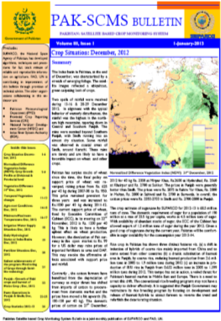
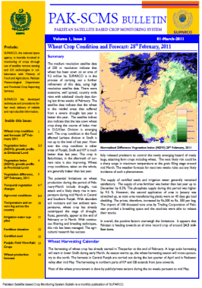
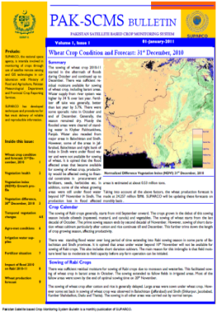
National capacity development IN Pakistan
Technical Consultations & Reports: Pak-SCMS Bulletin
A monthly Pakistan Satellite based Crop Monitoring System (Pak-SCMS) bulletin is being issued since December 2010:
http://www.suparco.gov.pk/pages/pak-scms.asp

Slide 39
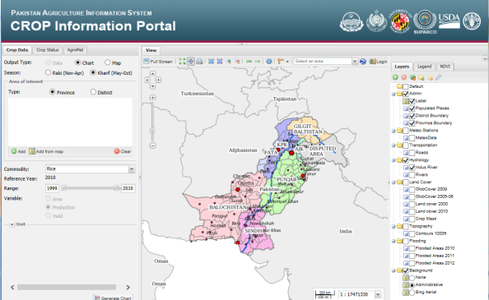
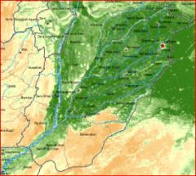
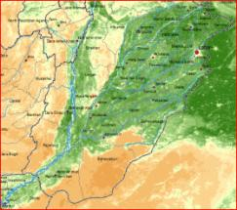

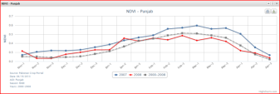
National capacity development IN Pakistan
Information Dissemination and Sharing
Crop performance in Punjab, Pakistan, according to the historical archive of crop production and agro-met conditions
  Analysis, Monitoring
  Assessment, Mapping
  Charting, Data access
  Reporting
Notes:
39
39

Slide 40

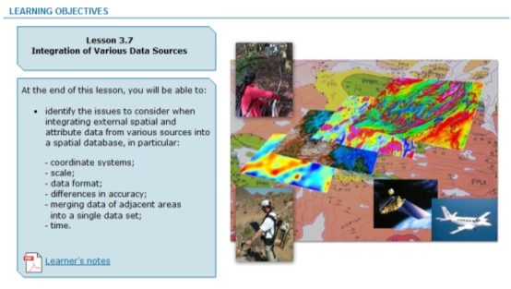
Partnership for the design of learning materials and e-learning ??
Identify learner (job) profiles
Identify key tasks
Define the knowledge required to carry out those tasks
Design learning elements in a logical pedagogic structure
E-learning Content
CD-Rom (self-paced)
Internet (self-paced)
F2F Training
University courses
Online tutored courses
Notes:
40

Slide 41

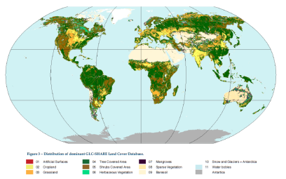
GLC-SHARE: fact-sheet
Uses the FAO SEEA LCML(*) legend
30 arc-second pixel resolution
11+1 layers indicating the % share of each class
Dominant land cover layer and quality score
Overall dominant class accuracy ~80%
Designed as a platform to facilitate crowd-sourcing
Compatible with FAOSTAT classification
Designed to be used for GAEZ 2010 update
Methodology and beta-release datasets will be available in 2014

Slide 42
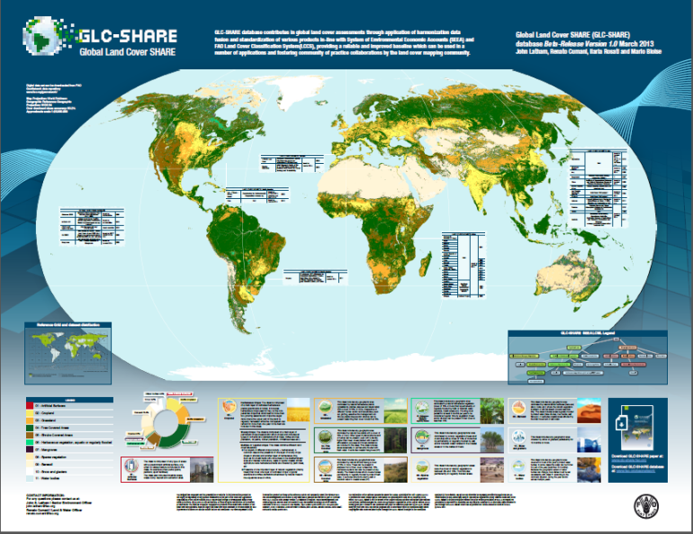

Slide 43
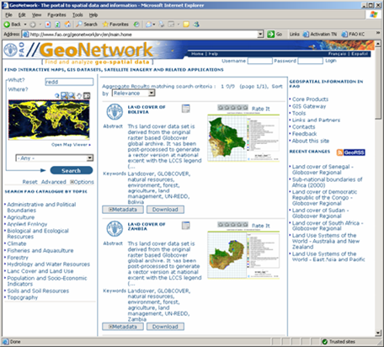
GEOGLAM Knowledge platform – a proposal
Development of
  data processing standards,
  protocols and standards
  related metadata
  core datasets
  pool training material and best practices
  E learning
to enable the inter-use of data from various platforms.

Slide 44
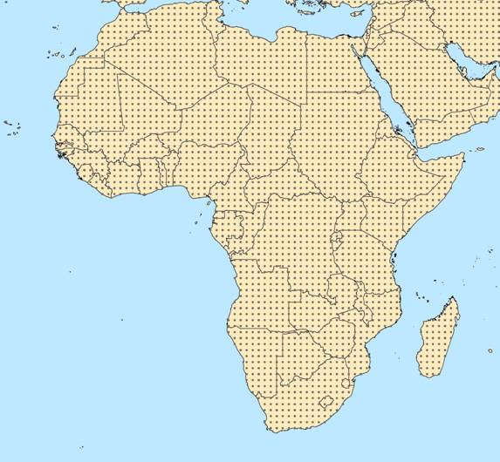
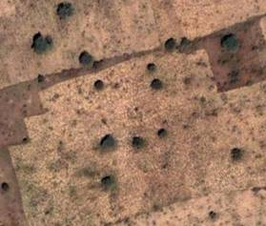
ECO–NET Africa
Earth Cover Network Africa
Sample tiles at 10 by 10 Km at half degree
Very high resolution imagery (targeted 5m or better)
Detailed land cover mapping using LCML enriched with vegetation index(es) from remote sensing
About 9,000 sampling sites
Coordinated and supervised by FAO with engagement of national experts
BASIC OBJECTS PROPRERTIES CHARACTERISTICS
Herbaceous Cover 30 – 50 % Cultivated
Rainfed
Field size 1 ha
Tree Cover 1 -3 % Natural
Height 5 -8 m. Disposition: irregular
Leaf type: Broadleaf
Leaf type % 100
Scrub Cover 2 – 4 % Natural
Height 1 – 3 m. Disposition: irregular
Leaf type: Broadleaf
Leaf type % 100
Notes:
44
Based on good practices and standards
It responds to the need for consistent and reliable information that serves multiple applications, interoperable and scalable and compliant with reporting needs.
Designed to:
Provide dynamic, multi-type, consistent acreage estimate and statistics of natural resources at regional, sub-regional, national and sub-national level
Establish the framework of consistent, detailed and dynamic test sites for calibration and/or accuracy assessment of any future wall to wall global or regional land cover, land use change and forestry
Promote and enable global partnership through effective and active participatory approach of the wider international community and engagement of partner countries to the achievement of environmental sustainability and assessment of natural resources

Slide 45
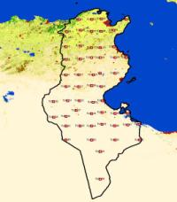
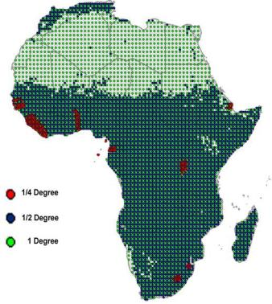
ECO-NET Outcomes
Create a database with extremely detailed information, global or regional, comparable and continually updated in support of a wide range of activities.
Serve as multi-statistical source of information at any level of detail or complexity. Using specific software on the Web, any end users worldwide will be able to define a geographical area and the categories for which area statistics will be generated.
Provide the most consistent, detailed and dynamic test site for calibration and/or accuracy assessment of any future wall-to-wall global, regional or national Land Cover mapping programmes
Notes:
45

Slide 46
THANK - YOU
Partners in developing countries
Capacity building and monitoring
John Latham
FAO

Slide 47

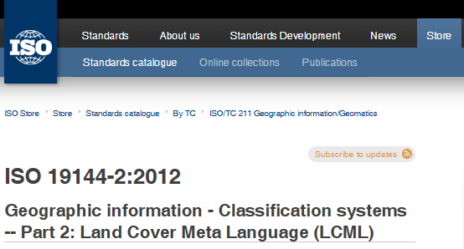
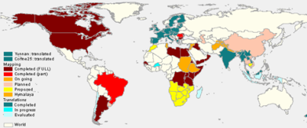

Building on Standards and Classification
System LCCS / LCML / ISO 19144-2:2012
LCCS: Comprehensive methodology for description, characterization, classification and comparison of most land cover features identified anywhere in the world, at any scale or level of detail: basis for comparative classification. (6 UN official languages)
Created in response to a need for a harmonized and standardized collection and reporting on the status and trends of land cover

Slide 48





Commonality of SOFTWARE - freeware
THEMATIC
& CART.
ASPECT
INTERPRETATION
EFFICIENCY
ACCURACY
ANALISYS
MULTI USER
DATA BASE
BROWSER
Land
cover
class.
Syst.
Map
Advanc.
DATA BASE
Acc.
Database
Prog.
GATEW.
DATA PRODUCERS
DATA USERS
Notes:
48
48

Slide 49
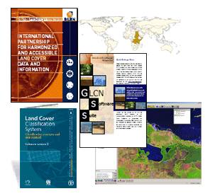
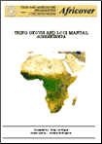






FAO GLCN Core activities
Land cover
Establish global network
Develop Land cover mapping methodology
Standards development (LCCS/LCML)
Land Cover Mapping Toolbox (LCCS/MadCat/ADG)
Technical assistance to national experts for land cover mapping activities
Preparation of guidelines, manuals, templates, workshops, technical papers, metadata
Capacity building
Awareness raising workshops, training resources and sessions
Dissemination and outreach (FAO GeoNetwork and FAO GLCN website)
Enable use of the land cover information
multi-date landsat imagery

Slide 50

LCCS databases
Global Land Cover (GLC) 2000
1 km resolution
The dataset was sponsored by members of the VEGETATION programme, including JRC. Each partner used the Land Cover Classification System (LCCS) produced by FAO and UNEP, which ensured that a standard legend was used across the globe

Slide 51

LCCS databases
GlobCover ~2006
300 m resolution
The GlobCover Land Cover product is based on ENVISAT MERIS data at full resolution from January 2005 to June 2006. The GlobCover Land Cover product is labelled according to the UN Land Cover Classification System
Notes:
Source: Wikipedia http://en.wikipedia.org/wiki/GLOBCOVER

Slide 52

Africa Land Cover products
Land Cover Mapping
Country scale (30m or better resolution)
on going ECONET
Ethiopia
2012 Fouta Djallon Highlands
        Malawi
2011 Sudan
2010 South Sudan
        Tunisia
Kenya Update
2007 Somalia
2006 Kenya LCC
2005 Senegal
2004 Libya
1998- 2002 AFRICOVER

Slide 53


GLCN/AFRICOVER: East Africa Module
Development of a regional database and regional aggregation
Project facts:
Mapped area: 8.5 million Km2
Countries covered: 10
Landsat Scenes used: more than 400
Period of activity: 1998-2004
Result: Multipurpose Africover Database for the Environmental Resources produced at a 1:200,000 scale (1:100,000 for small countries and specific areas)
Burundi, DR Congo, Egypt, Eritrea,
Kenya, Rwanda, Somalia, Sudan,
Tanzania and Uganda.

Slide 54




FAO/GLCN Regional Harmonization Programme (RHAP)
The GLCN RHAP initiative is a further extension/reinforcement of the regional activities.
GLCN as a catalyst to initiate a broad process of harmonization of thematic and cartographic standards to analyze and monitor natural resources.
RHAP is based on the experience gathered through GLCN activities over a number of years.
It takes into account that the modification of national approaches and the adoption of international standards are long processes that need the involvement and endorsement of numerous national institutions.
Himalaya
SADC
Mekong river basin
Caucasian region

Slide 55



Fouta Djallon Highlands land cover change
Fouta Djallon AOI: ca. 400,000 Km²
5 Countries within the AOI:
Guinea, Guinea-Bissau, Mali, Senegal, Sierra Leone
LANDSAT coverage (30m res) 1990-2005
ASTER coverage (17 m res) 2008-2011
RapidEye coverage (5 m res) ~2005

Slide 56



Malawi Land Cover/change database (1990-2010)
From other to cropland (square blue) and vice versa (circle orange)

Slide 57
ECO-NET Programme
FAO has developed ECO-NET programme a mapping approach based on statistical method
GOAL: to assure reliable information at country levels
MAPPING PROCESS based on samples chosen on a fixed grid with appropriate density interval.
OUTPUT: successfully validated in several demonstration countries in Africa
Mapping:
large area by samples, high level of details,
distributed in an appropriately dense grid
Benefits:
contribute to reduce costs and time
offer a solid baseline for updating
processing change assessment without affecting the soundness of the information in statistical generation in agriculture consistently

Slide 58
ECO–NET Africa
Earth Cover Network Africa
Sample tiles at 10 by 10 Km at half degree
Very high resolution imagery (targeted 5m or better)
Detailed land cover mapping using LCML enriched with vegetation index(es) from remote sensing
About 9,000 sampling sites
Coordinated and supervised by FAO GLCN with engagement of national experts
BASIC OBJECTS PROPRERTIES CHARACTERISTICS
Herbaceous Cover 30 – 50 % Cultivated
Rainfed
Field size 1 ha
Tree Cover 1 -3 % Natural
Height 5 -8 m. Disposition: irregular
Leaf type: Broadleaf
Leaf type % 100
Scrub Cover 2 – 4 % Natural
Height 1 – 3 m. Disposition: irregular
Leaf type: Broadleaf
Leaf type % 100
Notes:
58
Based on good practices and standards
It responds to the need for consistent and reliable information that serves multiple applications, interoperable and scalable and compliant with reporting needs.
Designed to:
Provide dynamic, multi-type, consistent acreage estimate and statistics of natural resources at regional, sub-regional, national and sub-national level
Establish the framework of consistent, detailed and dynamic test sites for calibration and/or accuracy assessment of any future wall to wall global or regional land cover, land use change and forestry
Promote and enable global partnership through effective and active participatory approach of the wider international community and engagement of partner countries to the achievement of environmental sustainability and assessment of natural resources

Slide 59
ECO-NET Outcomes
Create a database with extremely detailed information, global or regional, comparable and continually updated in support of a wide range of activities.
Serve as multi-statistical source of information at any level of detail or complexity. Using specific software on the Web, any end users worldwide will be able to define a geographical area and the categories for which area statistics will be generated.
Provide the most consistent, detailed and dynamic test site for calibration and/or accuracy assessment of any future wall-to-wall global, regional or national Land Cover mapping programmes
Notes:
59

Slide 60

FAO GAEZ data portal www.fao.org/nr/gaez
Provides interactive and dynamic web application to report on the current state and trends of agricultural production and crop suitability
Designed based on multi-dimensional, multi-temporal and multi-purpose database
Developed using standards and innovative technology
Enables public access to data and information, becoming a gateway global, regional and local geospatial and tabular information on agricultural resources and potential

Slide 61
GAEZ data portal capabilities
Designed to facilitate access to the GAEZ database and resources
Enables users management
Delivers terabytes of spatial data, maps, tables, statistics, metadata, reports
Fully documented (Data model, User’s Manual, GAEZ definitions, FAQ, limitations, and hints available)
Compliant with FAO definitions, classifications and standards, ISO metadata standards to feed FAO GeoNetwork

Slide 62

GAEZ menu structure

Slide 63

Land Resources Information Management System (LRIMS)
Designed and developed based on FAO guidelines for sustainable management of natural resources
Implements an integrated and interactive approach to land use planning enabling assessment and modeling of land suitability and responses to potential agricultural production
Integrates various functionalities and methodologies into one processing environment
Built on modular approach (extendable and replicable)

Slide 64
GeoNetwork – FAO metadata catalogue
Provides Internet access to interactive maps, satellite imagery and related spatial databases maintained by FAO and its partners.
The site is powered by GeoNetwork opensource, which is developed by FAO and other UN agencies and adopts a modern architecture based on the principles of Free and Open Source Software (FOSS) and International and Open Standards for services and protocols.
Almost 7000 records are stored.

Slide 65

Fouta-Djallon Highlands GeoPortal

Slide 66

World Bank method
Data Source: http://go.worldbank.org/TH1J3VGUT0
(World Bank - Statistical Capacity Indicator)
Statistical Capacity Indicator provides an overview of the statistical capacity of over 140 developing countries. It is based on a diagnostic framework developed with a view to assessing the capacity of national statistical systems using metadata information generally available for most countries, and monitoring progress in statistical capacity building over time.

Slide 67

World Bank countries selected
n. | Country | WB score
1 | Turkmenistan | 38
2 | D. R. Congo | 43
3 | Yemen | 43
4 | Liberia | 43
5 | Sudan(former) | 44
6 | Myanmar | 49
7 | Timor-Leste | 49
8 | Guinea-Bissau | 51
9 | Benin | 54
10 | Sierra Leone | 54

Slide 68
FAO-NRL Method and indicators
The selection criteria is based on the methodology developed in FAO-NRL based on the following indicators:
Importance of Agriculture for the national economy
  – percentage of agricultural value added to the total gross domestic product (GDP)
Contribution of the country to global food production
  – share of country’s cereal production to the world of cereal production
Share of rural population
Level of statistical development

Slide 69

FAO-NRL SIGMA Countries original selected
RANK | Countries | Country share of Cereal production 2010 | Percentage of Agriculture value added | Share of Rural Population 2010 | Income level 2011 | Level of statistical capacity
1 | Bangladesh | high | medium | high | Low income | medium
2 | India | high | medium | high | Lower middle income | high
3 | Argentina | high | medium | low | Upper middle income | high
4 | China, mainland | high | low | medium | Lower middle income | medium
5 | Indonesia | high | low | medium | Lower middle income | high
6 | Brazil | high | low | low | Upper middle income | medium
7 | Myanmar | medium | high | high | Low income | low
8 | Viet Nam | medium | medium | high | Lower middle income | medium
9 | Pakistan | medium | medium | high | Lower middle income | medium
10 | Ukraine | medium | medium | medium | Lower middle income | high

Slide 70

AMIS Countries selected among the main producing, exporting and importing countries
America: Canada, USA, Mexico, Brazil, Argentina
Africa: Nigeria, Egypt, South-Africa
EU: UK, Spain, France, Italy, Germany
Europe-Asia: Russian Federation, Ukraine, Turkey, Kazakhstan, Saudi Arabia
Asia: India, China, Republic of Korea, Japan, Vietnam, Thailand, Indonesia,
Philippines
Notes:
Established at the request of the Agriculture Ministers of the G20, the Agricultural Market Information System (AMIS) is an inter-Agency Platform to enhance food market transparency and encourage coordination of policy action in response to market uncertainty. The initial focus of AMIS is on four crops that are particularly important in international food markets, namely wheat, maize, rice and soybeans.

Slide 71

AMIS Participating Countries
AMIS seeks to strengthen collaboration and dialogue among main producing, exporting and importing countries. Apart from G20 members plus Spain, participants in AMIS include seven major producing, consuming and exporting countries of commodities covered by AMIS. Together, these countries represent a large share of global production, consumption and trade volumes of the targeted crops, typically in the range of 80-90 %. In addition, AMIS reaches out to other key stakeholders in international food markets such as commodity associations and institutional investors in commodity markets.
Notes:
Established at the request of the Agriculture Ministers of the G20, the Agricultural Market Information System (AMIS) is an inter-Agency Platform to enhance food market transparency and encourage coordination of policy action in response to market uncertainty. The initial focus of AMIS is on four crops that are particularly important in international food markets, namely wheat, maize, rice and soybeans.

Slide 72
GEOGLAM aim and actions
The Group on Earth Observations Global Agricultural Monitoring (GEOGLAM) initiative aims at strengthening the international community’s capacity to produce and disseminate relevant, timely and accurate forecasts of agricultural production at national, regional and global scales through the use of Earth observations.
Action 1. Strengthening national capacities for agric. monitoring
Capacity development for the use of EO, experience sharing, research;
Action 2. Global and regional agricultural monitoring Systems
Harmonizing, connecting, strengthening inter-comparing existing systems, disseminating information.
Action 3. At risk regions and countries agricultural monitoring
Improving monitoring methods, tools and systems for vulnerable agricultural systems
Action 4. Global Earth observation system of systems for agriculture
Developing an operational system : coordinated satellite and in-situ Earth Observation and weather forecasting.
Notes:
The main objective of GEOGLAM is to reinforce the international community’s capacity to produce and disseminate relevant, timely and accurate forecasts of agricultural production at national, regional and global scales by using Earth Observation data. This will be achieved by:
enhancing national agricultural reporting systems, including through a geo-spatial education curriculum to enable training of participants worldwide;
establishing a sustained international network of agricultural monitoring and research organisations and practitioners; and
harmonizing the operational global agricultural monitoring systems based on both satellite and in situ observations, including through improved coordination of satellite observations
We commit to improve market information and transparency in order to make international markets for agricultural commodities more effective. To that end, we launched: The “Agricultural Market Information System” (AMIS) in Rome on September 15, 2011, to improve information on markets. It will enhance the quality, reliability, accuracy, timeliness and comparability of food market outlook information. As a first step, AMIS will focus its work on four major crops: wheat, maize, rice and soybeans. AMIS involves G20 countries and, at this stage, Egypt, Vietnam, Thailand, the Philippines, Nigeria, Ukraine and Kazakhstan. It will be managed by a secretariat located in FAOThe “Global Agricultural Geo-monitoring Initiative” in Geneva on September 22-23, 2011. This initiative will coordinate satellite monitoring observation systems in different regions of the world in order to enhance crop production projections and weather forecasting data.
The overarching goal of JECAM is to reach a convergence of approaches, develop monitoring and reporting protocols and best practices for a variety of global agricultural systems. JECAM is enabling the global agricultural monitoring community to compare results based on disparate sources of data, using various methods, over a variety of global cropping systems. The JECAM experiments will facilitate international standards for data products and reporting, eventually supporting the development of a global system of systems for agricultural crop assessment and monitoring

Slide 73

GEOGLAM- Proposed countries (to be confirmed in Feb Meeting)
Criteria: Crops maize, wheat, corn soy producer countries
America
Argentina
Africa
Uganda
EurAsia
Russia
Ukraine
Australia
Source: Status Update on The GEOGLAM Inititive
I. Becker-Reshef, C. Justice, A. Whitcraft, M. Hansen, J. Soares
CEOS SDCG--‐3 Meeting
February 7--‐9, 2013
Sydney, Australia
Notes:
The main objective of GEOGLAM is to reinforce the international community’s capacity to produce and disseminate relevant, timely and accurate forecasts of agricultural production at national, regional and global scales by using Earth Observation data. This will be achieved by:
enhancing national agricultural reporting systems, including through a geo-spatial education curriculum to enable training of participants worldwide;
establishing a sustained international network of agricultural monitoring and research organisations and practitioners; and
harmonizing the operational global agricultural monitoring systems based on both satellite and in situ observations, including through improved coordination of satellite observations
We commit to improve market information and transparency in order to make international markets for agricultural commodities more effective. To that end, we launched: The “Agricultural Market Information System” (AMIS) in Rome on September 15, 2011, to improve information on markets. It will enhance the quality, reliability, accuracy, timeliness and comparability of food market outlook information. As a first step, AMIS will focus its work on four major crops: wheat, maize, rice and soybeans. AMIS involves G20 countries and, at this stage, Egypt, Vietnam, Thailand, the Philippines, Nigeria, Ukraine and Kazakhstan. It will be managed by a secretariat located in FAOThe “Global Agricultural Geo-monitoring Initiative” in Geneva on September 22-23, 2011. This initiative will coordinate satellite monitoring observation systems in different regions of the world in order to enhance crop production projections and weather forecasting data.
The overarching goal of JECAM is to reach a convergence of approaches, develop monitoring and reporting protocols and best practices for a variety of global agricultural systems. JECAM is enabling the global agricultural monitoring community to compare results based on disparate sources of data, using various methods, over a variety of global cropping systems. The JECAM experiments will facilitate international standards for data products and reporting, eventually supporting the development of a global system of systems for agricultural crop assessment and monitoring

Slide 74

COUNTRY
America
Mexico
Brazil
Argentina
Africa
Uganda
Algeria
Ethiopia
EurAsia
Russia
Ukraine
Belarus
Kazakhstan
Australia
Pakistan
Thailand
Lao
Philippines
Vietnam
GEOGLAM- Proposed countries
Selection Pilot - Priority countries/regions:
Proposed countries and regions as larger producers / at risk (to be confirmed in February meeting)
REGIONAL
North Africa
Southern Africa
(SADC)
Criteria: Crops maize, wheat, rice, soybeans producer countries

Slide 75

JECAM Countries Selected
America
Canada
USA
Mexico
Argentina
Brazil
Paraguay
Uruguay
Africa
Burkina-Faso
Madagascar
Morocco
South Africa
Tanzania
Tunisia
Asia
China
Saudi Arabia
Taiwan
Europe
Belgium
France
Italy
Russia
Ukraine
Notes:
The main objective of GEOGLAM is to reinforce the international community’s capacity to produce and disseminate relevant, timely and accurate forecasts of agricultural production at national, regional and global scales by using Earth Observation data. This will be achieved by:
enhancing national agricultural reporting systems, including through a geo-spatial education curriculum to enable training of participants worldwide;
establishing a sustained international network of agricultural monitoring and research organisations and practitioners; and
harmonizing the operational global agricultural monitoring systems based on both satellite and in situ observations, including through improved coordination of satellite observations
We commit to improve market information and transparency in order to make international markets for agricultural commodities more effective. To that end, we launched: The “Agricultural Market Information System” (AMIS) in Rome on September 15, 2011, to improve information on markets. It will enhance the quality, reliability, accuracy, timeliness and comparability of food market outlook information. As a first step, AMIS will focus its work on four major crops: wheat, maize, rice and soybeans. AMIS involves G20 countries and, at this stage, Egypt, Vietnam, Thailand, the Philippines, Nigeria, Ukraine and Kazakhstan. It will be managed by a secretariat located in FAOThe “Global Agricultural Geo-monitoring Initiative” in Geneva on September 22-23, 2011. This initiative will coordinate satellite monitoring observation systems in different regions of the world in order to enhance crop production projections and weather forecasting data.
The overarching goal of JECAM is to reach a convergence of approaches, develop monitoring and reporting protocols and best practices for a variety of global agricultural systems. JECAM is enabling the global agricultural monitoring community to compare results based on disparate sources of data, using various methods, over a variety of global cropping systems. The JECAM experiments will facilitate international standards for data products and reporting, eventually supporting the development of a global system of systems for agricultural crop assessment and monitoring

Slide 76

JECAM Countries Selected
America
Canada
USA
Mexico
Argentina
Brazil
Paraguay
Uruguay
Africa
Burkina-Faso
Madagascar
Marocco
South Africa
Tanzania
Tunisia
Asia
China
Taiwan
Saudi Arabia
Europe
Belgium
France
Italy
Russia
Ukraine
Notes:
The main objective of GEOGLAM is to reinforce the international community’s capacity to produce and disseminate relevant, timely and accurate forecasts of agricultural production at national, regional and global scales by using Earth Observation data. This will be achieved by:
enhancing national agricultural reporting systems, including through a geo-spatial education curriculum to enable training of participants worldwide;
establishing a sustained international network of agricultural monitoring and research organisations and practitioners; and
harmonizing the operational global agricultural monitoring systems based on both satellite and in situ observations, including through improved coordination of satellite observations
We commit to improve market information and transparency in order to make international markets for agricultural commodities more effective. To that end, we launched: The “Agricultural Market Information System” (AMIS) in Rome on September 15, 2011, to improve information on markets. It will enhance the quality, reliability, accuracy, timeliness and comparability of food market outlook information. As a first step, AMIS will focus its work on four major crops: wheat, maize, rice and soybeans. AMIS involves G20 countries and, at this stage, Egypt, Vietnam, Thailand, the Philippines, Nigeria, Ukraine and Kazakhstan. It will be managed by a secretariat located in FAOThe “Global Agricultural Geo-monitoring Initiative” in Geneva on September 22-23, 2011. This initiative will coordinate satellite monitoring observation systems in different regions of the world in order to enhance crop production projections and weather forecasting data.
The overarching goal of JECAM is to reach a convergence of approaches, develop monitoring and reporting protocols and best practices for a variety of global agricultural systems. JECAM is enabling the global agricultural monitoring community to compare results based on disparate sources of data, using various methods, over a variety of global cropping systems. The JECAM experiments will facilitate international standards for data products and reporting, eventually supporting the development of a global system of systems for agricultural crop assessment and monitoring

Slide 77

Gates Foundation Priority Countries
These countries are selected based on a number of criteria including
the current status of use of geospatial information
status of natural resources
sustainable development and food security
use of geospatial information in policy and programming.
Africa: Burkina Faso, Ghana, Mali, Ethiopia, Nigeria, Kenya, Tanzania, Uganda
Asia: India*, Bangladesh
* 2 states

Slide 78


FAO country Frequency table
The table summarizes the frequency of selected countries by the programme and initiate
The availability of digital land cover database is considered as additional criterion
Other criteria can be considered to define the “Country of Interest”

Slide 79

Priority countries

Slide 80
Extra criteria for selection
High res. images available in Google Earth
Farming System/Agro-Ecological Zones
Security Level in the Country (from FAO UNSSD)
Total Area of the country (Km²)
Total Agriculture area (Km²)
Crop calendar, field size distribution …
…….

Slide 81


Definitions and Standards
Global land cover datasets
Comparison of forest classes
Important factors for disagreement:
Land cover/forest definitions:
  IGBP legend : percent tree cover >60%
  GLC2000 legend : percent tree cover >15%
Thematic accuracies
Spatial heterogeneities

Slide 82
Global Strategy and National Capacity Development
Technical Assistance Component
Improve institutional and organizational aspects of the agricultural statistical systems (coordination for agricultural data producers & users)
Mainstream agricultural statistics in NSDS
Areas of assistance to countries
    Plan and management of agricultural census/ link with the Population Census
    Develop master sample frame / design integrated survey frameworks
    Improve the quality and use of agricultural administrative data
    Support data analysis/forecasting
    Data Dissemination (integrated databases)
    Document good practices

Slide 83
Linking to the Global Strategy and National Capacity Development
Training Component
Strengthen existing training institutions
    Establish regional centers of excellence for advanced training
    Decentralize initial training to National Institutions
Improve the curricula existing courses and develop new ones
    Specialized courses (use of remote sensing)
    Develop a broad package of training courses
      (initial/advanced, general/specialized, long/medium/short duration; formal/on the job, etc.)
Promote e‐learning & distance learning
Strengthen real demand for training / Develop a training market

Slide 84
Technical Assistance Component
Improve institutional and organizational aspects of the agricultural statistical systems (coordination for agricultural data producers & users)
Mainstream agricultural statistics in NSDS
Areas of assistance to countries
    Plan and management of agricultural census/ link with the Population Census
    Develop master sample frame / design integrated survey frameworks
    Improve the quality and use of agricultural administrative data
    Support data analysis/forecasting
    Data Dissemination (integrated databases)
    Document good practices

Slide 85



Capacity Development - FAO et al
Awareness workshops, seminars, training resources and sessions
  Regional awareness workshops/seminars by FAO staff on land cover mapping methodology, standards and tools
  National on-the-job trainings to support national mapping and monitoring programmes
  Project coordination and backstopping
Sudan
Uruguay
Nepal
Notes:
85

Slide 86
GIEWS Countries Requiring External Assistance as reported by FAO/GIEWS (Dec 2013)
Indicators:
  Natural Disasters
  Slow: Slowly developing disasters e.g. drought, adverse weather, trans-boundary diseases, avian influenza, pests, etc.
  Sudden: Sudden on-set disasters such as floods, cyclones, hurricanes, earthquakes, volcanoes, locusts, etc.
  Man-Made Disasters
  War: War-conflict type disasters, such as war, civil strife, refugees, internally displaced persons, etc.
  Socio-economic disasters: economic crises due to commodity price collapse, loss of export markets, currency problems, land tenure problems, HIV/AIDS health related crises
Combination of Natural and Man-Made Disasters

Slide 87


GIEWS Countries Requiring External Assistance - as reported by FAO/GIEWS (Dec 2013)
List of Priority countries

Slide 88
Areas of Activity
National capacity development IN Pakistan
Outputs
(B) Improved approaches and survey methodology, peer reviewed and validated for the generation of timely crop area estimates for major crops at provincial level in Pakistan
(C) Revised field data collection methodology tested in the field in 2 provinces of Punjab and Sindh during the Rabi and Kharif seasons 2012-13 and 2013-2014
(C) Set-up of fully functional operational units in offices of the two selected provincial Crop Reporting Service (Punjab and Sindh)
(A) Trainings for staff of SUPARCO, CRS, and FBS in statistics, remote sensing, GIS and mobile computing to improve crop acreage and yield estimation, and improve the capability of the provincial CRSs to utilize satellite imagery and other data for producing crop estimation and forecasts.
(B) Development of an "after action plan" that addresses how Pakistan can move forward in provincial level crop reporting after this project has ended particular emphasis will be developed on what happens after the project's conclusion, and explicitly build on what was covered in the project.
(A) Assessments of provincial (Punjab and Sindh) crop reporting services for their capability of utilize remotely-sensed satellite imagery, field and other data for producing and making available to the public timely market-oriented reports on crop estimation and forecasts.
TRAINING
TECHNICAL CONSULTATIONS
OPERATIONAL UNIT SET-UP
Notes:
Improved approches and survery methodology, peer reviewed and validated for the generation of timely crop area estimates for major crops at provincial level in Pakistan
Methodology Assessment
AF Improvement
Trained Prov/State Staff
Technical Consultations
Develop Technical Report
Survey & Methodology Review W/shop
Review of Project Expansion
Enhancing Report & Dissemination
Demo: Cooperative Data Use & Sharing
Revised field data collection methodology tested in the field in 2 provinces of Punjab and Sindh during the Rabi and Kharif seasons 2012-13 and 2013-2014
Procurement, Transportation & Training
2012-13 Field Campaign Implementation
Agric Survey Equipment Review W/shop
Set-up of fully functional operational units in offices of the two selected provincial Crop Reporting Service (Punjab and Sindh) whereby a small team is fully able to provide valuable agricultural crop statistics derived from the integration of ground truth data and earth observation satellite systems
Design & Testing Sampling Strategies
Support Use of LCCS IN AF Sampling
Report: Use of LCCS in Agric Surveys
Refinement of Sampling Strategy AF
Trainings for staff of SUPARCO, CRS, and FBS in statistics, remote sensing, GIS and mobile computing to improve crop acreage and yield estimation, and improve the capability of the provincial CRSs to utilize satellite imagery and other data for producing crop estimation and forecasts.
Training Needs Assessment
Training Material
Development Training (through UMD)
Prototyping Protocols/Procedures
US-Based Specialized Training
Development of an "after action plan" that addresses how Pakistan can move forward in provincial level crop reporting after this project has ended particular emphasis will be developed on what happens after the project's conclusion, and explicitly build on what was covered in the project.
Analysis & Evaluation of "New" Sampling
National Sampling Methods Plan
Develop Crop Forecast Commodity Report
Assessments showing provincial (Punjab and Sindh) crop reporting services capable of utilize remotely-sensed satellite imagery, field and other data for producing and making available to the public timely market-oriented reports on crop estimation and forecasts.
Review & Refinement of Monthly Reports

