Slide 1
SDCG-5 Session 2 Landsat 7/8 status and 2013 Implementation Plan (Element 1)
Gene Fosnight

Slide 2
Mission Landsat Launch and commissioning
Landsat 7
Operational: since 15 April 1999
Expected life time:; anticipate decommissioning in 2017
Landsat 8
First OLI image 18 March on WRS since 11 April 2013
Design Life: 5 years OLI and 3 years TIRS
Fuel: 12+ years
Data policy: Free and open access
8 day repeat cycle using both satellites; 30 meter pixel; 185 km swath

Slide 3
Mission Landsat-7 and -8 Acquisition Strategy
Construct an objective Global Environmental Record using a long-term acquisition plan
We propose to focus the use of Landsat 7 on continental land masses
Reduce the use of Landsat 7 for acquisitions of island, night, ocean, and Antarctica scenes
Landsat 8’s larger daily acquisition limit and sensor characteristics provide opportunities for increased extreme latitude, island, ocean and night acquisitions to complement a Landsat 7 LTAP focused on continental land masses

Slide 4
Long-Term Acquisition Plan Summary
Prior
Current
Landsat 7
Images 350 – 450 images per day out of 540 - 630 sun-lit land opportunities
ETM+ has strict duty cycle constraints
Power cycling incurs warm up and data overhead penalties for short intervals equivalent to 4 scenes
Storage capacity constraints
Since the Scan Line Corrector failure, the LTAP pursues image pairs
Acquires oceanic islands at reduced priority and frequency
Acquires Arctic once per season
Landsat 8
Currently acquiring 550 images per day
Acquires using a formal LTAP
Specified to acquire and distribute 400 images per day
Deep Blue Band for ocean monitoring
Better cloud detection with Cirrus Band
Improved dynamic range
Landsat 7
Increased imaging of continental land masses improved coverage of persistently cloudy areas and better gap filling
Eliminate routine imaging of islands, water and Antarctica
Increase imaging from 369 images/day (69%) to approximately 438 images/day (91%)
Reduce ETM+ duty cycle from 15.1% to 14.4% and power cycles from 28.6 to 17.5 per day
Landsat 8
Constrained by download costs/opportunities
Higher island priority
More frequent imaging for islands and Arctic
Lower sun elevation constraint from 15% to 5%
Increase Antarctica acquisitions
Support selected night campaigns (such as urban heat islands, fires, sea ice, and volcanoes)
Include selected near shore and interior water scenes
Support large water campaigns
Increase ascending node day acquisitions

Slide 5
Landsat 7 Continental versus Ops Model
Modeled one-year global coverage
Ops one-year global coverage

Slide 6
Mission Landsat Data processing
Processing levels:
Systematic-Corrected (L1G): Landsat 1-7
Systematic- and Terrain- Corrected (L1Gt): Landsat 7-8
Precision- and Terrain-Corrected (L1T): Landsat 1-8
If precision control is available, we attempt to create an L1T. If, for example due to cloud cover, enough control cannot be found, we fall back to a systematic product.
Data formats:
GeoTIFF
Means for data distribution
Download only

Slide 7
Spatial Accuracy Assessment
Percentage of L1T products with better than 1 pixel accuracy
MSS: 89.91% Precision RMSE;
93.72% Independent RMSE (if RMSE>10 pixels, auto fallback to L1G
TM:99.48% Precision RMSE;
88.04% Independent RMSE (No fallback threshold)
ETM+: 99.05% Precision RMSE
OLI: 100% Precision RMSE (over 30 meters will fall back to L1Gt)
OLI: L1Gt RMSE better than 30 meters
Rules of thumb
To automatically stack images, the RMSE should be less than 1 pixel
MSS data cannot be auto-stacked
TM & ETM+ L1T can be auto-stacked with caution
TM & ETM+ L1G and L1Gt cannot be auto-stacked
OLI/TIRS can be auto-stacked
When in doubt inspect image and use information in metadata

Slide 8
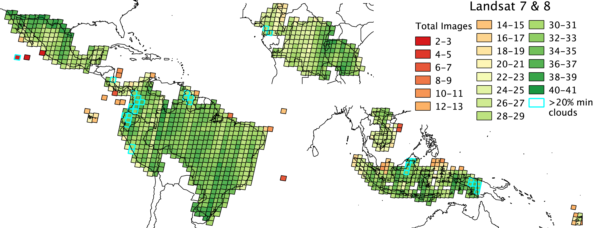
Total GFOI Landsat ETM+ and OLI Images in 2013
Landsat 7 & 8 acquired up to 41 images for each scene
Landsat 8 only imaged during the last three quarters
Scenes (34) highlighted in cyan have no image with better than 20% cloud cover

Slide 9
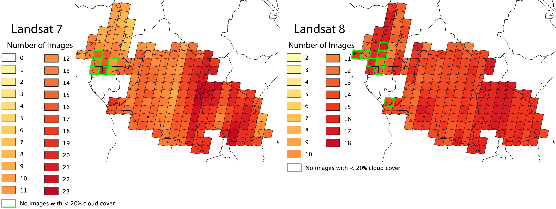
Landsat 7 & 8 2013 - Africa

Slide 10
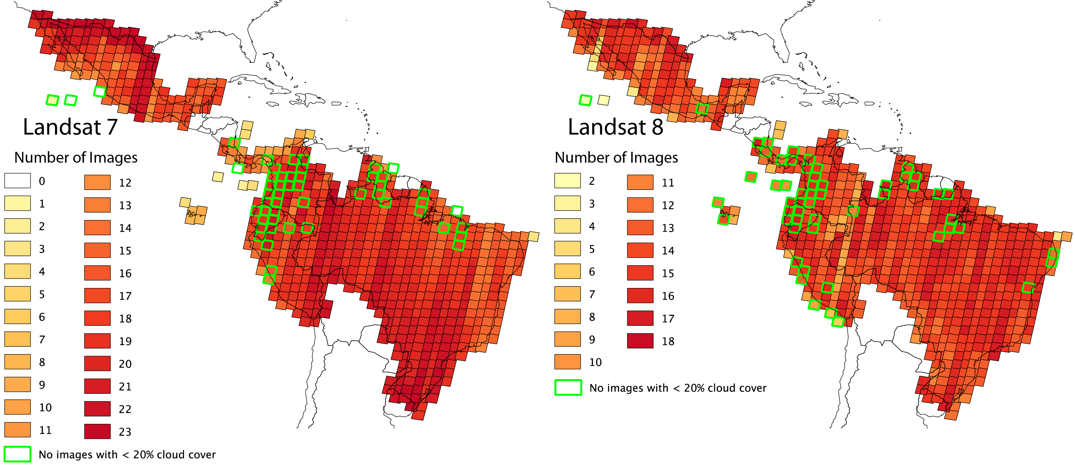
Landsat 7 & 8 2013 - Americas

Slide 11
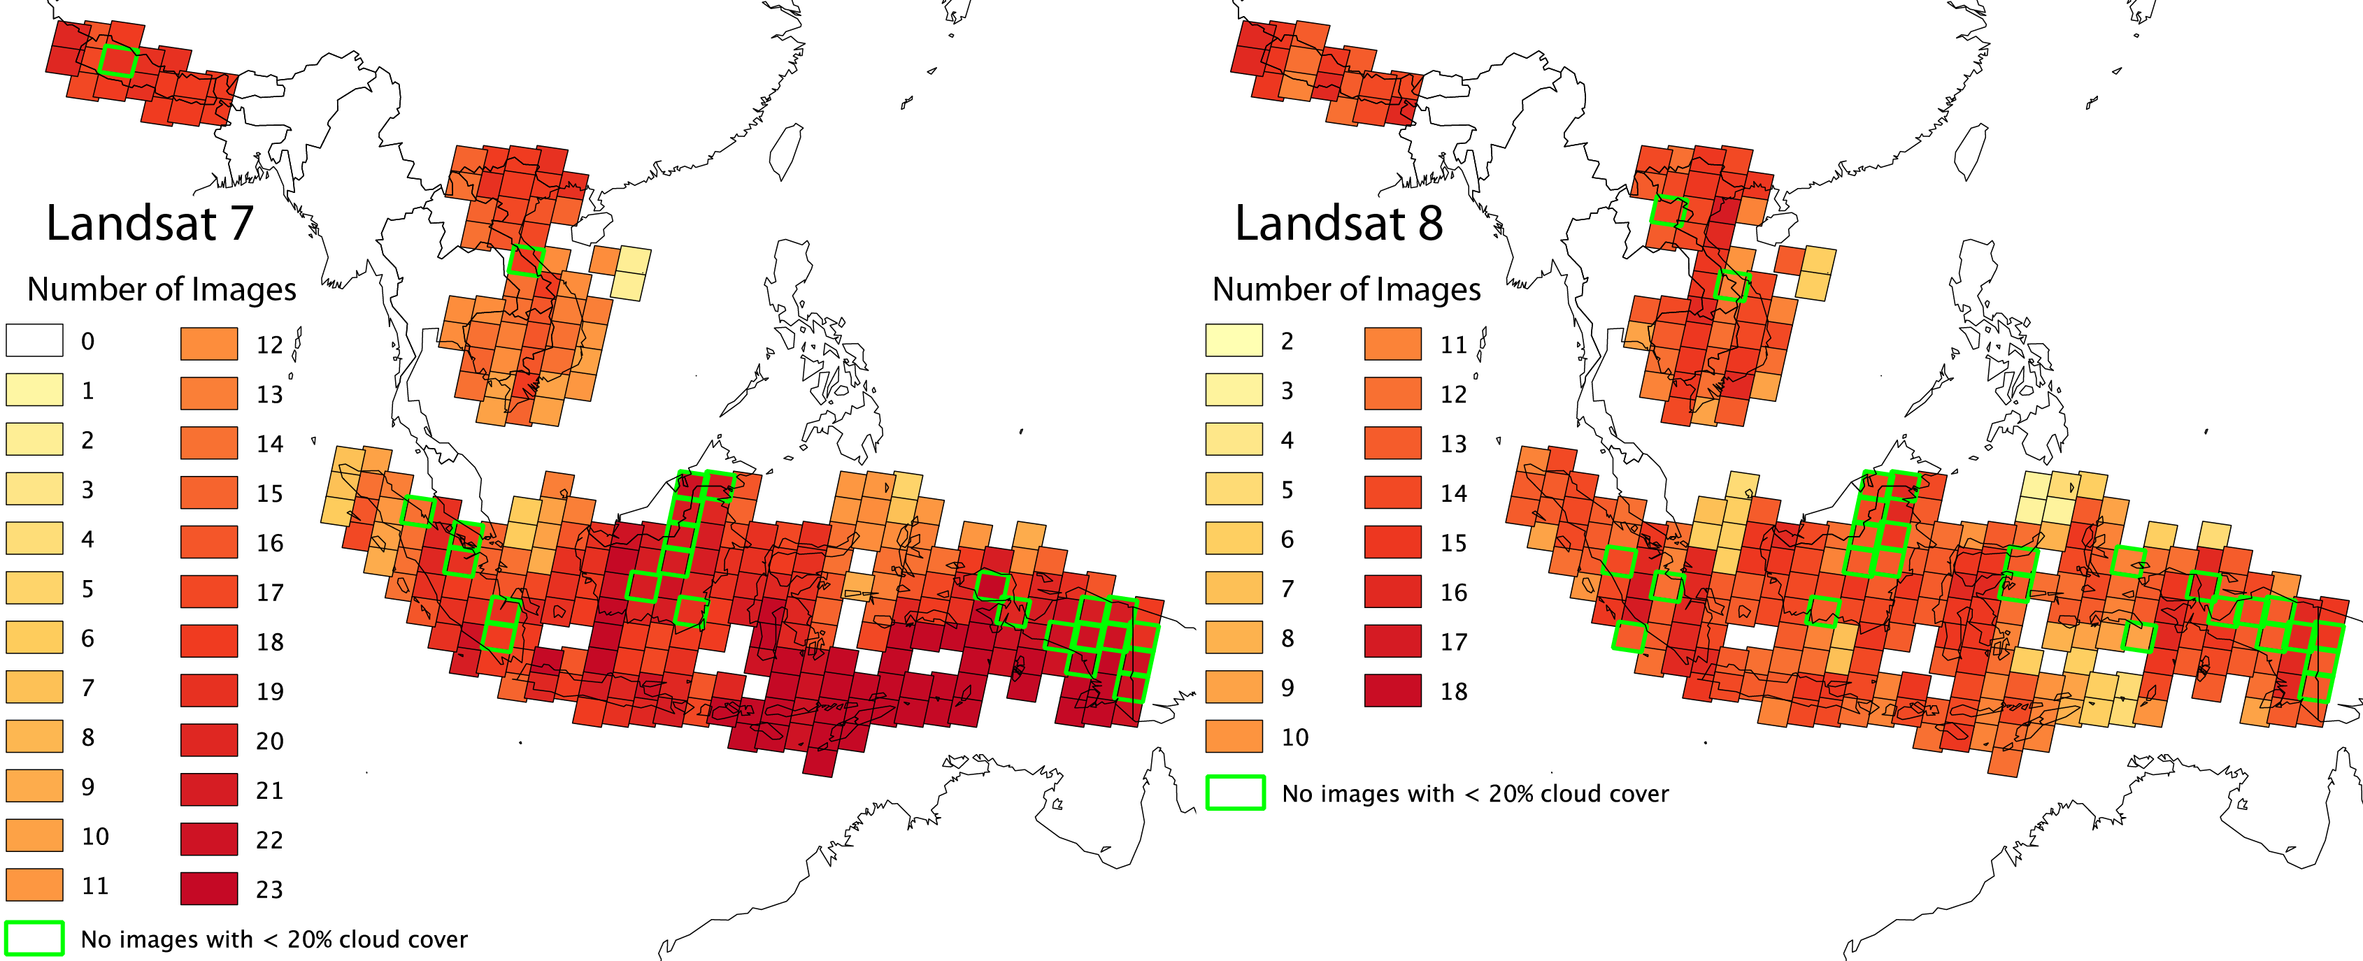
Landsat 7 & 8 2013- Asia

Slide 12
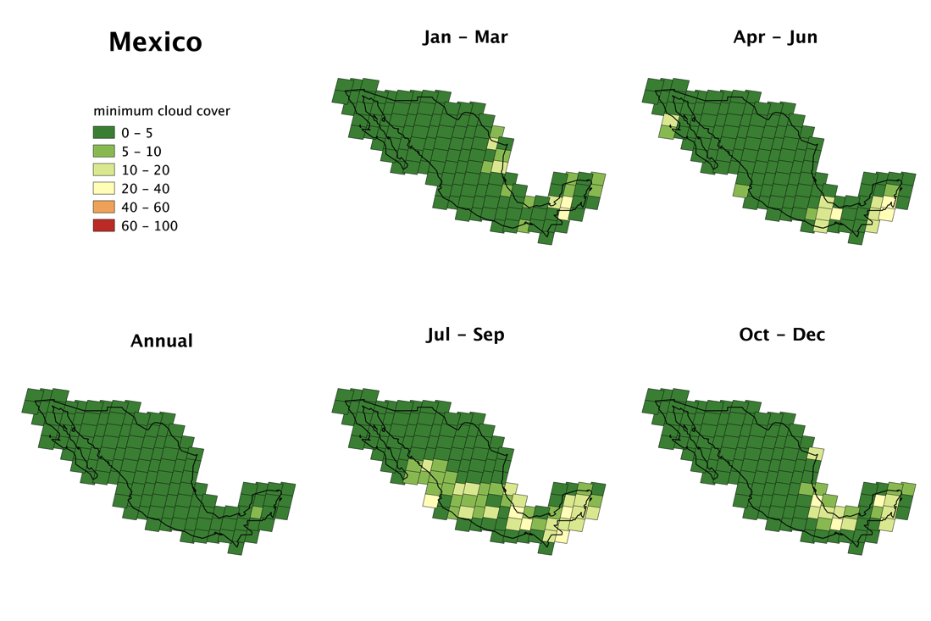
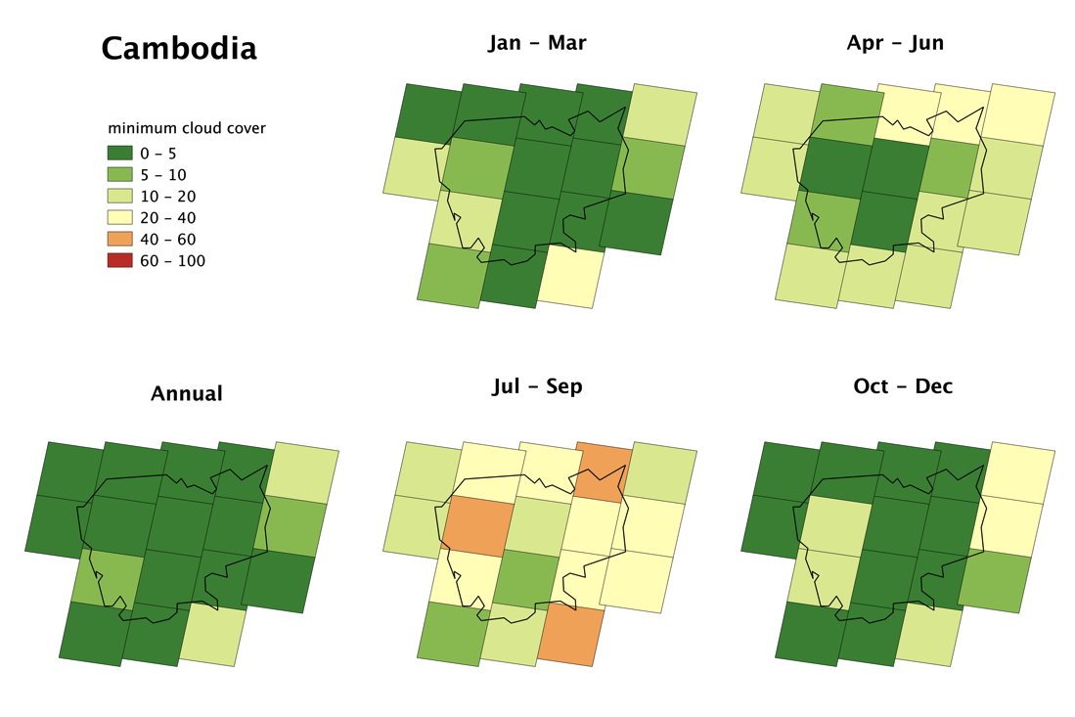
Landsat 7 & 8 2013 Best Cloud Cover by Season
The 2013 implementation report includes annual and seasonal maps for each country

Slide 13
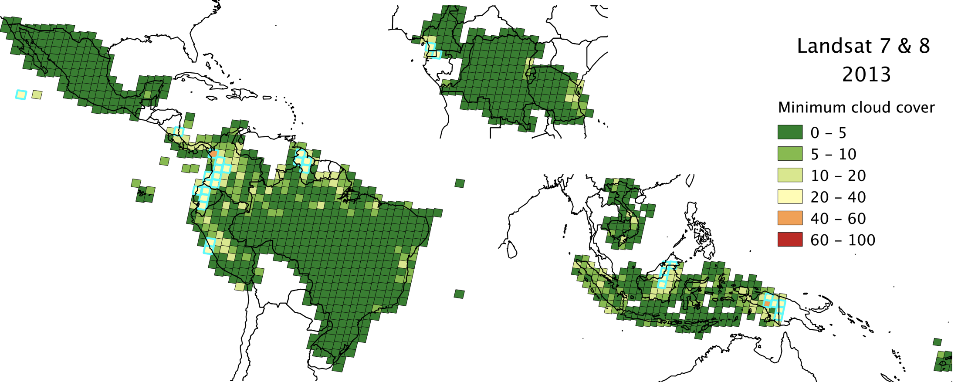
Total GFOI Landsat ETM+ and OLI Images in 2013
30% of the scenes had cloud free images
70% of the scenes had images with better than 3% cloud cover
90% of the scenes had images with better than 10% cloud cover

Slide 14
Landsat 7 & 8 2013 Best Cloud Cover by Season
With Landsat 7 only the best cloud cover for 90% of the scenes is 15.62%.
With Landsat 8 only the best cloud cover for 90% of the scenes is 16.83%.
However using both Landsat 7 & 8 the best cloud cover for 90% of the scenes drops to 9.79%.
Landsat 8 statistics are worse than Landsat 7, presumably due to the lack of 1st quarter data.
Landsat 7 end of life will be no later than early 2018!

Slide 15
Landsat 7 & 8 2014 and beyond
Acquisitions will continue at the current 550 images per day or greater
We currently acquire using cloud avoidance, so there are diminishing returns on additional acquisitions.
To do better requires more frequent coverage: Sentinel-2, CBERS-4
Radar and Airborne platforms provide the best opportunities for cloud avoidance…

Slide 16
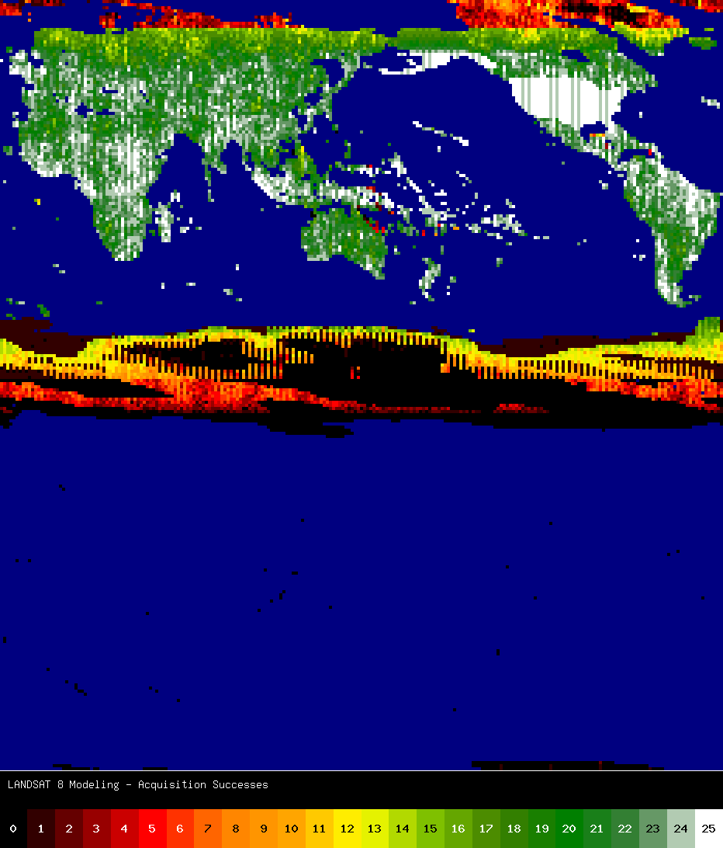
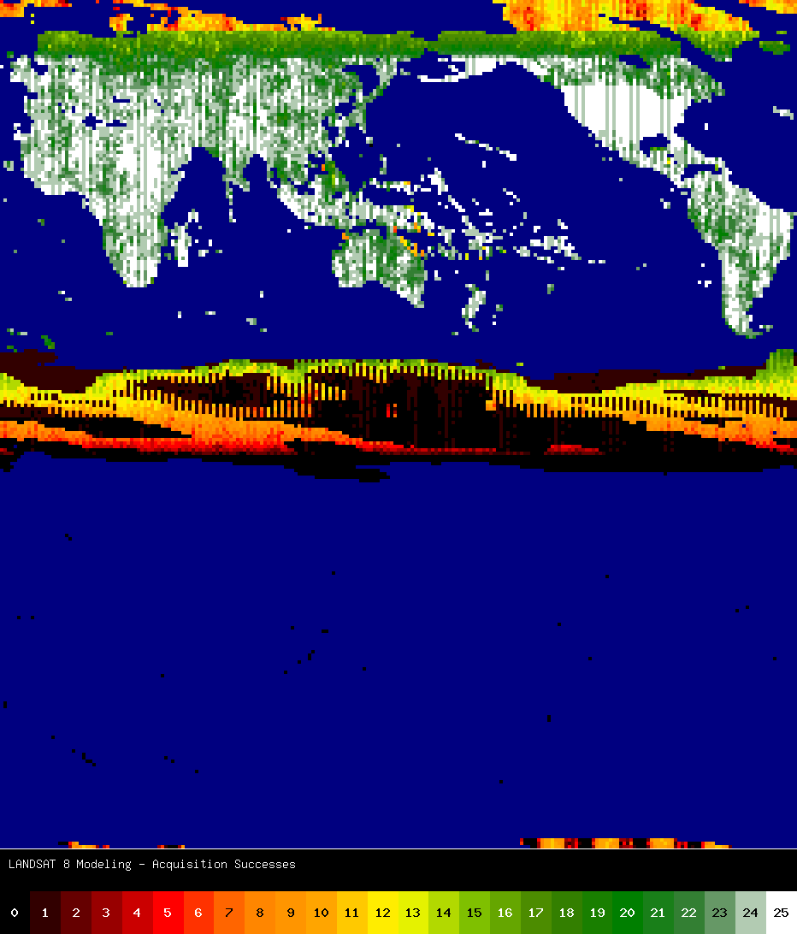
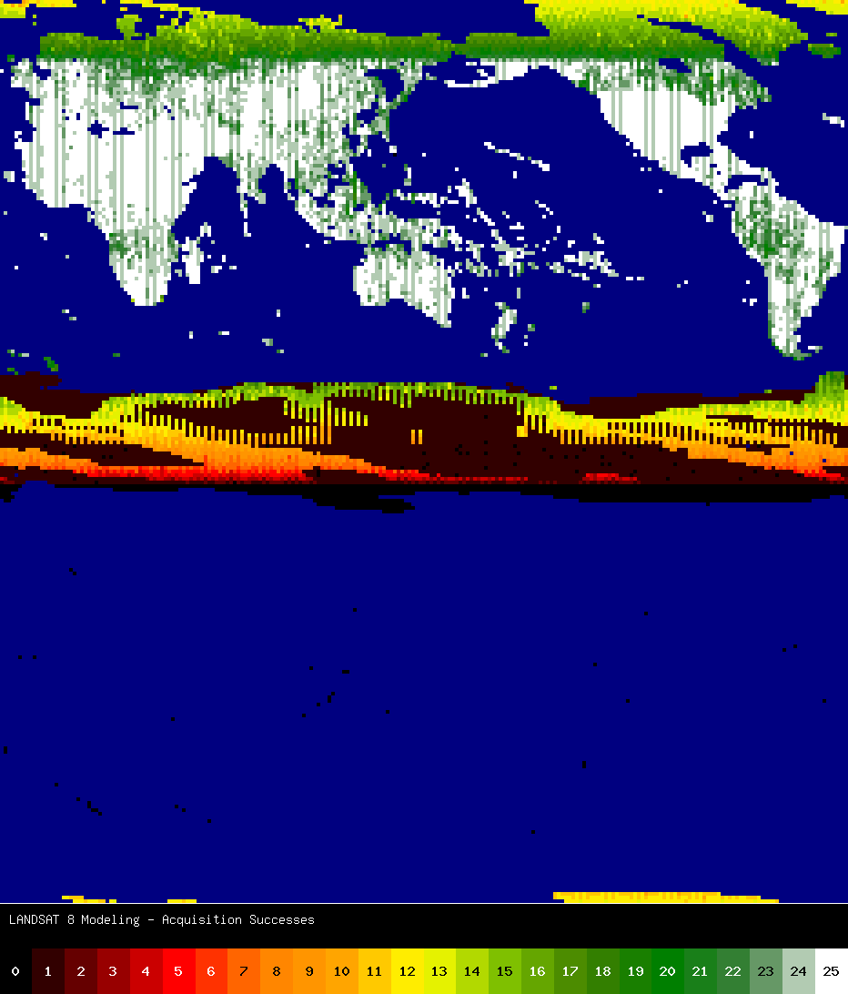
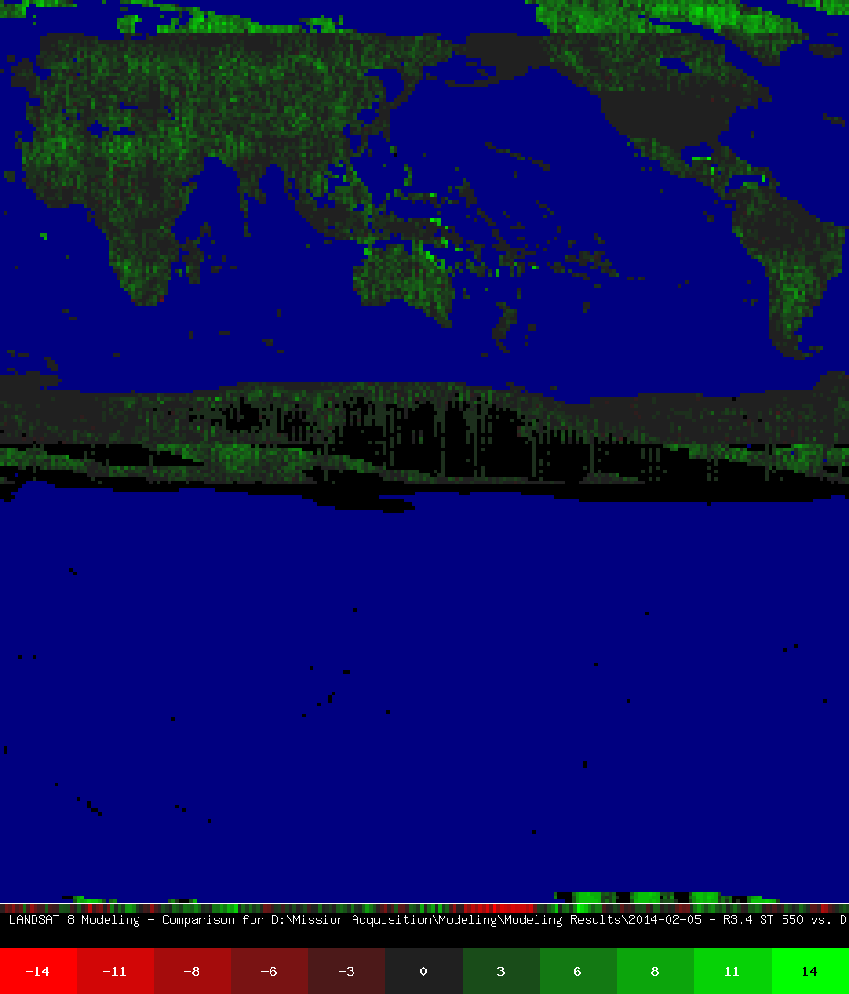
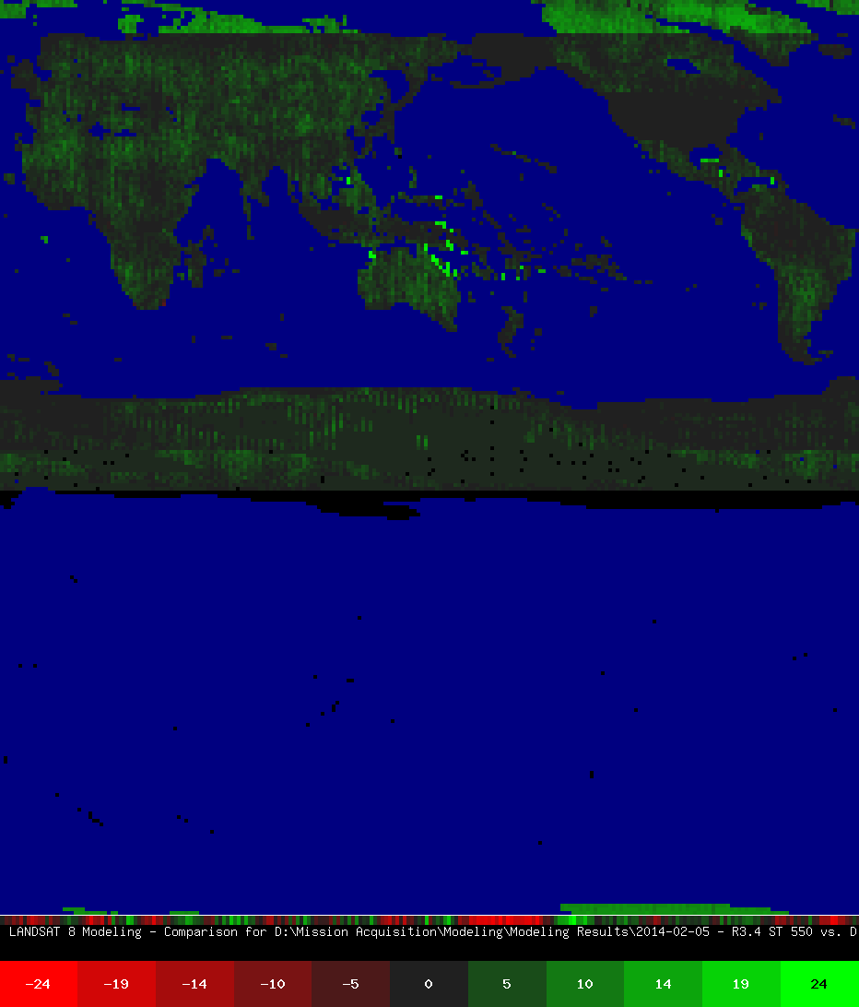
Looking forward to 2014
550
current
600
possible
750 unlikely
600 - 550
750 - 550

Slide 17
Hopes and expectations
Good chance we’ll increase to 600 images/day at least for the northern hemisphere summer
Download costs and shutter use are limiting constraints
Will add selected “interior” water bodies
Will create a smooth priority ramp at poles to shift additional resources to vegetated regions
Will not be able to add more night imaging
Data distribution continues to be a challenge

Slide 19
Thank You!
Questions?

