Slide 1
GEOGLAM Programmatic and Institutional Status Outcomes from GEO Ministerial / Plenary Implementation plan progress and resources GEOGLAM objectives for 2014 Current issues
Michel Deshayes - GEO
CEOS-GEOGLAM meeting, 27th-28th February 2014
ESA/ESRIN, Frascatti, Italy

Slide 2
Outcomes from GEO Ministerial / Plenary
GEO extended for another 10 years (2015-2025)
GEO created in 2005 for 10 years
Ministerial January 2014: GEO extended until 2025
Other outcomes
Role/importance of special initiatives (GFOI, GEOGLAM..)
Continue to advance broad open data policies
Linkage to Sustainable Development Goals (SDG's)
Increased partnership with private sector

Slide 3
GEOGLAM Structure & Work plan
GEOGLAM Steering Committee
Including G20 Donor representation, program stakeholders
Program Coordination office
+ Secretariat
Implementation Group
consisting of Implementation Team leads
Global / Regional System of Systems
main producer countries, main commodities
2. National capacity development
for agricultural monitoring using EO
3. Monitoring countries at risk
food security assessment
4. EO data coordination (w. CEOS)
5. Method improvement through R&D coordination (e.g. JECAM)
6. Data products and information dissemination
Tasks
Tasks
Tasks
3 / 21

Slide 4
Implementation plan progress and resources
Implementation Plan
Evolving document, with first version dated July 2013
6 components (see below)
4 phases to 2017 (Operational Phase)
2014 transition from Phase-1 (Foundation) to Phase-2 (Expansion)
6 GEOGLAM components
1. Global / Regional System of Systems
main producer countries, main commodities
National Capacity Development
for agricultural monitoring using earth observation
3. Monitoring countries at risk
food security assessment
4. EO data coordination
5. Method improvement through R&D coordination (eg. JECAM)
6. Data products and information dissemination
Tasks
Tasks
Tasks

Slide 5
GEOGLAM objectives for 2014
Continuation of C#1 – Global / main producers
With link to AMIS (Agricultural Market Information System)
Work on ways to synthetically present results (for non-EO specialists)
Continuous improvement of Crop Monitor website interface
Developing coordination of 2 components
C#2 – Capacity Building
Need to define criteria for country selection
C#3 – Countries at Risk
Need to define criteria for country selection
Continuous link with CEOS
GEOGLAM website
Development and launch (<6 months)

Slide 6
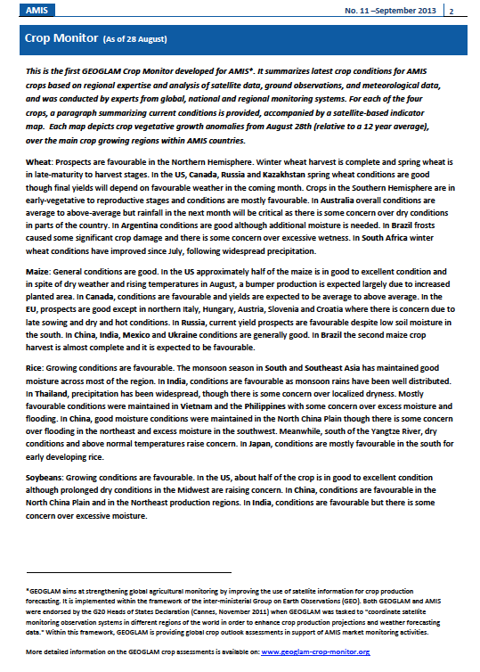
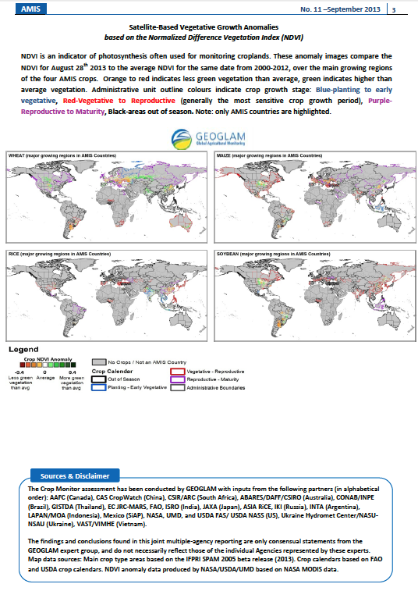
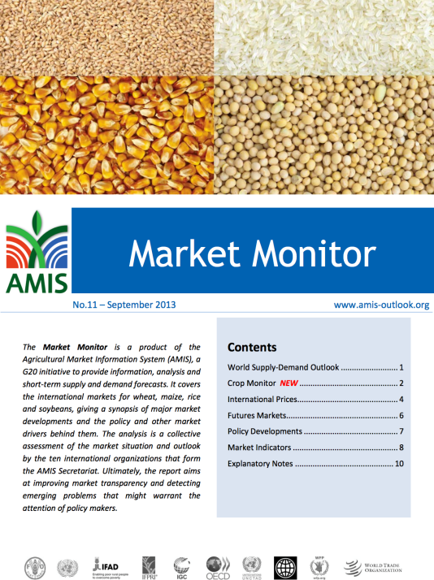
GEOGLAM Crop Monitor Current Status
June-July 2013: Prototyped crop outlooks for review by AMIS
Sept. 2013: Started provision of routine Crop Monitor to AMIS
Since Sept. 2013: Regular monthly reporting and refining tools and processes for information collection, maps and synthesis
6/35

Slide 7
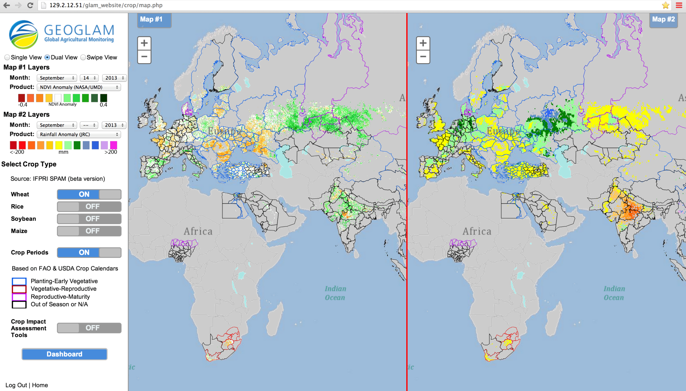
GEOGLAM Crop Monitor Assessment Interface
Enables comparison among relevant datasets (global, regional and national), by crop type and accounting for crop calendars; enables crop condition labeling and commenting to reflect national expert assessments
7/35
Notes:
I would add to the top of the list the Crop Monitor- saying it is operational and provided to AMIS
You could also change the order, so first show the list of accomplishments with the crop monitor as one, and then give the example after
7

Slide 8
Current issues
Phase 1
R&D achievements : a certain difficulty to assess data delivery by space agencies, hence their use
Reason: one-to-one delivery, no global view
Phase 2
Need to design and share criteria for selection of countries for C#2 Capacity Building and C#3 Countries at Risk
Cf. FAO’s work (J. Latham et al.)

