Slide 1
Review of Outcomes from CEOS Plenary
George Dyke / Brian Killough
27th-28th February 2014
ESA/ESRIN, Frascatti, Italy

Slide 2
Welcome!
Overview of CEOS Phase 1 Strategy
CEOS Plenary endorsement of Strategy
Implementation actions
word cloud of our email domains

Slide 3
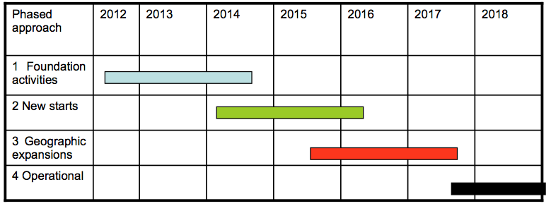
CEOS Phase 1 Strategy
Phased approach in response to the GEOGLAM IP
Scope of CEOS to addressed Phase 1 “foundation activities”

Slide 4
Strategy Highlights
Address the minimum space data provision necessary for GEOGLAM Phase 1 countries
As agency data policy allows, provide access to the resulting data archives for national agricultural forecast information systems
Responds to current GEOGLAM IP, but anticipates future phases and capacity

Slide 5
Approach
Target Products
Requirements
Data Streams
Crop Mask; Crop Type, Area, and Growing Calendar; Crop Condition; Crop Yield; Crop Biophysical Variables; Environmental Variables; Ag Practices / Cropping Systems
11 Requirements by Resolution
> 100m
10-100m
5-10m
<5m
Primary
Primary Source, Optimally free and open
Secondary
Secondary Source to be evaluated as Primary
Potential
To be assessed

Slide 6
Phase 1 Data Streams
Primary
> 100m
GCOM-W
MODIS
10-100m
Landsat
RADARSAT-2 (P1-3)
Sentinel-1
5-10m
RapidEye
Secondary
> 100m
Proba-V
S-NPP
SMOS
SPOT (VEG)
10-100m
ResourceSat-2
RISAT-1
TerraSAR-X
5-10m
SPOT (HRG)
Potential
> 100m
Sentinel-3 (P2-3)
SMAP
10-100m
ALOS-2
CBERS-3
Sentinel-2 (P2-3)
< 5m
Pleiades

Slide 7
Plenary Outcomes and Actions
Ad hoc Working Group to coordinate implementation of the Strategy, and provide an update to SIT-29;
Provisionally target an update to the Strategy for the 28th CEOS Plenary updating progress on Phase 1 implementation, and potentially proposing a Strategy to address GEOGLAM Phase 2; and
Confirming continuation of the CEOS ad hoc Working Group on GEOGLAM to continue to manage CEOS support and interactions with GEOGLAM.

Slide 8
Results Since Plenary (Nov.)
Coordination of data supply to Asia-RiCE
RADARSAT-2, ALOS archive, RISAT-1
Business as usual Landsat acquisitions
Combination of LS-7 and LS-8 providing good coverage (Gene to report)
Coordination of physical data distribution for 2013 coverage
Support to JECAM acquisitions
On going coordination of CEOS support to GEOGLAM
Optimisation of Phase 1 approach, looking ahead to Phase 2

Slide 9
Questions?

