Slide 1

GEOGLAM Phase 1 Implementation
Status
Phase 1 country engagement
Data access and processing product generation
Crop Monitor for AMIS Update
Inbal Becker – Reshef, Michel Deshayes, Alyssa Whitcraft
CEOS-GEOGLAM meeting, 27th-28th February 2014
ESA/ESRIN, Frascati, Italy

Slide 2
GEOGLAM Phase 1
Phase 1 spans over the 2012-2014 time frame
focuses on
  foundation activities,
  building on existing activities
  pilot projects for a few countries
  scoping out the programme for the following phases

Slide 3

GEOGLAM Phase Timing
Does this timeline need to be revisited?
Phased approach
2012
2013
2014
2015
2016
2017
2018
1 Foundation activities/feasibility
demonstration
2 Review and expanded initiatives
3 Thematic and Geographic expansion
4 Operational
Phase 1 Activities: focus on foundation activities, selected countries, prototype/feasibility demonstrations
Phase 2 Activities: GEOGLAM funded tasks implementation of feasibility projects

Slide 4


The GEOGLAM Components
4. EO DATA COORDINATION
5. METHOD IMPROVEMENT through R&D coordination (JECAM)
6. Data, products and INFORMATION DISSEMINATION
Notes:
Component 1: Monitoring Global Producer Countries
Focus: Global markets and trade
Component 2: National Monitoring Systems
Focus: National forecasts & statistics
Component 3: Countries at Risk
Focus: Early warning & food security
Component 4: Observations Coordination
Focus on acquisition, availability, access needed for GEOGLAM implementation
Component 5: R&D
Focus: Operational R &D, Best practices, Research to Operations
Component 6: Information dissemination
Focus on timely and transparent availability of information

Slide 5
Phase 1/2 by Component as stated in GEOGLAM Implementation Plan
C1: Global/Regional systems
  Crop Monitor
  Improved global baseline data sets
  Asia Rice
C2: National Capacity Development
  Develop a series of regional workshops for status assessment, needs and priorities;
    Argentina workshop
    Russia workshop
    Ukraine workshop planned in May
    East Africa workshop planned in June
  National engagement and commitments by interested parties
  National Implementation
  Regional training / information exchange and continued regional networking
Need better tracking of status and successes

Slide 6
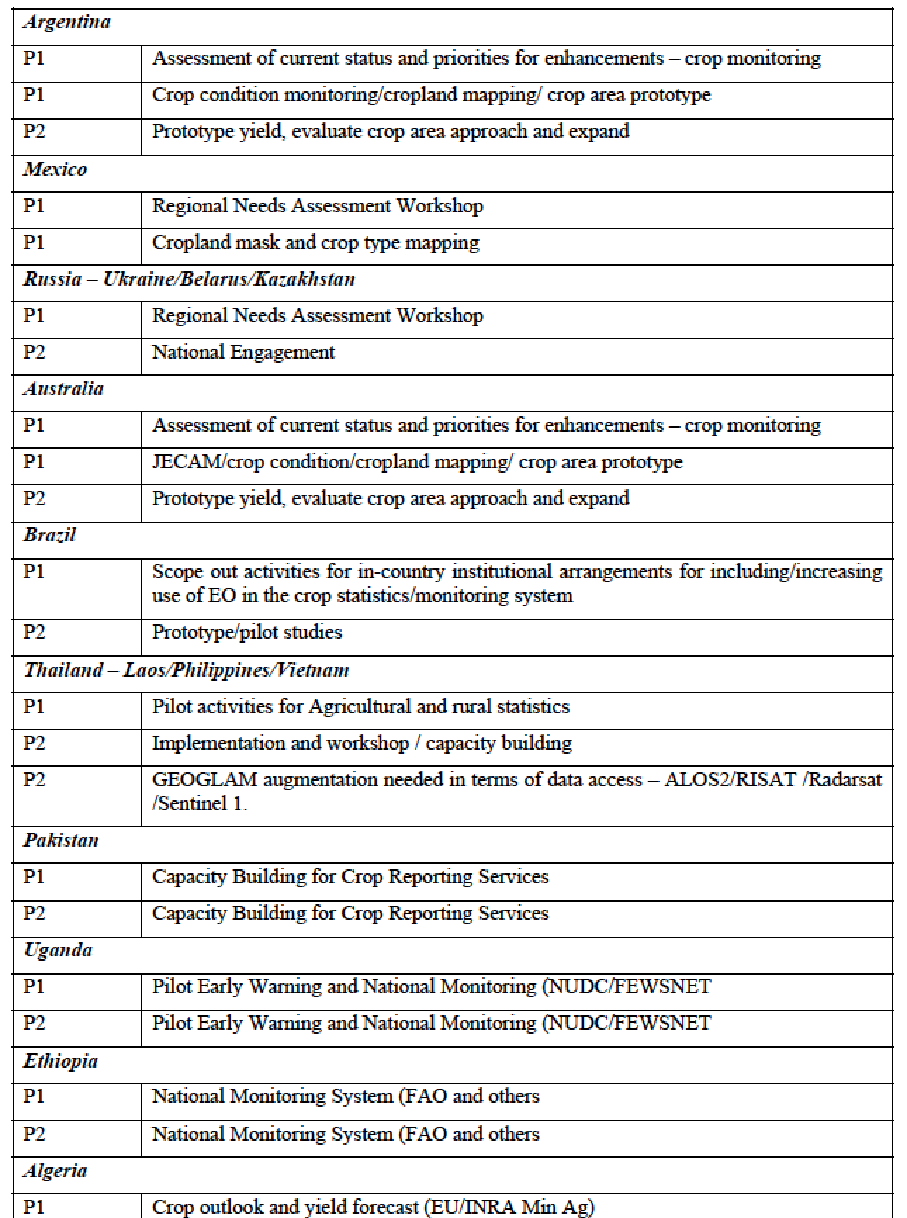
C2 Activities and Countries

Slide 7
C3: Countries at-risk
  East Africa selected as initial target region, given that there have been identified potential partners and in-kind sources such as JRC, FAO GIEWS, FEWSNET CMRD, the SERVIR regional hub, ICPAC and the Gates Foundation
  build on existing systems and established collaborative networks (with potential for growth)
  Initial development stages- focus of Phase 2

Slide 8
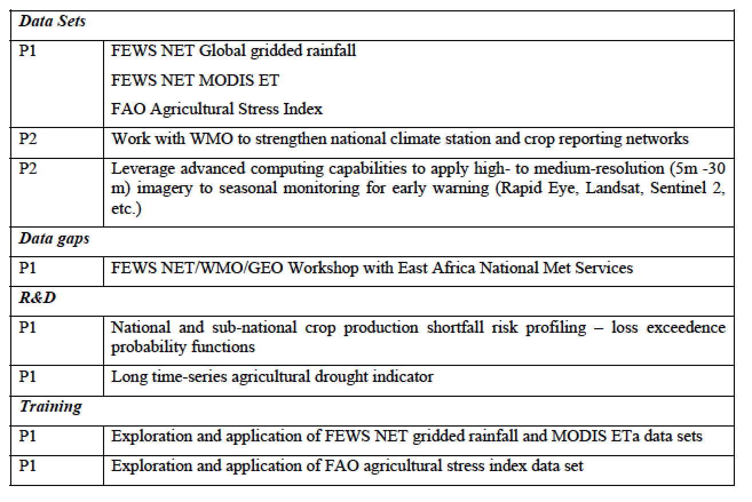
C3 Activities

Slide 9
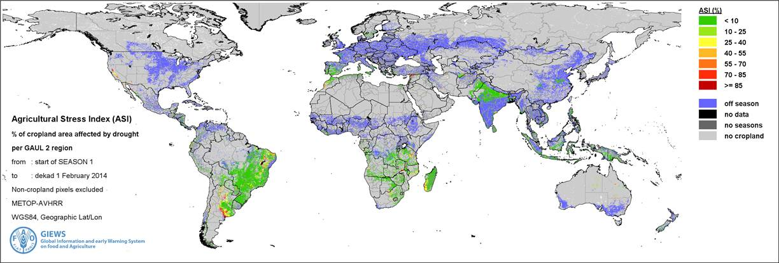
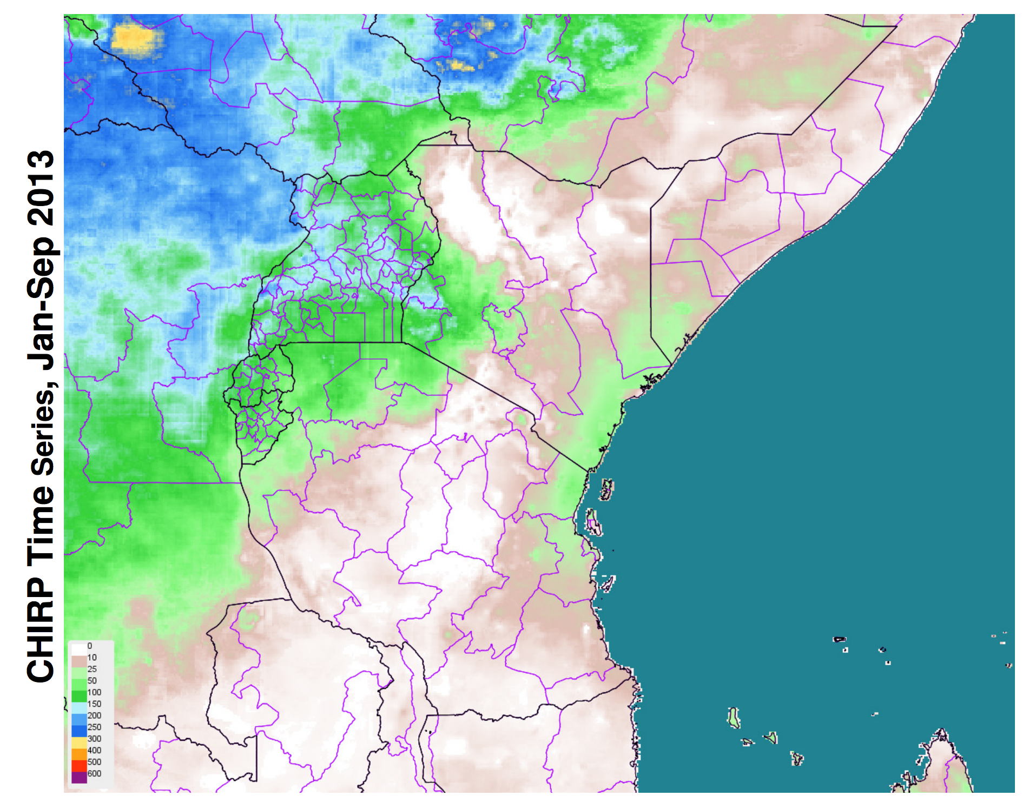
Examples of Phase 1 Data Products for C3
ASIS – Agricultural Stress Index FAO GIEWS
CHIRPS- Global gridded rainfall from FEWSNET

Slide 10
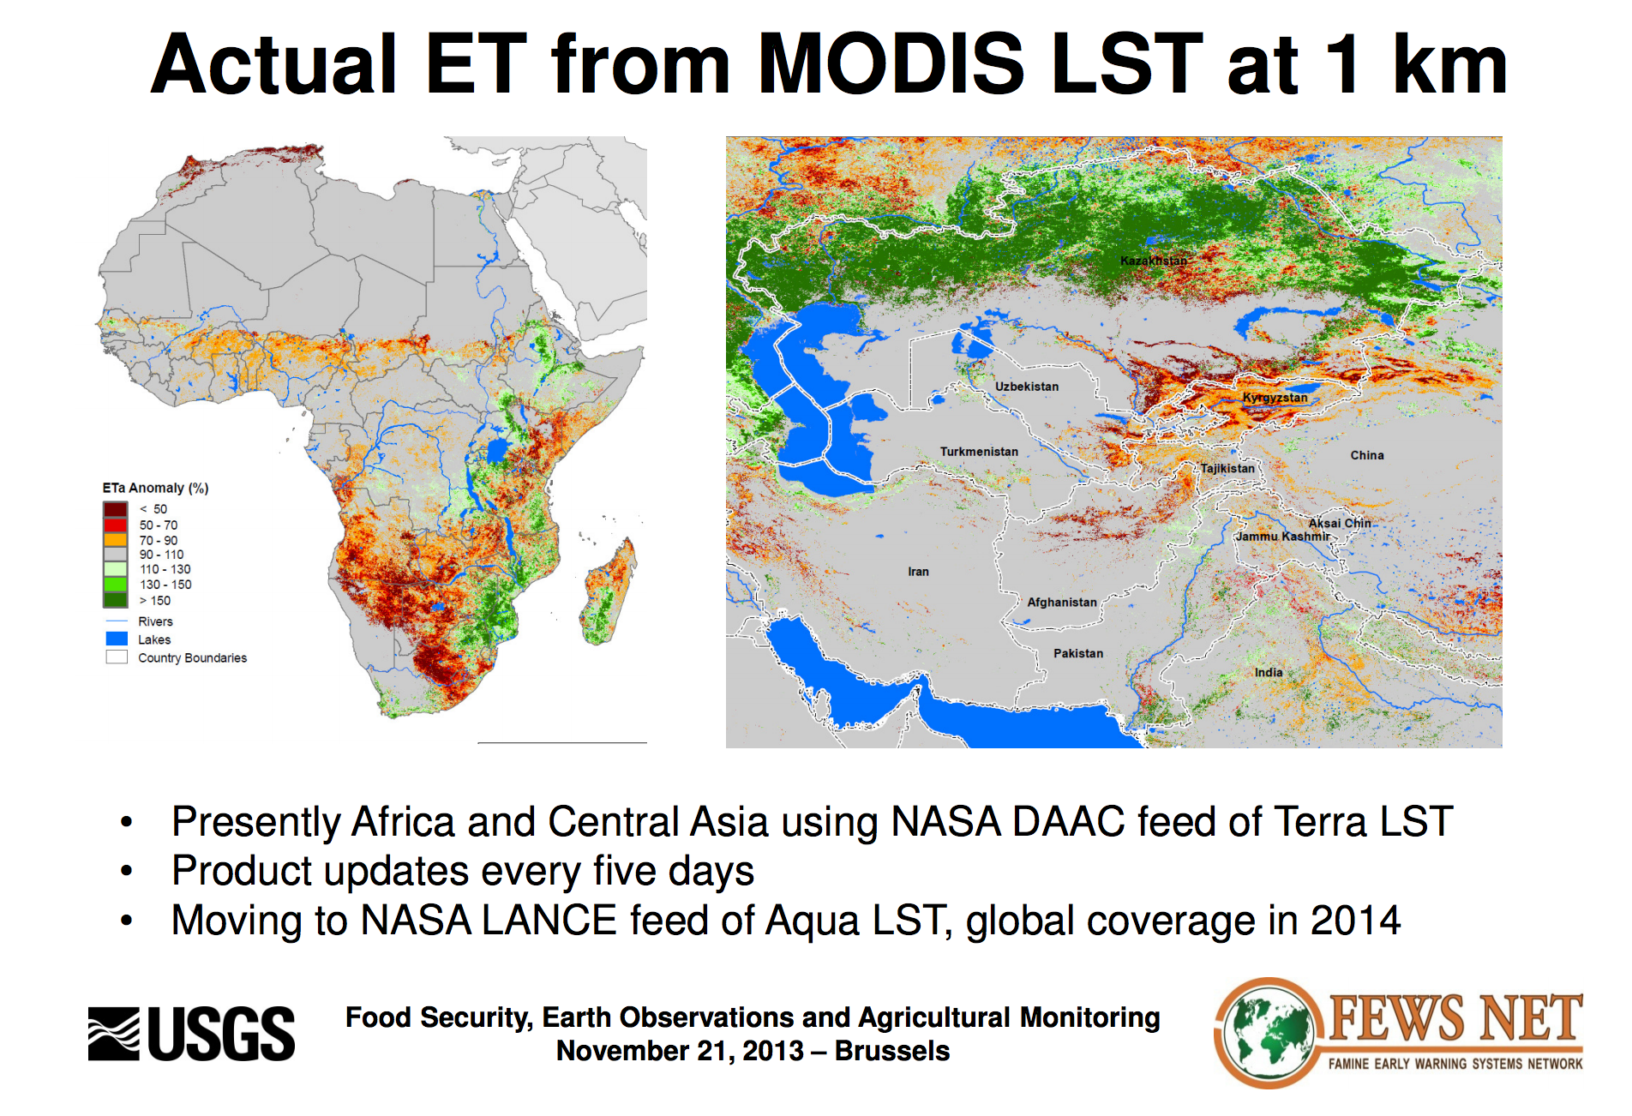

Slide 11
C4: Earth Observation coordination
Overall Phasing Approach- permit an evolution of growing capacity in:
  Increased number of countries;
  Integration of additional sensors as agencies and new sensors come on board, and datasets are made available;
  Assimilation, processing, product creation, distribution and integration of information products into decision making processes,
  Capacity building, particularly in at-risk countries for ingestion and processing of EO data
Phase 1/2: Support for demonstration and feasibility
  Test sample sites and information products, to validate their usefulness, robustness and affordability
  Focus on major commodities (wheat, maize, rice and soybean)
  Some observations will be wall to wall, cropland extent others will be sampled
  The Rice Monitoring pilot study plan will be expanded with available SAR data in Asia and other regions

Slide 12
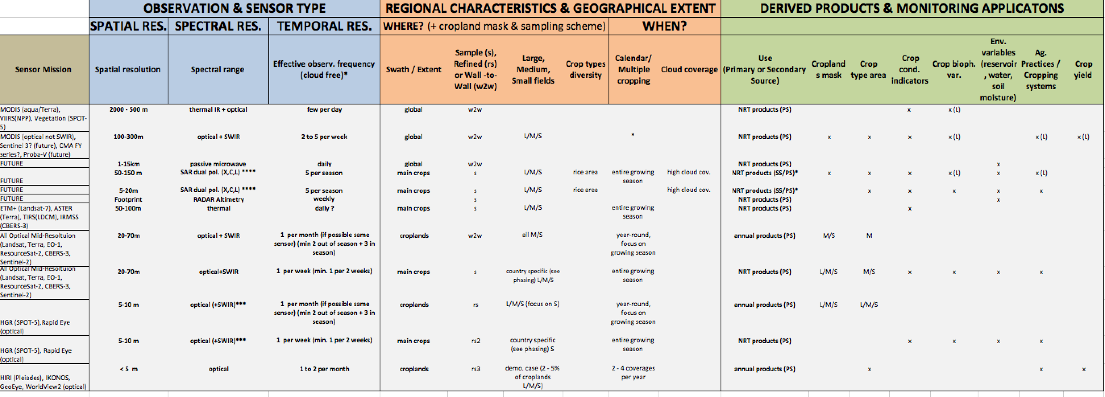
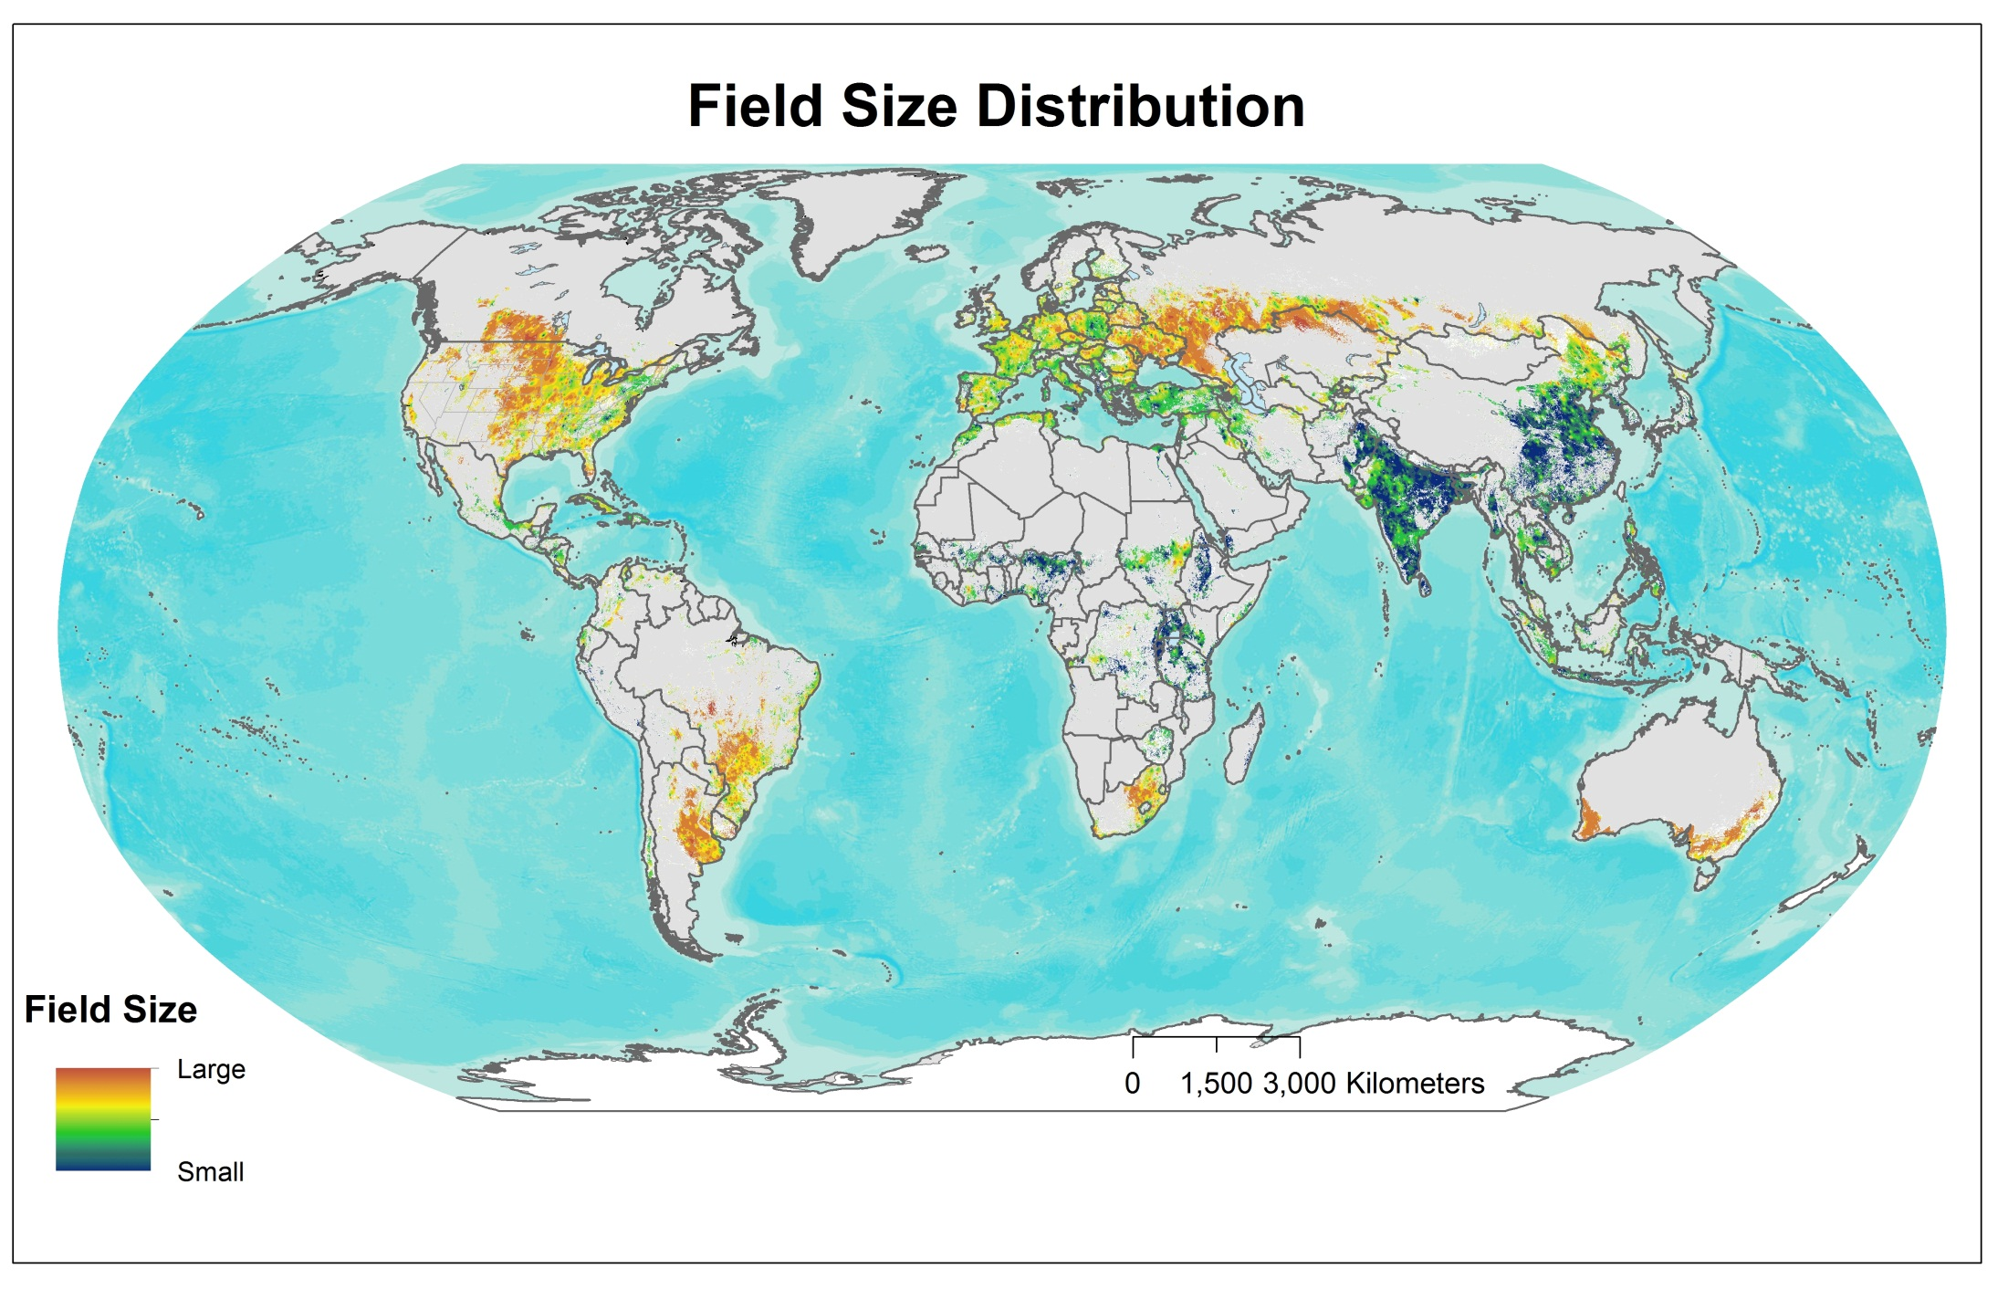
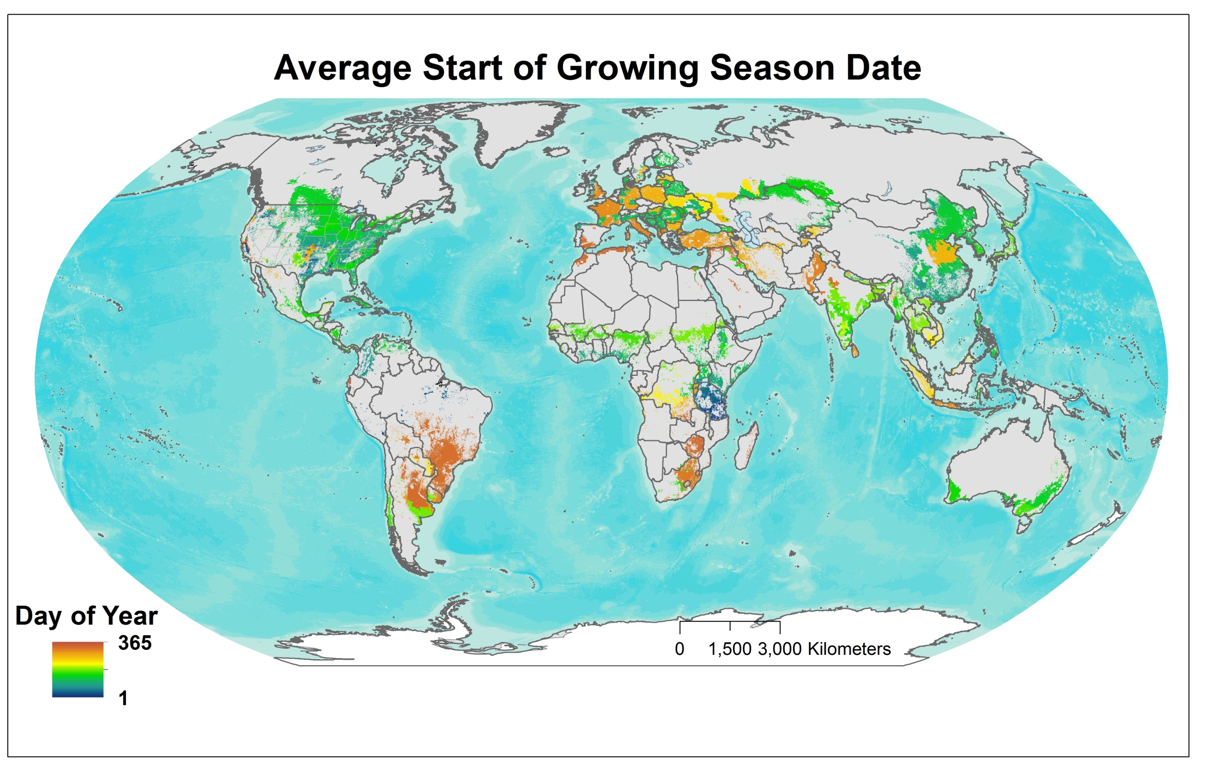
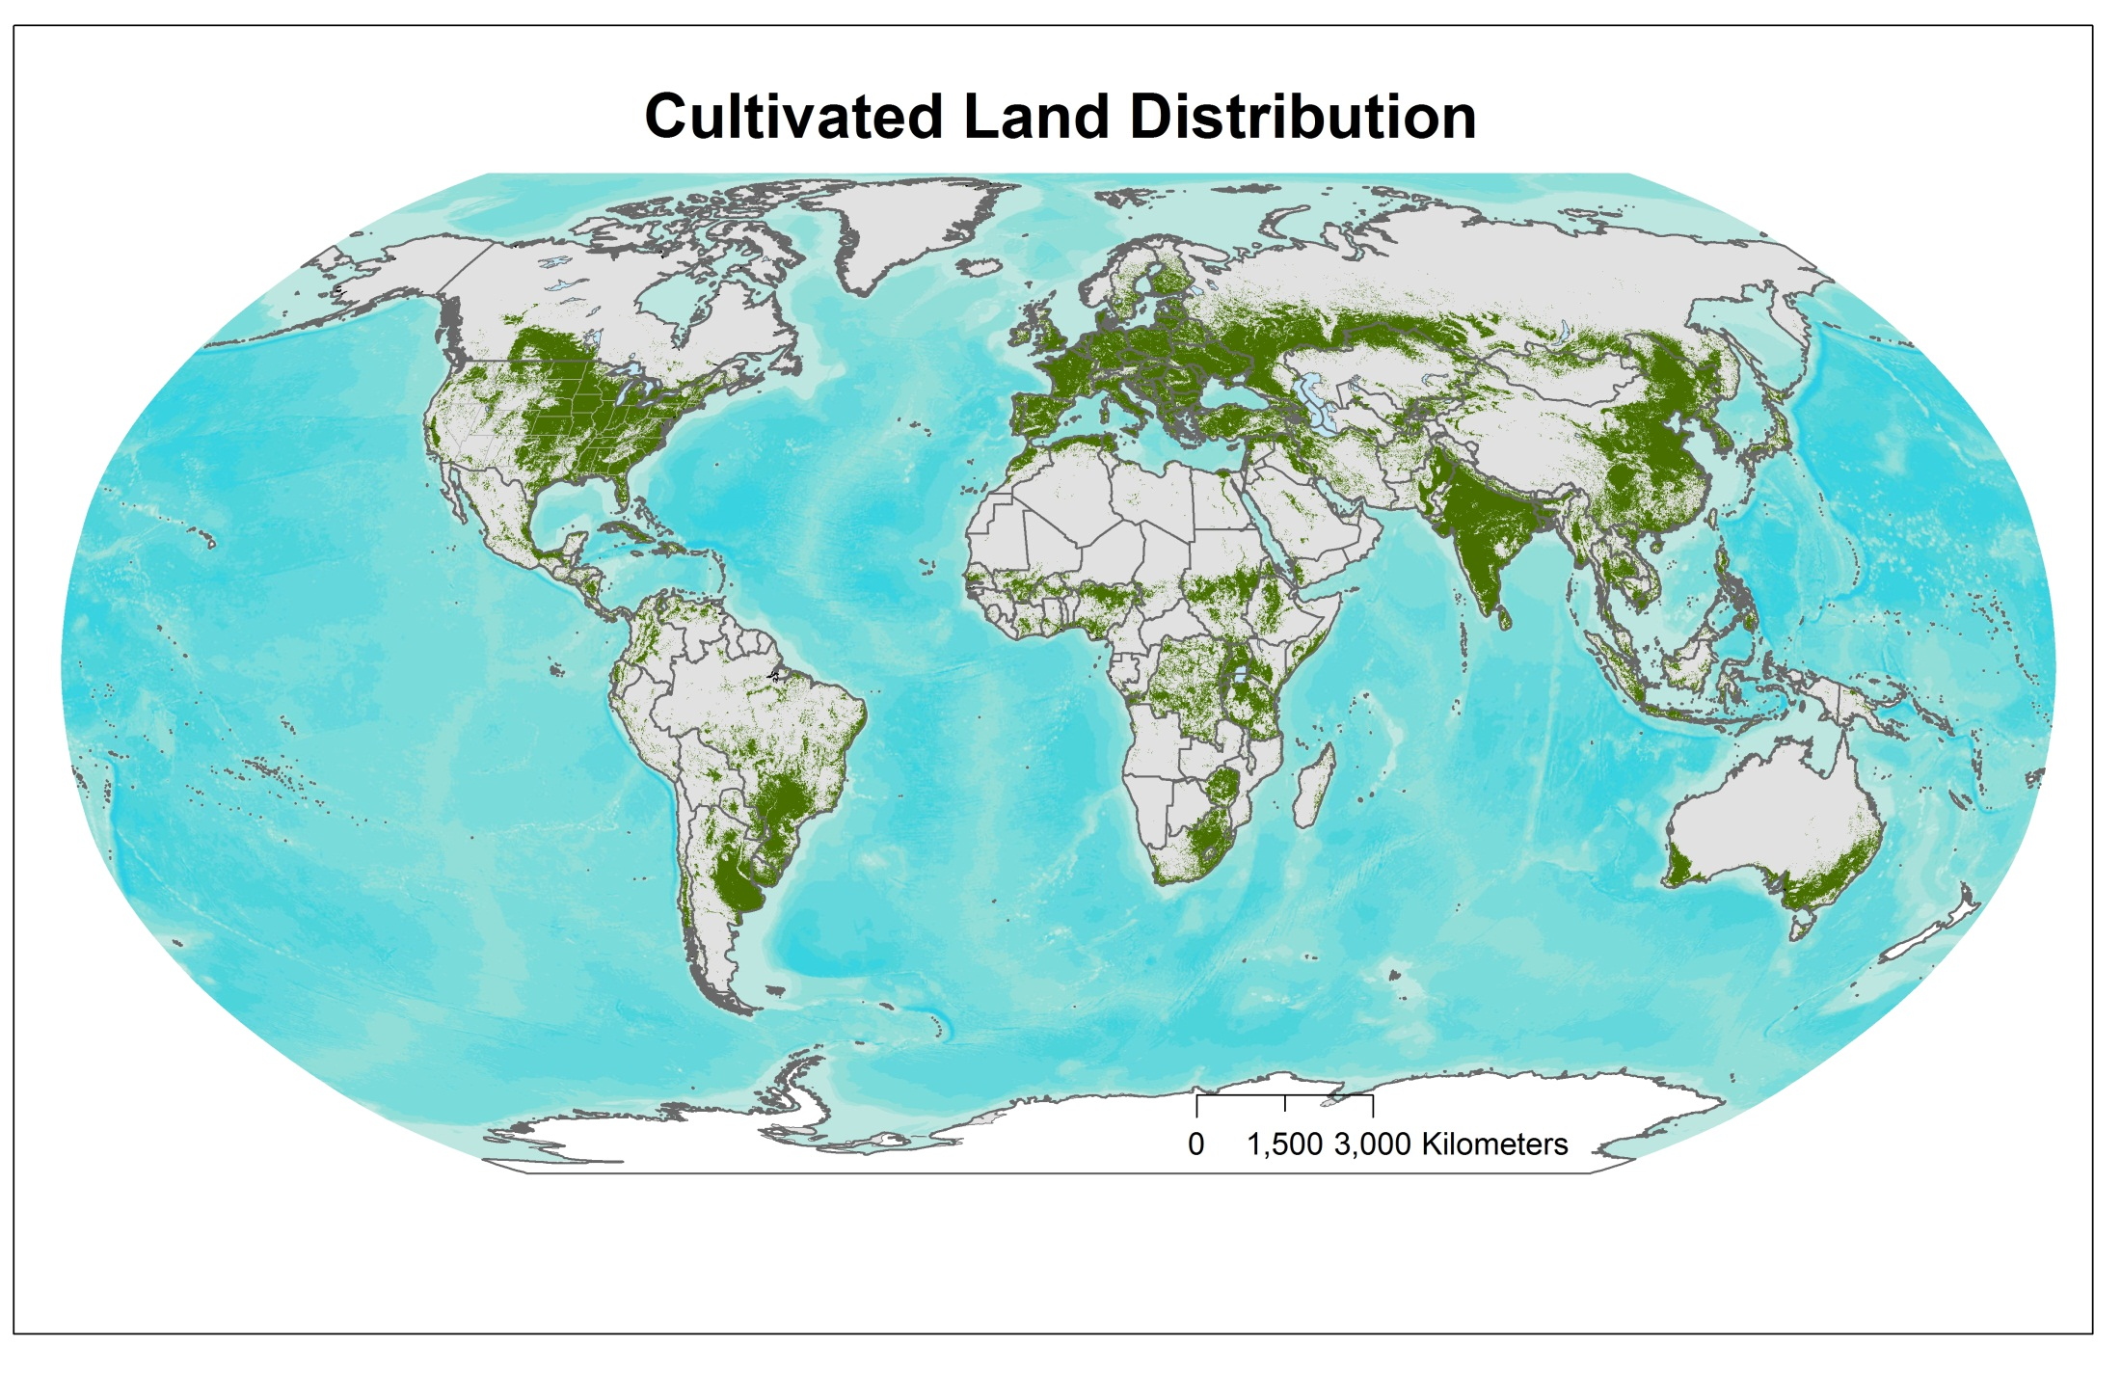
EO Data Requirements Framework & Base Datasets
  developed taking into consideration the observation needs, the derived products they will
  serve, and regional specificities; CEOS-GEOGLAM July 2012 Montreal)
How often ?
Where?
When?
For What?
spatial & spectral
Notes:
THE SEO has the volumetric assessment – item #31-d
The baseline data layers for guiding these have been developed- in order to support the volumentric analysis- GEOGLAM produced these to facilitate the volumetric assessemnt

Slide 13
C5: R&D JECAM
Annual JECAM Meetings
Directed Workshops to address GEOGLAM research needs, including National Capacity building
SAR for Soil moisture Monitoring, SAR for monitoring crops in tropical-subtropical regions
Sampling Frameworks for agric monitoring
Best practices for crop monitoring
Defining minimum data requirements across JECAM sites and data collection protocols
Linking to AGMiP
Data dissemination
Sigma Project
STARS: Spurring a Transformation for Agriculture through Remote Sensing

Slide 14
Phase 1 Country engagement
Phase 1 Country Engagement

Slide 15
Australia
National partners: CSIRO & ABARES
Prototype MODIS crop & rangelands condition system
Prototype MODIS-Landsat wheat classification (leveraging existing projects)
  Australia has receiving station for Landsat- have wall to wall time series
  Sampling strategy for fine res data
Expect new funds in July 1 2014 to support crop type mapping
Notes:
DEMO of transition capacity to phase 1 countries-

Slide 16
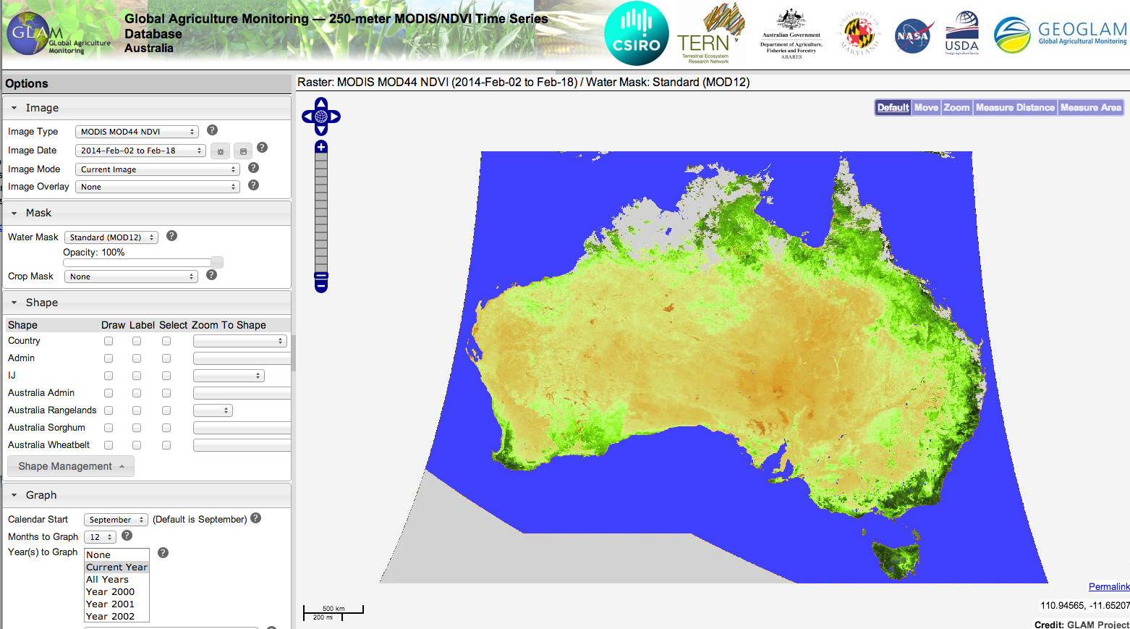
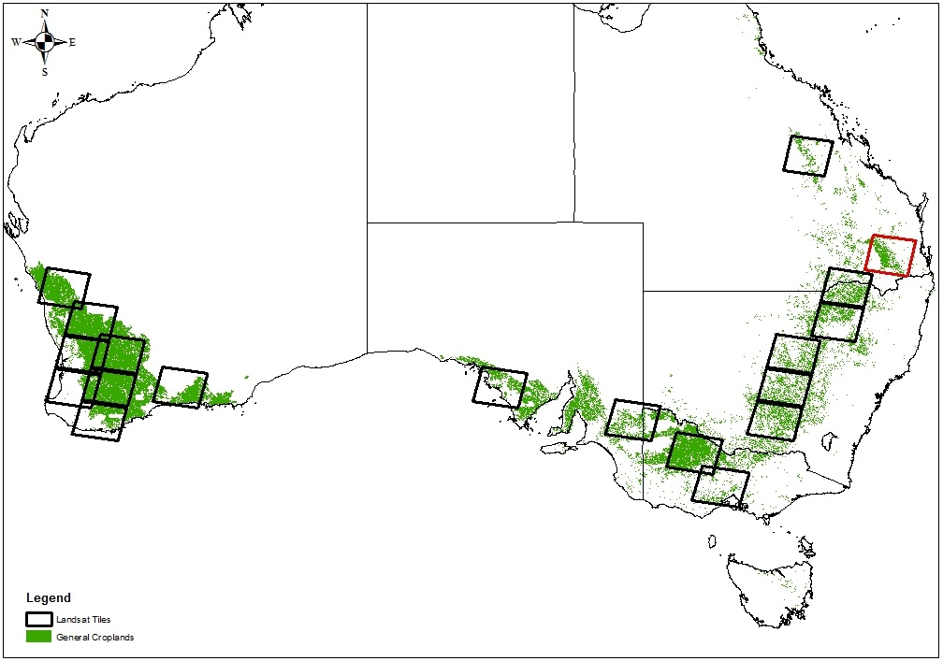
Prototype MODIS Crop & Rangelands Condition System
Prototype MODIS Wheat Mask for prototyping sampling strategy

Slide 17
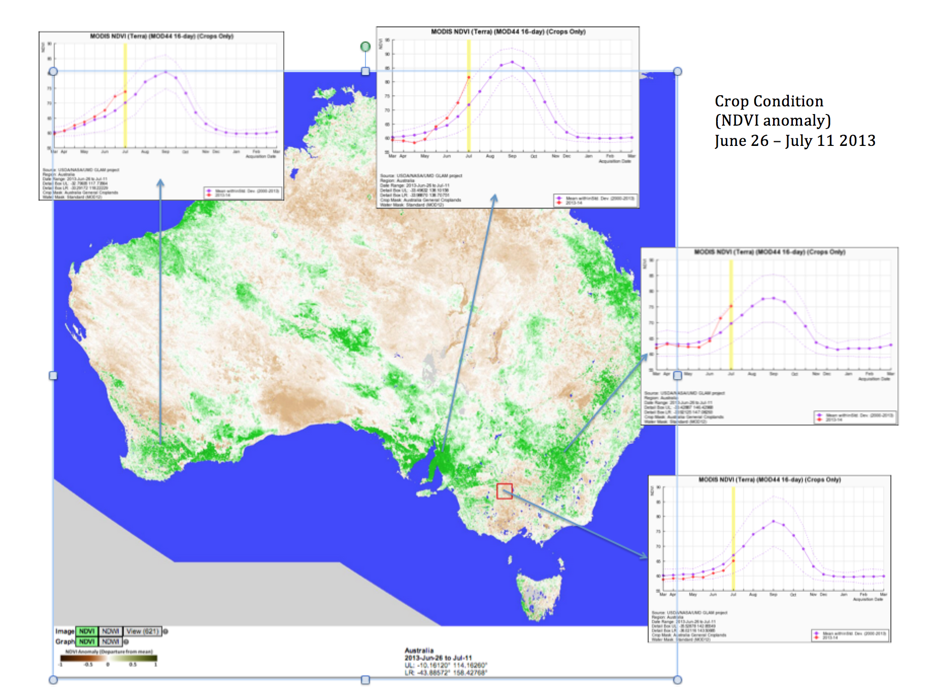

New Collaboration between CSIRO, ABARES, UMD, NASA and USDA)
Notes:
Western victoria some dry conditions affecting dairy and pastures
Green in Queensland- higher normal rainfall- grazing land, though to the west there is a remarkable drought- these weather patterns are importnatn and the impact
NSW, southern A wales and western above average going into tihe winter crop season

Slide 18
Argentina
National Partner: INTA
Prototype MODIS Crop Condition system
MODIS stratification map for soy (leveraging existing projects)
  Sampling strategy for landsat and RE defined
  5 RE scenes acquired per sample blocks over growing season
Preliminary EO based soy area estimate
Notes:
DEMO of transition capacity to phase 1 countries-

Slide 19
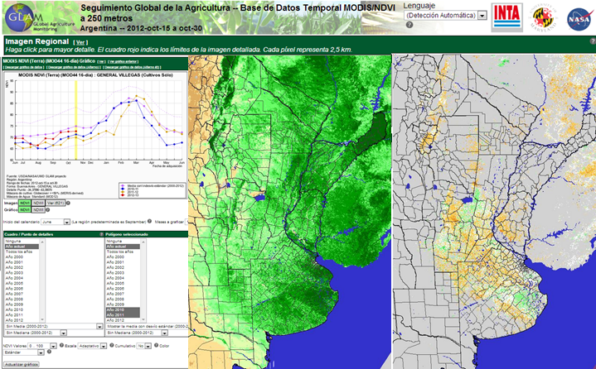
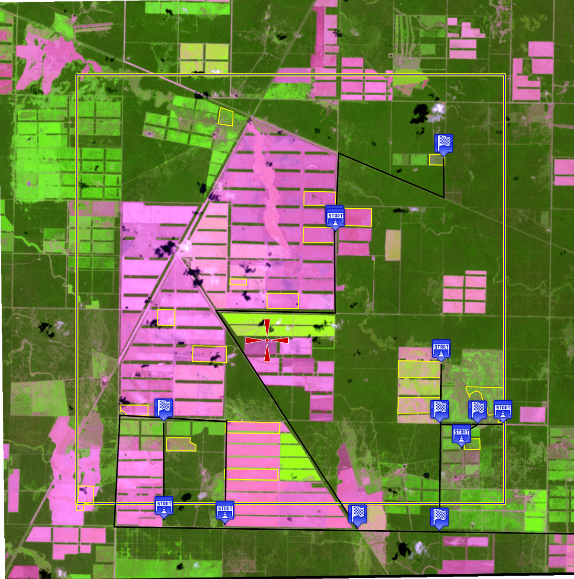
Argentina
Prototype MODIS Crop & Rangelands Condition System
Argentina RE sample blocks

Slide 20
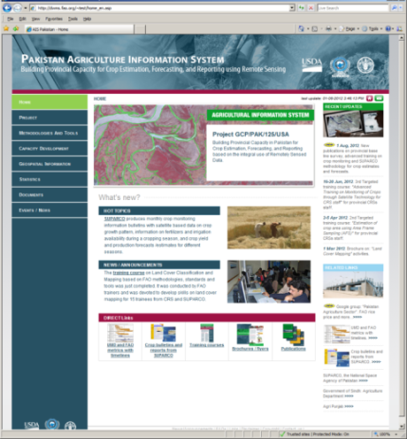
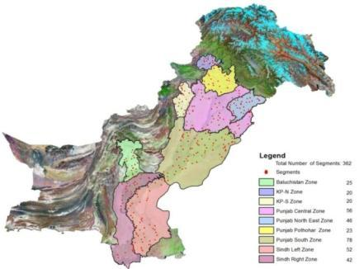
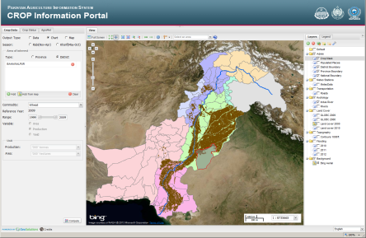
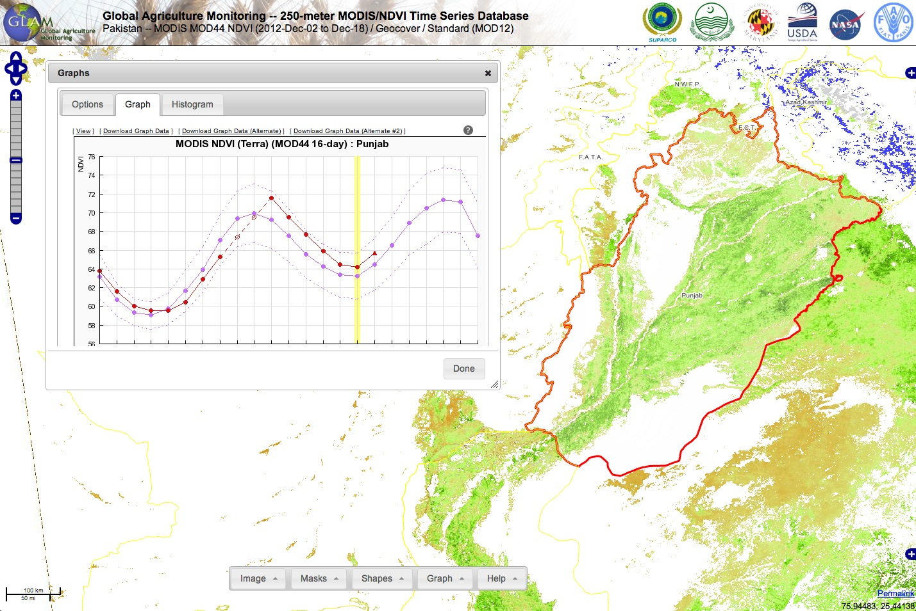
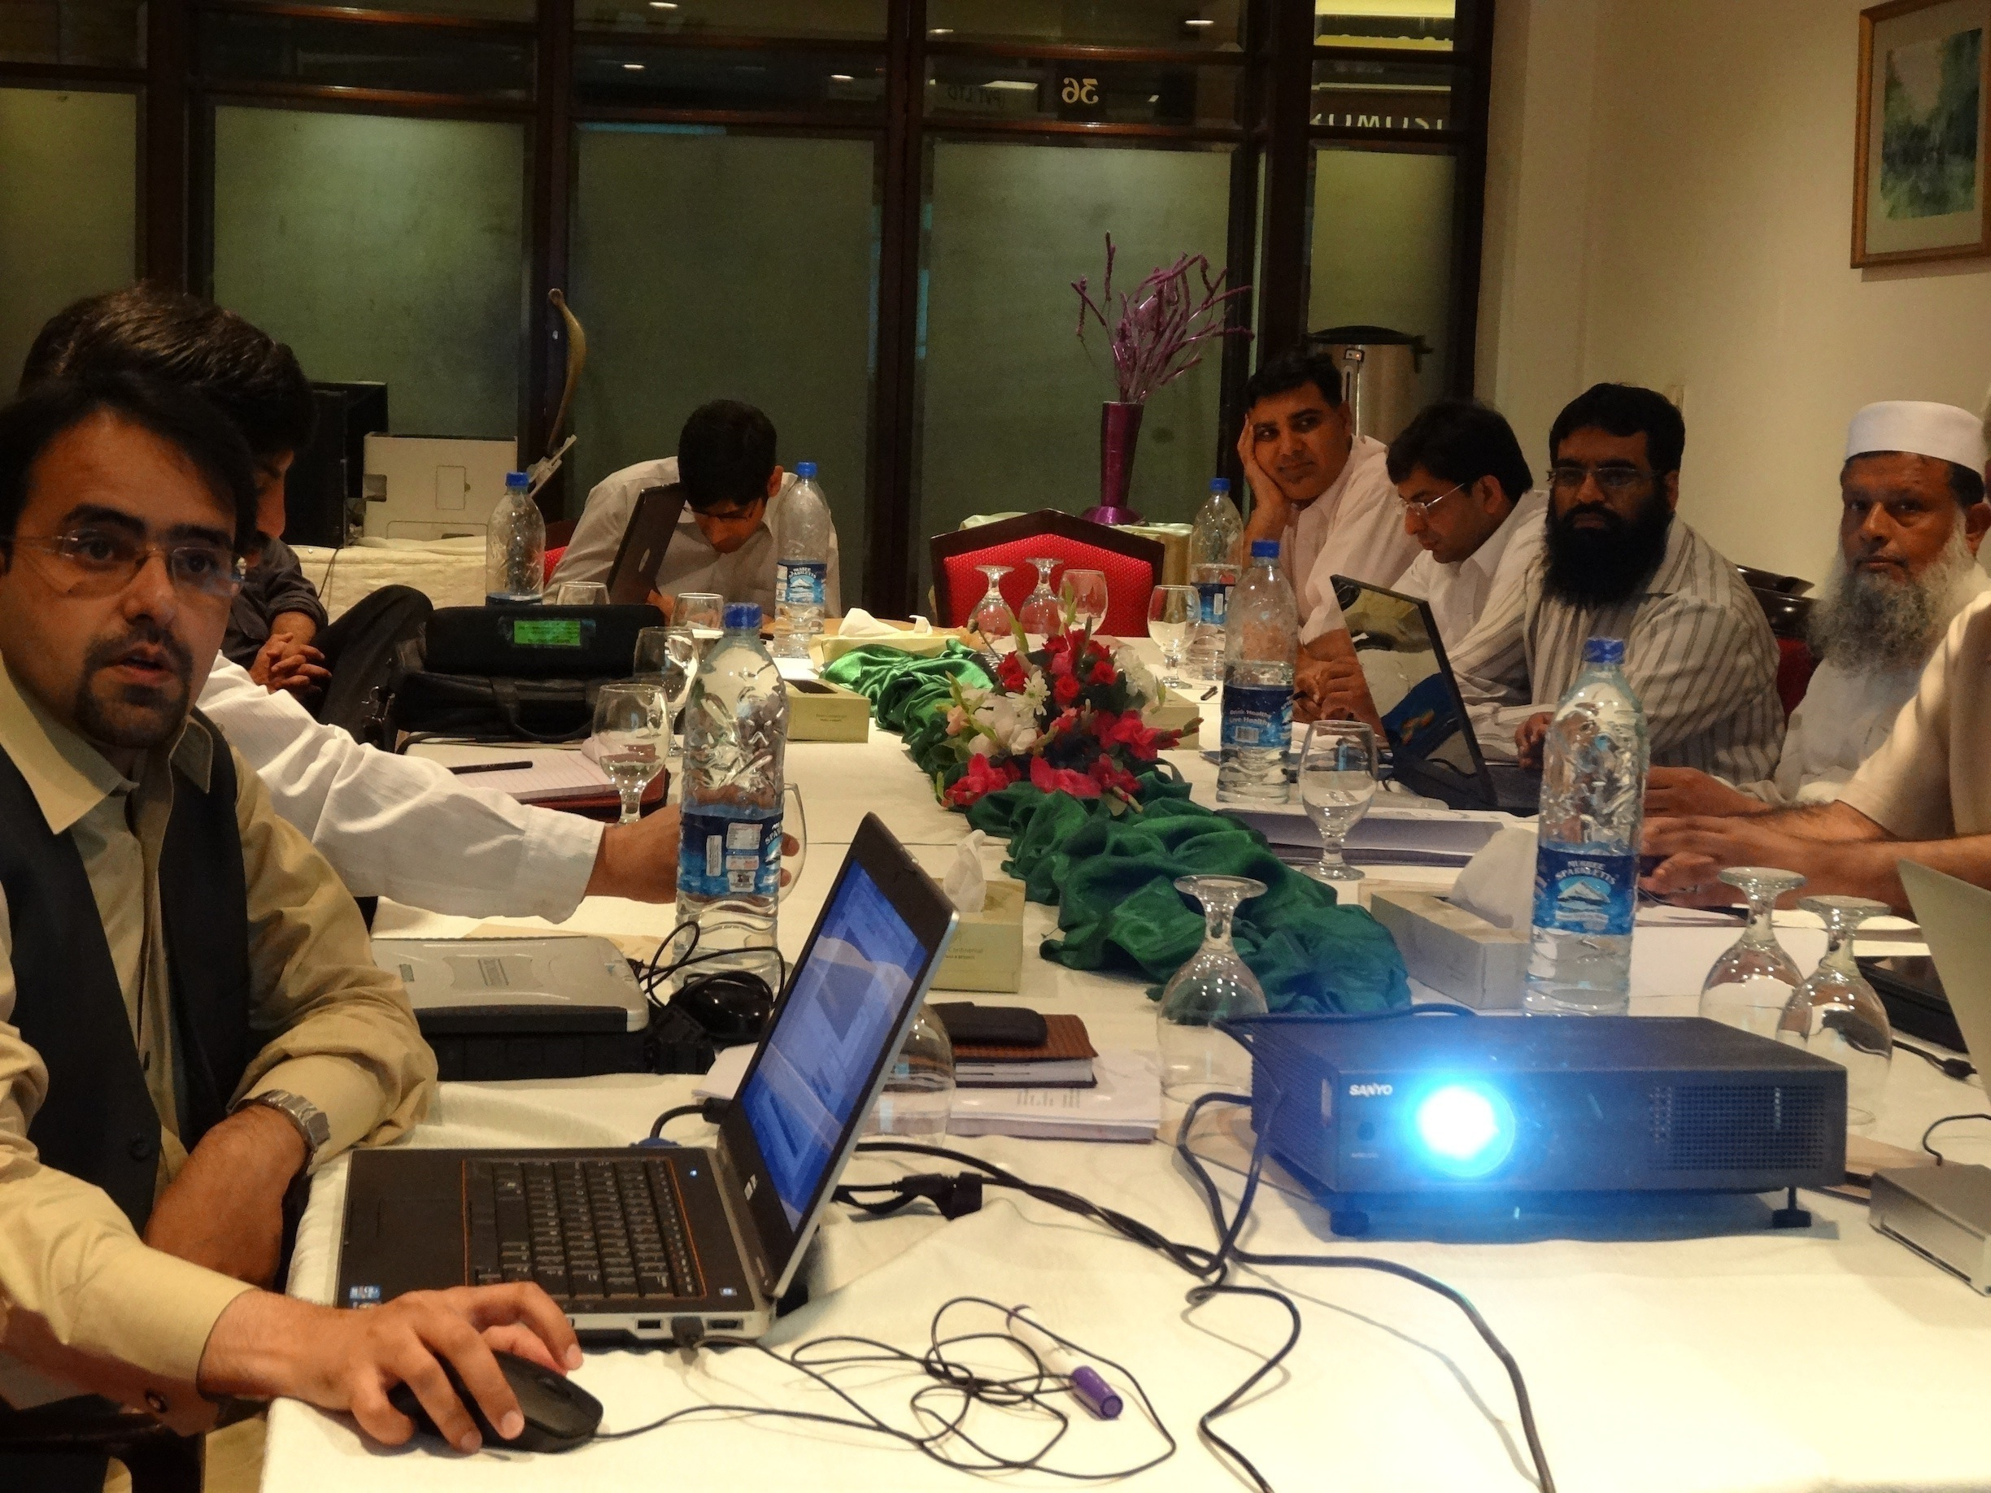
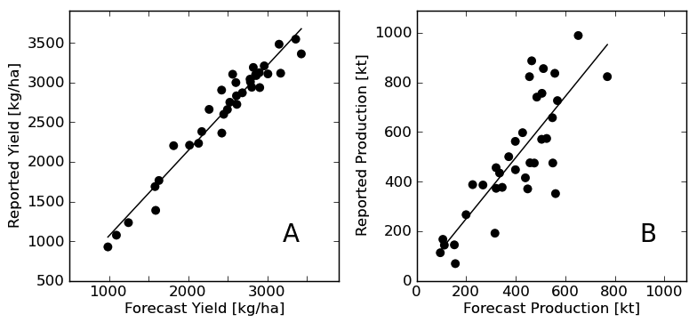






Pakistan: Strengthening Provincial Capacity
(collaboration between USDA, FAO, SUPARCO, CRS Pakistan, & UMD)
Training Workshops

Slide 21
New Development:
Phase 1 planning for Phase 2 implementation
New STARS project- coordinated by ITC
(Spurring a Transformation for Agriculture through Remote Sensing)
Funded by BMGF
Strong synergy with JECAM
East Africa (Tanzania/Uganda), West Africa (Mali/Niger), S Asia (Bangladesh)
CSIRO, ITC, UMD, ICRISAT, CIMMYT

Slide 22

GEOGLAM Crop Monitor for AMIS
(Agricultural Market Information System)
Objective: develop transparent, timely, crop condition assessments in primary agricultural production areas highlighting potential hotspots of stress/bumper crop
These assessments reflect an international consensus of crop conditions
  This activity is led by UMD with support from NASA Applied Sciences

Slide 23
Crop Monitor Achievements
Developed Operational international consensus crop assessments!
  Positive response high level of engagement
  A focus on high quality national information
  Referenced in commodity reports and press releases
International high level support
Developing awareness & demand for RS based information
Operational community guiding the research agenda

Slide 24
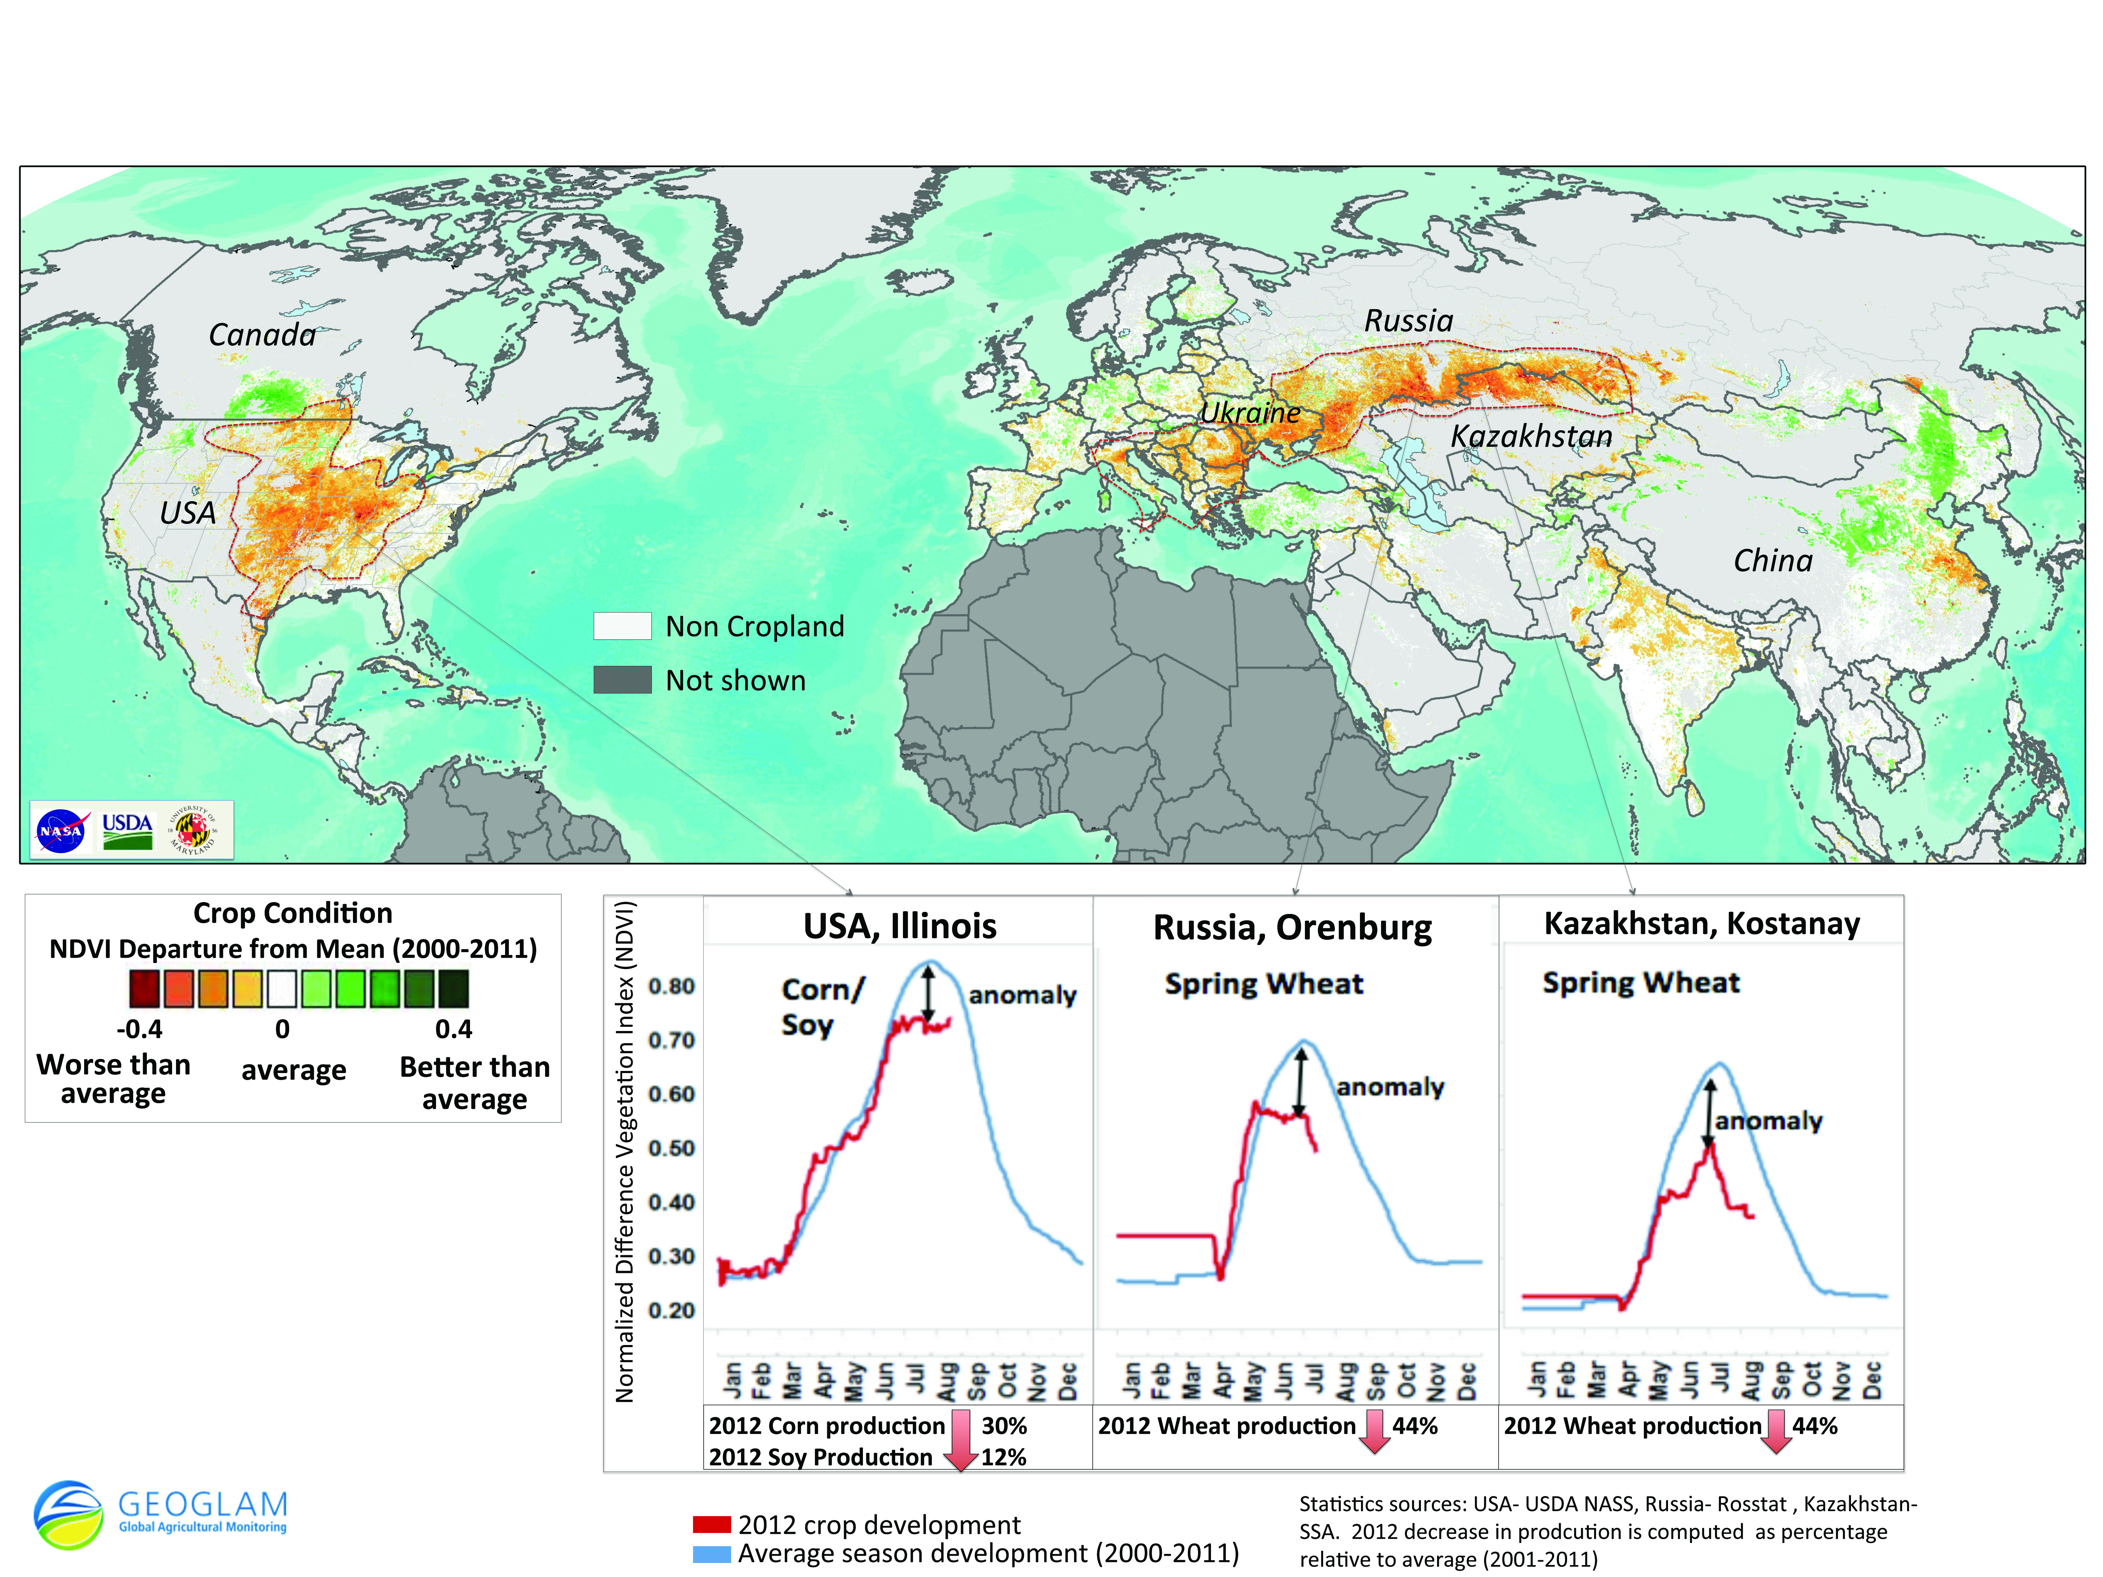
Where we started: Crop NDVI Anomaly, August 15 2012

Slide 25
GEOGLAM Crop Monitor Partners
Developing Monthly Crop Condition Assessments
(>25 partners & growing)
  USDA FAS, NASS
  NASA
  UMD
  EC JRC
  Canada (Agriculture Canada)
  FAO
  China CropWatch
  Russia (IKI)
  Ukraine (Hydromet, NASU-NSAU)
  Kazakhstan (ISR)
Australia (ABARES, DA, CSIRO)
South Africa (NRC)
JAXA/Asia Rice
AFSIS
Indonesia (LAPAN)
Thailand (GISTDA)
Vietnam (VAST,VIMHE)
IRRI
Argentina (INTA)
Brazil (CONAB, INPE)
India (ISRO)
Mexico (SIAP)
GEO SEC

Slide 26
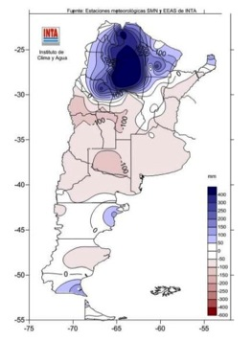
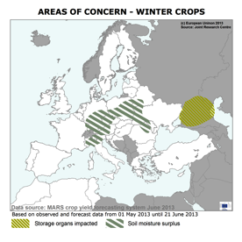
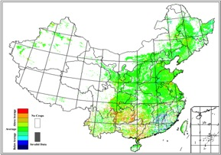
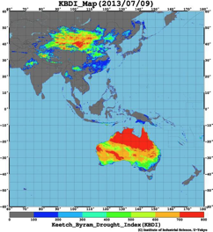
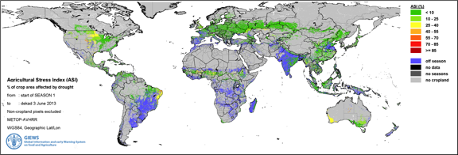
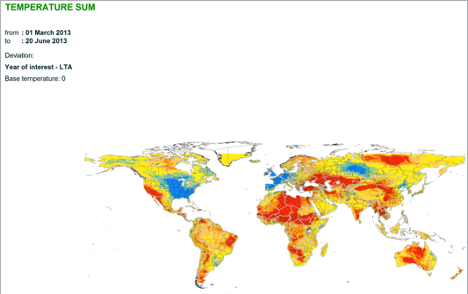
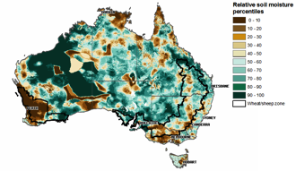
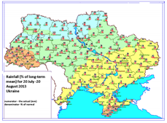


Examples of Input Data National –Global: EO indices, weather, model outputs etc
Growing Degree Day Anomaly
Synthesize and distil a range of data & information from multiple sources while preserving the wealth of underlying data within supporting materials document

Slide 27
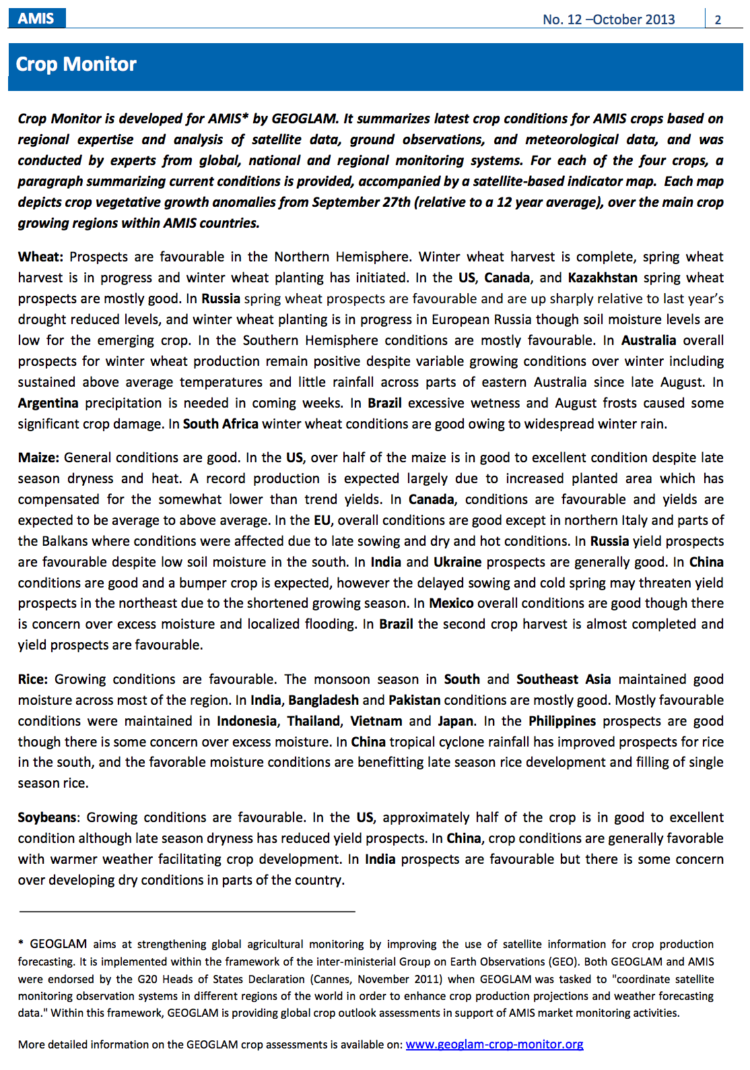
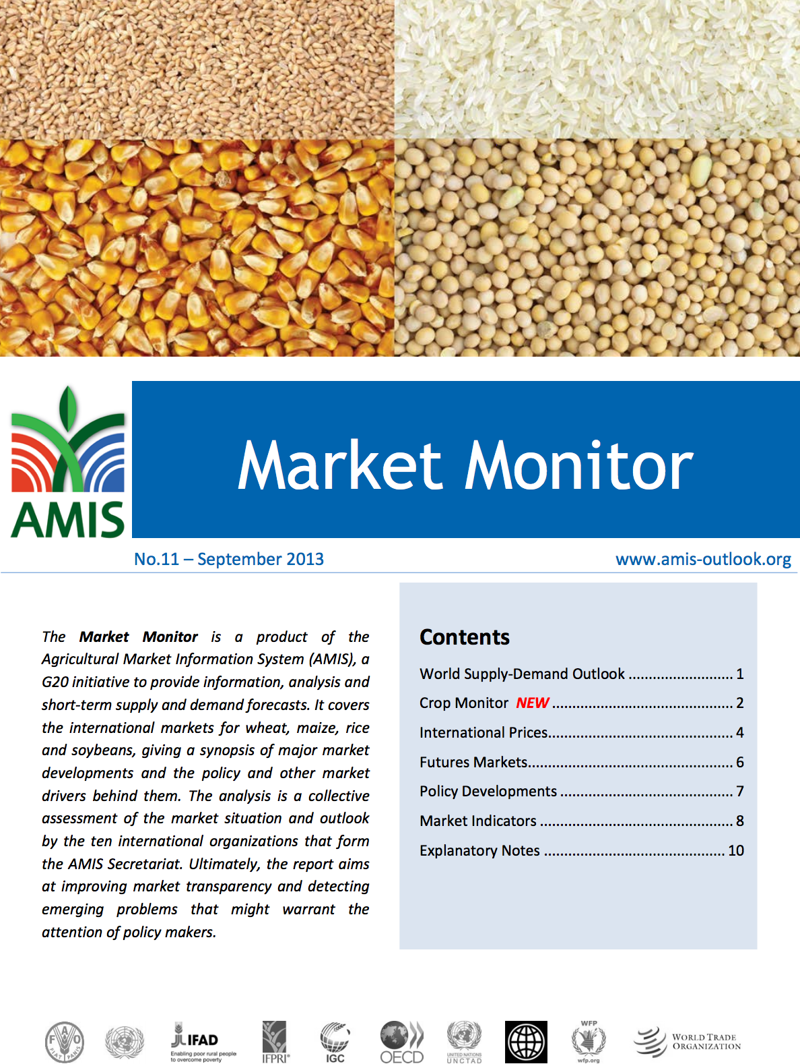
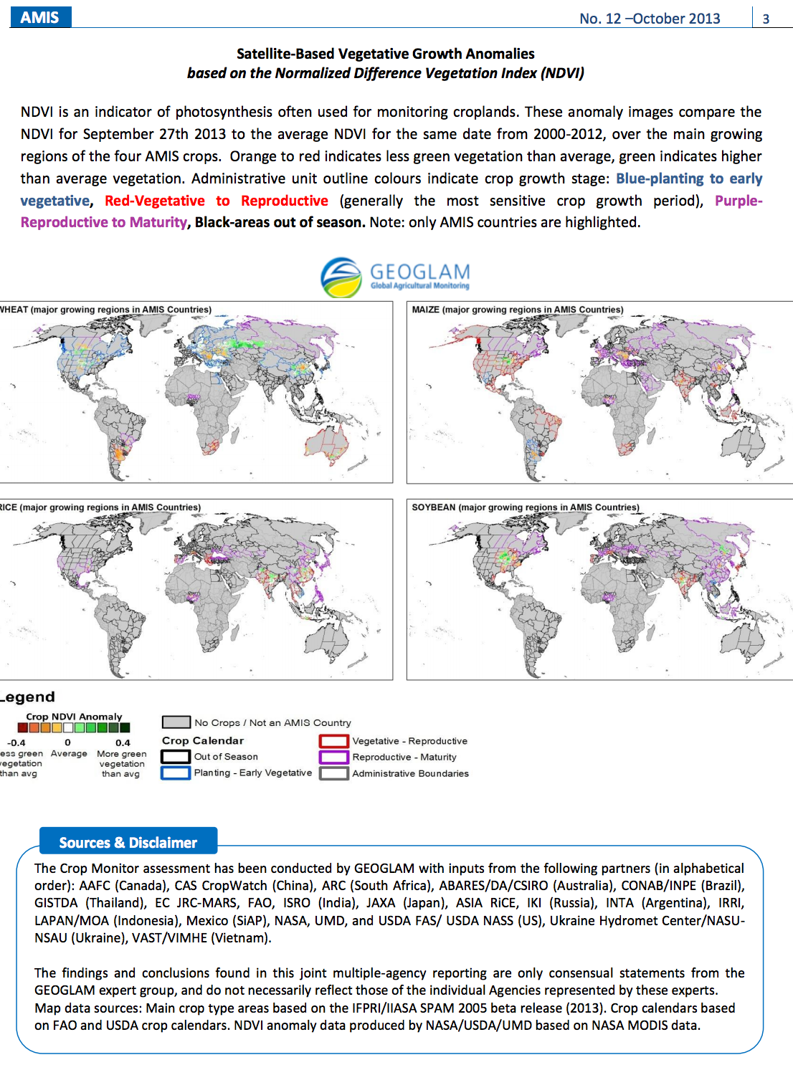
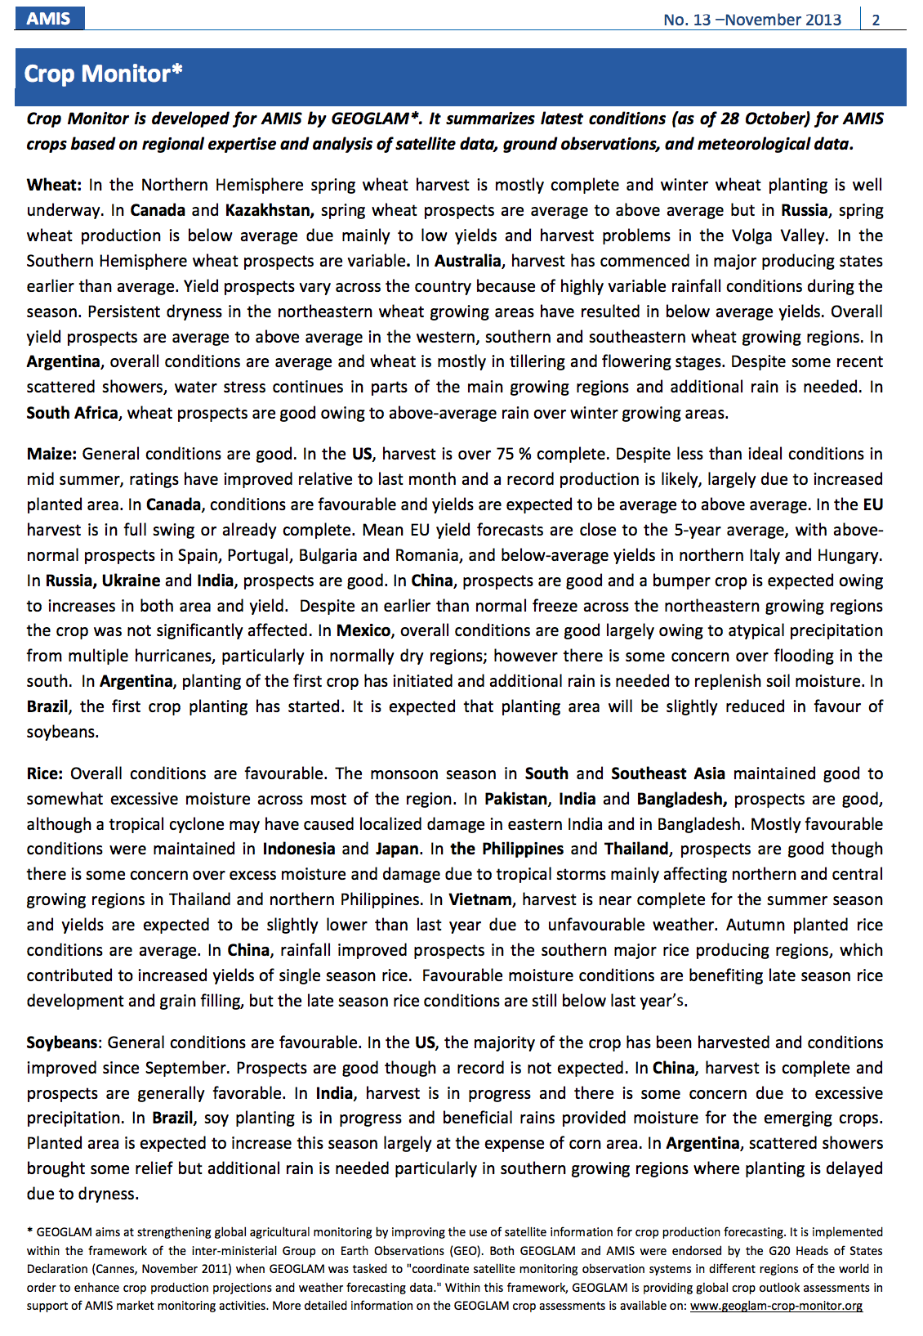
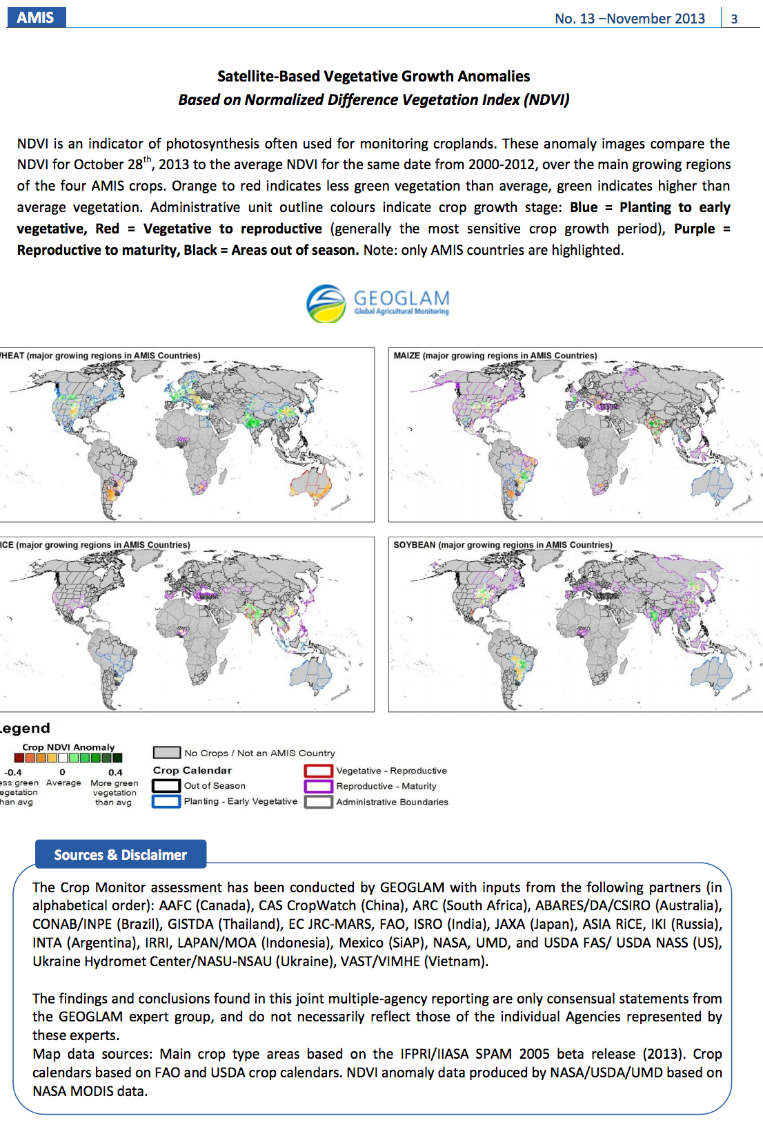
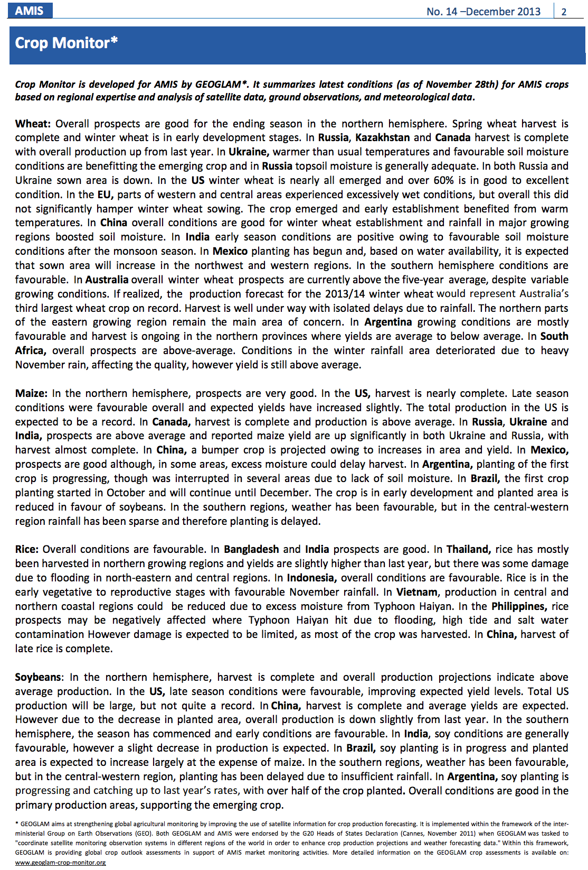
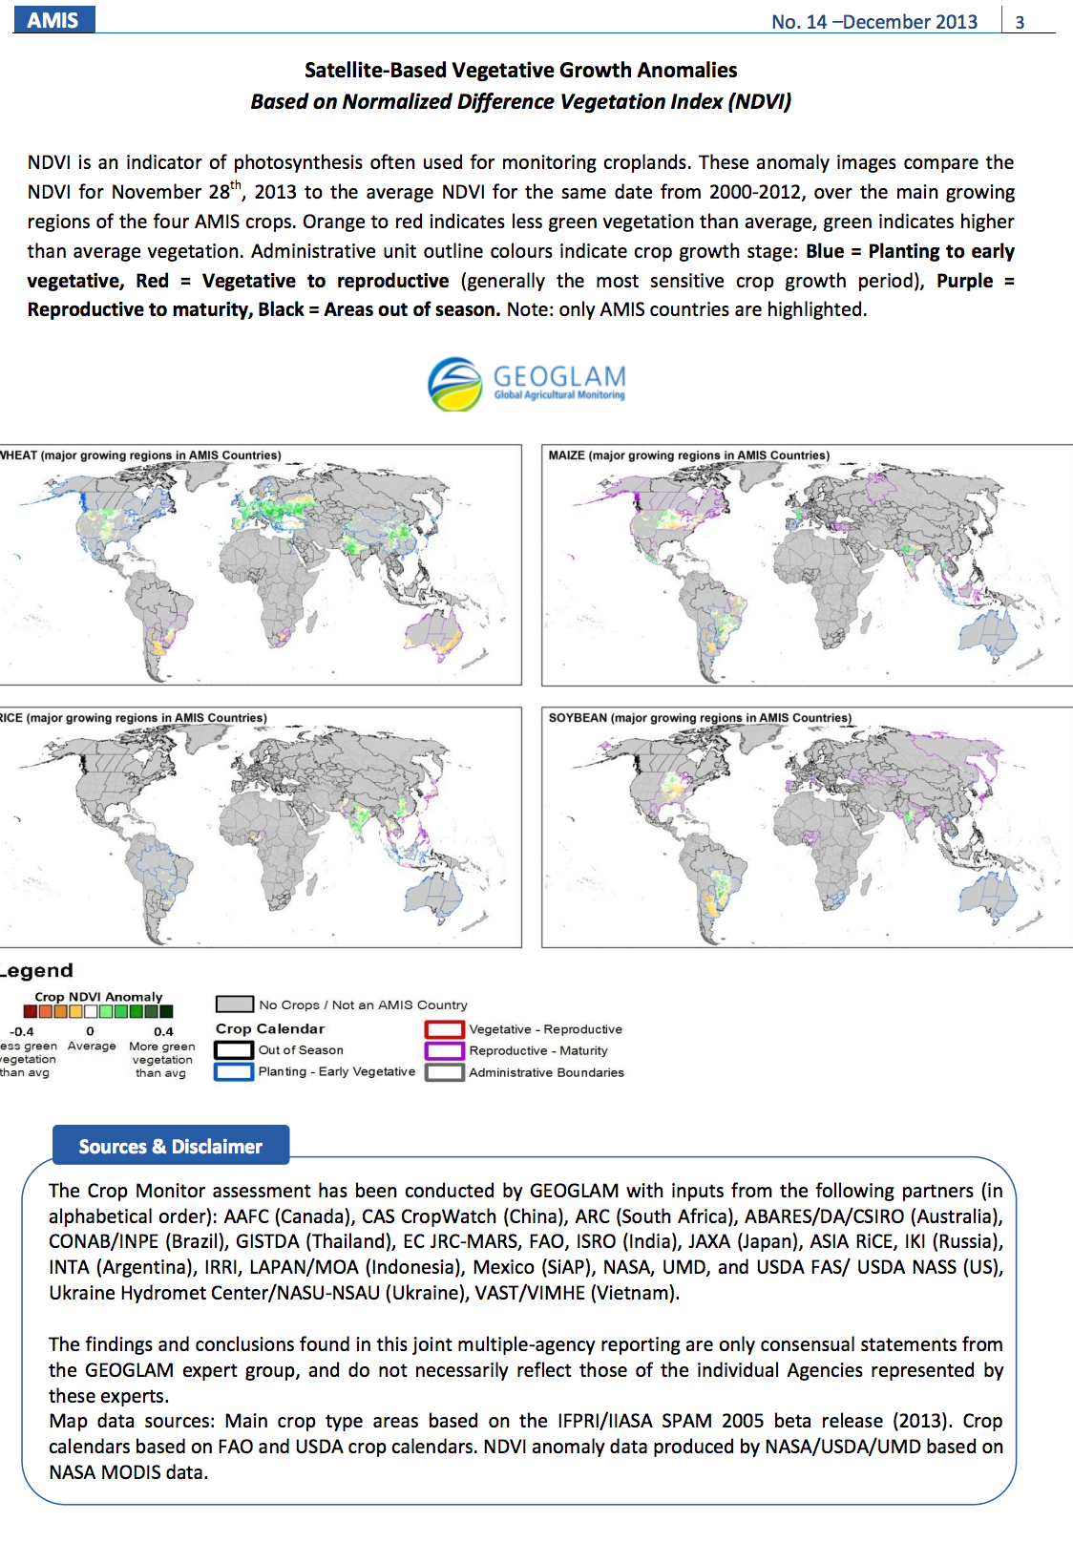
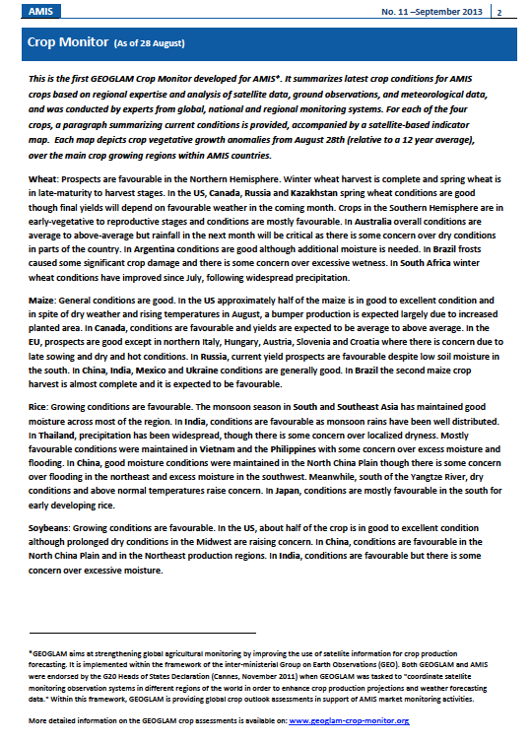
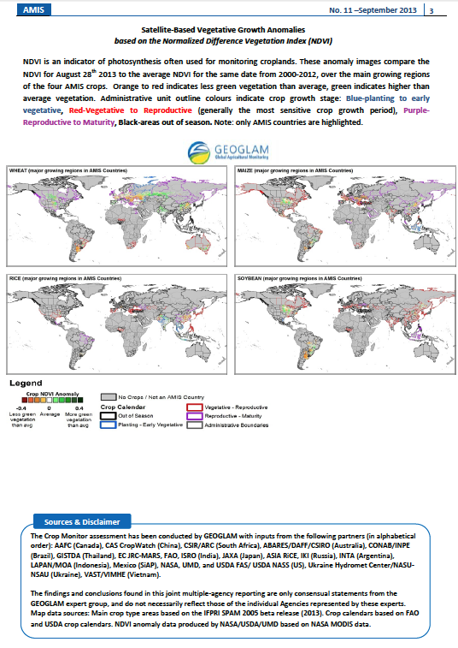
October
November
December
September
Operational GEOGLAM Global Crop Condition Assessments published monthly within the G-20 AMIS Market Monitor Bulletin
Notes:
Examples of the Crop Monitor publications, which is published once a month within the G-20 AMIS Market Monitor Bulletin

Slide 28
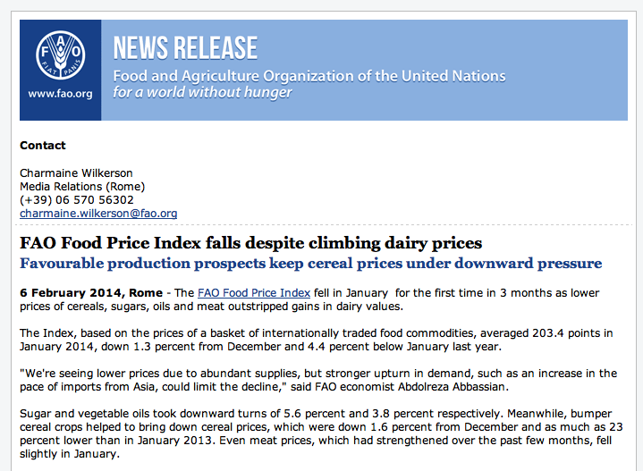
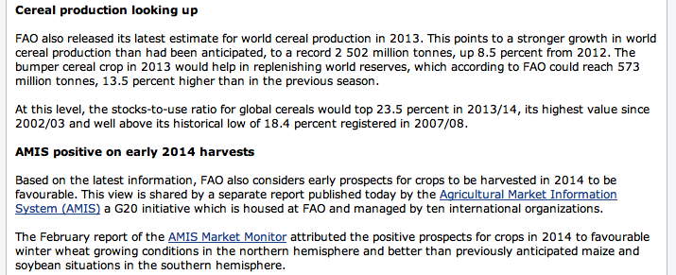
FAO February 2014 Press Release referencing information from the GEOGLAM Crop Monitor which is published in the AMIS Market Monitor
Notes:
Press release from Feb 7th, 2014 from FAO, that references the information published in the GEOGLAM Crop Monitor.

Slide 29
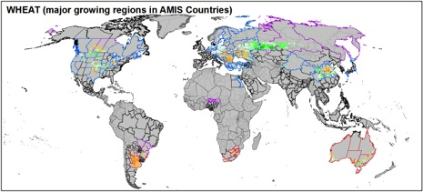
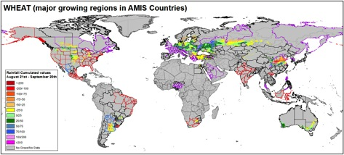

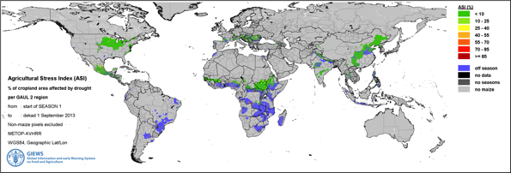
NDVI Anomalies by Crop Type
Precipitation Anomalies by Crop Type
New FAO Crop Stress Index (ASIS)- under evaluation

Slide 30
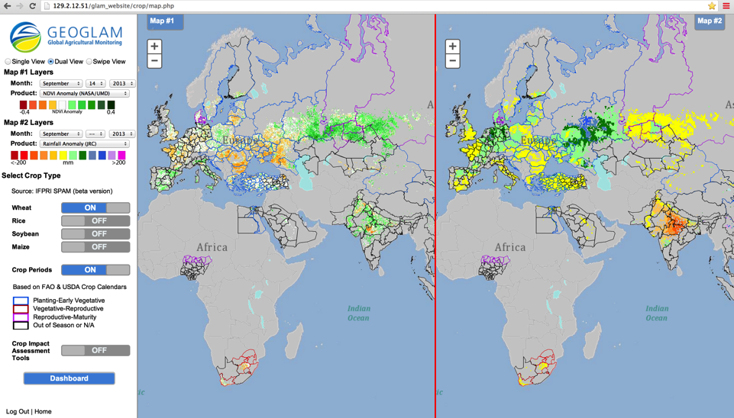
Crop Assessment Interface
Data include: NDVI, Precip and Temperature Anomalies from NASA/UMD and JRC
Enables comparison between relevant datasets (global, national and regional), by crop type and accounting for crop calendars and enables crop condition labeling and commenting to reflect national expert assessments

Slide 31
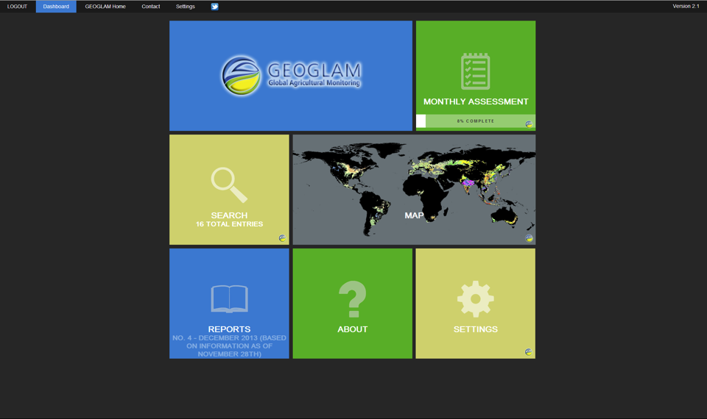
Crop Monitor Dashboard for GEOGLAM Analysts

Slide 32
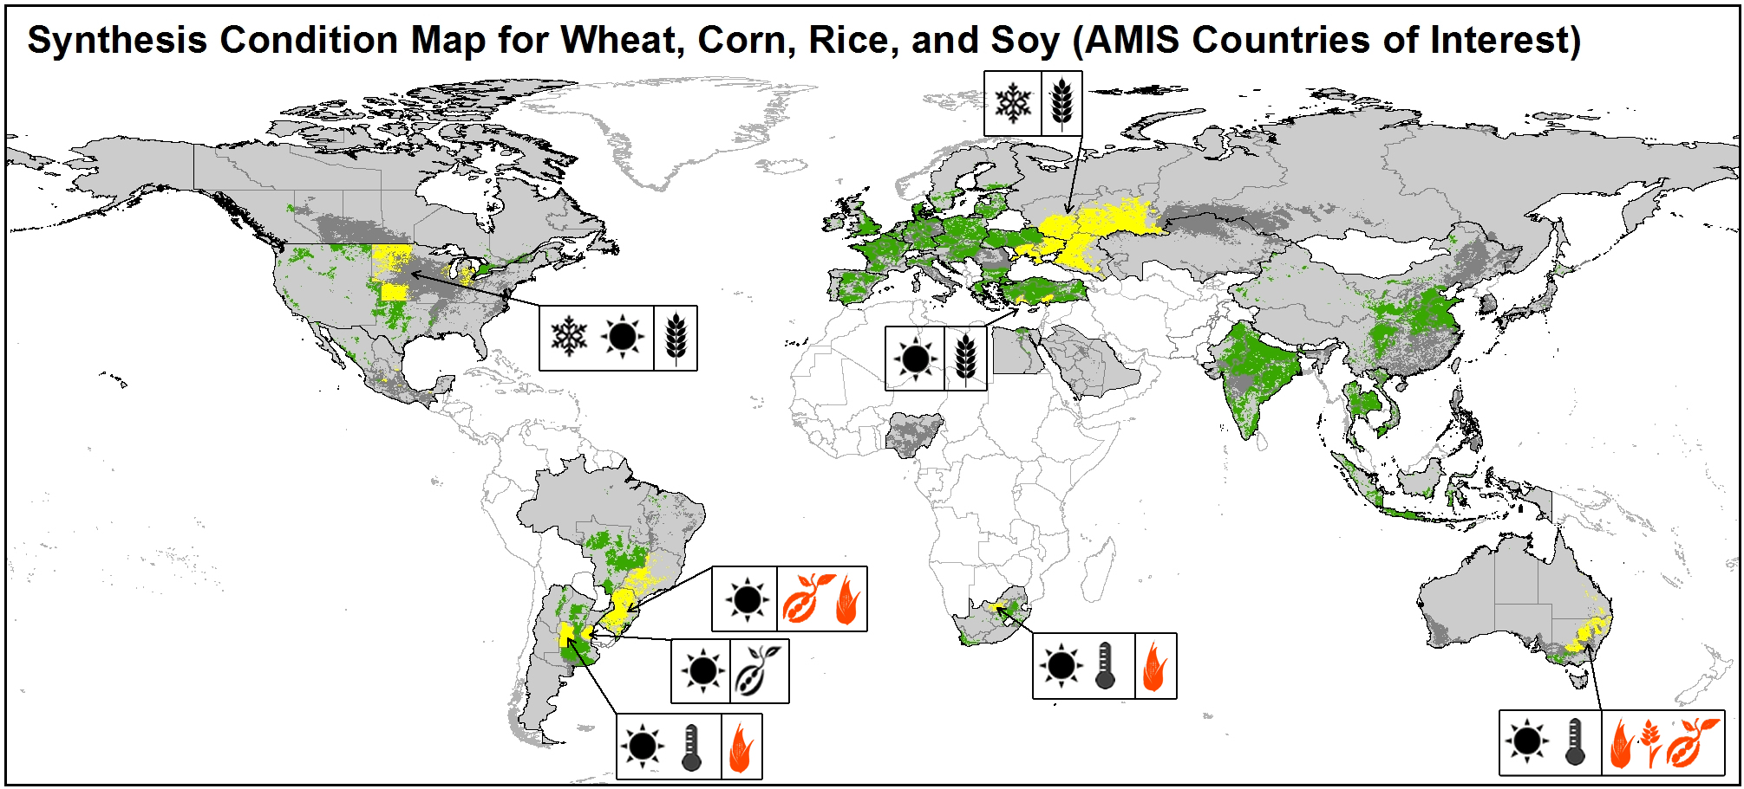
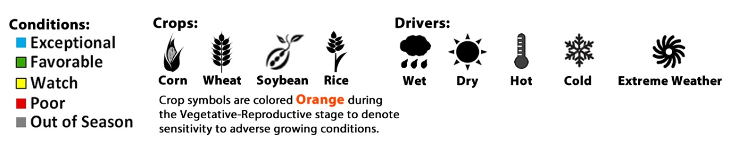
Prototype Synthesis Condition Maps

Slide 33


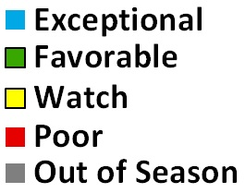


Conditions January 2014
Percent of AMIS Production:
Top 90% producers
Conditions:
Other
AMIS
Countries
Turkey
European
Union
Ukraine
WHEAT
Canada
WHEAT
Drivers:
Australia
Wet
Dry
Hot
Cold
Extreme Weather
Russia
China
United
States
India
AMIS Countries Represent 87.3% of Global Production
Notes:
Pie charts showing the percent of AMIS countries production based upon the average of the last 5 years. Inner ring are the individual countries and their percent of AMIS countries production. Second ring shows what the current condition of their crops are.

Slide 34
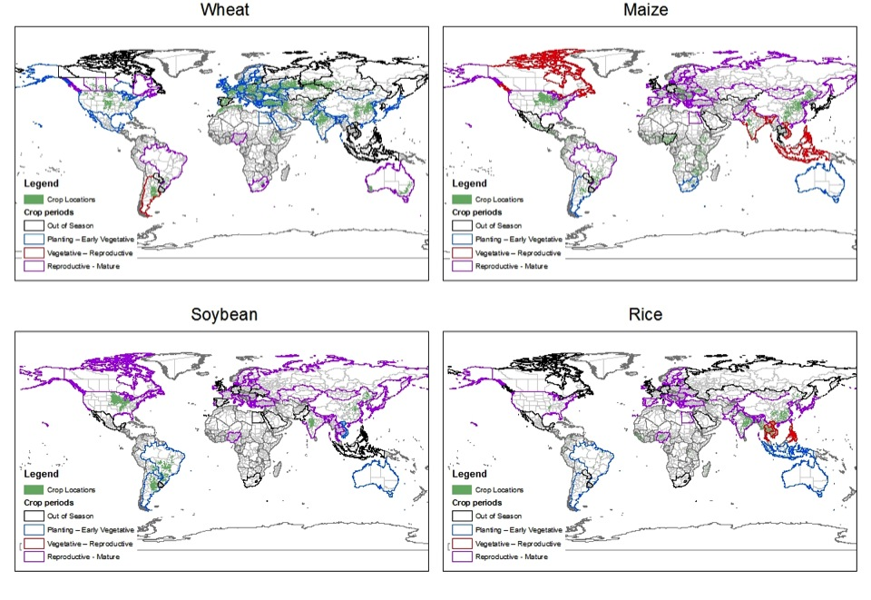
Base Layers: Crop Calendars and Crop Masks

Slide 35
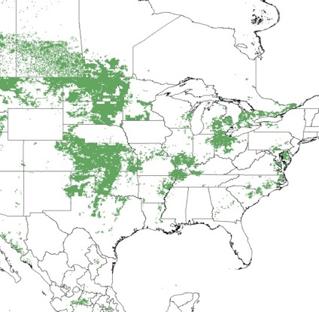

Best Available Crop Type Maps:
Wheat
SPAM 2005 beta
Combined USA and Canada
3 percent threshold

Slide 36

Wheat

Slide 37


Wheat
SPAM 2005 beta
National level Australia
3 percent threshold

Slide 38

Crop Monitor Website: www.geoglam-crop-monitor.org

Slide 39
Many achievements to GEOGLAM’s credit
Substantial effort with CEOS to develop requirements/data plan
Operational international crop outlooks for AMIS
Asia Rice (www.asia-rice.org)
Global Rangelands monitoring initiated (CSIRO)
JECAM Network of pilot site across the globe (www.jecam.org) with increasing number of new funded sites
CoP with more than 300 members initiated by the GEO Ag Task
Increasing # of funded projects including EC SIGMA
USDA GEOGLAM office under the Deputy Under Secretary of Research
Regional and National engagement
Many At-Risk –country activities involving AG CoP being better organized
FEWSNet dialogue with WMO on improving in-situ EO data in Africa
Attracting attention from potential donors as WB and Gates Foundation (pilot projects in Tanzania and Ethiopia)

Slide 40


June G8 UK Summit Magazine included an article on GEOGLAM and early stages of outlooks
Notes:
June G8 UK Summit Magazine Article on GEOGLAM Included

Slide 41
Topics for Discussions
Data access and processing product generation
  What are current options
  Overlap with GFOI
  ESRI solution? NASA solution? Vega? Others?
  What are our min requirements
    Accessibility
    Cloud data sharing
    Processing levels
  Data policy, sharing and tracking
  Processing levels
What has the CEOS Phase 1 endorsement translated into?
Are data being acquired- if so- how are they being tracked?
Do we have the timeline & objectives right?
Lessons learned from Phase 1 to inform phase 2
Funding strategy
reporting

