Slide 1
Asia-Rice team Update
Shinichi Sobue, Kei Oyoshi and Tsugito Nagano
On behalf of Asia Rice crop team (Asia-RiCE)
February 26, 2014
Notes:
I appreciate this kind of opportunity to explain our proposal.

Slide 2
G20 France 2011 Summit Final Declaration
Action Plan on food price volatility and agriculture 26. We recognize the importance of timely, accurate and transparent information in helping to address food price volatility, and agree on the need to improve the quality, reliability, accuracy, timeliness and comparability of data on agricultural markets (production, consumption and stocks). We decide to launch: - Agricultural Market Information System (AMIS), - Global Agricultural Geo-Monitoring Initiative (GLAM). [Meeting of G20 Agriculture Ministers, 2011] [G20 France 2011 Summit final declaration, 2011]
10
Notes:
AMIS & GLAM
They committed to improve market information and transparency in order to make international markets for agricultural commodities more effective.
To that end, they will launch Agricultural Market Information System" (AMIS) and "Global Agricultural Geo-monitoring (GLAM) Initiative".

Slide 3
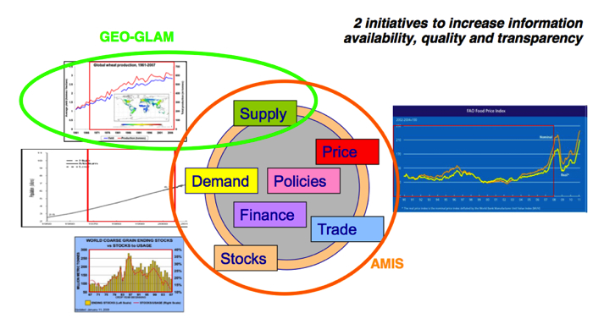
Contributions of Remote Sensing to GLAM
Global Agricultural Geo-monitoring Initiative (GLAM) - Strengthen global agricultural monitoring by improving the use of remote sensing tools. - To enhance crop production projections and weather forecasting. - Useful input for AMIS concerning the provision of more accurate crop forecasts data.

Slide 4
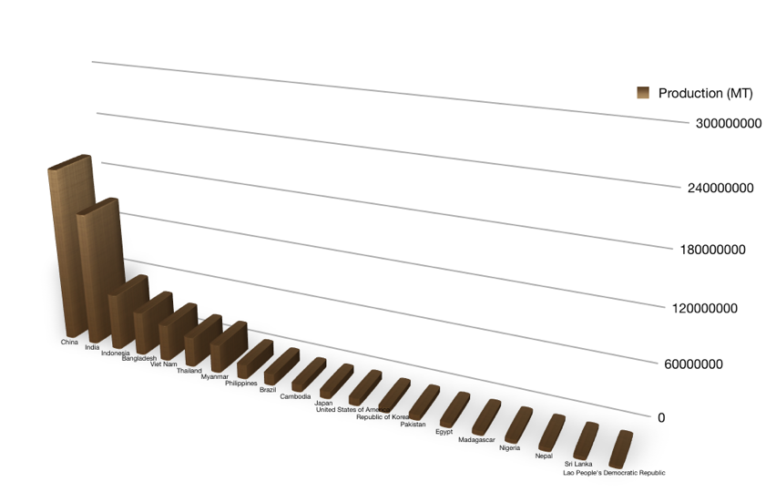
Importance of Rice in Asia
Asian countries are responsible for approximately 90% of the world rice production and consumptions.
Rice is not just a food, but closely related to culture.
China
Top 20 Rice Production Countries in 2011
India
Indonesia
Bangladesh
Vietnam
Thailand
Myanmar
Philippines
Brazil
Cambodia
Japan
[FAOSTAT]
Rice related statics or information are imperative for decision making.

Slide 5
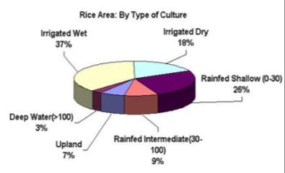
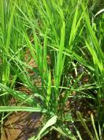
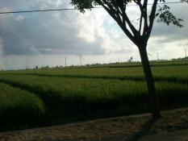
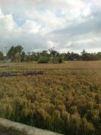
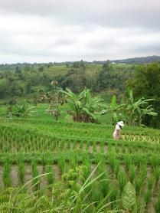
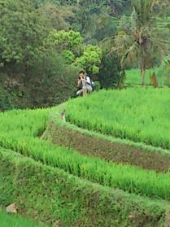
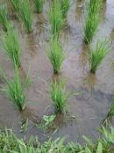
Special Characteristics of Asian Rice Crop Growing Regions
Multi-season crops
Variable crop calendars within a season
Diverse growing practices
Water resource dependency (Water stress – irrigated, rain-fed)
Rainy season growth (cloud)

Slide 6
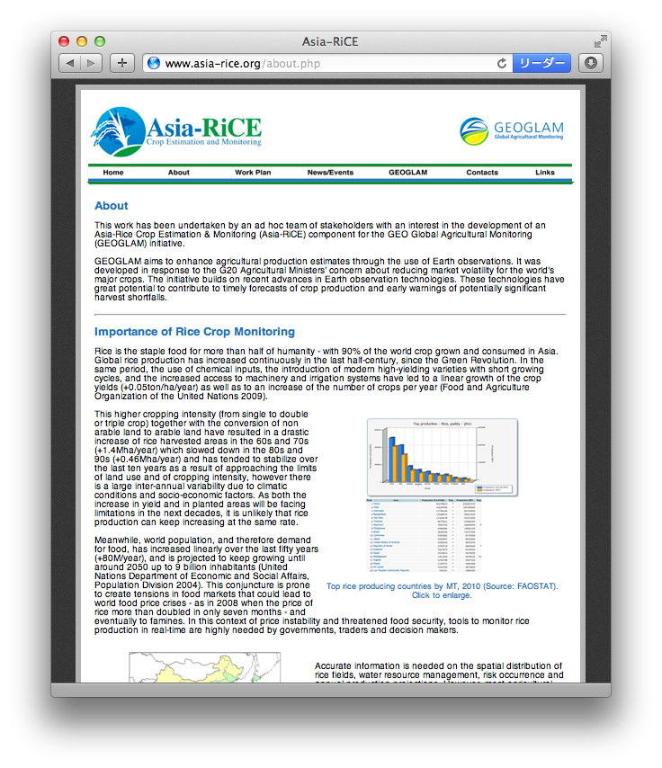
Asia rice crop team in GEO GLAM
Asia-Rice is an Asian Rice Crop Estimation & Monitoring (Asia-RiCE) component for the GEO Global Agricultural Monitoring (GEOGLAM) initiative since 2012
2012: Publish Asia rice crop team work plan version 1.0
2013/9 - Define technical demonstration sites with 100km x 100km area in each country in members and implement phase 1A with Indonesia, Thailand and Vietnam to estimate rice crop area and production using available SAR and other satellite data with ground observation data and statistical information
2013/10 – Provide rice outlook information to FAO AMIS using agro-meteorological data derived from EO satellites including MODIS, GCOM-W, TRMM and others with ASEAN+3 (AFSIS)
2014 – Will start phase 1B implementation and develop phase 2
http://www.asia-rice.org

Slide 7
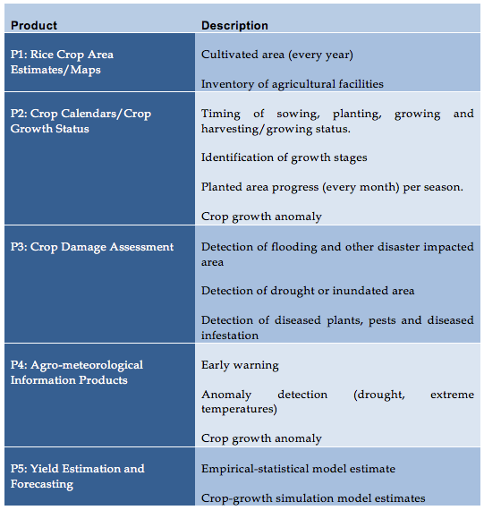
Asia Rice crop target products / services
http://www.asia-rice.org

Slide 8
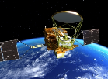
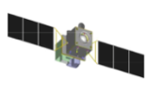
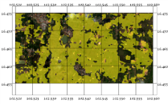
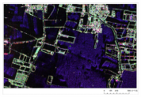
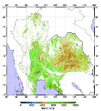
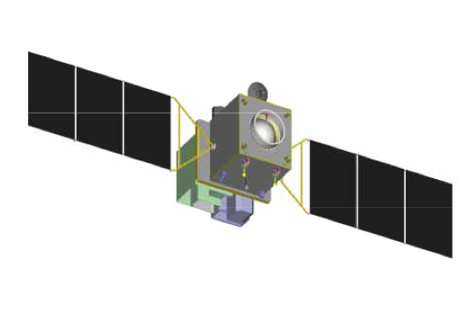
Data Integration
Only one sensor / satellite can not solve application requirements - Multi-satellite observation including international constellation is definitely needed.
Satellites/Sensors
SAR
Microwave Radiometer
Precipitation Radar
Optical Sensor (Global Imager)
Optical Sensor (High Res.)
Products from satellite data
Paddy Field Mapping
Flood Monitoring
Crop Growth
Agro-meteorological Monitoring
Topography
Agricultural Applications
Agricultural Stat
Early Warning
Damage Assessment
Land Resource Management

Slide 9
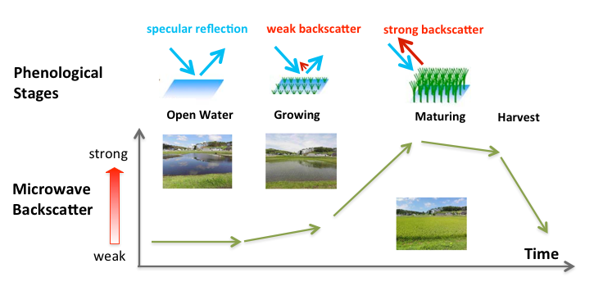
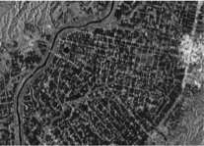
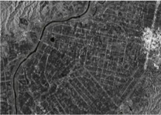
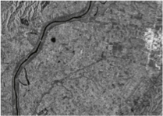
Seasonal Backscatter Characteristics of Paddy Field
Seasonal changes in microwave backscatter is useful information to detect paddy field area.
SAR Backscatter
Low
High

Slide 10
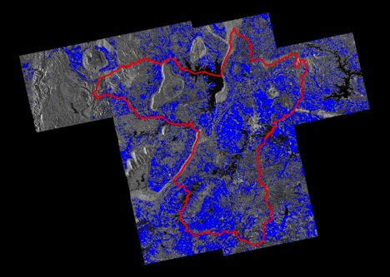
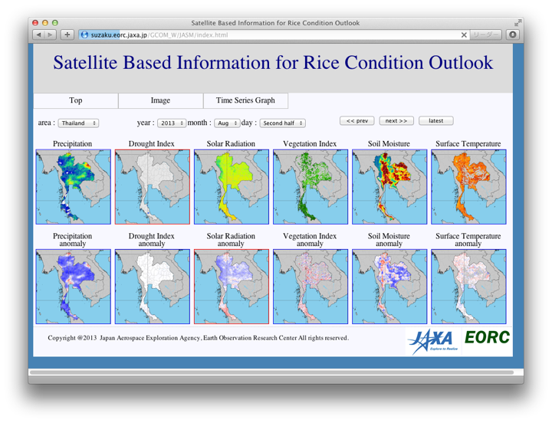
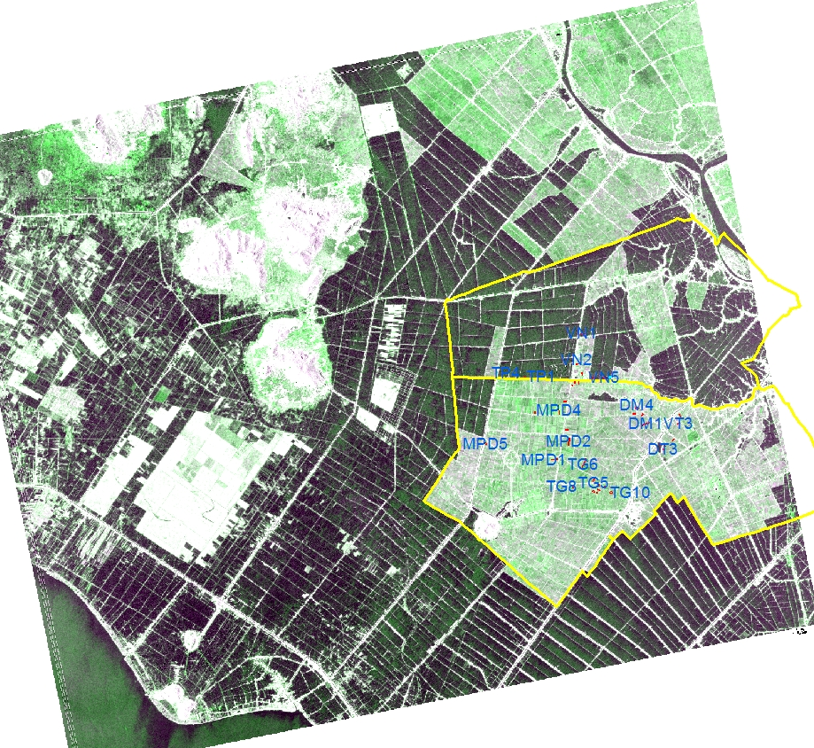
Product examples
Rice crop area estimation using SAR in Thailand and Vietnam
Agro-meteorological information for rice crop outlook
http://www.asia-rice.org

Slide 11
Asia Rice crop team meeting in Bali, ACRS2013 co-hosted by MOA and JAXA

Slide 12
Agenda and Topics
Asia rice crop team homepage update
Agree to post today’s PPTs to home page
Work plan update
Need to update with outlook activity with linking JAXA’s outlook homepage (JASMIN) and UMD homepage
Joint publishment
Agree to think to submit joint research paper for TDSs phase 1A sites with Japan
Next face-to-face meeting (APRSAF EOWG@Hanoi and SAFE WS@TBD, next May)
Agree to hold phase 1A sites face-to-face meeting and compile phase 1A study early result to present at GEO plenary by Shinichi on behalf of Asia rice crop team
Propose to hold SAFE workshop with Asia rice crop team meeting in conjunction with The Institution of Geospatial & Remote Sensing Malaysia (IGRSM) (http://www.igrsm.com) will be organising the 7th IGRSM International Remote Sensing & GIS Conference and Exhibition in Kuala Lumpur, Malaysia, on 22-23 April 2014

Slide 13
Scope of Phase 1
Phase 1A of Asia-RiCE will consist of four technical demonstration sites in three countries
Each of these will focus on the development of developing provincial-level rice crop area estimations.
Phase 1B, and/or Phase 2, additional technical demonstrators will be added, and/or the scope may be increased to produce whole country estimates.
Thailand will likely be used as a demonstration of whole-country “wall-to-wall” rice crop area estimation capability, using ScanSAR and other data.

Slide 14
Country Phasing
Phase-1A
Indonesia (Subang, West Java Island);
Thailand (Suphan Buri province);
Vietnam (Thai Binh (North));
Vietnam (An Giang (South));
Phase-1B
Lao P.D.R. (Savannakhet province);
Philippines (Nueva Ecija for RIICE project, TBD for BAS);
China (Taishan, Guangdong Province);
India (West Bengal state);
Japan (Tsuruoka, Yamagata Prefecture);
Malaysia (IADA Barat Laut Selangor Province).
Chinese Taipei (Taiwan) (Chang Hua, Yun Lin, and Chiayi Counties)
South Korea (Location, TBD)
Myanmar, Bangladesh and Cambodia

Slide 15
Support to GEOGLAM Phase 1
Definition of observational requirements for Asian Rice Crops for GEOGLAM Phase 1 – 2013-2014
Rice crop requirements distinct from other cereal crops
Input to CEOS acquisition planning process
Coordination of key data streams, including SAR
Radarsat-2, RISAT-1, ALOS/ALOS-2, TerraSAR-X, Cosmo-Skymed
Development of Technical Demonstrator Sites for Phase 1A and 1B

Slide 16
Status of Satellite observation plan and TDS phase 1 activity
Result from Asia rice crop team face-to-face meeting in rice crop workshop in ACRS at Bali co-hosted by Indnesian MOA and JAXA
1. Radarsat-2 JECAM-SOAR proposal by TDSs phase 1
Submitted: Chinese Taipei, Indonesia, Japan, Malaysia, Philippine, Vietnam, Thailand
Preparation: China, India, LaoPDR,
Loan data agreement submitted; Indonesia, Thailand, Vietnam and Japan
2. RISAT-1 – ISRO: Coordinate with ISRO
3. ALOS/ALOS-2
Completed: ALOS archive to phase 1A TDSs
ALOS-2 observation planning is underway
Asia rice crop team plans to submit team JAXA’s K&C RA proposal this spring (TBD)
4. TerraSAR-X
Tandem-X science proposal was accepted but there was very few chance to receive Balistic mode of SAR data
New TerraSAR-X proposal was accepted but there was limitation of amount of data (target to two countries from April)
5. Cosmo-Skymed
Thai and south Vietnam have some data under their own frameworks
6. Sentinel-1
Coordinate with ESA
Revised our requirement document of Asia RiCE with adding Indian TDS

Slide 17
Institutional Arrangement for Phase 1A and…
1. Asian Development Bank - ADB funded project 2013-4 (- Japan Fund for Poverty Reduction)
“R-CDTA 8369: Innovative Data Collection Methods for Agricultural and Rural Statistics”
Aims to assist the selected pilot countries (Lao PDR, Philippines, Thailand, and Viet Nam (North)) in developing and adopting space-based technology (SBT) and similar tool application methods in estimating rice crop area and production.
Under JAXA-ADB agreement (LOI) using JAXA’s satellite data and application
2. APRSAF SAFE projects 2013-4 (Supported by JAXA)
Asia Pacific Regional Space Agency Forum – Space Application for Environment
Aims to encourage environmental monitoring for climate change mitigation and adaptation studies, as well as studies on other forms of practical application, using space applications.
Open to every agency in Asia-Pacific Region for submitting new proposal.
Two prototyping for rice crop monitoring are on-going in Indonesia and South Vietnam
3. IFC, World Bank and JICA
Some discussion with donors about crop insurance to insurance company using space based observation data
4. Other on-going and/or operational activities
FASAL-India, CropWatch-China, RIICE-IRRI and other R&D in Asia-RiCE team

Slide 18
Phase 1A discussion topic with CEOS
Complicated procedure to get free data from CEOS agencies
Each country PI selection, paper works
No allow to share data within our Asia team
Ground based observation and other statistical data sharing obligation
Request to publish scientific research paper even if GEOGLAM is to promote practical data use to SBA
Resource availability to do data processing, sharing, etc.
Major issue is to get data from CEOS agencies to respected country by using Internet (too big data transfer to Asia by Internet !!!) and share data among CO-Is
SDMS test bed?

Slide 19
GEO GLAM Outlook to FAO AMIS Agro-met information using satellites

Slide 20
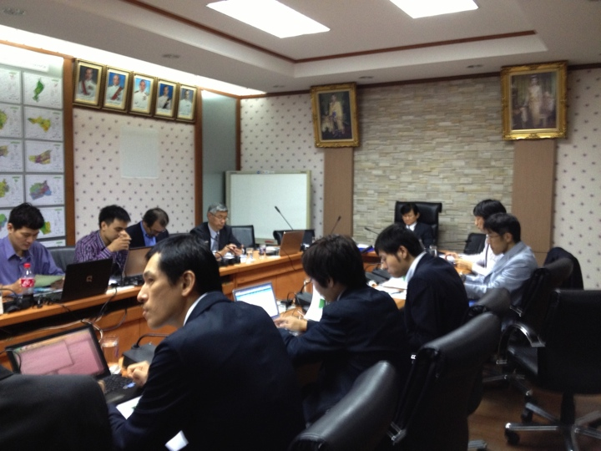
Collaboration with AFSIS for phase 1A - Rice Growth Outlook
GEOGLAM Consultation Meeting co-hosted by ASEAN+3 Food Security Information System (AFSIS) project and JAXA
Phase1A Country: Indonesia, Thailand, Vietnam
Submit outlook description to phase 1A countries statistic organizations through AFSIS (20th), then share in Asia-RiCE (23rd) , and submit to GEOGLAM
Outlook is not directly connected with official statistic information from statistic organizations because of temporal requirement and administrative issue
Satellite derived agro-met information will serve as supporting evidence & data
18 October 2013
@OAE, Bangkok, Thailand
AFSIS : ASEAN+3 Food Security Information System (Office in Bangkok)

Slide 21
Asia-RiCE phase 1A crop outlook flow to FAOAMIS
(a)
(a) Drought index (KBDI), Precipitation, LST, NDVI, Soil moisture (provincial / national / regional) anomaly by GCOM-W, GSMaP, MODIS, etc. by JAXA with UT(contract to RESTEC) and other team members
Agro-met information by JAXA using EO and by other team members
(b) Interpret agro-met information to a rice outlook information by rice crop experts in Asia in cooperation with AFSIS project (for phase 1A, three countries (Indonesia, Thai, Vietnam are targeted
(b)
(b1)
(b1) Review and add some outlook information with provision of additional agro-met information and rice crop growth information derived from Asia rice crop team
(c) Develop monthly outlook report for corn, wheat, soy bean and rice by GEO GLAM team including Asia rice crop outlook submitted by AFSIS and post on UMD outlook page by USDA and other crop experts with GEO GLAM team (NASA, USDA, CSA, JAXA, EC, …)
(c)
(d)
FAO
(d) Submit monthly outlook report using EO satellites information to FAO AMIS from September, 2013

Slide 22
Assessment Source for Rice Growth Outlook
Satellite observation provides “Current Condition” and “Anomaly” information and they are updated every 15 days (twice a month).
Parameters | Interval | Spatial Resolution | Data Period (anomaly calc.) | Satellite Data Source
Precipitation | Cumulative (15-day) | 10 km | 2002- (2002-2012) | GSMaP (GCOM-W1, TRMM, MTSAT etc.)
Solar Radiation | 15-day Average | 5 km | 2007- (2007-2012) | MODIS
Land Surface Temperature | 15-day Average | 5 km | 2002- (2002-2012) | MODIS
Soil Moisture | 15-day Average | 50 km | 2009- (2002-2012) | AMSR-E, WINDSAT
Drought Index | 15th /31[30]th day of month | 10 km | 2003- (2003-2012) | GSMaP, MTSAT
Vegetation Index | 15th /31[30]th day of month | 5 km | 2002- (2009-2012) | MODIS

Slide 23
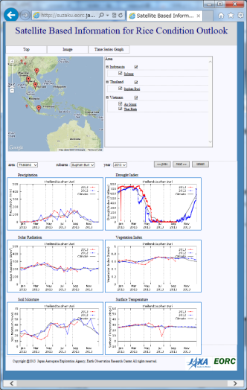
JASMIN - Data-distribution System for Rice Outlook
Each data will be updated twice a month (15th, 31th day of month).
Users can access and get latest data any time.
Spatial Distribution
Time-Series
Top
http://suzaku.eorc.jaxa.jp/GCOM_W/JASM/index.html

Slide 24
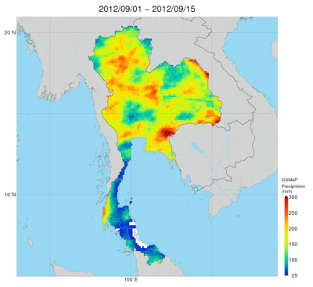
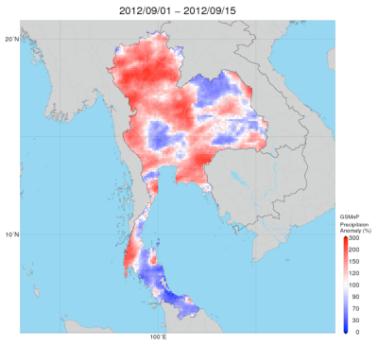
Precipitation
This system provide “Precipitation” accumulated 15-day precipitation.
Few precipitation can causes drought and too much precipitation can causes flooding.
Current Condition
Anomaly
Much
Much
Less
Less

Slide 25
Data requirement for outlook
Improve existing agro-met data
Precipitation, LST: GPM and new generation of geostationary weather satellites
PAR, LST, NDVI: NPP, Sentinel-2 and GCOM-C
Soil moisture, drought : SMOS, SMAP,
Flood and water related disaster: MODIS,AMSR-2, NPP, Sentinel-2 and GCOM-C as well as ScanSAR of SARs
Adding countries for outlook to AMIS and ASEAN
Cambodia, LaoPDR, Philippine, Myanmar with Indonesia, Thailand, Vietnam
Need collaborative work to apply agro-met information derived from satellites to outlook text through holding capacity building under institutional support since agro experts don’t think they need those agro-met information for their outlook work

Slide 26
Questions?

Slide 27
APPENDIX – phase 1a requirements

Slide 28
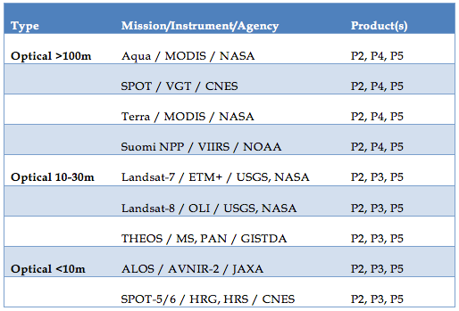
Phase 1A Space Data Requirements
Optical

Slide 29
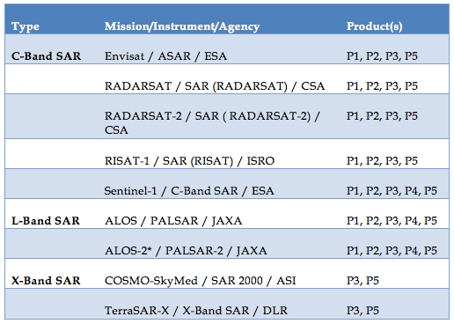
Phase 1A Space Data Requirements
SAR

Slide 30
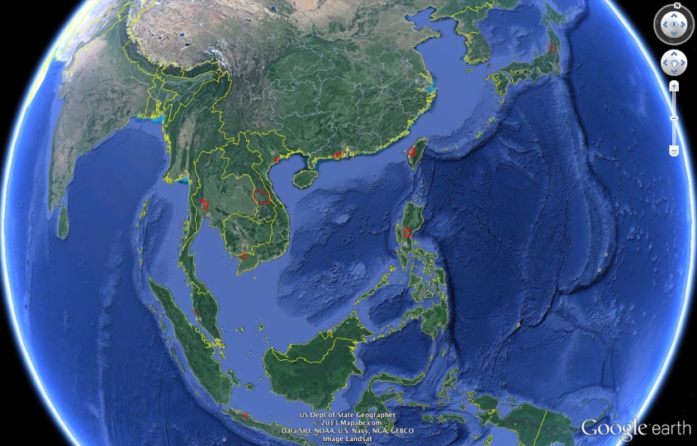
Technical Demonstrator Sites (TDS) for Asia-RiCE
India
Vietnam (N)
China
Taiwan
Laos
Philippines
Vietnam (S)
Malaysia
Phase-1A
Phase-1B
Indonesia
30

Slide 31
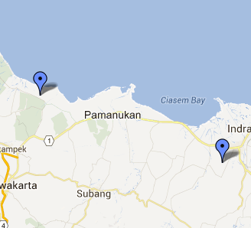
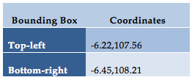
Phase 1A: Indonesia
Indonesia – Subang, West Java Island
Aim: To develop and use the rice crop yield estimation model (with a focus on Western Java Island) to provide comprehensive and accurate information to the BPS and Ministry of Agriculture.
Responsible Agency: Indonesian National Institute
of Aeronautics and Space (LAPAN).
Technical/Implementation Agency:
LAPAN, Indonesian Center for Agricultural Land Resources Research and Development (ICALRD), Indonesian Agency of Agricultural Research and Development (IAARD), Ministry of Agriculture (MoA) of Republic of Indonesia, Bogor Agricultural Institute (IPB)
Links to Existing Agricultural Authorities: Ministry of Agriculture (MoA).
Subang Region, West Java Island.

Slide 32
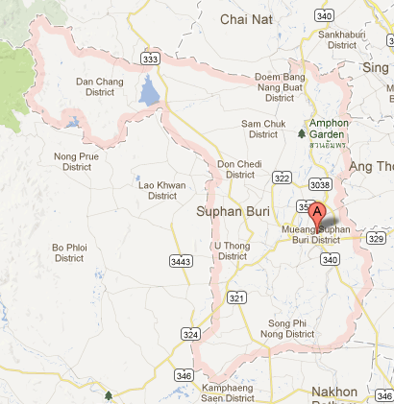
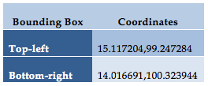
Phase 1A: Thailand
Thailand – Suphan Buri Province
Aim: To produce a rice crop area and yield prediction algorithm.
Responsible Agency: Office of Agricultural Economics (OAE), Rice Department (RD).
Technical/Implementation Agency: Office of Agricultural Economics (OAE), GISTDA.
Links to Existing Agricultural Authorities: Ministry for Agricultural and Cooperatives (MOAC).
Suphan Buri Province.

Slide 33
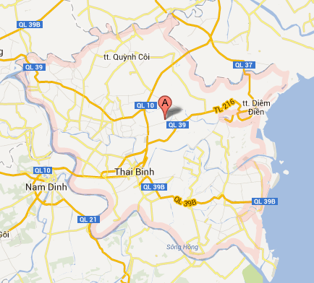
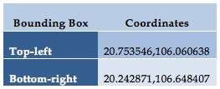
Phase 1A: Vietnam (North) – Thai Binh
Vietnam – Thai Binh (North)
Aim: To improve the accuracy of rice mapping and to refine yield estimation models.
Responsible Agency: Centre for Informatics and Statistics (CIS), Ministry of Agriculture and Rural Development (MARD)
Technical/Implementation Agency: Vietnam Academy of Science and Technology (VAST), Space Technology Institute (STI), GIC
Links to Existing Agricultural Authorities: NIAP, Agriculture and Rural Development Department of Thai Binh Province
Thai Binh Region

Slide 34
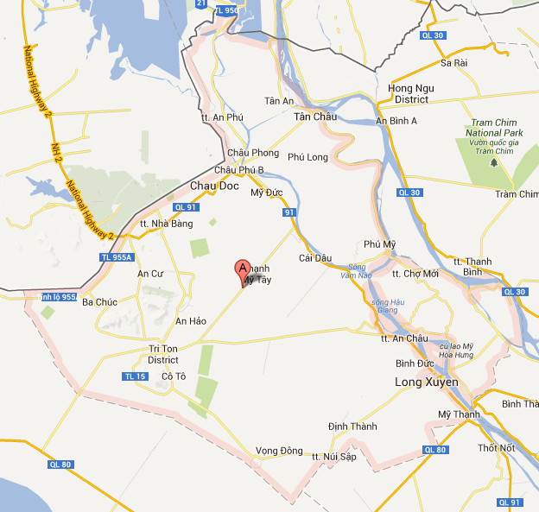
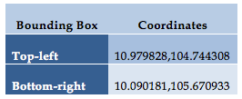
Phase 1A: Vietnam (South) – An Giang
Vietnam – An Giang (South)
Aim: To produce more accurate and reliable remote sensing methods for operational rice crop monitoring. More accurate rice area and rice production estimates are desired to supplement current in-situ measurements to support agricultural managers and planers at local to national level to enhance rice monitoring capability and yield forecast accuracy.
Responsible and Technical/Implementation Agency: Vietnam Academy of Science and Technology (VAST), Ho Chi Minh Institute of Resources Geography (HCMIRG).
Links to Existing Agricultural Authorities: Ministry of Agriculture and Rural Development (MARD), Center for Informatics and Statistics (CIS), Department of Agriculture and Rural Development (DARD) in An Giang Province.
An Giang Region

Slide 35
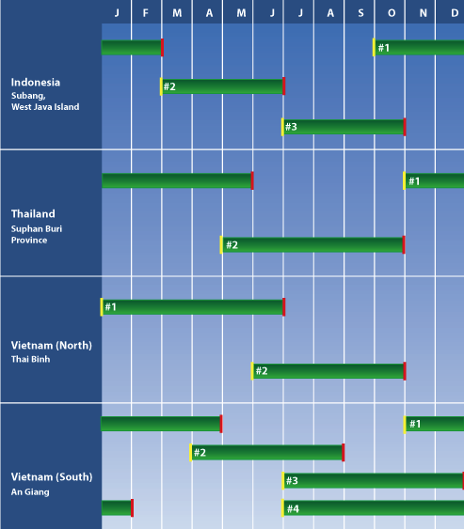
Phase 1A Crop Calendars
Indonesia (Subang, West Java Island);
Thailand (Suphan Buri province);
Vietnam (Thai Binh (North)), (An Giang (South));

Slide 36
APPENDIX – phase 1a countries

Slide 37
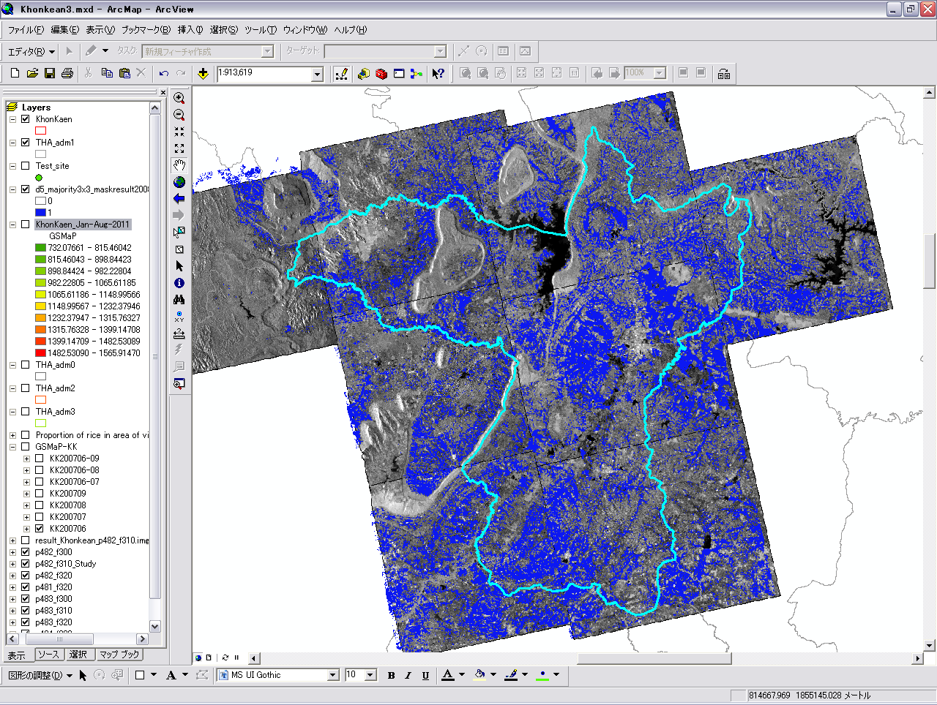
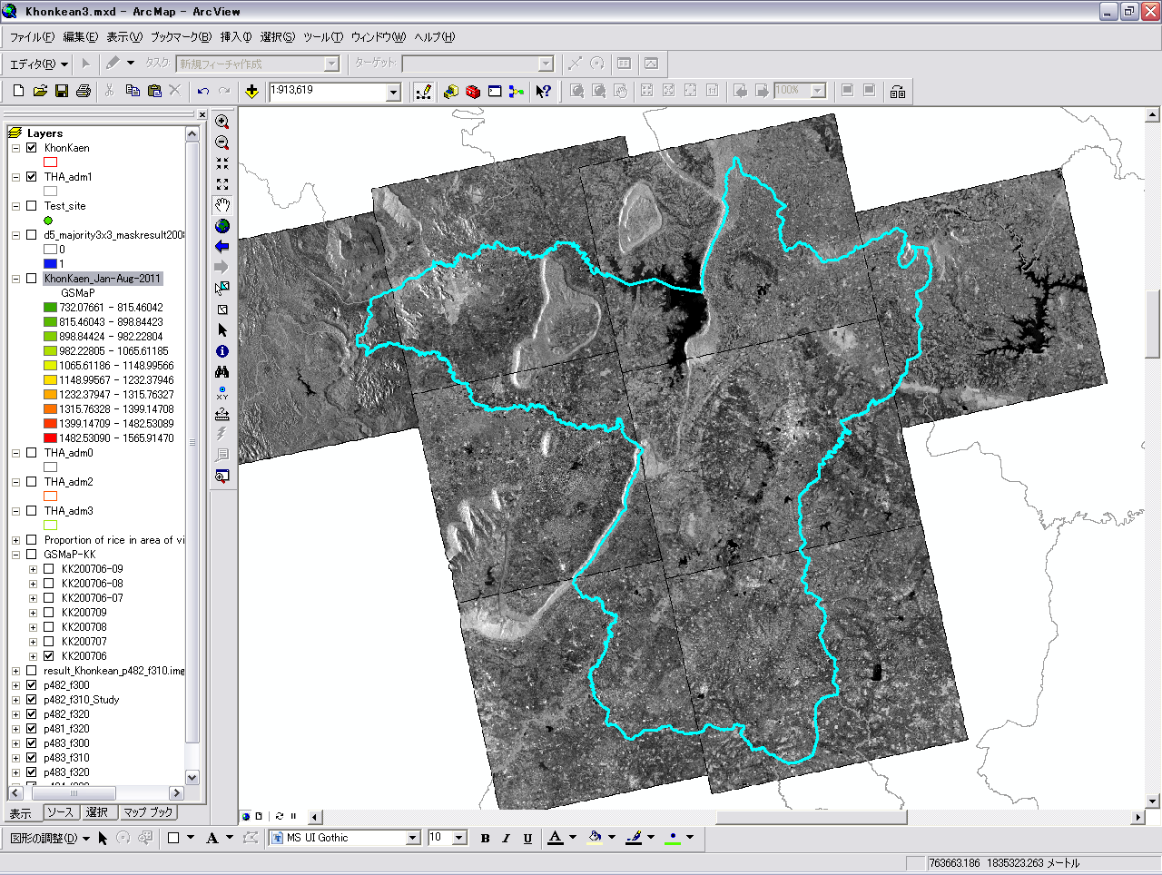
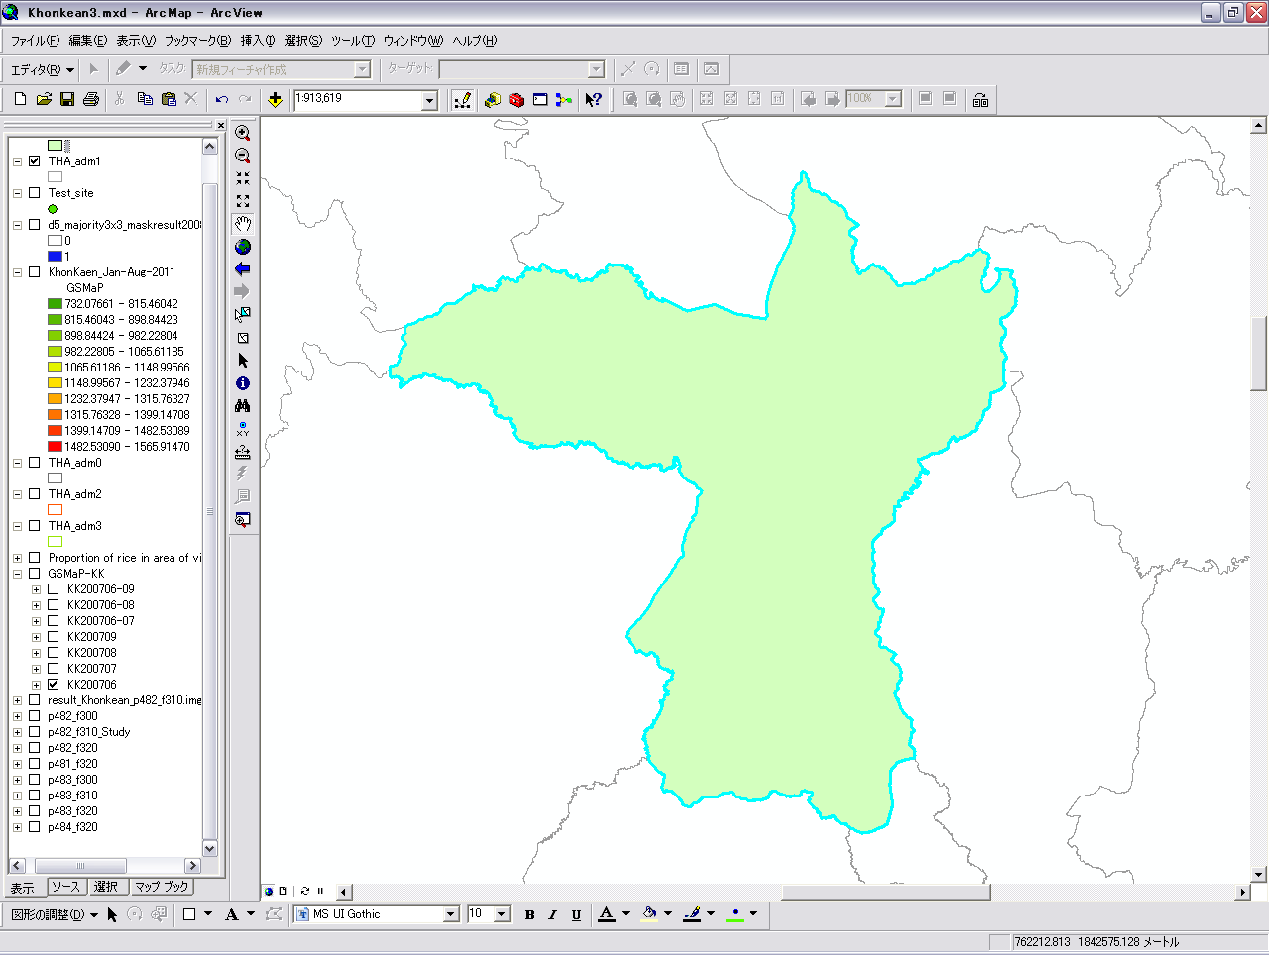
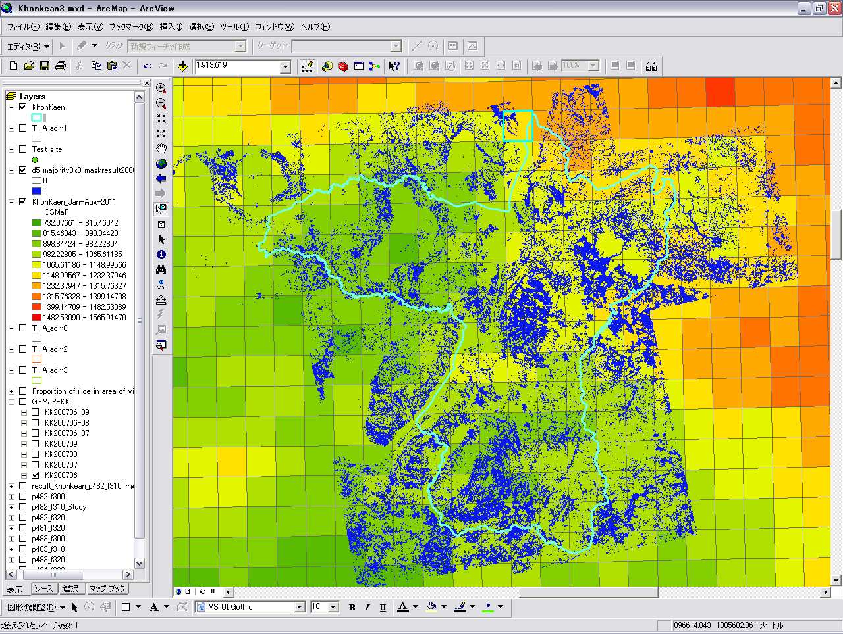
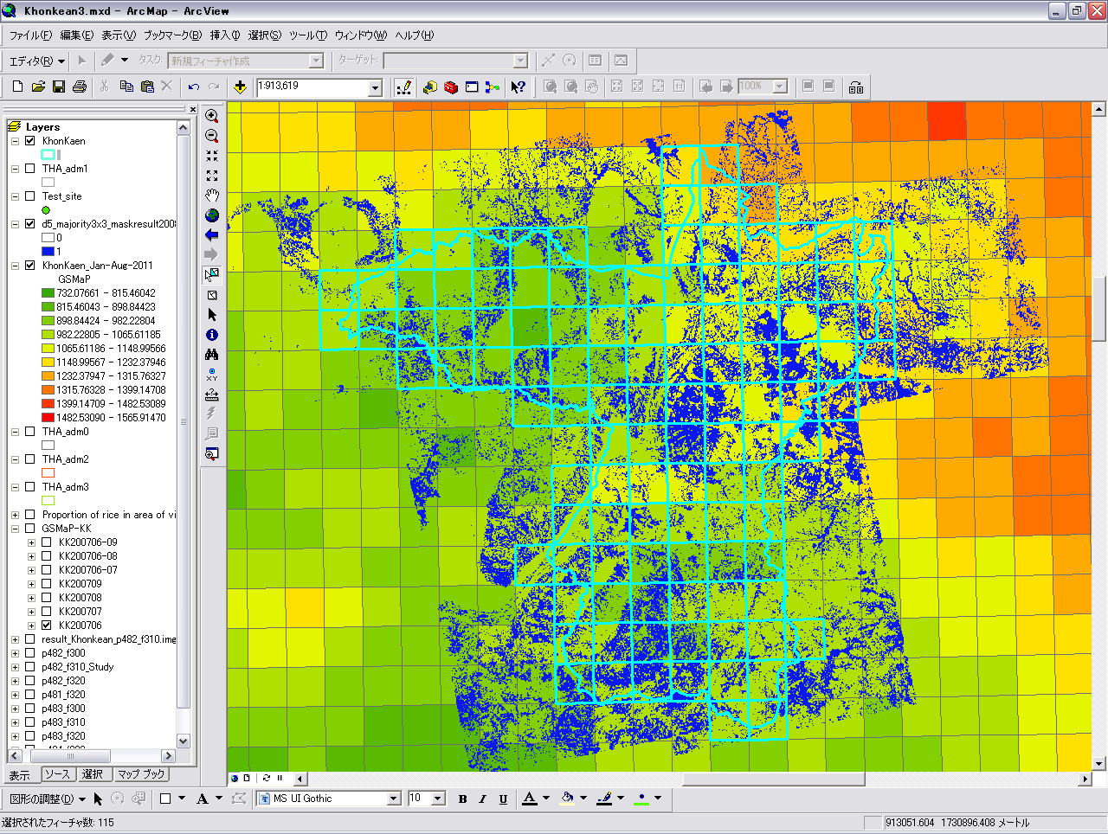
Rice crop production estimation
Acreage
*
Yield
696,258
[ton]
Production
37

Slide 38
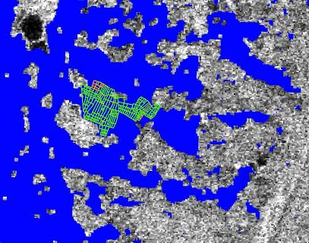
Validation
Statistic
Information*
Acreage x Yield
*Statistic information : Average of the past five years.
Estimating acreage is good.
Estimating production depends on yield by statistic information.
38

Slide 39
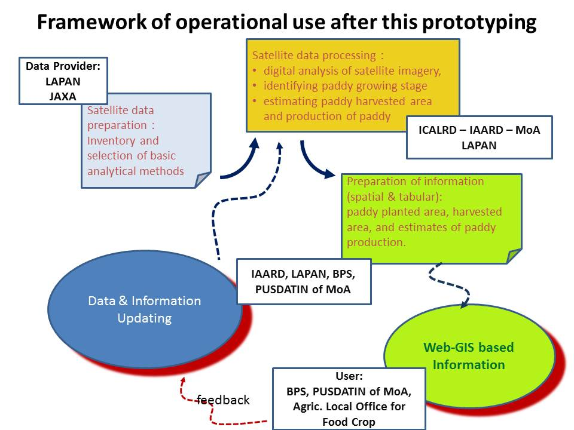
Indonesia TDS - framework of operational use after this prototyping
Engagement between space organization, Ministry of Agriculture, university and statistic office with successful prototyping to proof of concept

Slide 40
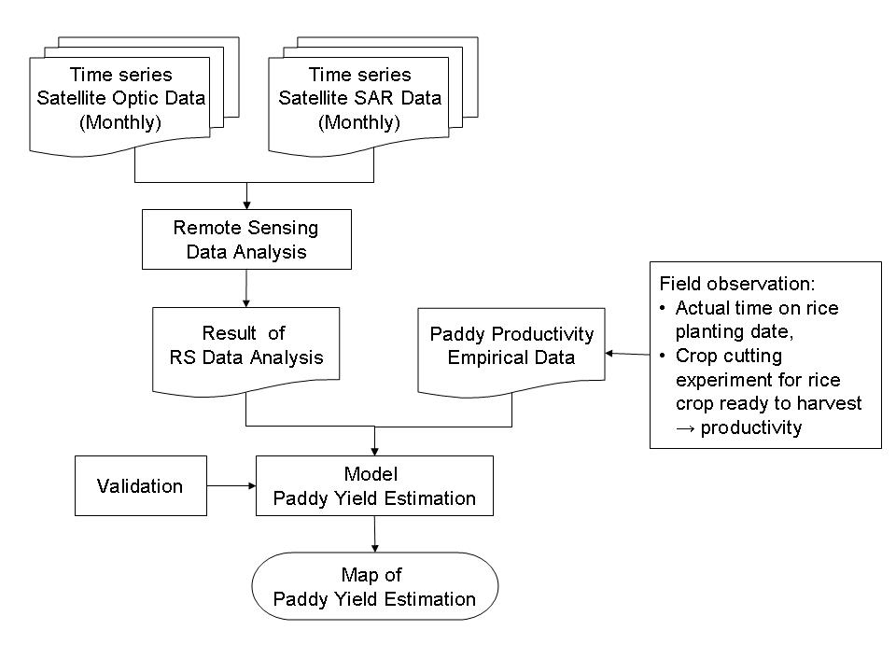
Indonesia TDS - Methodology and Data Used
EVI based empirical model by LAPAN

Slide 41
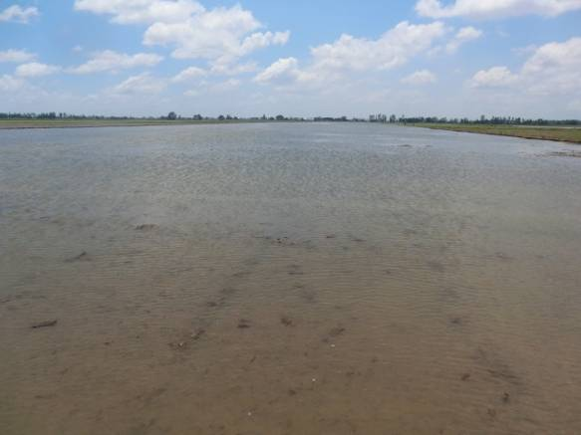
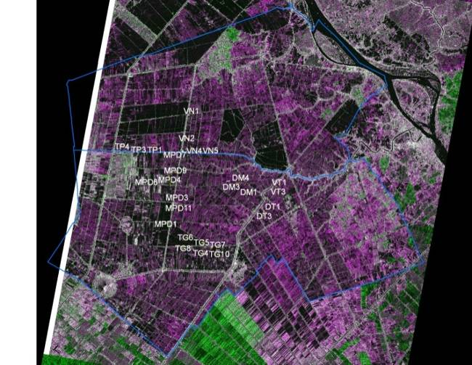
South Vietnam TDS
19 Aug 2013 (2)
19 Aug 2013
Sample rice field MPD3 sown on 17 Aug 2013
Cosmo SkyMed data: StripMap Pingpong: HHVV
10 dates (19 Aug – 23 Nov)
An Giang (Thoai Son & Chau Thanh districts): 40 samples in red.
4 Sep 2013 (18)
4 Sep 2013
41
13 Sep 2013 (27)
20 Sep 2013

Slide 42
APPENDIX – JAXA’s new mission for geo glam

Slide 43
ALOS-2 Specifications .
ALOS-2
ALOS-2 satellite
Launch : 2014
Orbit type : Sun-synchronous
Altitude : 628 km +/- 500 m (for reference orbit)
Revisit time : 14 days
LSDN : 12:00 +/- 15 min
PALSAR-2
L-band Synthetic Aperture Radar
Active Phased Array Antenna type
two dimensions scan (range and azimuth)
Antenna size : 3m(El) x 10m(Az)
Bandwidth : 14 – 84MHz
Peak transmit Power : 5100W
Observation swath : 25 – 490km
Resolution : Range: 3 m to 100 m
Azimuth: 1 m to 100 m
X
Solar paddles
Y
Z
SAR antenna
Notes:
Increase prio 1 polygon from N60 to N70 deg

Slide 44
Observation pattern for annual acquisitions*
Super sites （TBD)
* 3m SP and 6m QP modes require 3 and 5 years for global coverage
44

Slide 45
Global Precipitation Measurement (GPM)
Launch in February 28, 2014
Core Satellite (JAXA, NASA)
Dual-frequency Precipitation Radar (DPR)
GPM Microwave Imager (GMI)
GMI (Microwave Imager)
Improve the accuracy of weather forecasts
Improve water resource management
KuPR: 13.6GHz radar (phased array)
KaPR: 35.5GHz radar (phased array)
Item | GPM Dual-frequency Precipitation (DPR) |  | TRMM Precipitation Radar
Abbreviation | KuPR | KaPR | PR
Swath Width | 245 km | 120 km | 245 km
Horizontal Resolution | 5 km |  | 5 km
Observation Range | Upto 19km |  | Upto 15km
Minimum Detect Ze (Rainfall Rate) | < 18 dBZ (< 0.5 mm/hr) | < 12 dBZ (< 0.2 mm/hr) | < 23 dBZ (< 0.7 mm/hr)
Core
Satellite
Constellation
Satellites

