Slide 1
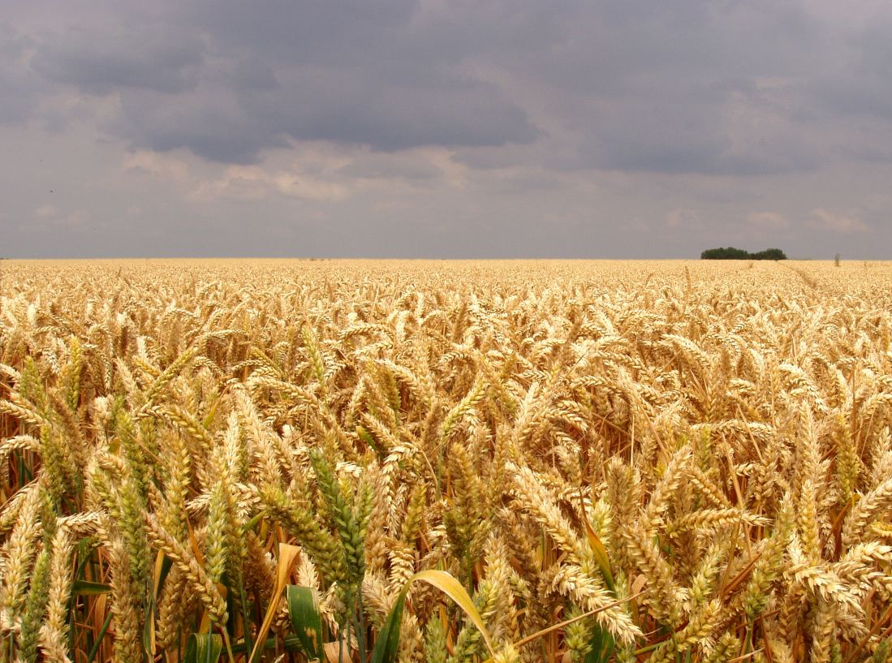
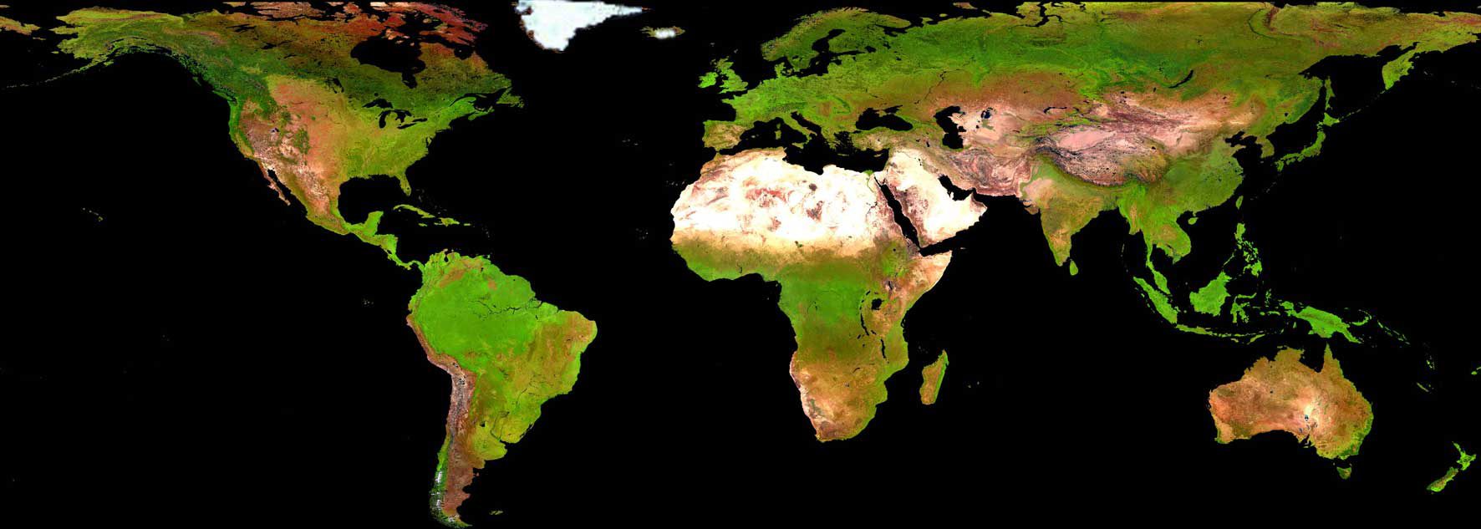
Overall Requirements Framework
Pierre Defourny
UCL/ELI -Geomatics, Belgium – co-lead of JECAM
with contributions of GEOGLAM and JECAM partners
GEOGLAM--‐CEOS Global Agricultural Monitoring Co-community Meeting
ESA/ESRIN 27 ‐ 28 February 2014
© UCL-Geomatics
Notes:
T. Newby Agricultural Research Council - South Africa

Slide 2
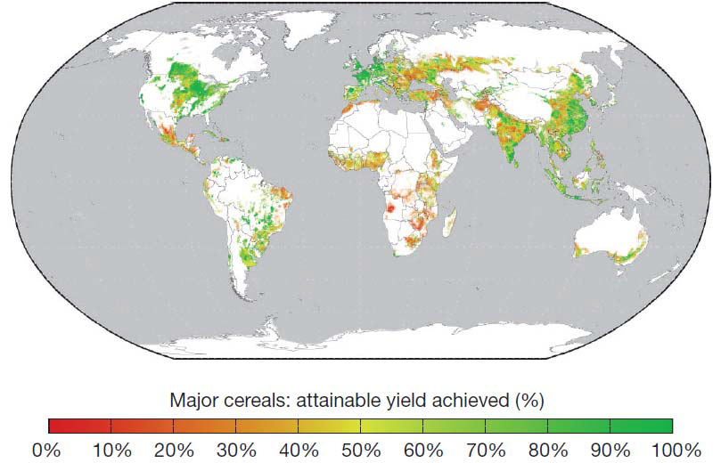
For agriculture …yield gaps are still very significant !
Average yield gaps for major cereal crops, maize, wheat and rice
Mueller et al., Nature 2012
Satellite EO is really expected to make a difference for ag.
…but only a limited part of its potential is achieved !
Notes:
Figure 4. Average yield gaps for major cereal crops, maize, wheat and rice [4].

Slide 3
Why ag. monitoring is still a challenge for EO ? - Fantastic diversity of cropping systems around the world and also along from one place to the next - Most dynamic land use / land cover of the Earth on annual and long term scales - Great complexity of patterns/mixing in many places (variable practices, multi-cropping, associated crops, etc) - Robustness much expected (conservative/careful sector) - Potential interest of all scales => priority needed !
Notes:
As this is clear that we need all that why ….
Unlike in forest area where change do not need to go through the mapping, this is not feasible in agriculture area monitoring due to strong seasonal effect and various crops calendars

Slide 4
EO rarely matches the 4 agrosystem constraints :
the timeliness of ag. information
availability of the data
processing time to deliver the final product
the frequency of useable observations
due to cloud coverage during the growing season
the spatial structure of the agricultural landscape
EO compatible to field size for crop specific approach
the spectral bands for efficient cloud/shadow masking and atmospheric correction (even more critical for variable VZN’s TS)
=> Coordination much needed to reach the operational thresholds for many countries

Slide 5
Preliminary work for EO requirements by
Ag. Community of Practices
AGRISAT Conference, Brussels, 2010
Instruments specifications for large fields |  |  | landscape
Spatial resolution | Spectral range | Revisiting cycle | Valid obs. freq. | Swath | Use (Primary/Second. Source)
500m | optical+ThIR | hourly | few per day | global | NRT products (SS)
100-250m | optical+SWIR | daily | 2 to 5 per week | global | NRT products (PS)
10-75 m | SAR dual pol. | weekly | 1 per week | main crops | NRT products (SS/PS)*
10-30 m | optical+SWIR | biweekly | < 1 per month | croplands | Annual Products (PS)
Instruments specifications for small fields |  |  | landscape
Spatial resolution | Spectral range | Revisiting cycle | Valid obs. freq. | Swath | Use (Primary/Second. Source)
500m | optical+ThIR | hourly | few per day | global | NRT products (SS)
10-30m | optical+SWIR | near daily | 2 to 3 per week | main crops | NRT products (PS)
5-10 m | SAR dual pol. | weekly | 1 per week | main crops | NRT products (SS/PS)*
5-10 m | optical+SWIR | 5 to 7 days | 1 to 2 per month | Croplands | Annual Products (PS)
* PS in regions with frequent cloud cover NRT : |  | Near-Real Time - Valid | observation frequency | expected during | the ag. Season in cloudy regions
AGRISAT, 2010

Slide 6
First GEOGLAM/CEOS Ad Hoc working group Workshop on Developing the GEOGLAM OBSERVATION REQUIREMENTS CSA, Montreal July 10-11, 2012
Tabulating the satellite observation requirements (spatial resolution, frequency, and period of coverage ) for GEOGLAM

Slide 7
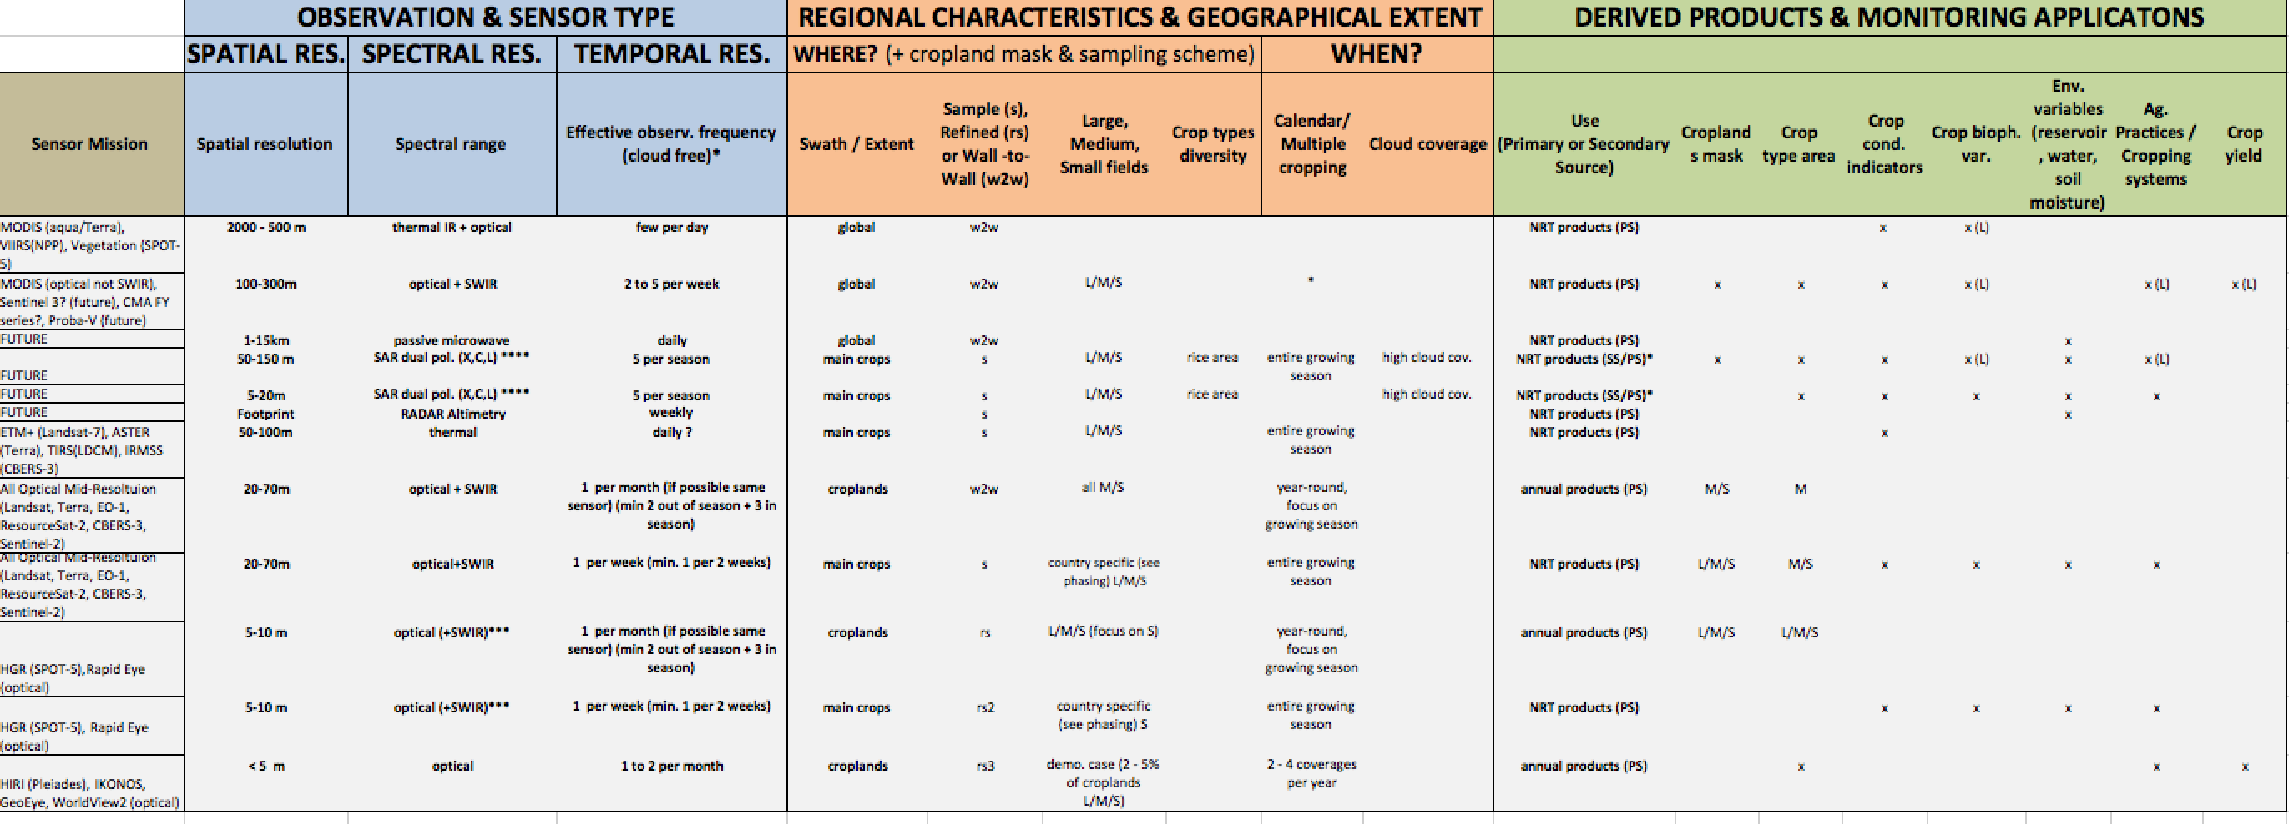
GEOGLAM CEOS: EO Data Requirements Table
developed taking into consideration the observation needs, the derived products they will
serve, and regional specificities; CEOS-GEOGLAM July 2012 Montreal)
How often ?
Where?
When?
For What?
spatial & spectral
GEOGLAM data plan to be submitted to the CEOS plenary in 2013
Notes:
THE SEO has the volumetric assessment – item #31-d
The baseline data layers for guiding these have been developed- in order to support the volumentric analysis- GEOGLAM produced these to facilitate the volumetric assessemnt

Slide 8
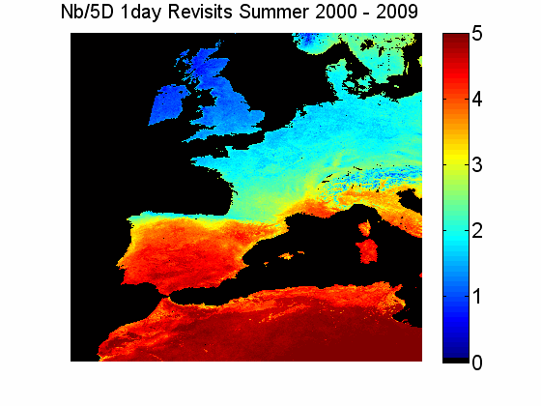
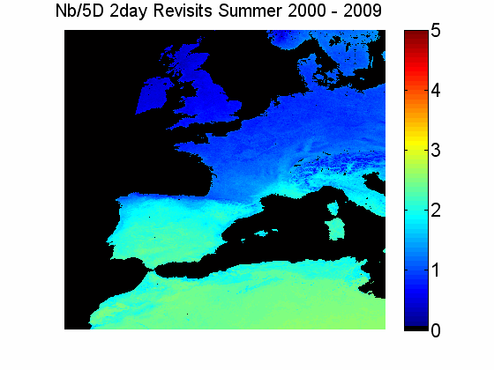
Nominal revisit capabilities are far from actual observation frequency
Sentinel 2 A&B, together, will provide a 5 day revisit cycle
=> one useful image every month on average
Number of cloud free days per 5 day-periods, for different revisits
Analysis of MODIS cloud masks (2000-2009) over Europe for summer (June 1st - August 31st), for 1 day and 2 days revisit assumptions
Lagouarde et al.: The MISTIGRI thermal infrared project: scientific objectives and mission
specifications, International Journal of Remote Sensing,, 2012

Slide 9
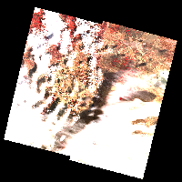
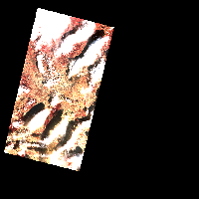
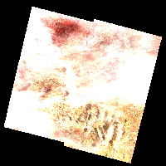
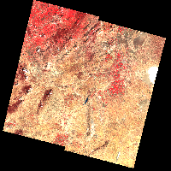
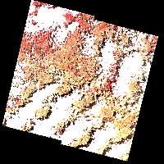
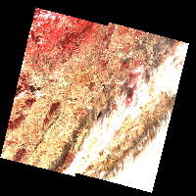
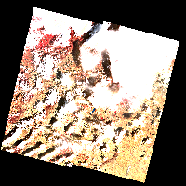
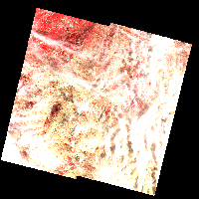
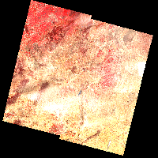
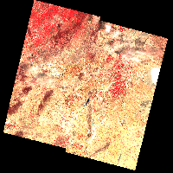
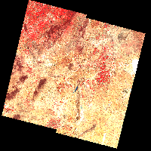
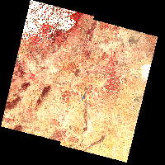
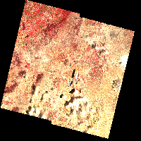
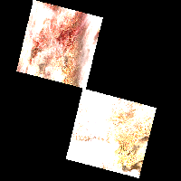
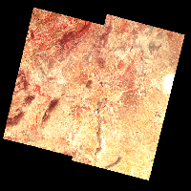
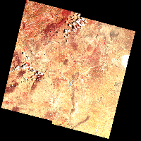
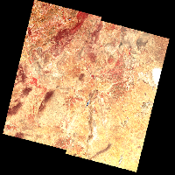
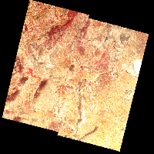
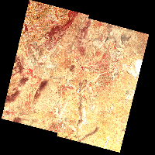
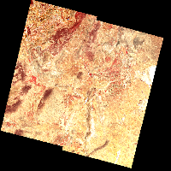
SPOT4 Take Five experiment very illustrating
Tunisia site : 11 valid out of 28 obs.
SPOT 5 = Green bars
3 Fév 8 Fév 13 Fév 18 Fév
10 Mars 15 Mars 20 Mars 25 Mars 30 Mars 4 Avril 9 Avril
14 Avril 19 Avril 4 Mai 9 Mai 14 Mai
Lepage et al., 2013
19 Mai 24 Mai 3 Juin 8 Juin 13 Juin 18 Juin
Notes:
11 images claires sur 28 acquises à partir du 3 février (39%). Les 7 premières scènes sont nuageuses. 1ère image claire le 10 mars (+ 35 j). 2ème image partiellement claire le 9 avril (+ 31 j.),
photomètre réseau AERONET (site Ben Salem) + microtops, NDVI-mètre en continu sur un champ de blé irrigué, Cropscan

Slide 10
SPOT4 Take Five experiment very illustrating
Tunisia site : 11 valid out of 28 obs.
3 Fév 8 Fév 13 Fév 18 Fév
One image every 5 days (Sentinel 2 simulation)
The first 7 images are cloudy (35 days)
11 clear images out of 28
Take 5 experiment : 42 sites worldwide
(CNES, ESA, JRC, NASA & CCRS)
Free data : www.ptsc.fr
10 Mars 15 Mars 20 Mars 25 Mars 30 Mars 4 Avril 9 Avril
14 Avril 19 Avril 4 Mai 9 Mai 14 Mai
19 Mai 24 Mai 3 Juin 8 Juin 13 Juin 18 Juin
Notes:
11 images claires sur 28 acquises à partir du 3 février (39%). Les 7 premières scènes sont nuageuses. 1ère image claire le 10 mars (+ 35 j). 2ème image partiellement claire le 9 avril (+ 31 j.),
photomètre réseau AERONET (site Ben Salem) + microtops, NDVI-mètre en continu sur un champ de blé irrigué, Cropscan

Slide 11
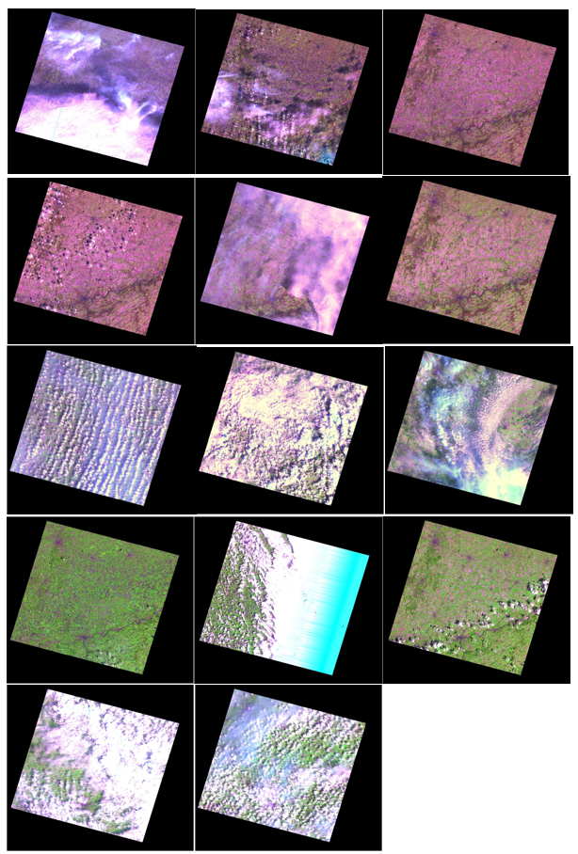
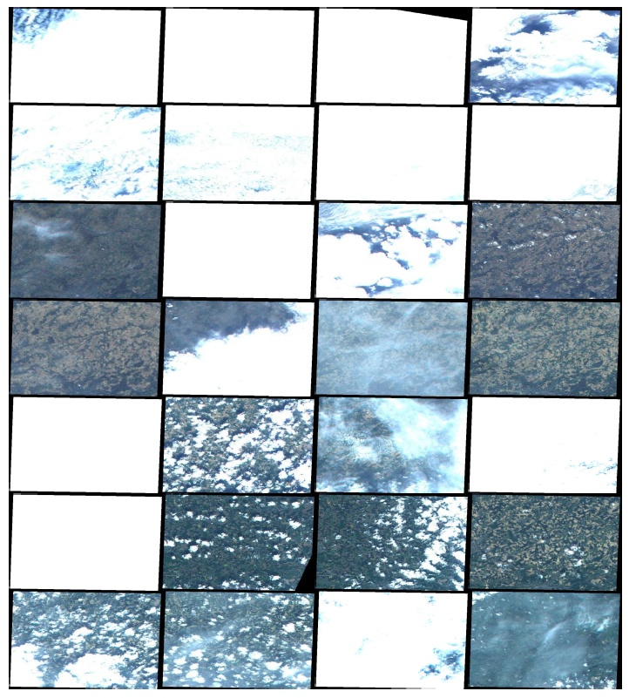
JECAM site in Belgium : SPOT4 take 5 and ESA TPM :
SPOT4
Take 5
RapidEye
2013 : very cloudy growing season
Notes:
… here are the quicklooks. As you can see, most of those images are cloud covered.

Slide 12
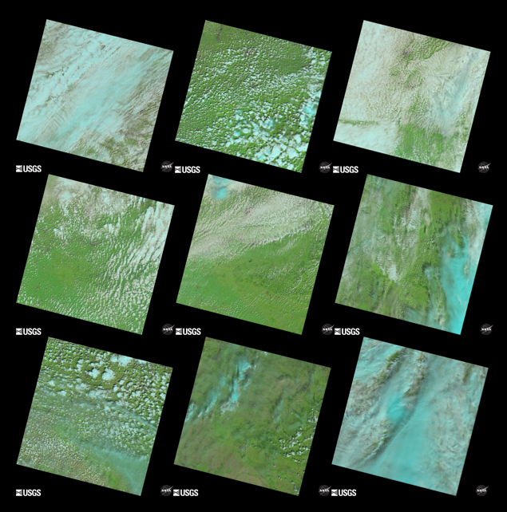
JECAM site in Belgium : Landsat 8
Landsat 8
Example: 2013 growing season
Notes:
But we ve also got Landsat 8 data now. Here are the quicklooks

Slide 13
JECAM site in Belgium : 11 RADARSAT-2 images
RADARSAT-2 quad pol
2013 : very cloudy growing season
Notes:
But we ve also got Landsat 8 data now. Here are the quicklooks

Slide 14
JECAM site :
EO data acquisition during the 2013 growing season
February |  |  |  |  |  | March |  |  |  |  |  | April |  |  |  |  |  | May |  |  |  |  |  | June |  |  |  |  |  | July |  |  |  |  |  | August
SPOT4
(take 5)
RapidEye
(ESA)
Landsat 8
RADARSAT-2
SPOT4
RapidEye
Landsat 8
Useful for analysis
14%
17%
Partly cloud covered
Cloud covered
Notes:
So for all application that require data acquired regularly , not only for agriculture monitoring, , a multi-sensor approach should be considered. In this optic, through the JECAM initiative we have also acquired RADARSAT-2 data . Advantage is that SAR is not affected by cloud cover but it is SAR so difficult to intepret and presence of lot of noise. (

Slide 15
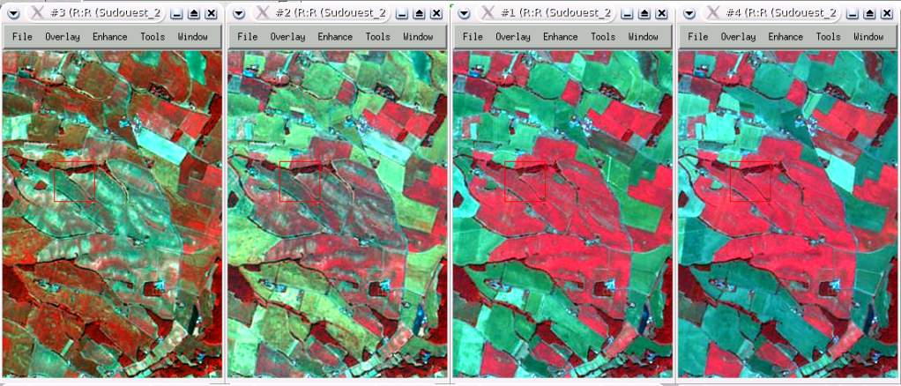
EO expectation for agriculture
Crop growth indicators : every 5 to 10 days
June 5th 2006
June 14th 2006
June 23th 2006
June 29th 2006
Formosat-2 images, 8m resolution : green, red, near infrared colour composite

Slide 16
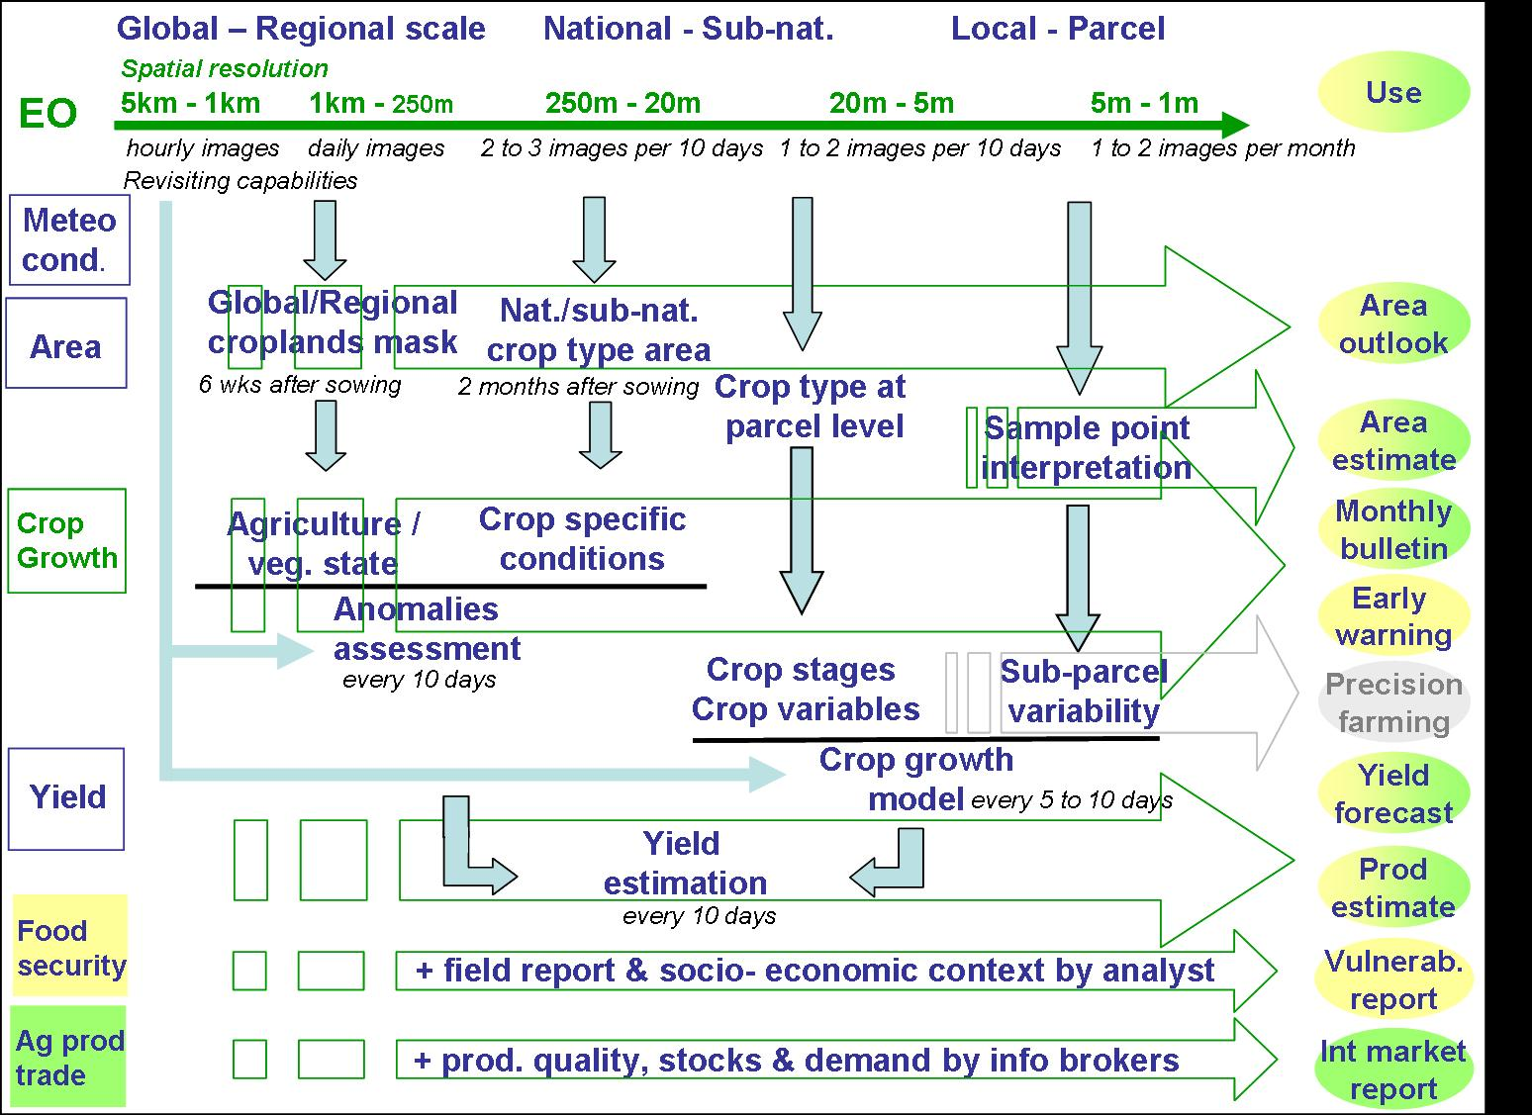
Overall framework

Slide 17
EO requirements framework for Phase 2
Crop Monitor System :
Continuity /redundancy of operational missions supporting the monthly report
- MODIS for daily global surface reflectance
- PROBA for daily global surface reflectance

Slide 18
EO requirements framework for Phase 2
R&D GEOGLAM components (pr:
Asia-rice already covered by Shin-ichi Sobue
call for coordination between SAR missions for regular acquistions
Country demonstration : area estimate using area frame sampling
extension of Landsat-8 acquisition priority to selected countries
Rapideye – Pléiades time series (3 to 5) over distributed samples
access to Landsat/SPOT historical archives for stratification

Slide 19
EO requirements framework for Phase 2
R&D GEOGLAM components :
JECAM network
common minimum data set for each site :
systematic Landsat-8 acquisition priority
systematic Sentinel-2 acquisition
3 to 5 Pléiades acquisition (calibration/validation)
Rapideye time series with constrained viewing angle range
systematic RADARSAT-2 acquisition (same configuration)
systematic Sentinel-1 acquisition (during ramp up pha
regular TerraSAR acquisition (1 to 3 day coherence product)
systematic AWIFs acquisition
PROBA 300 m and 100 m resolution

Slide 20
EO requirements framework for Phase 2
R&D GEOGLAM components :
JECAM network
data ordering mechanism to be simplified as much as possible
data provision mechanism to be improved (centralized delivery ?)
(better tracking, easier sharing)
JECAM multi-user license mechanism for sharing data across the network partners (as for the in situ data)

