Slide 1
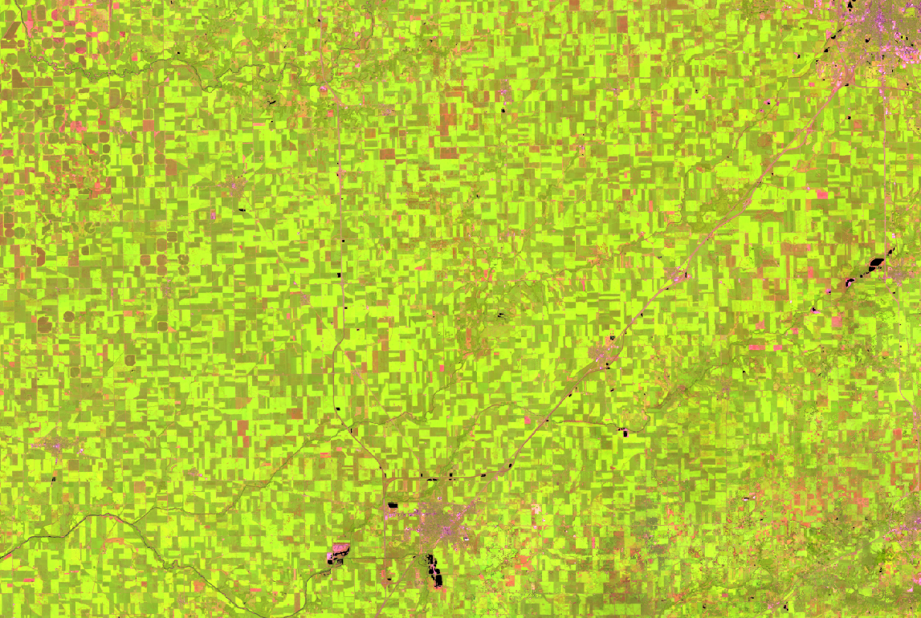

Developing a Sampling Strategy:
Examples from Phase 1 using multi-source remotely sensed data
Matt Hansen, Carlos Di Bella, Inbal Becker-Reshef, Ian Jarvis, Alyssa Whitcraft

Slide 2
Current Status
Initial piloting leveraging existing projects- demonstrating feasibility
  Argentina
  US
  Canada
  Australia
Need discussion on next steps
  Currently IP states a global sampling approach for main producer countries

Slide 3
Generic multi-source approach
  Wall to wall is not always feasible, however sampling frames may provide statistically viable data at a fraction of the cost and effort
Philosophy – integrate time-series multi-spectral, multi-resolution remote sensing data streams to improve cropland characterization for area estimation
National-scale indicator mapping with coarse res MODIS data by crop type for targeted stratification, calibrated by Landsat cover characterizations
Samples of Landsat and RapidEye to derive cultivated area estimation
Incorporation of national-scale indicator maps in a regression estimator procedure

Slide 4

Sampling Strategy
  A nested stratified, multi-resolution sampling approach is a complementary approach which allows for more frequent acquisitions over selected sites that are statistically representative of entire area, often at higher resolution
  Nested Scales:
  S1: Moderate res sample blocks
    Number of sample blocks depends primarily on variability of crop types, of crop rotations, size of region, desired standard error
    Blocks should be quite small (~20km)
  Frequency of acquisition, will depend on the complexity of the cropping system- approximately 5 scenes per growing season; 1-2 out of season
  S2: Fine res sample blocks
    Smaller Subset of sample blocks requested for fine res with same acquisition frequency as S1 blocks

Slide 5
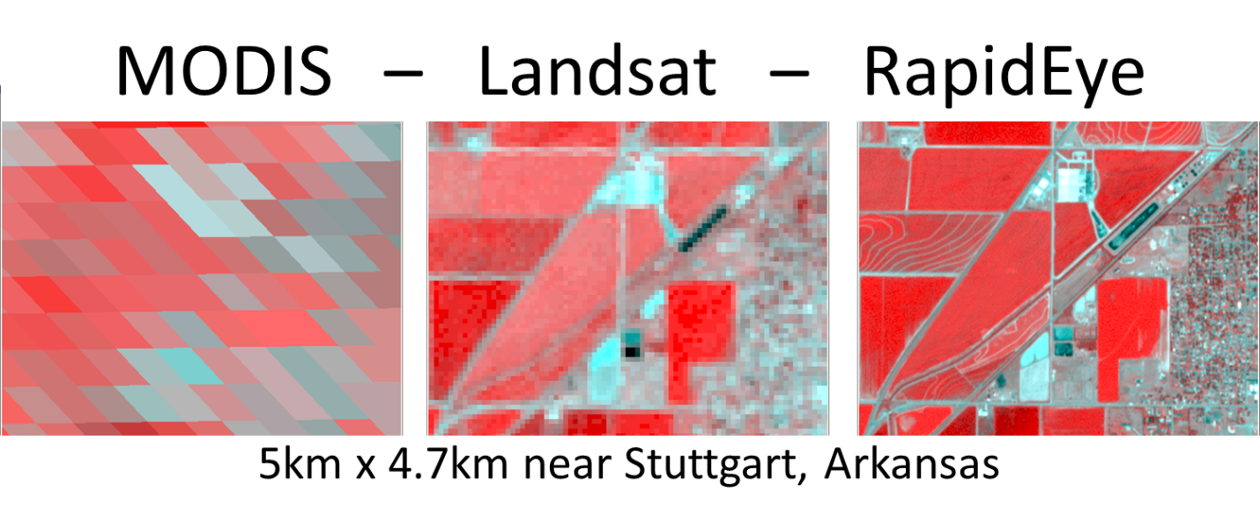
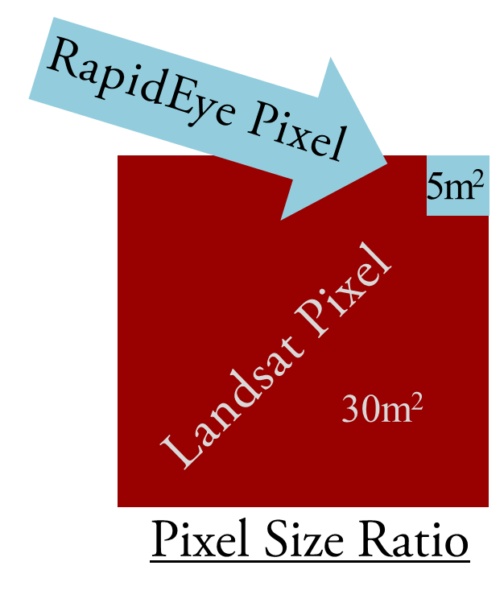
Multi-Resolution Data for developing a generic approach to crop type area estimation
250 meter MODIS data used to identify the study area and samples, Landsat for mapping each sample
rapideye for calval

Slide 6
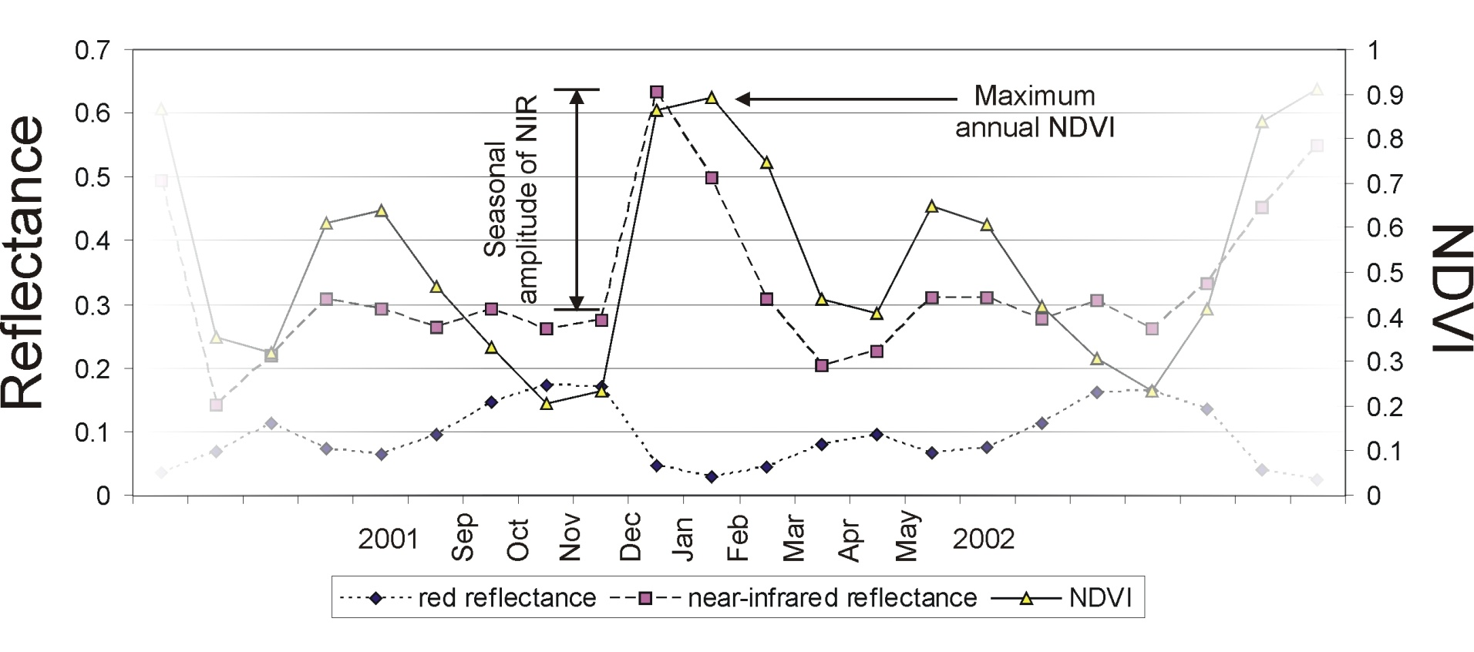
High Temporal Frequency is Critical for Crop Type Discrimination

Slide 7
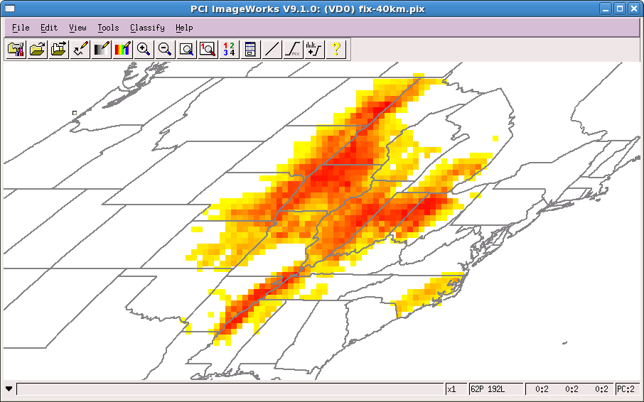
Sample population – MODIS percent soybean per 40km block, 2007 to 2010
%
40
0

Slide 8
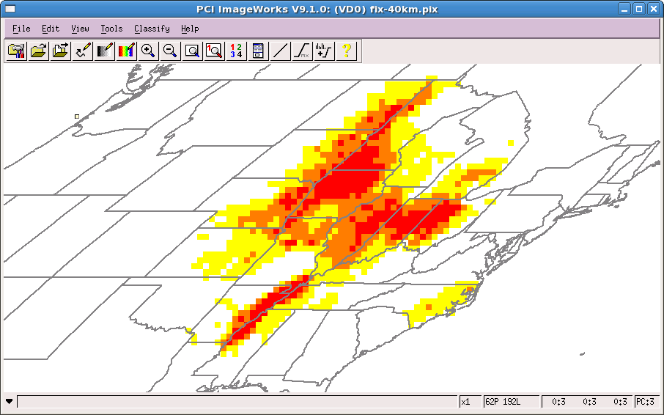
High, medium and low soybean strata
Red=high (>19.8%), orange=medium (7.2-19.8%), yellow=low (0.5-7.2%)

Slide 9
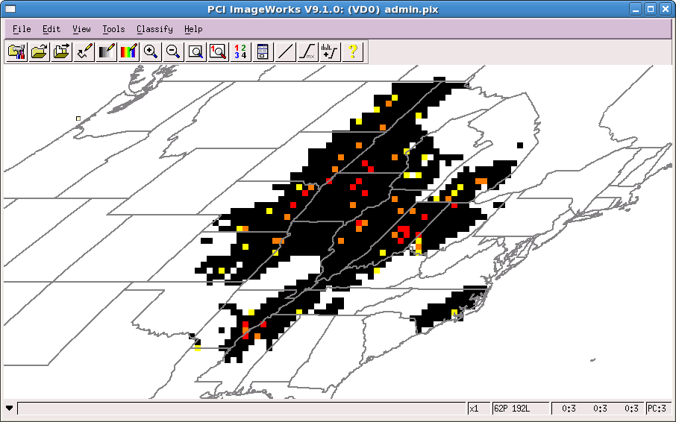
Landsat sample blocks
Red=high (>19.8%), orange=medium (7.2-19.8%), yellow=low (0.5-7.2%)

Slide 10
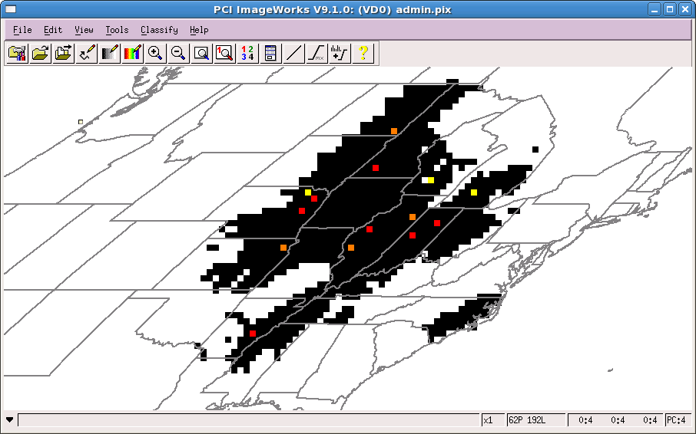
RapidEye locations
Red=high (>19.8%), orange=medium (7.2-19.8%), yellow=low (0.5-7.2%)

Slide 11
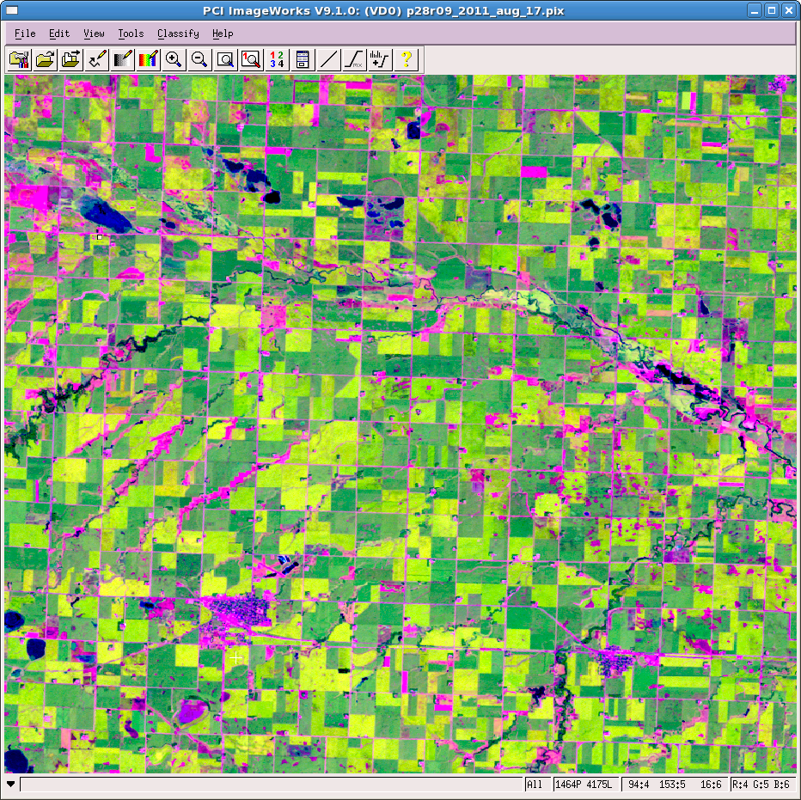
SW Minnesota Landsat 5-4-3
24km x 20km, centered on 95 35 24W, 44 19 38N

Slide 12
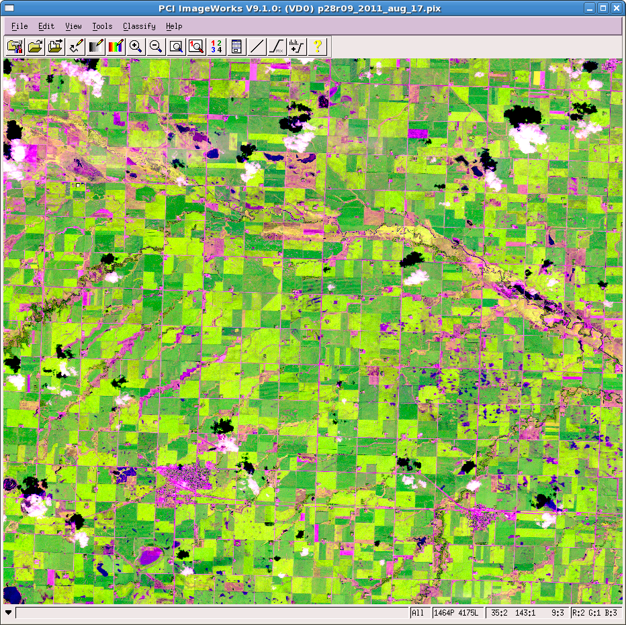
SW Minnesota RapidEye 4-5-3

Slide 13
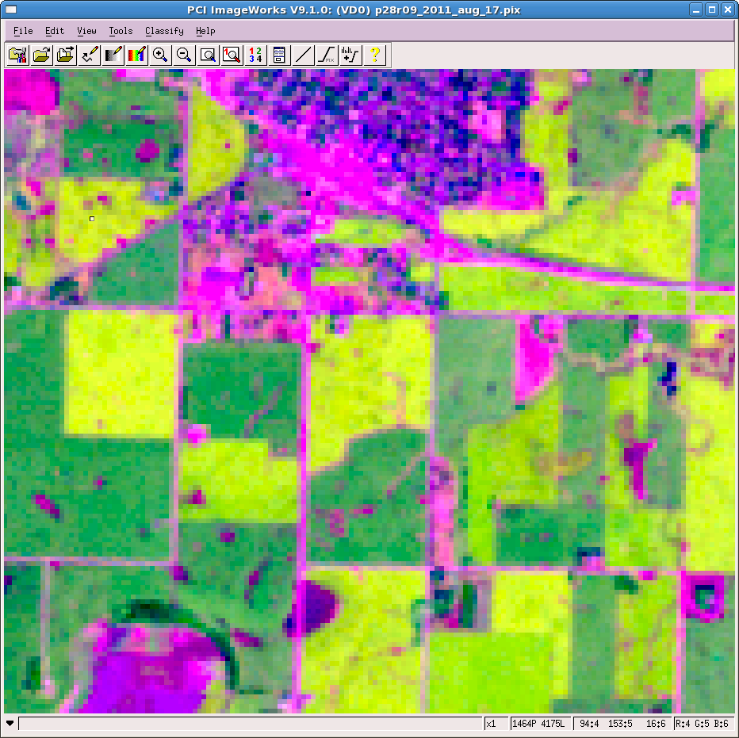

Slide 14
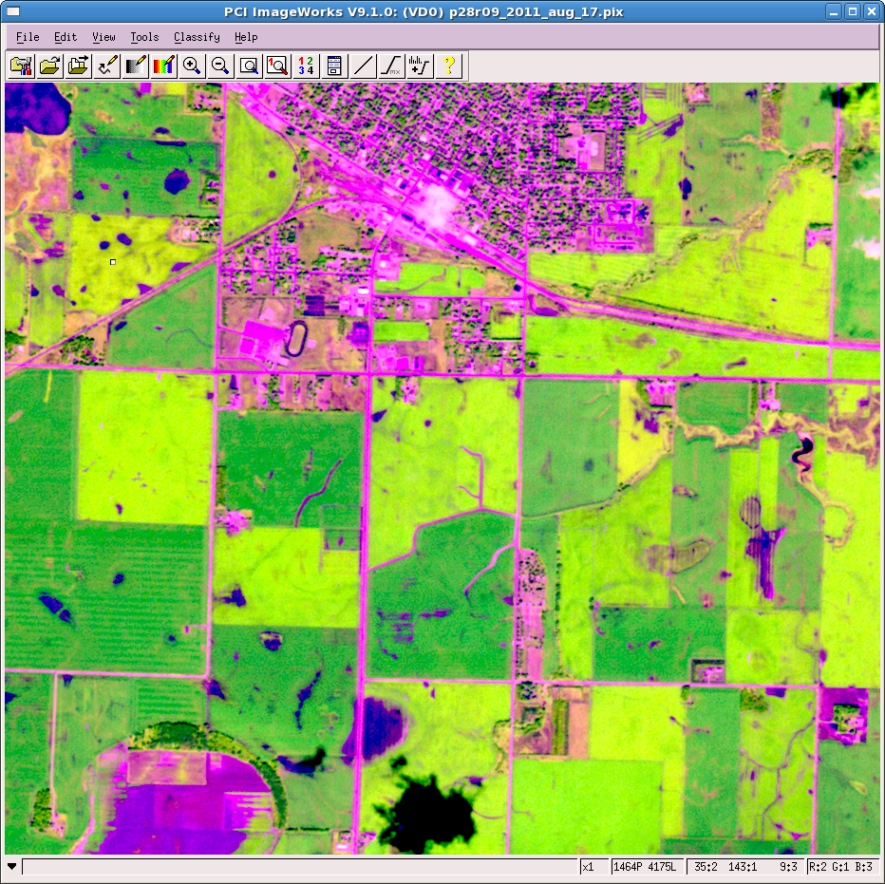

Slide 15
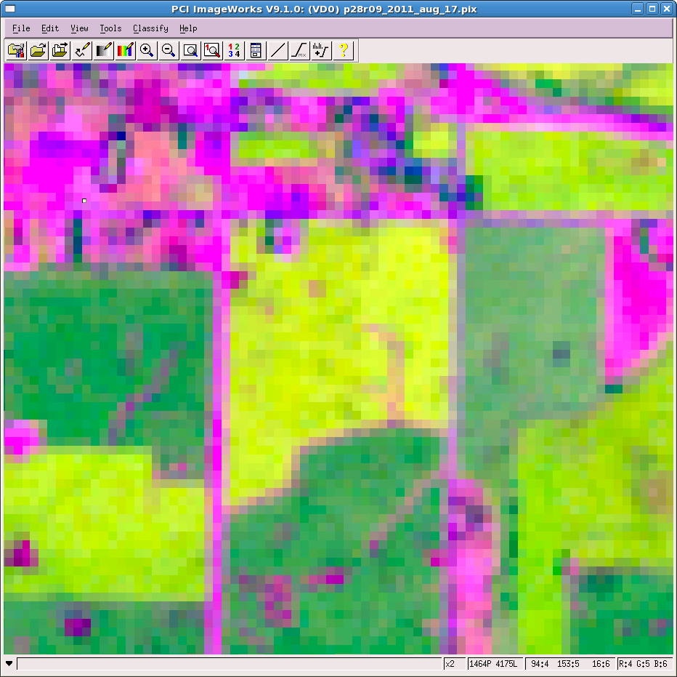

Slide 16
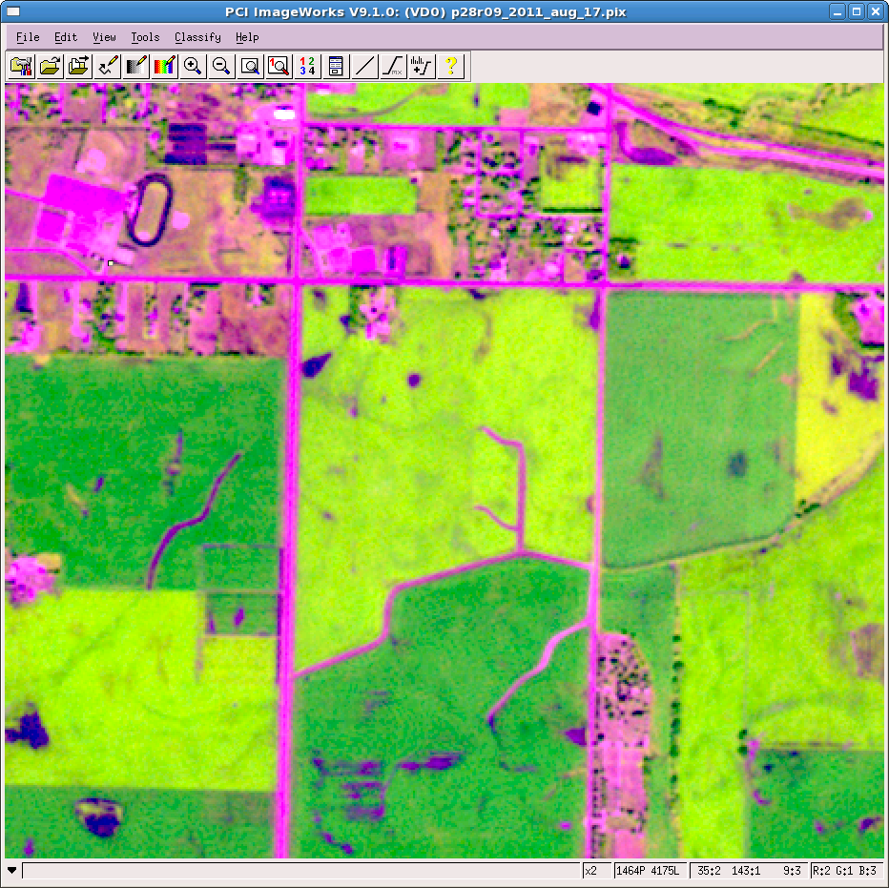

Slide 17
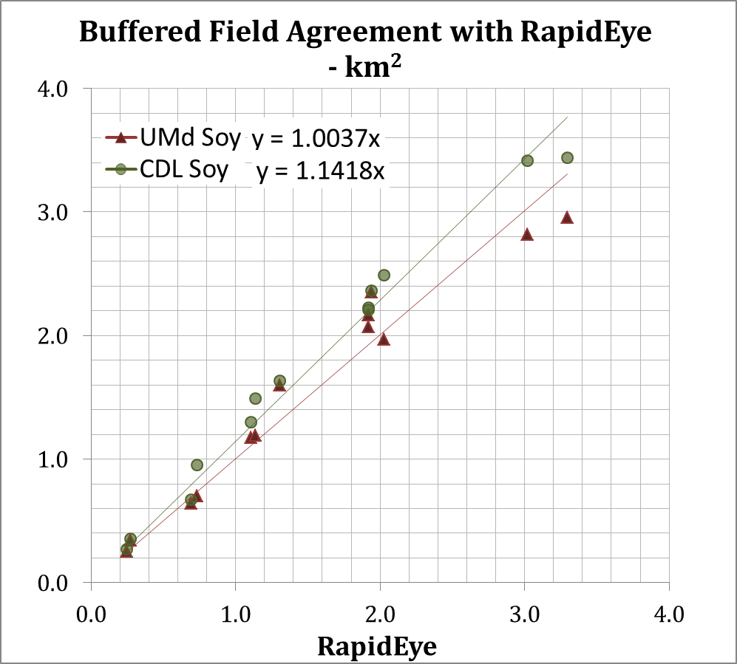


Field-Scale Classification Comparison
Field
Notes:
And a comparison of results show that the cdl tends to overestimate while UMd is almost 1 to 1 for soy area in all RapidEye blocks. This is because, as you can see here in the confusion matrix results for the buffered area, cdl has high commission errors, while our product is balanced with omission and commission errors. And, over 90% of the disagreement can be found along the field edge which is, on average only 13% of the study area.

Slide 18
Argentina RE Sample Blocks

Slide 19
Sampled Fields visited for Validation within a block

Slide 20
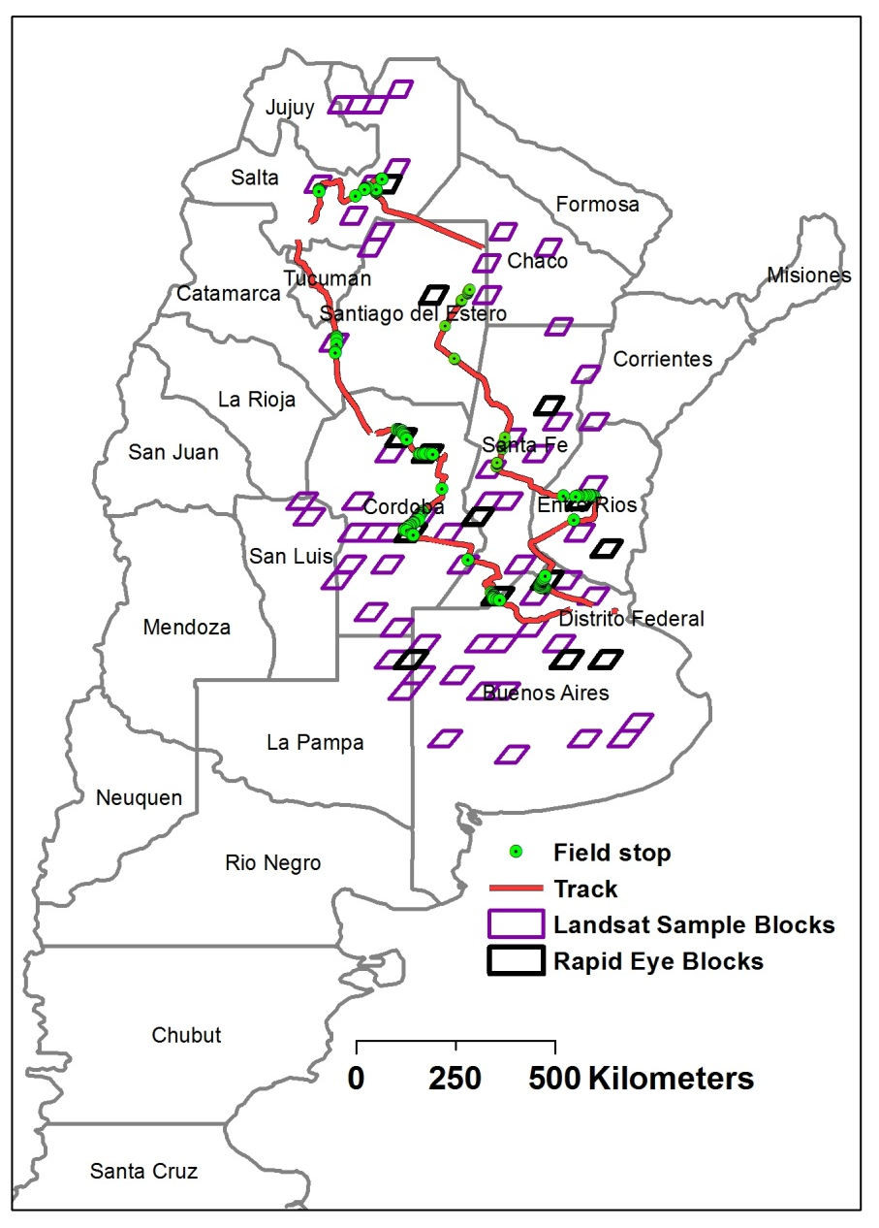
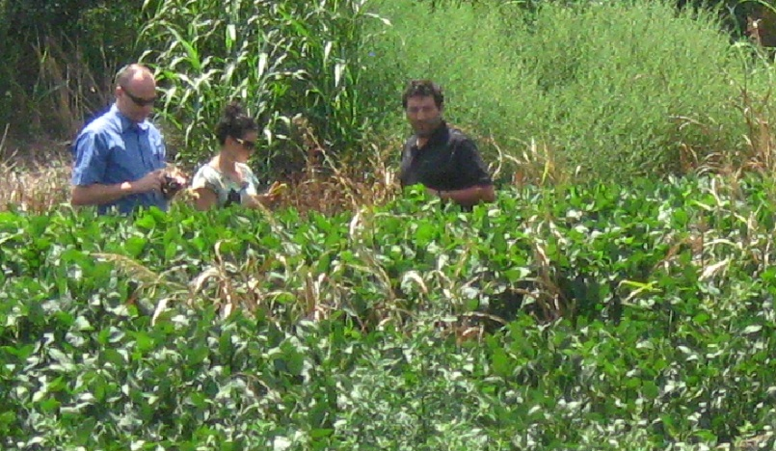
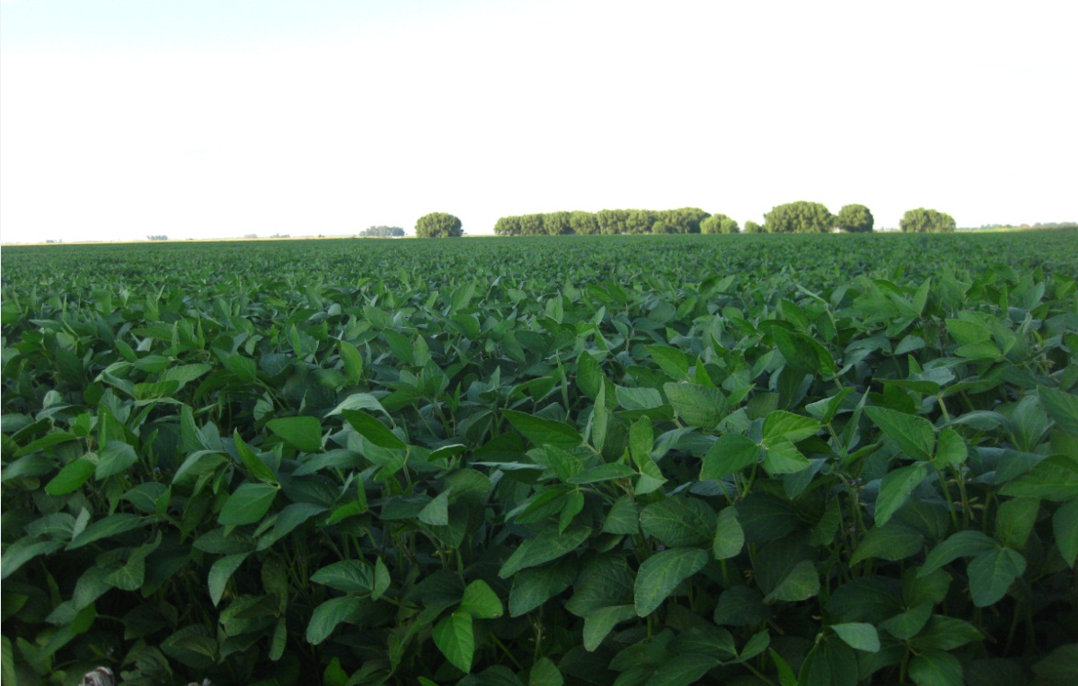
Argentina 2011-12 Field Campaign

Slide 21
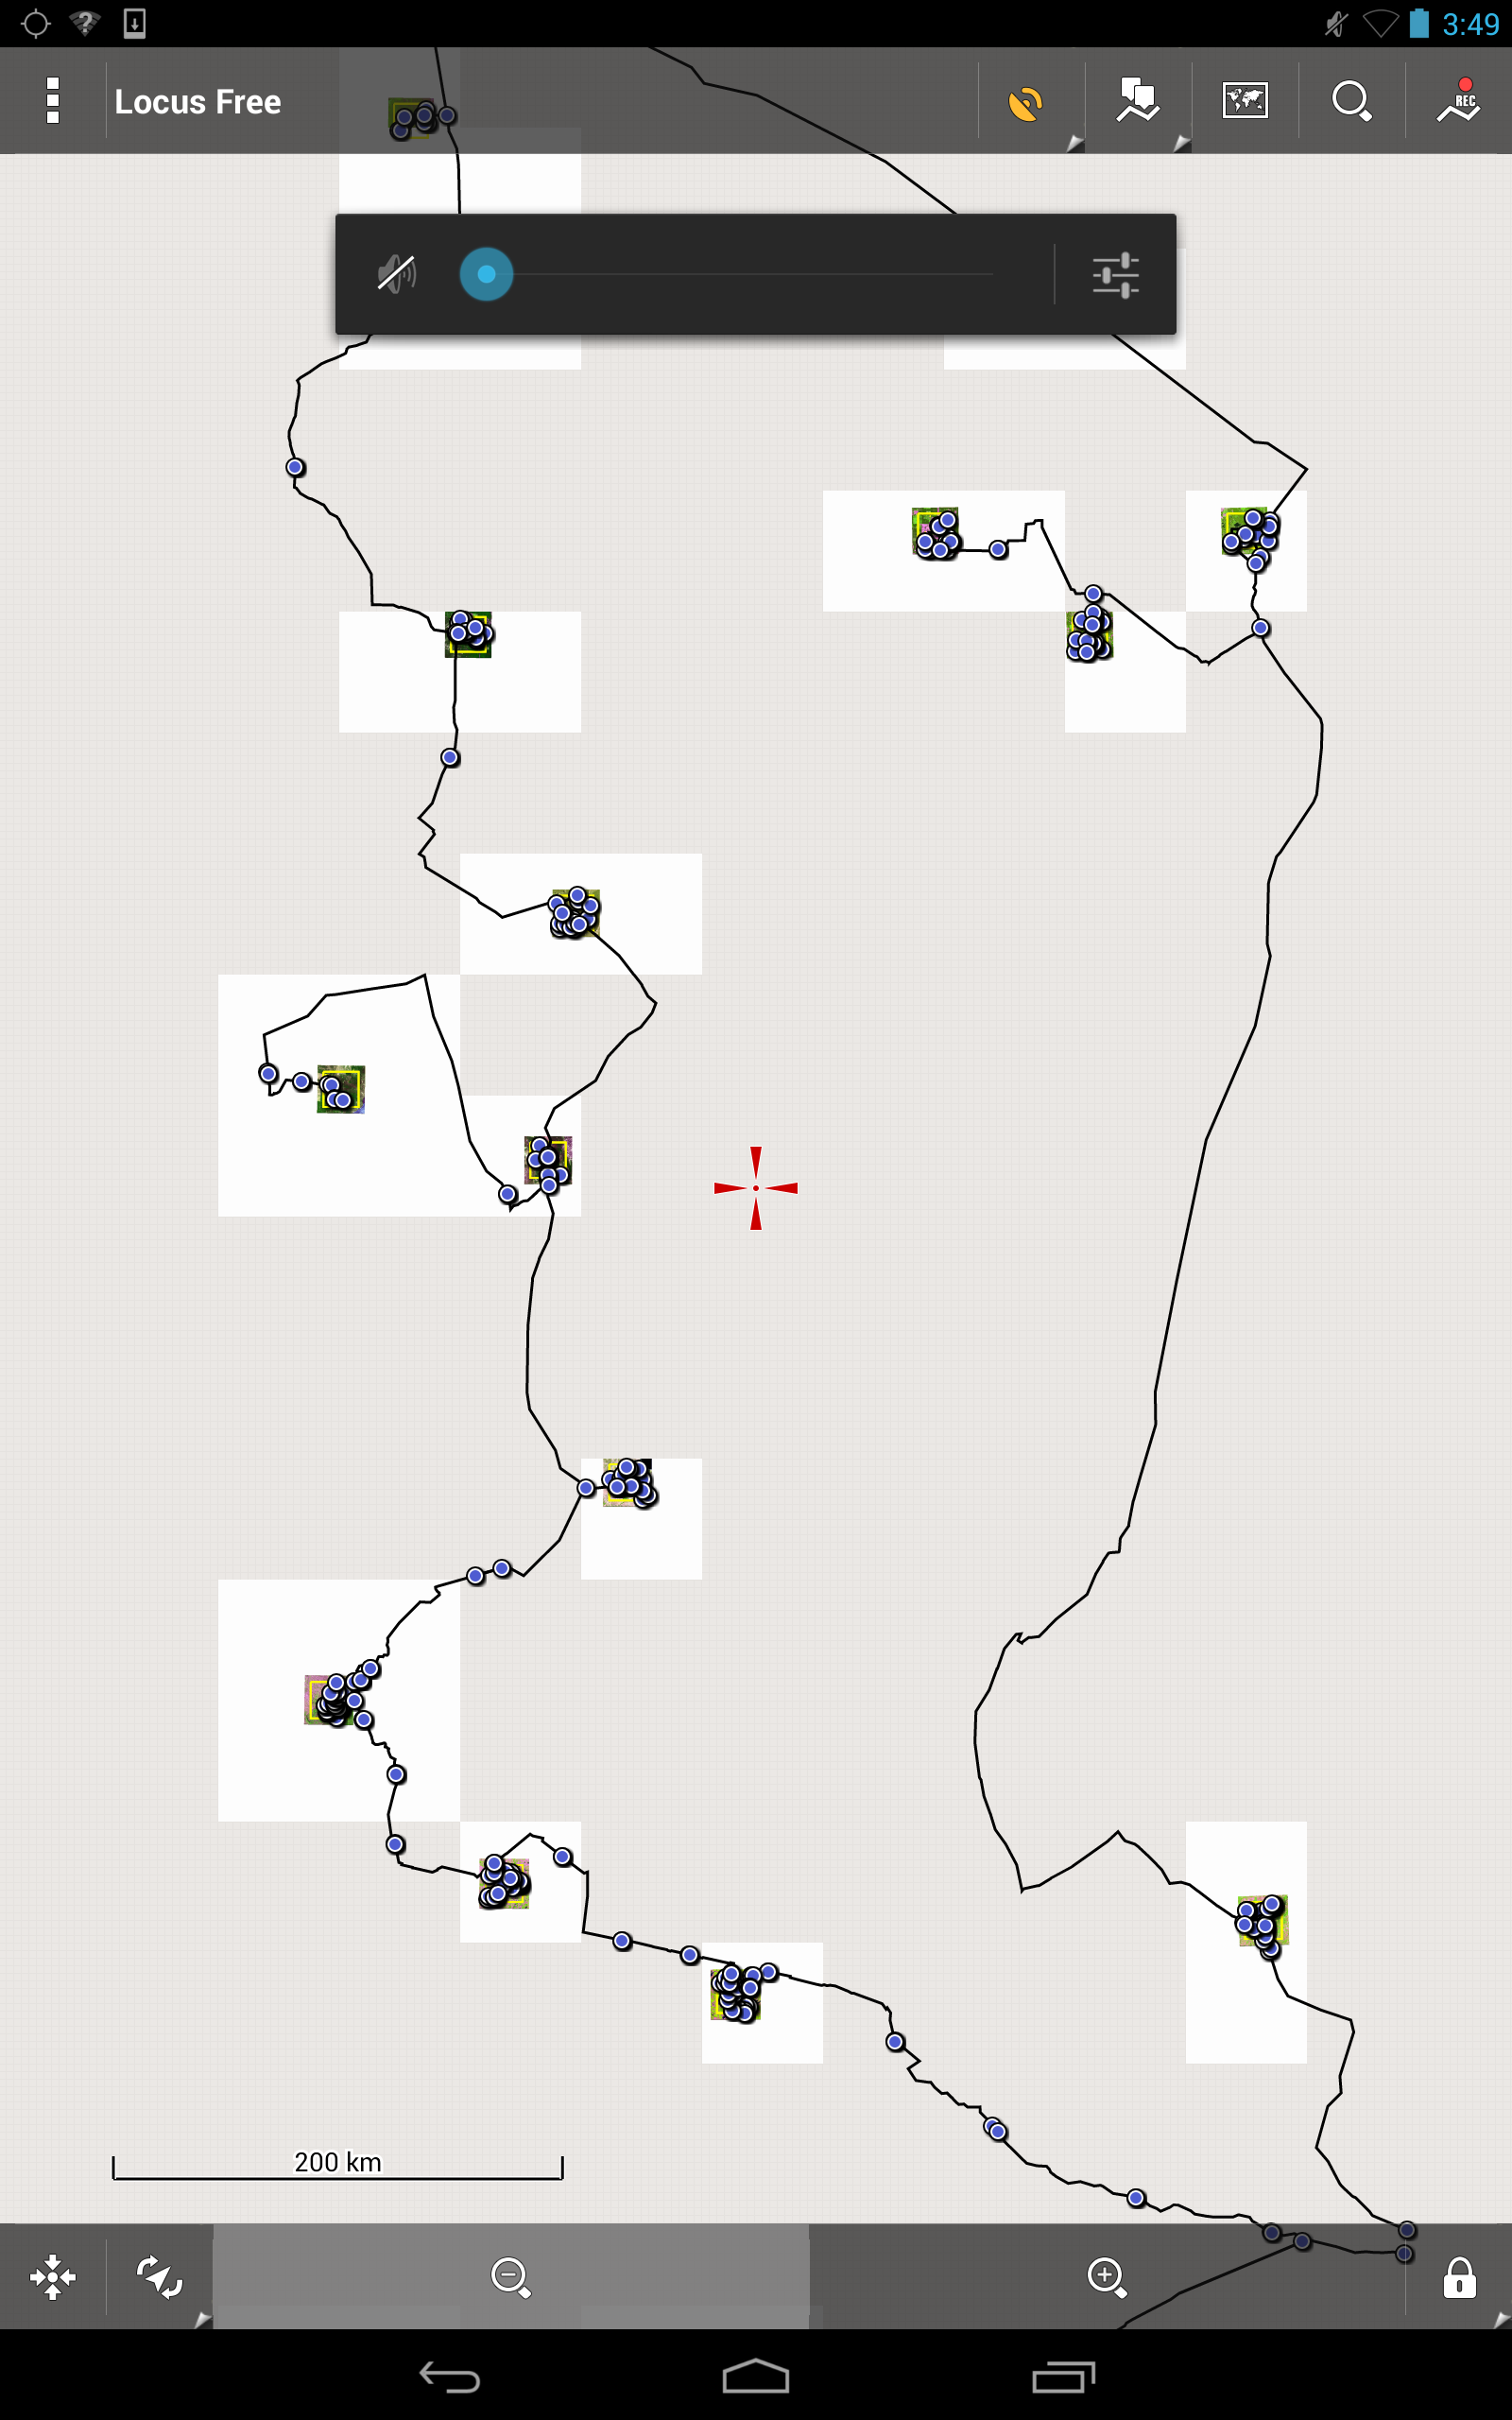
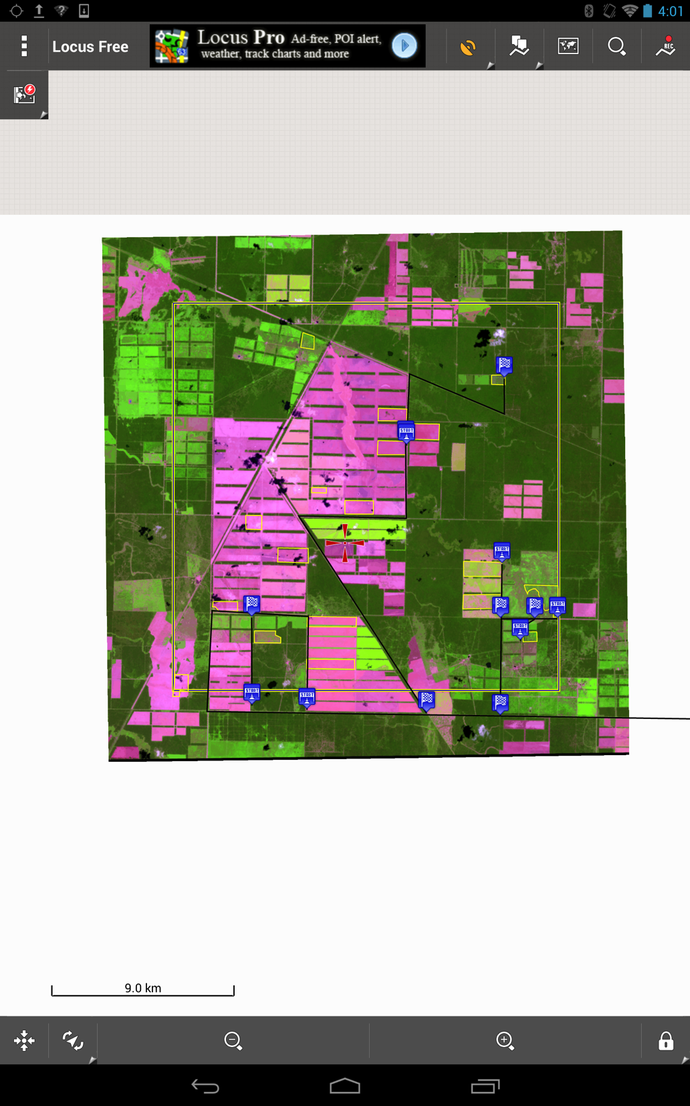
RE Blocks and 2014 Field Campaign

Slide 22
Example results to date for 2011
Argentina
  USDA estimate – 178,000km2
  MODIS/Landsat estimate – 117,800km2 +/-6,502 SE
USA
  USDA estimate – 298,600km2
  MODIS/Landsat estimate – 212,324km2 +/-6,645 SE
Brazil
  USDA estimate – 250,000km2
  MODIS/Landsat estimate – 171,000km2 +/-9,064 SE

Slide 23
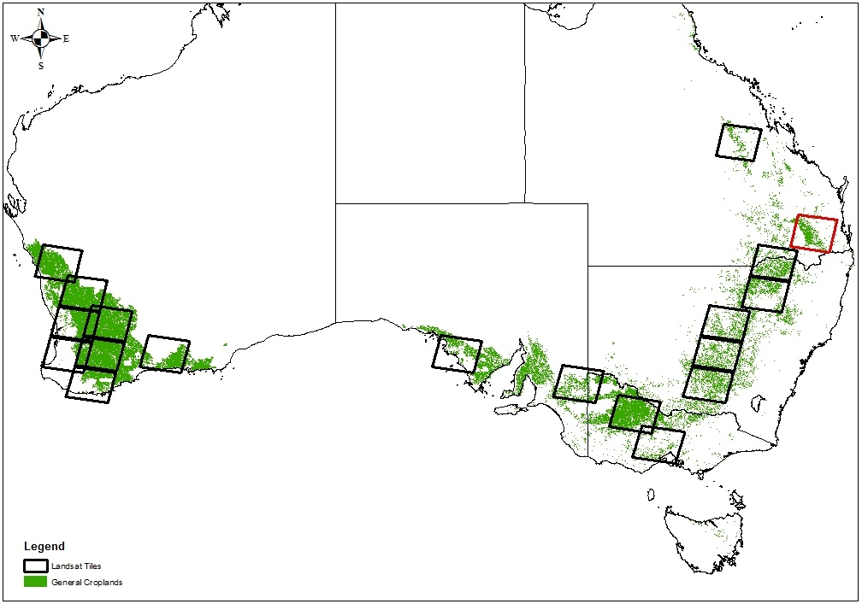
Landsat tile selection based on a general croplands mask and available cloud free scenes

Slide 24
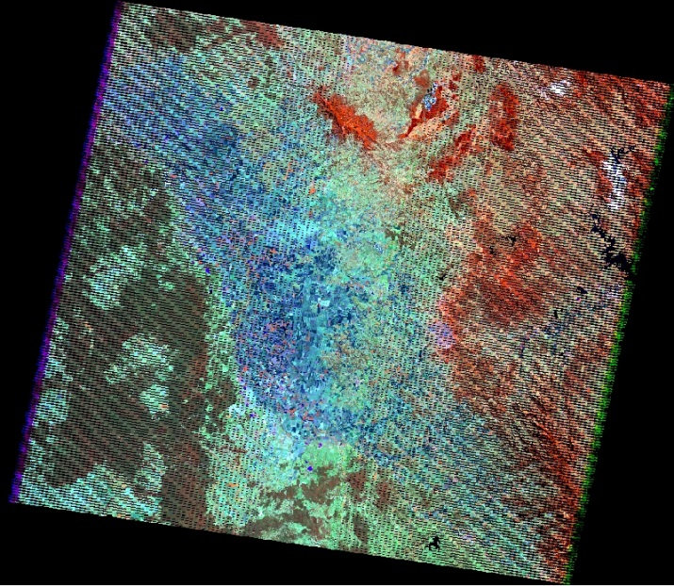
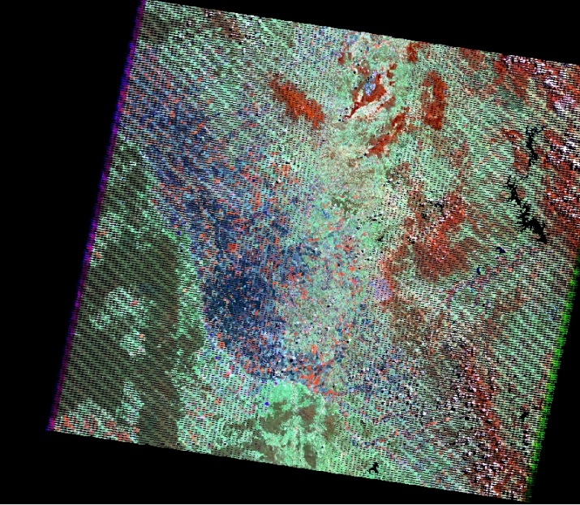
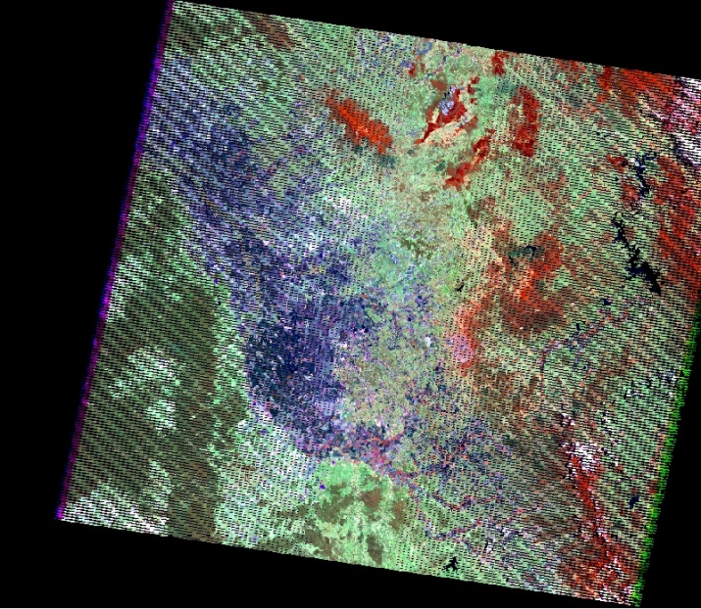
Three Landsat scenes chosen for training: before peak, peak, and after peak
May 9th 2012
September 14th 2012
November 1st 2012
Notes:
090_079

Slide 25
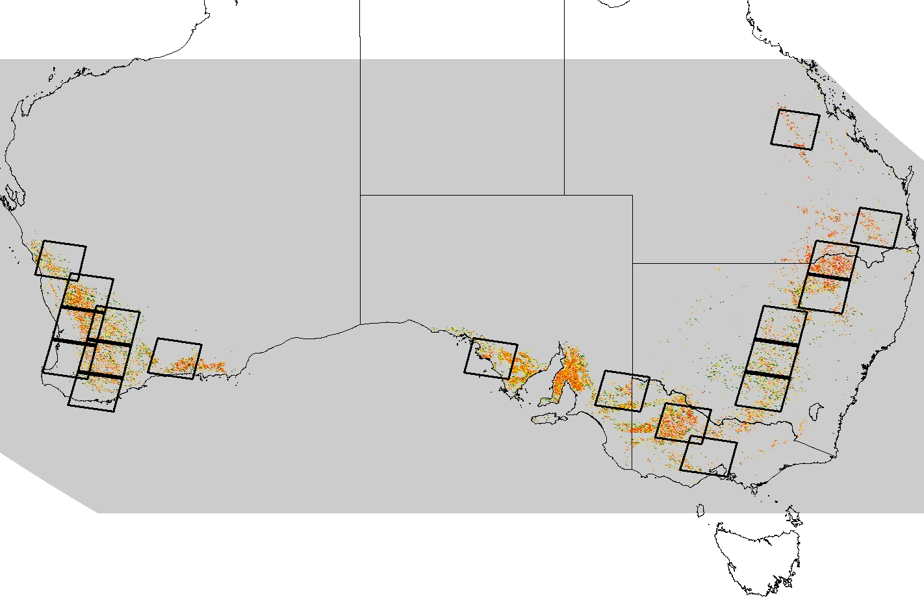

Final MODIS level wheat mask for Australia expanded out beyond initial training Landsat tiles

Slide 26
Conclusions
Still R&D mode- objective is to evaluate operational feasibility
For area estimation of crop type using earth observations, sampling is a viable option
  In most cases, there are not sufficient time-series observations at an appropriate spatial resolution to perform wall-to-wall mapping of crop type
Developing a sound sampling strategy is complex and costly!
Scale must be considered per agricultural growing region
  Can MODIS be used for a stratification – or does landsat need to be used?
  can Landsat or RapidEye provide reliable area estimation in China for soybean cultivated area? How many within-season images are needed for more complicated early/late planting systems as in Argentina?
Validation of sample block data is critical!!
  Crop type identification (per field classification)
  Field extent (pixel counting and possible bias in area mapped per field)
Coarse Res (MODIS) is important
  Used to stratify regions to improve sampling efficiency
  Used as a within-season crop indicator auxiliary variable in a regression estimator procedure to reduce uncertainty
Generic methods that can be ported globally are possible
  Will provide internally consistent comparisons for global production estimation
GEOGLAM needs to develop requirements for sampling this calendar year- commentary to requirements developed within JECAM

