Slide 1
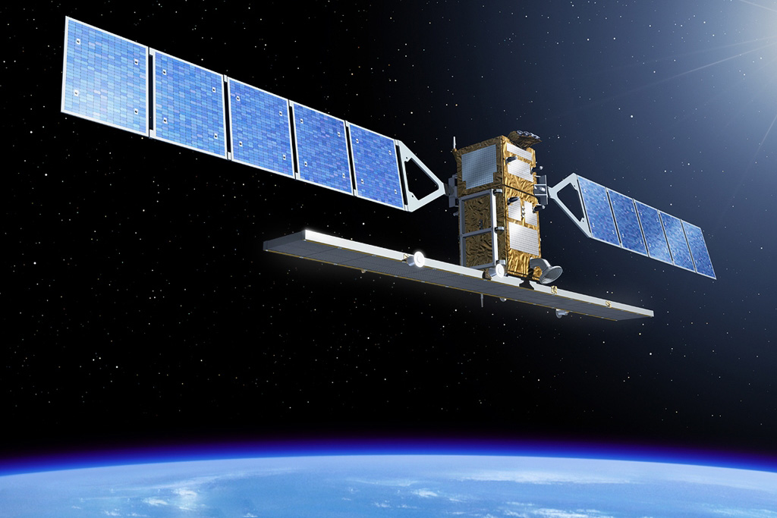
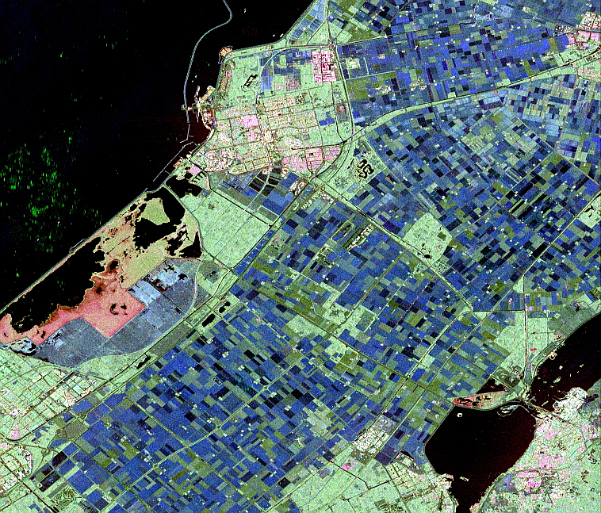
Copernicus Sentinel-1
Launch: 3rd of April 2014, end of 2015, ...
Constellation of two satellites
C-Band Synthetic Aperture Radar, weekly coverage (2 satellites)
Nominal lifetime in orbit of 7 years (max. 12 yrs)

Slide 2
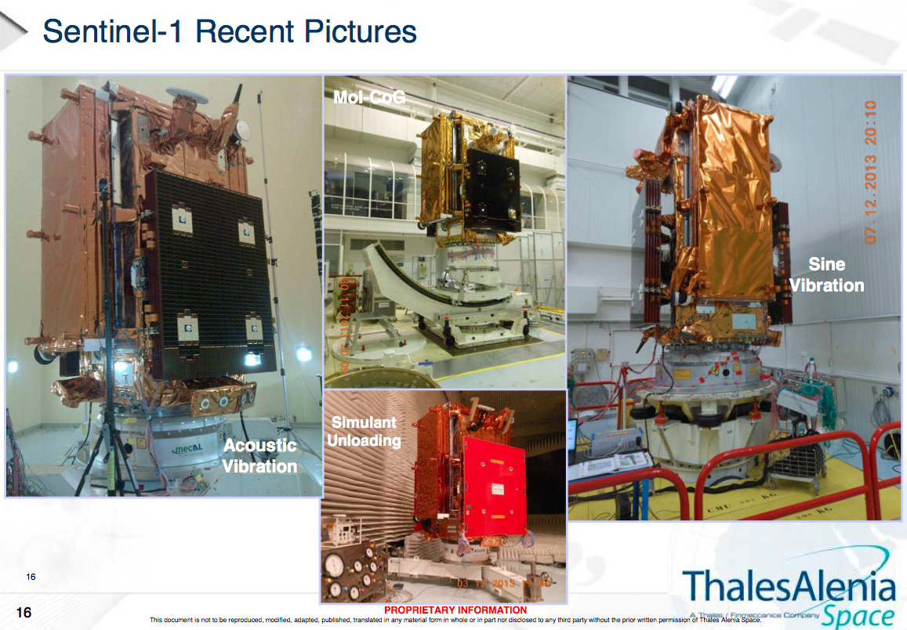
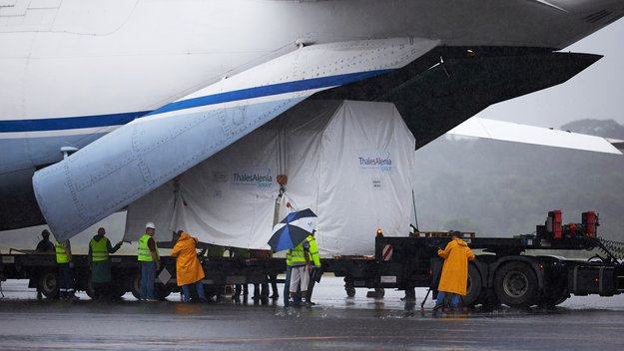
Sentinel-1A major milestones
I. Sentinel-1 mission overview
Sentinel-1 Mission Facts
QAR KO (Satellite Qualification
Review) → January 13th, 2014
QAR Conclusion
→ February 18th, 2014
Arrival in Kourou and
start of Launch Campaign
→ February 24st, 2014
Launch: April 3th, 2014

Slide 3
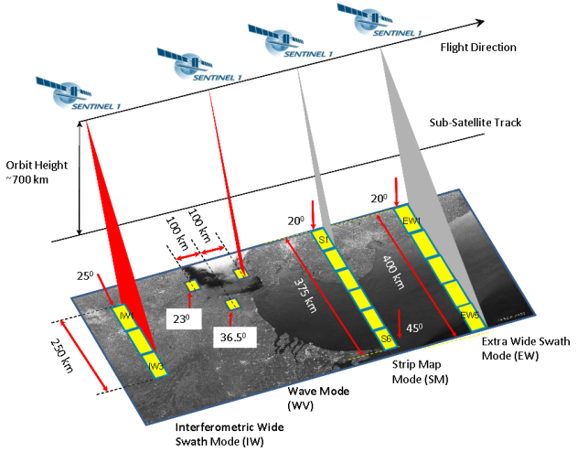
I. Sentinel-1 mission overview
Sentinel-1 SAR imaging modes
4 mutually exclusive SAR modes with different resolution and coverage
Polarisation schemes for IW, EW & SM:
  single polarisation: HH or VV
  dual polarisation: HH+HV or VV+VH
Wave mode: HH or VV
SAR duty cycle per orbit:
  up to 25 min in any of the
  imaging modes
  up to 74 min in Wave mode
Main modes of operations:
IW over land and coastal waters (normally VV or VVVH polarization)
EW over extended sea (VV or VVVH) and sea-ice (HH or HHHV) areas
WV over open oceans

Slide 4
II. Sentinel-1 acquisition plans
Basic observation characteristics (excerpt)
Mode | Swath Wide
Stripmap (SM) | 80 km
Interferrometric Wide Swath (IWS) | 250 km
Extra Wide Swath (EWS) | 400 km
Wave (WV) | 20 x 20 km
Standard production
PRODUCT | RESOLUTION (rg. X az.) | No. of looks
GRD-MR | 88 x 87 m | 22 x 5
GRD-HR | 20 x 22 m | 5 x 1
SLC (selected areas only) | 2.7-3.5 x 17.4 m | 1 x 1
Standard mode – polarization combinations
Over land* | IWS VV or VVVH
Major ice-caps | IWS HH
Sea-ice* | EWS HH or HHHV
(European) marginal seas* | IWS or EWS VV or VVVH
* Some exceptions

Slide 5
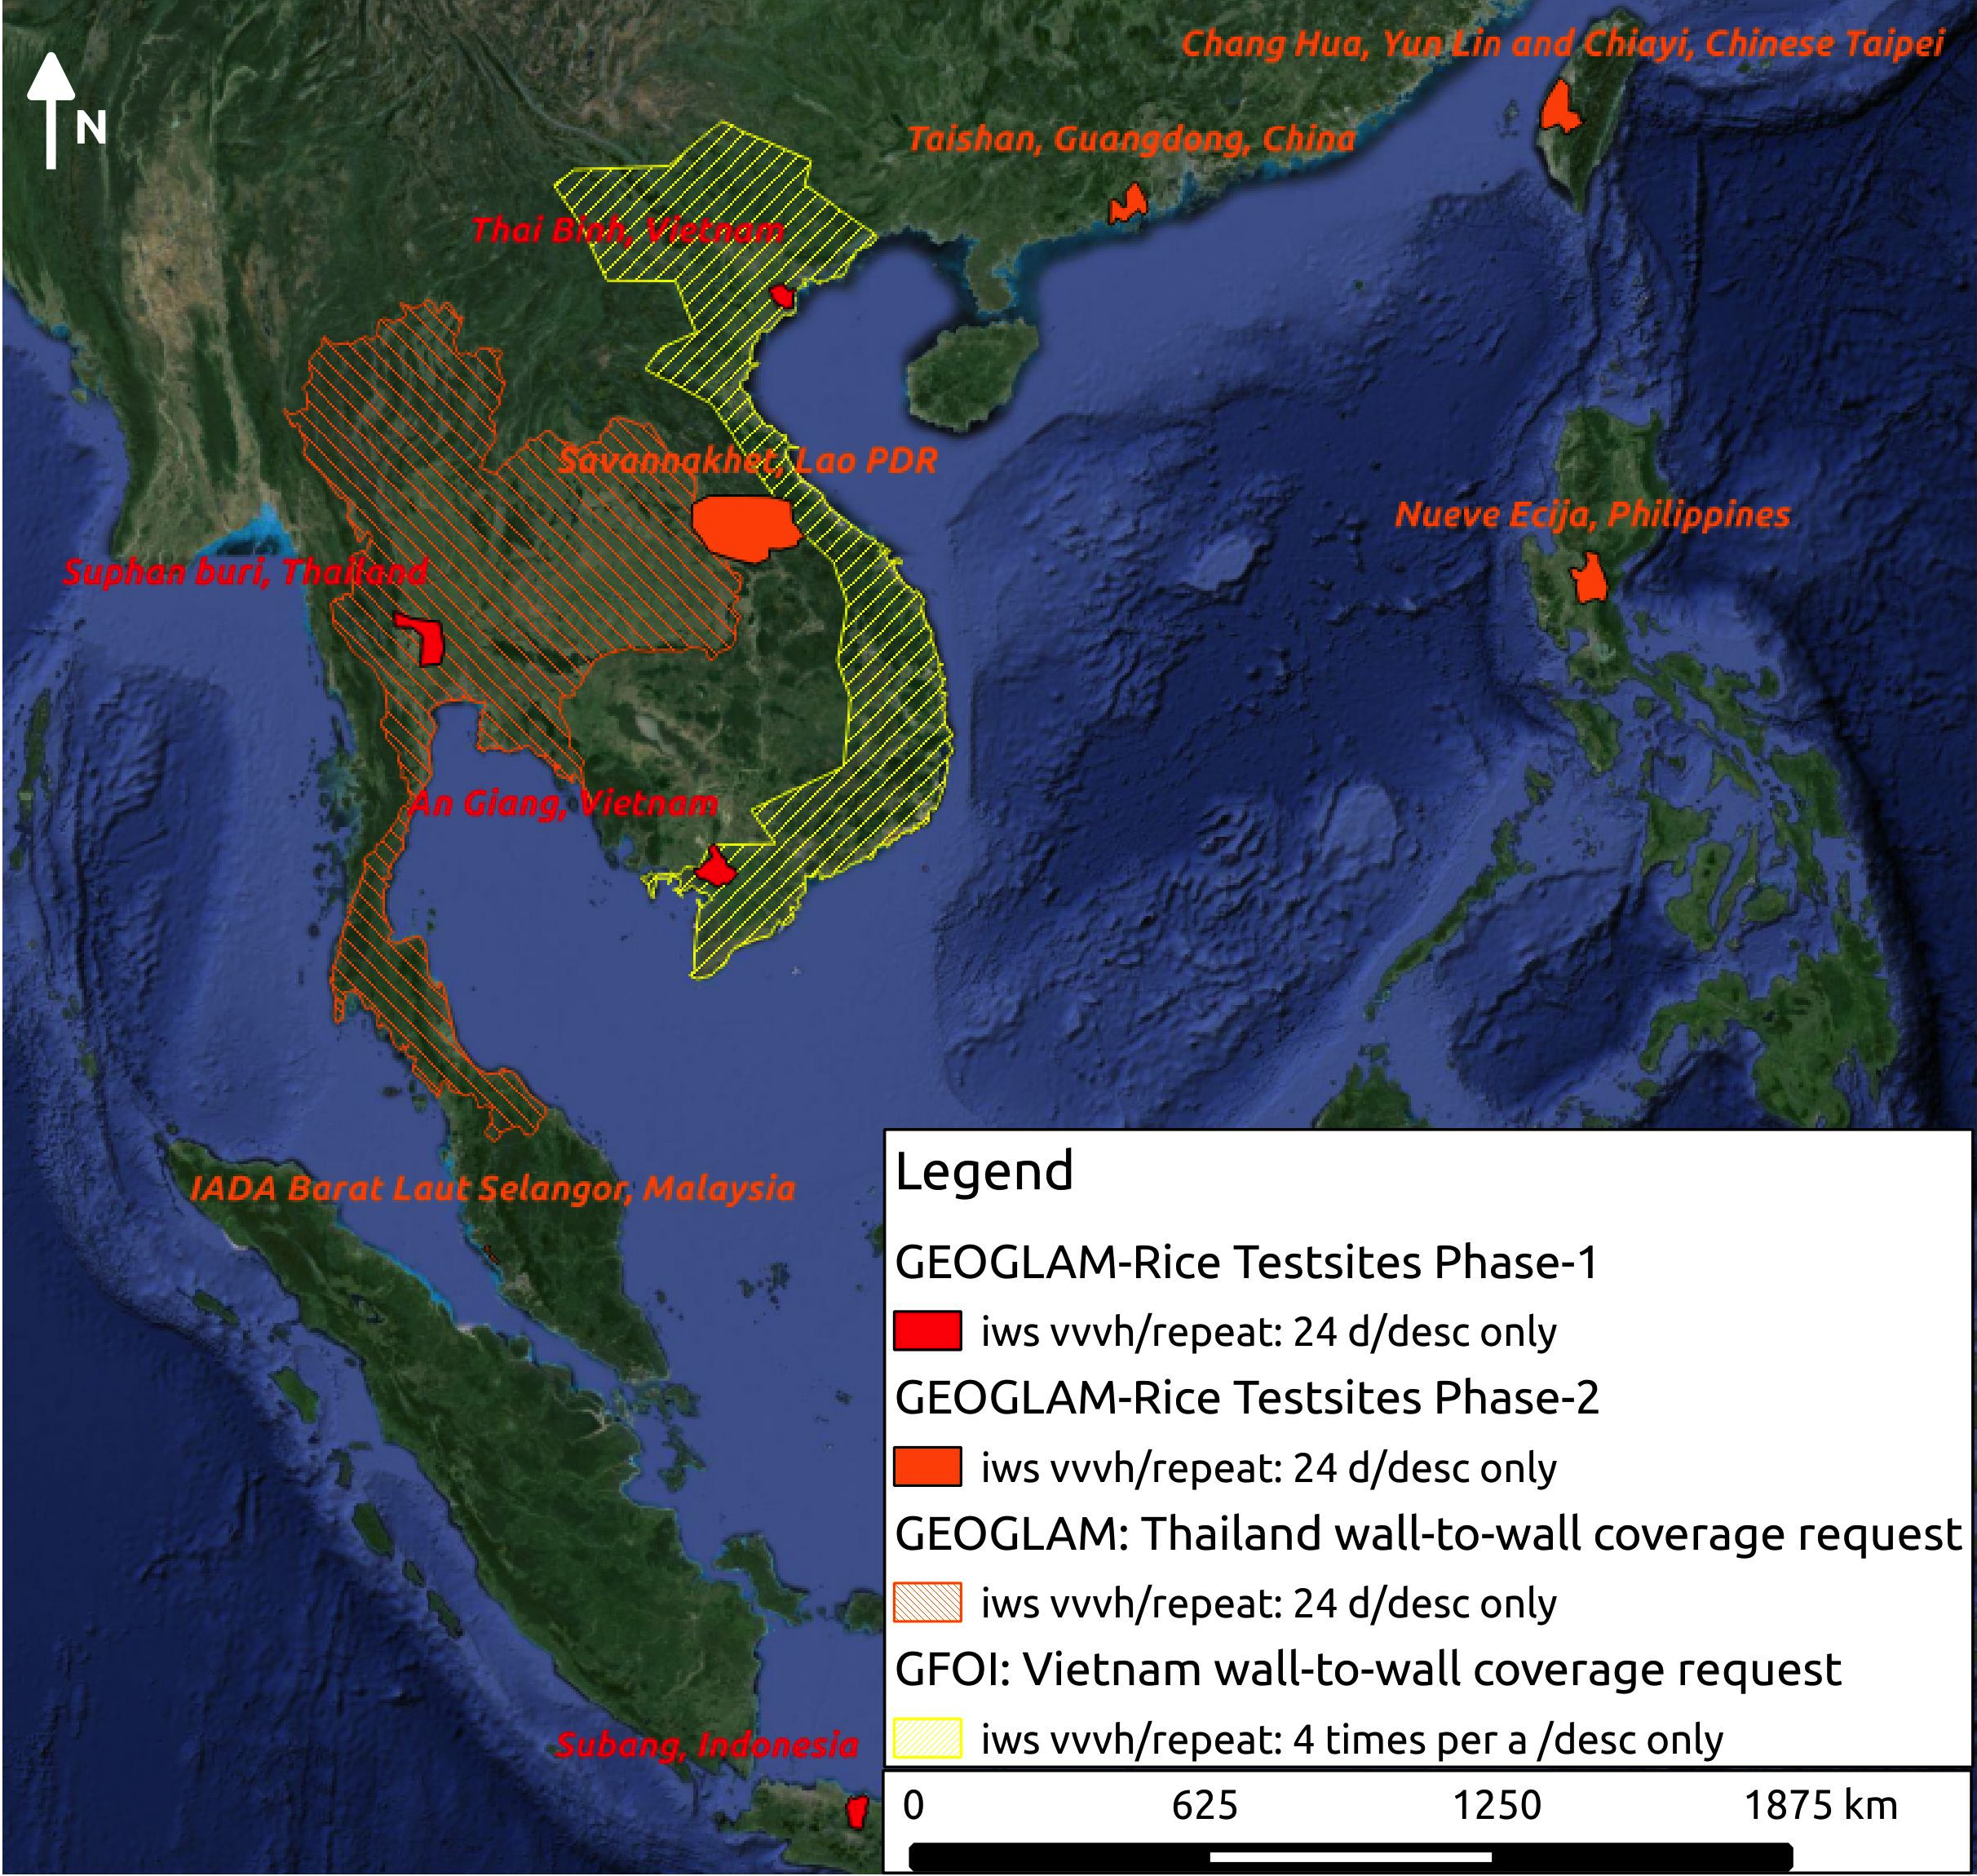
Tentative Sentinel-1 acquisition plan
Support to GEOGLAM Asia-Rice
Support to GEOGLAM Phase 1a:
4 rice test-beds
Every 24 days
IWS mode, VVVH polarization

Slide 6
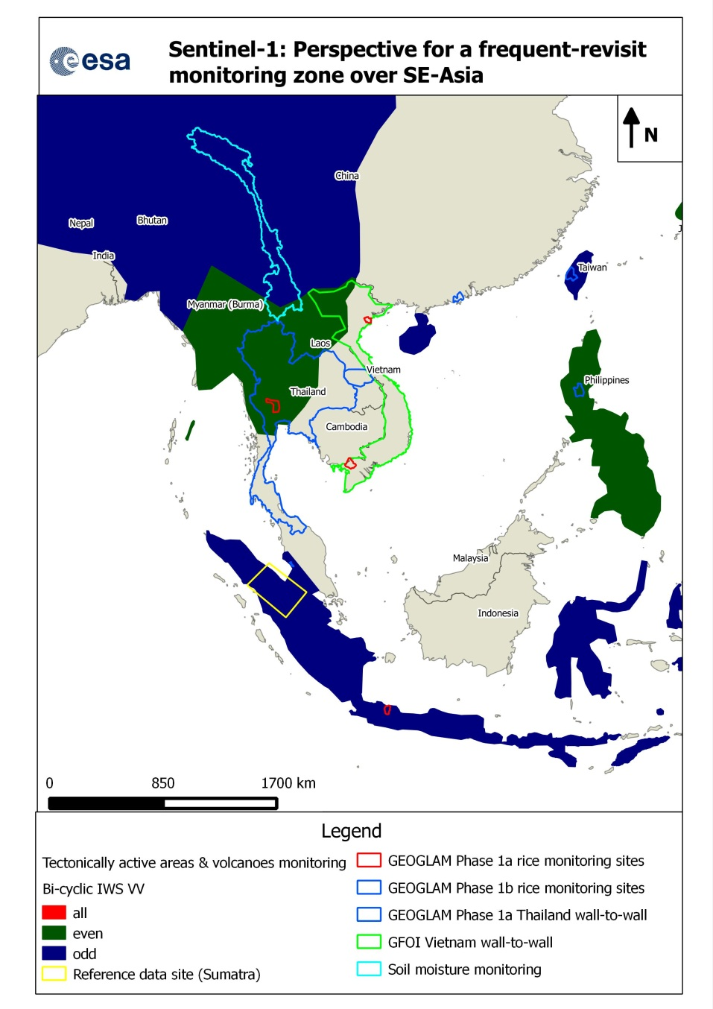
Perspective SE-Asia
Perspective SE-Asia
Potential for a frequent-revisit zone
On the SE-Asian Peninsula:
Clustering of requirements in the
region
Sufficient resources may become
available last quarter 2014
Potentially one-pass coverage,
dual polarization (VVVH)
Under discussion and evaluation

Slide 7




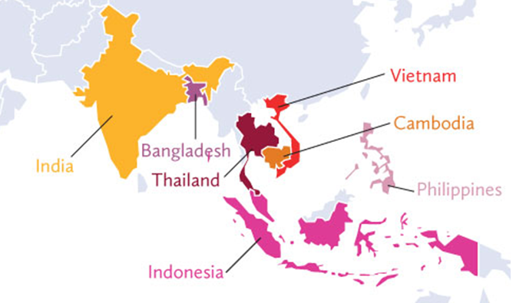
Sentinel-1: Rice mapping example
Supporting national scale crop information in Asia:
RIICE project with Swiss Development Cooperation
Issues: food security and crop insurance.
EO service: crop acreage & crop season stage
Full scale testing in 7 countries.
National scale rice mapping (1 ha) in the Philippines using multi-year ASAR data (2003-2010).
Annual rice area (15 m)
ASAR & ALOS data
Notes:
RIICE: REMOTE SENSING-BASED INFORMATION AND INSURANCE FOR CROPS IN EMERGING ECONOMIES - See more at: http://www.riice.org/#sthash.DbWXcQG5.dpuf

Slide 8
Sentinel-1 acquisition plans
Sentinel-1 observation scenario constituents
Keep updated - follow Sentinel-1 on the web:
Further information on Sentinel-1 observation scenarios will become
available at ESA`s ‘Sentinel online’ website including:
A detailed description of the Sentinel-1 observation scenario for the ramp-up
phase before launch (HLOP already present)
Consolidated observation plans (will allow to browse through strips) successively
for the ramp-up phase published during the commissioning
THANK YOU!

