Slide 1
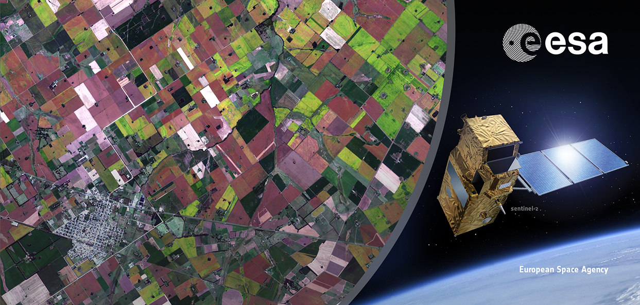
Sentinel-2
for Agricultural monitoring
Benjamin Koetz

Slide 2






Sentinel Missions
Joint EU-ESA Copernicus Space Programme
Long-term Continuity and Access to suitable EO data
  Free, full and open data policy*
Sentinel 1 – SAR imaging
All weather, day/night application e.g. floods, rice mapping
2014 & 2016
OPERATIONAL
Sentinel 2 – Multi-spectral imaging
Land applications: urban, forest, agriculture,..
Continuity of Landsat, SPOT
Press Release:
Open data policy
2014/15 & 2016
Sentinel 3 – Ocean and global land monitoring
Wide-swath ocean color, global vegetation, sea/land surface temperature, altimetry
2014/15 & 2016
* Joint EU/ESA Data Policy Principles adopted by ESA member states in Sep ‘09, EU announced for Nov. 2013

Slide 3
Sentinel contribution to GEOGLAM
Primary missions for all Targets Products
Sentinel-3
Global Land Programme
SMOS
Sentinel-2
Sentinel-2
Sentinel-1
^{Source:} CEOS ACQUISITION STRATEGY FOR GEOGLAM PHASE 1

Slide 4
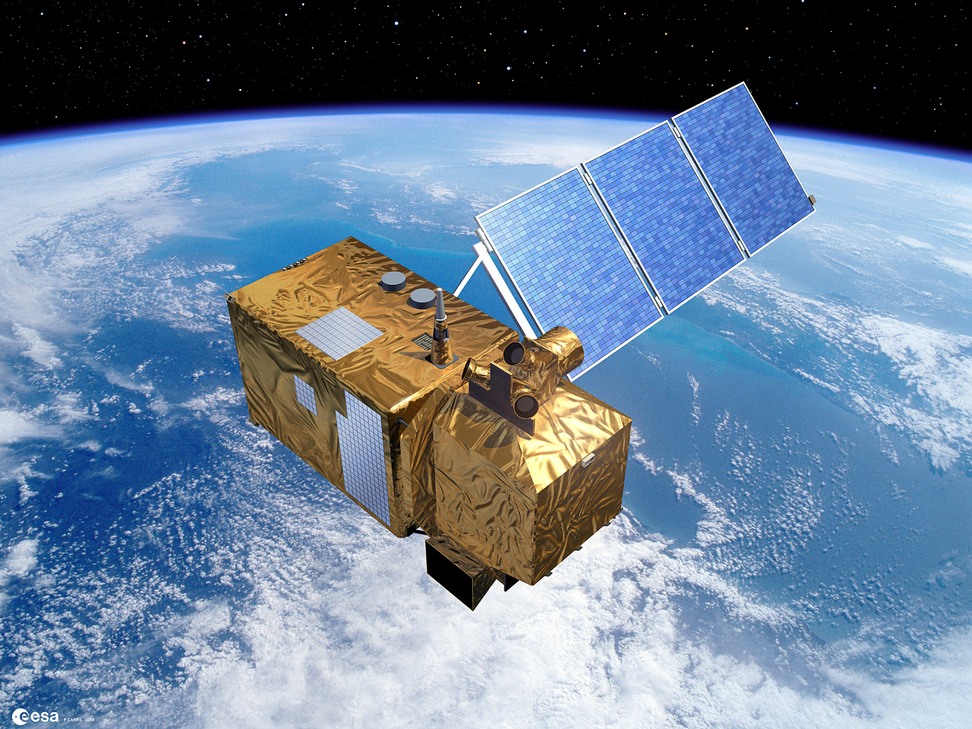
Copernicus Sentinel-2
Multispectral High Resolution Optical Imager
Launch: 2014/15, 2016, ...
13 bands (VIS, NIR & SWIR)
290 km swath at 10, 20 and 60 m
Systematic acq. of all land and coasts
5 days repeat cycle with 2 satellites
7 years design lifetime (max. 12 yrs)

Slide 5
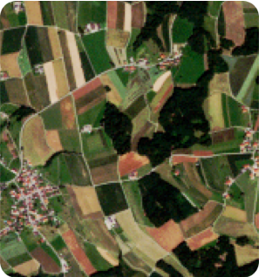
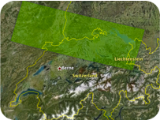
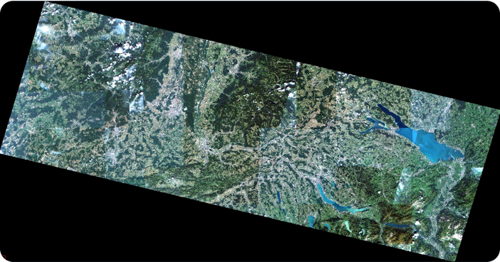
SENTINEL-2 coverage and resolution
Sentinel-2: Coverage & Resolution
10 m resolution for field scale mapping
100 km
10 meters resolution
290 km
Courtesy of RapidEye
Notes:
A mockup of the high-resolution images that the future Sentinel-2 mission will deliver. Using 82 observations from the German RapidEye satellites, the image covers the border area of northern Switzerland, southern Germany and eastern France, and includes a small portion of Austria and Lichtenstein.This mosaic shows what a Sentinel-2 product could look like, with a swath of 290 km and a resolution of 10 m per pixel.
Based on RapidEye data sets – freely available, disseminated at the S2 preparatory symposium

Slide 6
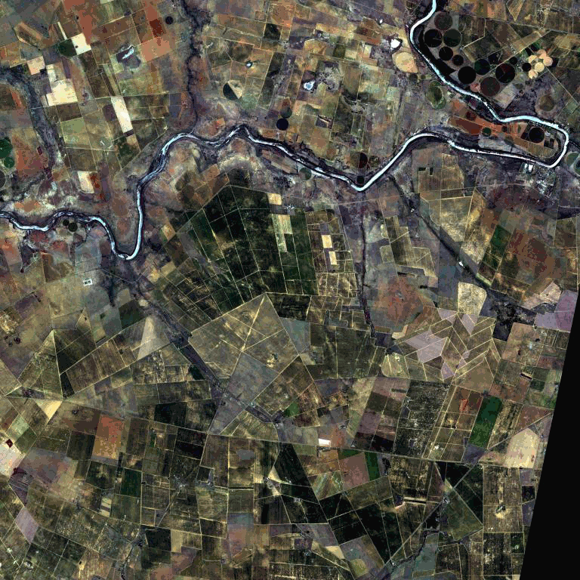
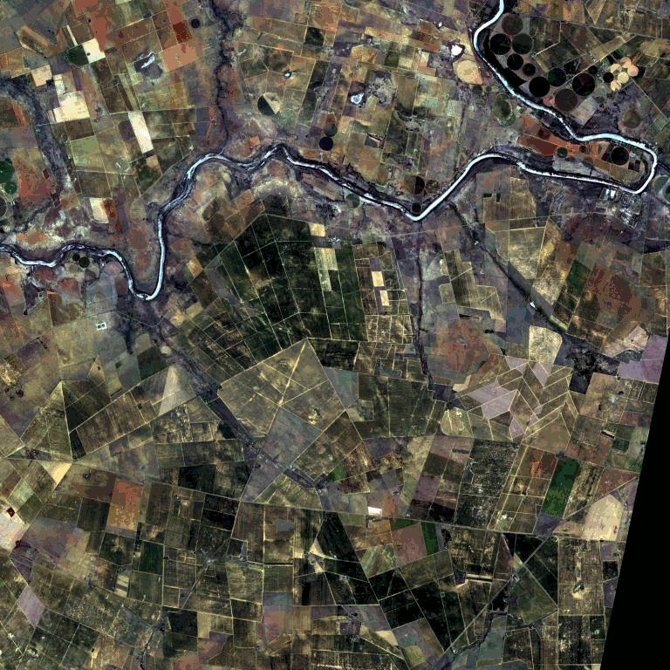
Sentinel-2 Revisit Time Capability
5 days revisit for crop dynamics
days
Effective coverage in summer with S2-A&B:
repeat cycle of 5 days cloud coverage <15%
South Africa JECAM site: 5 days revisit, February-June 2013 - RapidEye
Monthly cloud free composites possible for most areas

Slide 7

Overview of S2 Time Series: RapidEye
Total of 390 acquisitions, 24-30 per site
38% cloud free of total acquisitions (0-65% at site level)
Even with 5 days repeat, low coverage over Europe during growing season

Slide 8
S2 Products / Overview
Name | High-level Description | Production | Preservation Strategy | Volume
Level-1B | Top-of-atmosphere radiances in sensor geometry | Systematic | Long-term | ˜27 MB (each 25x23km²)
Level-1C | Top-of-atmosphere reflectance in cartographic geometry (UTM/WGS84) | Systematic | Long-term | ˜500 MB (each 100x100km²)
Level-2A | Bottom-of-atmosphere reflectance in cartographic geometry | On user side (using Sentinel-2 Toolbox) | - | ˜600 MB (each 100x100km²)

Slide 9
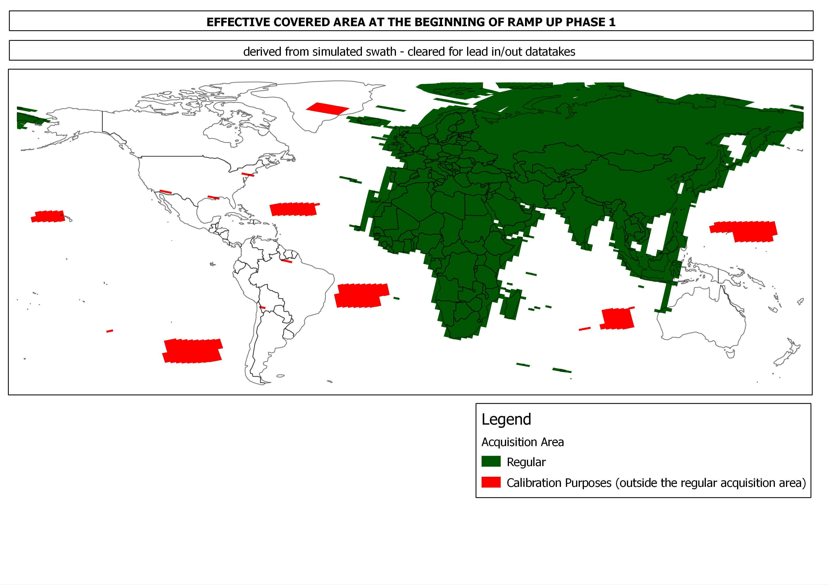
Sentinel-2 Indicative Acquisition Plan:
Gradual ramp-up focusing on Europe & Africa: after commissioning
Ensuring coverage of global Cal/Val
Ensuring COPERNICUS CORE datasets needs for Europe/Africa systematically
Ensuring maximum coverage/orbit length for GRI generation
Products will become available immediately, data quality will be refined until full GRI (Global reference Image) is available
Assuming availability of 2 downlink stations out of 4

Slide 10
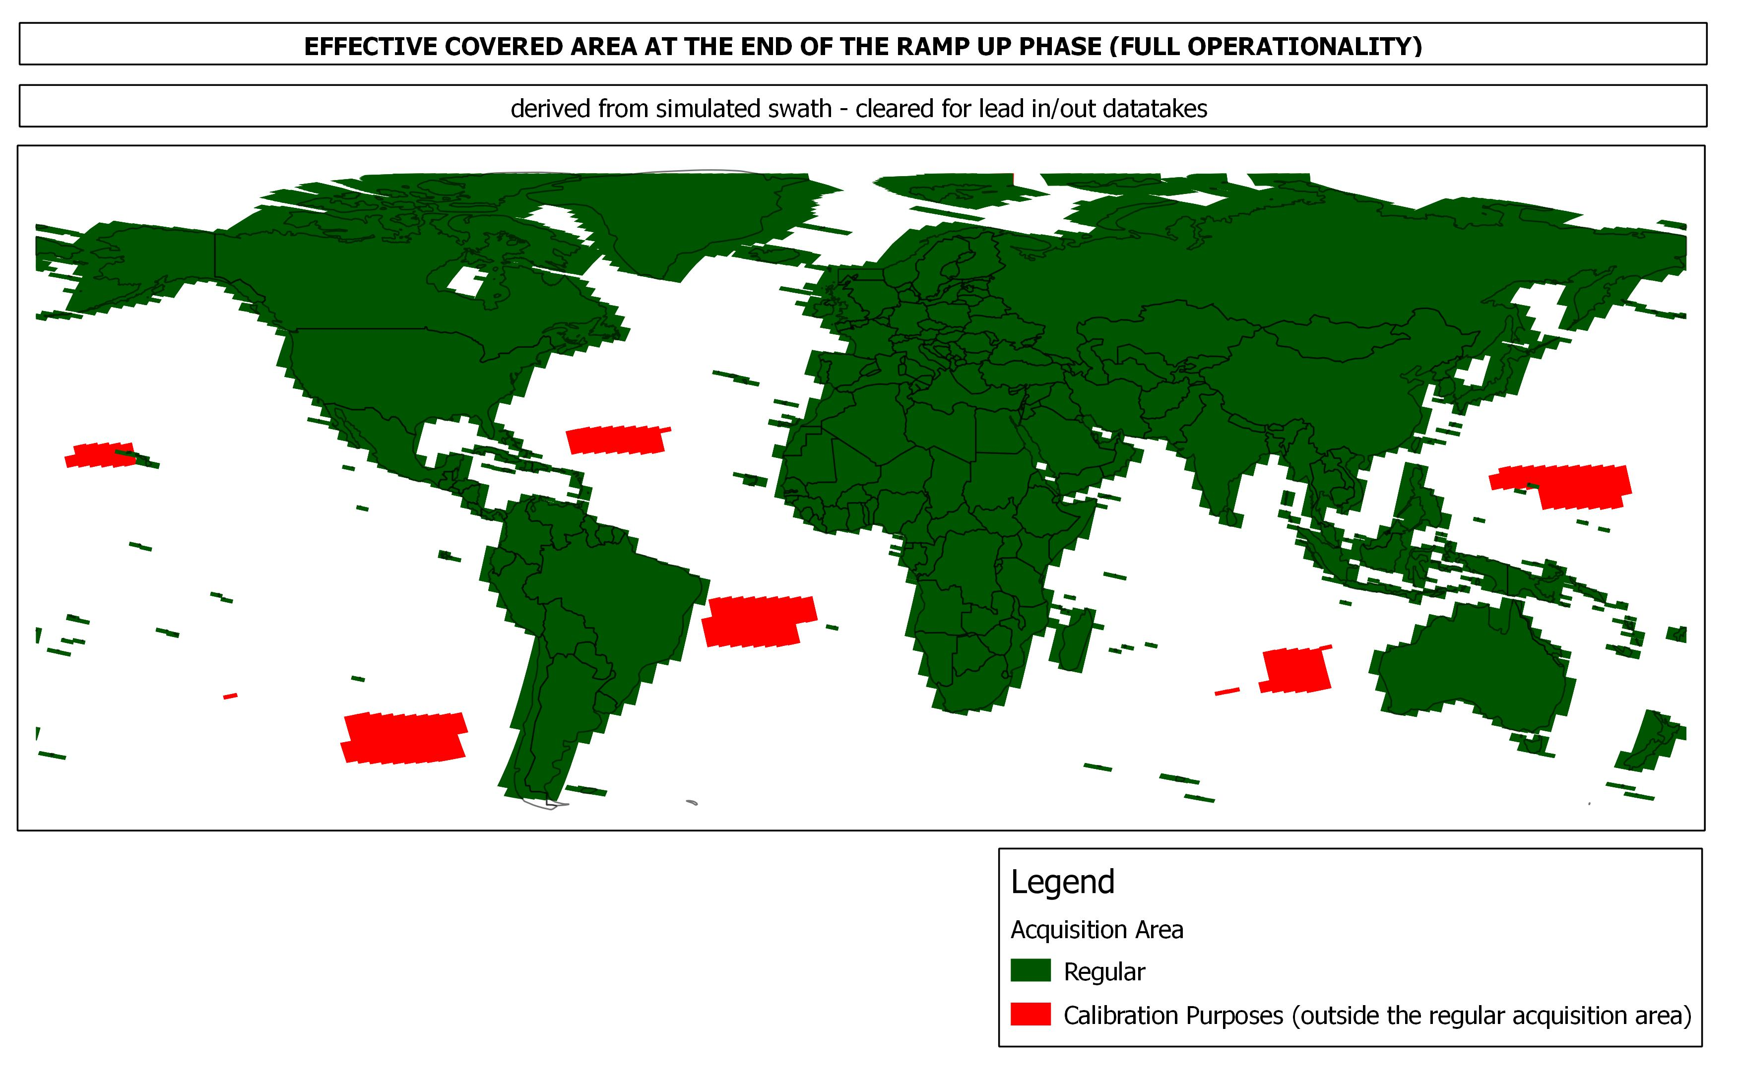
What is clear: at the end of the S2 ramp-up phase
  Systematic acquisition of:
    All land surfaces (-56° and +84° latitude);
    Major (greater than 100 km² size) and EU islands;
    Coastal/inland waters, Mediterranean Sea and all closed seas;
    Cal/Val sites.

Slide 11

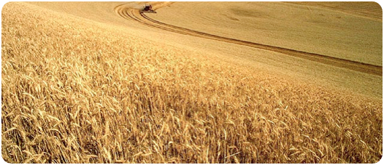
Sentinel-2 for Agriculture
Preparatory Activities S2 for Agriculture
Resolution and temporal frequency of Sentinel-2 present unique opportunities for agricultural monitoring
Agricultural Needs & Drivers:
High temporal crop dynamics
Large variability of crops / practices
Wide range of applications (local – global)
Project Set-up
  Team: UCL, CESBIO, CS-France, CS-Rumania
  Time Frame: 3 years, KO January 2014
  Budget: 1.5 Meuro

Slide 12
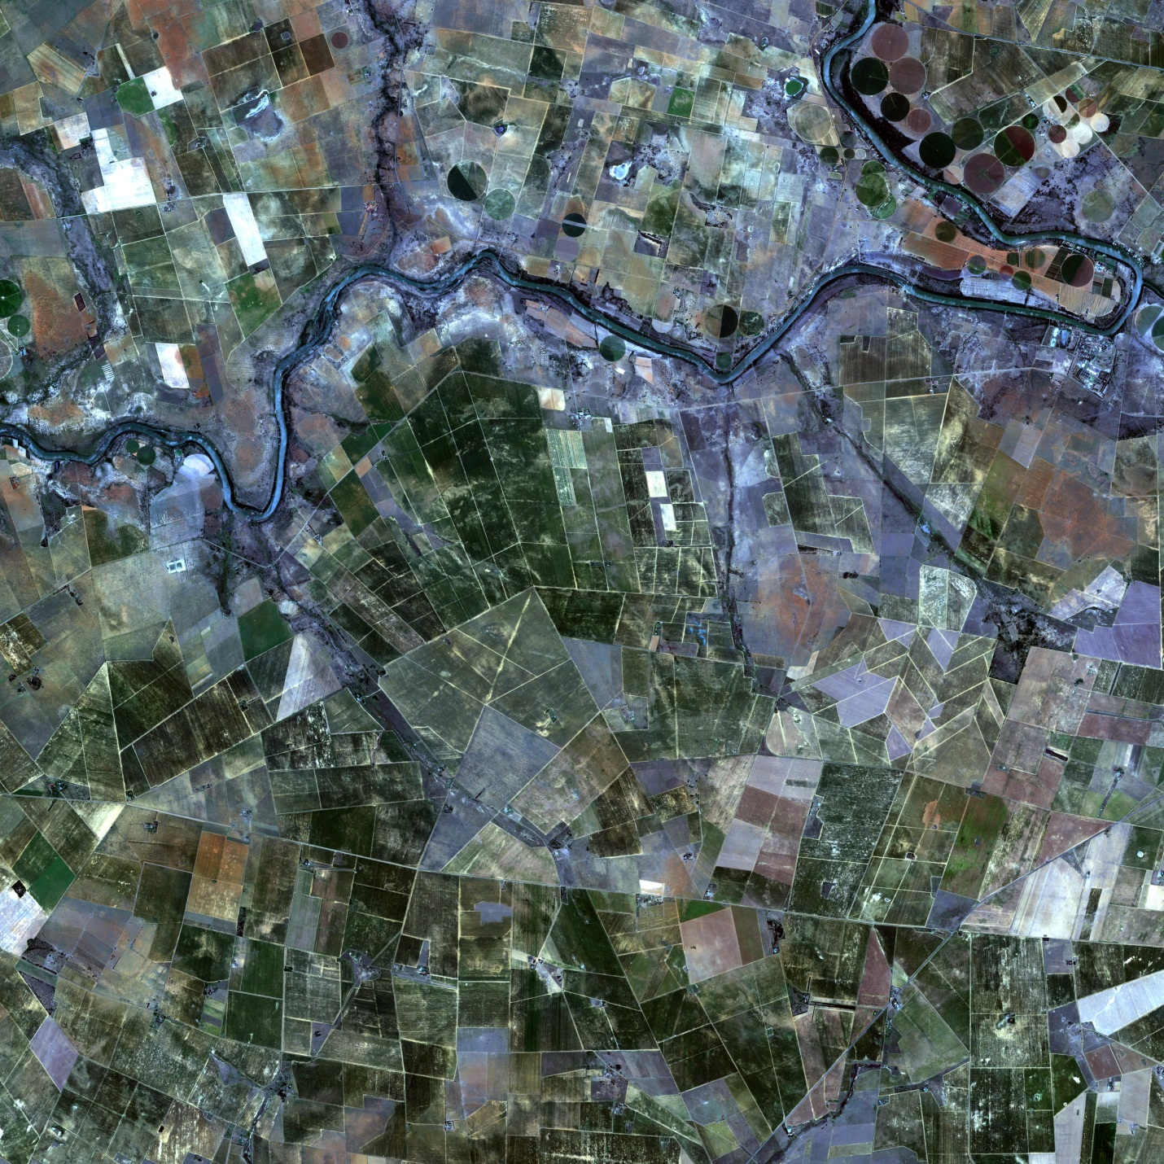
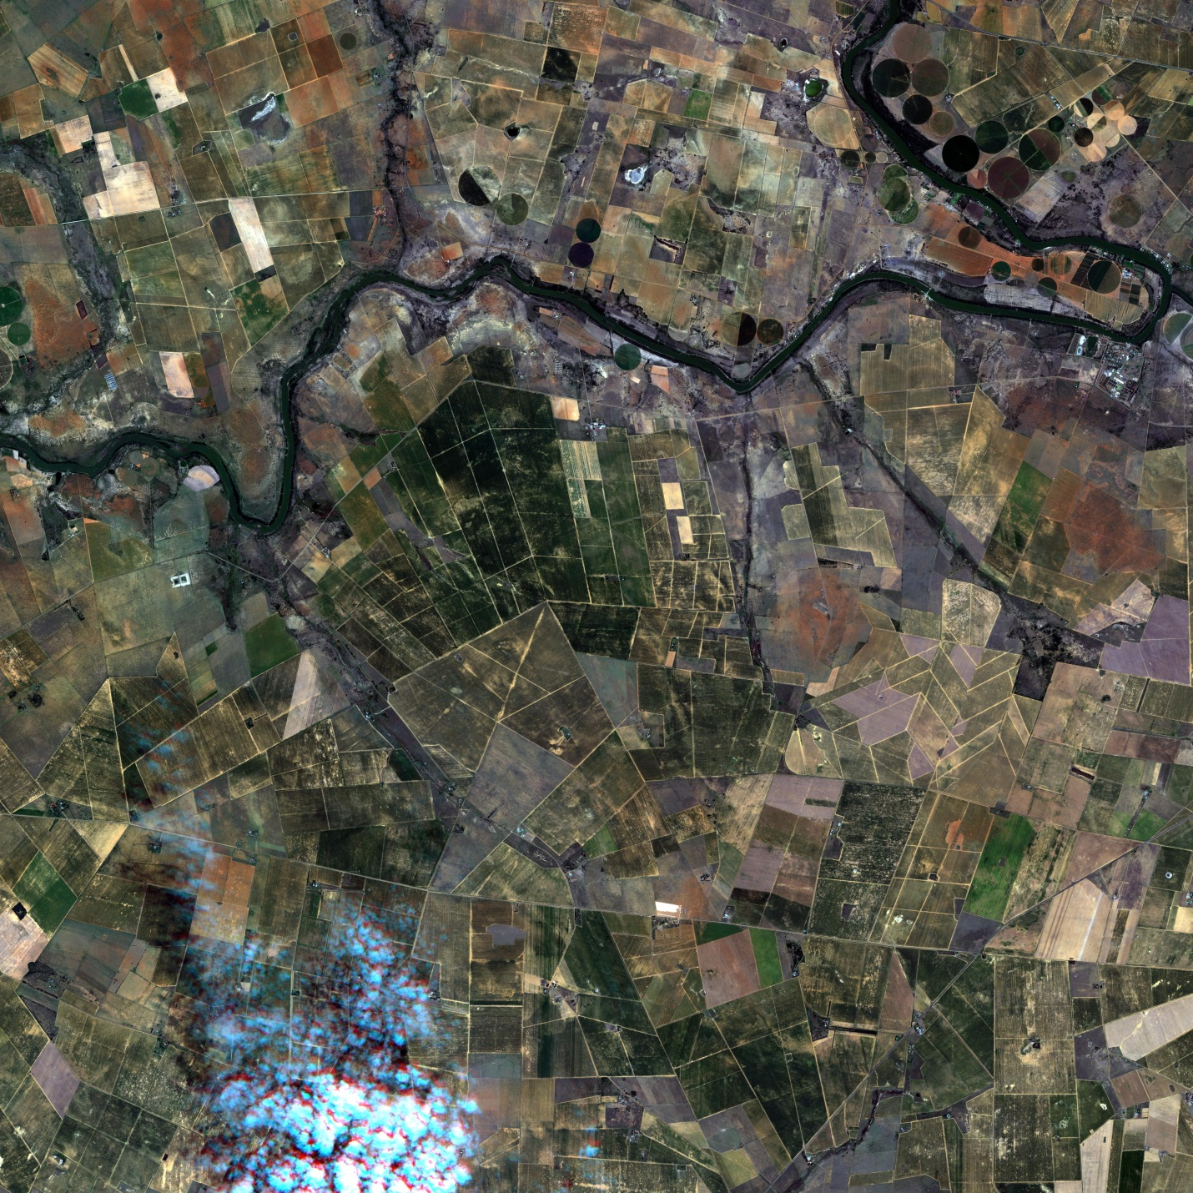
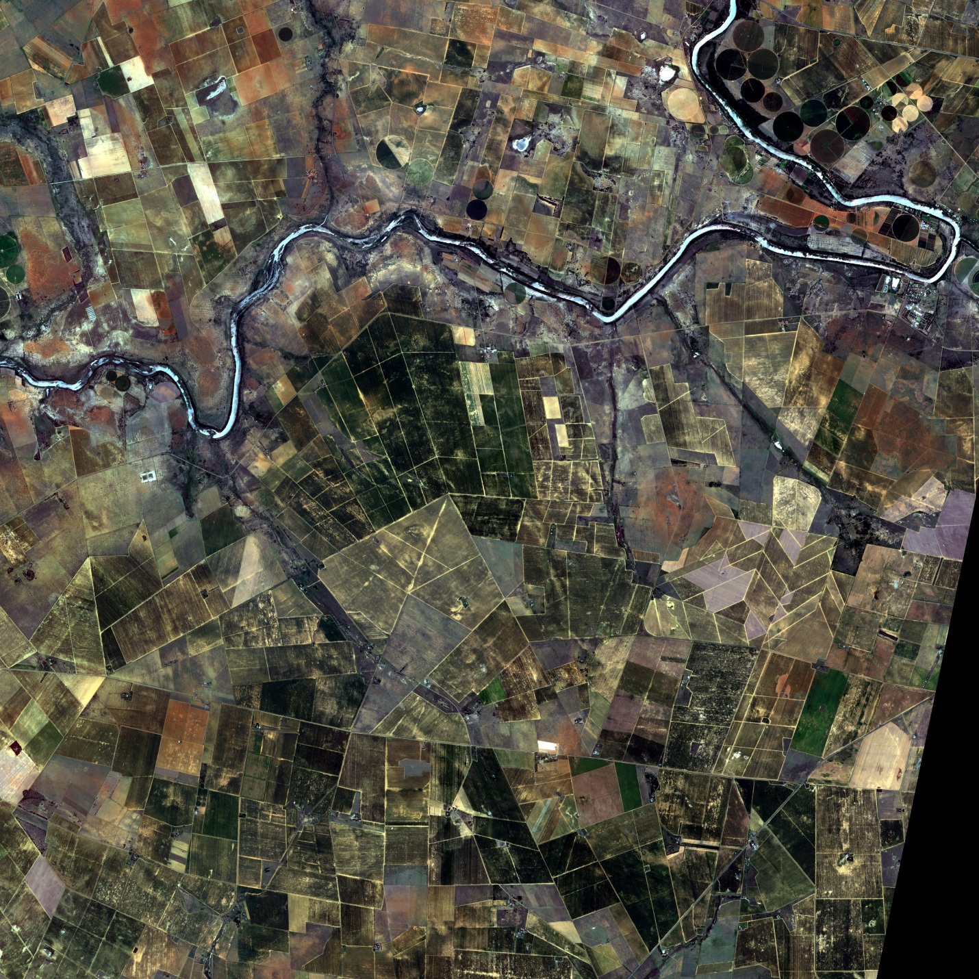

Sentinel-2 for Agriculture:
Objectives & Concept
Algorithm Development
Prototypes of EO products
Demonstration & Validation
Main Design Activities:
User Requirements
EO product specification
Algorithm Development
Processing System:
4 agricultural EO products
Open source system
Testing & validating of EO prototypes (12 sites)
Use cases:
3 national coverages & 5 local sites (290x290 km)
Validation of EO products
Transfer to national users

Slide 13
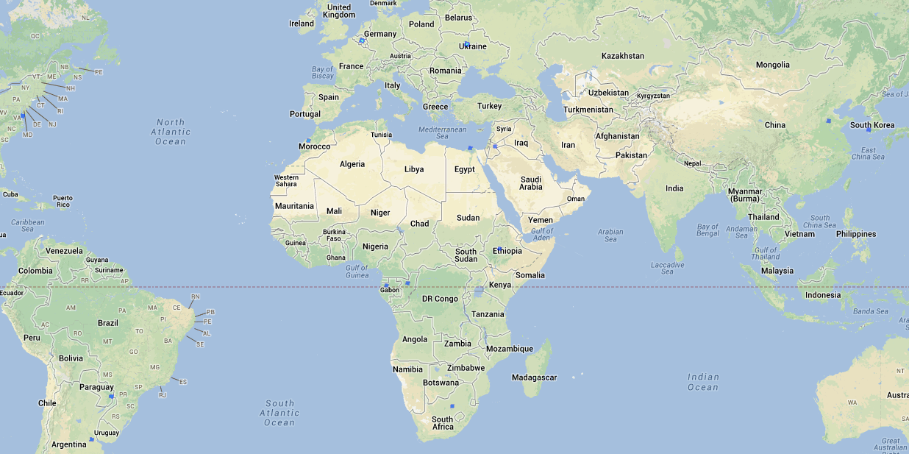
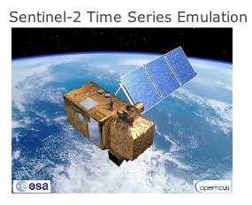
Sentinel-2 for Agriculture:
Project Implementation
Sentinel-2 Time Series (February-June 2013)
  SPOT4: 5 days, 20 m, 60x60 km2 (CESBIO/CNES)
  RapidEye: 5 days, 5 m, 25x25 km2
  Landsat-8: 16 days, 30 m, 180x180 km2
Agricultural EO products
  Dynamic Cropland mask
  Cultivated crop type & area
  Crop condition indicator / biophysical var.
  Cloud free S2 composites
FREE access:
http://due.esrin.esa.int/s2t5.php

Slide 14
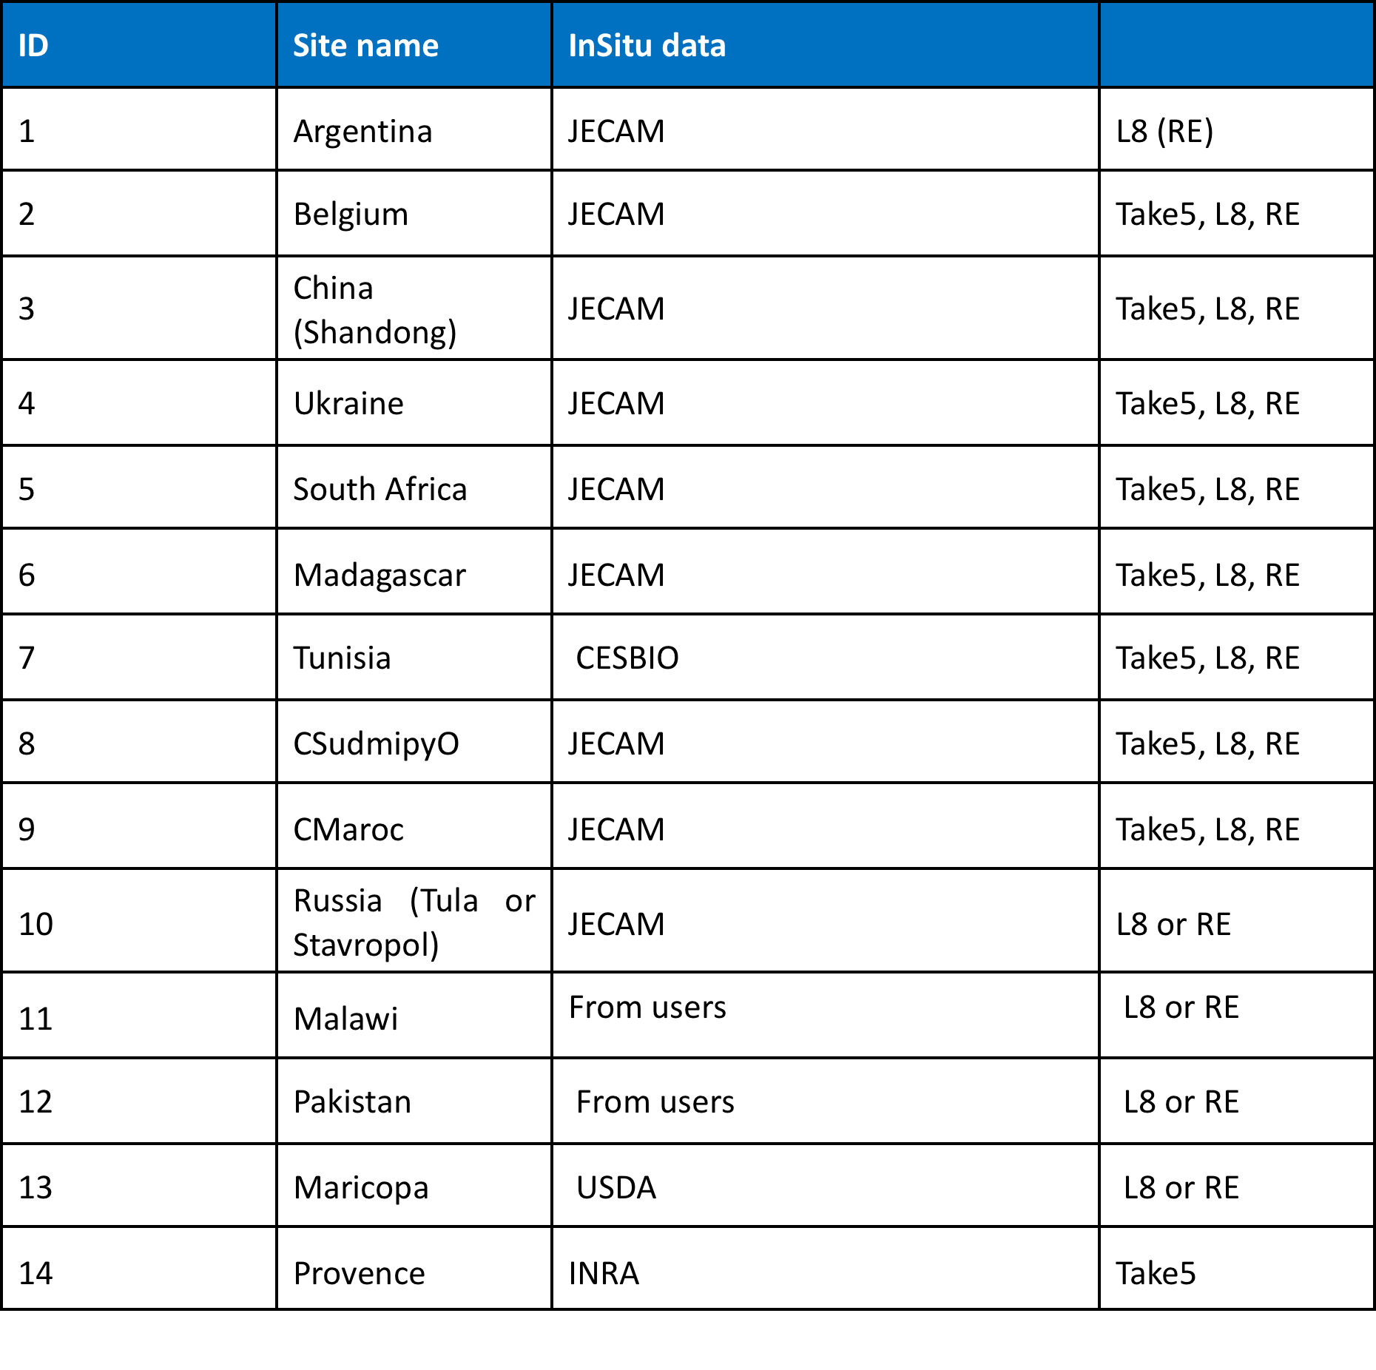
Sentinel-2 for Agriculture:
Test sites & demonstration
Potential National
Demonstration:
Sudan
Morocco
Malawi
Pakistan
Russia
Ukraine

Slide 15






Sentinel-2 for Agriculture:
Expected Outcome
  Preparation for national to regional agricultural monitoring based on Sentinel-2
    R&D for full exploitation of temporal & spatial resolution of S2
  Consolidate Best Practices for EO agricultural monitoring
    Benchmarking & validation of algorithms for 4 EO products
    Testing products over a wide range of conditions (JECAM community)
  Strengthening National Capacity for Agricultural Monitoring
    Open source system supporting national reporting & food security
    Transfer to users including local system installation & training
    Demonstration of validated agricultural EO products at national scale
User & Partners
  15+ committed key users: national institutions, experts, internat. organization
  6 JECAM sites: Belgium, South Africa, Ukraine, China, Argentina, Paraguay +?

Slide 16
Sentinel-2 for Agriculture:
Expected Outcome
  Preparation for national to regional agricultural monitoring based on Sentinel-2
    R&D for full exploitation of temporal & spatial resolution of S2
  Consolidate Best Practices for EO agricultural monitoring
    Benchmarking & validation of algorithms for 4 EO products
    Testing products over a wide range of conditions (JECAM community)
  Strengthening National Capacity for Agricultural Monitoring
    Open source system supporting national reporting & food security
    Transfer to users including local system installation & training
    Demonstration of validated agricultural EO products at national scale
User & Partners
  15+ committed key users: national institutions, experts, internat. organization
  6 JECAM sites: Belgium, South Africa, Ukraine, China, Argentina, Paraguay +?

Slide 17
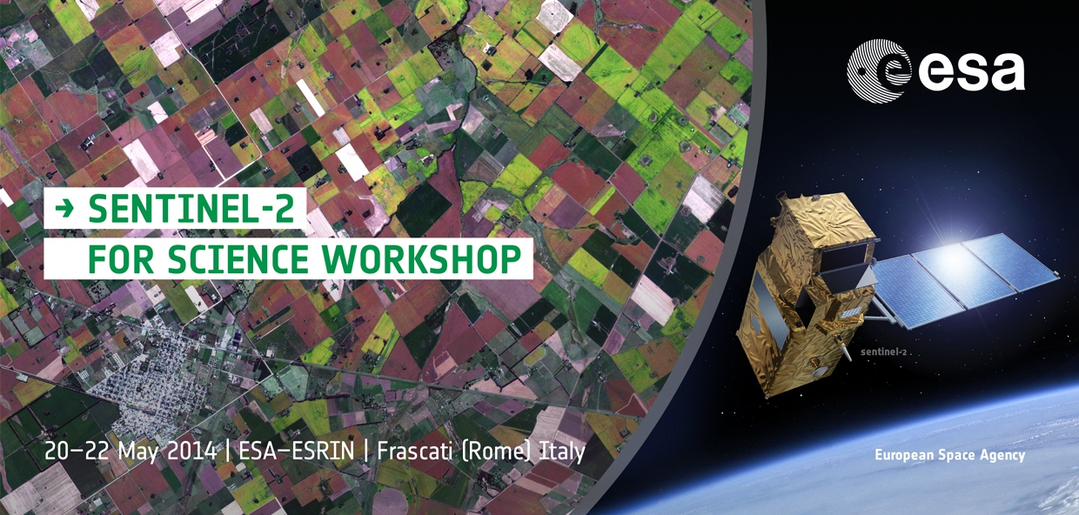

Conclusions:
Sentinel-2 Potential for Agriculture
  Operational Observations from Sentinel-2
    Continuous information from field to global scale
    Responding to most GEOGLAM target products
    Open data policy & long-term continuity for sustainable uptake
  Preparatory activities needed for full exploitation
    R&D for optimized and validated EO products
    Facilitation of EO data access & handling (e.g. composites)
Sentinel-2 for Science Workshop
20th-22nd of May 2014
http://seom.esa.int/S2forScience2014/

Slide 18
http://sentinel.esa.int
http://spaceinvideos.esa.int/Videos/2013/09/Living_Planet_2013_-_Sentinel-2_mission

