Slide 1
LAND COVER CLASSIFICATION 2010
Ministry of Water & Environment,
National Forestry Authority,
by
Edward Ssenyonjo
Remote Sensing Specialist
Joseph Mutyaba
Cartography Specialist
25 February 2014
FAO-Rome, Italy

Slide 2
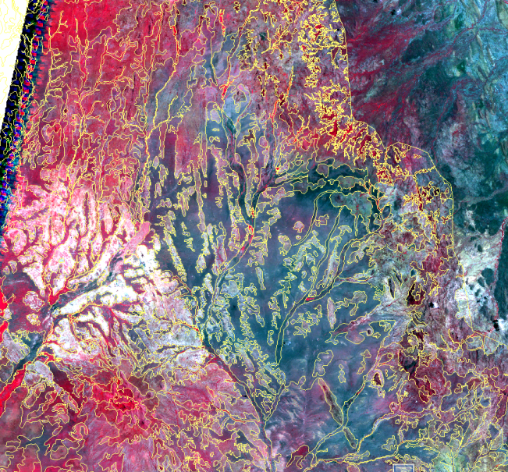
Where we have come from
Land cover 2005 (Before FRA trianing,02/13)
Heads up digitising
Time consuming 2004 – 2009,
Very manual
Elements of human bias

Slide 3
Where we are
Land cover 2010 (After FRA trianing,02/13)
Computer aided digitizing
Time saving: April 2013 – June 2014
Automated digitizing & classification
Assumed objectivity
Segmentation graphic

Slide 4
Where we want to go
Land cover 2015 (in collaboration FRA)
Computer aided digitizing
Saving more time: < 3 months
Sharable on-line and interactively eg CartoDB, MapBox etc

Slide 5
Working with FRA
There are 17 global FRA samples (10x10km) in Uganda
Uganda is covered by 520 national tiles generated prior to the Feb 2013 training (20x20km).
The 520 were adjusted to 312 historical tiles by Dept of Lands & Surveys (27x27)
During FRA Training:
The Ugandan team was introduced to Open Foris Geo-spatial Toolkit (OFGT)
OFGT is command line and script based (R, perl etc)
Semi-automated (both segmentation & classification) and
Very fast (on Ubuntu OS)
The resultant land cover map & statistics concentrated on FAO FRA classes forests F, OWL, OL, H₂0
Uganda would like to include other classes(=13)
So far OFGT is being used for data preparation i.e Image stacking and sub setting

Slide 6
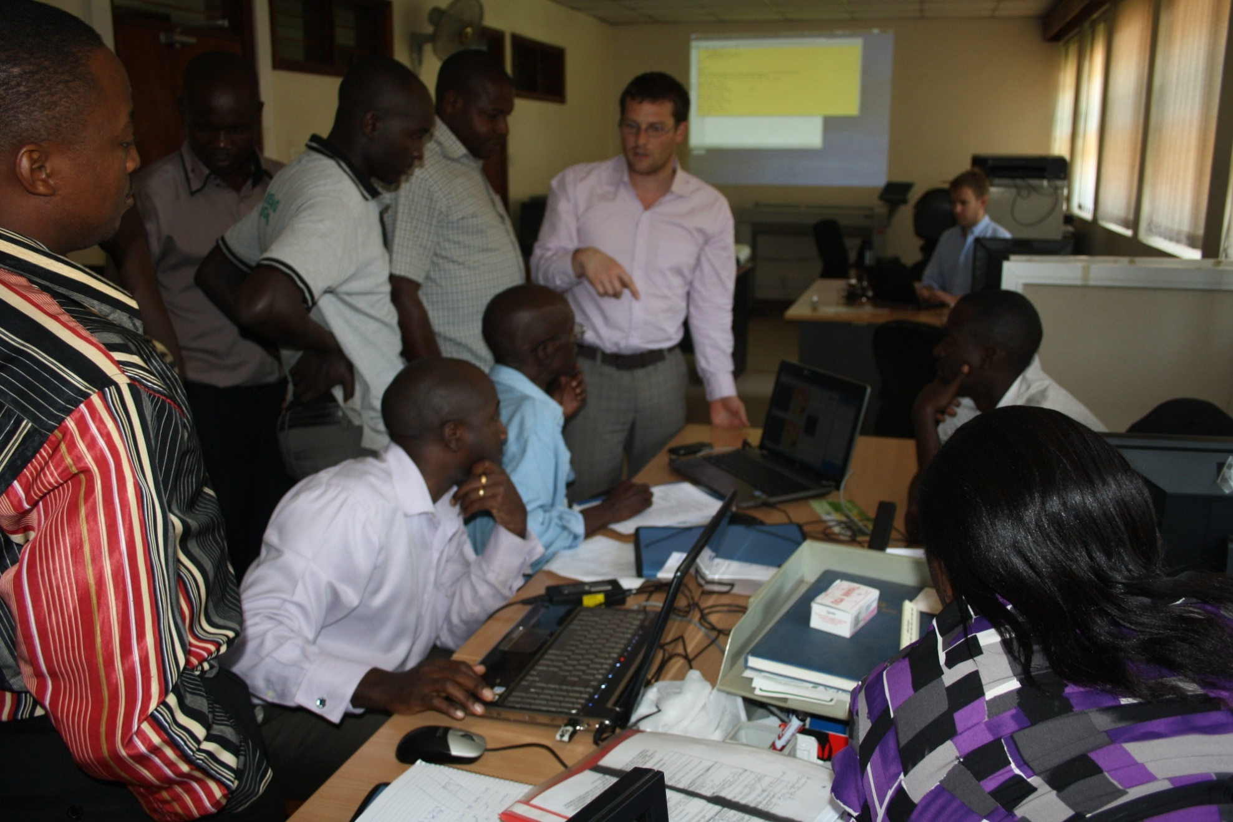
Erik and Remi with the Ugandan team during training Feb 2013

Slide 7
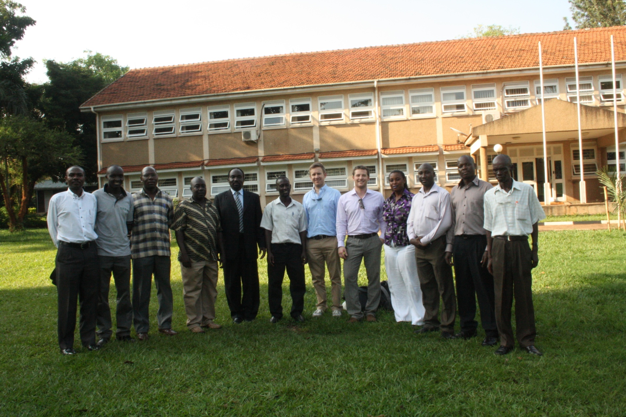
The team with trainers

Slide 8
Segments from Open Foris Tool Kit

Slide 9
IMAGE SEGMENTATION WITH ORFEO TOOLBOX (OTB)
OTB interface work on Windows, MacOS and Linux operating systems.
It too, is free Open Source software supported by the OSGeo4W
Has many modules –the segmentation module was used with the mean shift algorithms.
It has an advantage of producing very neat and interactive vector segments based on spatial radius, range radius and region size.

Slide 10
IMAGE CLASSIFICATION WITH R®
After segmenting the raster with OTB, an R script is used to calculate segment statistics using the raw image stack.
a set of training points chosen from the image in form of a shapefile or x, y data (in a csv or dbf table).
These statistics and training data are then used in another R script to classify the segments using the Random forest module so far up to 10 classes.
Note: The scripts were written by Ned Horning and Wynne Walker from Woods Hole Research Centre, MA.

Slide 11
Raw Image
Satellite Image to Land cover stratification
Raw image as statistics input
Raster segments
Classifying segments
Output
Qualifying segments
R
Classified Image
Input
Input
Segment selection
Input
R,
csv
Qualifying segments
Training required for classification
Segment statistics
Vector segments
Selecting training samples
Training data

Slide 12
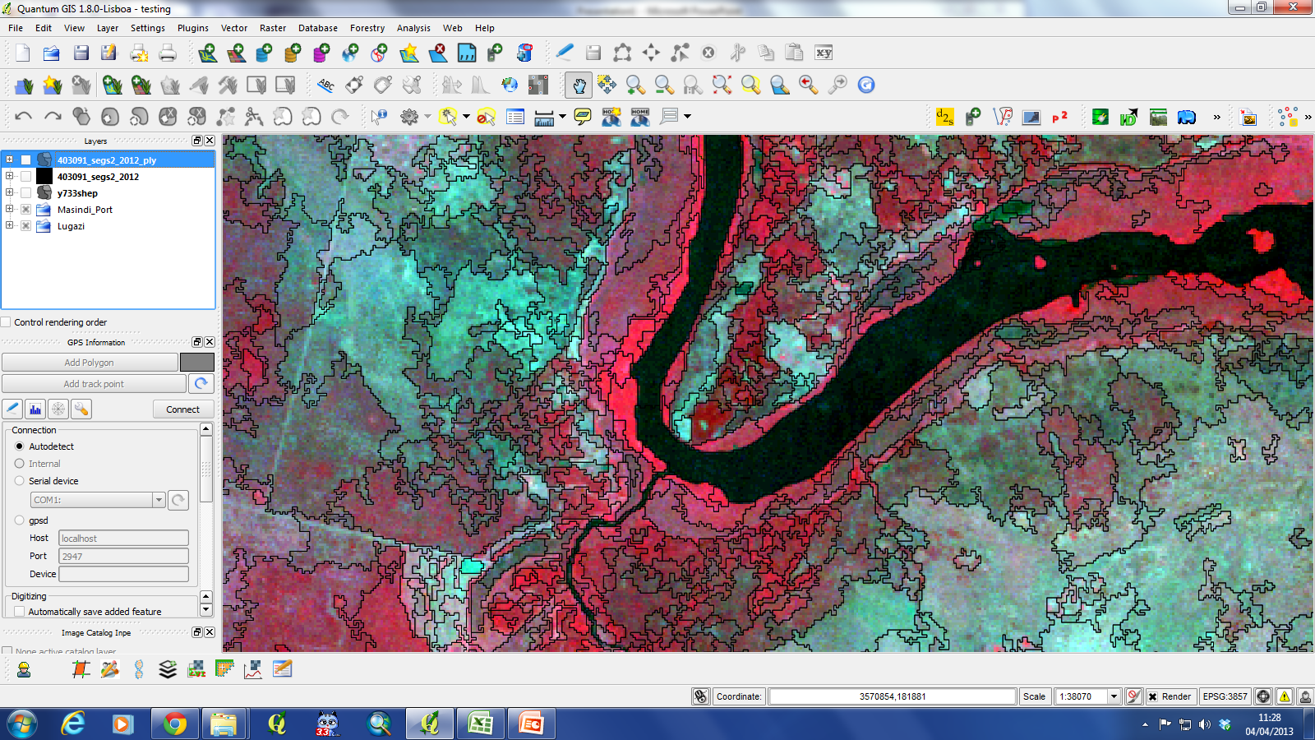
Segments from Orfeo Tool Box

Slide 13
OTB & OFT Segments Compared
OFGT
OTB

Slide 14
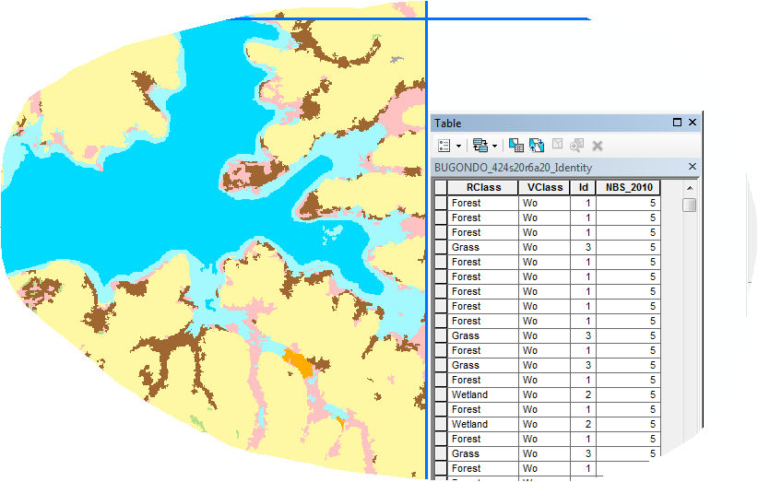
VALIDATION WITH ArcMap
First step of adding relevant fields is done using model builder in ArcGIS.
The fields are populated in ArcMap
This where the 10 classes are translated to 13
Vclass | NBS
BTP | 1
CP | 2
THFW | 3
THFL | 4
Wo | 5
B | 6
G | 7
We | 8
SF | 9
CF | 10
BA | 11
OW | 12
I | 13
Id | Rclass
1 | Forest
2 | Wetland
3 | Grass
4 | Bush
5 | Agriculture
6 | Towns
7 | Water
8 | Impediments
9 | Cloud
10 | Cloud shadow

Slide 15
RESULTS &STATISTICS (Achievements)
So far classified 94.55% of the country
Generated statistics for 81% of the 312 tiles
Validated 14% of the tiles

Slide 16
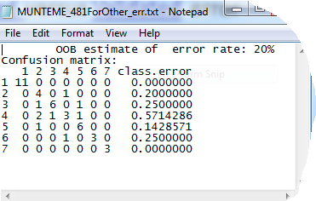
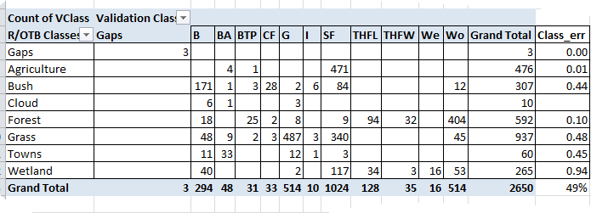
STATISTICS Analysis
Classified versus Validated error
The importance of validation
Example of classified image
Example of validated image
Study the trend in classification error from R to Validation (Ground truthing)
Notes:
The importance of validation can only be more emphasized by an Example. There are fewer categories for a classified image. While there are more classes for the validated image.

Slide 17
CHALLENGES
Steep Learning curve
Cloud cover
Topological (overlapping polygons & gaps)
Difficulty in comparison of 2010 LC with previous LC datasets due to the generalization of earlier datasets.
Ability to edit rasters attributes to minimize usage of vectors and there topological issues

Slide 18
SUMMARY
No silver bullet
Data Preparation
Stages
Segmentation
Classification
Validation
Tools
OFGT
OTB
R
ArcGIS
Image stacking & Compositing
Sub setting
Table schema (Model builder)
Attribute editing
Result is either raster or vector
R scripting (Statistics calculation)
Classification
Ops

Slide 19
Grazie !!

