Slide 1

Democratic Republic of Congo “DRC”
KAYEMBE MUMONAYI François
National Consultant FAOCD/UN-REDD
Geomatic Laboratory
Inventory and Forest Management Direction (DIAF)
Environment, Nature Conservation and Tourism Ministry (MECNT)
Kinshasa / D.R. C
franckafong@yahoo.fr
francois.kayembe@fao.org
Tel: +(243) 817 356 409
SDCG Country Days of the Global Forest Observations Initiative (GFOI)
Tuesday, 25 February 2014
Room: German Room, FAO, Rome

Slide 2
Area of DRC Forest Cover: 155 million hectares - 67%

Slide 3
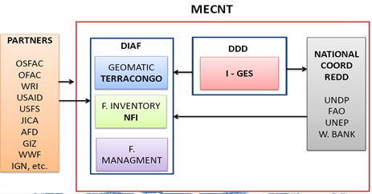
Product Creation

Slide 4
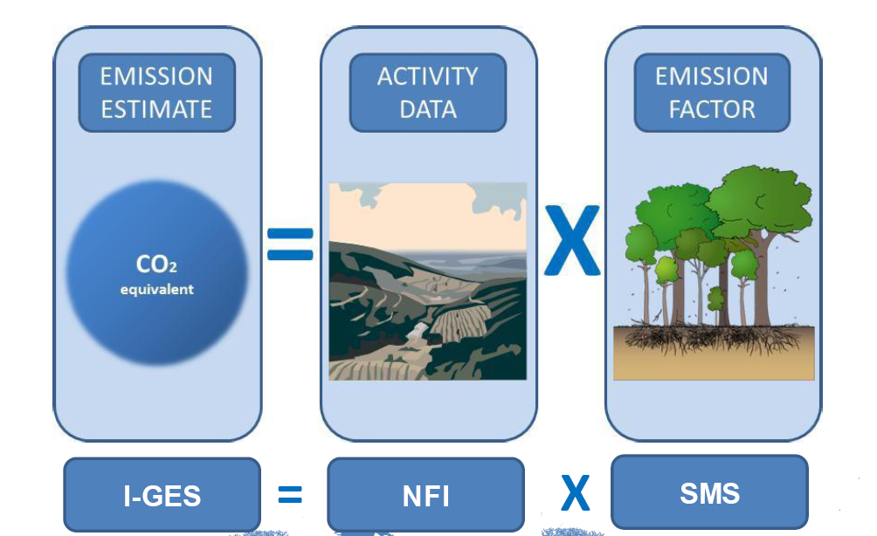
Satellite Data Sources

Slide 5
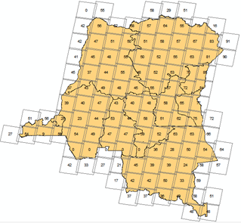
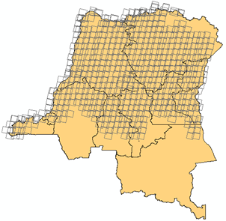
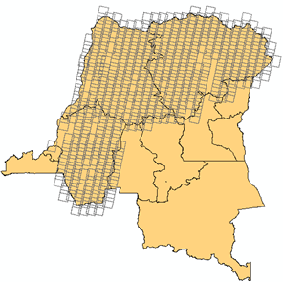
Our partners with whom we are working for several years have not waited until they were officially seized by letter from the Minister, by usual contacts they have made ​​available DIAF all satellite data held:
- The Satellite Observatory for the Forests of Central Africa (OSFAC) gave 5671 Landsat image
- The French Development Agency (AFD) through IGN gave 507 SPOT images
The gift of Japan to the DRC 223 SPOT images;
The gift of Japan to the DRC 797 Alos images
- Group on Earth Observations (GEO) 51 ALOS images

Slide 6
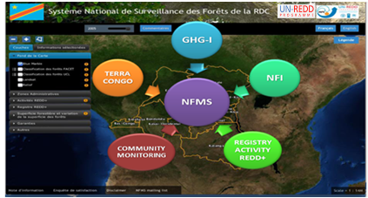
What we are doing with these images?
Spot images are distributed to organizations operating in REDD projects and Landsat in National Satellite Land Monitoring System named “TerraCongo” and National Monitoring System of Forest “NFMS” installed in Inventory and Forest Management (DIAF).

Slide 7
TERRACONGO: GENERAL PRINCIPLES:
• Be able to incorporate existing data and products Use officially-adopted forest map in image segment classification
• Involve country experts from the beginning
Experts post-process forest mask and track forest area change, using TerraAmazon
• South-South collaboration
Brazilian INPE/FUNCATE and the DRC’s Ministry of Environment, facilitated by UN-REDD
• Allow timely hand-over of technology and know-how:
Training and working with country data started from the very beginning
• Focus on open/free technologies: TerraAmazon, GeoServer, suite of Linux-based data processing tools
• Focus on freely available data: Landsat used as a basis

Slide 8
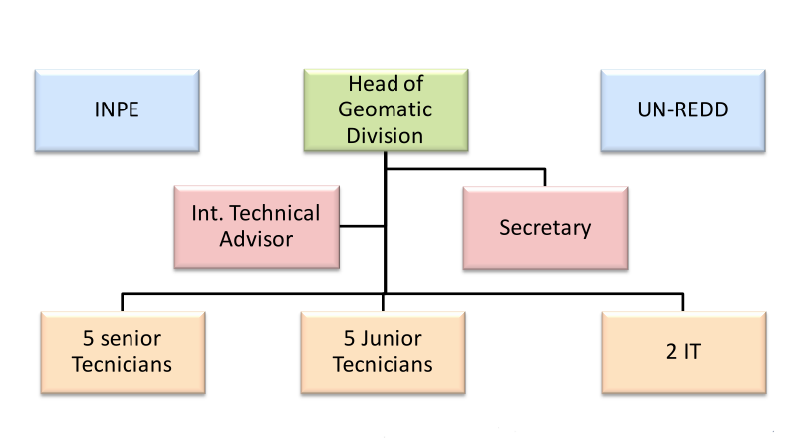
TERRACONGO TEAM

Slide 9
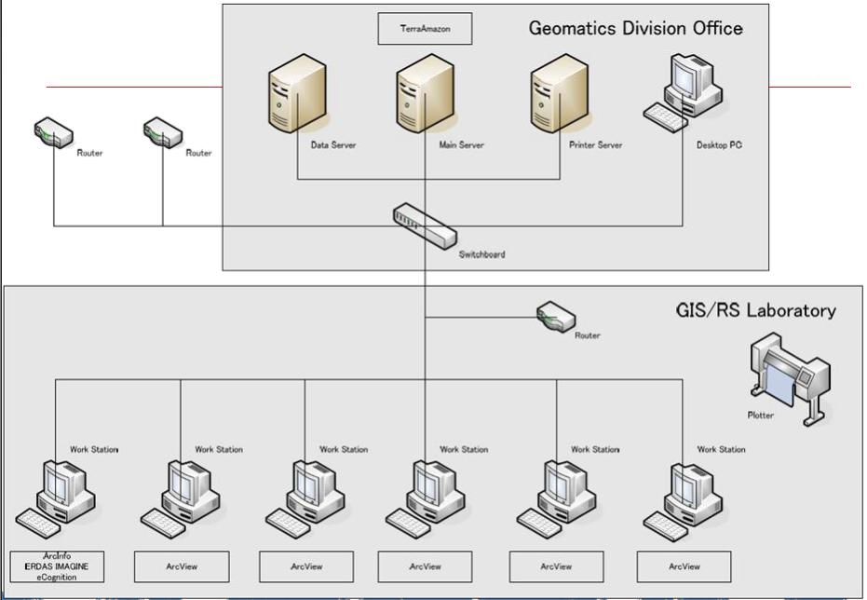

Slide 10
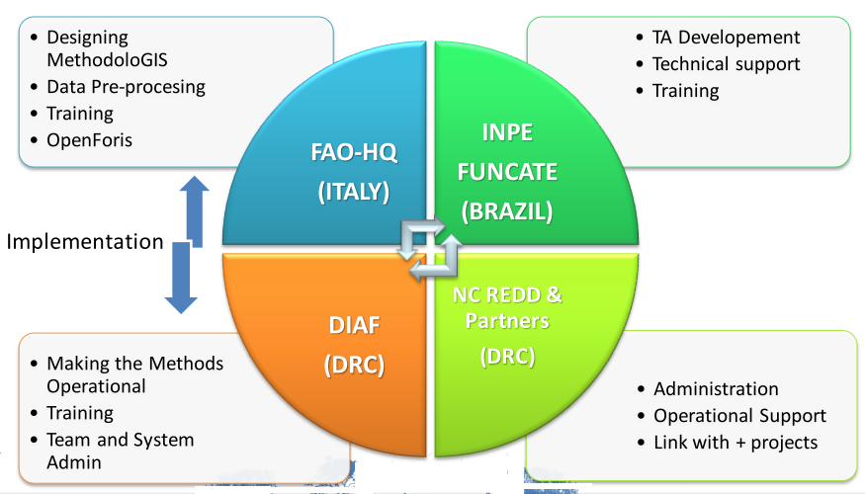
TERRACONGO WORKFLOW

Slide 11
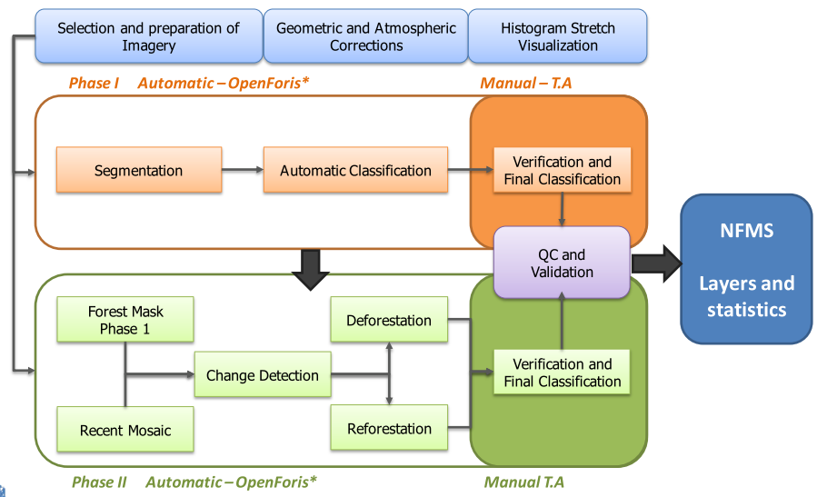
METHODOLOGY

Slide 12
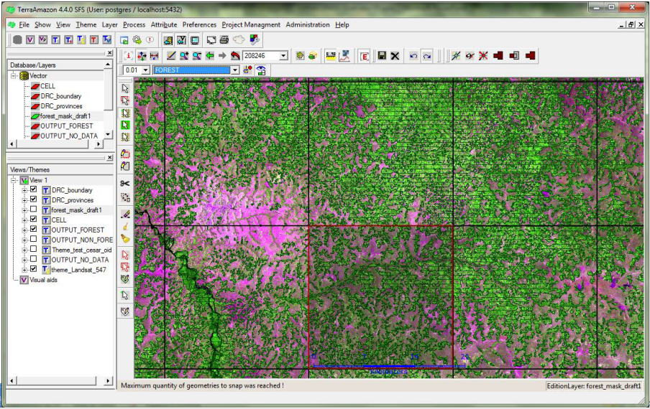
PLATTFORM TERRAMAZON

Slide 13
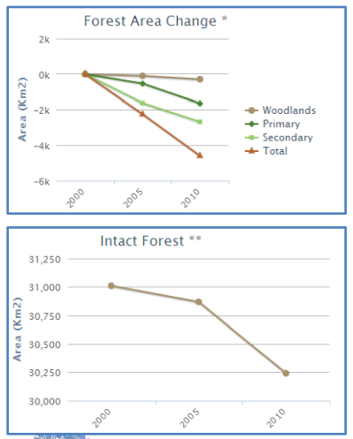
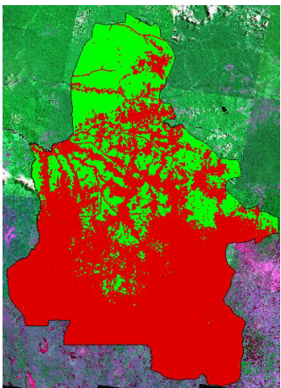
Statistics of Kasaï-Occidental Province

Slide 14
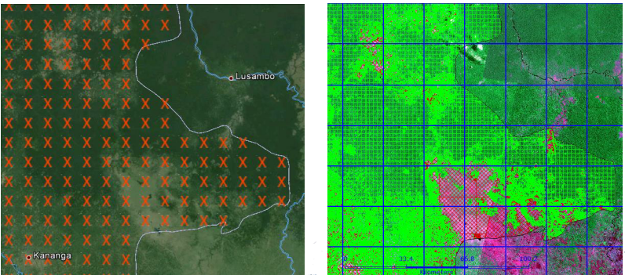
The SFMS needs to provide full coverage of the
national territory, to detect and prevent leakage
occurring from one region to the next

Slide 15
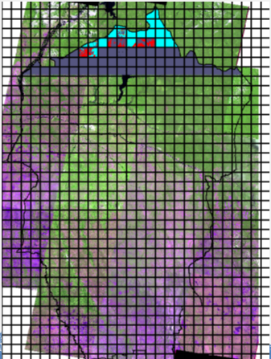
Bandundu Province The Current Project
Bandundu is classify as One of Forest Provinces of DRC, many parteners of DRC have project in: e.g: JICA through JAFTA in National Inventory, to constitute a data base of layers (Road, Village and river); WWF Germany with Lidar for Carbon Mapping.

Slide 16
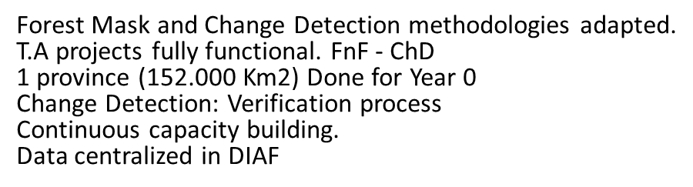
Key of Achievements

Slide 17
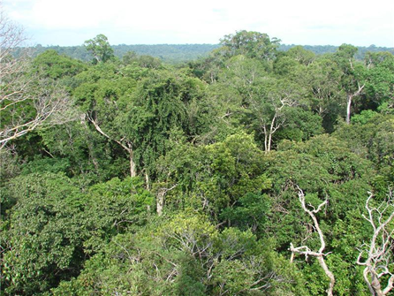
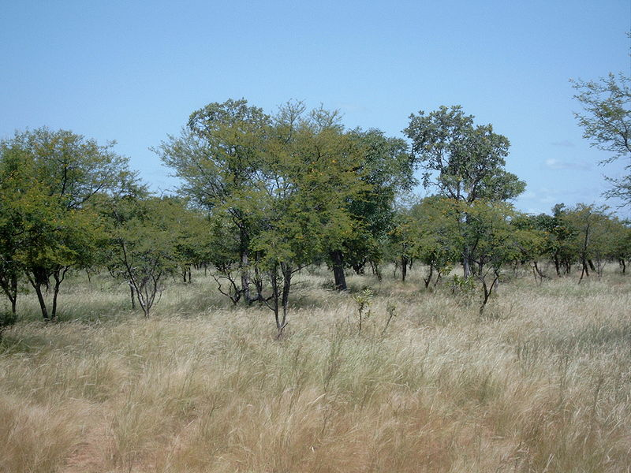
Challenge 1
TECHNICAL
Landsat classification difficult in the mosaic forest-savanna.
TerraAmazon: DB and Admin advance courses.
OpenForis: No Linux experts
Field Verification: Roads conditions
Monitoring Deforestation
Low capacities

Slide 18
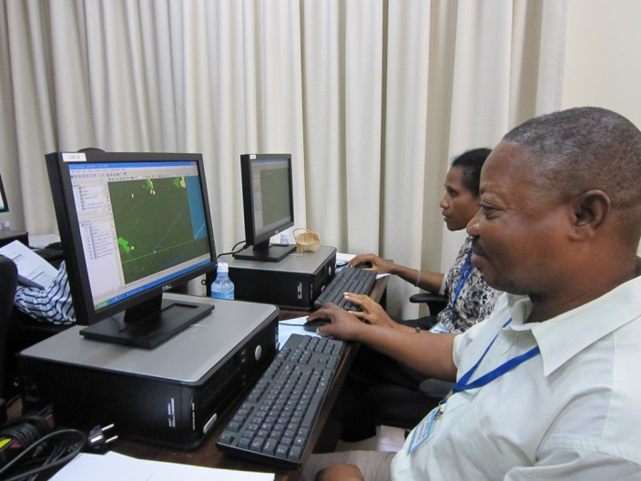
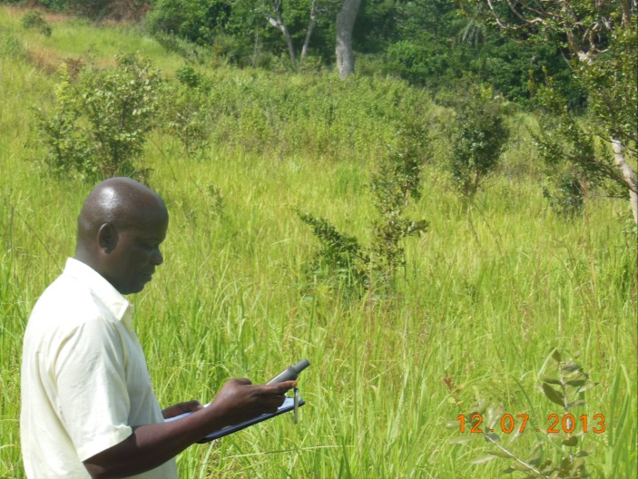
Challenge 2
OPERATIONAL
Planning budget from specific to general activities.
Preprocessing Develop in HQ.FAO Rome come later
Setup and test the system before hiring all staff
Hard relationship with some Joint projects.
Internet Connection
To get images of high resolution in order to detect forest degradation

Slide 19
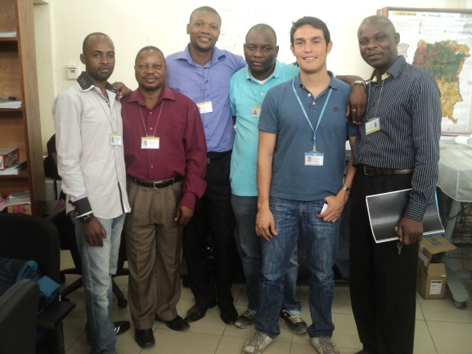
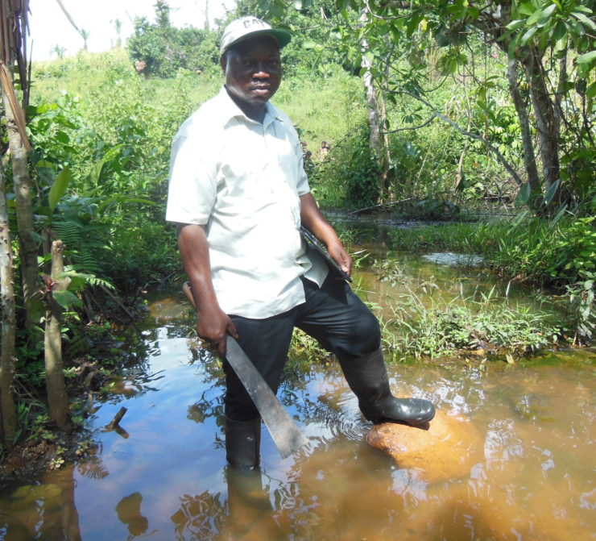
Thank you

