Slide 1
Shuttle Radar Topography Mission-2 (SRTM-2) Update
Kerry Ann Sawyer
CEOS Executive Officer
SDCG-5
ESRIN - Frascati, Italy
February 24-26, 2014

Slide 2
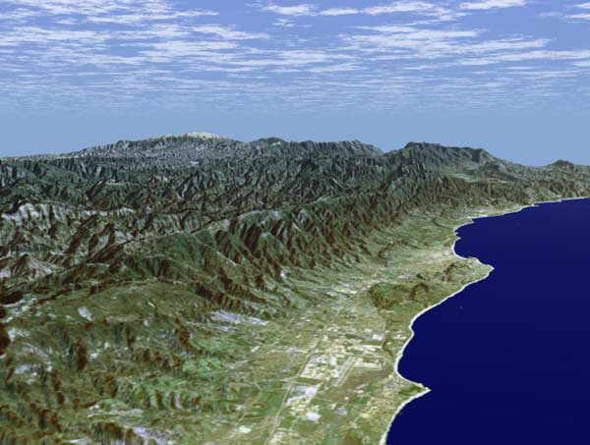
SRTM-2 Status – as of 23 February 2014
Data are under the jurisdiction of the U.S. National Geospatial-Intelligence Agency (NGA)
A consortium of U.S. agencies, led by NGA, is reviewing agency submissions to remove the LIMDIS caveat from the data. Their review is expected to conclude on 20 Mar and a determination on when/if data can be released will be made on 17 Apr – Official announcement is expected late April/early May 2014
Decision is on full and open release of SRTM-2 data for entire world.
WGCapD is shepherding the release of
data and sharing with CEOS community
and external stakeholders
Should the data be a full and open release,
it would most likely be available via the
USGS website like the SRTM-1 90m data
Santa Barbara, California, USA
Notes:
The process is longer than was previously thought but we have a better understanding of it now and we remain optimistic.
Shuttle Radar Topography Mission (SRTM) is a joint project between the National Geospatial-Intelligence Agency (NGA) and the National Aeronautics and Space Administration (NASA). The objective of this project is to produce digital topographic data for 80% of the Earth's land surface (all land areas between 60º north and 56° south latitude), with data points located every 1-arc-second (approximately 30 meters) on a latitude/longitude grid. The absolute vertical accuracy of the elevation data will be 16 meters (at 90% confidence). This radar system will gather data that will result in the most accurate and complete topographic map of the Earth's surface that has ever been assembled.

Slide 3
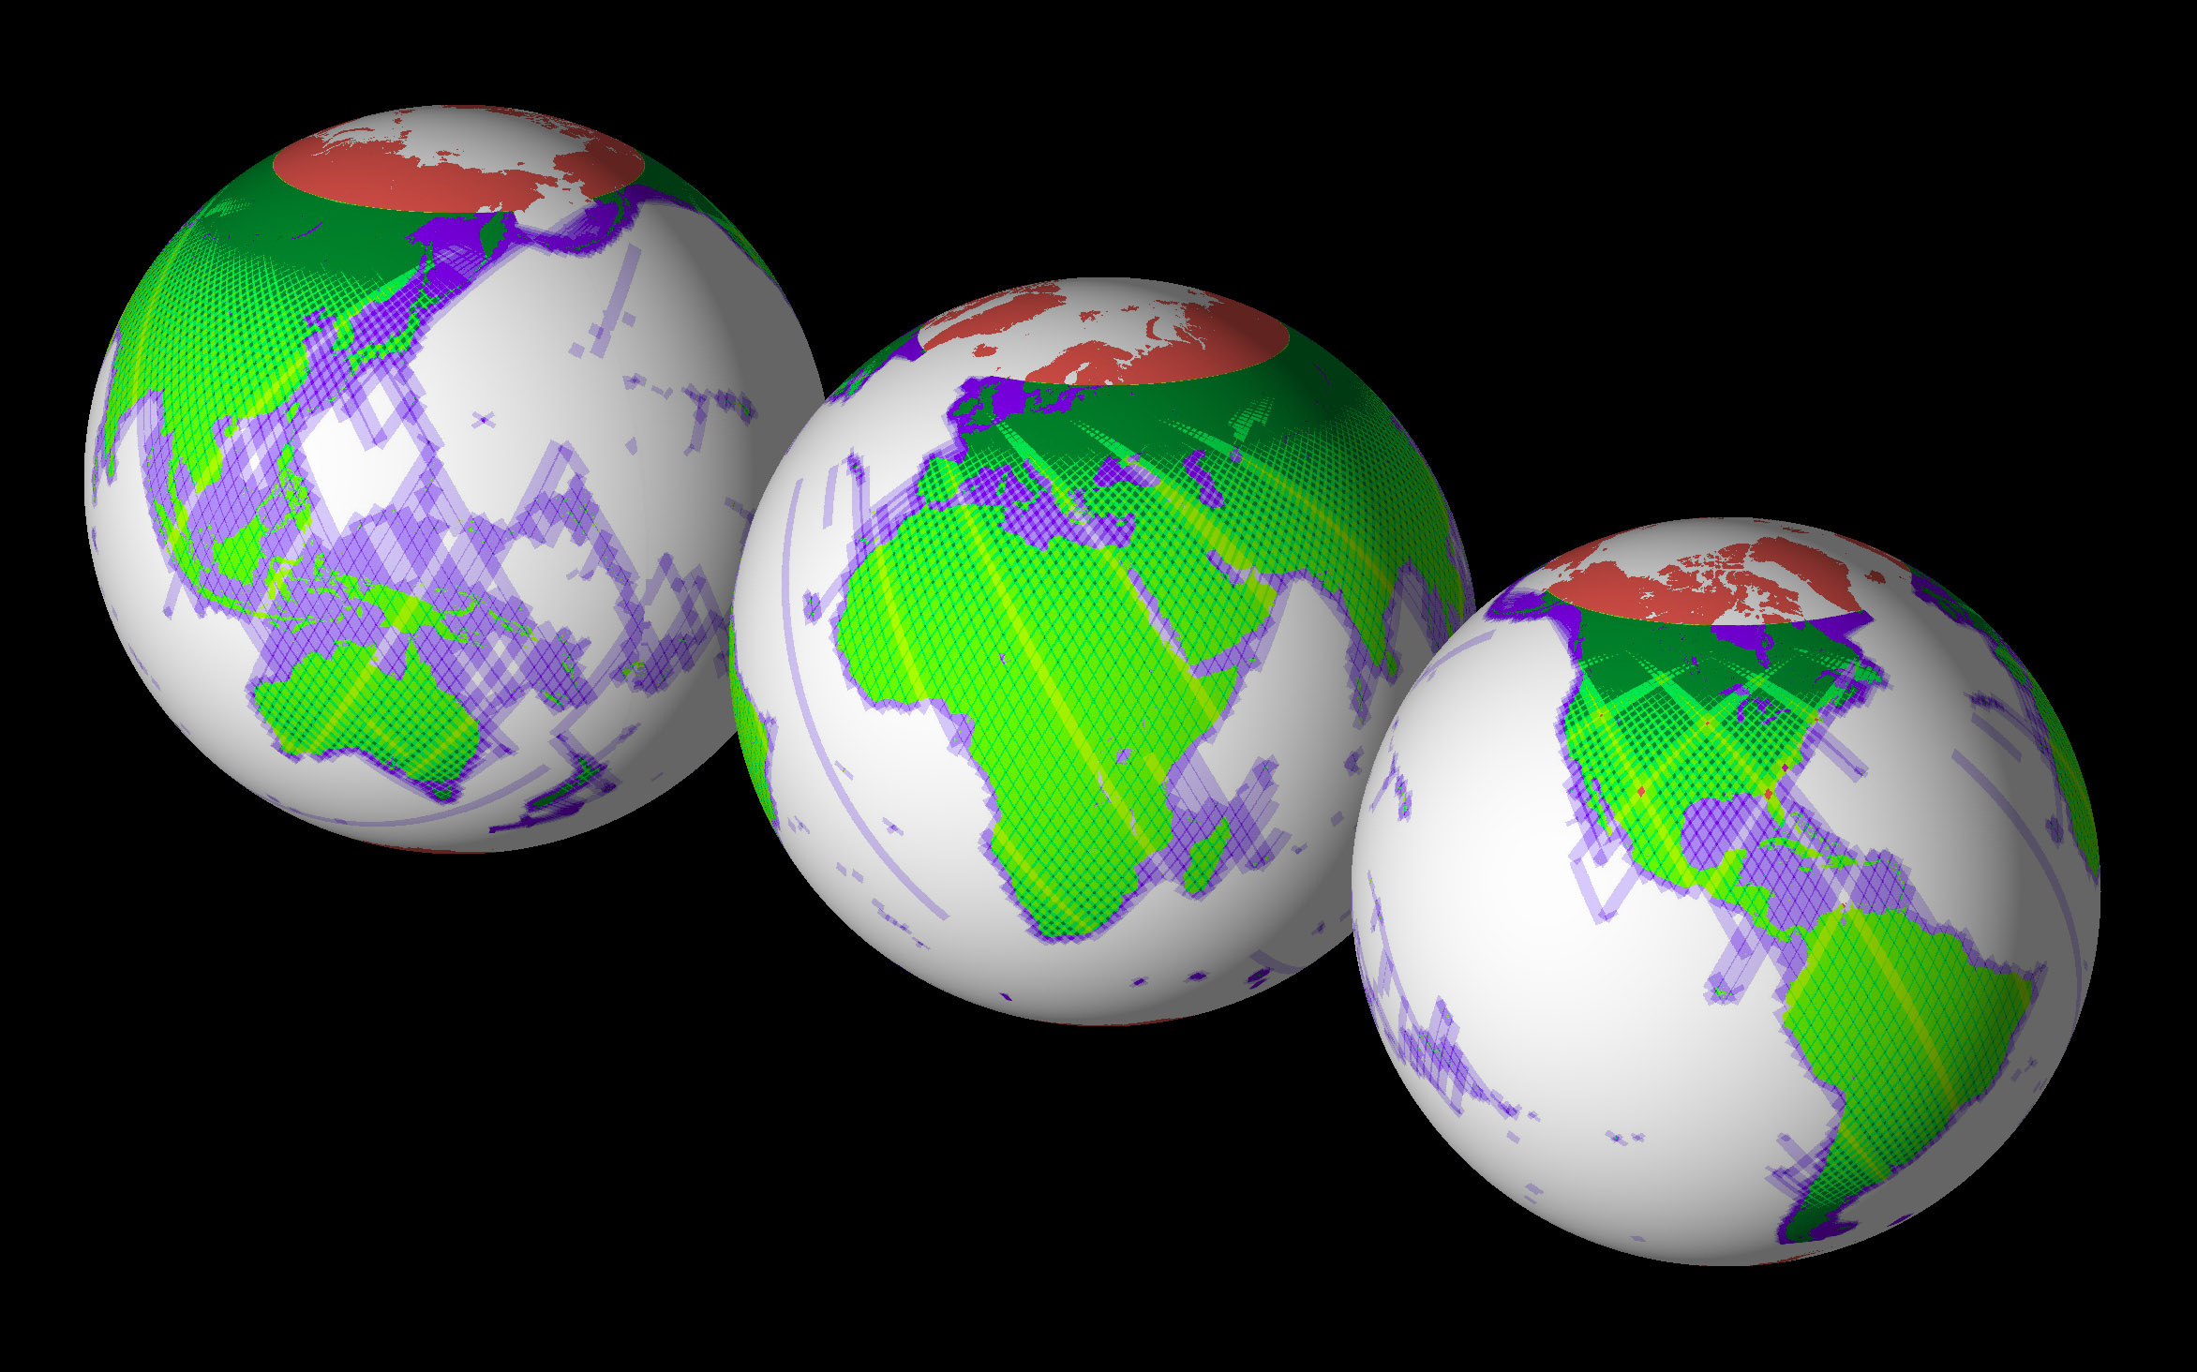
Want to publicly utilize the data to help “other governments and
researchers contribute to a better understanding of critical issues
such as climate impacts, forest and wildlife management,
environmental analysis, water resources modeling, and hazard
risk assessment.”
Notes:
SRTM has collected data over most of the land surfaces that lay between 60 degrees north latitude and 54 degrees south latitude. That's about 80% of all the land on the Earth.
In the maps below, the colors of the swaths indicate the number of times the area was imaged by SRTM. For land, one-time coverage is green, twice is yellow- green and so on, as shown in the key at lower left. Over water, the color code is in shades of blue as shown in the key at lower right. Areas in red could not be mapped. SRTM is a topography mission, so data was mostly acquired over land. Small amounts of data were collected over the water for calibration purposes.
- Information directly quoted from USGS website (srtm.usgs.gov)

