Slide 1
Session 8
Element 2 Conclusions
Chair: S Ward (Australia)

Slide 2
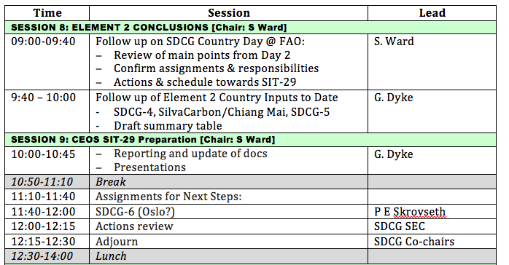

Slide 3
Session 8 objectives
Commit to quality follow up from Day 2 country discussions
Check on status of past engagements and whether maintenance is needed
Agree on steps to conclude the Space Data Services Strategy and to do the sales pitch to SIT-29 in Toulouse

Slide 4
Summary slide yesterday - Going forward
Confirm qualified points of contact with countries to establish dialogue with GFOI
Review respective presentations and trade questions and clarifications (on national needs, on what GFOI is/is not)
Request confirmation of national priorities and relevance to proposed Space Data Services
Some specific actions identified to address current national activities (eg SPOT archive data for Uganda) – others may emerge
Proceed to pilot most relevant of Services with countries via national points of contact

Slide 5
Some direct questions
Is there evidence that FAO/UN-REDD and WB/FCPF are taking steps to integrate GFOI deliverables (MGD and Space Data) into their in-country activities and programmes?
What concrete steps and what schedule?
Ask the Leads to confirm that our service model, based on their direction, is credible based on cooperation of FAO and WB?
Did the discussions on the SDSM get resolved in line with objectives of GFOI – serving needs of FAO, Norway, CEOS?

Slide 6
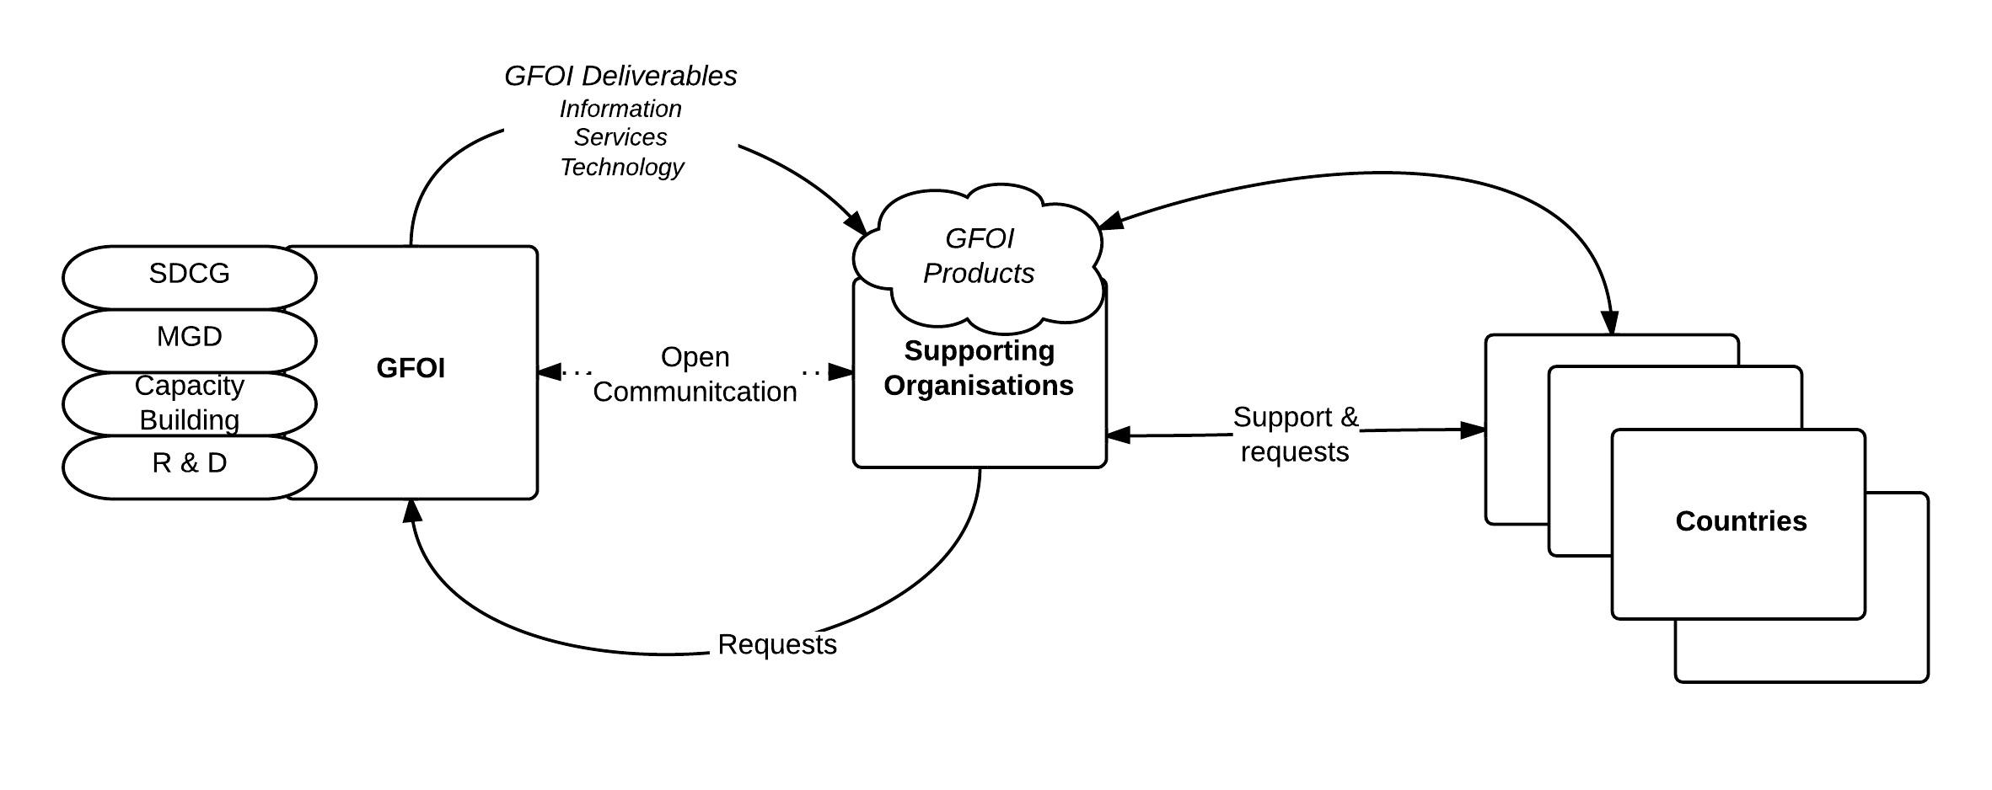

Slide 7
Session 8
Follow up of Element 2 Country Inputs to Date
G Dyke (Australia)

