Slide 1
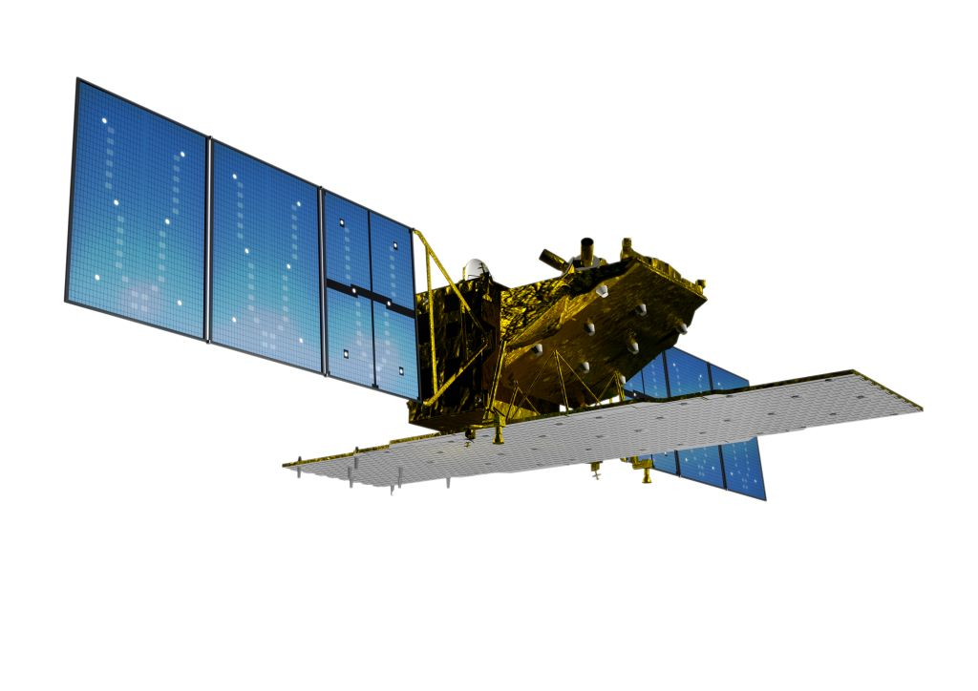
ALOS-2 Mission Status and
Basic Observation Scenario (BOS)
+ relevance for Ag Masanobu Shimada, Shin-ichi Sobue, Shinichi Suzuki, Fumi Ohgushi,
Hiroki Nishi, Kaoru Tsuzuku, Tomohiro Watanabe, Ake Rosenqvist
GFOI SDCG#5
Frascati, Italy, Feb 24-26, 2014

Slide 2
ALOS-2 Mission Status .
On Feb 19, 2014, ALOS-2 received formal "GO" for launch
ALOS-2 scheduled for launch in 2014
A global systematic acquisition strategy (“Basic Observation Scenario” – BOS) has been developed
The ALOS-2 BOS will provide continuity of acquisitions with the acquisition strategy of ALOS (2006-2011), but with enhanced image characteristics (spatial resolution, polarisations, radiometric sensitivity).
The ALOS-2 Data Policy will remain the same as ALOS, but with lower prices.
Notes:
Increase prio 1 polygon from N60 to N70 deg

Slide 3
ALOS-2 Specifications .
ALOS-2
ALOS-2 satellite
Launch : 2014
Orbit type : Sun-synchronous
Altitude : 628 km +/- 500 m (for reference orbit)
Revisit time : 14 days
LSDN : 12:00 +/- 15 min
PALSAR-2
L-band Synthetic Aperture Radar
Active Phased Array Antenna type
two dimensions scan (range and azimuth)
Antenna size : 3m(El) x 10m(Az)
Bandwidth : 14 – 84MHz
Peak transmit Power : 5100W
Observation swath : 25 – 490km
Resolution : Range: 3 m to 100 m
Azimuth: 1 m to 100 m
X
Solar paddles
Y
Z
SAR antenna
Notes:
Increase prio 1 polygon from N60 to N70 deg

Slide 4
ALOS-2 Specifications .
 |  |  | Spotlight | Ultra Fine | High sensitive | Fine | ScanSAR nominal |  | ScanSAR wide
Bandwidth |  |  | 84MHz | 84MHz | 42MHz | 28MHz | 14MHz | 28MHz | 14MHz
Resolution |  |  | Rg×Az： 3×1m | 3m | 6m | 10m | 100m |  | 60m
Swath |  |  | Rg×Az： 25×25km | 50km | 50km | 70km | 350km (5-scan) |  | 490km (7-scan)
Polarization |  |  | SP | SP/DP | SP/DP/FP/CP |  | SP/DP
NESZ |  |  | -24dB | -24dB | -28dB | -26dB | -26dB | -23dB | -23dB
S/A | Rg |  | 25dB | 25dB | 23dB | 25dB | 25dB |  | 20dB
 | Az |  | 20dB | 25dB | 20dB | 23dB | 20dB |  | 20dB
SP : HH or VV or HV , DP : HH+HV or VV+VH , FP : HH+HV+VH+VV , CP : Compact pol (Experimental mode)
Main applications:
Fine beam (DP): Forest and land cover monitoring
ScanSAR (DP): Rapid deforestation / wetlands / InSAR (ScanSAR-ScanSAR)
Spotlight (SP): Emergency observations
Ultra Fine (SP) : Global map, InSAR base mapping
High sensitive (QP): Global map
ScanSAR wide (SP) : Polar ice
Notes:
Increase prio 1 polygon from N60 to N70 deg

Slide 5
ALOS-2 Observation plan (BOS)
of relevance for Agriculture
(as of February 2014)

Slide 6
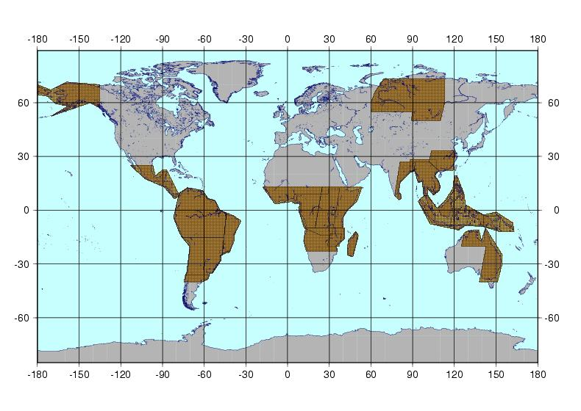
ScanSAR regular monitoring: Pan-tropical (incl Asia-RiCE)
Temporal repeat: 9 cov/year
GSD: 100 m (off-nadir 26.2°-41.8°)
Mode: ScanSAR 350km Dual-pol (HH+HV)
Notes:
Wetlands and rapid deforestation monitoring needs more frequent covering with ScanSAR dual polarization.

Slide 7
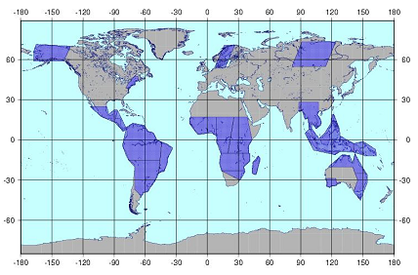
Forest monitoring: Pan-tropical (incl Asia-RiCE)
Temporal repeat: 6 cov/year
GSD: 10 m (off-nadir 28.2°-36.2°)
Mode: Stripmap Dual-pol (HH+HV/28MHz)
Notes:
Forest monitoring needs frequent covering with 10m resolution with dual polarizarion.

Slide 8
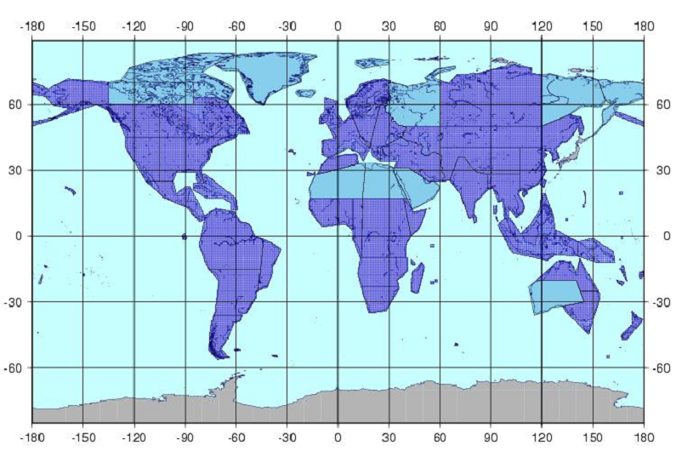
Global baseline: certain additional Ag coverage
Temporal repeat: 2 cov/year
GSD: 10 m (off-nadir 28.2°-36.2°)
Mode: Stripmap Dual-pol (HH+HV/28MHz)
Prio 1
Prio 2
Notes:
Following pages show target area, frequency and imaging mode for each applications .
Baseline mapping is common observation including deformation and forest monitoring.

Slide 9
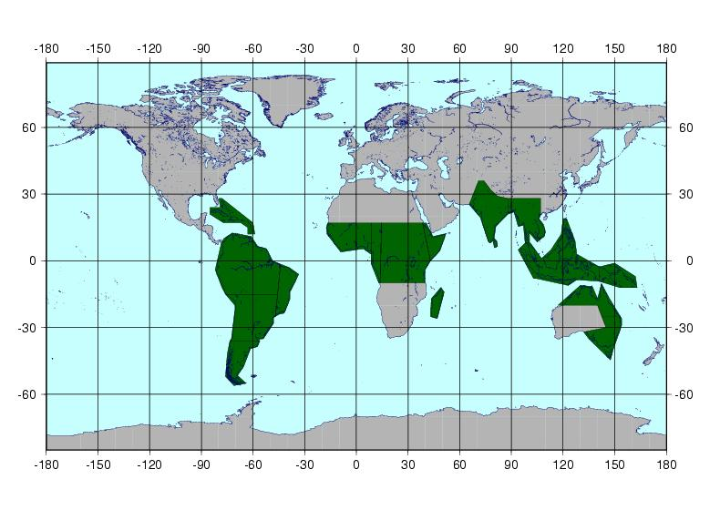
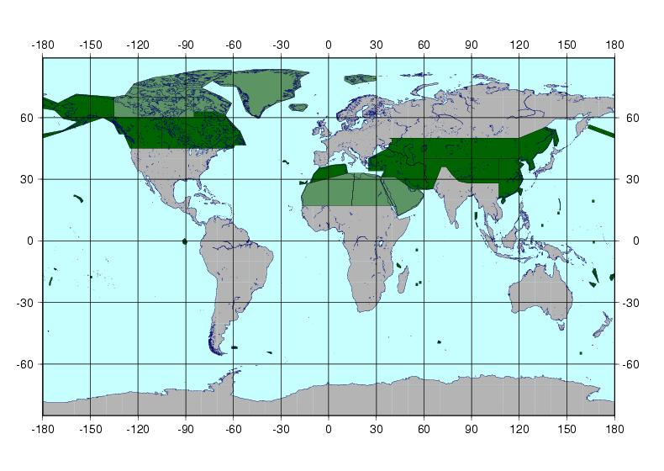
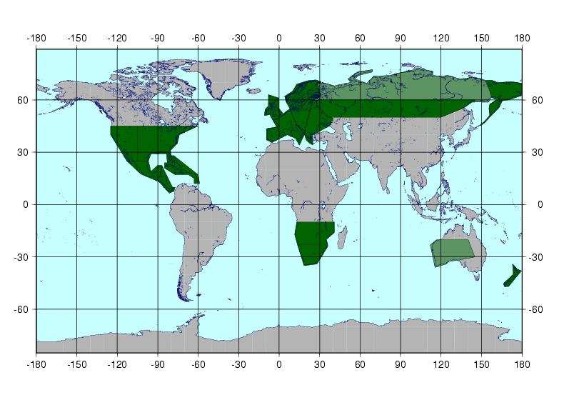
Global land areas – VHR baseline mapping
Temporal repeat: 1 cov/ 3 years
GSD: 3 m (off-nadir 29.1°-38.2°)
Mode: Stripmap Single-pol （HH/84MHz）
1st year
2nd year
3rd year
Prio 1
Prio 2
* 3 years required for global coverage in 3m mode
Notes:
Very High Resolution Mapping with 3m resolution covers global areas for every three years.

Slide 10
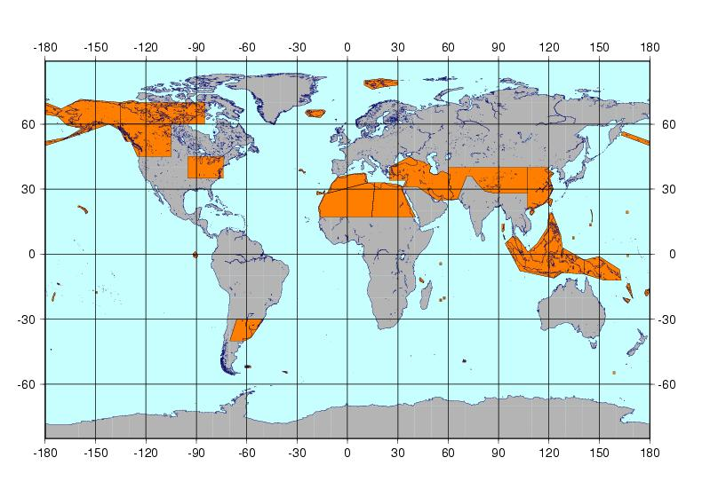
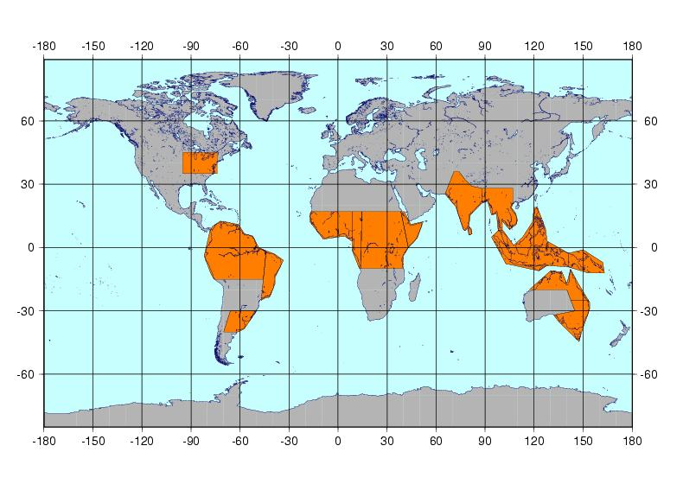
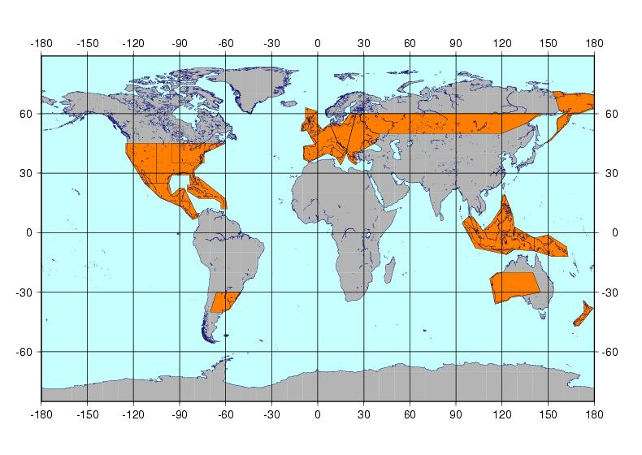
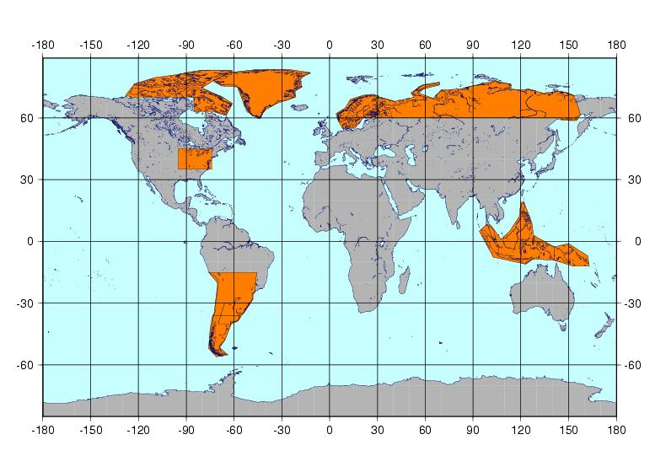
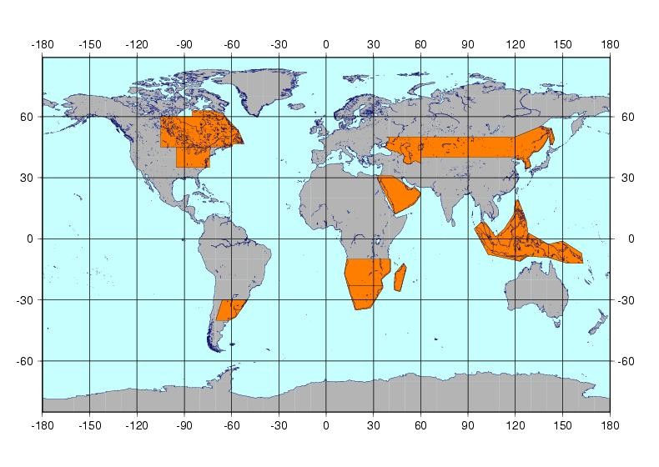
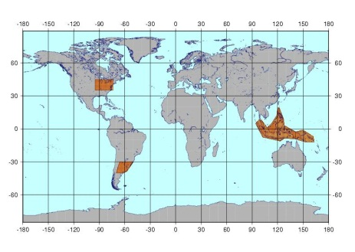
Global Quad-pol baseline: Asia-RiCE & Pampas annually
Temporal repeat: 1 cov/ 5 years
GSD: 6 m (off-nadir 25.0°-34.9°)
Mode: Stripmap Quad-pol (HH+HV+VV+VH)
1st year
2nd year
3rd year
4th year
5th year
Areas observed every year
* 5 years required for global coverage in 6m QP mode
Notes:
Quad polarimetry with 6m resolution covers global areas for 5 years.

Slide 11
Observation pattern for annual acquisitions*
Super sites （TBD)
11
* 3m SP and 6m QP modes require 3 and 5 years for global coverage

Slide 12
SUMMARY – PALSAR-2 obs of relevance for Ag
Pan-tropical, incl. Asia-RiCE regions
ScanSAR (100 m HH+HV) 9 times/year (every 42 days)
Desc: Jan + Feb + Mar/Apr + May + Jun + Jul + Aug/Sep
+ Oct + Nov
Fine Beam (10 m HH+HV) 6 times/year
Asc: Jan/Feb + Jun/Jul + Aug/Sep + Nov/Dec
Desc: March-June (14-day InSAR pair)
Quad-pol (6 m QP) 1 time/year
Asc: March-May window

Slide 13
Grazie ありがとう。
GFOI SDCG#5
Frascati, Italy, Feb 24-26, 2014

