Slide 1
GEOGLAM Status update Objectives of GEOGLAM Co-Community meeting and implementation summary to date
Michel Deshayes
Co-session GFOI-GEOGLAM, 26th February 2014
ESA/ESRIN, Frascatti, Italy

Slide 2
GEOGLAM Structure & Work plan
GEOGLAM Steering Committee
Including G20 Donor representation, program stakeholders
Program Coordination office
+ Secretariat
Implementation Group
consisting of Implementation Team leads
Global / Regional System of Systems
main producer countries, main commodities
2. National capacity development
for agricultural monitoring using EO
3. Monitoring countries at risk
food security assessment
4. EO data coordination (w. CEOS)
5. Method improvement through R&D coordination (e.g. JECAM)
6. Data products and information dissemination
Tasks
Tasks
Tasks
2 / 9

Slide 3
Co-community meeting Objectives
Assessment of GEOGLAM Phase 1 (2012-2014)
Main producers – Wheat, Maize, Soya, Rice (C#1)
Research & development (JECAM, C#5)
Countries at risk (C#3) - Capacity building (C#2)
EO Data coordination - CEOS (C#4)
Planning of GEOGLAM Phase 2 (2014-2016)
Countries at risk (C#3) - Capacity building (C#2)
Research & development (JECAM, C#5)
Main producers – Wheat, Maize, Soya, Rice (C#1)
EO Data coordination - CEOS (C#4)

Slide 4
Implementation summary
C#1 – GEOGLAM Crop Monitor
Monthly delivery to AMIS
C#5 – GEOGLAM R&D – JECAM
JECAM = Joint Experiments for Crop Assessments and Monitoring
A network of test-sites with in-situ measurements, to address the diversity of farming systems
C#4 – EO data coordination (CEOS)
Governance : Implementation Plan (Jul. 2013)

Slide 5
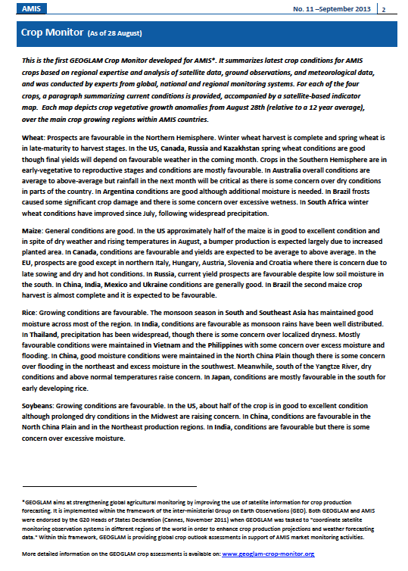
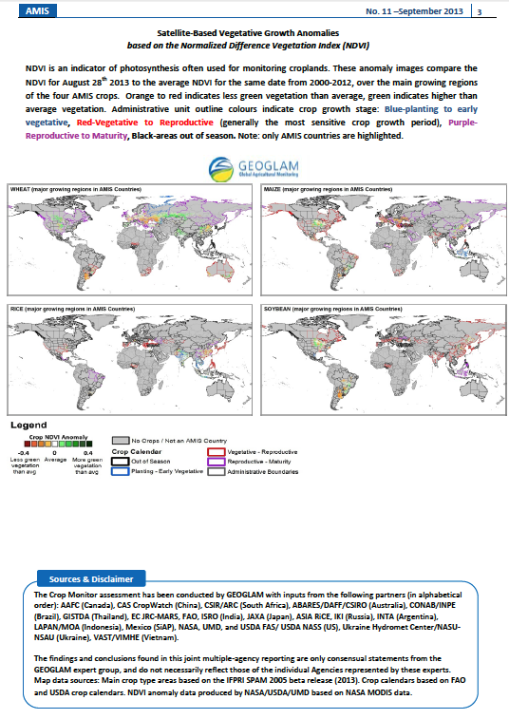
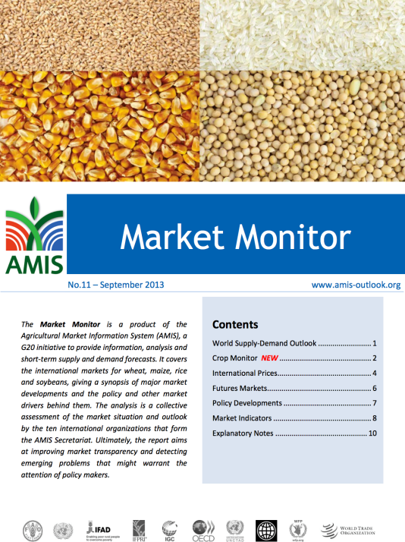
GEOGLAM C#1 - Crop Monitor Current Status
June-July 2013: Prototyped crop outlooks for review by AMIS
Sept. 2013: Started provision of routine Crop Monitor to AMIS
Since Sept. 2013: Regular monthly reporting and refining tools and processes for information collection, maps and synthesis
5/9

Slide 6
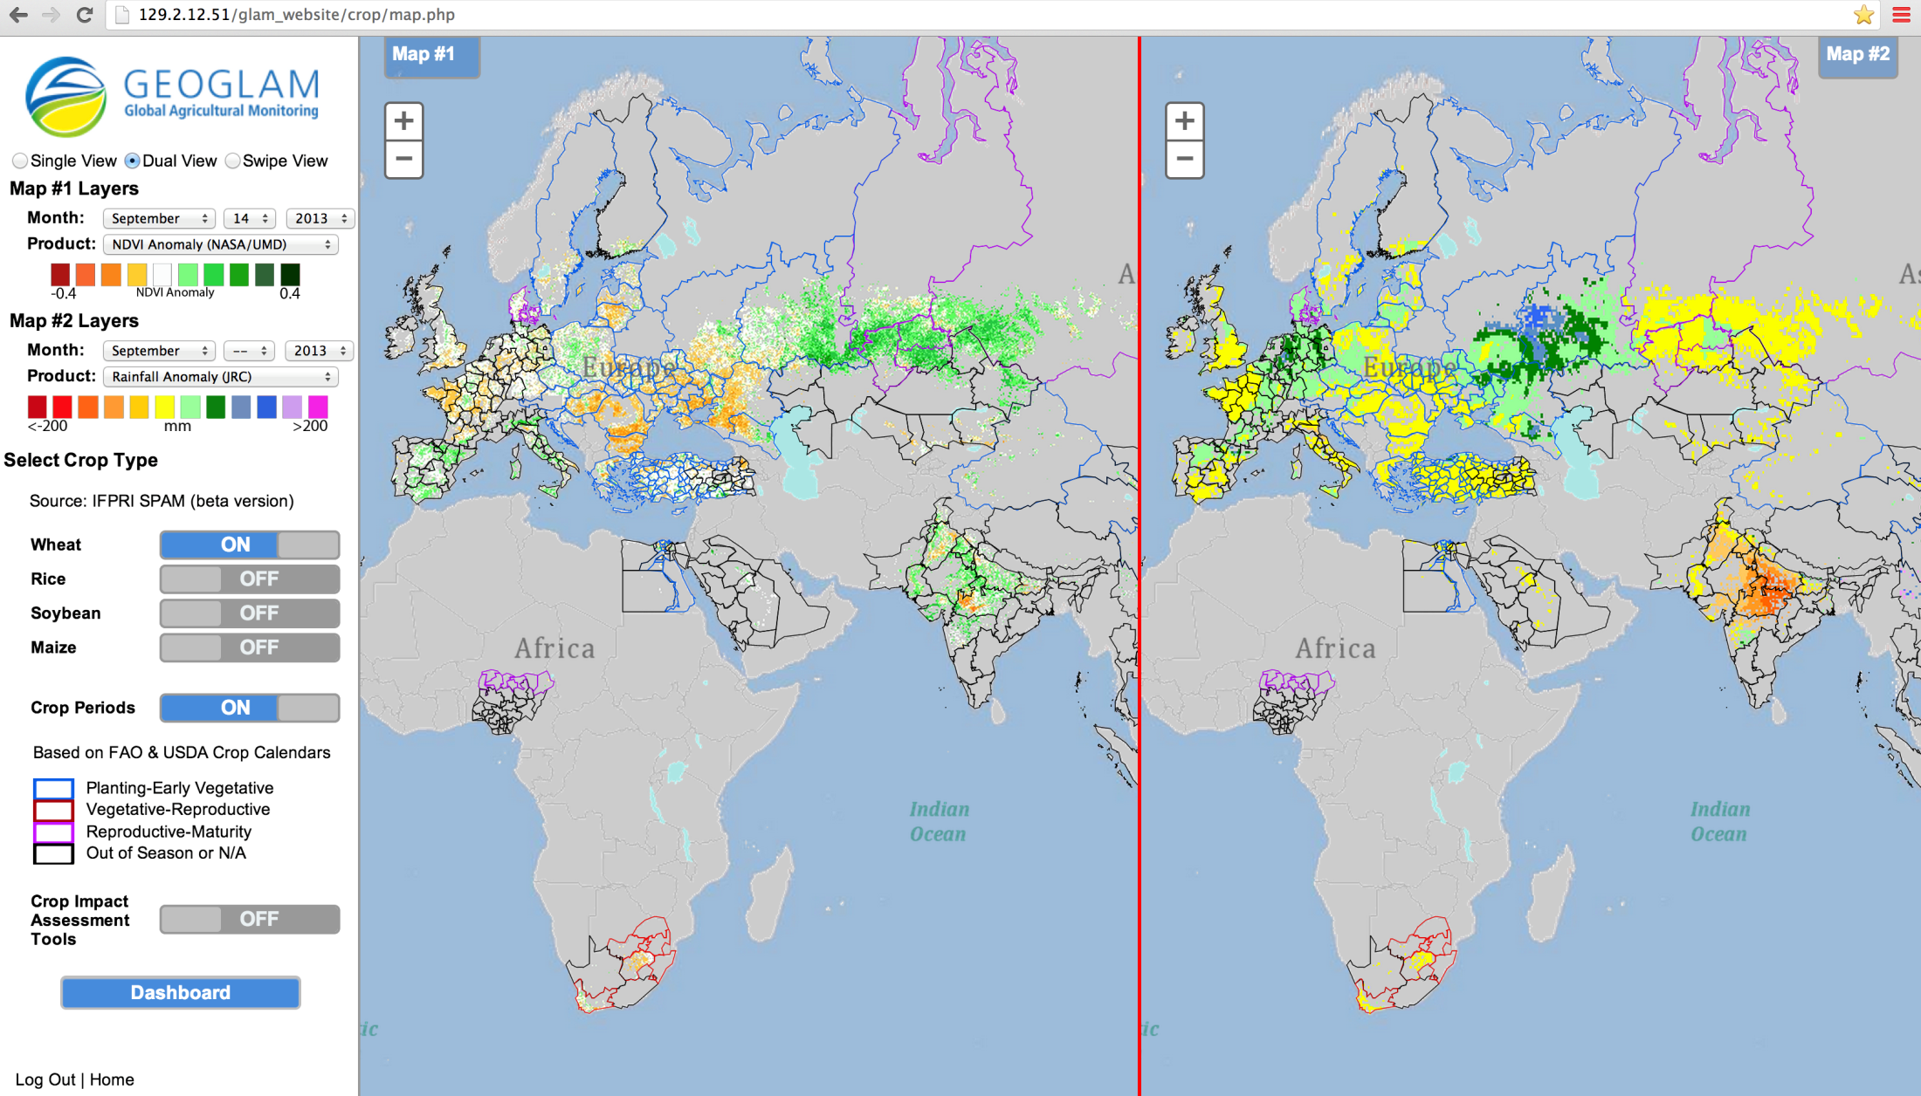
GEOGLAM C#1 - Crop Monitor Interface
Enables comparison among relevant datasets (global, regional and national), by crop type and accounting for crop calendars; enables crop condition labeling and commenting to reflect national expert assessments
6/9
Notes:
I would add to the top of the list the Crop Monitor- saying it is operational and provided to AMIS
You could also change the order, so first show the list of accomplishments with the crop monitor as one, and then give the example after
6

Slide 7
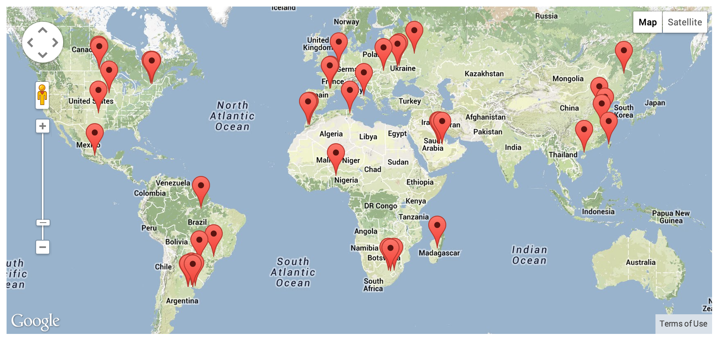
GEOGLAM C#5 R&D – JECAM Joint Experiments for Crop Assessments and Monitoring
A network of sites representative of the world’s cropping systems
A focus for international satellite data acquisition by CEOS
R&D to support enhancements for operational agricultural monitoring systems
JECAM Program Office coordinated by AAFC-Canada and UCL-Belgium
Developing linkages with AgMIP sites and modeling community
www.jecam.org
Notes:
7

Slide 8
GEOGLAM C#2 - Capacity Building Ex : Pakistan Agricultural Information System (Collaboration among CRS, FAO, SUPARCO, UMD & USDA)
Crop type classification
Crop condition
EO Estimated vs Reported Wheat Production
Yield Forecasting
8/9

Slide 9
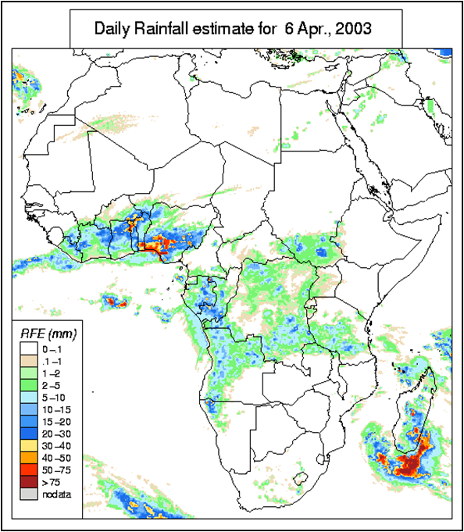
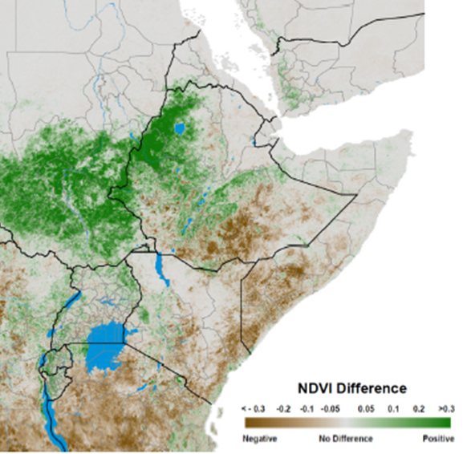
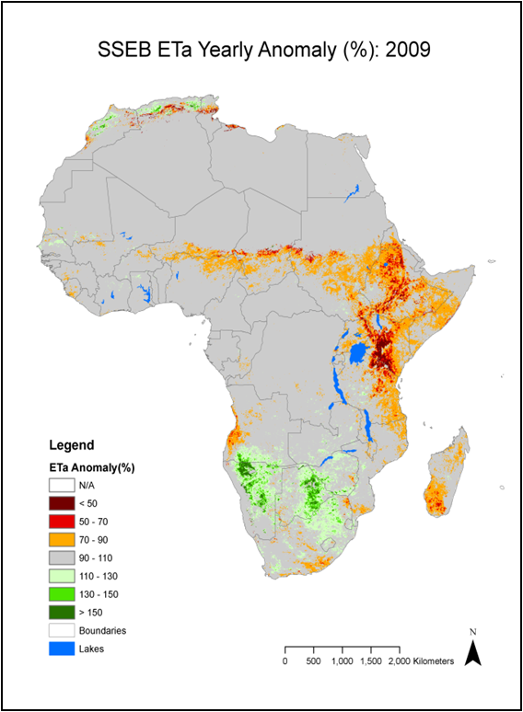
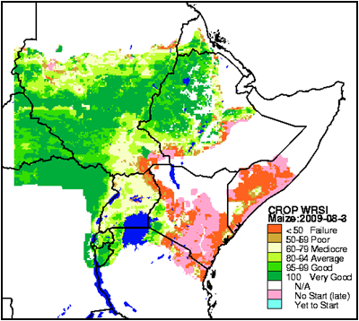
GEOGLAM C#3 – Countries at Risk Satellite Information for Crop Monitoring (ex. FEWS-Net)
Satellite Vegetation Index (NDVI) Difference 2009
Evapotranspiration Yearly Anomaly 2009
Water Requirement Satisfaction Index 2009
9/9

