Slide 1
Confirmation of 2015 Task Focus SDCG-6 Session 3, Item #16
G. Dyke
SDCG SEC

Slide 2
Baseline Global Acquisitions

Slide 3
Baseline Global Acquisitions
What USGS and ESA should be doing in 2015:
Building baseline coverage capacity (i.e. LS-7/LS-8, S-1A, S-2A)
Study of data flows across baseline missions
Mission acquisition strategy inputs (in particular S-1A and S-2A)
Bringing CBERS-4 on stream
Refinement of data product delivery

Slide 4
Space Data Services

Slide 5
Space Data Services
What the SEO should be doing in 2015:
Developing relationships and interfaces with FAO and with the MGD
Developing relationship with SilvaCarbon, and confirming strategic and tactical alignment
Development of archive characterisation and data discovery tools

Slide 6
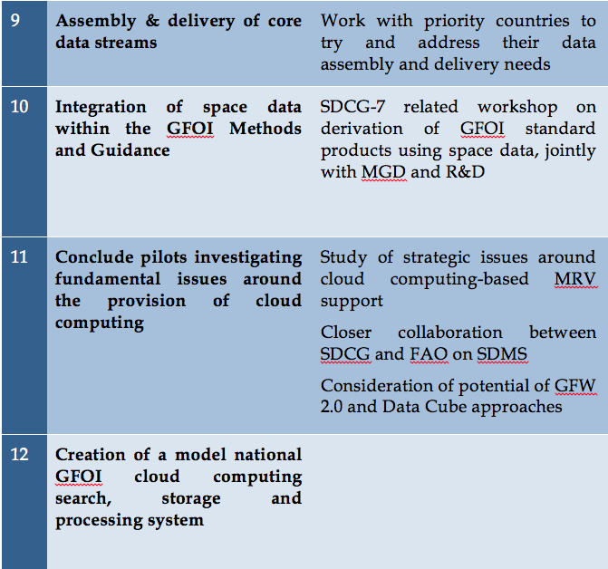
Space Data Services Continued

Slide 7
Space Data Services
What the SEO should be doing in 2015:
Data stream assembly for priority countries
Further integration with interactive MGD
Study and development of cloud computing strategy – continuing pilot implementation

Slide 8
R&D

Slide 9
R&D
What the Ake? should be doing in 2015:
Completion of the R&D Strategy (Element 3) and presentation for endorsement at SIT-30
Alignment of SCDG R&D acquisitions with the GFOI R&D plan, in support of MGD
Dedicated acquisition of key sites

Slide 10
GFOI Components and Countries

Slide 11
GFOI Components and Countries
What we should be doing in 2015:
Work with all GFOI components and other parties (e.g. FAO) to create a coherent plan, and cohesive structures which builds on the relative strengths and weaknesses of all actors
Improved visibility for space data providers into user needs and relationships in order to optimise service provision – user relationship should not end at the database

Slide 12
2015 Task Priorities
Any other tasks not covered that should be a priority for 2015?

