Slide 1
Baseline Strategy Update for SIT-30 SDCG-6 Session 6: Baseline Strategy Update Element-1 Strategy
Ake Rosenqvist, Gene Fosnight, Frank Martin Seifert

Slide 2
Global Baseline Acquisition Strategy for GFOI (Element 1)
Element 1 tasks to complete for SIT-30
Element 1 2015 Strategy update and 2014 Implementation report
Combined update as annex to 2014 Strategy Report
Notes:
Busy agenda for coming years and are trying to figure out how to manage the demands on us by creating a 3-year plan that manages expectations of governments approaching GFOI

Slide 3
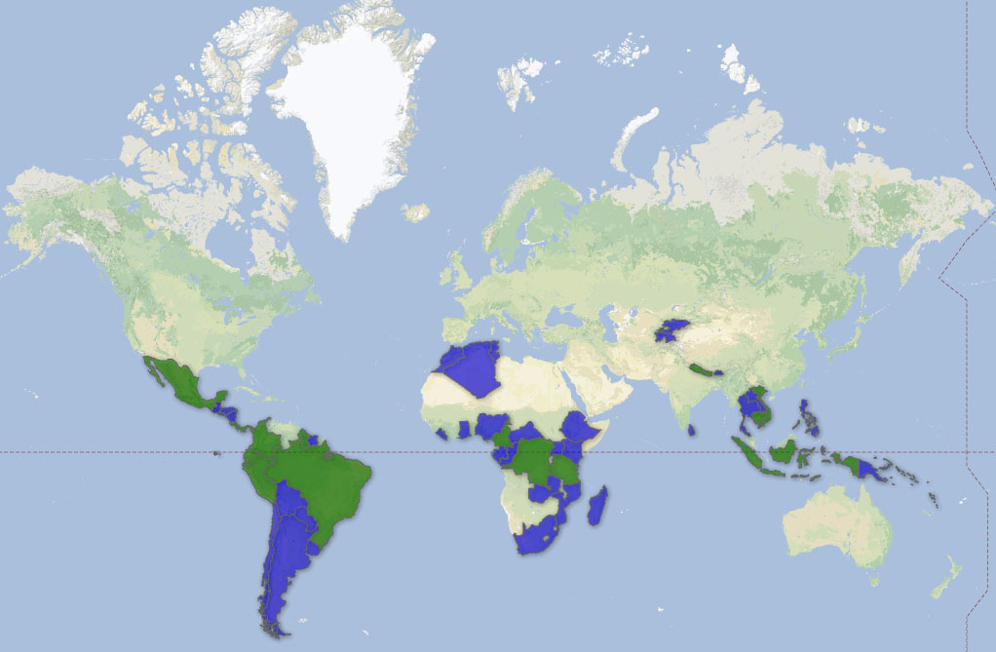
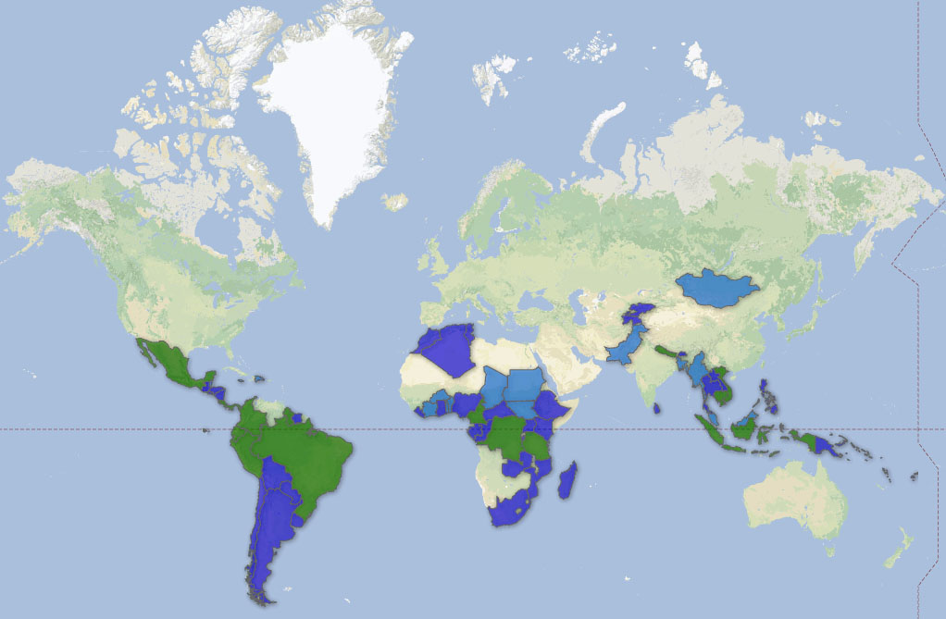
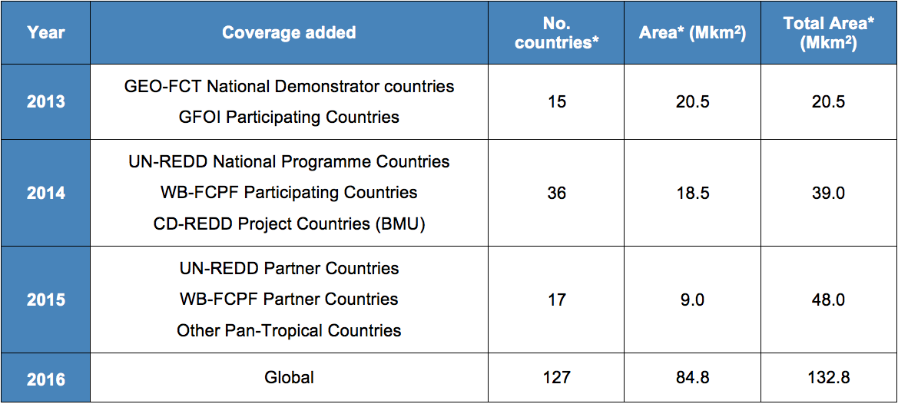
Outlook for 2015 IP
Add 17 additional counties in 2015
Min. requirement: at least one cloud-free annual optical coverage/country
2015 transition year to full global coverage in 2016
Build toward full integration of Space Data Services and Methods and Guidance workshops
2014
2015

Slide 4
Update to Element 1: Baseline Strategy Report
Implementation report for 2014
Update 2015 Strategy Report
Transition to global coverage building on Space Data Services
Assume near global coverage by Landsat and Sentinel-2
Enhance Sentinel-1 tasking and acquisition
Moderate resolution compliment as annex

Slide 5
Outlook for 2015 IP
Mission Status – Core missions
Landsat:
Landsat 7/8 the primary Core Mission in operation for 2014-2015
Sentinel-1:
Sentinel-1A: Limited operations in support of GFOI in 2014-2015
Operational mode in April 2015
Not directly complementary to optical
Sentinel-2:
Sentinel-2A launch in April 2015. Expected limited operations for GFOI in 2015.

Slide 6
Outlook for 2015 IP
Mission Status – Core missions
CBERS-4:
Launch date 4 December 2014!
CBERS-4a follow-on to be released within three years
ResourceSat-2 will be available for Amazon region
RapidEye:
In operation

Slide 7
Outlook for 2015 IP
Mission Status – Contributing missions
SPOT:
SPOT-4 de-orbited, SPOT-5 scheduled to begin de-orbit end of 2014.
CNES’s ISIS program supports sharing of Pléiades and SPOT 1-5 data to registered science users.
SPOT 1-5 archive data over GFOI R&D sites (processing is a cost) through SPOT World Heritage programme

Slide 8
Outlook for 2015 IP
Mission Status – Contributing missions
ALOS-2:
ALOS-2 was launched on 24 May 2014
ALOS-2 to be declared operational around November 25, 2014
Commercial
ALOS-1 and -2 25m (Nov 2014) and 50m mosaic data publicly available
Provision of ALOS-1 and -2 data to endorsed GFOI R&D activities

Slide 9
Outlook for 2015 IP
Mission Status – Contributing missions
RADARSAT-2:
In operation
Provision of data to endorsed GFOI R&D activities
RADARSAT Constellation Mission:
Launch foreseen...
Current plan is for free and open access

Slide 10
Outlook for 2015 IP
Mission Status – Contributing missions
COSMO-SkyMed:
In operation
Potential provision of data to endorsed GFOI R&D activities
TerraSAR-X (2007) and TanDEM-X (2010):
In operation
Provision of TerraSAR-X data to endorsed GFOI R&D activities
Limited TanDEM-X bistatic acquisitions are possible
DEM (Dec 1015) and biostatistic
SAOCOM:
In operation

Slide 11
Deliverables for SIT-30
Slide to be updated based on session 1 agency presentations
Action items:
.....

