Slide 1
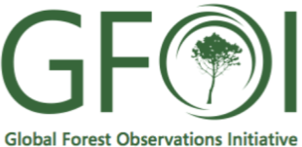
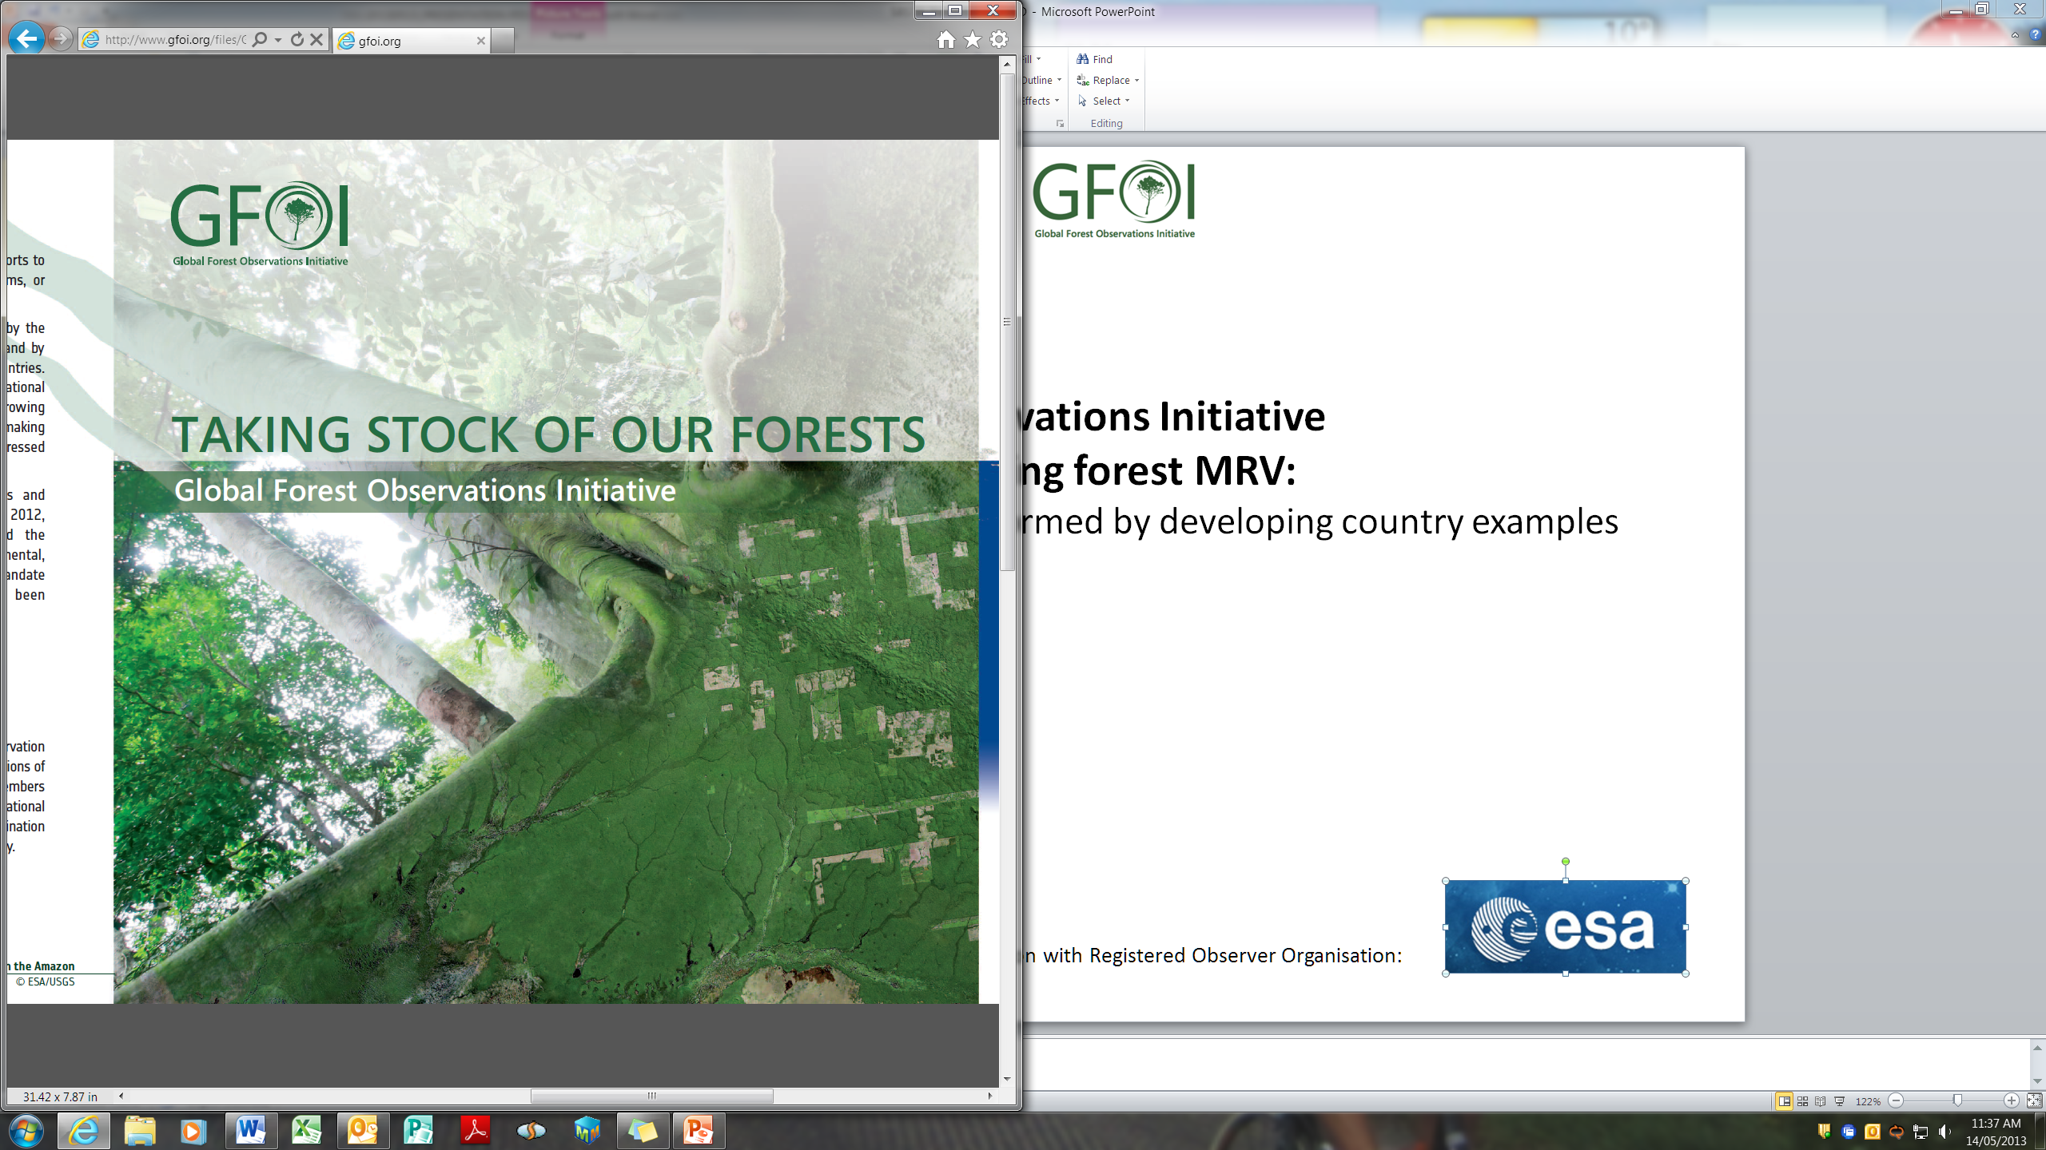
SilvaCarbon Program
Capacity building based on the MGD
Sylvia Wilson
U.S. Geological Survey
SilvaCarbon Program
snwilson@usgs.gov

Slide 2

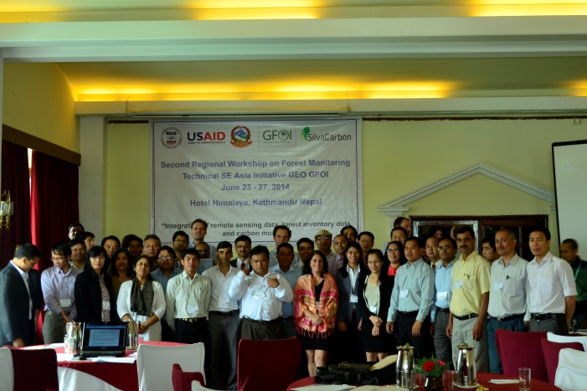
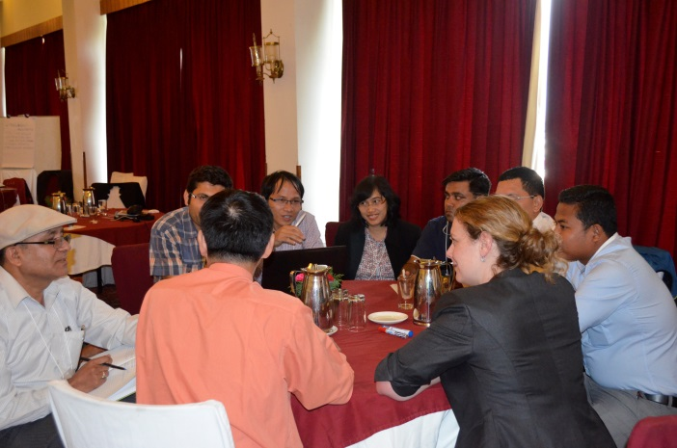
GFOI Capacity Building based on the MGD
Accuracy Assessment :
Regional in Latinoamerica – Activity data
Time series systems methods:
Regional in the Americas - UMD Methods
Peru, Colombia y Ecuador
Early Warning Systems:
Forest Disturbances – Regional in Latinoamerica
  Deforestation
  Degradation
Forest Degradation:
Regional in SE Asia
Regional in Latinoamerica

Slide 3
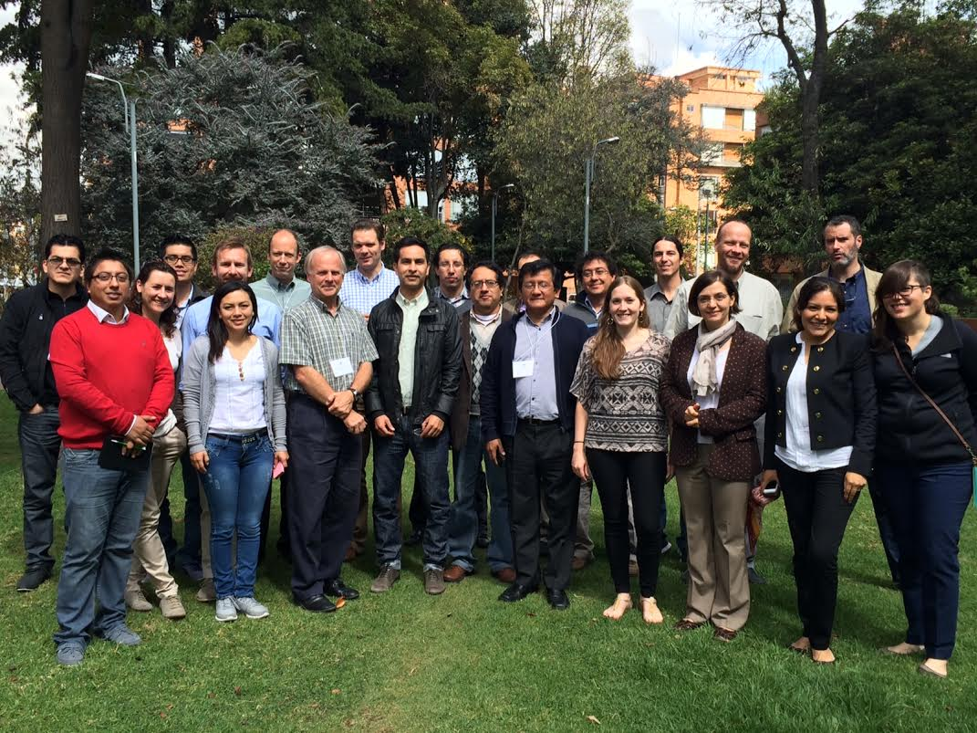
GFOI Planned Capacity Building based on the MGD
Accuracy Assessment :
Regional in SE Asia – Activity data
Regional in Central America – Activity data
Honduras
Vietnam for LULC maps
Nepal
Philippines with combination of ground based data validation
Time series systems methods:
Regional in Central Africa
Regional in the Americas - UMD Methods
Peru, Colombia y Ecuador
Regional in Central America
BU Methodology in Thailand
Early Warning Systems:
Forest Disturbances – Regional in Latinoamerica
  Deforestation
  Degradation
Regional in Central Africa
Forest Degradation:
Regional in SE Asia, Latinoamerica

Slide 4
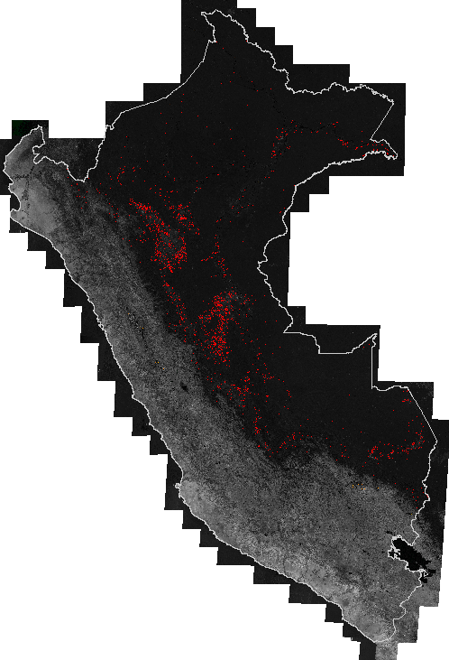
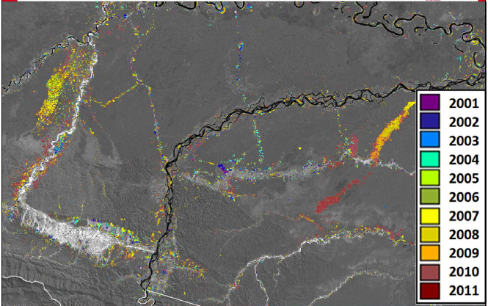
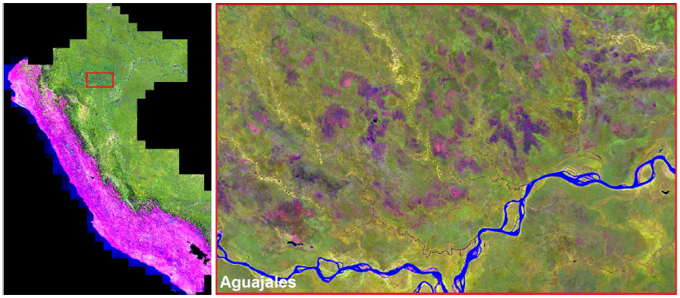


Example of GFOI Regional Activity
Working with Universities for capacity building
Agencies involved: USGS, USFS, and EPA
Countries: Colombia, Ecuador and Peru
Forest change maps
Six IPCC land cover classes map
Accuracy assessment and validation of maps
Notes:
This is the example of multiagency coordination. EPA, USGS, FS and the Universities. UMD system was implemented in Peru (pictures are the 2012 composite and forest loss). UMD is working now with Peru developing new metrics for mapping change on the IPCC land cover classes. The accuracy assessment methods used in the UMD methodology have been revise by BU and Syracuse university. In Colombia a parallel methodology of accuracy assessment was develop with BU to compare the precision of the forest change algorithm developed by Maryland

Slide 5
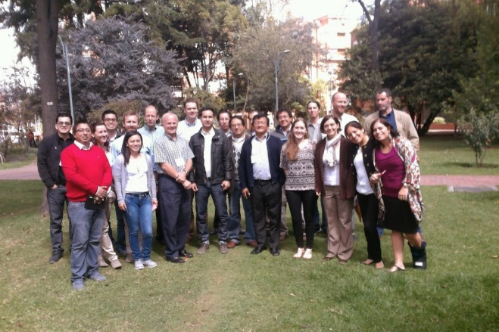
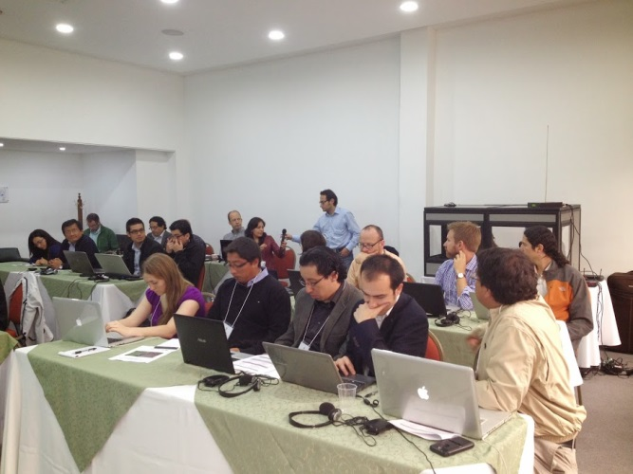
Example of GFOI Regional Workshop
11Th GFOI Capacity Building Workshop – Accuracy Assessment of Activity Data (Bogota – Colombia, Sep 2014)
Objectives:
Review of the stratified estimation of accuracy and area
Review of the fundamental principles of design and analysis for map accuracy assessment
Discussion of accuracy estimation using NFI (National Forest Inventory) and maps
Review of past and current efforts and guidance for future efforts
Outcomes:
Review of validation methodology used by each country
Countries found their efforts closer to write protocols
Open discussions among countries and Academia. Universities worked with each of theses countries in a validation protocol
Coordination of efforts among FAO, SilvaCarbon, UMD, Boston University and Syracuse University
www.gfoi.org
Notes:
This workshop focused on national-level activities related to accuracy assessment and area estimation of land cover change in Colombia, Ecuador, Peru and Mexico. It included a review of past activities and sessions aimed at answering questions practitioners had regarding these activities. For example, in some countries the accuracy assessments have not been implemented by the practitioners responsible for reporting, and there are requests from countries to learn more about accuracy assessment and area estimation. The goal was to provide participants from the Americas countries with knowledge of past efforts and guidance on future efforts.

Slide 6
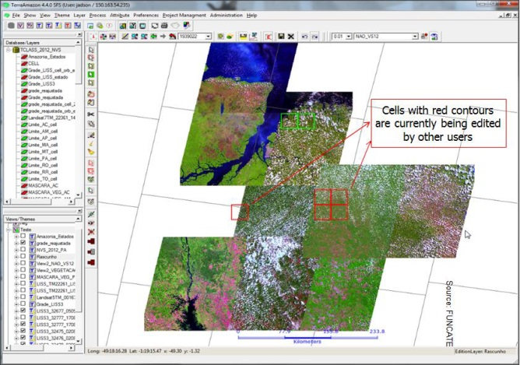
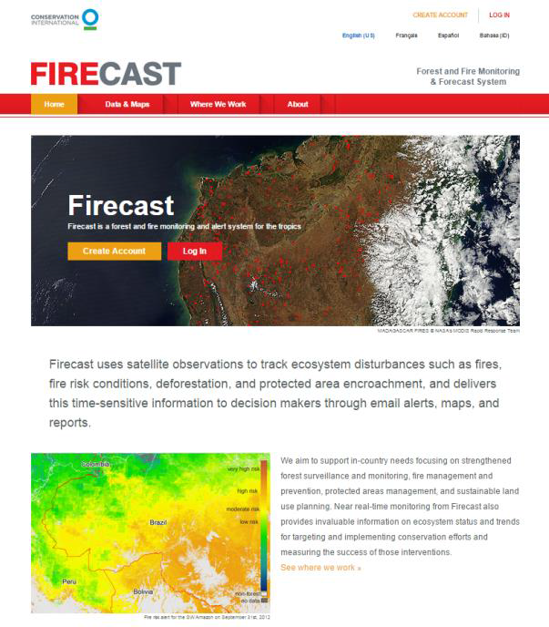
Example of GFOI Regional Workshop
12Th GFOI Capacity Building Workshop – Early Warning Systems for Deforestation and Degradation, January )
Objectives:
Showcase the methodologies of existing early warning systems to the Americas SilvaCarbon countries: Ecuador, Colombia, Peru and Mexico.
One half day of this workshop will focus solely on fire early warning systems and their important in detecting degradation.
Outcomes:
Revision of methodologies
Open discussions among countries and Academia.
Coordination of efforts among FAO, SilvaCarbon, UMD, Boston University, US Forest Service and CI.

