Slide 1
German activities with relevance to GFOI
Tuesday Session: Partner Presentations
Helmut Staudenrausch, DLR

Slide 2
Outline
German REDD+ policy
Supporting programmes and actors
Project examples

Slide 3
German REDD+ policy
Strong commitment on REDD+ in Germany’s international climate policy
Substantial bilateral activities and regional partnerships in Latin America, Africa and Asia
One of the donors of the World Bank’s Forest Carbon Partnership Facility
Maintain support to REDD readiness and increase support to those moving forward
Partnerships e.g. with Norway, UK
N

Slide 4
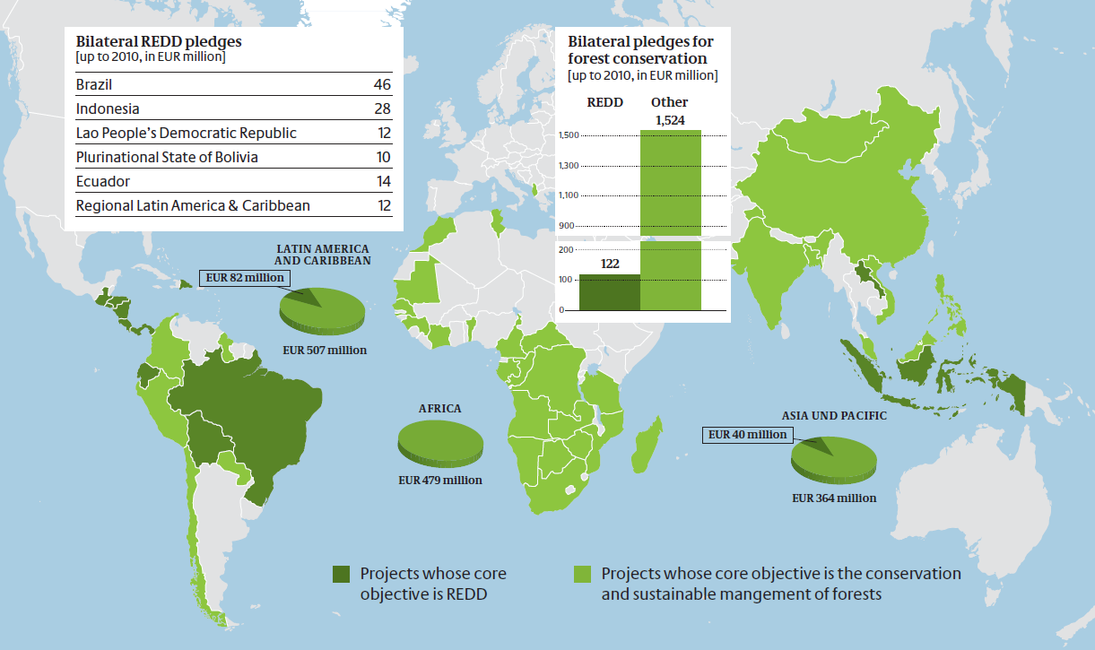
BMZ
Bilateral and regional initiatives to support REDD readiness
  Implemented mostly by GIZ (tech. cooperation) and KfW (financial cooperation); also PPP projects
  Remote sensing is integral part of many projects
  Often supported by regional GIZ offices

Slide 5
BMZ’s REDD Early Movers
REDD Early Movers Programme – Rewarding Pioneers in Forest Conservation
  Addresses gap between numerous readiness activities and few financial incentives in REDD interim phase
  Combines support to readiness with incentive or performance-based payments
  High standard MRV needed: support for establishing MRV systems can be included

Slide 6
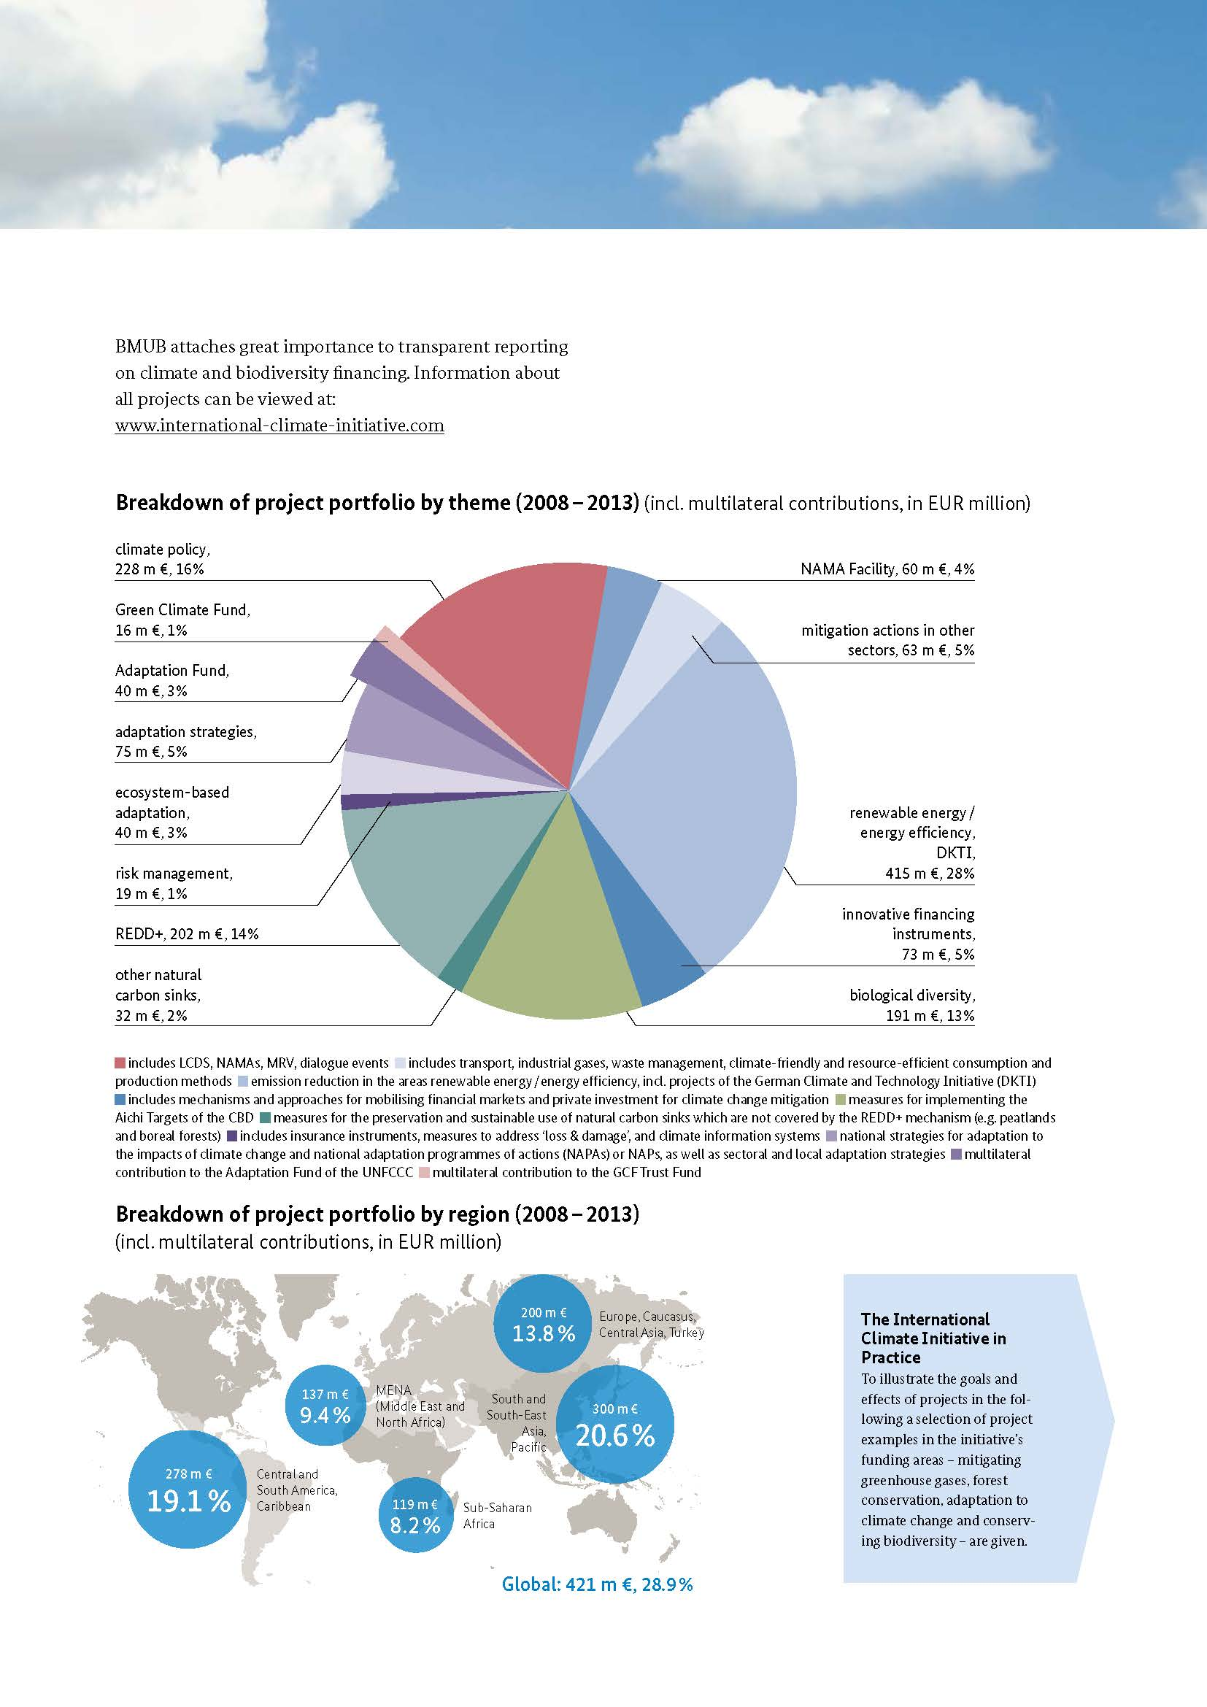
BMUB’s IKI
International Climate Initiative (IKI)
84 projects, 234 mio. € on REDD+ since 2008, making IKI one of the world’s big REDD+ donors
Implemented by GIZ and many other national and international organizations (governmental, NGO, Private Sector)

Slide 7
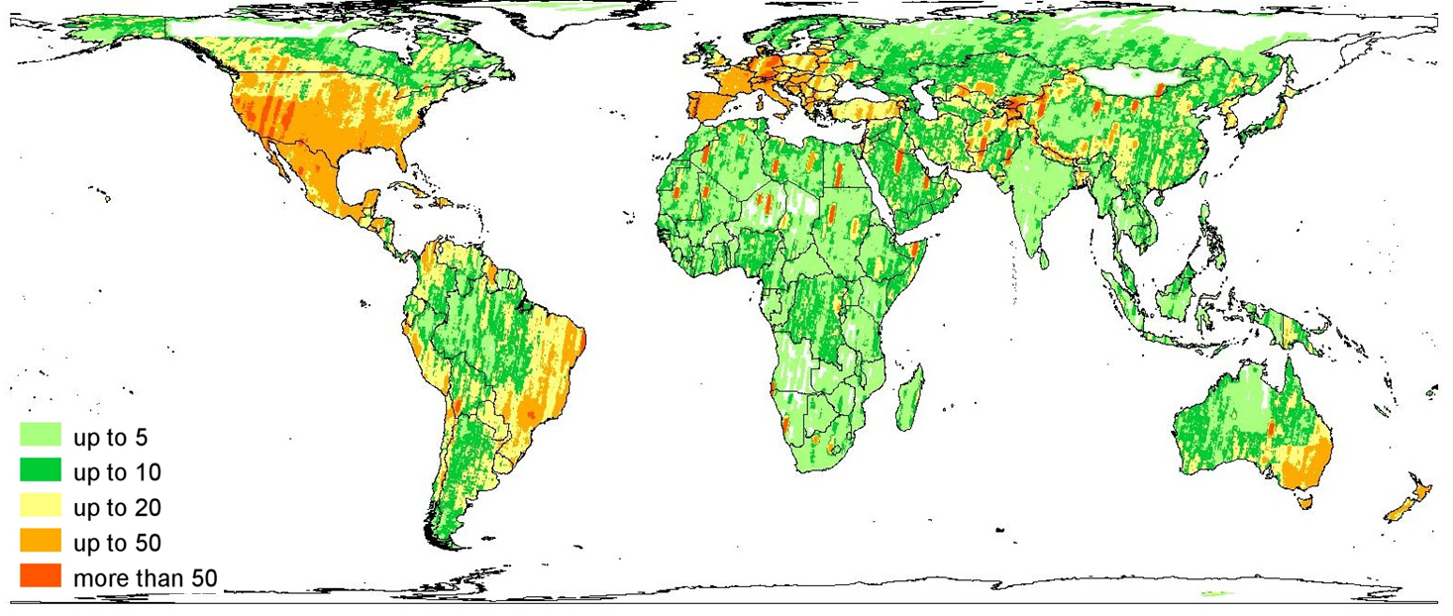
DLR
Funding R&D for REDD monitoring and data processing methods
  Sensor interoperability, large area automated processing, degradation, biomass estimation
  New call for proposals, dedicated on global monitoring issues, planned for spring 2015, including GFOI R&D
Providing access to TerraSAR-X/TanDEM-X and RapidEye data (via partnership with Blackbridge) for R&D
Training material specifically for SAR data (saredu.dlr.de)

Slide 8
Project examples #1
Support the development of the national integrated Forest Monitoring System in Mexiko (BMZ). Implemented by GIZ, seconded experts
  Establish national System for management, processing and integrating satellite data for carbon emission estimation.
  Development of AD component using Landsat and Rapideye with automized generation of 16 forest types and 8 savannah classes, as well as annual forest change dynamics with respect to Deforestation, Reforestation, Afforestation, Degradation and Regeneration.
Support Ethiopia in their REDD+ MRV activities based on RapidEye imagery (BMZ). Implemented by GIZ, RSS , Blackbridge
  Build technical and training capacities using multitemporal satellite imagery,
  Ensure knowledge transfer into working groups of Ethiopean REDD institutions.

Slide 9
Project examples #2
Development of integrated monitoring systems for REDD+ in the SADC region (IKI), Implemented by GIZ, GAF
  application of remote sensing data (satellite images) for the assessment of Activity Data (i.e. deforestation and degradation assessment)-for historic epochs
  Implementation of a Regional terrestrial inventories in four Pilot Countries for Biomass and Carbon stock assessments
  Assessment of Emission Factors and Reporting
  Capacity building, pilot implementations in 4 countries and pre-audit
The National Forest Monitoring and Information Systems for a transparent and truthful REDD+ (IKI), Implemented by FAO, INPE
  South-South cooperation project in 18 partner countries
  Knowledge exchange/transfer and capacity building in the context of implementing a software tool for forest monitoring, using remote sensing technology and geoinformation systems to extend the countries’ forest monitoring systems.

Slide 10
Project examples #3
Forest Degradation (DLR), implemented by Airbus, Institute for World Forestry, Uni Hamburg
  Development of degradation monitoring methods using Sentinel-2 and TDX data
  Case studies in and with partners from Surinam, Ghana and Indonesia.
Develop and improve methods for automated, large area monitoring of changes in forest cover and land-uses relevant for REDD+ (DLR), implemented by Humboldt and Free Universities Berlin
  Test in Brazilian states of Mato Grosso and Para, gradient from agriculture to primary forest and deforestation areas,
  Collaboration with INPE and regional authorities.
BioTrop-X (DLR), implemented by Helmholtz Centre for Environmental Research (UFZ)
  Development of new methods for the biomass estimation and monitoring of tropical forests using TanDEM-X data and forest modelling
  Testing in Panama: Barro Colorado Island, Shermann, Cocoli; Ecuador: Reserva Biológica San Francisco; Sri Lanka: Sinharaja; Taiwan

Slide 11
Linking with GFOI
Joint BMZ/DLR International conference on REDD MRV
  Tentative place and date: Bonn, 21 – 22 September 2015
  possibly with a focus on measuring forest degradation
  Involvement of GFOI foreseen
  DLR offer to hold next meeting of CEOS SDCG in support of GFOI back to back with this

