Slide 1
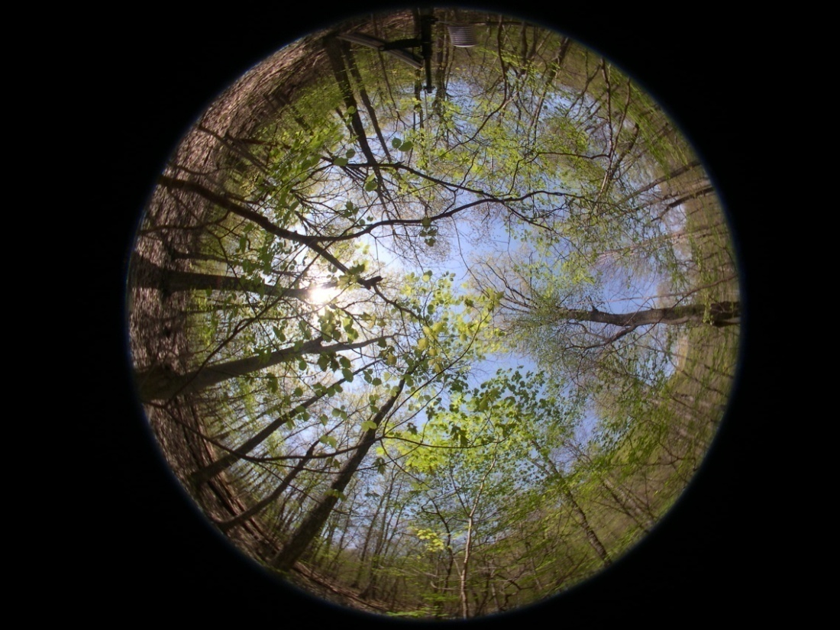

U.S. SilvaCarbon Country Engagement
Douglas M. Muchoney
USGS Climate and Land-Use
Change
GFOI - SDCG
Sydney
3 March 2015
U.S. Geological Survey U.S. Department of Interior

Slide 2
Overview
Provide a brief description of US SilvaCarbon contributions to GFOI
Update on where we are at currently
Way forward for implementation

Slide 3








U.S. science, innovation, and technical expertise to assist developing countries in monitoring and managing forest and terrestrial carbon
Strengthening global capacity to understand, monitor, and manage forest and terrestrial carbon
U.S. Agency for International Development
U.S. State Department
U.S. Geological Survey
U.S. Forest Service
NASA
U.S. Environmental Protection Agency
NOAA
Smithsonian Institution
As well as U.S. universities, NGOs, donors and industry
Notes:
United States federal agencies have joined together to create the SilvaCarbon program to enhance capacity worldwide for monitoring and managing forest and terrestrial carbon. SilvaCarbon draws on the expertise of the U.S. scientific and technical community including experts from government, academia, non-governmental organizations, and industry.

Slide 4
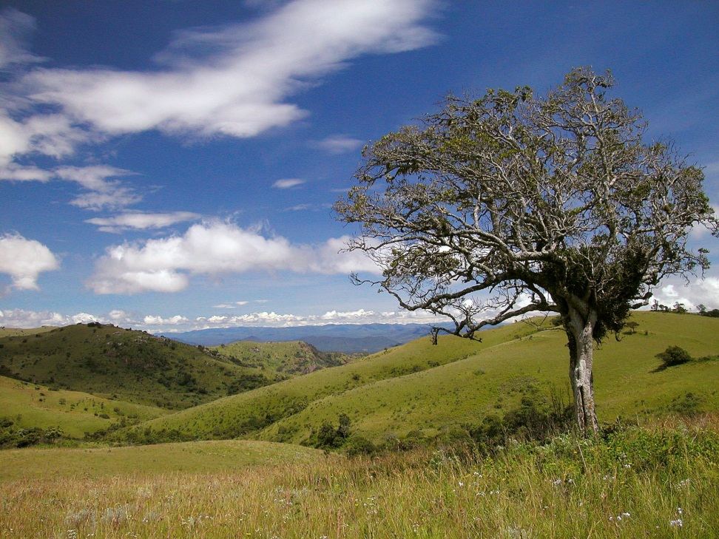
Program Overview
Under the President’s Global Climate Change Initiative, SilvaCarbon is a U.S. contribution to the Global Forest Observation Initiative of the Group on Earth Observations (GEO)
SilvaCarbon works to:
  Partner with developing countries to improve monitoring of forest and terrestrial carbon
  Improve understanding of methodologies and collection and dissemination of data
  Coordinate US science, innovation, and technical expertise
Notes:
SilvaCarbon is a flagship program that supports the Administration’s comprehensive strategy for fast start financing for reducing emissions from deforestation and forest degradation and enhancing forest carbon stocks (REDD+) in developing countries, announced on October 28. REDD+ is a priority of the Administration, which has dedicated $1 billion between 2010 and 2012 to help countries slow, halt, and reverse deforestation as a key strategic component of the U.S. “fast start” climate financing announced in the context of the Copenhagen Accord. USAID and the U.S. State Department are supporting the program in cooperation with other Federal agencies such as U.S. Geological Survey, U.S. Forest Service, U.S. Environmental Protection Agency, Smithsonian Institution, and NASA.

Slide 5
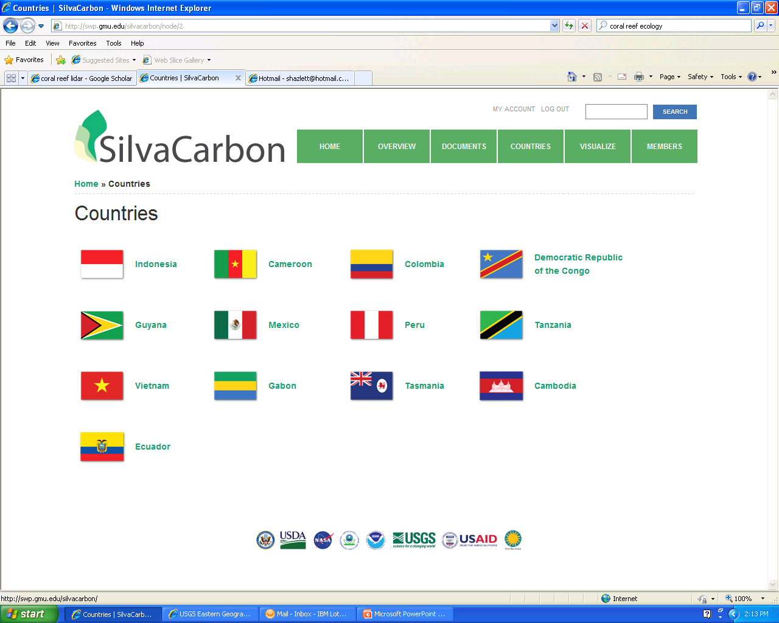

Slide 6
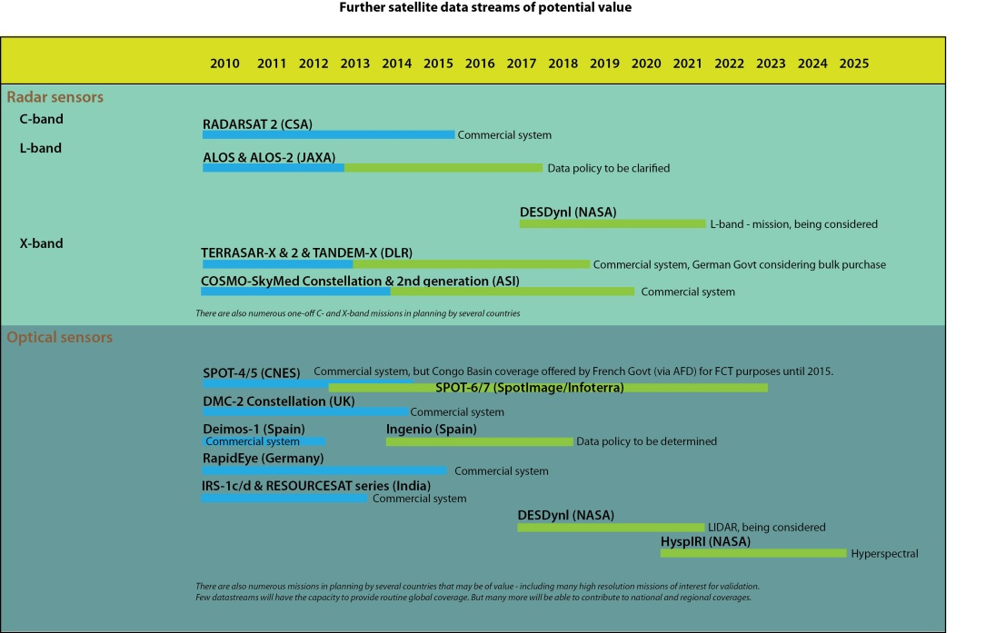
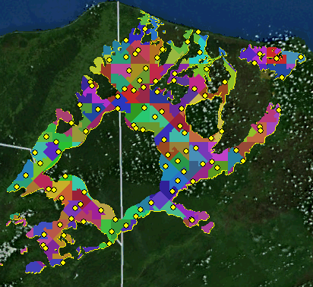
Technical Areas
Sampling protocols
Data processing, archiving, distribution
In Situ data collection/analysis, including engaging local communities
Integration of remotely sensed and in situ data
Classification/mapping of forest cover
Carbon stock and flow estimation
Design of monitoring systems for multiple uses
GHG inventory and reporting (ALU tool)
Land use analysis and planning

Slide 7
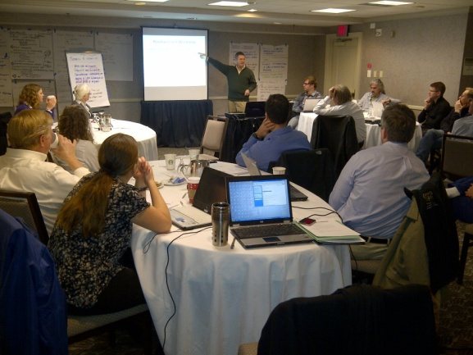
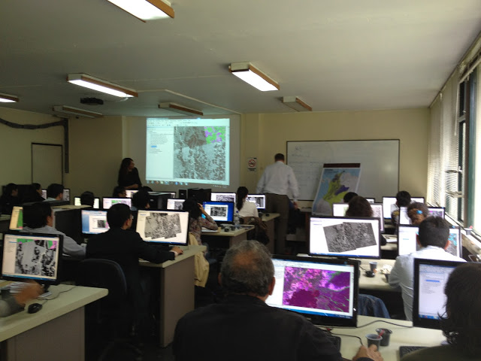
Improved Methodologies & Dissemination of Data
Technical Workshops with US Research Community on:
Linking Field and Remotely Sensed Data
Estimating Carbon
Measuring Forest Degradation
Estimating Uncertainty
Regional Capacity Building Workshops
Radar Imagery for Forest Monitoring - Bogotá, Colombia
Advancing Practical Methods for Forest Degradation Monitoring – Bangkok, Thailand (in collaboration with LEAF program)
Developing Consistent GEO Forest Information Products from Time-series Mid-resolution – Sioux Falls, South Dakota
Notes:
SilvaCarbon Objectives
Objective 1: Demonstrate and compare forest and terrestrial carbon measurement and monitoring methodologies.
Objective 2: Build capacity of selected developing countries to use forest and terrestrial carbon monitoring and management methodologies and technologies.
Objective 3: Facilitate, in cooperation with the Committee on Earth Observing Satellites (CEOS) and other partners in the GEO Forest Carbon Tracking task, the coordinated collection and dissemination of earth observation data related to forest and terrestrial carbon monitoring and management.
Objective 4: Strengthen the community of forest and terrestrial carbon technical experts

Slide 8
WHAT SILVACARBON BRINGS TO THE GFOI
Develop regional workshops and trainings, highlighting them as GFOI activities.
Make guidance, materials, and technical tools in support of MRV development readily available online to all members of GFOI and the wider international MRV community, such as the Design Tool for Inventory & Monitoring (DTIM) to assess country information needs for forest monitoring.

Slide 9
WHAT SILVACARBON BRINGS TO THE GFOI
Invite members of the academic and research community, especially at the country-level, to participate in GFOI meetings. Support the participation of SilvaCarbon-funded researchers, including scientists from developing countries, in GFOI’s research workshops.
Solicit feedback from in-country partners on how to improve the MGD’s applicability to national and regional MRV contexts, and promote the use of GFOI products.

Slide 10
WHAT SILVACARBON BRINGS TO THE GFOI
Serve as a link between countries and the Spatial Agencies to foster the sustained availability of space-based observations for national forest monitoring systems and to assist countries in making the best use of these observations.

Slide 11
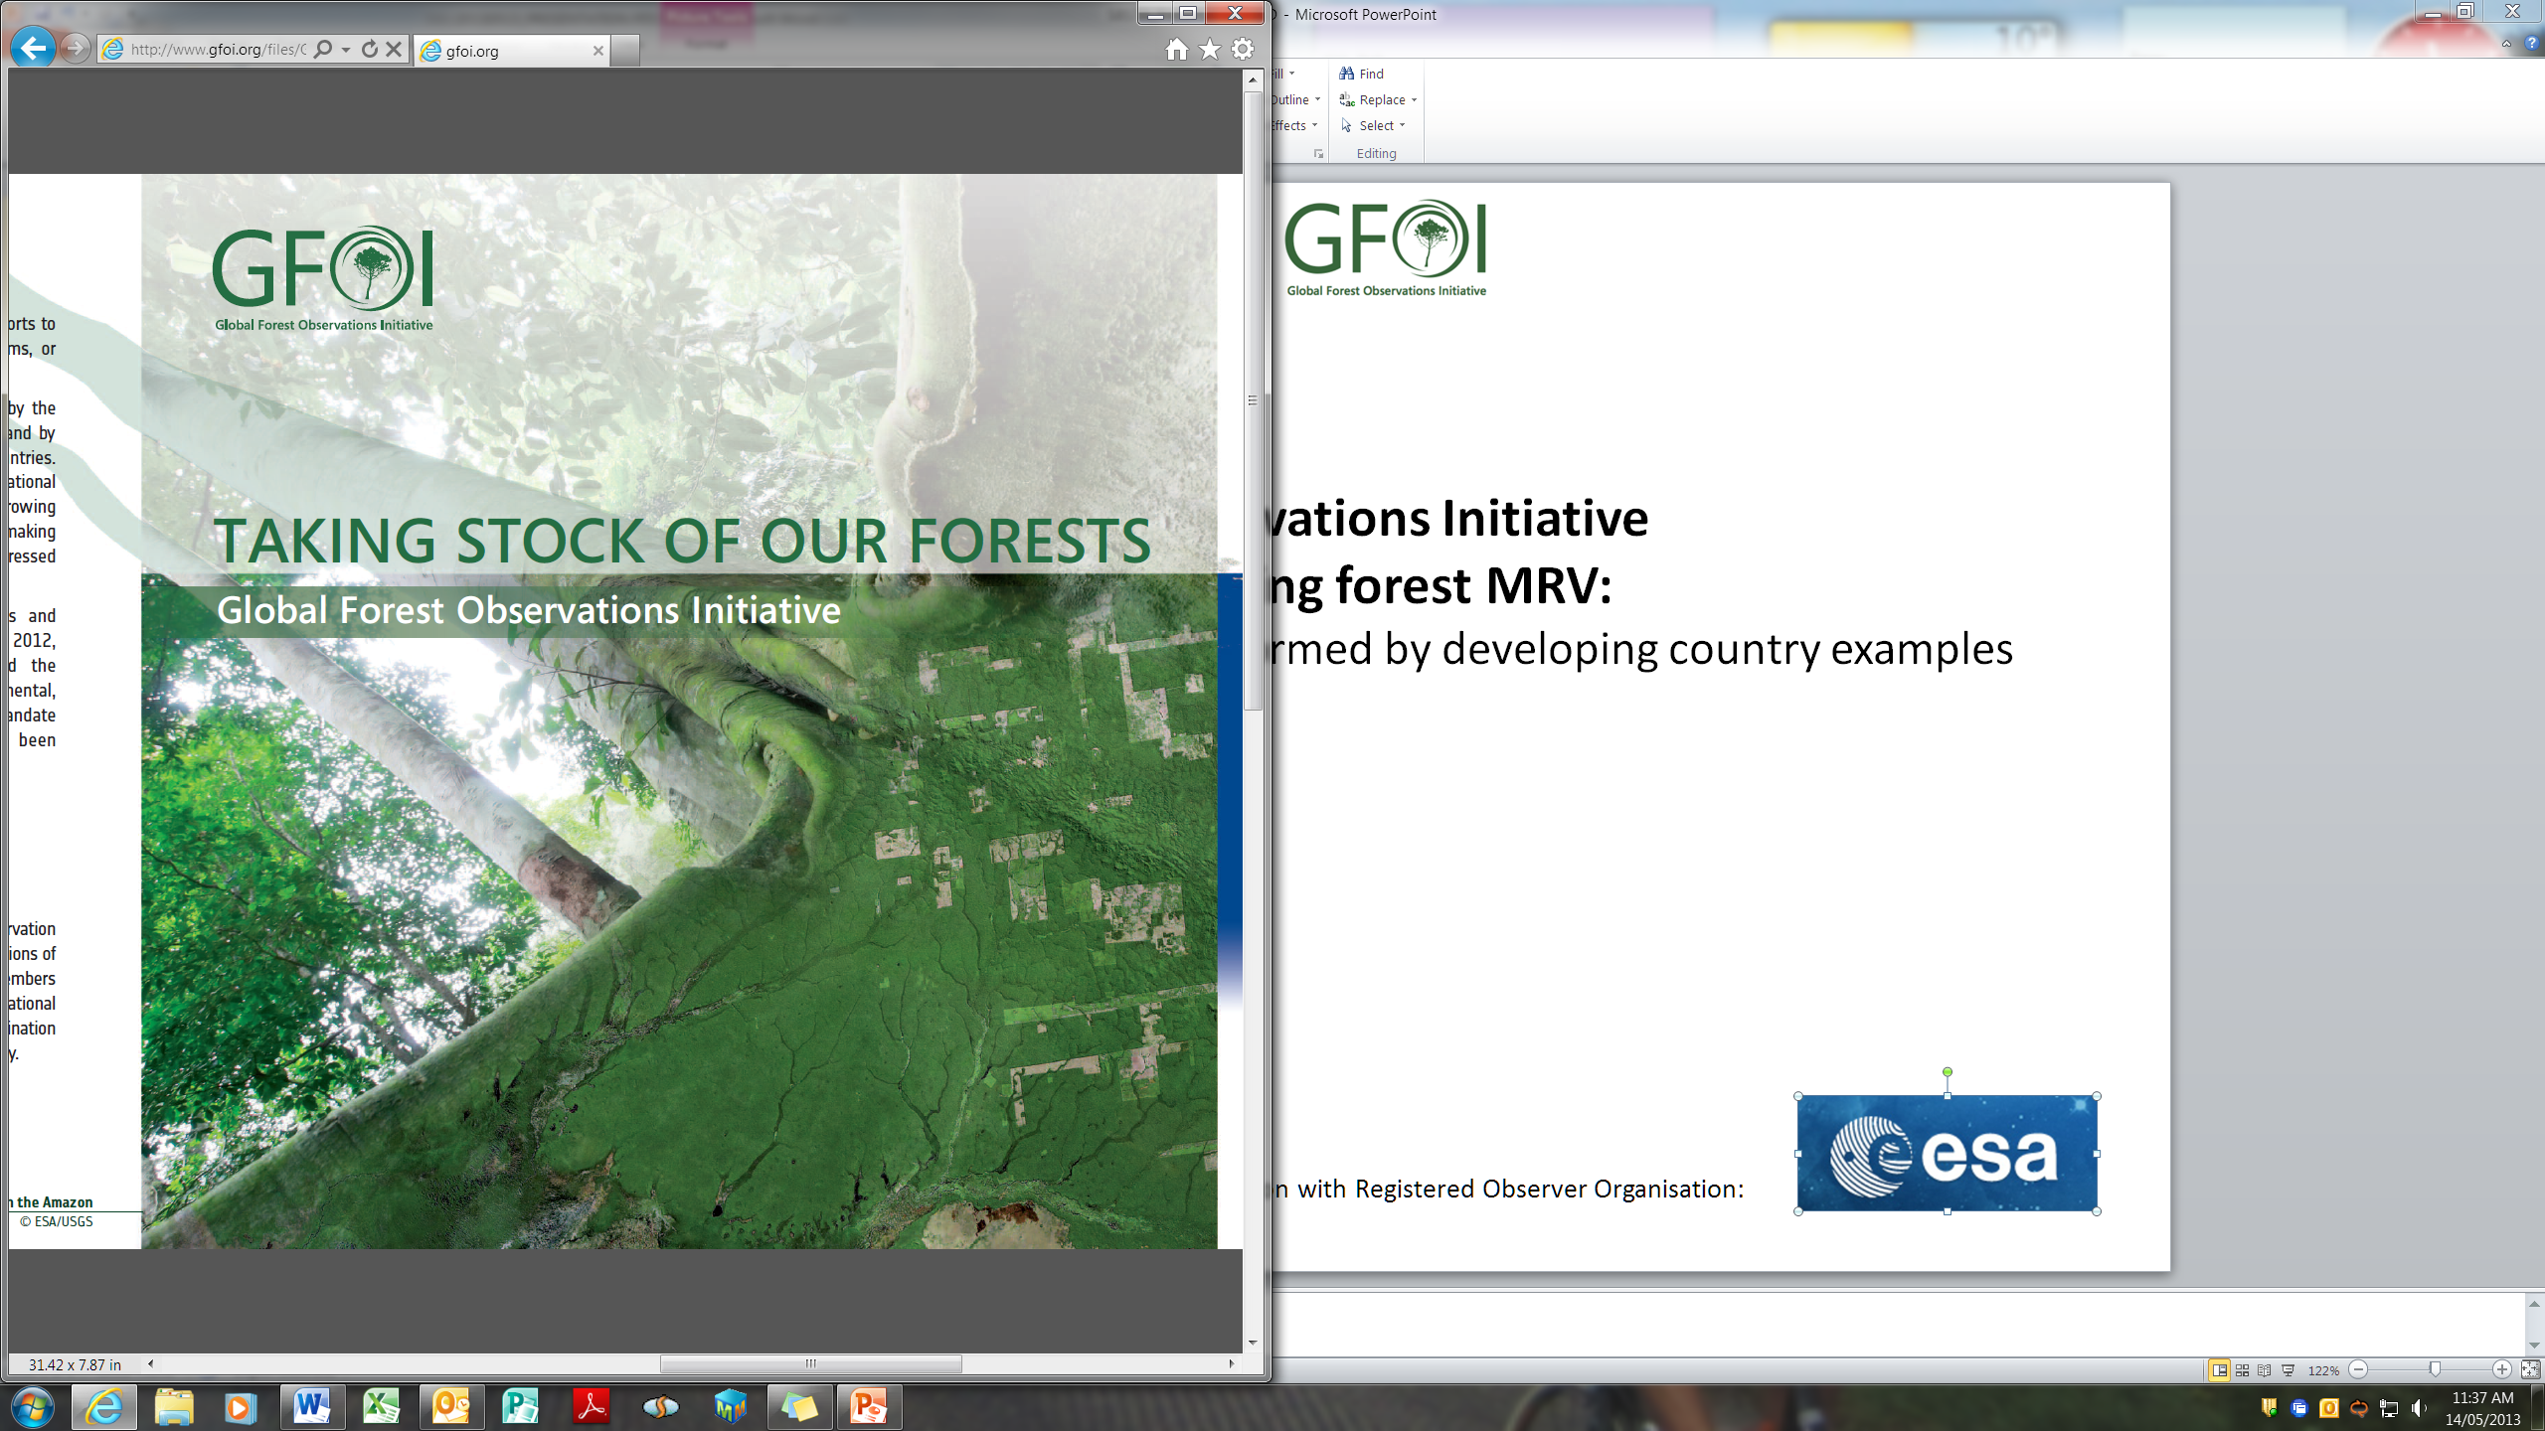
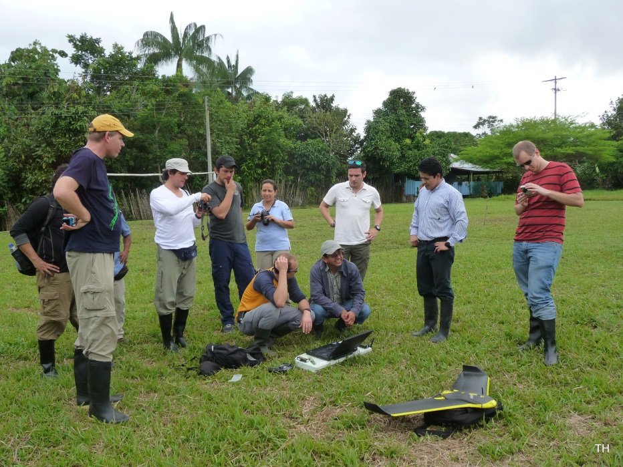
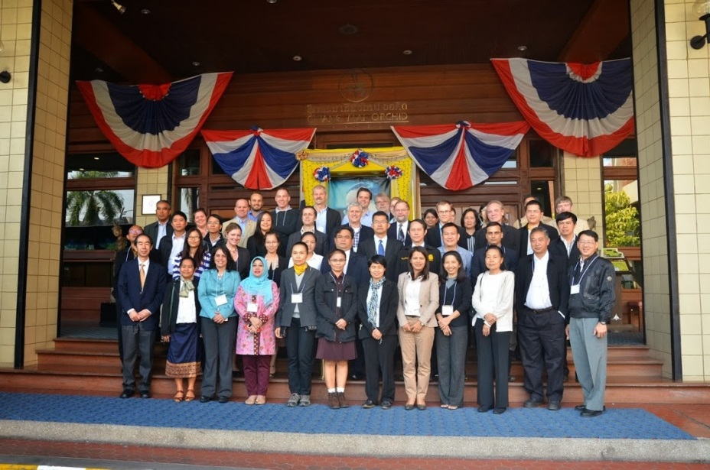
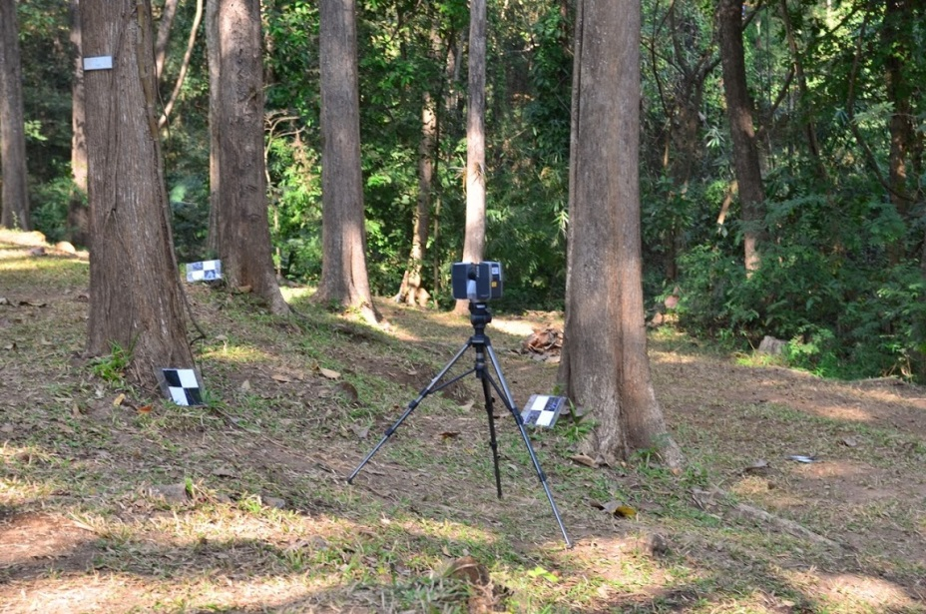
SilvaCarbon Program – US Contribution to GFOI
Regional GFOI Workshops
13 in Latin-America
https://sites.google.com/site/talleresgeofct/
2 in SE Asia
https://sites.google.com/site/gfoiseasiacapacitybuilding/
1 in Central Africa
https://sites.google.com/site/gfoiafricacapacitybuilding/home/first-gfoi-forest-monitoring-workshop
Objectives
Showcase operational methodologies for different aspects of forest monitoring
Provide and space for discuss new cutting edge research methodologies
Provide an space for testing and demonstration of field methods using new technologies
www.gfoi.org
Notes:
To date there has been 11 regional workshops in Latin America. The themes of the workshops are picked based on regional capacity building needs and request for countries. There are two modalities for these workshops, hands on and a methodology showcase. These meetings are also a plataform for south south collaboration and also a great oportunity to get hands on new non operational approaches. It is important to differentiate among what is operational and what is research. We rely in University partners of GFOI to show current research, and field techniques, their downside and their potential for inclusion in an operational system for monitoring (example is the case of the UAVs, and terrestrial LiDAR)

Slide 12
Global Forest Observations Initiative
Development of a governance structure around the 5 components
GEO Plenary
GFOI Leads
Aus, Nor, US, CEOS, FAO
Coordination of satellite data supply
CEOS
Capacity Building
US
GFOI Steering Committee
Leads plus Brazil, China, Japan, MGD AG Chair, IPCC, UNFCCC, World Bank, GOFC-GOLD, GEO Sec Dir , National Demonstrator Reps
Methods & Guidance Documentation
Australia
R&D Plan
Norway
Admin & Coordination
Programme Office
GFOI and FCT elements in all components

Slide 13
Methods & Guidance Documentation
A user-friendly reference for the use of remotely-sensed data and methodologies and ground observations in the establishment of countries’ National Forest Monitoring and Carbon Tracking systems, compatible with eventual funding through REDD+
Advisory Group and Authors Team assembled
Draft document in review and refinement
Review and field testing 2015-2015
On-line
Use in capacity building workshops
Notes:
AG and authors include World Bank, FAO, UNREDD+, stellar suite of expertise including GOFC-GOLD, and developing countries

Slide 14
Research & Development Plan
Areas where research is needed in support of GFOI objectives
(new sensors, capabilities, methodologies…)
E.g. Forest Degradation, mapping of particular forest types (mangrove, peat forests, etc), comparison of forest biomass and allometrics estimation methodologies, data-model integration.
RFP issued to address forest degradation characterisations
Exploring complementary interests with research-funding organisations.

Slide 15
GFOI CB objectives
Enhance the capacity of countries to initiate forest and terrestrial carbon assessment and monitoring, and to use management methodologies and technologies.
Strengthen the community of forest and terrestrial carbon technical experts.

Slide 16
What sorts of capacity?
developing and delivering good practice guides, manuals, training, and tools;
facilitating learning exchanges, regional fora, and networks to enhance sharing among countries;
providing technical advice and assistance to governments (and others);
partnering with other donors and with International Organizations to multiply impact and reach.

Slide 17
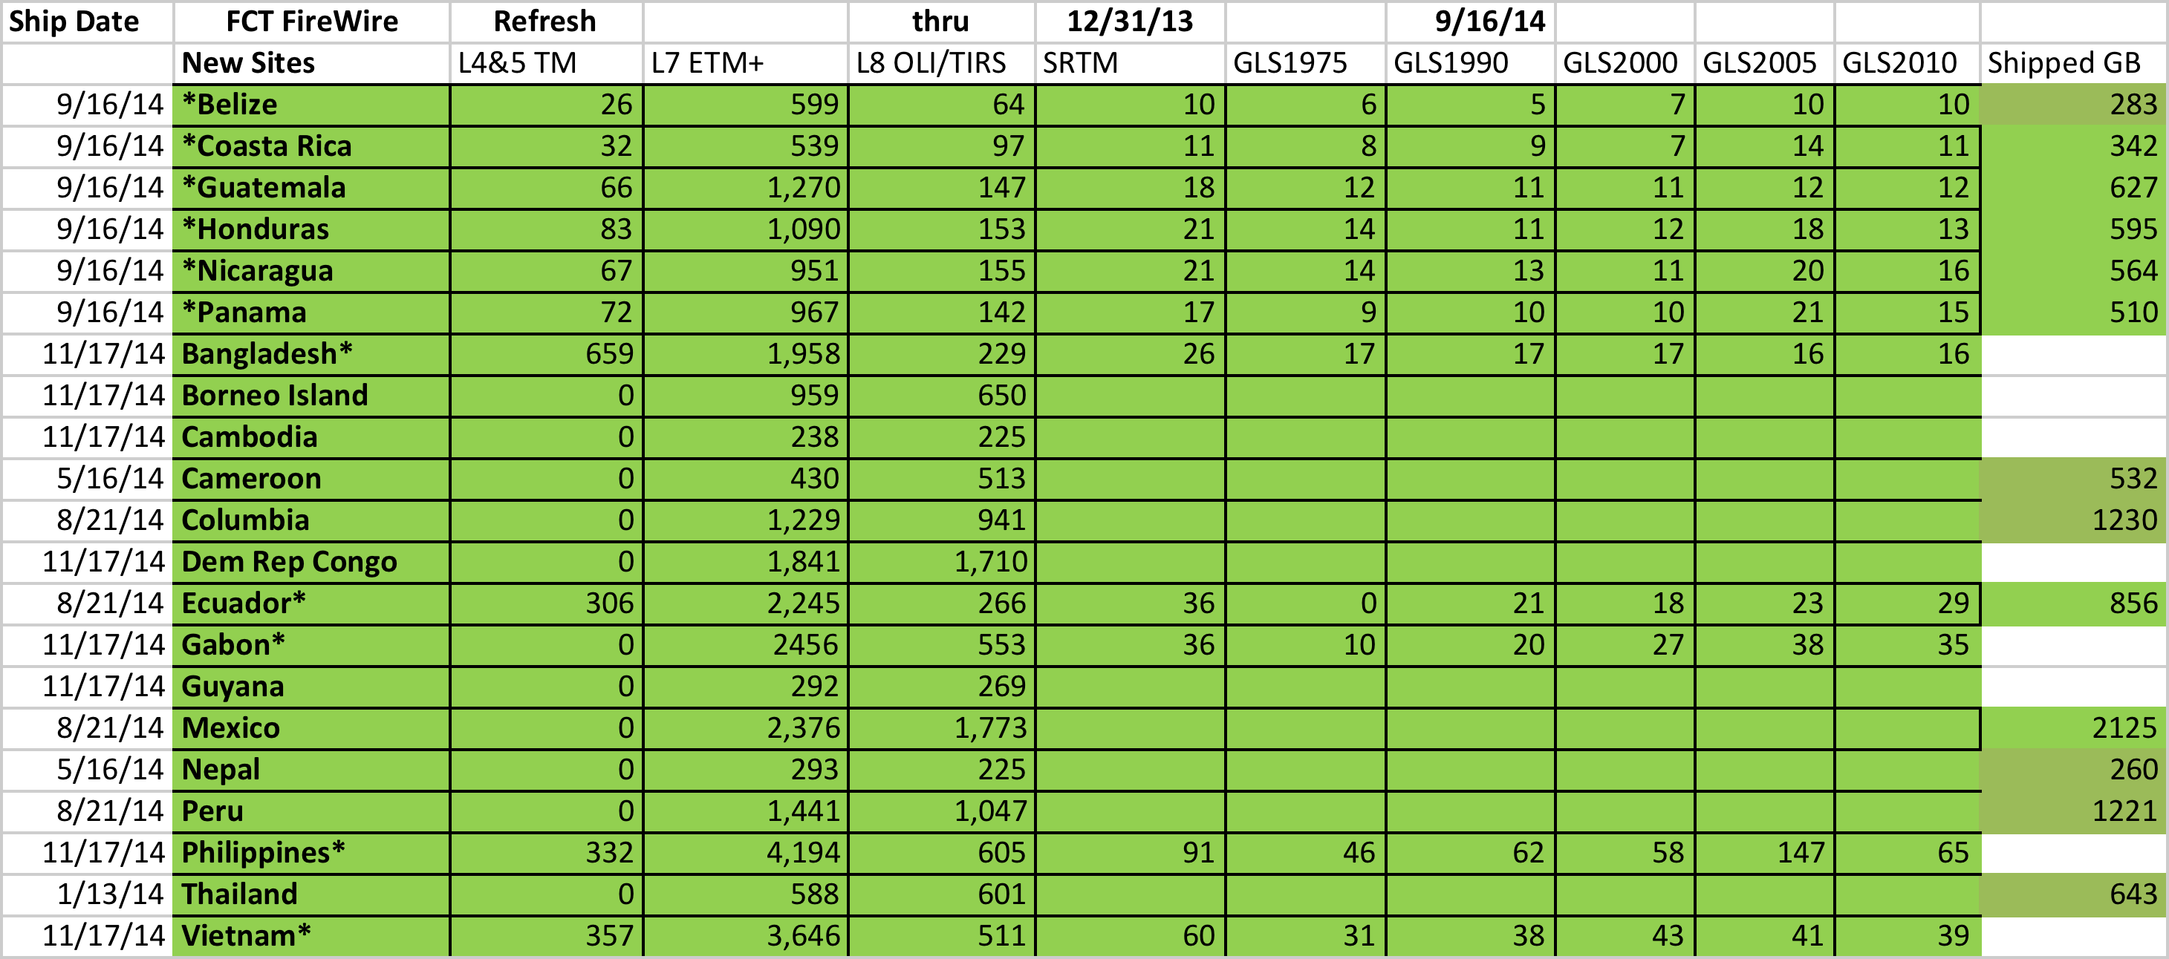
USGS Data Delivery

Slide 18
Key Accomplishments
Inter-agency coordination
Leveraging funding
Supporting regional and national programs (e.g. USAID Lowering Emissions from Asian Forests (LEAF)
Provision of data
Strengthening national science partnerships
Technical advisory role to nations and US policy
Joint international research on important issues like forest degradation, use of air and terrestrial LiDAR
Notes:
Excellent coordination of US agencies via the SilvaCarbon Steering Committee and Technical Team.
Consolidated US contribution to GEO and GFOI
USGS, via our contribution to the Committee on Earth Observing Satellites (CEOS), is providing Landsat and other data to SilvaCarbon, USAID and GFOI priority countries.

Slide 19
"What do you consider the largest map that would be really useful?"
"About six inches to the mile."
"Only six inches!" exclaimed Mein Herr. "We very soon got to six yards to the mile. Then we tried a hundred yards to the mile. And then came the grandest idea of all! We actually made a map of the country on the scale of a mile to the mile!"
"Have you used it much?" I enquired.
"It has never been spread out, yet," said Mein Herr: "the farmers objected; they said it would cover the whole country and shut out the sunlight! So we now use the country itself, as its own map, and I assure you it does nearly as well."
Lewis Carroll, Sylvie and Bruno Concluded

Slide 20
Links…
https://sites.google.com/site/gfoiseasiacapacitybuilding/home/
www.silvacarbon.org
www.gfoicapacitybuilding.org
www.gfoi.org
Notes:
Facilitation of forest observations in support of national forest information systems is a
fundamental objective for GFOI. CEOS established the Space Data Coordination Group to
support GFOI’s requirements in publicly available Earth Observation data.
The SDCG has followed its 2012 Work Plan generally to schedule:
Establishment of the SDCG and terms of reference (completed at 1st SDCG meeting Mar 2012).
Development of GFOI dataset requirements (draft developed Mar 2012, ongoing activity
to meet changing scenarios.)
Development of a first draft of the baseline global data acquisition strategy (draft to be
discussed at 2nd SDCG prior to submission for adoption at the CEOS Plenary October 2012).
Inform GFOI of data gaps which may require purchase/negotiation of alternative data sources
(October 2012 following CEOS Plenary endorsement)
Ongoing data acquisitions in support of FCT & National Demonstrator needs, with possible
expansion to include more REDD+ countries (during 2012/2013).
Initialising planning for national data acquisitions (late 2012/2013).
Liaise with GFOI on the development of interface(s) with commercial data providers and
possible data donors to optimise their acquisition strategies and donations (late 2012).
Concur with FCT/GFOI on data process/packaging and distribution process (late 2012/2013)

Slide 21
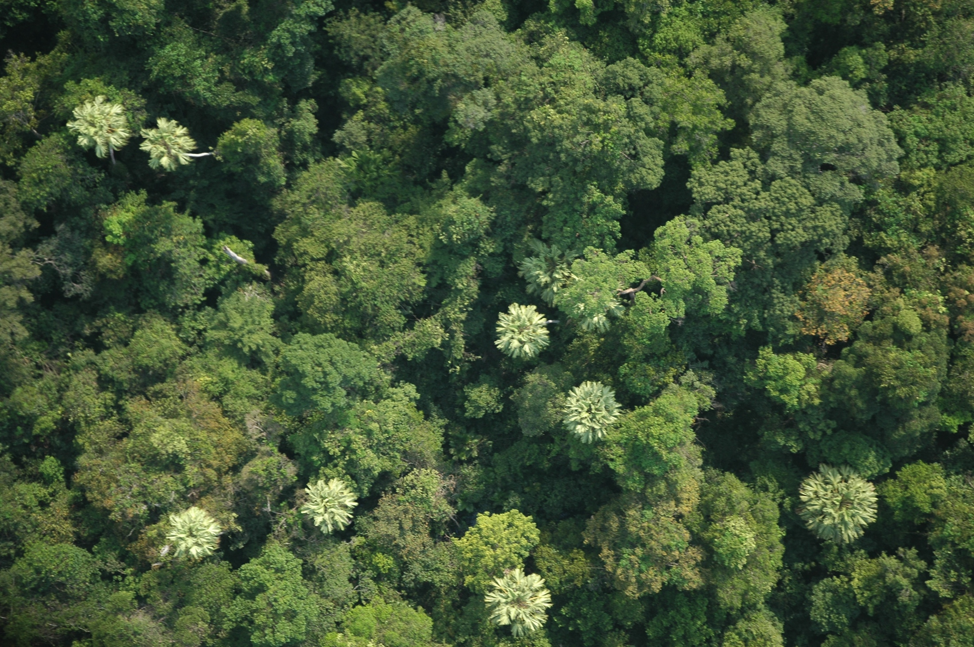
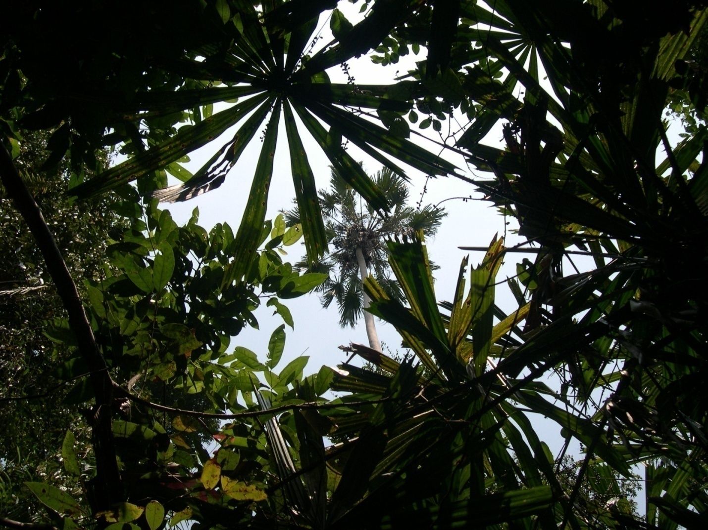
Thank you!
Douglas Muchoney (USGS): dmuchoney@usgs.gov
www.silvacarbon.org
www.gfoi.org

