Slide 1
SDCG Element 3: Satellite Data Support to GFOI R&D Activities
Ake Rosenqvist, Nobuyoshi Fujimoto/ JAXA
SDCG-8 Session #1, Agenda Item #7

Slide 2
Satellite data support to GFOI R&D
– SDCG Element 3
GFOI R&D & SDCG
GFOI R&D Component (Lead: GOFC-GOLD)
- Coordination of R&D towards GFOI priority topics
- Management of research groups (R&D programme)
- Mechanism for integration of new methods into GFOI MGD
- Mechanism for reporting and feed-back to space agencies and GFOI
- Catalysing R&D through organisation of R&D Expert workshops and science meetings
Space Data Coordination Group (Lead: CEOS)
- Satellite data support to the GFOI R&D Component through the SDCG Element-3 strategy

Slide 3
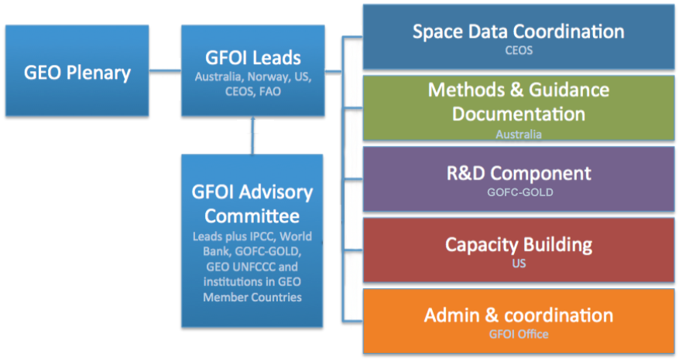
Satellite data support to GFOI R&D
– SDCG Element 3
GFOI R&D & SDCG
__
SDCG Element-3
Data support
__
GFOI R&D programme

Slide 4
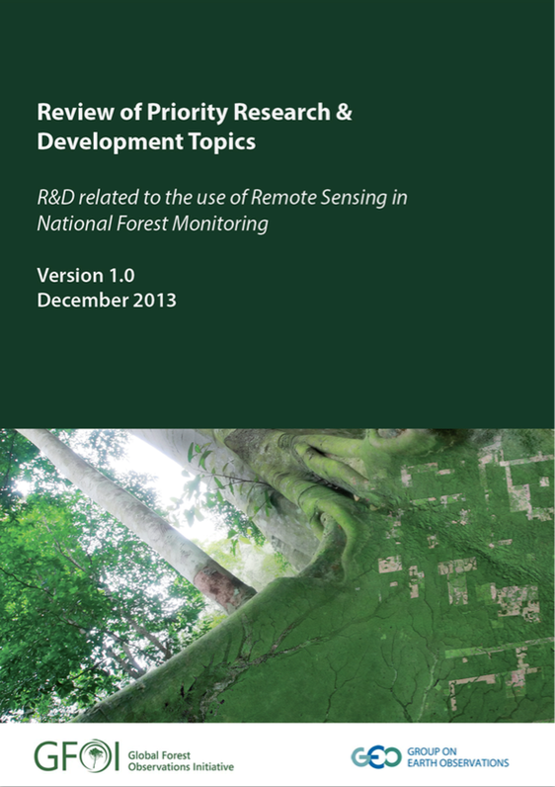
GFOI R&D Component –
Review of Priority R&D Topics
What are the “GFOI Priority R&D Topics”?
R&D topics of importance to elevate to operational status (for future inclusion in GFOI Methods and Guidance Doc)
Thematic topics
Degradation (and enhancements) of Carbon stocks
Degradation type mapping
Forest stratification methods
Forest/Non-Forest Change
Land Use/Cover Change
Above-ground biomass stocks and change
Cross-cutting topics
Sensor interoperability and complementarity
Uncertainty and accuracy
Available at
http://www.gfoi.org/rd/

Slide 5
Satellite data support to GFOI R&D
– SDCG Element 3
SDCG Element 3: Satellite Data in support of GFOI Research & Development (R&D) Activities
R&D focus provides a means also for CEOS agencies with commercial missions (PPPs etc.) to actively contribute to GFOI with satellite data at no cost
Contributing agencies and missions
- ASI: COSMO-SkyMed
- CNES: Pléiades, SPOT 1-5
- CSA: RADARSAT-1 and RADARSAT-2
- DLR: TerraSAR-X and TanDEM-X
- JAXA: ALOS and ALOS-2
and in addition, “Core Mission” agencies ESA,
INPE and USGS with Sentinels, CBERS and Landsat
Commercial Data Providers – invited to participate and contribute

Slide 6
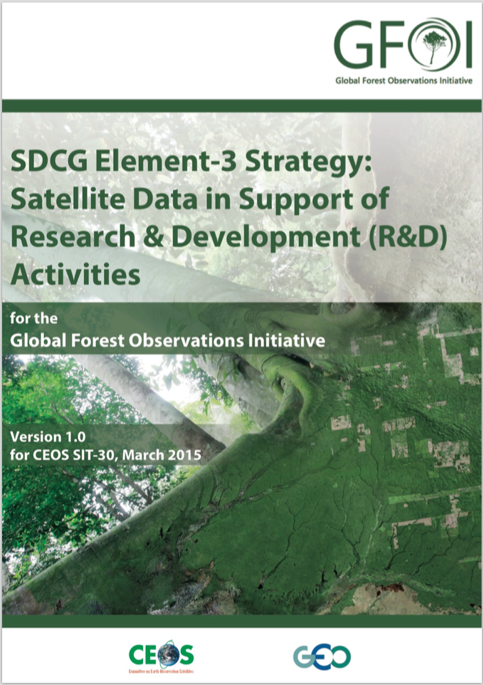
Satellite data support to GFOI R&D
– SDCG Element 3
SDCG Element-3 Strategy
Endorsed by CEOS SIT-30 (Paris, April 2015)
Describes the SDCG R&D support plan to
GFOI in detail:
Background to CEOS support to GFOI R&D
How research needs were identified and
prioritised
Links to GFOI R&D programme
- Participating research groups and their research objectives
- GFOI R&D Study Sites
Specifies satellite data requirements (archived, new) per sensor/sensor type
Optical high- and VHR
L-band SAR
C-band SAR
X-band SAR
DEM data
Available at
http://ceos.org/ourwork/
ad-hoc-teams/sdcg/

Slide 7
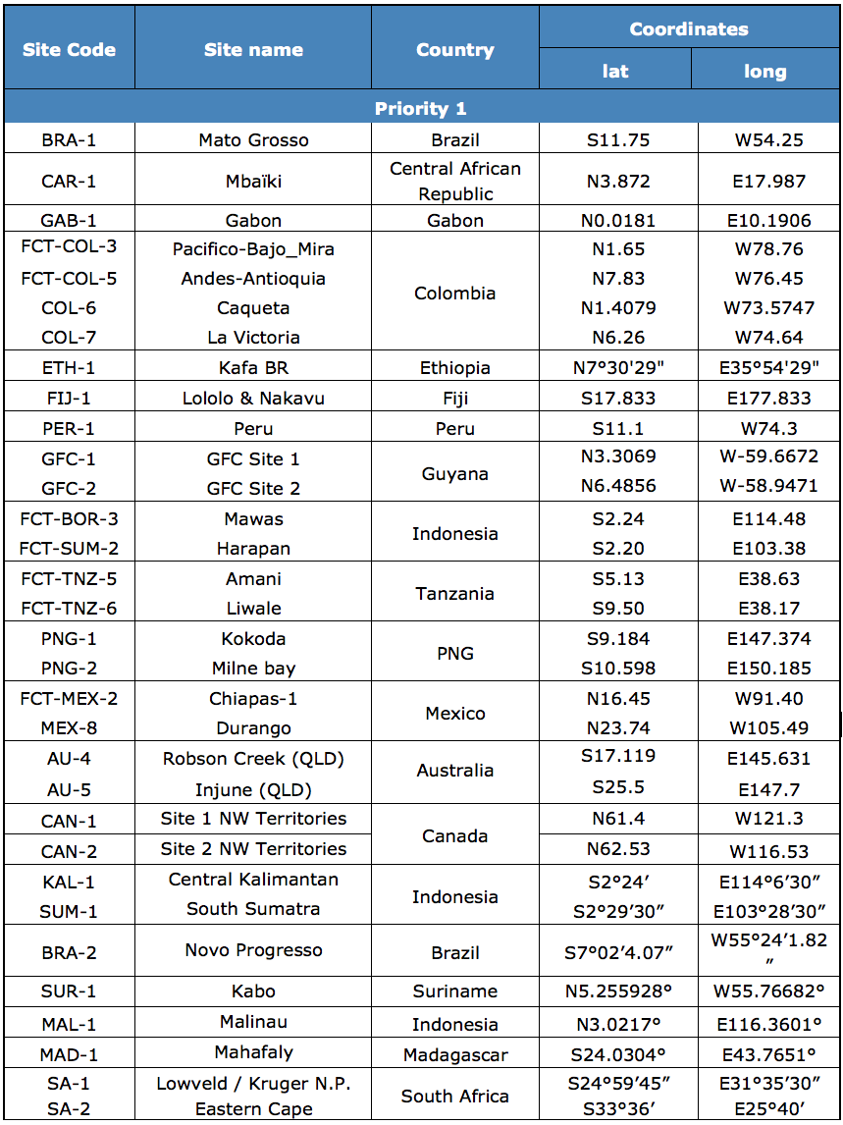
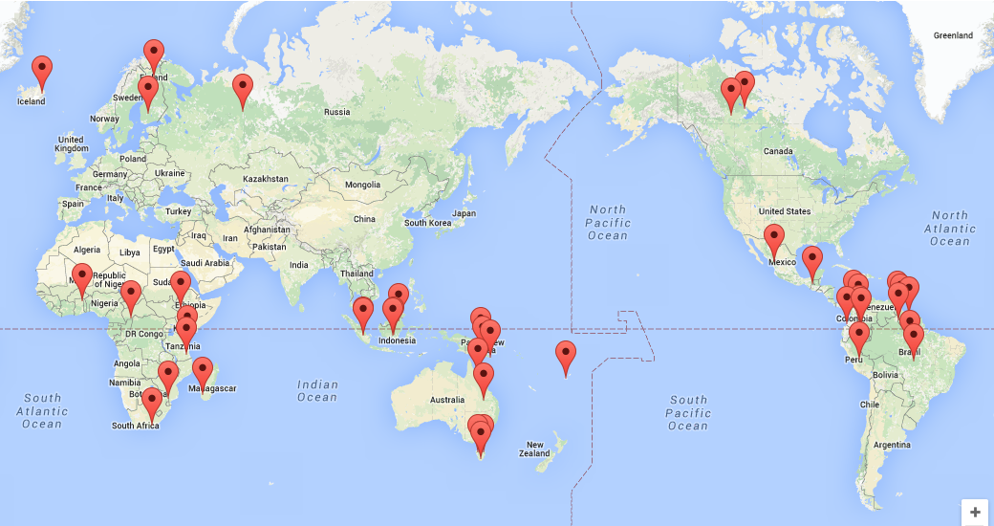
Satellite data support to GFOI R&D
– SDCG Element 3
GFOI R&D Study Sites & R&D teams
Currently 32 multi-disciplinary sites, addressing multiple GFOI Priority R&D topics
Including Study Sites in former GEO-FCT National Demonstrator countries
Currently 13 R&D teams from GFOI countries and national and int’l research organisations

Slide 8
Satellite data support to GFOI R&D
– SDCG Element 3
Process (1/3)
1. Identification of priority R&D topics for GFOI
- Through Review of Priority R&D Topics (peer-reviewed study, published by GFOI Office Dec. 2013)
- Country consultations (GFOI capacity building workshops and SDCG “country days”)
2. Engagement of int’l science community
- Organisation of workshops for top experts in the field - “R&D Expert workshops” - with focus on selected priority topics.
- Sensor interoperability/complementarity (Boston/US, May 2014)
- Forest degradation (Wageningen/NL, Oct. 2014)
- Vegetation biomass est. (Brisbane/AU, Feb. 2015)
- Further workshops planned for 2015-2016 (TBA by GOFC-GOLD)

Slide 9
Satellite data support to GFOI R&D
– SDCG Element 3
Process (2/3)
3. Group/project selection
- Experts engaged through GFOI workshops
- Nominations by space agencies
- “National Demonstrator” country groups from GEO-FCT R&D prog (2009-2011)
- Accommodation of new groups and Study Sites as GFOI R&D Component progresses? (SDCG and GOFC-GOLD to discuss).
- Focus on one or more GFOI Priority R&D Topic prerequisite for participation
4. Funding
- GFOI provides no funds for research groups. R&D programme depends entirely on voluntary contributions by external groups. Sub-optimal but reality. “Bait”: access to EO data for R&D and shared research interests
5. Programme timelines
- Start October 2015 (through GOFC-GOLD LC office)
- Programme duration: 2-3 years minimum requirement of meaningful R&D. Continued funds for coordination anticipated.

Slide 10
Satellite data support to GFOI R&D
– SDCG Element 3
Process (3/3)
6. Reporting
- Technical progress reports (compilation of research group results) – published annually for CEOS (Oct/Nov) [ = GEO-FCT R&D prog.]
- Presentations at annual GFOI Science meeting and Expert Workshops
- Dedicated reports to space agencies and data providers in accordance with relevant user agreements.
- Final reports by all groups at end of programme
7. Assessing progress
- GFOI R&D goal: Advancing R&D topics towards operational (or pre- operational) status
- Assessment criteria to be defined
8. Links to GFOI MGD and GOFC-GOLD Sourcebook
- Mechanism for integration of new “mature” methods into GFOI Methods and Guidance Document – to be defined through GFOI Component Coordination
- Results screened for possible inclusion in yearly updates of G-G Sourcebook

Slide 11
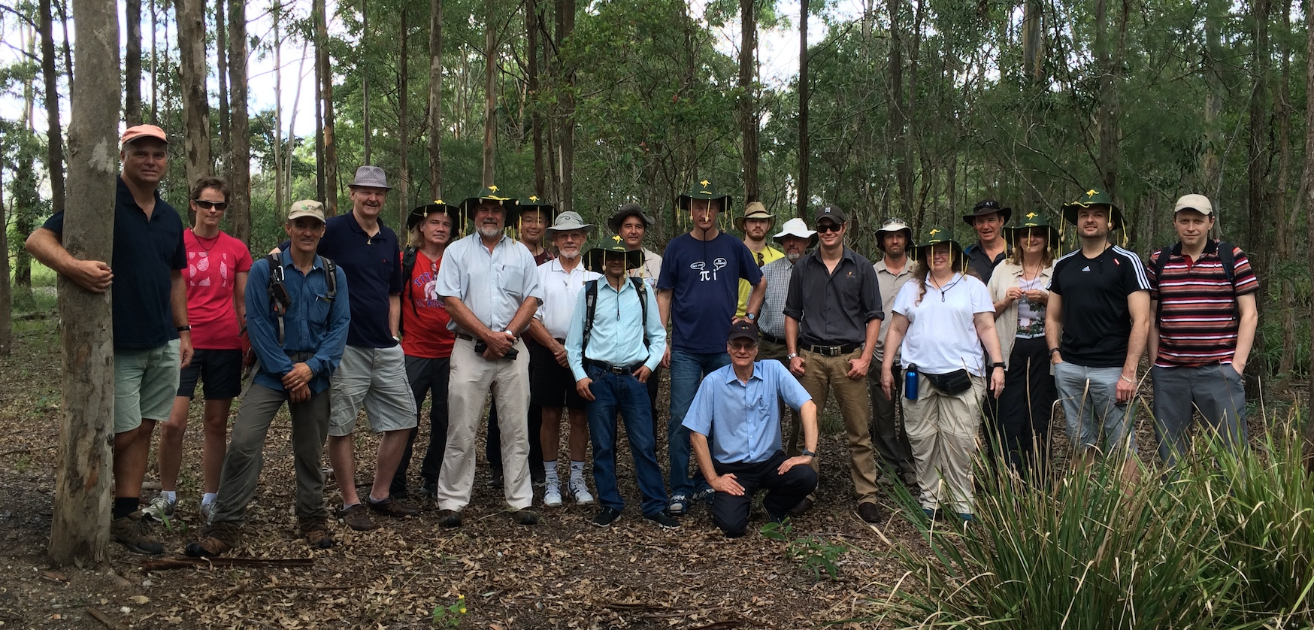
Satellite data support to GFOI R&D
– SDCG Element 3
Possible means for commercial data providers to contribute/participate (all voluntary)
• Provision of satellite data over GFOI R&D Study Sites
- New data acquisitions (satellite tasking)
- Historical (archive) data
and/or
• Funding opportunities
- Sponsoring/collaboration with GFOI R&D groups undertaking research of specific interest
and/or
• Expertise
- Participation at R&D Expert workshops,
science meetings and other GFOI R&D
events
3rd GFOI R&D Expert Workshop – Biomass est.
(Brisbane, Australia, Feb. 2015)

Slide 12
Satellite data support to GFOI R&D
– SDCG Element 3
Why does SDCG seek your participation?
Participation completely voluntary and should be “win-win” – no requirements or expectations from SDCG
Satellite sensors complementary – utilisation of multiple-sensors of benefit for all. Several sensor types (HR & VHR optical, L-band SAR, X-band SAR) available only through commercial or semi-commercial missions.
Benefits for you?
“Free” research on topics of common interest
Potential discovery of new applications not previously envisaged
Opportunity to demonstrate usefulness to GFOI countries and users
Others?...
Note: Project descriptions and data requirements are listed in Element-3 document. Supporting selected projects of interest possible.

Slide 13
Satellite data support to GFOI R&D
– SDCG Element 3
Extra slides

Slide 14
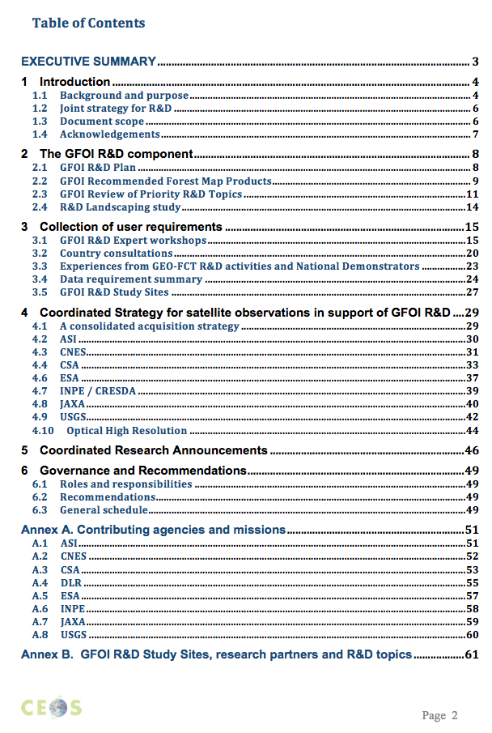
SDCG
Element 3

Slide 15
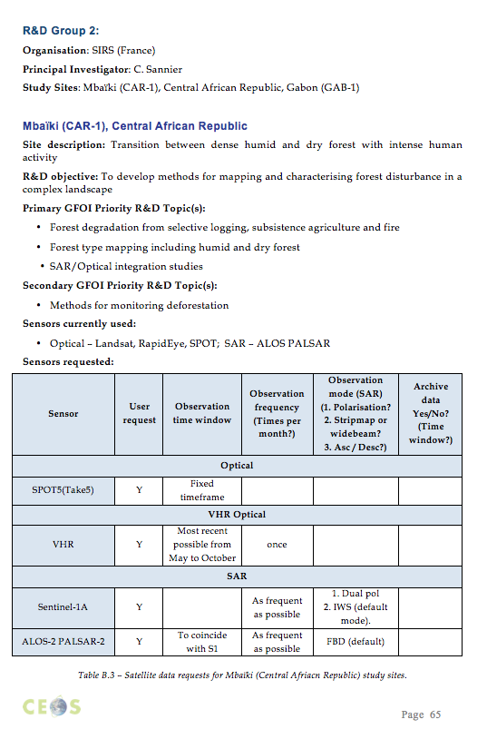
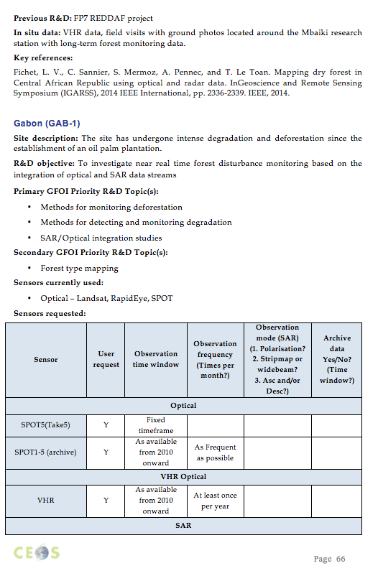
Satellite data support to GFOI R&D
– SDCG Element 3
GFOI R&D Groups

Slide 16
Satellite data support to GFOI R&D
– SDCG Element 3
GFOI R&D Study Sites

Slide 17
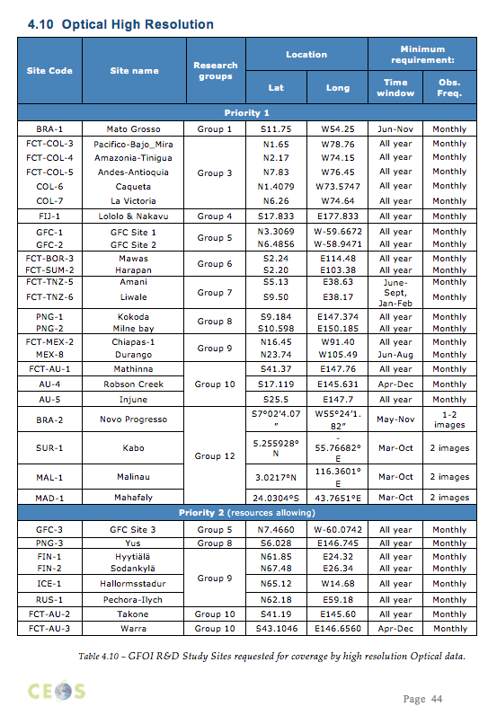
SDCG
Element 3
Example
Data requests for optical high res (here: 5~10m GSD)

