Slide 1
Global Forest Observations Initiative Time Series Consistency Methods and Guidance
Dr Carly Green – MGD Component Manager
SDCG 25th September 2015, Bonn, Germany

Slide 2
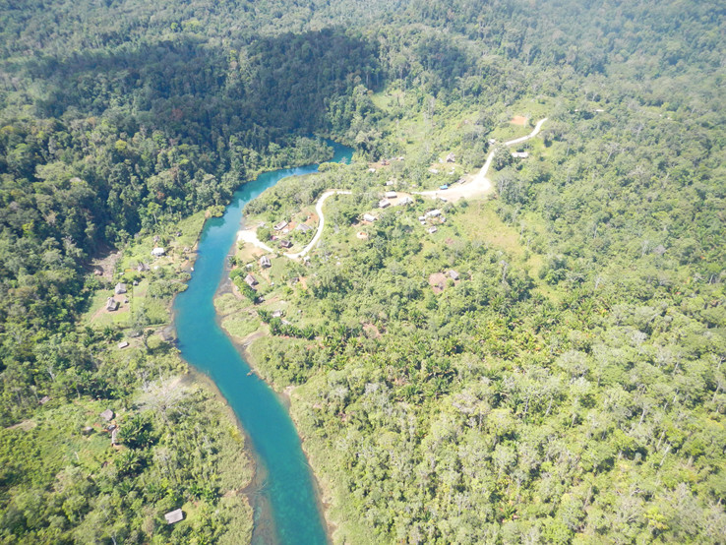
Presentation Outline
MGD Milestones
MGD Version 2.0
MGD Online Portal
Notes:
1m

Slide 3
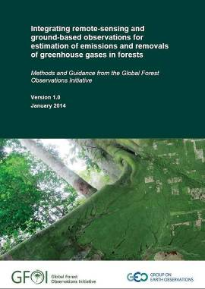
Methods and Guidance Document
Current Status
MGD Version 1.0 pdf is available for download from the GFOI website in English/Spanish/French
More than 200 printed versions of the document have been distributed in developing countries
Rapid response modules have been developed related to global map products and reference emission levels
Cross referencing with other GFOI partner resources has been a focus
USAID FCMC Manual
GOFC-GOLD/World Bank REDD+ Training Modules
Notes:
1m

Slide 4
Methods and Guidance Document
Plan for Update of Guidance Document
Technical material in the MGD is currently being updated
Version 2.0 will be released in June 2016
Lead authors (Jim Penman, Curtis Woodcock, Pontus Olofsson, John Raison, Carly Green)
Curtis Woodcock leads the activity data section
Primarily covers space data and remote sensing observations
Notes:
1m

Slide 5
Methods and Guidance Document
Plan for Update of Activity Data Section
Expand guidance on the use of global data sets
Include options for managing large datasets
Cover any tools that have been released since publication of Version 1.0
Review and update satellite data table
Anything else?
Notes:
1m

Slide 6
Methods and Guidance Document
Plan for Update of Activity Data Section
Expand guidance on the use of global data sets
Include options for managing large datasets
Cover any tools that have been released since publication of Version 1.0
Review and update satellite data table
Anything else?
Interested Contributing Authors / Reviewers of this section
Anthea Mitchell
Erik Lindquist
Notes:
1m

Slide 7
Methods and Guidance Document
MGD Version 2.0 Schedule
Review of existing material and identification of gaps in material (end September)
Engage with willing contributing authors to fill gaps (October-January 2016)
Lead authors collate and edit material to generate first draft of Version 2.0 (February 2016)
External review of Version 2.0 (March 2016)
Integration of review comments (April 2016)
Copy edit process of Version 2.0 (May 2016)
Publication of Version 2.0 (June 2016)
Notes:
1m

Slide 8
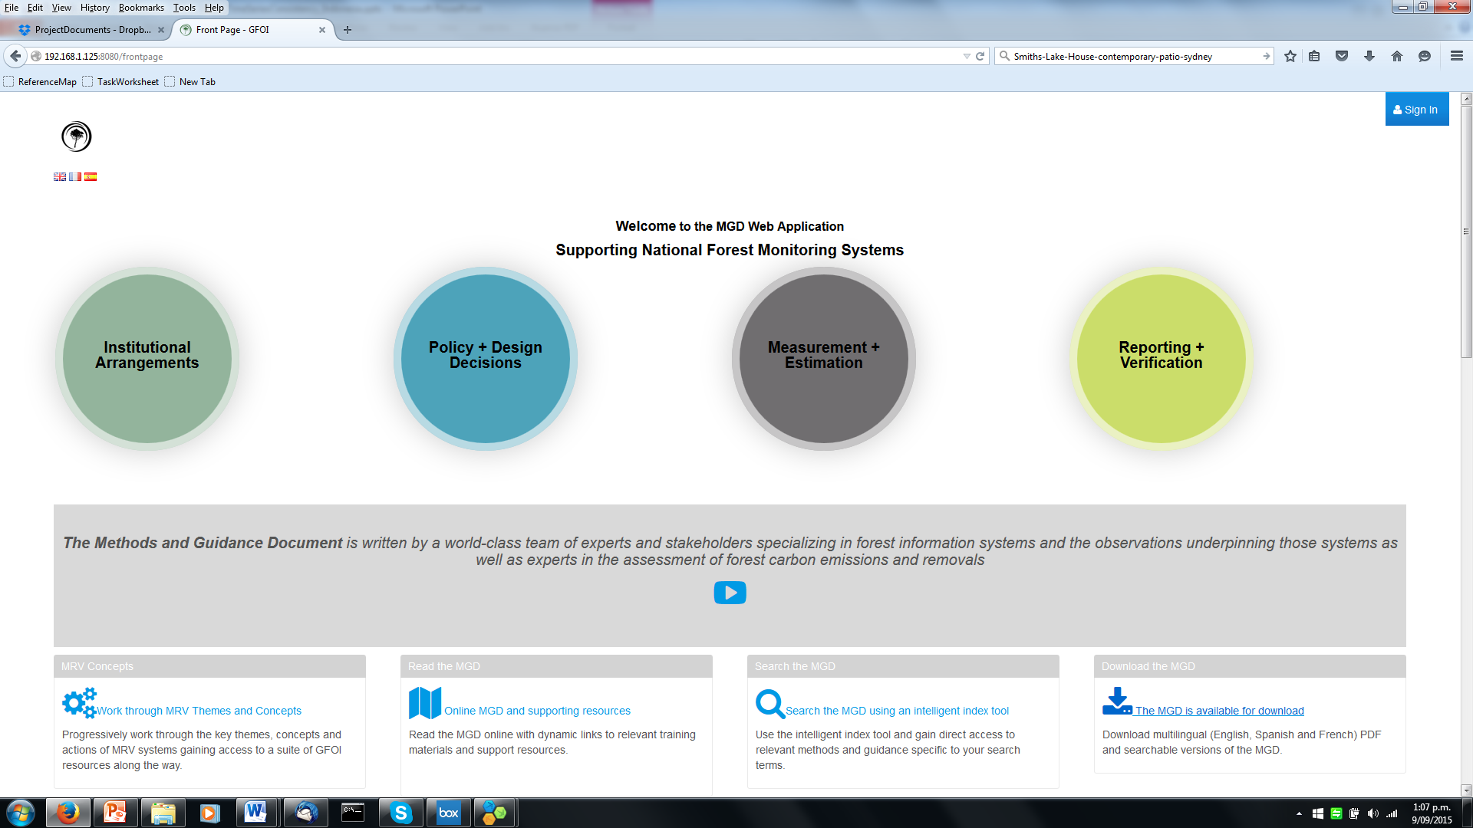
Methods and Guidance Web Application
Purpose
Link users to methods and guidance resources
Allow easy updates of the electronic form of the MGD and its translations
Increase engagement of the MGD target audience through dynamic interface which progress users through the elements of MRV systems
Notes:
1m

Slide 9
Methods and Guidance Web Application
Development Process
Review of Alpha release version – ends 25th September 2015
Integrate suggestions and release Beta version – Sept/Oct 2015
Test with users – Oct/Nov/Dec 2015
Integrate suggestions/lessons learnt from user testing – Jan/Feb 2016
Release Web Application – Apr 2016
Integrate MGD Version 2.0 material into portal – May/Jun/Jul 2016
Notes:
1m

Slide 10
Methods and Guidance Web Application
Notes:
1m

Slide 11
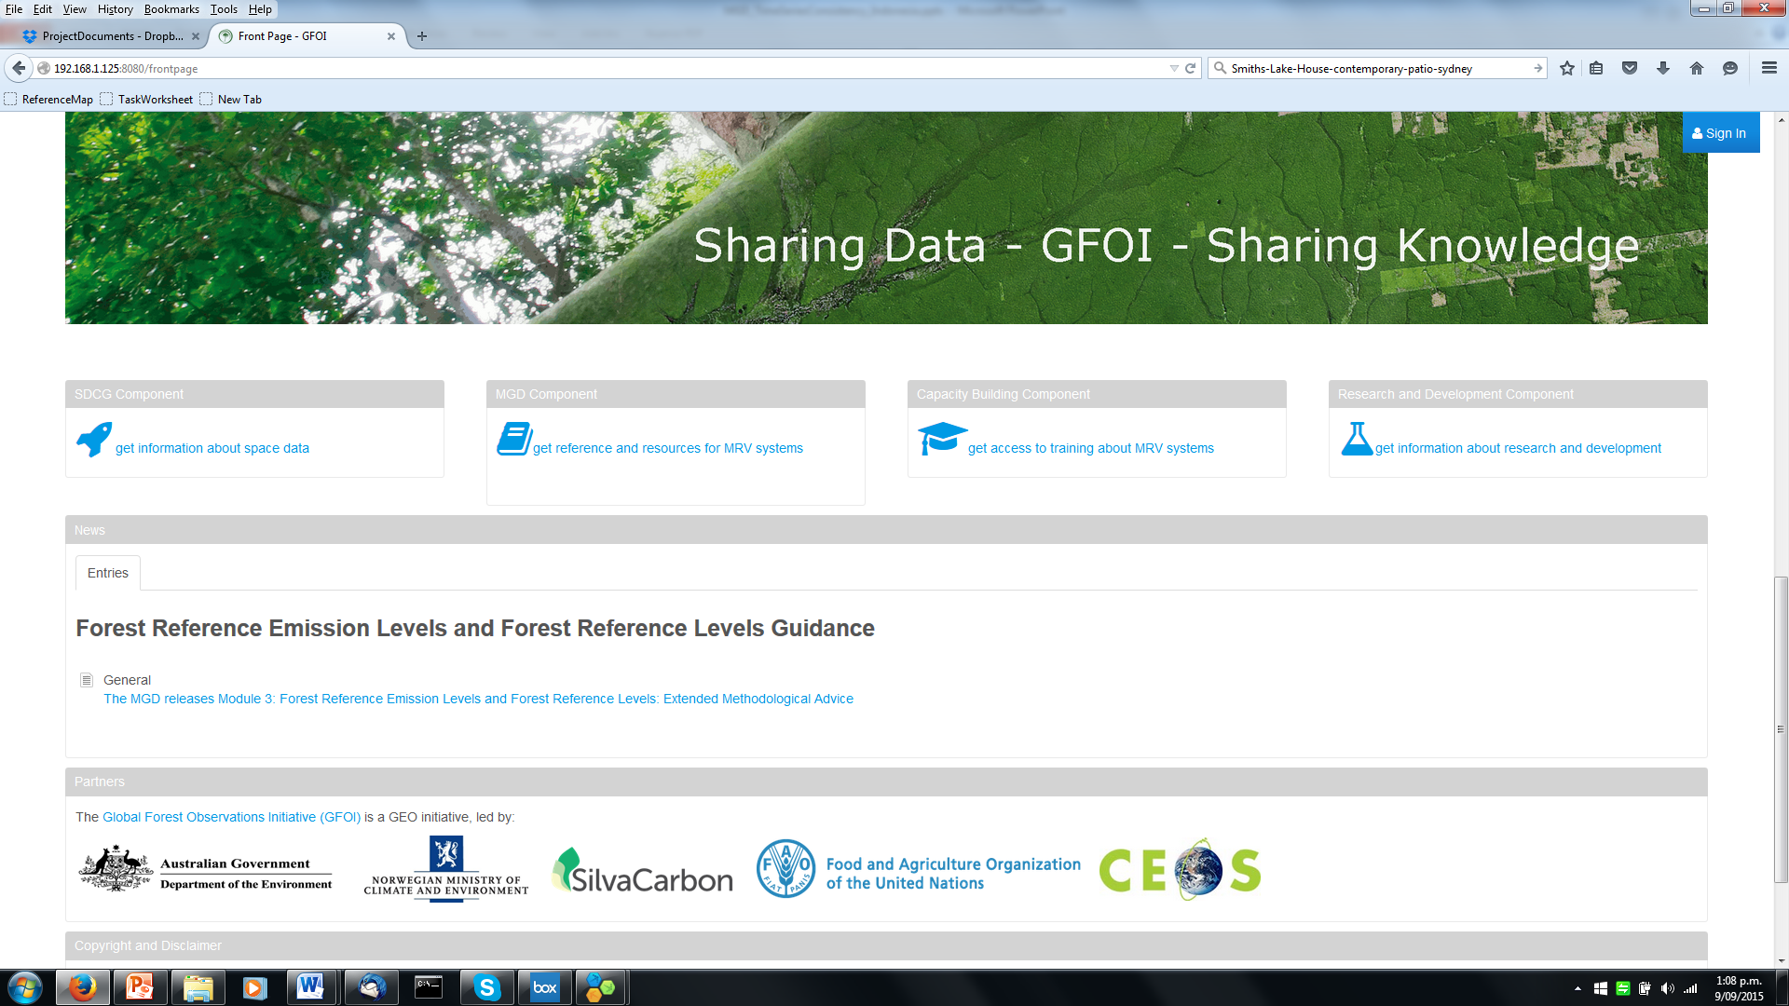
Methods and Guidance Web Application
Current Advances in Guidance
MGD Online Application under development and will be available
Notes:
1m

Slide 12
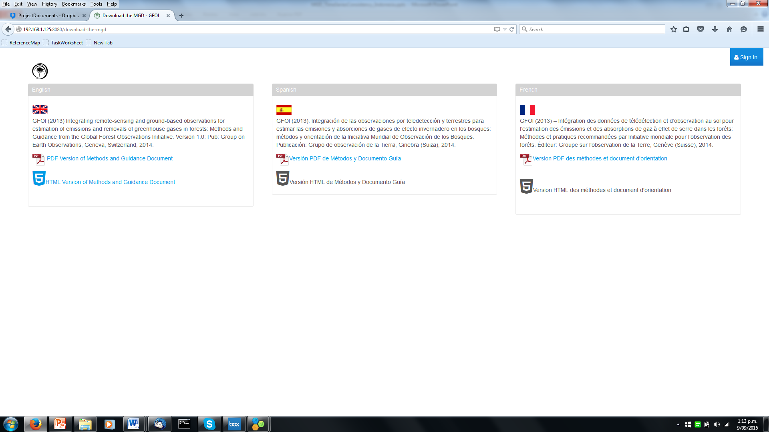
Methods and Guidance Web Application
Notes:
1m

Slide 13
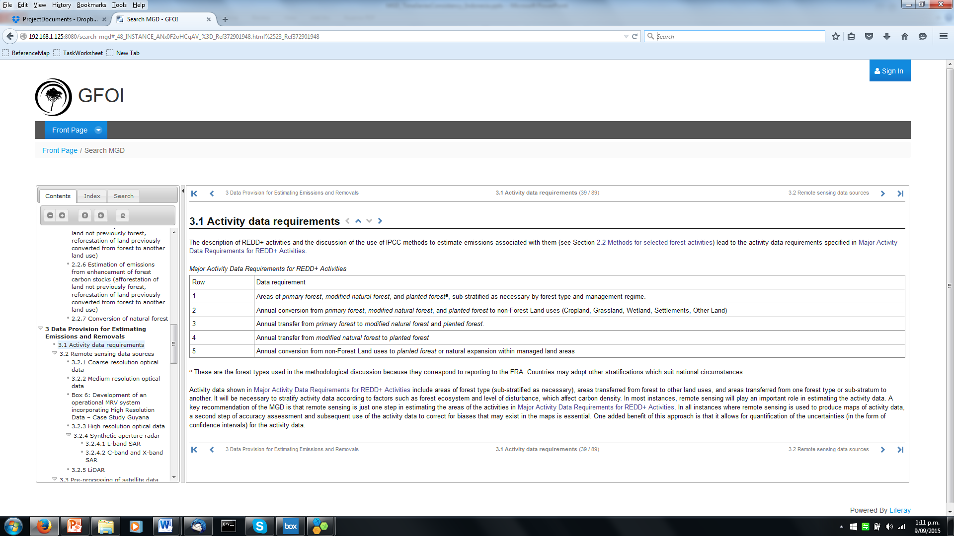
Methods and Guidance Web Application
Notes:
1m

Slide 14
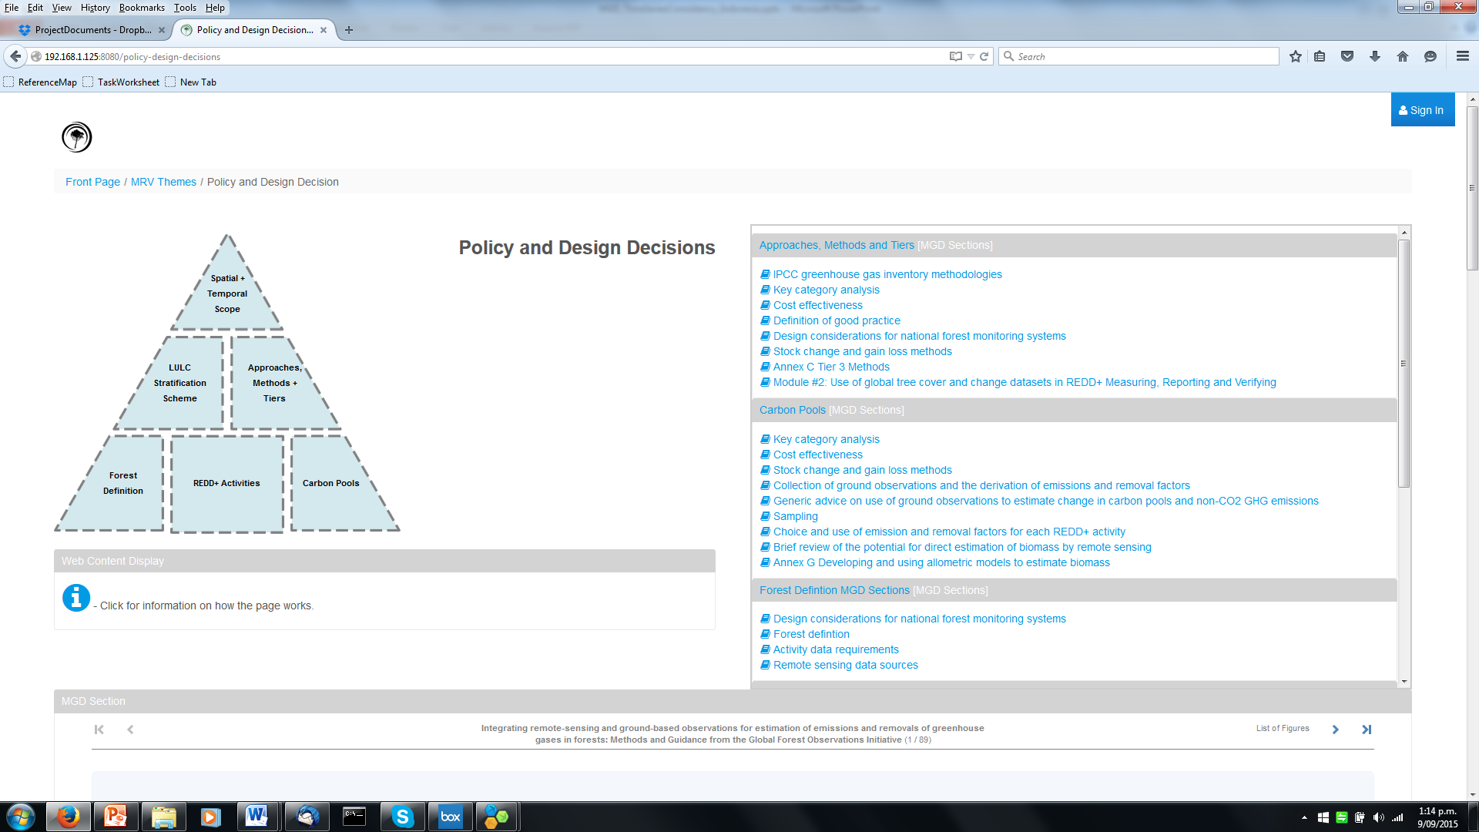
Methods and Guidance Web Application
Notes:
1m

Slide 15
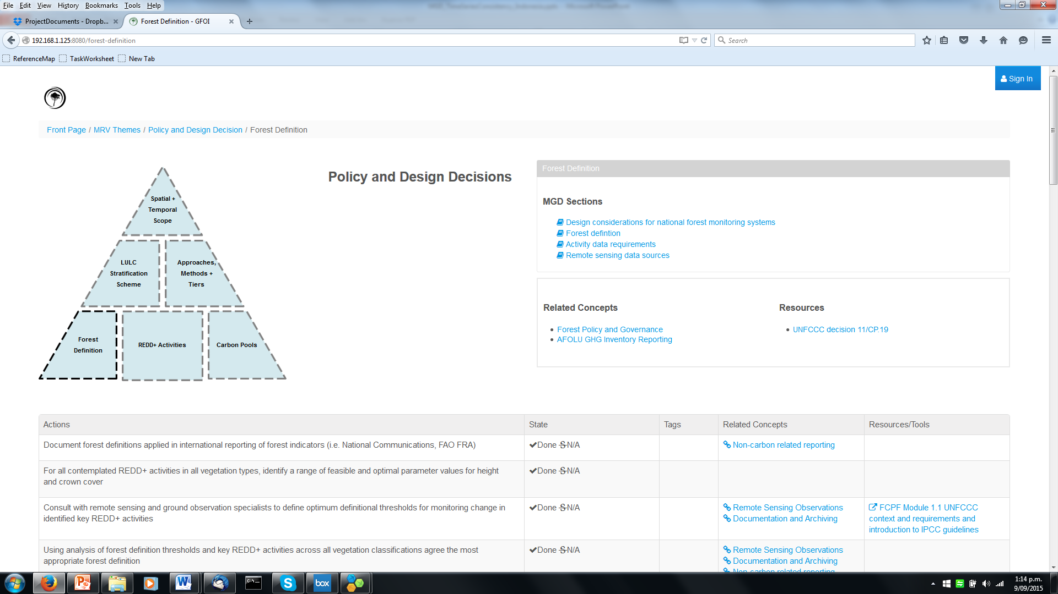
Methods and Guidance Web Application
Notes:
1m

Slide 16
Methods and Guidance Web Application
Notes:
1m

Slide 17
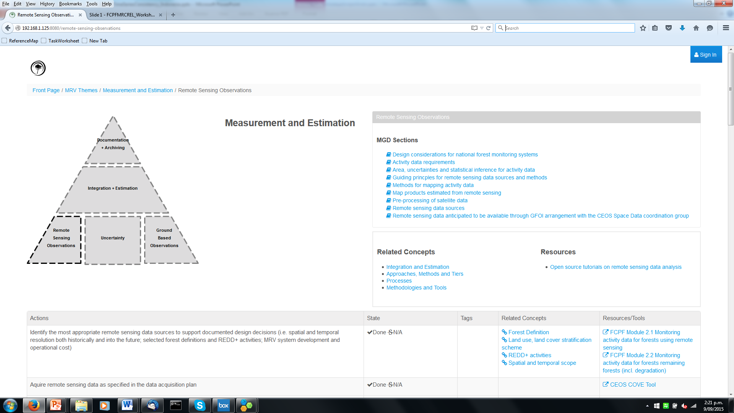
Methods and Guidance Web Application
Notes:
1m

Slide 18
Methods and Guidance Web Application - SDCG
Aim to improve the quality of the communication and iteration between data suppliers and countries.
Currently there is a mismatch:
Typically countries ask: What can we get? We don't know what we can do because we don't know what is available. What are the parameters that need to be specified in a request. Supplier: What do you need? Which <very specific technical detailed point> do you want? What are you going to use the data for?
Clear Methods and Guidance combined with targeted capacity building can reduce the iteration

Slide 19
Methods and Guidance Web Application - SDCG
Improve the quality of the communication and iteration between counties and GFOI
Currently a mismatched communication between data suppliers and countries
Country: What can we get? We don't know what we can do because we don't know what is available. What are the parameters that need to be specified in a request. | Supplier: What do you need? Which <very specific technical detailed point> do you want? What are you going to use the data for?
Notes:
1m

Slide 20
Methods and Guidance Web Application - SDCG
If a protocol can be defined or better structured, data needs can be more readily identified and justified and further effort can be focused efficiently on interested/active countries need.
The portal is capable of collecting and storing information related to design decisions which can be sent with data requests to SDCG.
Would this be of value/interest?
Notes:
1m

Slide 21
MGD and SDCG
MGD Version 2.0
Contributing authors
Reviewers
MGD Web Application
Review comments
Suggestions of how to integrate SDCG materials
Suggestions of useful country profile information
Notes:
1m

Slide 22
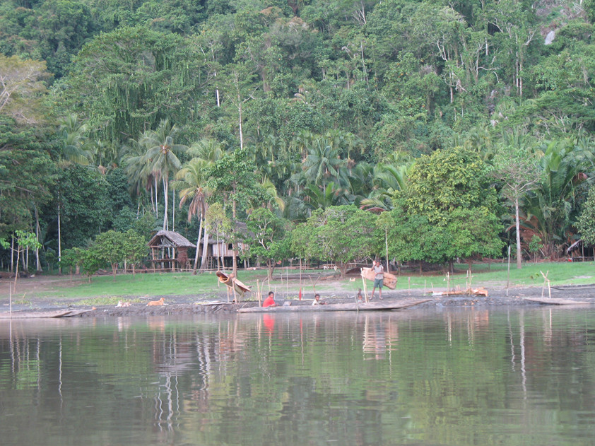
Thanks
If you have an interest in authoring or reviewing MGD material please contact:
Dr Carly Green
MGD Component Manager
carly.green@enviroaccounts.com
Notes:
1m

